Slide 1
LTEC: Spotlighting us
Presenters:
Jess Power John Dermo Siân Etherington
Amina Helal Calum Thomson
Notes:
Jess

Slide 2
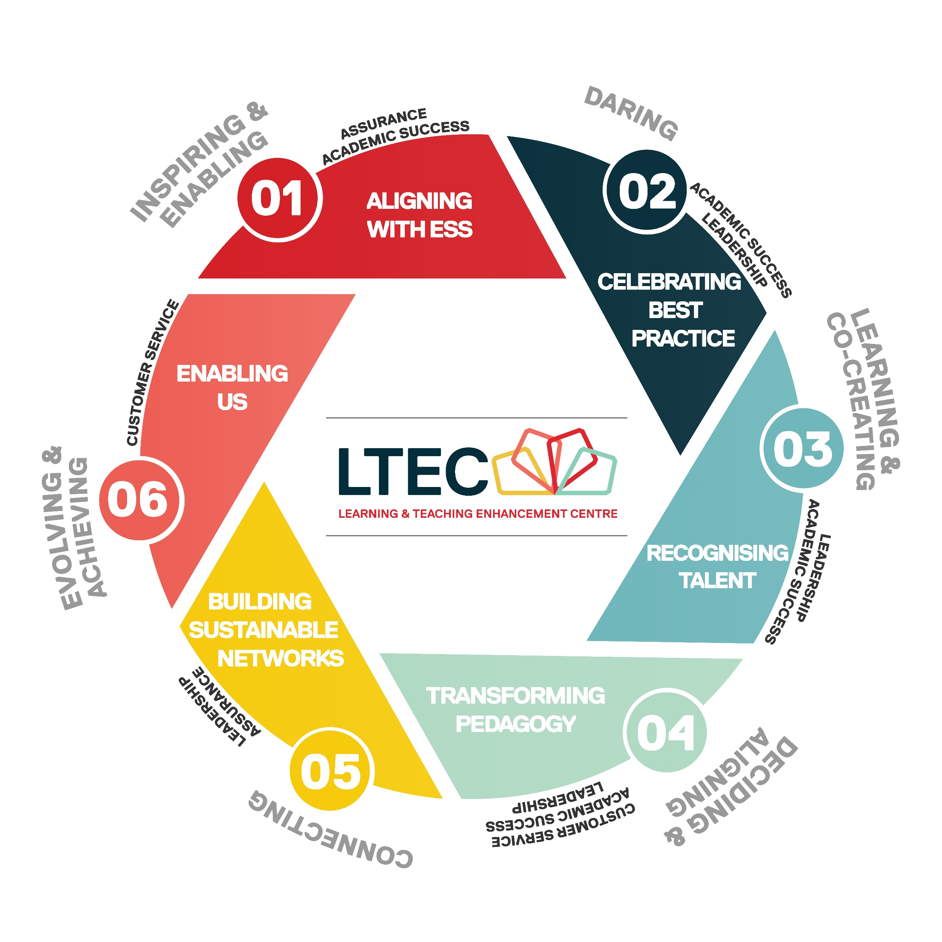
Our Vision: To be a nationally recognised Centre of Excellence for higher education pedagogical enhancement and development; achieving outstanding recognition for our staff and supporting inspirational learning and teaching to transform lives.
Notes:
Jess

Slide 3
Recognising Talent
At the University of Salford we take great pride in the outstanding commitment of our staff to excellence and expertise in Teaching and Learning.
LTEC support applications from staff for three Advance HE schemes:
National Teaching Fellowship Scheme (NTFS) - celebrating individuals who have made an outstanding impact on student outcomes and the teaching profession in HE
Collaborative Awards for Teaching Excellence (CATE) - recognising collaborative work with a demonstrable impact on teaching and learning
HEA Fellowship (Associate Fellow, Fellow, Senior Fellow and Principal Fellow) - professional recognition for teaching and supporting learning in HE, and reflect the wide range of practice and roles carried out by individuals
Notes:
John

Slide 4
Upcoming in 2022-23
NTF and CATE Schemes 2023
Oct 2022 – launch of new scheme and introductory workshop
Nov – Expressions of Interest to LTEC, first NTF/CATE writing retreat
Dec – Mentor support – first draft
Jan 2023 – Second NTF/CATE Writing retreat
Feb - Final Claim ready
March – Statements of Support and Submission
July/Aug - Outcomes announced
Autumn 2023 – National Awards Ceremony
Support for HEA Fellowship
Dedicated cost code for fee payment
Oct 2022 – Introductory workshop
Fellowship Writing retreats throughout year
November, March, July
Ongoing support to discuss drafts
Online peer support community via Teams site
Recognising Talent
Notes:
John

Slide 5
Transforming Pedagogy
LTEC SCELT scholarship awards
Showcase and extend your pedagogic innovation and enhancement work (supported by up to £5K)​
Develop research-informed educational practice​
Develop pedagogic research skills and understanding​
Network with other scholars and project teams through a development programme ​
Move into educational leadership through ongoing mentoring and coaching​

Slide 6
LTEC-SCELT scholarship awards
Friday 28 October
Deadline for applications
December 2022
Panel decision and feedback
January – March 23
Development and mentorship programme
April
Midpoint scholars meeting: where scholars will share good practice and discuss progress to date
31 July 2023
Deadline for any awards to be spent 31 July 2022
September 2023
Festival of Learning and Teaching presentations

Slide 7
Spotlights 2022
Spotlights are the mechanism LTEC is use to promote different aspects of academic practice, which are fundamental in continually energising and improving the education we offer.
Spotlights are about the themes, and have taken a range of formats, from bookable events, to curated resources and school based delivery.
Spotlights are also an opportunity for other colleagues, Schools or Services to surface and share with colleagues anything theme related.
“Taking time out to able to talk about the big picture principles behind what we do.”
Notes:
How we work with Schools and Professional services
The Salford Principles
Building on the Enabling Student Success framework we support a flexible approach to learning and teaching building: sense of belonging, sense of purpose, self-efficacy, resilience and engagement.
Delivery that is diverse and inclusive to promote authentic learning and assessment, with an assessment for learning approach.
Our enriched learning approach combines the benefits of in-person learning and on-demand high quality digital resources with externally-engaged interdisciplinary collaborative problem-based learning and real-world experiences which articulate the University’s ESS vision.
We provide co-created environments within and outside the core curriculum to develop autonomous learners.
Our learning and teaching have flexible and inclusive design that aligns to the University values for ethical behaviour.
Students develop digitally fluency through our blended delivery, which provides research-informed, sophisticated, flexible, formal and informal learning environments using specialist facilities to provide a transformative student experience which will hold value and a clear path to professional, life-wide and life-long learning.

Slide 8
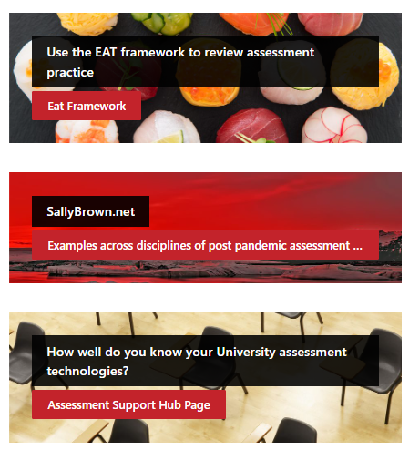
Spotlight resource + next year
Conversation starters: questions to open conversations. How would you answer, talk to colleagues about how they would answer and what they do in their teaching...
“Hearing about the on the ground experience of other teachers.”
Event recordings
Collections of Key Resources
Practising for success
Assessment Student Capability Focus
Creating intellectually stimulating content/ Challenging students
organising learning content
Modes of delivery
Supporting socialisation
Learning through play
Curriculum development & including everybody
Decolonising the curriculum
22-23 Proposed themes

Slide 9
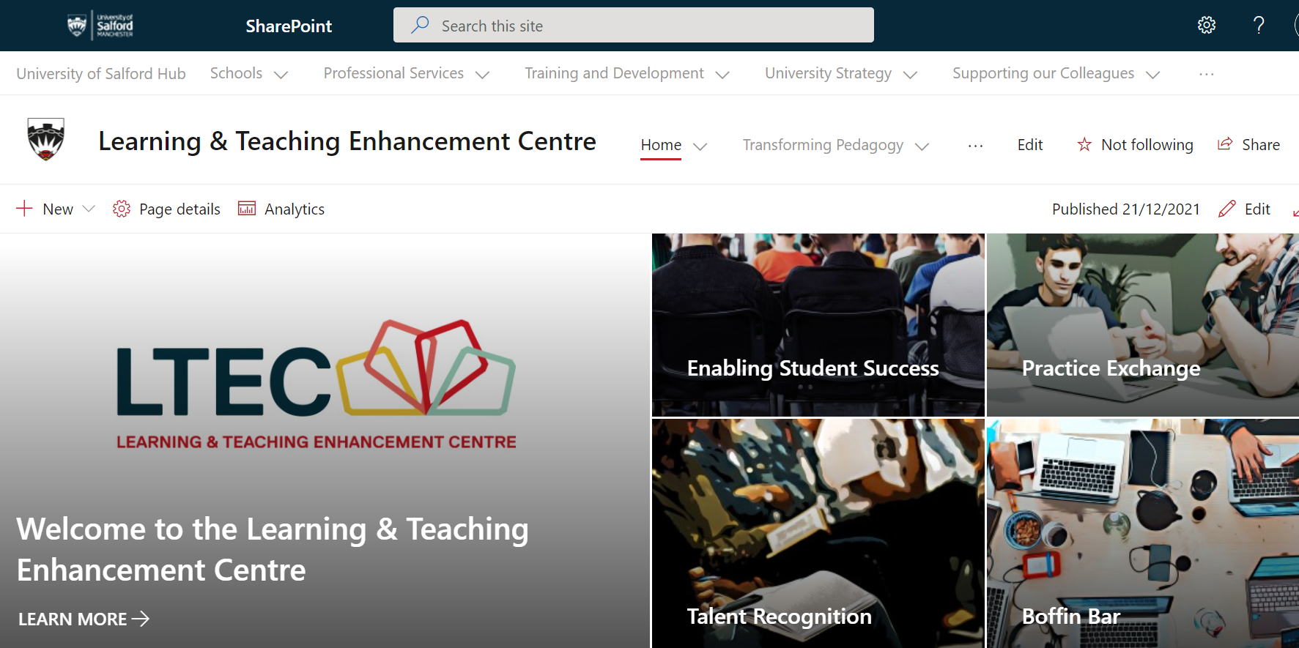
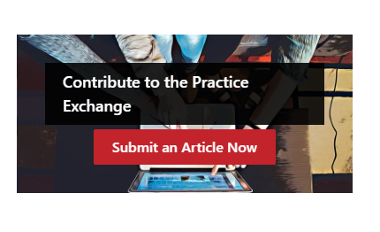
Academic Practice Exchange
Online space for colleagues to share practice and resources.
Explore contributions from colleagues using a simple search tool.
Discover a range of teaching related practice and resources from across disciplines and in a range of media.
Easy to contribute to with a simple form to submit details and a basic review process with LTEC colleagues.

Slide 10
Learning Technologies
Technologies
Blackboard
Teams & Office 365
Turnitin
Screencast-O-Matic
Mentimeter
Padlet
Box of Broadcasts
LinkedIn Learning
Support and Training
Open Workshops
Bespoke Teaching Team Support and Development
One to One Appointments
Hub Guidance
Self-Directed Training
DIT Helpdesk Support

Slide 11
“We’re on a journey”
And moving fast
Thank You!
Any
Questions!
Photo by Jake Blucker on Unsplash

