Slide 1
The power of challenge-led learning
Prof Jess Power NTF SFHEA CTEXT FTI

Slide 2
VALUE
Design-led approaches to problem solve
DC (2018)
Better equipped to deal with complex challenges
RAE (2012)
Stimulating environments
to promote entrepreneurial mindsets and cultures
RAE (2012)
Expanding beyond one discipline to support complex problem solving
AoM (1970)

Slide 3
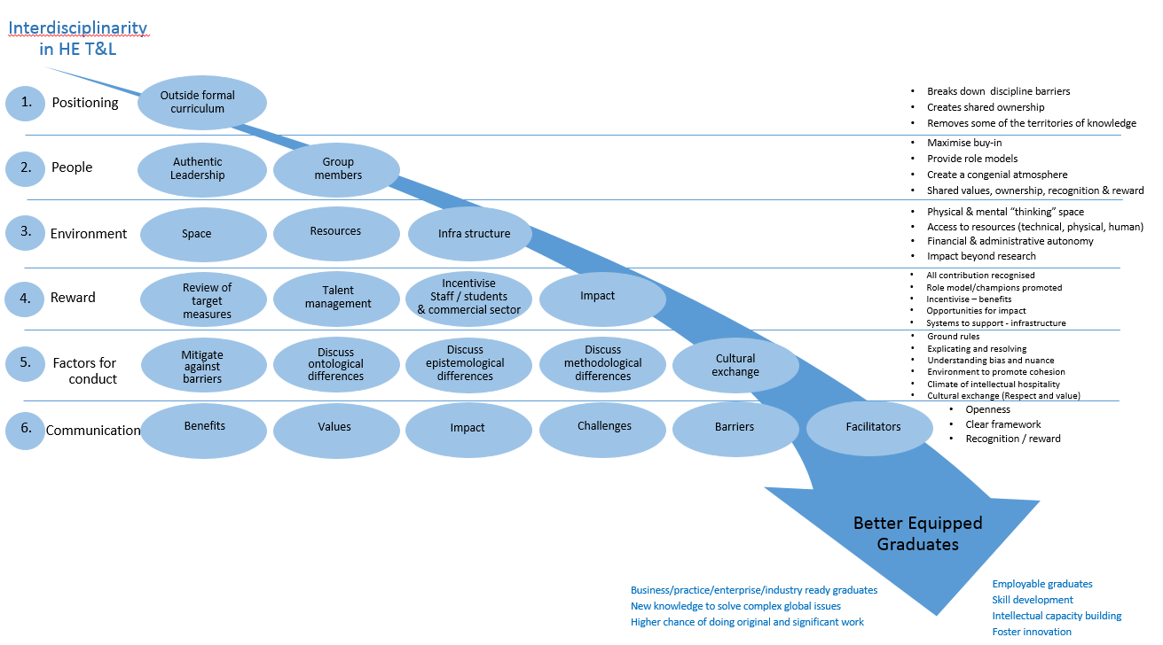
Higher Education Interdisciplinary Model (HIM)
(Power, and Handley; 2017)

Slide 4

Challenge-led Learning
Bridging discipline gaps through the creation of a network
of exchange to develop a legacy of learning
“ICE”
>>>>INSPIRE>>>>INNOVATE>>>>IMPACT>>>>
Design Challenges
24 hour Challenges
7 hour
24 hour Challenges
Commercial
Challenges

Slide 5
Challenges
Successes
Internal structures and processes (climate/culture/environment)
Regulations
Reward/Impact
Communication
Best practice model (HIM) – interdisciplinary collaborations in HE
A blueprint – Challenge-led learning
Measurable Impact – students, commercial, university

Slide 6
Student
Impact
Skills beyond their studies
Metacognitive appreciation
Value of networks
Appreciation of positive disruption
Change of mind-set (risk taking)
Challenge-led learning benefits in career
Awareness of opportunities (dreams)
Better ENGAGEMENT (retention, employable, attainment)

Slide 7
Commercial
Impact
Changed mind-set – what a university is for
- changed branding strategy
- exploring KTP
- exploring research projects
Inventive and exciting concepts and solutions
- opportunities to explore new concepts (Nudge theory)
Overwhelmed by new ideas (commercial awareness)
- ideas were taken forward into the commercial sector
Great design is a team approach –opens new perspectives
- Resulted in recruiting fashion students for web design

Slide 8
University
Impact
Brought people together (knowledge communities)
Team of staff short listed for an international prize
Opened up facilities (technical services)
Snowballed into lots of other opportunities
Benchmark statements (co-creation, IP, commercial awareness)
Streamlined IP (two models)
Changed mindset (entrepreneurial)
Blueprint for innovation and learning (active)

Slide 9
Thanks
To
Liz Towns-Andrews, Leigh Fleming and Abi Blower
University of Huddersfield
Visiting Professors of Innovation
Jonathan Sands
Stefan Gabriel
Royal Academy of Engineering
The Power….
“ICE”
Student skills
Engagement
Impact case-studies
Model of good practice
Impact on society
Impact on region

Slide 10
What is a university for?
“Generate knowledge for the good of mankind”

Slide 11
Reading list
DC (2015). Design Council Celebrating 70 years, Design Council. Retrieved from http://www.designcouncil.org.uk/about-us/celebrating-70-years (May 2015)
Design Council (Feb 2018) Designing in the public sector. https://www.designcouncil.org.uk/sites/default/files/asset/document/Design_in_public_sector_evaluation_feb18.pdf
Elsevier, (2015). A review of the UK’s interdisciplinary research using a citation-based approach. HEFCE.
Evans, S. (2016) Latest Insight into Graduate Recruitment: AGR Survey 2016 Discovery graduates http://www.discovery-graduates.com/latest-insight-into-graduate-recruitment-agr-survey-2016/
Power, E. J. (2016) 24 hour interdisciplinary Challenge, Experiential Entrepreneurship Exercises Journal - Enabling More Active Entrepreneurial Classrooms Through Sharing, Learning & Doing ISSN: 2374-4200 (online) Volume 1, page 70-75. Issue SI-ETC (special issue is a collaboration with “ETCToolkit” www.etctoolkit.org.uk). http://launchideas.org/wp-content/uploads/2016/05/EEEJ-Issue-ETC-Special-Issue.pdf
Power, J. and Handley, (2017) J. A best-practice model for integrating interdisciplinarity into the Higher Education student experience “Studies in Higher Education”.
Power, E.J. ‘Experiential learning in Practice’’. In: Experiential Learning for Entrepreneurship. London, UK: Palgrave Macmillian. June2018).
RAE (2012) Educating engineers to drive the innovation economy, The Royal Academy of Engineering - www.raeng.org.uk/innovationeconomy
Thomas, L., Hill, M., O' Mahony, J., Yorke, M. (2017) Supporting student success: strategies for institutional change. What works, HEA

