Slide 1
International Federation for Theatre Research Galway 2021
The Death, Dinner and Performance: A Study of the Efficacy of Performance to Enhance Conversations Around Death and Dying project
Sheila McCormick
https://www.facebook.com/332885657279093/videos/427827524644250

Slide 2
Origins and Critical Context
Dying, death and bereavement are subject to a range of misconceptions and ignorance (Kellehear and O’Connor 2008).
There is a growing consensus that palliative care needs to encompasses a ‘health promoting’ element so as to encourage openness about death which in turn will encourage people to develop ways to live and support each other with death, dying and bereavement (Patterson and Hazelwood 2014, 77).

Slide 3
Theatre and Death
If death is not to dominate us, we have to learn to live with it. And this must have a double focus: how to live with the shadow of our own mortality, and how to survive the death of others’ Robson (2019: IX).
The theatre’s persistent confrontation with death […as] one of the vital ways in which it continues to find an ethical and political force (Ibid).

Slide 4
the elephant in the room
Death Cafes, Death Over Dinner, The Conversation Project, Before I Die Festivals
The Death, Dinner and Performance project: developing a performance strategy and ritual event to examined the potential of intimate performance in a communal, commensal setting to transgress taboo and enable access to the often-difficult subjects of death and dying.

Slide 5
About the Practice as Research: Overview
Three death dinners in total were held in the New Adelphi Studio Theatre, UoS in October/ November of 2018.
Three Courses/ Three Monologues
Monologues were based on my own lived experience and explored my concerns around death and dying.
Questions:
1: Can you remember when you first became aware of death? What was that like? What impact did it have?
2: What does death mean to you at this moment in time?
3: Is there such a thing as a good death?

Slide 6
Efficacy and PAR Outcomes
Efficacy
The efficacy of the performance material to prompt conversation around death and dying
The efficacy of the theatrical strategies to encourage those conversations to develop
The efficacy of the event in its entirety to encourage ongoing reflection on death and dying for the participants of the project.
PAR Outcomes
Commensality
Use of autobiographical material

Slide 7
Autobiographical Performance Thinking about death makes us think about life
‘that [death] is possible in every moment’ (Heiddegger, 2010, p52)
‘a fullness of life that would not exist without it’(May, 2009, 4)
‘death in mine and mine alone’ (Heidegger, 2010 p53)
‘thinking about death leads us to think fruitfully about life’ (May, 2004:4).
”‘here-and-nowness of autobiographical performance’ and the ‘visible presence of the performing subject’ – their here and nowness too” (Heddon, 2008, 6).
‘the relationship between performer and spectator does set this mediation of experience apart from other modes. Though it is not less mediated, its different form of mediation enables a potentially different impact that can be capitalised on strategically’ (ibid)

Slide 8
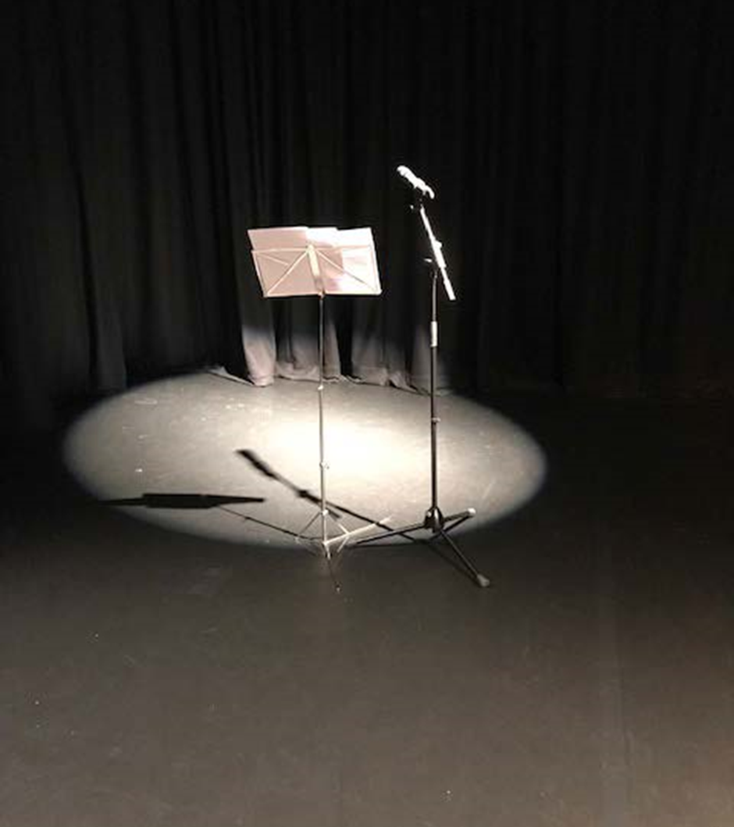
Monologues
‘were very effective in giving the event a structure and in bringing one into the evening’ (2019).

Slide 9
Monologues
First experience of death as a child.
Experience of death as a palliative care nurse
Exploring notions of a ‘good death’
Responses from Death, Dinner and Performance Participants
The performances were thought provoking and sparked conversation (2018).
The moments of performance worked very well structurally to move conversation into different areas, while also offering a hook for us to attach our responses to, to link back to and to reference in the course of the conversation (ibid).
It was important to feel held, and that someone was leading the conversation, even if you didn’t actually need to add a lot. It allowed us to relax and not feel responsible for anything other than thinking, reflecting and sharing our experiences (ibid)

Slide 10
Commensal Practice
Commensality is a fundamental social activity that both creates and cements relationships.
In all cultures eating is a social activity and that commensality as an act, is itself an articulation of human society in (Fisher, 2011, 529).
Persons who in no way share any special interest can get together over a common meal […] There lies the immeasurable social significance of the meal (Simmell, 1997, 130).

Slide 11
Commensal Practice
Examples
Burtin’s The Midnight Soup
Reckless Sleepers’ The Last Supper
Responses from Death, Dinner and Performance Participants
‘Having something else to do (i.e. eating) is always a really great way of conversation flowing in a more organic way than I think it does when the focus is entirely on having to make that conversation’ (2018).
‘Eating, drinking wine and talking about our demise at the same time was a comfort and a funny little contradiction’ (Ibid).
‘The experience for me was very heartening. I ‘enjoyed’ talking and listening’ (Ibid).
‘Eating and chatting with wine felt like an excellent formula!’ (Ibid).

Slide 12
Themes that arose over the Death Dinners
Experience of death as a child and its future impact
Fear: pain, loss, having lived a life unfilled
Types of death
Death as Taboo: inability to discuss death with loved ones
Choice, palliative care
Liminality and death
Mixed feelings: trepidation and excitement

Slide 13
New Insights
Pace
Timing
Space for contemplations
Silence
Proximity
Moving from the commensal/ performance/ participation space back into the ‘real’ world
The role of autobiographical performance as a prompt

Slide 14
Life Beyond the Death Dinners
The role of the pre-dinner questionnaire and how can it be adapted for a public audience.
The position of the host/ performer with a larger group of participants?
With a small, invited audience, outcomes are measured and insights gleaned using the questionnaires. How would this be managed with a larger, public audience?

