Slide 1
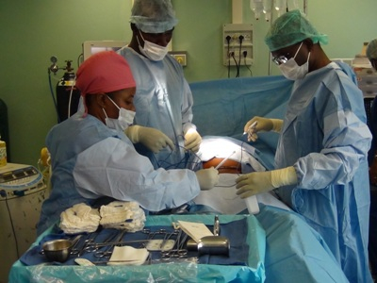
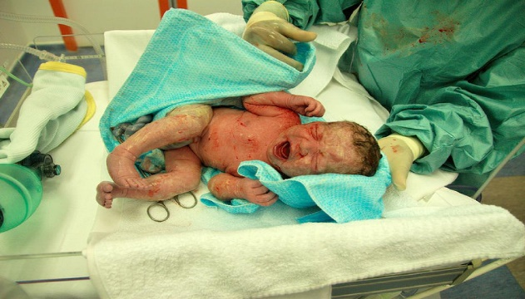
Background Birth asphyxia defined as a failure to initiate or sustain spontaneous breathing at birth. According to the American College of Obstetricians and Gynecologists and the American Academy of Pediatrics a neonate is labeled to be asphyxiated if the following conditions are fulfilled: Umbilical cord arterial pH <7; Apgar score of 0-3 for longer than 5 min; neurological manifestations (e.g., seizures, coma, or hypotonia); and multisystem organ dysfunction, e.g., cardiovascular, gastrointestinal, hematological, pulmonary or renal system. Adverse birth outcomes continues to be a global public health challenge, particularly in developing and underdeveloped countries. Over 1 million asphyxiated babies die annually around the globe and almost the same number developed severe consequences such as epilepsy, cerebral palsy, and developmental delay. Birth asphyxia accounts for about 23% of the neonatal deaths, and 10% of all deaths in children less than 5 years of age that occur each year worldwide, 98% of which occur in developing countries where more than half of the deliveries in developing countries occur at home. The world Health statistics reported remarkable progress in reducing child mortality, with the global under-five mortality rate dropping from 93 per 1000 live births in 1990 to 41 per 1000 live births in 2016 in the developed world. However, developing countries still have a higher rate, ranging from 4.6 per 1000 in Cape Town to 26 per 1000 in Nigeria, with case fatality rates around 40%. Source: Parker (2012) Source: SIMA (2013) Source: Bahuguna (2015) Objective The aim of the present study was to determine the correlation between mode and location of delivery and neurodevelopmental sequelae in infants who suffered birth asphyxia in Kano, Northern Nigeria. Methods A cross-sectional study of all neonates diagnosed with birth asphyxia admitted in the neonatal unit of the Murtala Mohammed Specialist Hospital and Hasiya Bayero pediatrics Hospital over a 12 months period (January 2017–December 2018) was undertaken. The occurrence rate of neurodevelopmental sequalae were determined using Modified Robins Smith questionnaire, while relationship between mode and location of delivery and the occurrence of neurodevelopmental sequalae were calculated with the correlation coefficient. Data entry and analysis were performed using SPSS version 21. Results Results revealed a statistically significant negative correlation between mode of delivery and some of the neurodevelopmental sequelae (NDS) Moro reflex and ANTR at (r = -0.454, p = 0.004**, r = -0.536, p = 0.001**). However, statistically significant positive correlation was found between location of delivery and some of the neurodevelopmental sequelae (NDS) such as the fine motor, speech and communication, Moro reflex and head lag pull to sit legs at (r = 0.597,p = 0.001** , r = 0.540,p = 0.001**, r = 0.580,p = 0.001** , r = 0.536,p = 0.001**) respectively. Conclusion The study concluded that there are relationship between mode and location of delivery and the occurrence of neurodevelopmental sequelae in infants who suffered birth asphyxia. But to establish these findings on a solid ground a larger multi-centers study is needed References 1. Organization WH. World Health Organisation. Basis newborn resuscitation: a practical guide 1999 [Internet]. 1998 [cited 2019 Sep 17]. Available from: https://apps.who.int/iris/bitstream/handle/10665/63953/WHO_RHT_MSM_98.1.pdf 2. Ibrahim NA, Muhye A, Abdulie S. Prevalence of Birth Asphyxia and Associated Factors among Neonates Delivered in Dilchora Referral Hospital, in Dire Dawa, Eastern Ethiopia. Clin. Mother Child Heal. 2017;14. 3. Halloran DR, McClure E, Chakraborty H, Chomba E, Wright LL, Carlo WA. Birth asphyxia survivors in a developing country. J. Perinatol. [Internet] 2009 [cited 2019 Sep 17];29:243–9. Available from: https://www.nature.com/articles/jp2008192 4. Al-Macki N, Miller SP, Hall N, Shevell M. The Spectrum of Abnormal Neurologic Outcomes Subsequent to Term Intrapartum Asphyxia. Pediatr. Neurol. [Internet] 2009 [cited 2019 Sep 17];41:399–405. Available from: https://www.sciencedirect.com/science/article/pii/S0887899409003154 5. Pierrat V, Haouari N, Liska A, Thomas D, Subtil D, Truffert P. Prevalence, causes, and outcome at 2 years of age of newborn encephalopathy: Population based study. Arch. Dis. Child. Fetal Neonatal Ed. [Internet] 2005 [cited 2019 Sep 17];90. Available from: https://fn.bmj.com/content/90/3/F257.abstract
Relationship Between the Mode and Location of Delivery and Neurodevelopmental Sequalae in Infants Who Suffered Birth Asphyxia in Kano Northern Nigeria
Usman Tijjani Shehu, University of Salford UK, Musa Zakari, Bayero University Kano Nigeria
A. Yakasai Mohammed, University of KwaZulu-Natal SA, A. Muhammad, University Sultan Zainal Abidin Malaysia
Acknowledgements: Petroleum Technology Development Fund (PTDF) Nigeria. Further information: u.t.shehu@edu.salford.ac.uk

