Slide 1
‘There is a Fracture, We Need to Fix It’: The use of high fidelity simulation to improve student nurses’ confidence when caring for patients with complications of fracture
Nicola Pennington RN, MSc, PGCAP
Jennifer Klunder. RN, BSc, MSc

Slide 2
Background
Lecturers in undergraduate and post-graduate nursing
Trauma and Orthopaedic specialist backgrounds
State of the art facilities enable learning in an authentic environment.
Established use of High Fidelity Simulation within University
Notes:
We are both trauma and orthopaedic specialists, from differing sub-specialisms, teaching undergraduate and post-graduate nurses. Nicky is an ANP who helped to develop the RCN ortho competencies, and Jen is a ortho trauma scrub nurse who teaches on the faculty for Stryker - we have both received specific ortho training. We have noticed anecdotally that there is very little knowledge about care of the orthopaedic patient amongst undergraduate nurses, and that on the newer nursing curriculums there is very little specific learning materials aimed at care of surgical patients. We have both noticed in our areas of practice that the requirements to ‘specialise’ are falling out of fashion, with the increasing focus of the NMC and hospitals to be on nurses to generalise. However, we believe this has a major impact upon areas such as orthoapedics, as specialist knowledge needs to be developed to ensure patients ensure the best care. - the RCN competencies support the needs for this specialist knowledge, but we feel undergraduates do not have enough exposure to the speciality.
Kaddoura et al. (2016) support the use of multiple scenarios in one setting, as this makes the experience more authentic and realistic. In our trial scenario, we had a number of considerations for the students to engage with (e.g. drug use, presence of police, argumentative girlfriend) to ensure the scenario was as complex and realistic as in clinical practice. This led the students to follow diversions, believing the scenario was about pain management and communication, rather than about assessment skills.

Slide 3
Problem
RCN (2013) competencies for level 5 nurses not currently clearly supported undergraduate curricula
Lack of access to specialist post-graduate training
Newly qualified nurses can lack experience or exposure to emergency situations
Challenge of changes to CPD and funding
(Fawaz et al 2016, RCN 2013).
Notes:
Research has found that newly qualified nurses often do not have the clinical competency to manage specialised and emergency situations, often due to a lack of preceptorship and available mentorship in their clinical practice. Due to staffing issues in clinical care, students exposures can be further reduced by clinical areas not being able to facilitate large numbers of students, or support them in managing clinical emergencies. This results in newly qualified nurses potentially neither being able to recognise a complication or deterioration in a patient, nor being able to manage it.
Universities still offering orthopaedic post-graduate qualifications are UCL/Birmingham. Limited access and funding.
New NMC competencies are increasingly focussed upon a flexible, generically trained workforce, rather than specialist skills.

Slide 4
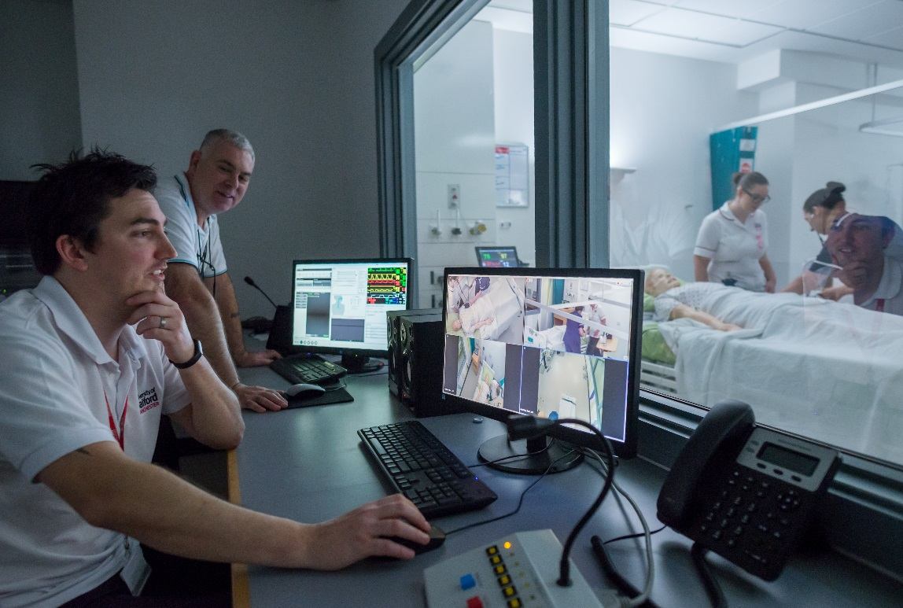
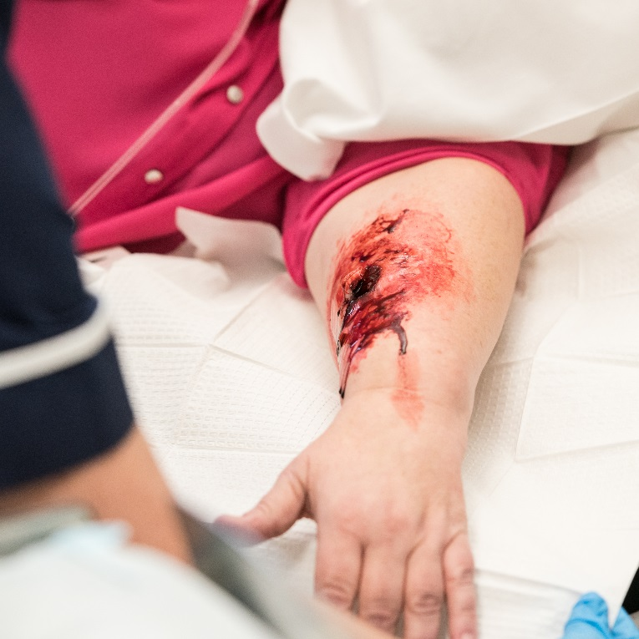
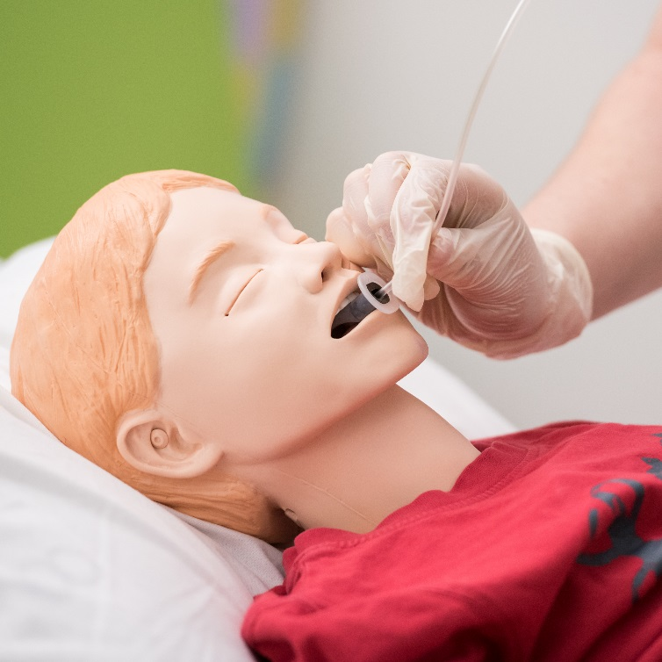
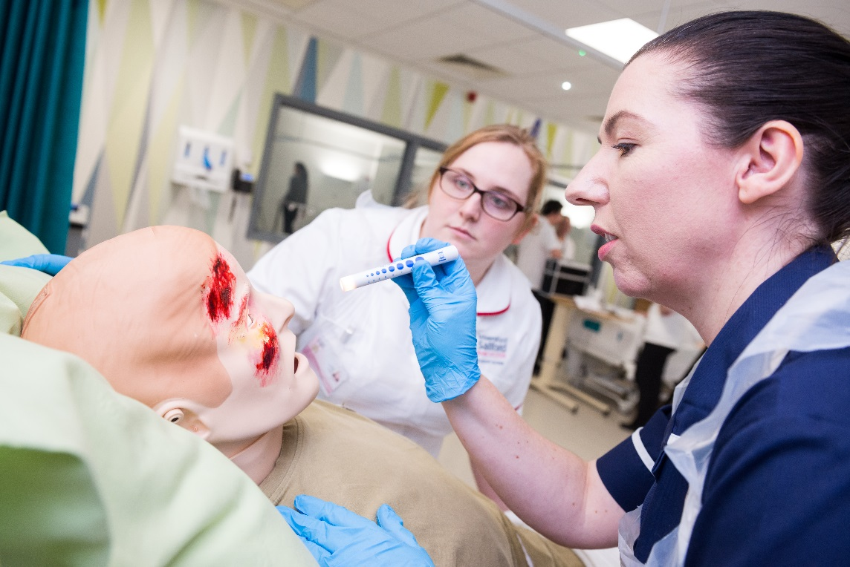

Slide 5
Solutions
Use of High Fidelity Simulation to facilitate psychomotor, cognitive and affective outcomes
Series of specialised simulation sessions - in line with RCN competencies for specific T&O complications
Debrief session to improve knowledge and skills through clinical exposure and reflection.
(Baptista et al. 2016, Fawaz et al, 2016, Khaddoura et al. 2016, Richardson et al. 2014, Nash and Harvey 2017)
Notes:
The use of high fidelity simulation is recognised to be a highly effective way of training health care professionals in an array of skills/circumstances in a safe manner - this allows our students to gain exposure to emergency trauma care, and gain experience being the primary nurse in trauma care, whilst also operating is a safe and controlled environment. Student satisfaction with HFS has been shown to be high, and it is an effective way of engaging students whilst also allowing them to practice and develop clinical skills. It has also been found to improve students motivation and engagement with their studies.
There is evidence to support that exposure to repeated HFS scenarios can be beneficial the undergraduates confidence and skill level.
UoS has exceptional simulation facilities, and is very pro-simulation, with a supportive environment and specialist technicians. We decided this would be the most efficient and effective way of exposing studets to trauma situations, with the aim to improve their knowledge and understanding of trauma care.
We have endeavoured to design scenarios that offer student a ‘real life’ exposure to trauma care, to facilitate their learning and engagement, but also improve the realism of the situation. E.g. compartment syndrome in a verbally aggressive patient with an open # tibia, who is accompanied by police and is a known drug user. Increasing complaints of pain, but the students focussed upon potential intolerance to opiates rather than assessing the fracture site.

Slide 6
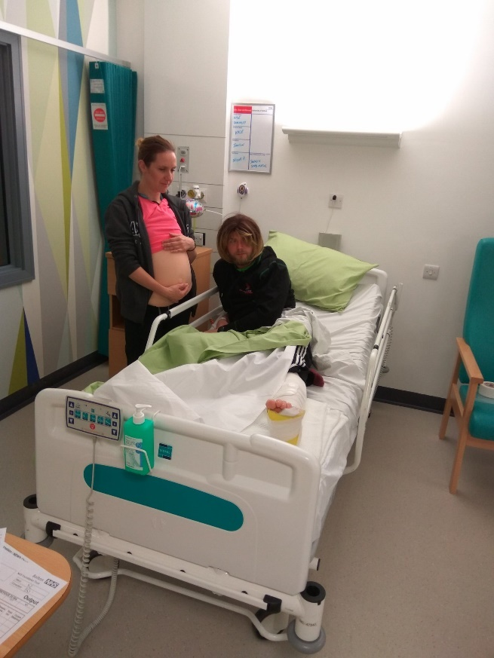
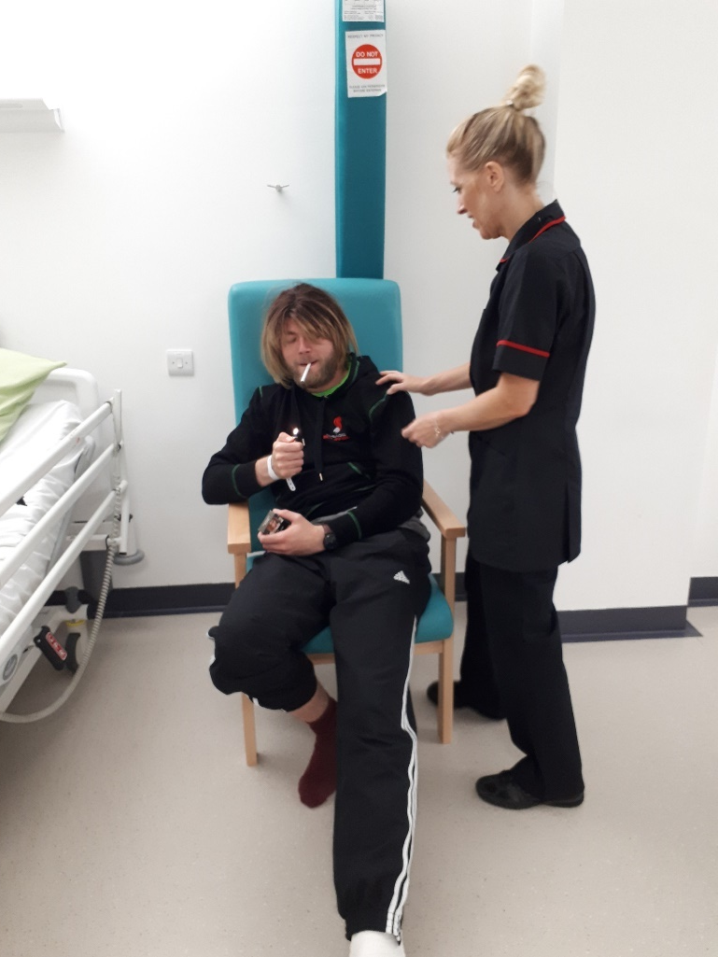
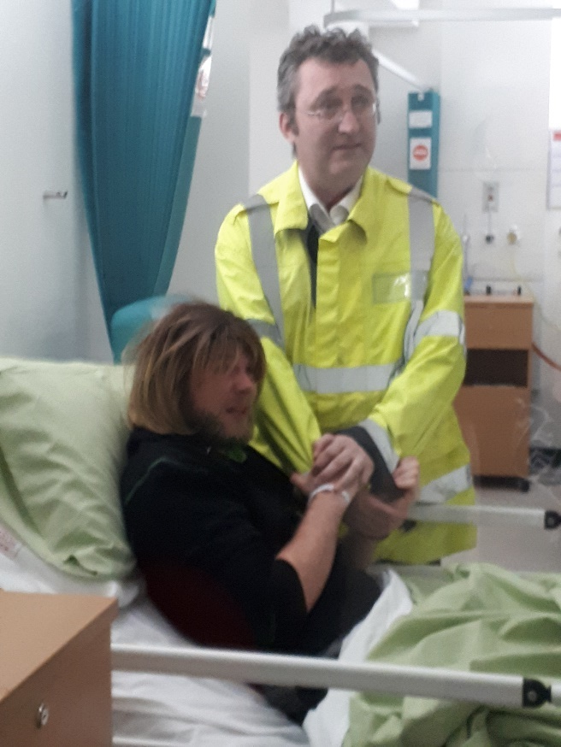
The Scenario
Notes:
Known IVDU brought in after attempting to evade police
# left tibia and dog bites to buttocks
Accompanies by police
Demanding and aggressive
Judgemental handover form nurse to student nurses
Wanting to go out for cigarettes, but complaining (very loudly) of pain
Assessment – compartment syndrome
After being taken to theatre the pregnant girlfriend arrives, having been asked to leave due to aggression in the early hours of the morning – agitated ++++

Slide 7
Aim and Learning outcomes
Aim:
For students to utilise clinical skills and knowledge to effectively manage preconceptions, and care for a patient following a traumatic fracture, recognising deterioration and complications of compartment syndrome.
 | Learning Objective
 | To undertake a comprehensive assessment of the pre-operative trauma patient, including a neurovascular status of the affected limb and pain management.
 | To identify a patient who is at risk of deterioration using an ABCDE approach.
 | To rationalise the use of observations and investigations.
 | To demonstrate effective communication skills using the SBAR tool.
 | To manage a deteriorating patient including emergency treatment, appropriate referrals, communication and pharmacology.
 | To be able to communicate sensitively and with empathy to patient and relatives.

Slide 8
Limitations
Optional sessions only, student attendance not guaranteed
Not part of the main curricula
Resources:
Staff (academic & technical)
Time (in relation to number of student reach)
Facilities (suite, AV)
Equipment (specialist)
Doesn’t replace clinical experience
(Richardson et al. 2014, Baptista et al. 2016, Nash and Harvey 2017)
Notes:
Although there is evidence to suggest that HFS can be effectively used to develop the clinical skills and critical judgement skills of nursing students, research suggests that it is best used in addition to clinical experience, not in place of it.
Nash and Harvey (2017) found that HFS can be effective, but it needs to be supported by clinical experience to truly ensure transfer of learning.

Slide 9
Progress
Student evaluations from first ‘scoping’ session were very positive
Feedback used to develop future sessions in the series
Increase in the number of specialised staff involved in the Trauma project - A&E, Theatres, Advanced Practice
Investment in specialised equipment from the University of Salford to improve realism and clinical context
Focus upon debriefing to aid understanding and support knowledge development.
(Nash and Harvey 2017)
Notes:
We designed an initial, optional ‘scoping’ session to get an idea of knowledge within the student body. Although findings have not yet been analysed, as they are part of an ongoing project, the feedback received was very positive. Anecdotally, students felt that their knowledge was improved, and their understanding of the importance of assessment of fractures increased. We used this feedback and reflection to help develop a series is simulation sessions. The University has invested in specialised equipment, such as thomas splints and traction frames, to improve the quality of sessions we can deliver, and the realism of injuries we can simulate. We have also expanded the team undertaking these sessions, to include a wider range of specialties - such as A&E staff. The aim is to give the students a fully rounded appreciation of trauma care from different aspects.
As predicted in the literature, and by the previous experiences of the staff involved, the students reported most satisfaction and learning from the debrief process. This forms the majority of the simulation session, and allows students to discuss their thoughts and ideas, and reflect upon their actions.

Slide 10
Over to you….
On your tables you will find proformas for developing a high fidelity simulation setting. We are challenging you with designing your own sim session for undergraduate nurses, focussing on an aspect of trauma care
Notes:
The idea is for you to see the work going into HFS, and how we can use scenarios to specifically target areas of learning we feel are lacking. We use the learning objectives to aid not only the initial design of the scenario, but also to guide discussion in the debrief.

Slide 11
References
Baptista, R., C., N., Paiva, L., A., R., Goncalves R., F., L., Oliviera, L., M., N., de Fatima, M., Pereira, C., R., and Martins, J., C., A. (2016) Satisfaction and Gains Perceive by Nursing Students with merdium and high fidelity simulation: A randomised controlled trial. Nurse Education Today. 46, 127-132.
Fawaz, M., A., Hamdan-Mansour, A., M. (2016) Impact of High-Fidelity Simulation on the Development of Clinical Judgement and Motivation Among Lebanese Nursing Students. Nurse Education Today. 46, 36-42.
Kaddoura, M., Vandyke, O., Smallwood, C., Gonzalex, K., M. (2016) Perceived Benefits and Challenges of Repeated Exposure to High Fidelity Simulation Experiences of First Degree Accelerated Bachelor Nursing Students. Nurse Education Today. 36, 298-303.
Nasg, R., and Harery, T. (2017) Student Nurse Perceptions Regarding Learning Transfer Following High-Fidelity Simulation. Clinical Simulation in Nursing. 13 (10), 471-477.
Nursing and Midwifery Council (2015) The Code for Nurses and Midwives
Richardson, K., J., and Claman, F. (2014)High Fidelity Simulation in Nursing Education: A Change in Clinical Practice. Nursing Education Perspectives. 35 (2) 125-127
Royal College of Nursing (2013) A Competence Framework for Orthopaedic and Trauma Practitioners. RCN, London.

