Slide 1
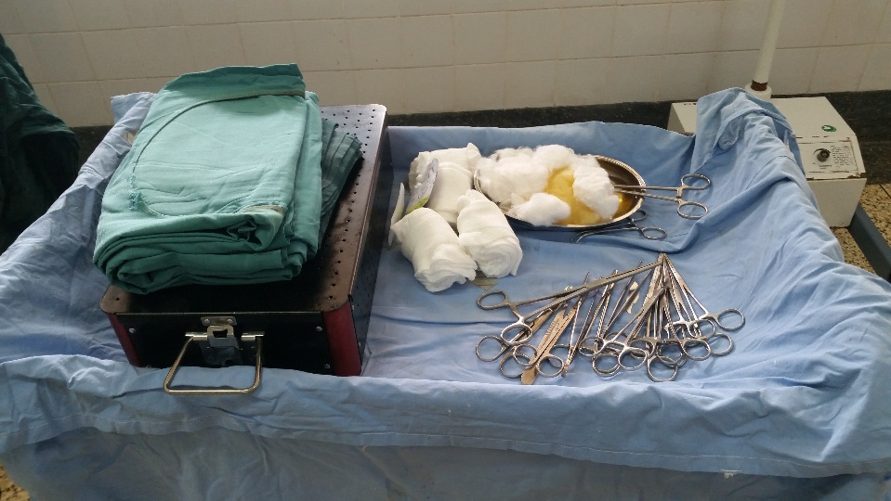
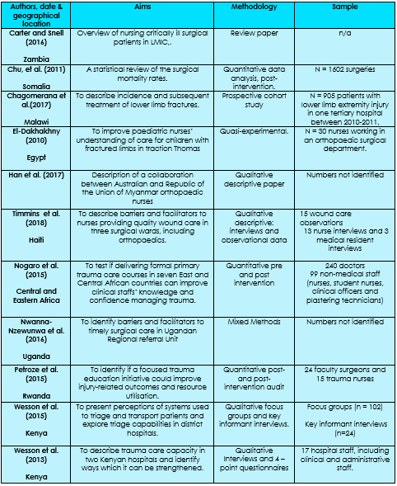
The case for prioritising the improvement of orthopaedic trauma nursing skills in Low to Middle Income Countries: A Scoping Review.
Jennifer Klunder-Rosser (University of Salford) Contact: J.A.Klunder-Rosser@salford.ac.uk Tel: 0161 2950256
Aims and Objectives
To identify the appropriate directions of educational programmes for nurses in low-to-middle income countries by analysing the global need for specialised trauma nursing skills, and understanding future directions for primary research.
Background
Traumatic orthopaedic injuries are responsible for 5.8 million deaths every year - 90% occurring in Low to Middle Income Countries.
Approximately 6 times as many people are injured due to trauma than those who die of it. Nursing is an under-utilised resource in global surgery with poor management of traumatic injuries associate with significant morbidity and disability.
Little research exists into the availability of skilled orthopaedic nurses in Low to Middle Income Countries, or what training in available to support development.
Findings and Key Themes Identified
Limited existing evidence looking at nursing role in global trauma surgery – only 11 papers identified, and 4 looking only at nursing.
Conclusions
Significant investment in training for orthopaedic nursing in Low to Middle Income Countries could reduce morbidity and mortality from traumatic injuries, improve staff retention and encourage nursing leadership.
Perceptions of nursing are a powerful global barrier to full utilisation of the workforce.
Considerable need for more primary nursing research due to a paucity of existing work.
Poor staff retention preventing development of staff, increasing staff burnout and undermining opportunities for nursing leadership.
.
Methodology
Due to limited evidence, a structured scoping literature review was used. 3 databases were searched using a combination of keywords and Boolean operators. These databases were CINHAL, Medline and SOLAR. 11 papers identified – overview in table below.
Nurses are an under-utilised resource in global trauma care, despite having skills, knowledge and potential to be able to reduce morbidity and mortality from traumatic injuries.
Task shifting and leadership identified as areas to develop to improve trauma care, nurses’ career satisfaction, patient outcomes.
Global Perceptions of nursing identified as a core barrier to the empowerment and utilisation of nurses, with nurses still being viewed in many countries as doctors ‘handmaidens’.
Nursing education identified as a vital to develop global surgery, with clear association between increased nursing education and improved patient outcomes.
References:
All-Party Parliamentary Group on Global Health (2016) Triple Impact: How Developing Nursing will Improve Health, Promote Gender Equality and Support Economic Growth. APPG, London. Carter, C. (2016) The Nurses’ Role in Delivering the Global Safe Surgery Campaign. British Journal of Nursing. 25 (16), P. 907 Meara, J., et al.(2015). Global Surgery 2030: Evidence and solutions for achieving health, welfare and economic development. The Lancet Commissions. 1-56. Nwanna-Nzewunwa, O., C., Ajiko, M-M., Kirya, F., Epodoi, J., Kabagenyi, F., Batibwe, E., Feldhaus, I., and Julliard, C. (2016) Barriers and Facilitaor of Surgical Care in Rural Uganda: A Mixed Methods Study. Journal of Surgical Research. 204 (1), pp 242-250

