Slide 1
Is excellence in education part of your institutional strategy and practice?
Dr Siân Etherington, Dr Jacqueline Leigh, Dr Chris Procter

Slide 2
The workshop outline
Aims and outcomes
Introductions and Context
Questions for discussion
Group discussion + Padlet
Plenary discussion
Next steps

Slide 3
Workshop aims:
This interactive workshop aims to create a space for discussion of shared experiences in the development of institution wide educational research communities of practice, which inspire and support innovative teaching and learning practice.

Slide 4
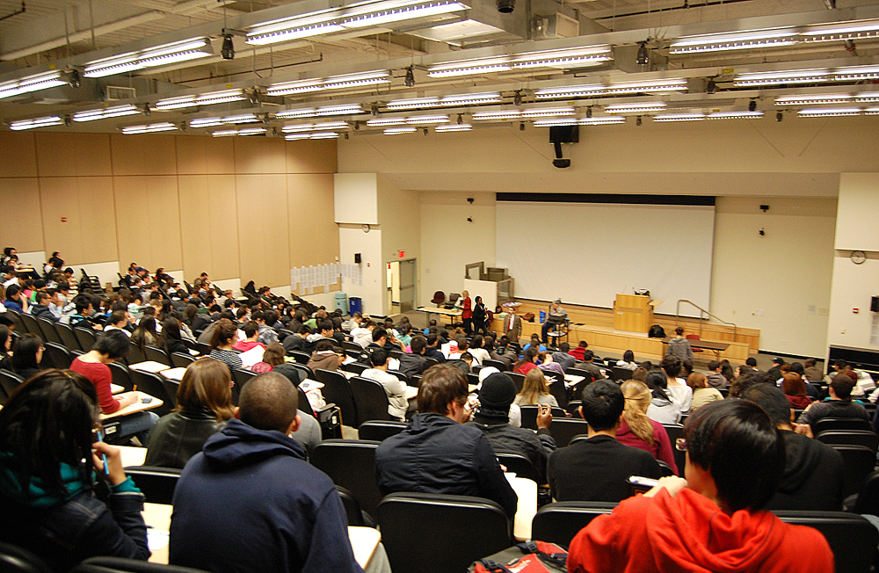
The HE context
Drivers for T&L innovation and change
Notes:
Scene setting and getting people to think about their institutional setting a little before group discussions. Can also use as activity for people to do as they arrive.
Ask participants to choose 1 or 2 pictures which are meaningful for their institutional context and discuss in pairs/ small groups
There are external and institutional drivers but also internal and more ground roots ones which relate to teachers wanting to improve their teaching and explore innovations.

Slide 5
The Salford context
Salford Community for Excellence in Learning and Teaching
https://educationalexcellencesalford.home.blog/
Festival of Research: Doing things differently in the classroom
Notes:
Only a little bit of Salford context to say that we have just started the journey towards developing a community of practice and some of the things we’ve done so far. Just 3 mins on this!

Slide 6
Question 1: In your experience ….
How is excellence in education (including innovation and educational research) implemented?

Slide 7
Question 2: In your experience….
How are communities of practice in teaching and learning fostered and encouraged?

Slide 8
Question 3: In your experience….
How does classroom practice inform teaching and learning strategy

Slide 9
Question 4: In your experience….
What challenges are there?
How have you solved them?

Slide 10
Go to menti.com and type in the code
https://www.mentimeter.com/s/91c3337a38d70d8042b581eb8368fb3c/8962b97d2a89

Slide 11
Padlet instructions
https://uos.padlet.org/nus575_63107/tl

Slide 12
North West Principal Fellow Meeting
26th June 2019
10-30AM -2-30PM
MS -175

Slide 13
1. How is excellence in education (including innovation and educational research) implemented? | 3. How does teaching and learning strategy inform classroom practice? And vice versa?
2. How are communities of practice in excellence in teaching and learning fostered and encouraged? | 4. How have you solved the challenges which have arisen?
Notes:
Groups discuss and move round tables with focus on one question per table. Move them so that they can discuss with different people at each stage?
Only about 8 mins per question. As ideas arise participants write comments in Padlet to be displayed on Padlet wall for discussion in plenary.

Slide 14
Themes, ideas, experiences…
Notes:
Plenary discussion

Slide 15
What are the next steps….?

Slide 16
Please email us:
s.etherington@salford.ac.uk
J.A.Leigh4@salford.ac.uk
C.T.Procter@salford.ac.uk

