Slide 1
Transforming Cultures- Implementing a coaching framework for undergraduate nursing students
Dr Jacqueline Leigh, March 2018

Slide 2
Aim
Why coaching?
Listening
Questioning
Coaching models
G.R.O.W.
Difficult Conversations

Slide 3
Challenging our assumptions about existing student support- stakeholder issues
Personal tutoring policy/practices not delivering vision for student experience transformation
Variable support in clinical practice for undergraduate student nurses, most of whom were not consistently encouraged to take ownership of their learning needs (unlock potential for learning)
NHS Trusts increased undergraduate student numbers by 100 but without growing the practice placement capacity
Strategies for smooth role transition from student to qualified nurse

Slide 4
What does coaching mean to you?

Slide 5
Coaching
Intervention aimed at performance improvement or developing a particular competence. It is an ongoing process that consists of facilitating another person’s learning, development and performance
Dembkowski et al. (2006)

Slide 7
Benefits from a student perspective
Ownership of own learning journey
Builds confidence in asking/seeking help
Builds knowledge base as applying skills to practice which have previously been taught in university
Feel part of the team
Reinforces existing knowledge and enhances skills as you teach others
Increases opportunities to learn as peers explain
Gains respect from other members of the MDT as student nurses are valued and seen as part of the team not just a student following a nurse
Identifies weaknesses to improve on
Helps to get the student ready for role transition upon qualification
Supernumerary status is upheld enabling more self directed learning

Slide 8
Observation from the coaching model in practice
Witnessed first year students flourish with confidence from starting placement and looking to the second years for guidance. They worked alongside them eventually gaining the skills and confidence to enable them to take the lead for their own patients and plan individualised care. This gave them skills and confidence to take with them throughout their training to develop further along the way.
The variation in student skills and knowledge helped the coach to safely monitor the bay which enabled a smooth transition from mentoring to coaching. Whilst not losing the intimacy of the one to one learning with a qualified nurse when and where applicable.

Slide 9
Coaching Benefits……
Coachee:
Increased performance
Higher motivation and commitment
Rapid personal growth
Higher quality of life
Greater work/life balance
Greater sense of purpose and satisfaction
Improved communication and relationships
Coach:
Increased self-awareness
Learning by listening to others
A sense of satisfaction due to making a difference
Intellectual challenge
Improved skills e.g. listening, questioning
Increased awareness of issues
Enhanced ability to manage people and teams
CIPD
Notes:
There is a growing body of evidence showing the effectiveness and impact of coaching both within and outside of academia. Coaching is highly valued in the corporate sector with 90% of organisations in the UK and 93% in the USA using coaching interventions resulting in improved performance, confidence, motivation and effective leadership. Although less commonly adopted within HE, a rising number of examples of Universities offer one to one coaching using internal coaches with varying degrees of internal and external training (Vitae review 2012). Early evaluation of HE coaching programmes for postgraduate students and staff at all stages of their academic careers shows increased self-awareness and self discovery, confidence, communication skills, increased project completion, lower stress and improved working relationships. Little longer term or higher level evaluation has been carried out in HE beyond Kirkpatrick’s level 1 ‘reaction’ and level 2 ‘learning’.
Definition of a personal tutor: Each student shall have Personal Tutor support to provide general guidance on academic and non-academic issues and problems and to suggest other sources of help. That support shall accommodate the needs of students whatever their mode of study. For example, for Distance Learning students only, attendance at a meeting may
mean virtual attendance. In some instances the Personal Tutor shall also provide specific guidance and signpost specific services or sources of help where that need is urgent and apparent.

Slide 10
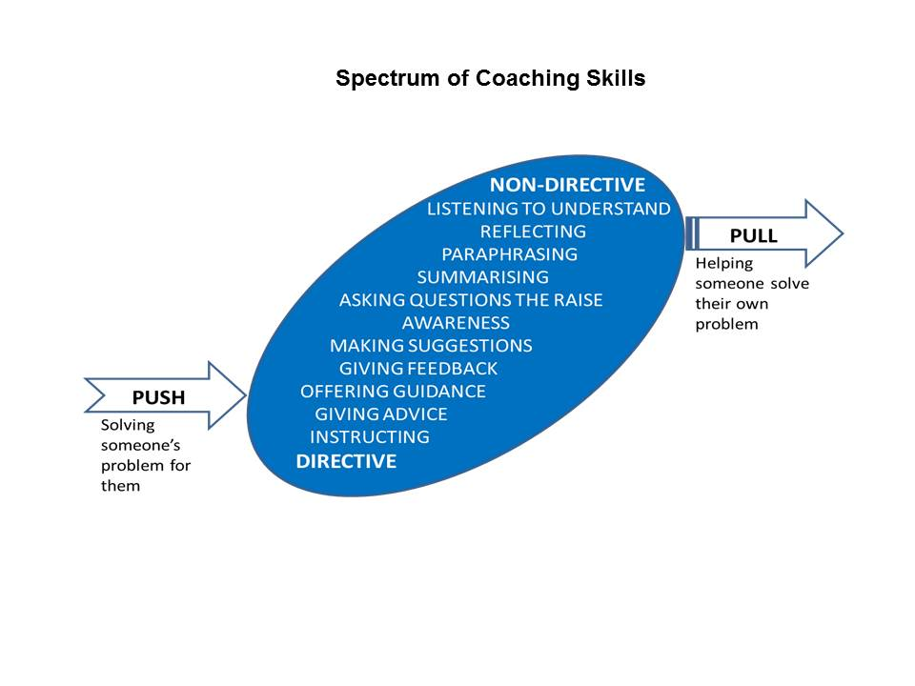
Spectrum of Coaching Skills
Taken from: Downey, M. (1999). Effective coaching (Orion business toolkit). London: Orion Business

Slide 11
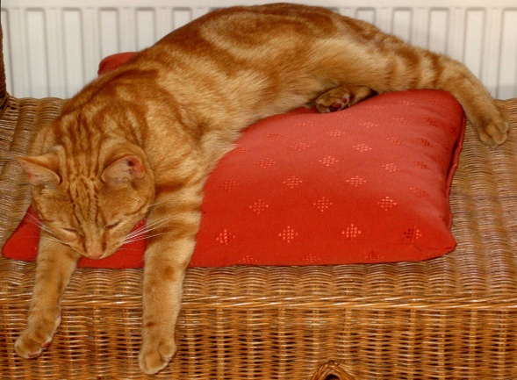



Challenge and support
SUPPORT
COMFORTED
EMPOWERED
BORED
STRESSED
CHALLENGE
Adapted from: Blakey, J., Day, Ian, CIPD, & Ebrary, Inc. (2012). Challenging coaching:
Going beyond traditional coaching to face the facts. London ; Boston: Nicholas Brealey Pub.
Notes:
Bored – No impact
Comforted – Feels cosy, builds dependence, unpredictable results
Stressed – Focused on short term results, erodes self confidence, Alienates leader
Empowered – Delivers high quality results, builds self esteem, increases productivity

Slide 12
Levels of Listening
Level 3 – Global
Picking up emotions, tone body language, environment and self talk
Level 2 – Focused
The focus is with the coachee, listening to every word and conversational nuance
Level 1 – Internal
Hear the words but primarily aware of own opinions, feelings and needs
Level 0 – Tuned out
Not listening
Adapted from: Kimsey-House, K., Kimsey-House, H., Sandahl, P., & Whitworth, L. (2011).
Co-Active Coaching (3rd ed.). London: Nicholas Brealey Publishing.

Slide 13
Skill and Will
GUIDE
DELEGATE
High Will
Low
Will
DIRECT
EXCITE
Low Skill
High Skill
Landsberg, M. (2003). The Tao of Coaching: Boost Your Effectiveness at Work by
Inspiring and Developing Those Around You. Profile Books.
Notes:
The skill/will matrix was introduced by Max Landsberg in his book, The Tao of Coaching. Since then it has been widely adopted and is a useful method of ensuring that a coach’s style of interaction is matched to a coachee’s readiness for a particular task. Whilst more appropriate for managers, it can also be used by both internal and external coaches with no line management responsibility for the coachee. Coaching takes place when there is a particular situation, issue or task that the coachee needs help with. The skill/will matrix requires a coach to assess the coachee’s level of skill for dealing with that situation, issue or task and also their level of will. • Skill depends on experience, training and understanding. • Will depends on desire to achieve, incentives, security and confidence. The matrix works by plotting the level of the coachee’s skill against their will, either high or low, in order to determine the appropriate style of interaction for the coach to adopt:

Slide 14
Questioning Skills
Effective Coaching Questions
Open
  (to promote discussion)
Probing
  (to follow up on what has been said)
Focussed
  (to establish the real situation and real actions to be taken)
Leading Questions
  (to be avoided!)
What, Where, When, How (Why needs to be used carefully to avoid appearing judgemental)
Can you tell me more about…?
What were your feelings at the time?
What action will you take?
Don’t you think it would be better if…?
Why don’t you do the following…?

Slide 15
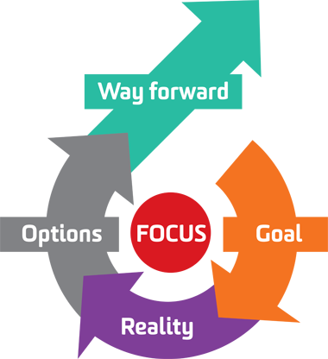
The G.R.O.W model
S.M.A.R.T. Goals
Specific
Measurable
Achievable/Action-oriented
Realistic
Time-bound
Image from http://aspirekc.com/Blog/2015/01/05/need-more-focus-try-the-grow-model/
Whitmore, J. (2009). Coaching for performance: GROWing human potential and purpose:
The principles and practice of coaching and leadership (4th ed.). London: Nicholas Brealey.

