Slide 1
Personal Tutoring at the University of Salford
Dr Jacqueline Leigh
Acknowledgements: Helen Parker, Dr Emma Gillaspy, Dr Rachel Cowan, Howard Barringer, Jo Lopas da Silva)

Slide 2
Overview
The story so far
The Student Success Project
Coaching skills session

Slide 3

The Brief
To develop a personal tutoring system based on the gym analogy. The less capable students will be pulled up to achieve at least an acceptable level of competence. The high performing students will be stretched to achieve even more.
The personal tutor is likened to the personal trainer

Slide 4
The Pillars of Personal Tutoring
Academic and study skills
Employability
Stretch and challenge / personal and professional growth
Pastoral support

Slide 5

Some of the challenges

Slide 6
The Pillars of Personal Tutoring
Academic and study skills
Employability
Stretch and challenge / personal and professional growth
Pastoral support

Slide 7
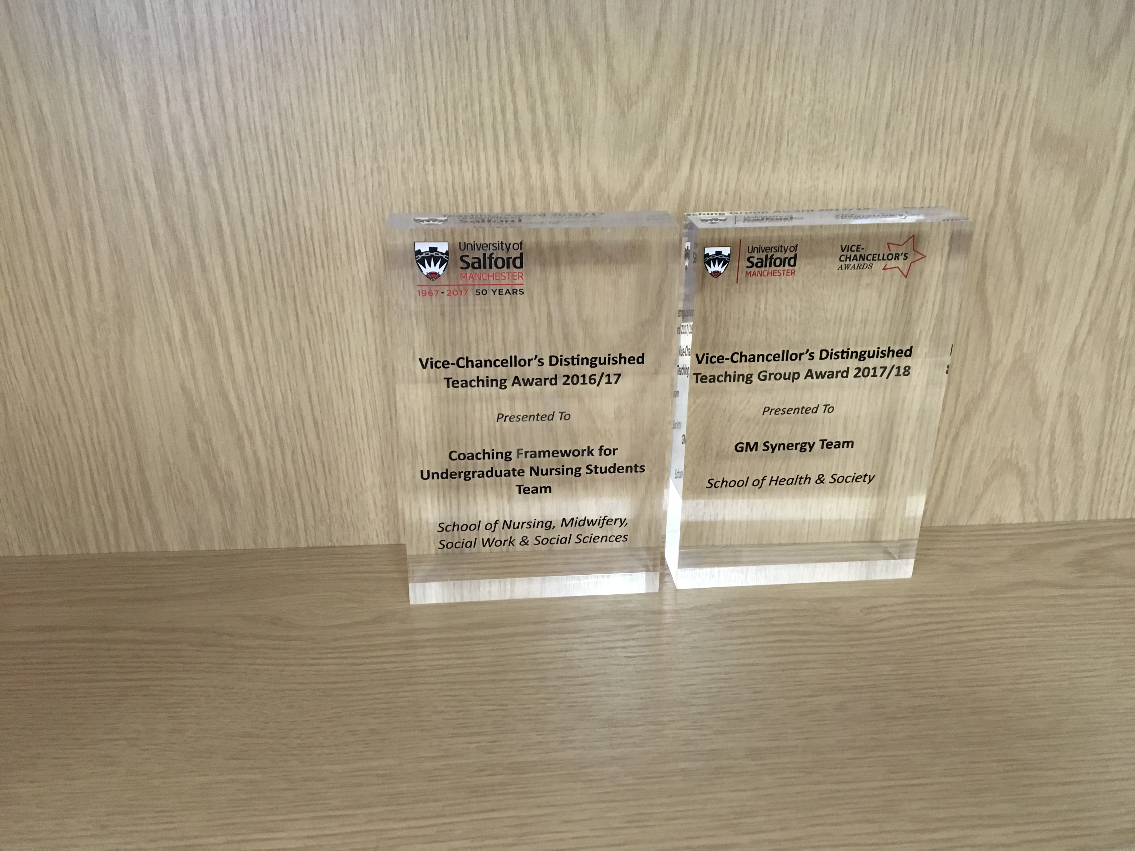




Slide 8

The Skills of the Personal Tutor
Based on an initiative developed in the School of Health and Society, coaching skills were identified as being core to the skills of the personal tutor

Slide 9
Coaching Evaluation
Personal Tutor Survey (N=39), that around a quarter of personal tutors used a “telling” approach to student support,
73% offering “guidance” and 32% “instructing” students.
Personal Tutoring Experiential Education Workshop was developed and implemented (N=39).
Notes:
UoS team members noted that undergraduate nursing personal tutors seemed to lack experience and expertise in coaching techniques. Collaborating with key personnel working as consultants to the GM Synergy team, they set out to understand the problem; put in place a teaching and learning intervention; evaluate impact; and make recommendations for change.
Key to understanding the problem was finding out, through a survey (N=39), that around a quarter of personal tutors used a “telling” approach to student support, with 73% offering “guidance” and 32% “instructing” students. The team’s evaluation was that this approach tends to mitigate against unlocking student potential. As a result, a Coaching for Personal Tutoring Experiential Education Workshop was developed and implemented (N=39). Three months post workshop, attendees reported that their three preferred and applied coaching techniques were: listening, summarising and asking questions (N=21). 57% felt that adopting a coaching approach would enhance personal tutoring, representing a significant shift from the starting position of “telling”. Recommendations from this work culminated in the further development of systems and strategies including the implementation of the Academic-Clinical Coaching Framework that places equal emphasis on coaching in the academic and clinical environment. This is achieved through systematically using learning needs analyses in undergraduate nursing programmes alongside continuing staff development and robust evaluation.

Slide 10
Coaching Evaluation
Three months post workshop, attendees reported that their three preferred and applied coaching techniques were: listening, summarising and asking questions (N=21).
57% felt that adopting a coaching approach would enhance personal tutoring, representing a significant shift from the starting position of “telling”. implementation of the Academic-Clinical Coaching Framework that places equal emphasis on coaching in the academic and clinical environment.
Notes:
UoS team members noted that undergraduate nursing personal tutors seemed to lack experience and expertise in coaching techniques. Collaborating with key personnel working as consultants to the GM Synergy team, they set out to understand the problem; put in place a teaching and learning intervention; evaluate impact; and make recommendations for change.
Key to understanding the problem was finding out, through a survey (N=39), that around a quarter of personal tutors used a “telling” approach to student support, with 73% offering “guidance” and 32% “instructing” students. The team’s evaluation was that this approach tends to mitigate against unlocking student potential. As a result, a Coaching for Personal Tutoring Experiential Education Workshop was developed and implemented (N=39). Three months post workshop, attendees reported that their three preferred and applied coaching techniques were: listening, summarising and asking questions (N=21). 57% felt that adopting a coaching approach would enhance personal tutoring, representing a significant shift from the starting position of “telling”. Recommendations from this work culminated in the further development of systems and strategies including the implementation of the Academic-Clinical Coaching Framework that places equal emphasis on coaching in the academic and clinical environment. This is achieved through systematically using learning needs analyses in undergraduate nursing programmes alongside continuing staff development and robust evaluation.

Slide 12

Why coaching?
Listening
Questioning
Coaching models
Difficult conversations
Notes:
What you want to get out of the session?

Slide 13
Coaching Benefits……
Coachee:
Increased performance
Higher motivation and commitment
Rapid personal growth
Higher quality of life
Greater work/life balance
Greater sense of purpose and satisfaction
Improved communication and relationships
Coach:
Increased self-awareness
Learning by listening to others
A sense of satisfaction due to making a difference
Intellectual challenge
Improved skills e.g. listening, questioning
Increased awareness of issues
Enhanced ability to manage people and teams
Adapted from p41 of www.cipd.co.uk/NR/rdonlyres/C31A728E-7411-4754-9644-46A84EC9CFEE/0/2995coachbuyingservs.pdf
Notes:
There is a growing body of evidence showing the effectiveness and impact of coaching both within and outside of academia. Coaching is highly valued in the corporate sector with 90% of organisations in the UK and 93% in the USA using coaching interventions resulting in improved performance, confidence, motivation and effective leadership. Although less commonly adopted within HE, a rising number of examples of Universities offer one to one coaching using internal coaches with varying degrees of internal and external training (Vitae review 2012). Early evaluation of HE coaching programmes for postgraduate students and staff at all stages of their academic careers shows increased self-awareness and self discovery, confidence, communication skills, increased project completion, lower stress and improved working relationships. Little longer term or higher level evaluation has been carried out in HE beyond Kirkpatrick’s level 1 ‘reaction’ and level 2 ‘learning’.

Slide 14
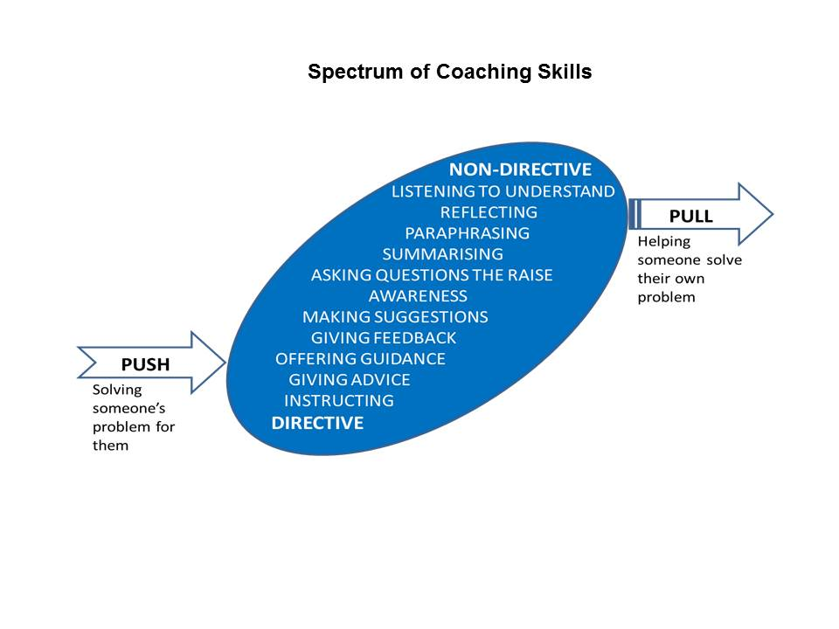
Spectrum of Coaching Skills
Taken from: Downey, M. (1999). Effective coaching (Orion business toolkit). London: Orion Business

Slide 15
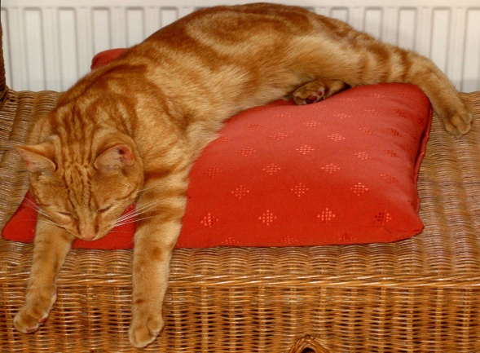



Challenge and support
SUPPORT
COMFORTED
EMPOWERED
BORED
STRESSED
CHALLENGE
Adapted from: Blakey, J., Day, Ian, CIPD, & Ebrary, Inc. (2012). Challenging coaching:
Going beyond traditional coaching to face the facts. London ; Boston: Nicholas Brealey Pub.
Notes:
Bored – No impact
Comforted – Feels cosy, builds dependence, unpredictable results
Stressed – Focused on short term results, erodes self confidence, Alienates leader
Empowered – Delivers high quality results, builds self esteem, increases productivity

Slide 16
Levels of Listening
What are your personal actions to advance towards Level 3 listening?
Level 3 – Global
Picking up emotions, tone body language, environment and self talk
Level 2 – Focused
The focus is with the coachee, listening to every word and conversational nuance
Level 1 – Internal
Hear the words but primarily aware of own opinions, feelings and needs
Level 0 – Tuned out
Not listening
Adapted from: Kimsey-House, K., Kimsey-House, H., Sandahl, P., & Whitworth, L. (2011).
Co-Active Coaching (3rd ed.). London: Nicholas Brealey Publishing.

Slide 17
Skill and Will
GUIDE
DELEGATE
High Will
Low
Will
DIRECT
EXCITE
Low Skill
High Skill
Landsberg, M. (2003). The Tao of Coaching: Boost Your Effectiveness at Work by
Inspiring and Developing Those Around You. Profile Books.
Notes:
The skill/will matrix was introduced by Max Landsberg in his book, The Tao of Coaching. Since then it has been widely adopted and is a useful method of ensuring that a coach’s style of interaction is matched to a coachee’s readiness for a particular task. Whilst more appropriate for managers, it can also be used by both internal and external coaches with no line management responsibility for the coachee. Coaching takes place when there is a particular situation, issue or task that the coachee needs help with. The skill/will matrix requires a coach to assess the coachee’s level of skill for dealing with that situation, issue or task and also their level of will. • Skill depends on experience, training and understanding. • Will depends on desire to achieve, incentives, security and confidence. The matrix works by plotting the level of the coachee’s skill against their will, either high or low, in order to determine the appropriate style of interaction for the coach to adopt:

Slide 18
Questioning Skills
Effective Coaching Questions
Open
  (to promote discussion)
Probing
  (to follow up on what has been said)
Focussed
  (to establish the real situation and real actions to be taken)
Leading Questions
  (to be avoided!)
What, Where, When, How (Why needs to be used carefully to avoid appearing judgemental)
Can you tell me more about…?
What were your feelings at the time?
What action will you take?
Don’t you think it would be better if…?
Why don’t you do the following…?

Slide 19
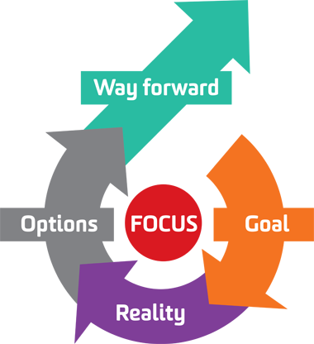
The G.R.O.W model
S.M.A.R.T. Goals
Specific
Measurable
Achievable/Action-oriented
Realistic
Time-bound
Whitmore, J. (2009). Coaching for performance: GROWing human potential and purpose:
The principles and practice of coaching and leadership (4th ed.). London: Nicholas Brealey.
Image from http://aspirekc.com/Blog/2015/01/05/need-more-focus-try-the-grow-model/

