Slide 1
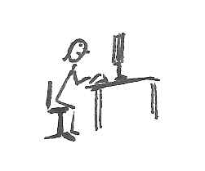
The distribution of activPAL postural and stepping classifications within ActiGraph activity classifications
Alex Clarke-Cornwell
Lecturer in Public Health, University of Salford, UK a.m.clarke-cornwell@salford.ac.uk

Slide 2


Happy to be tweeted!
@barmyalex

Slide 3
Background
Guidelines of physical activity and sedentary behaviour are dependent on how we define and quantify physical behaviour
Important to understand the validity of objective measures of physical activity and sedentary behaviour

Slide 4
Background
Particularly when examining associations with physical behaviour and health-related outcomes
The counts per minute outcome variable is widely used across studies that use/d accelerometers, i.e. NHANES, Health Survey for England
  Enhances comparability of physical behaviour across studies

Slide 5
How do we measure physical behaviour?
Practicality and validity of physical activity measures (adapted from Dugdill & Stratton, 2007)
Notes:
Can’t provide contextual information

Slide 6
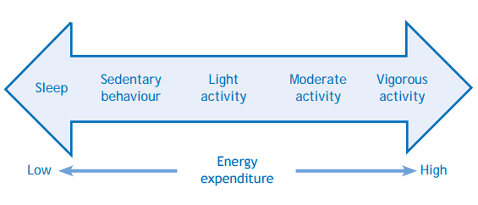
Movement continuum
Movement continuum in terms of energy expenditure (BHF, 2012, adapted from Tremblay et al., 2010)

Slide 7
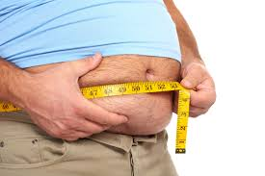
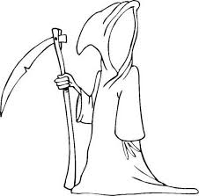
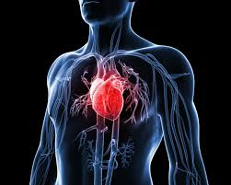
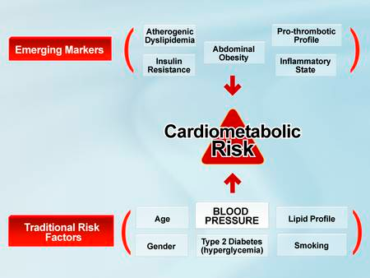
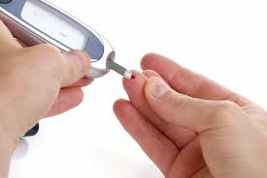

Health consequences
Notes:
In the fast emerging literature,a number of studies that have found associations between sedentary behaviour and health-related outcomes, including
Obesity
CVD
Cardio-metabolic risk factors
Some cancers
Diabetes
Premature Mortality

Slide 8
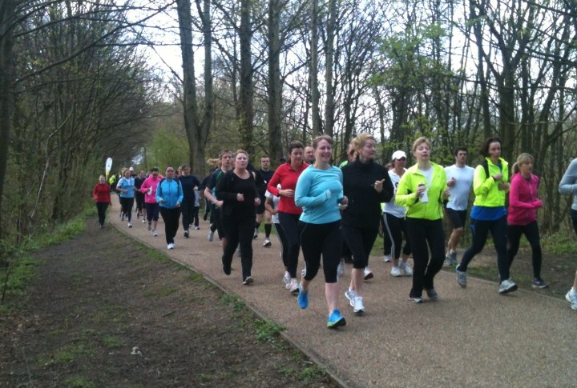
Sedentary behaviour, independent of physical activity levels
Notes:
And these associations have been independent of physical activity levels.

Slide 9
Study aim
This study aimed to evaluate the activity classifications of the ActiGraph GT3X+, using activPAL3 postural and stepping classifications as a criterion reference, in a free-living environment.

Slide 10
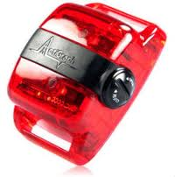
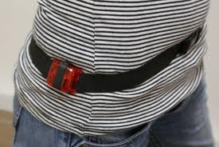
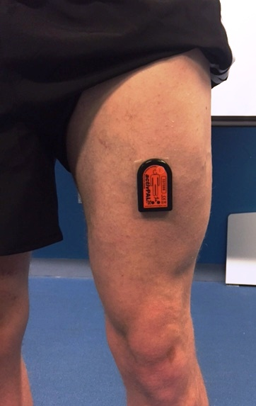
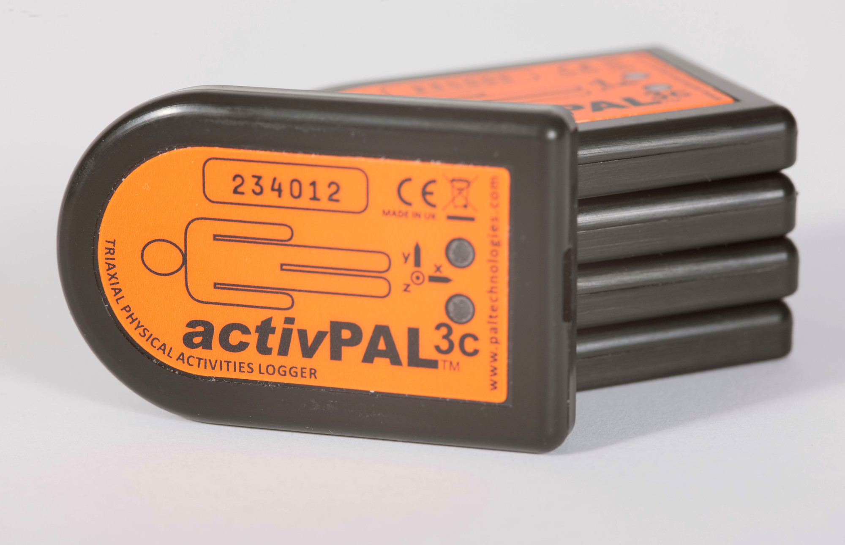
Methods
Notes:
A convenience sample of 30 employees and postgraduate students from the university of Salford, who spent most of their time at work sitting were asked to participate in the study. Participants were asked to wear the ActiGraph and the activPAL simultaneously for 7 days.

Slide 11
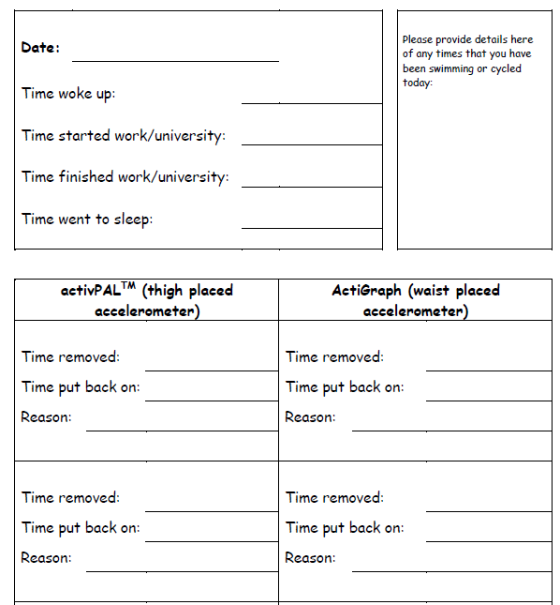
Methods
Notes:
Participants were asked to record their sleeping hours in an activity diary; they were also asked to record their working hours, if either accelerometer was removed, the time it was removed and the reason it was removed.

Slide 12
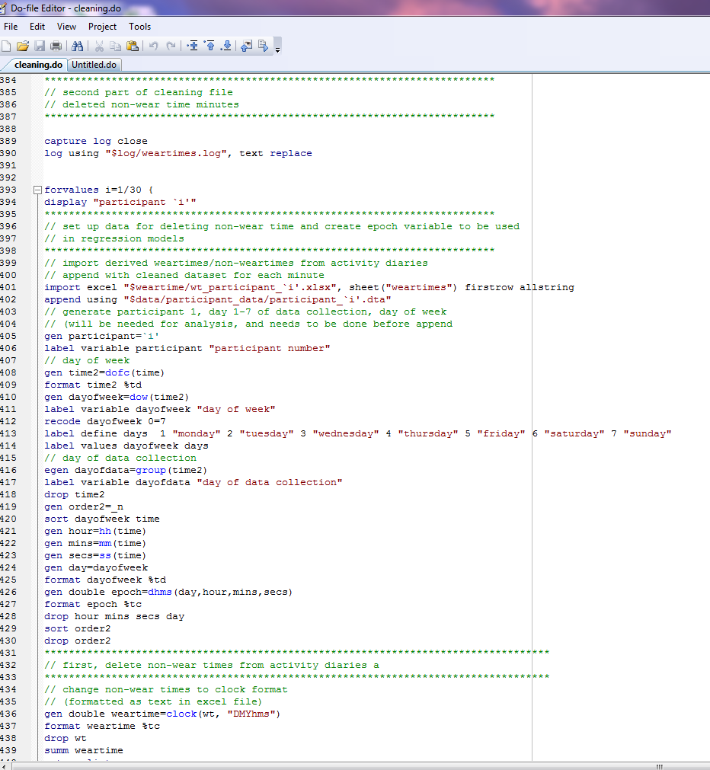
Data processing
Notes:
Data were downloaded in 1-minute epochs and non-wear time was removed, using information from activity diaries and the Troiano algorithm for AG counts.

Slide 13
Methods
ActiGraph data were categorised using the Freedson activity cut-points for sedentary, light, moderate and vigorous physical activity (≤99, 100-1951, 1952-5724, ≥5725)
For each of these categories, the percentage of activity (sitting/lying, standing and stepping) from the activPAL was calculated

Slide 14
Results
30 university employees (females, 66.67%); age 40.47±10.95 years; BMI 23.93±2.46 kg/m²)
Participants provided on average 11h 58 min of data per day.
Using ActiGraph cut-points, the majority of these minutes (64.4%) were classified as sedentary behaviour, 30.5% light physical activity, and 5.1% moderate to vigorous physical activity.

Slide 15
Results
activPAL minutes classification | ActiGraph count distribution
 | Median | Interquartile range | Range
Sitting/Lying | 1 | 0-30 | 0-9808
Standing | 5 | 0-39 | 0-4452
Stepping | 3990 | 2968-4882 | 0-13247
Notes:
The AG count distribution, median (interquartile range:range), for AP minutes that were wholly classified as

Slide 16
Results
Notes:
The AG sedentary category contained 16.8% standing; LPA contained 35.9% sitting/lying; (85.4%) of MVPA categories were accumulated in steps (figure).

Slide 17
Results - cadence (steps/min)
125
111
90
Notes:
The AG sedentary category contained 16.8% standing; LPA contained 35.9% sitting/lying; (85.4%) of MVPA categories were accumulated in steps (figure).

Slide 18
% activPAL categories by sedentary bout
Notes:
% of activPAL categories accumulated within ActiGraph sedentary classification for varying bout lengths – activities that are difficult to classify accurately using a waist worn accelerometer

Slide 19
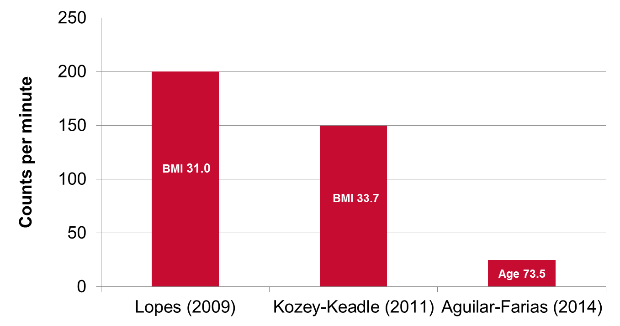
Implications – cut-points and context
Notes:
May need to consider population context before using cut-points at the lower end of the movement continuum.

Slide 20
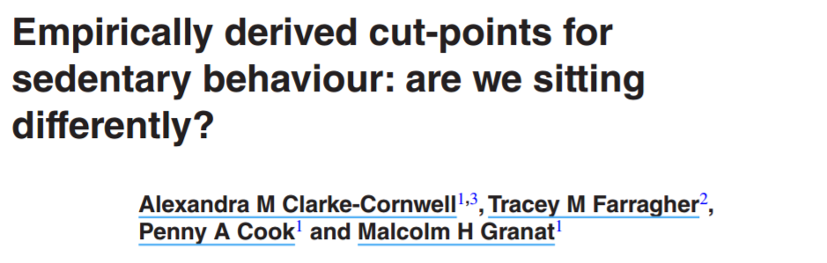
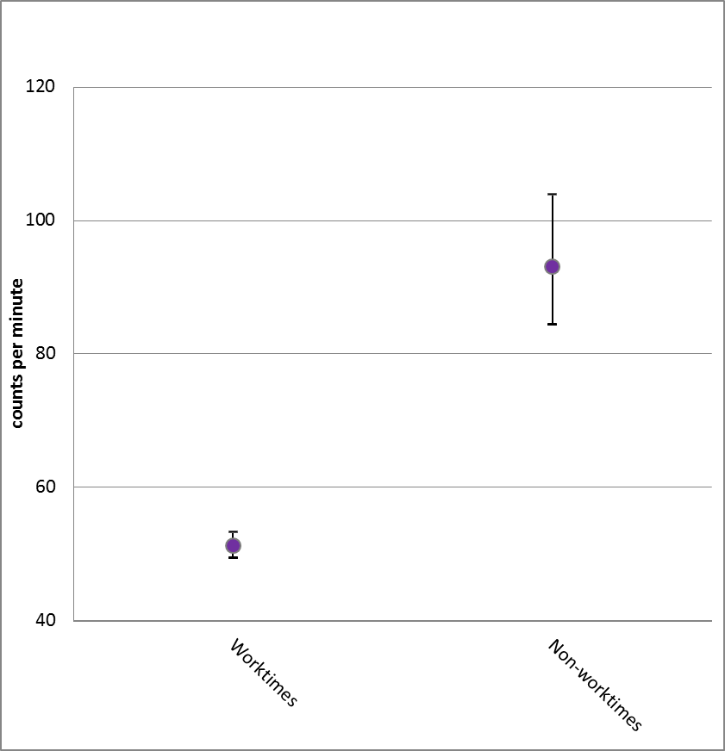
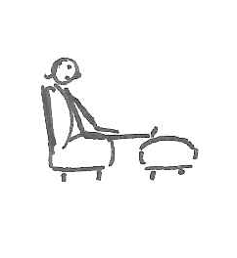
Implications
Notes:
So are we sitting differently? Derived cut-points for worktimes and non-worktimes were significantly different – worktimes, 53 counts per minute and non-worktimes at 93 counts per minute.
Cut-points for sedentary behaviour can depend on day and domain
Nature of sitting differs depending on the context in which sedentary time occurs
With independent links to health outcomes, it is important to have accurate and reliable measures of sedentary behaviour

Slide 21
Different types of sitting

Slide 22
Final thoughts
The misclassification of standing within the ActiGraph sedentary classifications, supports recent evidence that the 100 cut-point for sedentary behaviour can over or under estimate sedentary time depending on the underlying population
Methodological implications of how we measure and describe physical behaviours – context of how we accumulate physical behaviour at lower end of movement continuum may also be important

Slide 23
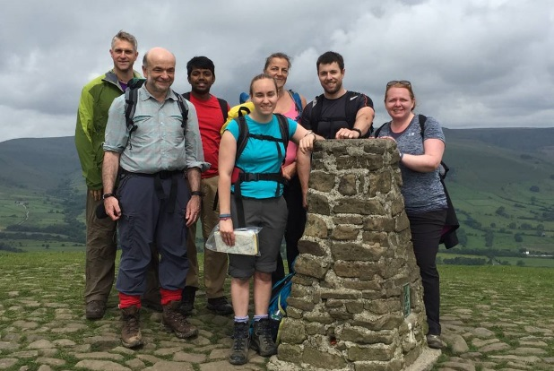
Thank you for listening
Measurement and Quantification of Physical Behaviour group at the University of Salford (http://www.salford.ac.uk/research/health-sciences/research-groups/measurement-and-quantification-of-physical-behaviour)

