Slide 1

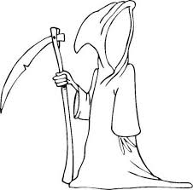
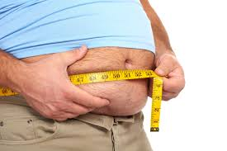
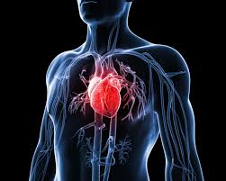
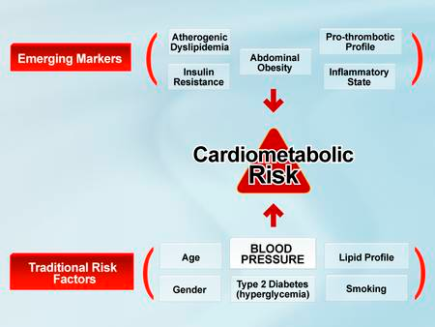
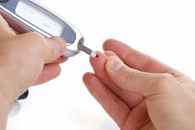

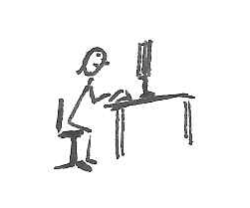


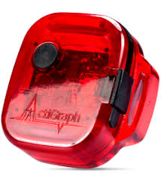

Occupational sedentary time and associations with adiposity markers: a quantile regression analysis
A.M. CLARKE-CORNWELL¹, P.A. COOK¹ and M.H.GRANAT¹
1. School of Health & Society, The University of Salford, UK
Introduction
Sedentary behaviour is associated with a number of health-related outcomes, independent of physical activity
There is limited research that has examined the role that occupational sedentary time contributes to these associations
For those who are economically active, the majority of their sedentary time may be accrued in the workplace
Results
Of the 2356 adults with accelerometer data, 911 were in full-time employment
Men (n=557) were significantly older than women (n=354) who were in full time employment (43.92 vs. 41.67, p=0.008)
The mean BMI was 27.27 kg/m²; there was no statistically significant difference in BMI between males and females (27.50 vs. 26.90, p=0.079)
The mean waist circumference was 93.34cm – males had a significantly higher waist circumference compared to females (97.67 vs 86.23)
Occupational sedentary time was not associated with either waist circumference or BMI across quantiles of these adiposity markers, after regression models were adjusted for moderate to vigorous physical activity; both cut-points produced similar results
Moderate to vigorous physical activity was a significant predictor in change in adiposity markers
For each one minute increase per day in moderate to vigorous physical activity, there were significant associations with reduced waist circumference (cm), and this effect varied with increasing quantiles of waist circumference (β coefficients for the 25th, 50th, 75th quantiles were -0.045*, -0.065*, -0.101*)
For each one minute increase per day in moderate to vigorous physical activity, there were significant associations with reduced BMI and this effect varied with increasing quantiles of BMI (β coefficients for the 25th, 50th, 75th quantiles were -0.011, -0.021*, -0.021*)
*significant, p<0.05
The coefficients for the quantile regression analysis for moderate to vigorous physical activity were not significantly different from the coefficient from the ordinary least squares regression model for waist circumference (-0.061) and BMI (-0.020; Figure 1)
Figure 1 Coefficient graph for BMI quantile regression model, for moderate to vigorous physical activity
Conclusions
Associations between occupational sedentary time and adiposity markers can be explained by moderate to vigorous physical activity
In contrast to studies that have found associations with both total sedentary time and leisure time sedentary behaviour and detrimental health outcomes, there was no evidence that occupational sedentary time is associated with health-related outcomes in the same way
It is not known if there are underlying mechanisms of sedentary behaviour in different domains that can explain these differences, and the effect that occupational sedentary time has on health
Although the coefficients for moderate to vigorous physical activity in the quantile regression analyses were not significantly different to the ordinary least squares regression models, the magnitude of the coefficients decreased along quantiles for both independent adiposity variables
Objective
The objective of this study was to examine the associations of occupational sedentary time with waist circumference and body mass index (BMI)
?
Methods
Data were taken from the Health Survey for England 2008, a nationally representative annual survey of adults (n=15,102)
Height and weight were measured, and BMI (kg/m²) calculated; waist circumference (cm) was measured during a nurse visit
The ActiGraph GT1M accelerometer was worn by a sub-sample of participants for seven days
The Troiano automated algorithm was used to remove non-wear time (Troiano et al 2008)
Physical behaviour variables were computed using accelerometer count data
Time in occupational sedentary behaviour was calculated using previously derived cut-points (<35 counts per minute; Clarke-Cornwell et al 2016), and the commonly used cut point of <100 counts per minute
Quantile regression models were used to examine the variable effects of occupational sedentary time on waist circumference and BMI
The Shapiro-Wilk test was used to test whether the measures of adiposity were normally distributed
Quantile regression models were adjusted for age, gender, accelerometer wear-time, lifestyle variables, health status, non-work sedentary time, and average time per day in moderate to vigorous physical activity
References
Clarke-Cornwell et al. Empirically derived cut-points for sedentary behaviour: are we sitting differently? Physiological Measurement 2016, 37(10), p.1669
Troiano et al. Physical activity in the United States measured by accelerometer. Medicine and science in sports and exercise 2008, 40(1), p.181
CONTACT INFORMATION
Alex Clarke-Cornwell, Lecturer in Public Health, School of Health & Society, University of Salford, Manchester, UK
Email: a.m.clarke-cornwell@salford.ac.uk
@barmyalex

