Slide 1
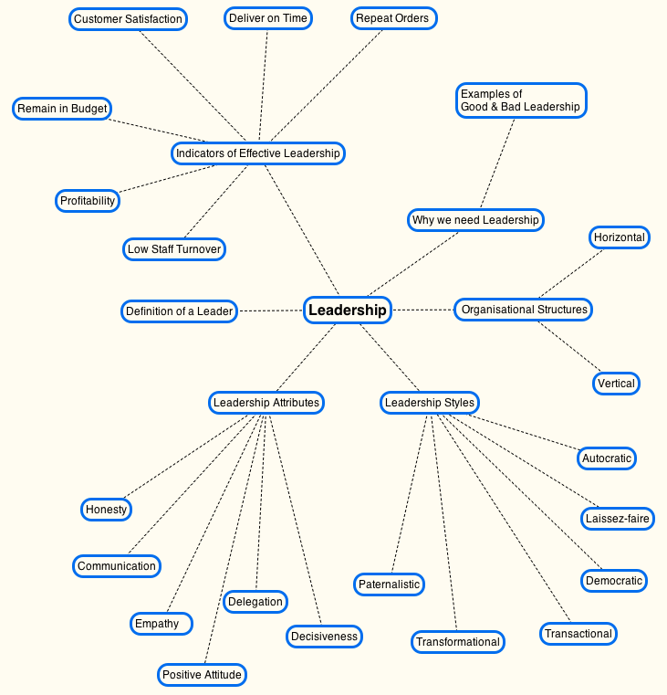
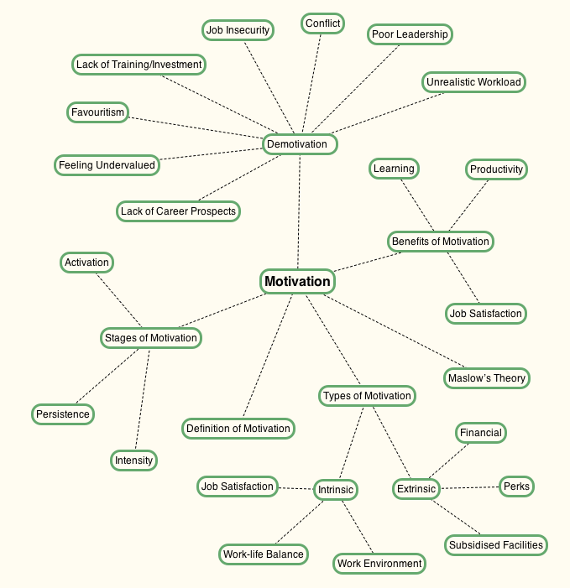
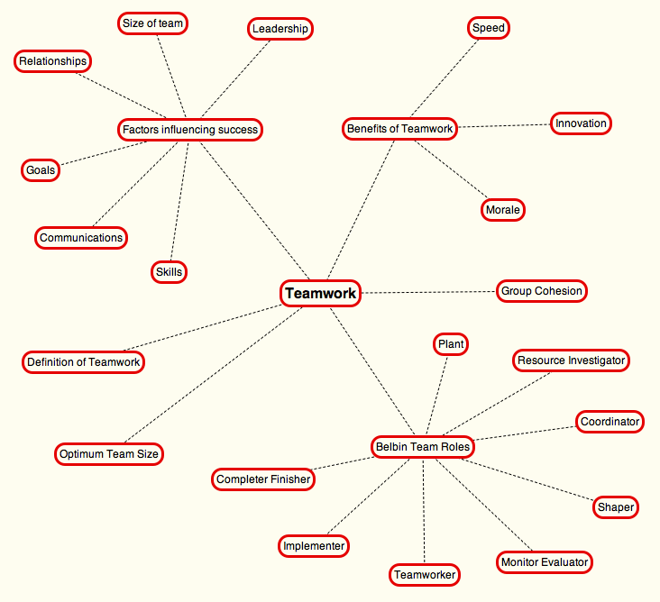
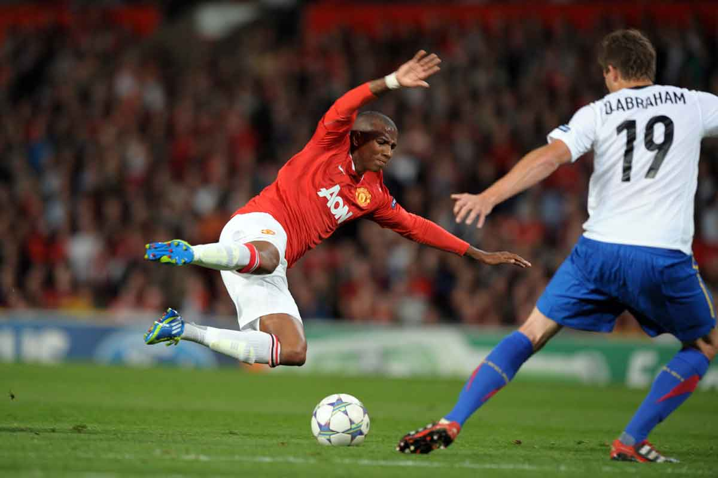
Becoming an Effective Leader, Motivating Others and Developing Teamwork within Engineering
Mr. Ian Hamp¹ & Dr. Ioannis Paraskevas²
¹Academic Group of Engineering, Sports and Sciences, University of Bolton
²Centre for Advanced Performance Engineering (CAPE), Academic Group of Engineering, Sports and Sciences, University of Bolton
Abstract
This work investigates the topics of Leadership, Motivation and Teamwork, introducing two self-developed theories on bogus problems raised within the workplace and whether or not opposing Belbin team roles can cause conflict between co-workers.
Effective leadership is somewhat of a mystery, with the question of why some individuals are perceived as good leaders and others as poor leaders, being the impetus for this report. Motivation and teamwork are elements associated with effective leadership, and this report aims to understand the importance of these elements. Mind Maps were constructed for each topic, and the accuracy of conclusions was tested against the opinions of engineers by means of two questionnaires and follow up interviews.
It was found that a “one size fits all” leadership style does not exist, with the key to effective leadership lying in knowing when to adopt a combination of leadership styles. Good Work-life Balance, Job Satisfaction and Money were found to be the top motivators, and smaller teams with a balance of skills were found to operate more effectively than those without, attaining optimum performance when a state known as Group Cohesion is reached.
The majority of those surveyed agreed that the volume of questions/queries they receive each day have a detrimental effect on their work output, and they also suspect individuals deliberately raise or exaggerate problems to conceal a different problem in their own domain. The analysis of Belbin team role behavioural traits also uncovered a possible link between opposing Belbin team roles and workplace conflicts.
Leadership
Leadership is required to get things done, without leadership tasks would simply meander along at their own pace without any clear direction.
Motivation
Motivation is perceived in its simplest form as being the internal driving force that causes individuals to take action or pursue a goal.
Teamwork
A state known as Group Cohesion is capable of bonding and intrinsically motivating team members to work harder towards common goals for the good of the team .
“Someone who has followers” (Drucker, 1999).
Self-developed… Bogus Problem Theory
Slow motion replays often capture football players deliberately taking a dive in order to gain an advantage. If professional footballers are capable of this type of deceit, it is conceivable that professionals in engineering may also exaggerate or invent problems to gain an advantage.
Bogus problems could be raised to increase the self-importance of an individual, justify their role within the organisation, or to provide a smokescreen to shield a second real issue that the individual wishes to temporarily hide.
Self-developed… Belbin Team Role Conflict Theory
The observation of a long-term volatile working relationship between two work colleagues within the same office, was the impetus for developing this theory. Both individuals believe the volatile nature of the relationship is not personal, and therefore theorised to be linked to a possible clash of their Belbin team role behavioural traits.
The Belbin team role profiles for 20 engineers were analysed and found to be unique for each individual, very much like a fingerprint.
For the two individuals involved in the volatile working relationship, large variances were found between 50% of the Belbin team roles justifying additional investigation as to a possible cause of workplace conflicts.
Conclusions
A “one size fits all” leadership style does not exist, the key to effective leadership is applying a combination of styles and understanding when to apply each particular leadership styles for a given task.
Organisational Structures do not influence the choice of any particular leadership style.
The top 3 leadership attributes an effective leader should possess are… Communication Skills, Positive Attitude & Honesty.
Of the 6 main leadership styles, no one single style stood out as being vastly preferred by subordinates.
The top 3 motivators were… Good Work-life Balance, Job Satisfaction & Money.
The top 3 demotivators were… Poor Leadership, Unrealistic Workload & Feeling Undervalued.
Smaller teams operate far more efficiently than larger teams, with the optimum team size for most teams comprising four to six members (Belbin, 2011).
Teams with a balance of the eight Belbin team roles, will operate more successfully than those without.
68% of questionnaire respondents indicated that the volume of questions/queries they receive each day has a “Moderate” or “Significant” effect on work output.
79% of questionnaire respondents indicated that they “Occasionally”, “Frequently” or “Always” suspect that some of problems encountered at work, were deliberately raised by others as a smokescreen to conceal a different problem in their own domain.
95% of questionnaire respondents indicated that they “Occasionally” or “Frequently” suspect individuals exaggerate the complexity of their work.
“Approximately 30% of engineering issues will resolve themselves or disappear, without the need to take any action”.
“Opposing Belbin team roles may cause conflicts in the workplace”.
(3News, 2013)
References
3News (2013) Young Faces Fresh Accusations of Diving [Online]. Available from: <http://cdn.3news.co.nz/3news/AM/2013/Ashley_Young-1200.jpg> [Accessed 12 December 2013].
Belbin (2011) Size matters: How to make the ideal team? [Online]. Available from: <http://www.belbin.com/rte.asp?id=73&pressid=31> [Accessed 4 January 2014].
Drucker, P.F. (1999) Managing the Non-Profit Organization. Oxford: Butterworth-Heinemann.

