Slide 1
Virtual Landscapes: A Practice-Based Exploration of Natural Environment Design
Dr Umran Ali
Universitsy of Salford
School of Arts & Media
0161 295 6094
u.ali@salford.ac.uk

Slide 2
About me
Senior Lecturer at University of Salford
Programme leader for BSc CVG, 6 years
Director of Creative Media, 2 years
Hardcore Gamer: 33 years!
eSports (Sci-Fi Gamer Finals 2003)
Destiny: 2000hrs
I collect games! (Games Collection featured on BBC News short (2004)

Slide 3
Introduction
This study is a practice-based investigation that proposes an interdisciplinary approach towards natural environment design in computer and video games.
In this study I argue the current virtual natural environment design practice within computer and video games is not sufficiently developed to meet current or future demands. This will be demonstrated by identifying areas of strong/weak practice with an aim to develop a new design framework that utilises a cross-disciplinary approach for practitioners, students and researchers.
The research proposes theoretical frameworks as well practical guidance within a new design framework for virtual natural environment design.

Slide 4
Introduction
Professional practice: my practise as a designer and artist over the last decade has involved undertaking a range of technical and creative problems at the forefront of artistic and commercial practice. Many of these challenges are only ever partially solved or left fully unexplored due to project limitations such as resource constraints. For a practitioner, these „unsolved‟ challenges can be frustrating, and after a number of projects a number of residual tasks, both creative and technical remained,
Personal Interest: The natural world, in particularly scenic landscapes, has captivated and held my attention for many years and as a result I have been an active and keen walker, as well as developing an interest in nature landscape photography. I am also a keen and passionate video game player, and advocate for the transformative
Reflection on Teaching Practice: I am an active Higher Education academic who has developed, written and taught on a range of programmes in the areas of creative and digital media, with a specific interest in computer and video games theory and practice. For over a decade I have taught on a games degree, and taught games design and production.

Slide 5
Introduction
This paper presents a theoretical and practical framework for virtual natural environment (VNE) design in computer and video games. By applying a practice-based research methodology, and a methodological ‘bricolage’, combining reflective practice, panoramic photography, virtual field trips and experimental design, elements of strong/weak environment design practice were analysed with an aim to develop a new VNE design framework. One of the contributions of this research, a visual artefact, is a three-volume series of books titled Virtual Landscapes, which presents for the first time a variety of gamespaces through high-resolution and digitally enhanced panoramic imagery.

Slide 6
Aims/Scope
The study does not focus on areas such as narrative design or gameplay which already constitute a significant proportion of established research in video games. This research proposes a practical model of how informed environment design can be achieved and incorporated in the creation of VNEs for games. It highlights the need for further exploration of games design, specifically environment design and encourages practitioner-academics, game developers and students to experiment with alternative theories and methods including using an interdisciplinary approach.
This research is located in the area of virtual environment design (both theory and practice) and is grounded in using practice as a method and as a focus for positioning the outputs of the research. Therefore, the design framework proposed by this research (composed of processes, tools and guidance) is intended to assist academics, students and practitioners in viewing games from an alternative perspective, and developing them from an informed position through the use of landscape architecture and aligned subject area.
The study does not focus on the aesthetics/visual elements of natural environment design, although there are several instances in which this is relevant to discuss and explore, it does so on a superficial level. The focus remains on developing a wider and more comprehensive design approach, process and practical implementation of VNE design. It is also not an analysis of games design or environment design in general as it looks specifically at VNE design within the context of computer and video games.

Slide 7
Research Questions
1. How have VNEs evolved in CVG over the last 30 years in both technological and design innovation and what has been (if any) the dominant design paradigm?
2. How have VNEs been perceived and experienced in games in CVG over the last 30 years
3. Can the intangible essence of natural landscapes be distilled into a structural production-based framework for virtual landscape design?
4. How can one employ a practical approach to natural environment design which goes beyond the dominant paradigm exemplified by narrative/visual driven design?
5. How can one create a framework for VNE designers that incorporates (external design and otherwise) traditions but remains connected to the reality of games production?

Slide 8
Theoretical Perspectives: Games Design as Spatial Art
Games design is a rapidly evolving discipline yet the field is still in the ‘feuding tribal’ era with pockets of competing theories and still has not ‘crystalized’ into a stable field of inquiry (Salen & Zimmerman 2004).
The study supports Aarseth’s (2007) assertion that spatiality is the defining element in computer games as virtual environments are capable of being the raison d’être’ of a game; i.e. they can be enjoyed either in their own right.
The study adopts Jenkins & Squire’s (2002) position of viewing digital games as ‘spatial art’ and as such, games design should be grounded in landscape art, architecture, gardening and park design

Slide 9
Literature Review
Game space has evolved significantly over the last 30 years from simple limited 2D fixed size space to massive 3D spaces to completely immersive virtual reality spaces (Wolf, 2002; Boron, 2007)
Games are increasingly becoming openworld, massive and complex; this is set to change further with the advent of VR and AR technologies (Fox, 2010; England, 2015).
A unified Monolithic level design is unlikely to emerge however Intersectional level design, one that utilises as many design traditions as possible depending on the context is more likely (Yang, 2005).
Architecture has been linked to games in both theoretical design (Totten, 2014) as well as and practical application (The Witness, 2016).

Slide 10
Theoretical Perspectives: Games Design as Spatial Art
"Landscape is not synonymous with environment, it is the environment perceived, especially visually perceived”. Appleton 1975
“The defining element in computer games is spatiality” (Aarseth, 2007, p.44)
“Games celebrate and explore spatial representation as a central motif and raison d’être.” (Aarseth, 2007, p.44)
“If games tell stories, they do so by organizing spatial features” Jenkins & Squire’s (2002)
Jenkins & Squire then move onto considering the aesthetic influences in gamespaces ranging from expressionism to romanticism and postulate that “as game designers dig deeper into these artistic traditions, they may develop more emotionally evocative and meaningful spaces” (2002, p.7).

Slide 11
Ruskinian Driven Design
Grounded in Ruskin’s manifesto
“Go to Nature in all singleness of heart, and walk with her laboriously and trustingly, having no other thoughts but how best to penetrate her meaning, and remember her instructions; rejecting nothing, selecting nothing, and scorning nothing; believing all things to be right and good, and rejoicing always in the truth.’ John Ruskin
I was particularly drawn to the idea of a ‘Ruskin experience’

Slide 12
Space & Place
Edward’s Relph’s Place & Placelessness
Relph’s existential insideness
“….a situation of deep, unself-conscious immersion in place and the experience most people know when they are at home in their own community and region” Seaman & Sowers (2008)

Slide 13
Methodology
By applying a practice-based research methodology, and a methodological ‘bricolage’, combining reflective practice, panoramic photography, virtual field trips and experimental design, elements of strong/weak environment design practice were analysed with an aim to develop a new VNE design framework.
Practice based research (making games!)
Reflective Practioner (Schon)

Slide 14
Methodology
Insider Research
Smith & Dean (2009, p.23) state “…the advantages of the practitioner-researcher role are compelling: your ‗insider‘ knowledge, experience and status usually lends your research credibility and trustworthiness in the eyes of your peers, that is, you are not an ‗external‘ researcher.”
Emergent Methodology
Bunnel (1998) defines this as "...possible strategies for problem solving emerge through immersion in the research problem and become more focused through action. Reflection in and on action and structured improvisation are valuable to the evolving research strategy".

Slide 15
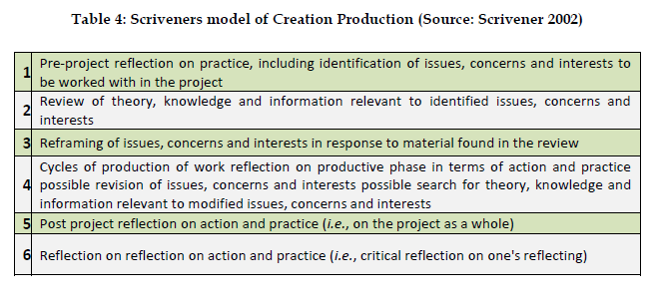
Methodology

Slide 16
Methodological Bricolage
Visual Grounded Theory
Konecki (2011, p.133) “allow[s] researchers to incorporate visual data while designing their research projects within the framework of grounded theory” and therefore VGT which ―…relies on visual data for constructing categories, describing properties and generating/constructing theoretical hypotheses, which account for the visual phenomena…”
Contextual Review
Gray & Malins (2004, p.49) “….to identify a ‗gap‘ in existing knowledge, thus providing a rationale for the new research and a context for its original contribution to knowledge”
70 different Computer & Video Games covered over 30 years period
3-4 years of work
~12 Different platforms
~350 Unique UltraHD Virtual Landscape Panoramas
~300 High Definition ‘extracted’ Virtual Landscapes
~150 Digitally Enhanced HD Virtual Landscapes
Spread over three volumes, available in print, digital(ebook, PDF & itunes) and interactive formats

Slide 17
Methodology
Virtual natural environments were examined through a contextual review, a combination of previous professional practice in addition to a selection of digital games across a variety of platforms and genres over the last 30 years. The contextual review involved a detailed textual and visual-based historical survey of virtual landscapes, resulting in a practice-based exploration of virtual natural environment design.
One of the contributions of this research, a visual artefact, is a three-volume series of books titled Virtual Landscapes, which presents for the first time a variety of gamespaces through high-resolution and digitally enhanced panoramic imagery

Slide 18
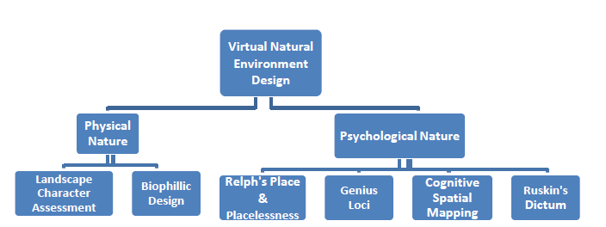
Methodological Bricolage

Slide 19
Methodological Bricolage
Photography
This method was chosen since it allows instant access to a place (virtual or physical space) in order provide a visual context to an otherwise difficult concept to describe) as a form of non-verbal communication, one that acts as entry point, to aid reflection and analysis, and as a method that allow the research to be transformed into more accessible (one that does not require lengthy time to absorb and digest) and appealing outcome; one that is more readily evolved into exhibit, ready to elicit response and incite critical discussion
Field Trip (Virtual & Physical)
This includes the standard definition of the term field trip (an observational method employed to gather data in a 'live' physical setting) but within this study I am including the virtual domain within this term (visiting a virtual space to observe and collect data for later analysis and reflection).

Slide 20
Methodology
ShadowMoss Island is a practice-based exploration of how VNE design can incorporate elements from Environmental Psychology and Geology, as well as reflections and observational analysis based on a field trip. Psychological elements added to this new design framework can radically improve the success and impact of a VNE.

Slide 21
Outcomes
The research has significance to both professional and pedagogic practitioners working in the area of computer and video game natural environment design.
A range of tools, processes, artefacts and extensive recommendations were developed in the course of the research, resulting in the creation of historical VNE visual archive in a range of digital and physical ‘artefacts’ forms.
An interdisciplinary design approach can benefit the growing complexity of contemporary VNEs and lead to more evocative and immersive game environments.

Slide 22
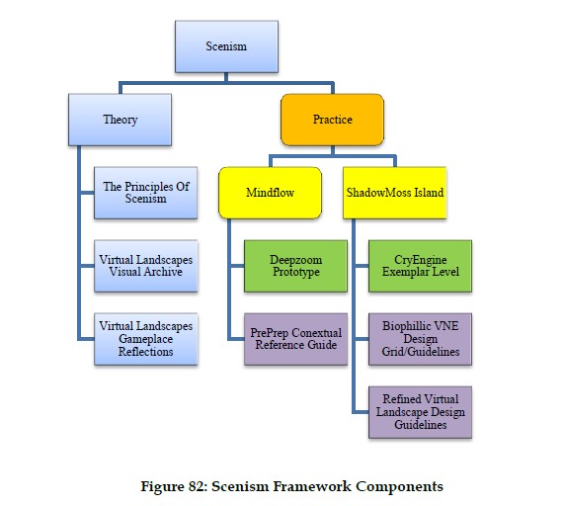
Outcomes

Slide 23
Outcomes
The research not only presents a theoretical model but also presents a practice-based outcomes to illustrate that this can be a creative and feasible approach. Within the framework, ShadowMoss Island provides a working exemplar of how field study could be conducted (capturing the field experience data in the journal/log) and provides a step by step guide in how a VNE design process should be staged in a contemporary (2017) games engine

Slide 24
Outcomes: World Architects
This research supports the assertion that video games have the power to forge the future of ludic space-time (Brouchoud 2013; Walz 2010) and that architecture, specifically landscape architecture, will increasingly blend with game design to create a new type of design and will herald new roles crossing the boundaries between games design and art.

Slide 25
Outcomes: Gameplace
This study proposes gameplace as a complimentary term to sit alongside gamespace; gamespace may refer to the particularly arrangement/configuration of the virtual space/environment in a game, whereas gameplace refers to a particular and specific location within a gamespace that evokes meaning, whether that is to an individual or a group on a personal, cultural or otherwise level.
The study argues that gamespaces have a significant impact on gameplay, as such the research looks specifically at the game design & production processes of a sub-type (virtual natural environments) with an aim in developing richer and deeper games design processes and methods in the practical implementation of VNE design.

Slide 26
Outcomes: Scenism
The study argues that gamespaces have a significant impact on gameplay, as such the research looks specifically at the game design & production processes of a sub-type (virtual natural environments) with an aim in developing richer and deeper games design processes and methods in the practical implementation of VNE design.

Slide 27
Outcomes: Scenism
Spatiality as Raison D’etre: Scenism embraces and develops the perspective of spatiality as one of the defining attributes of digital games and as such should be core focus of implementing a ‘scenistic’ approach. This perspective offers game developers an opportunity to develop engaging spatial experiences using an array of game technologies that may not use ‘traditional’ elements of gameplay, but instead focus on emergent spatial-play elements such as exploration & discovery, prospect and refuge.

Slide 28
Conclusions
The research concludes with proposing a practical framework driven by viewing environment design from an alternative perspective (spatial) to the narrative or aesthetic driven approaches employed by environment design practitioners. The experimental ‘Virtual Natural Environment Design’ (VNED) framework proposed in this study intends to assist practitioners in viewing and developing games from an alternative and informed position.
The research concludes with presenting ‘Scenism’ as the embodiment of the proposed VNE design framework, a unified and coherent construct, one that communicates the research in a more production focused manner for both professional and pedagogic practitioners working in the area of computer and video game natural environment design.

Slide 29
References
Aarseth, E.J. (2007). Allegories of space: The Question of Spatiality in Computer Games. In F. von Borries, S. P. Walz & M. Böttger (eds.) Space time play: computer games, architecture and urbanism: the next level (pp. 44-47) Berlin: Birkhauser Verlag AG
Adams, E. (2013). Fundamentals of game design. New Riders.
Appleton, J. (1975). The experience of landscape. Chichester: Wiley.
Boron, D.J. (2007). A short history of digital gamespace. In F. von Borries, S. P. Walz, & M. Böttger (Eds.) Space time play: computer games, architecture and urbanism: the next level. (pp. 26-31) Berlin: Birkhauser Verlag AG
Brouchoud, J. (2013, February 09). The Importance of Architecture in Video Games and Virtual Worlds. ArchVirtual. Retrieved January 15, 2016, from http://archvirtual.com/2013/02/09/the-importance-of-architecture-in-video-games-and-virtual-worlds/
Bunnell, K. (1998). The Integration of New Technology into Ceramic Designer-Maker Practice. (Unpublished PhD thesis) Robert Gordon University, Aberdeen.
England, L. (2015, March). Transitioning from Linear to Open World Design with Sunset Overdrive. Presented at GDC 2015 in San Francisco, California, USA. Retrieved from: http://www.gdcvault.com/play/1022341/Transitioning-from-Linear-to-Open.
Fox, N. (2010, March). Building an Open-World Game without Hiring an Army. Presented at GDC 2010 in San Francisco, California, USA. Retrieved June, 2015 from: http://gdcvault.com/play/1012448/Building-an-Open-World-Game
Jenkins, H. & Squire, K.D. (2002). The Art of Contested Spaces. In L. King (Ed.) Game On!. (pp.64-75). London: Barbican Press
Konecki, K.T. (2011). Visual grounded theory: A methodological outline and examples from empirical work. Revija za sociologiju, 41(2), pp.131-160
Malins, J. & Gray, C. (1995). Appropriate Research Methodologies for Artists, Designers and Craftpersons: Research as a Learning Process. Gray's School of Art, Centre for Research in Art & Design.
Salen, K. & Zimmerman, E. (2004). Rules of play: Game design fundamentals. MIT press.
Scrivener, S. (2002). Characterising creative-production doctoral projects in art and design. International Journal of design sciences and technology, 10(2), pp.25-44
Smith, H. & Dean, R. T. (2009). Practice-led research, research-led practice in the creative arts. Edinburgh University Press.
Smith, H. & Dean, R. T. (2009). Practice-led research, research-led practice in the creative arts. Edinburgh University Press.
Totten, C. (2014). An Architectural Approach to Level Design. CRC Press.
Walz, S. P. (2010). Toward a ludic architecture: the space of play and games. ETC press.
Yang, R. (2015). Level Design in a Day: Level Design Histories and Futures. Presentation, GDC 2015. [online]. Retrieved November 2015 from: https://archive.org/details/GDC2015Yang
.

