Slide 1
Raging against the machine:
Do students benefit from the use of Electronic Management Information Systems in Social Work Education Programmes?
Gabi Hesk
University of Salford
Phil Moses
SCN

Slide 2
Introduction
Rationale for the study
Historical impact of recording and how technology has been viewed in the past
Student experiences

Slide 3
Introduction
“A team meeting from three years ago still sticks with me. Asked by a manager about implementing a new way of divvying up initial assessments, a colleague of mine replied: “You can be a good social worker on paper in the office or a good social worker with people out of the office. You can’t be both”.”
Social Work Tutor in Community Care (http://www.communitycare.co.uk/2016/08/17/didnt-become-social-worker-feed-reports-computers/) accessed 18/07/2018

Slide 4
Introduction
Student experiences ‘I experienced difficulties initially due to a lack of confidence, particularly in navigating my way around the computer system. I felt a lack of general administration skills also hindered the speed at which I was able to react to different processes’ Jane – reflection following failed attempt at final placement

Slide 5
Charms
Made by Social Care Network Solutions, a social enterprise based in Manchester.
Case management system used across social care by over 30,000 users.
Used across fostering, adoption, child residential, supported employment, adult services and more.

Slide 6
Charms
Key commitment to making social work more accessible
Dedicated to keeping information safe and secure
Forward thinking and engaging with users

Slide 7
Models of working
Introduction sessions
Students are introduced to concepts of data security, data protection, concepts of record keeping
Students are given introduction to Charms where they log in, add a record, and log some case recordings, all in test data
Simulation exercises
Week long exercise where students engage with a case, carry out visits in a as-live scenario, perform follow up visits
Recordings and reflections are logged in Charms as they would be when out in practice

Slide 8
Reflections
Open question - What makes a good reflection?
Volunteer exercise - Recording a reflection in Charms
As a group - Reflecting on Charms

Slide 9
Simulation Exercise - video

Slide 10
Student reflections
Examples of student reflections
How would you support these students in practice?
Work in small groups and report back
(10 mins)

Slide 11
What do students think? ‘This will definitely assist me on my placement’ ‘I will know the basics so won’t feel overloaded having to learn about databases as well as everything else’ BA first year students

Slide 12
What do students think – post qualification? ‘ the training gave me confidence and I was able to explain what Charms was during the interview process’ ‘Although the council I work at don’t use Charms I was able to transfer my knowledge without any worries’

Slide 13
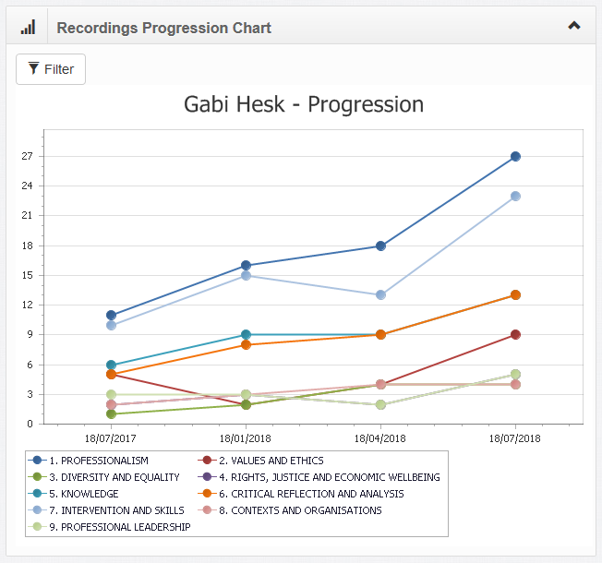
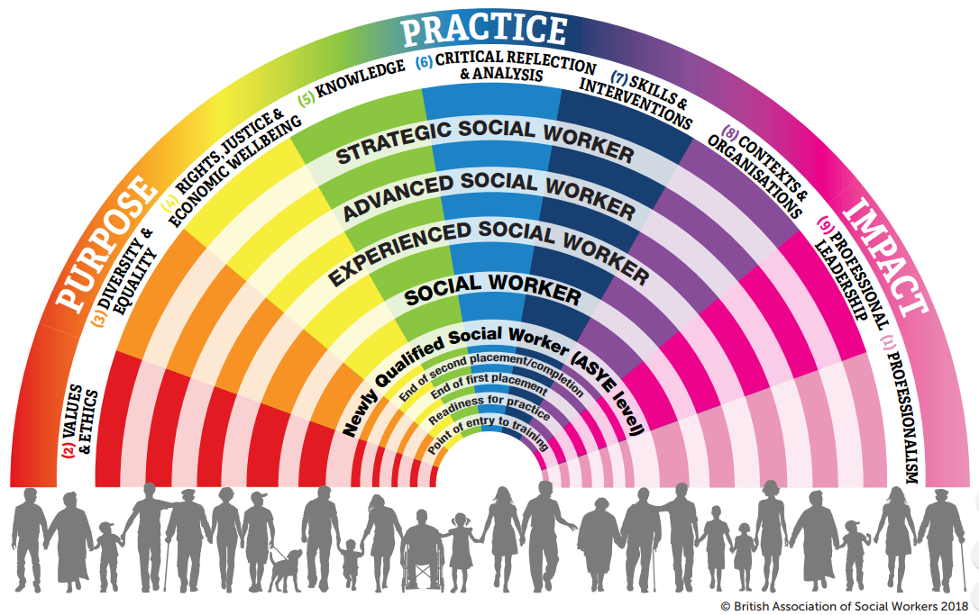
Recording the PCF in Charms
Notes:
Discuss link to PCF within Charms

Slide 14
Any questions?
Gabi Hesk
University of Salford
0161 295 5204
g.c.o.hesk@salford.ac.uk
Phil Moses
SCN
0161 237 1872
phil.moses@socialcarenetwork.com

