Slide 1
Virtual Ecosystems & Video Games.
Dr Umran Ali
University of Salford
School of Arts & Media
0161 295 6094
u.ali@salford.ac.uk

Slide 2
Session Outline
About Me
The Games Industry
My Research
Virtual Landscapes
Case Studies: Virtual Ecosystems
Gamification

Slide 3
About Me
Senior Lecturer at University of Salford
Past:
Programme leader for BSc Computer & Video Games
Director of Creative Media.
Taught D&P for CVG since 2005.
3D Artist & Game Designer
BSc, M.A & Ph.D…all around games/technology…

Slide 4
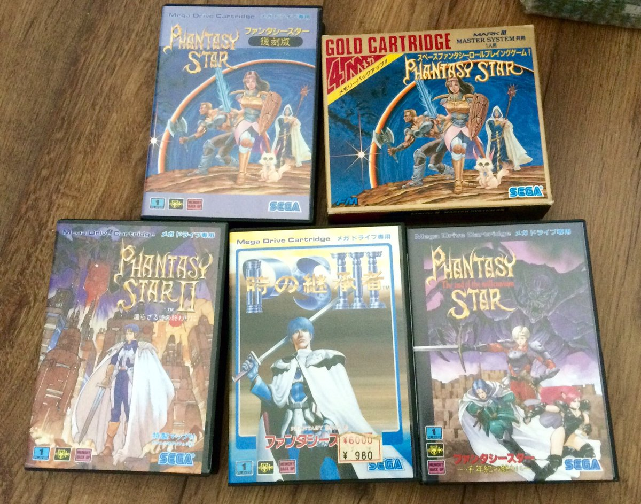
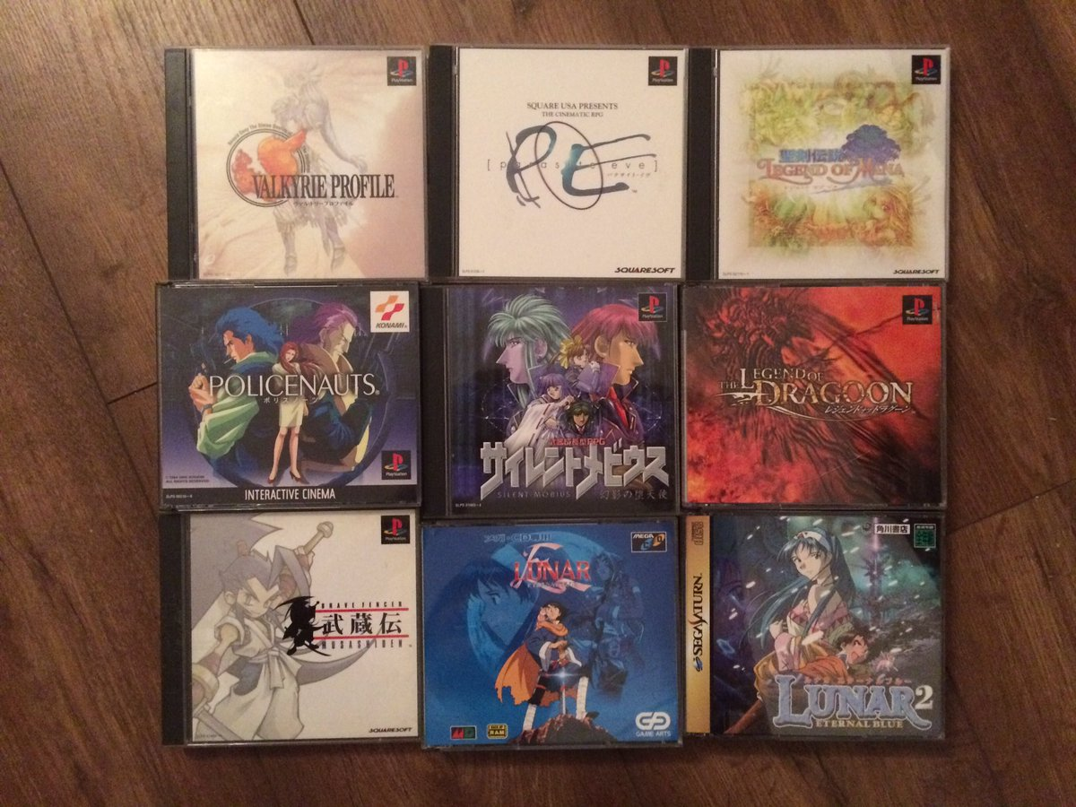
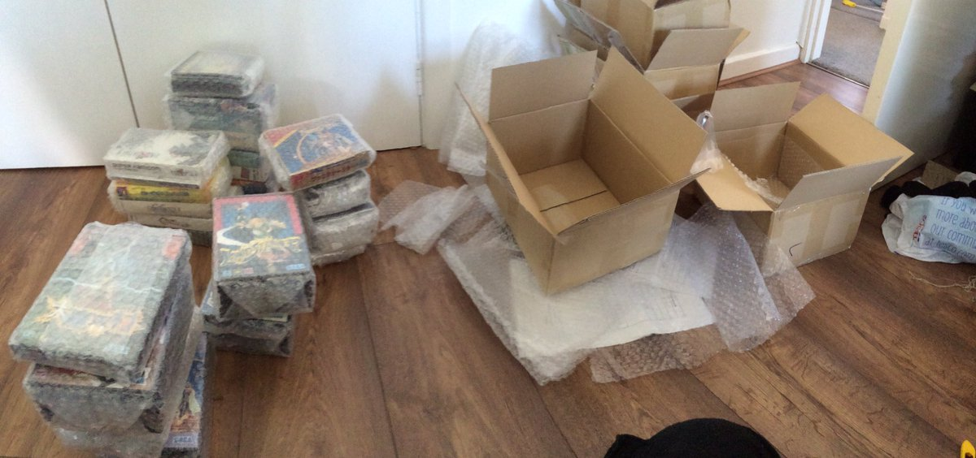
Overview
Notes:
Hardcore Gamer: 35 years...
eSports (Sci-Fi Gamer Finals 2003)
I collect games! (Games Collection featured on BBC News short (2004)

Slide 5
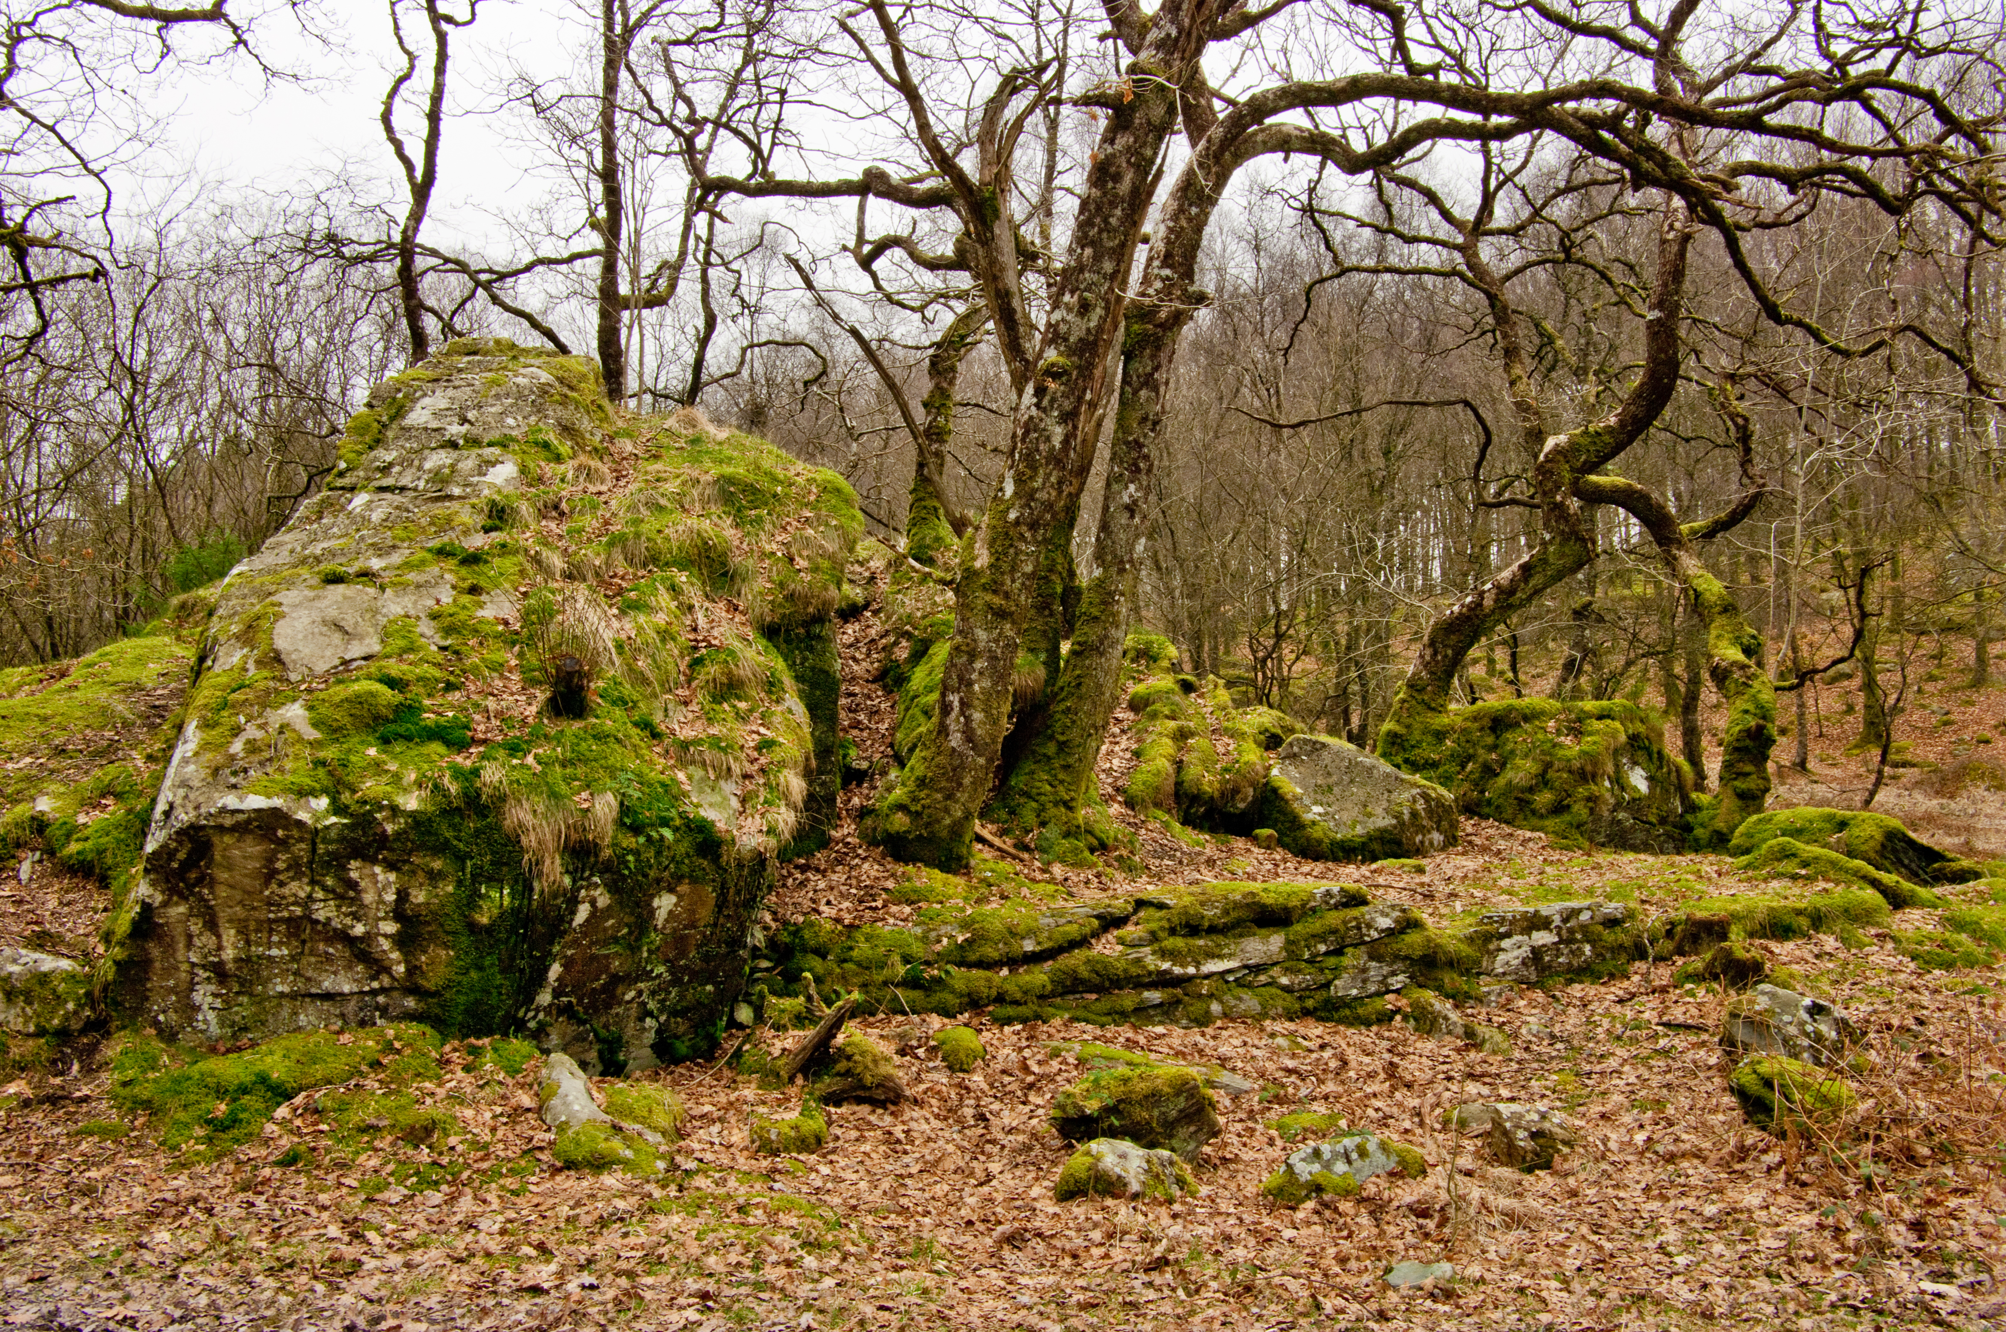
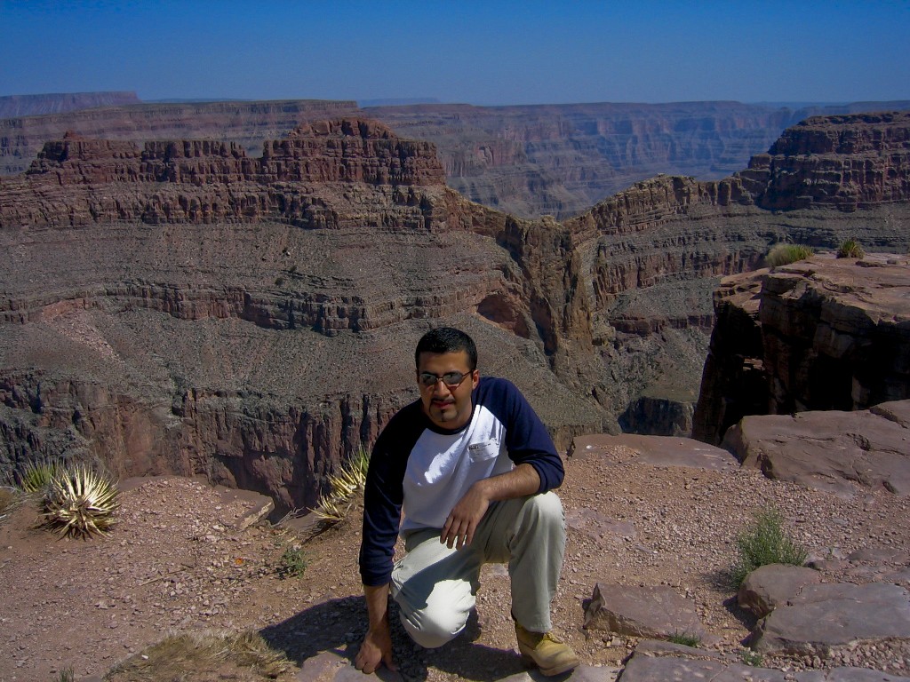
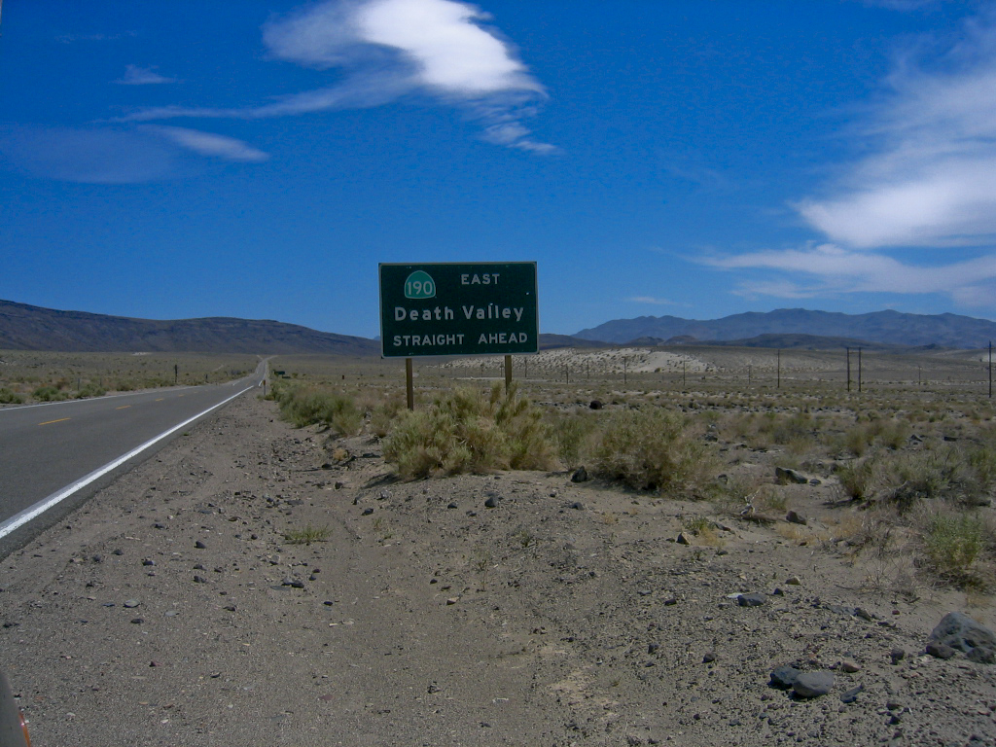
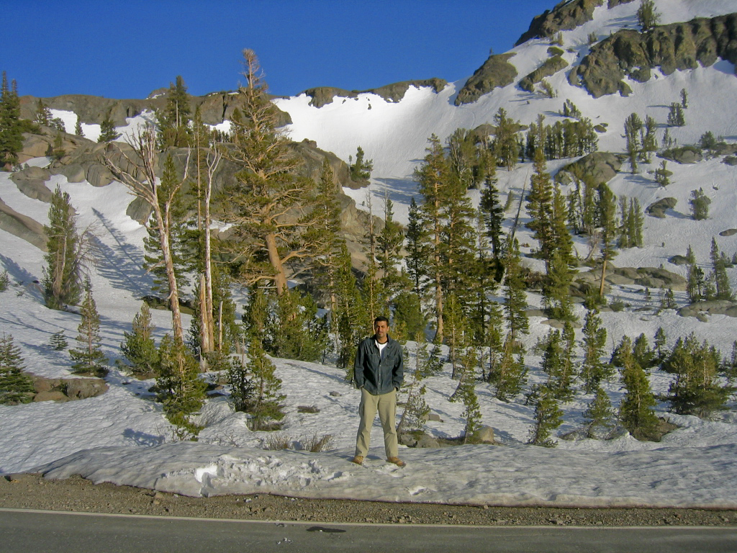
Notes:
My other passion is the natural environment, I’ve been a keen walker and climber for a number of years and I’ve been fortunate to have travelled across so many landscapes across the world , ranging from the snowy peaks of Yosemite park, the arid desserts of death valley to the wonderful rich mountains and valleys from across the UK.

Slide 6
Learning Objectives
Recognise and assess the importance of changing video games production technologies on ecology and environment design planning.
Identify and discuss areas of convergence between video games design and virtual ecosystems.
Effectively Identify and apply key games design principles to various aspects of habitat planning & design through 'gamification'.
Identify and appreciate the impact of key immersive technologies such as V.R on ecology, habitat planning & design.

Slide 7
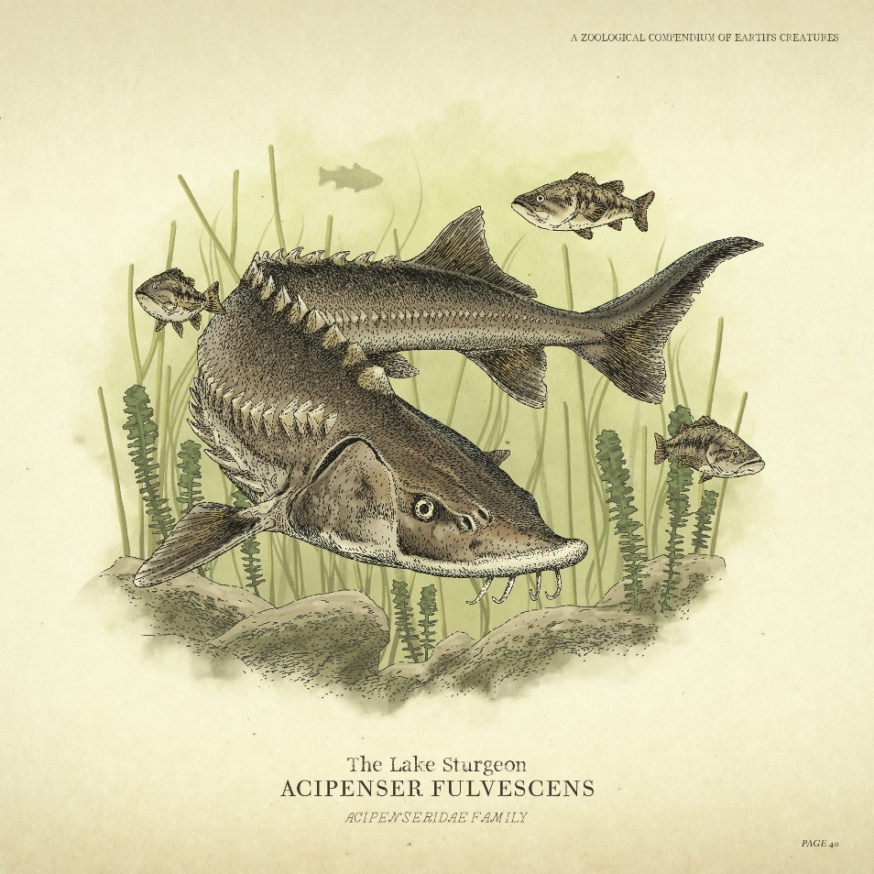
Deer, bison and pronghorns….
“Deer, bison and pronghorn traverse the plains in large herds," it says, "scavengers quickly sniff out carrion, sockeye salmon leap upstream, wolves attack in packs surrounding their prey, geese fly in fixed formations, possums play dead, rodents scamper into tree hollows, grizzly bears bluff charge when threatened, and birds of prey soars on thermals.“
Notes:
The above quote may sound like Canadian Mountie’s report on the Canadian wilderness, but it’s in fact how Rockstar recently promoted Red Dead Redemption 2; their new critically acclaimed sequel to Red Dead Redemption (released in 2010).
What was surprising is that the tweet did not mention what nearly everyone expected; there was no mention of the games characters or weapons or indeed plot, but in fact the virtual ecology in the game. Rockstar’s tweet in fact highlighted two things; one, video games were growing in scale and complexity to the point where complex virtual ecosystems were now technically possible and secondly there was a growing appetite and demand for games to more authentically reflect aspects of the real natural world.

Slide 8
The Games Industry
Rockstar’s GTA5 (£200M Dev, £4.5B Revenue, >>Gone with the Wind, Star Wars)
World of Warcraft (£8B Revenue) > GDP Maldives & Barbados
Global Games industry (2018) is 5 times larger than music industry, and 1.5 times larger than global movie industry (~£100 billion)
Notes:
Over the last few decades, Video games have gone from a niche pastime to one of the most popular entertainment industries surpassing TV, film and the music industries. From a bedroom industry to a multibillion pound industry , contemporary video games development can involve hundreds of specialists working across several years on budgets in excess of £2-300 million,
Globally the business and design of contemporary games is surpassing even the biggest Hollywood productions. As of 2018, the worldwide games industry is estimated to worth around £100 billion; to put that into perspective that’s 1.5 times bigger than the global movie industry and a whopping 5 times bigger than the global music industry, with 1 in three people on the planet being a gamer, not bad for an industry that is only around 40 years old.
.

Slide 9
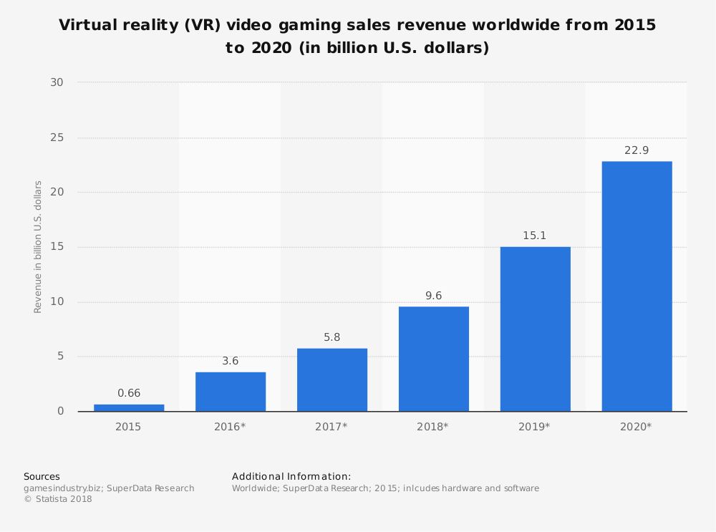
Notes:
Grand Theft Auto 5 has generated more than £1 billion in less than a week, and securing its place as the most successful media entertainment product of all time. Revenue for even single titles, such as Blizzards’ World of WarCraft illustrate the phenomenal financial success of modern games with the game generating more in revenue than the entire 2018 GDP of Barbados and the Maldives combined
The growth of sub-areas such as V.R for instance illustrate it’s a thriving and every growing industry.

Slide 10
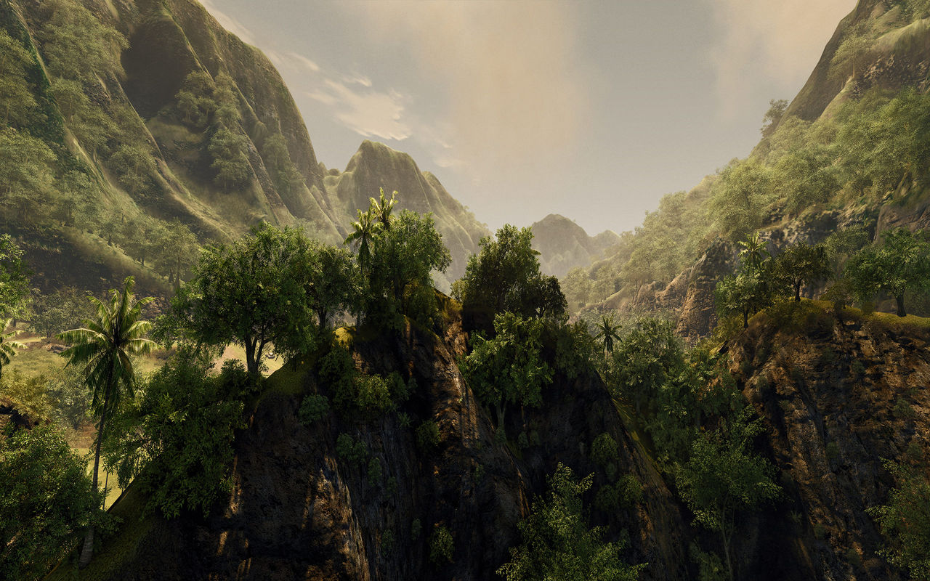
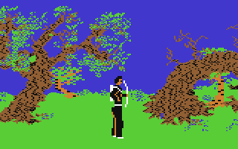
Notes:
It’s something that still takes many by surprise; but video games have gone from simple mono-block representations of the natural landscape to massive virtual environments with complex landscapes replete with dynamic and interactive ecosystems, plants that can be foraged (specific to certain in-game regions) with a variety of wildlife that not only demonstrate complex A.I driven behaviours that can interact with the player, but with each other. This is even more impressive when we consider that all this has been achieved in a single generation; video games one could argue are in the ‘silent, black and white era’ but modern games clearly illustrate their huge potential as a medium.

Slide 11
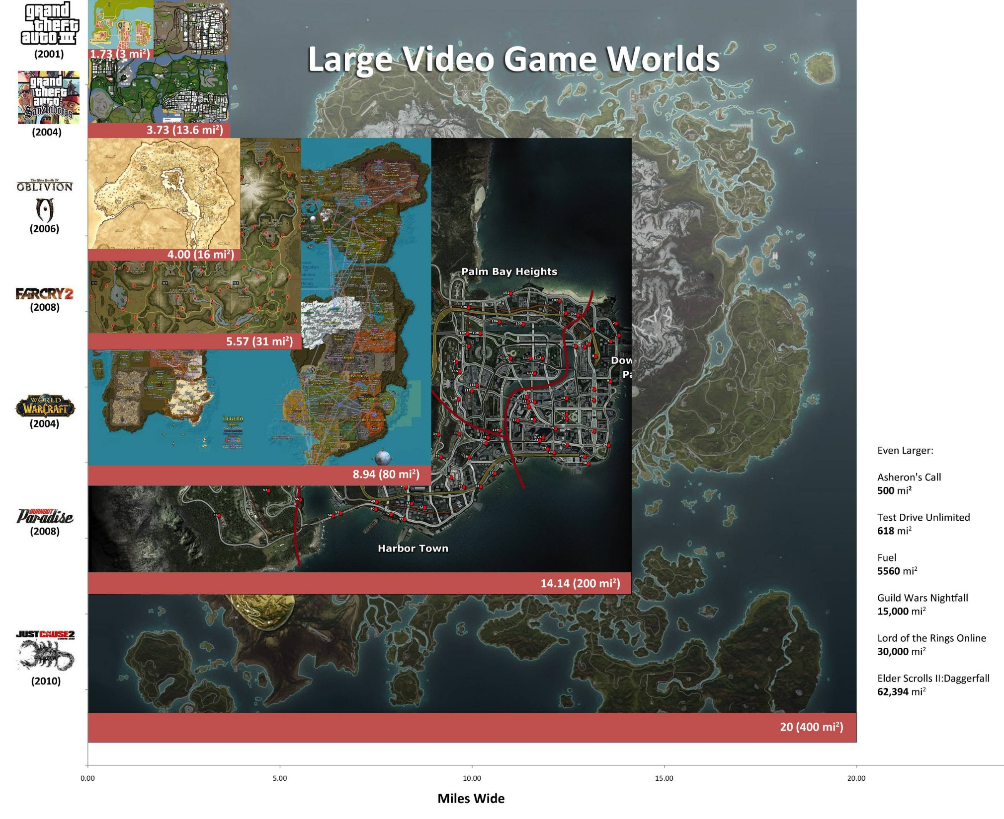
Linear Vs Open World (Source: GDC Presentation, England, 2015)
Notes:
Alongside the financial success; gamespaces (the spatial configuration of a game) has evolved significantly over the last 30 years from simple limited 2D fixed size space to massive 3D spaces to completely immersive virtual reality spaces
Digital Games have increasingly becoming openworld, massive and complex; this is set to change further with the advent of VR and AR technologies, what has powered this phenomenal technological evolution is the ‘game engine’

Slide 12
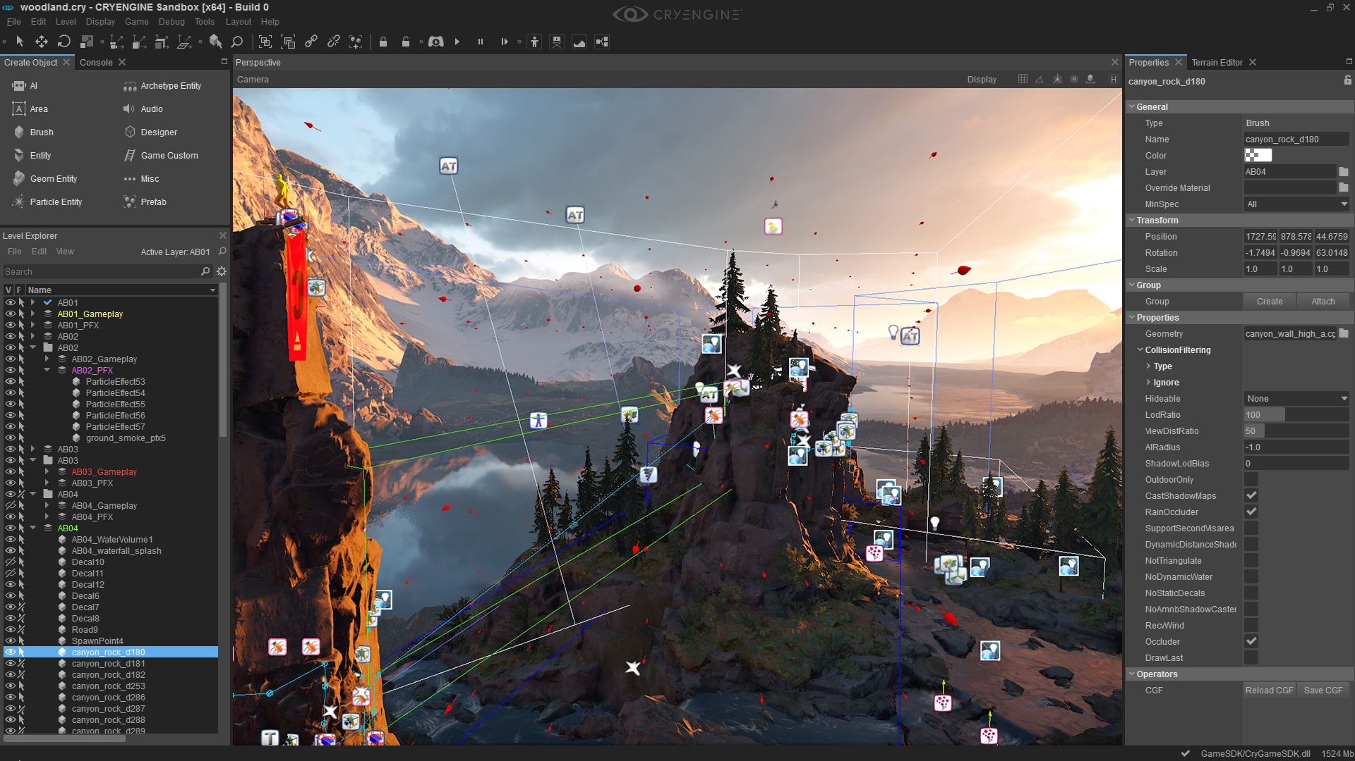
What is a Game Engine?
Crytek’s CryEngine 5 Sandbox Editor
Notes:
So what is a game engine: simply put: A game engine is the software that provides game creators with the necessary set of features to build games quickly and efficiently. A game engine is a framework for game development that supports and brings together several core areas. You can import art and assets, 2D and 3D, from other software, such as Maya or 3s Max or Photoshop; assemble those assets into scenes and environments; add lighting, audio, special effects, physics and animation, interactivity, and gameplay logic; and edit, debug and optimize the content for your target platforms….more accurate to call them virtual environment engines as you don’t have to create a game as the final output.

Slide 13
Game Engine Evolution
Notes:
What has changed?
Diversification: Over 200 modern games engines in use today (2018) from only ~5 in 1998.
Functionality : From simple 2D engines to full 3D-VR engines capable or realtime rendering on par with film.
Cost: Licensed development to open access, subscription model based development(2018) vs £500,000 dev licenses (2013)
Availability of game development software did not really exists 20 years ago: now CryEngine, Unity, Unreal are all essentially free for any developer (Royalty based model)
Support: The odd hidden manual on IRC (1995) to full V.T.T and educational programmes(inc CPD/degree) offering training/guidance
Diversification: From purely games industry, to film, TV, animation, business, military (i.e. serious games)…and now ecology!
Accessibility: across any pc/phone even browser based(i.e. shareholders inc clients, government officials, schoolchildren)

Slide 14
Notes:
Engines such as CryEngine 5 offer an extraordinary amount of tools and pre-made assets; you can rapidly prototype large natural landscapes and environments without the need to build assets( flora, fauna, terrain), it’s free and even for commercial projects is very very competitive. AI behaviours can be assigned to flora and fauna and this can be observed in realtime.

Slide 15
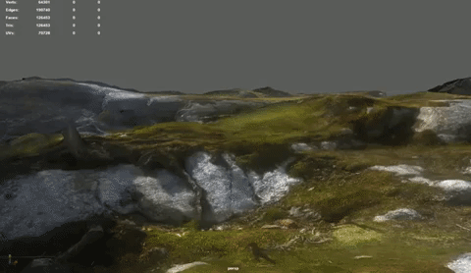
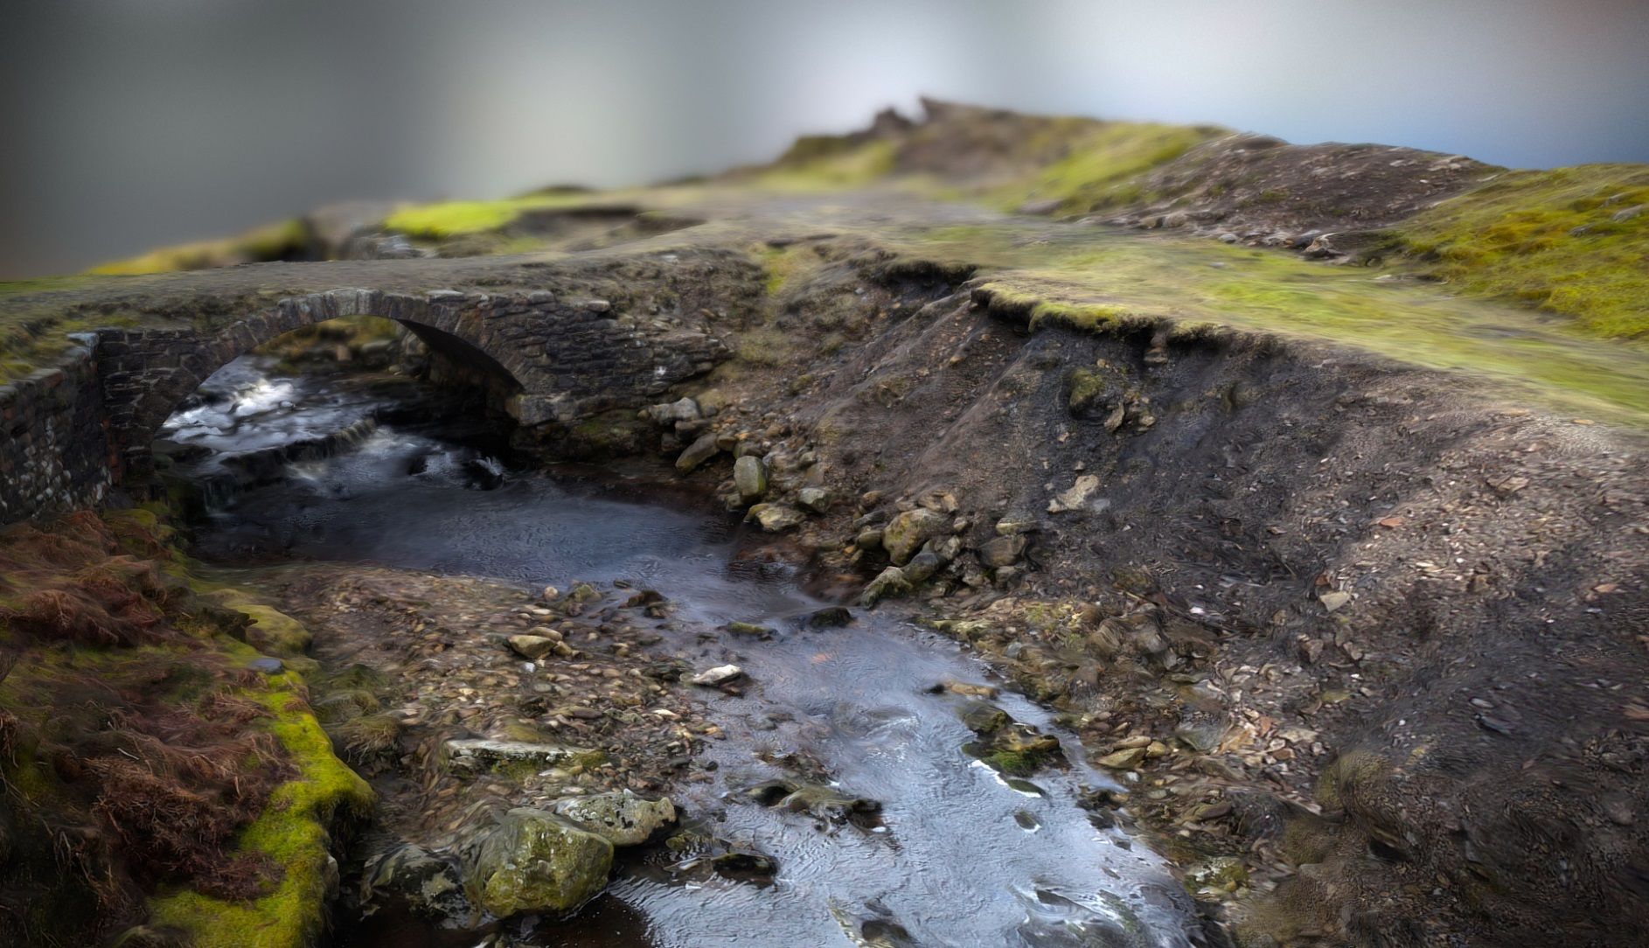
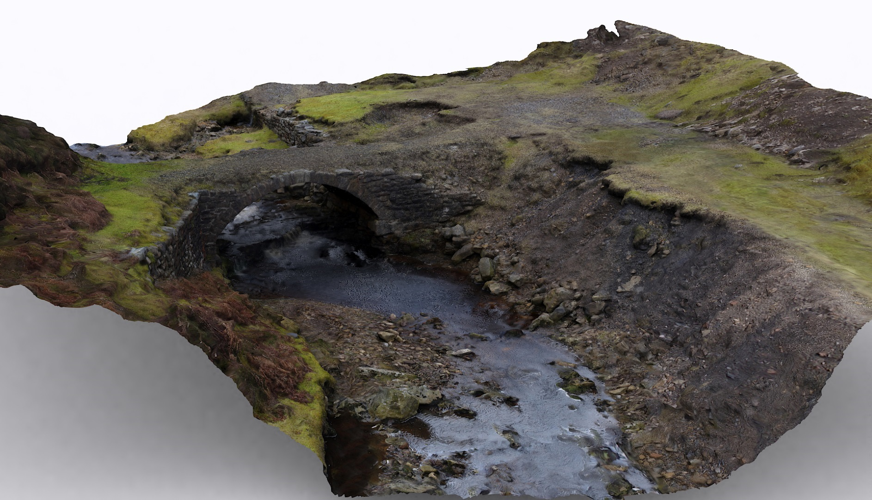
Video Games & New Technologies Photogrammetry
Henning Birkeland 55 images taken with mobilephone (AgiSoft PhotoScan)
© Paul Dickinson
© Paul Dickinson
Photogrammetry(measure/3D model building from photographic/LIDar data)
Drones/High spec cheap camera’s as well as software(Agisoft Photoscan, Reality Capture) now make the process affordable and easy
Photogrammetry model->Game Engine workflow; ‘play’ space with relative ease.
Notes:
Photogrammetry(measure/3D model building from photographic/LIDar data)
Drones/High spec cheap camera’s as well as software(Agisoft Photoscan, Reality Capture) now make the process affordable and easy
Photogrammetry model->Game Engine workflow; ‘play’ space with relative ease.

Slide 16
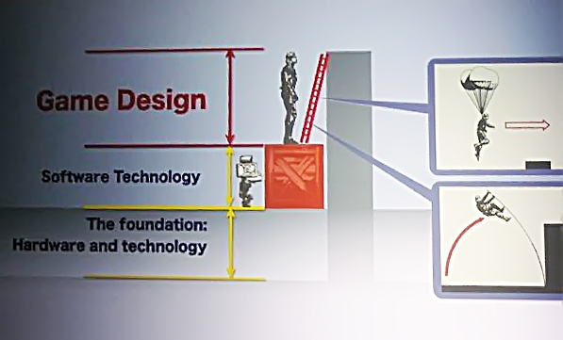
My research: Games Design
Kojima’s Hierarchy of Technology & Games Design (Source: GDC 2009)
Notes:
My research focuses on the area of games design, which has moved from computational-centric (1970’s) to graphics-centric (90’s) position and it is moving away into something else…and as Aerseth and Totten argued that something else could include spatial design

Slide 17
Games Design principles
Definition of Games Design:
A technical and artistic process in which systems and rules are designed in order to serve the function of gameplay. (Ali, U, 2016)
It’s all about ‘gameplay’
To create more meaningful and evocative spaces (places?), in order to deepen immersion and hence better gameplay
Structured design processes (i.e. level and environment design as a sub-set in games design)
Notes:
So what do I mean by games design, well simply

Slide 18
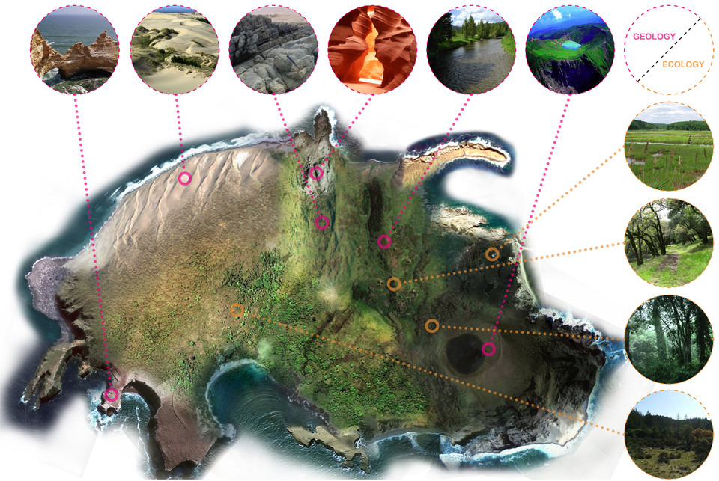
Games Design Diversification
The Witness (2016) Island biome design (Source Gamasutra.com 2016)
Notes:
However as Robert Yang argued , the idea of a unified Monolithic level design process is unlikely to emerge however, Intersectional level design, one that utilises as many design traditions as possible depending on the context is more likely
Interestingly over the last few years this is exactly what has occurred; landscape architecture for instance has been increasingly used to games in both theoretical games design (Christopher Totten), as well as practical application. The Witness, a game released in 2016 , had the game designers worked with professional architects as consultants to drive the design of the game. There have been edutatinment games in the past that focused on Ecology(Sim Animals, Spore?) but they are explicit in their use of ecology(teach ecology) what is emerging is embedded use, where ecology is integrated with wider gameplay elements.

Slide 19
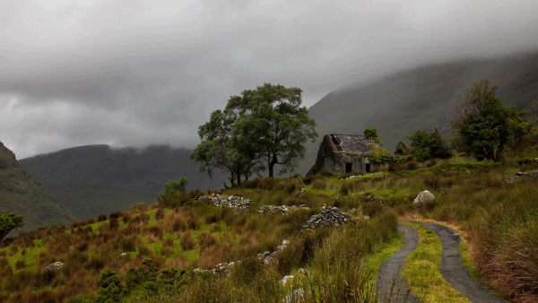
Video Games as… Spatial Art?
Salen & Zimmerman (2004): Games design not ‘crystalized’ into a stable field of inquiry
Aarseth’s (2007): Spatiality as the raison d’être’ of games
Jenkins & Squire’s (2002) : Games as ‘spatial art’
Notes:
As Aeseth noted “The defining element in computer games is spatiality” (Aarseth, 2007, p.44)
“Games celebrate and explore spatial representation as a central motif .” (Aarseth, 2007, p.44)
Jenkins & Squire’s noted: “If games tell stories, they do so by organizing spatial features” Jenkins & Squire’s (2002)
They also considered the aesthetic influences in gamespaces ranging from expressionism to romanticism and postulate that “as game designers dig deeper into these artistic traditions, they may develop more emotionally evocative and meaningful spaces” (2002, p.7).

Slide 20
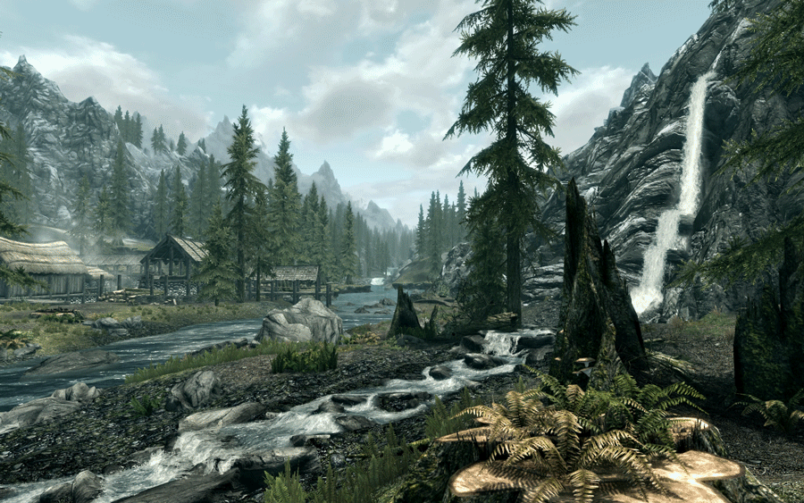
Video Games as Spatial Art
“Games celebrate and explore spatial representation as a central motif .”(Aarseth, 2007)
“If games tell stories, they do so by organizing spatial features” (Jenkins & Squire’s , 2002)
“…as game designers dig deeper into these artistic traditions, they may develop more emotionally evocative and meaningful spaces”
(Jenkins & Squire, 2002)
Notes:
As Aeseth noted “The defining element in computer games is spatiality” (Aarseth, 2007, p.44)
“Games celebrate and explore spatial representation as a central motif .” (Aarseth, 2007, p.44)
Jenkins & Squire’s noted: “If games tell stories, they do so by organizing spatial features” Jenkins & Squire’s (2002)
They also considered the aesthetic influences in gamespaces ranging from expressionism to romanticism and postulate that “as game designers dig deeper into these artistic traditions, they may develop more emotionally evocative and meaningful spaces” (2002, p.7).

Slide 21
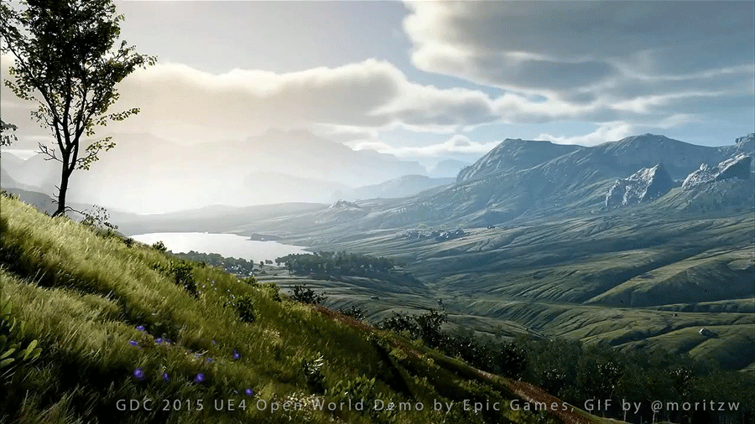
Research Problem
Given the rapid and every increasingly complex nature of natural environment and landscapes in digital games, how will these spaces be designed and what if any is the dominant or emerging paradigms in the current design thinking, and what can and will inform the design and planning of these interactive and immersive future spaces?
Notes:
So the literature review and my professional practice had indicated the problem essentially was this: Given the rapid and every increasingly complex nature of natural environment and landscapes in digital games, how will these spaces be designed and what if any is the dominant or emerging paradigms in the current design thinking, and what can and will inform the design and planning of these interactive, dynamic immersive future spaces?

Slide 22
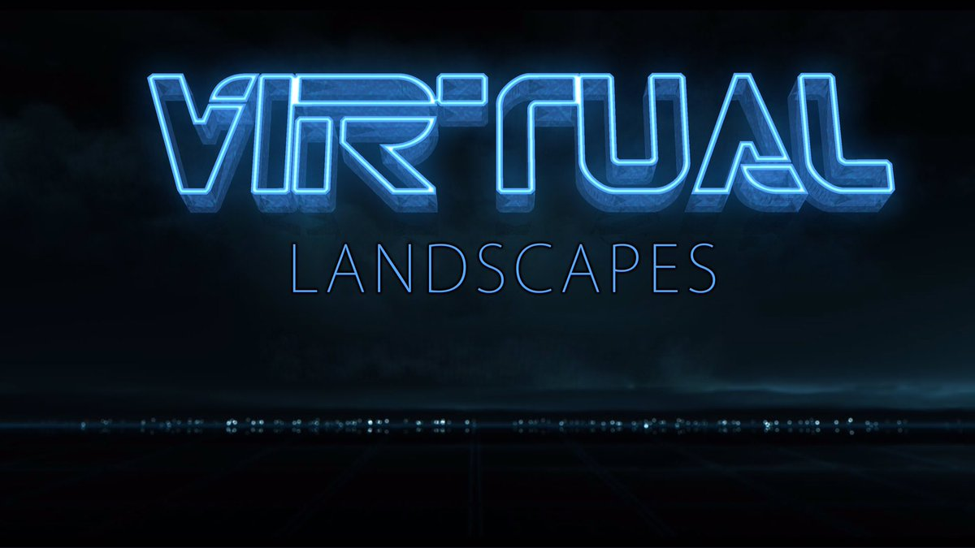
Notes:
This led to the first major part of the research, Virtual natural environments, in particular game landscapes were examined through a contextual review, a combination of previous professional practice in addition to a selection of digital games across a variety of platforms and genres over the last 30 years. The contextual review involved a detailed textual and visual-based historical survey of virtual landscapes, resulting in a practice-based exploration of virtual natural environment design.

Slide 23
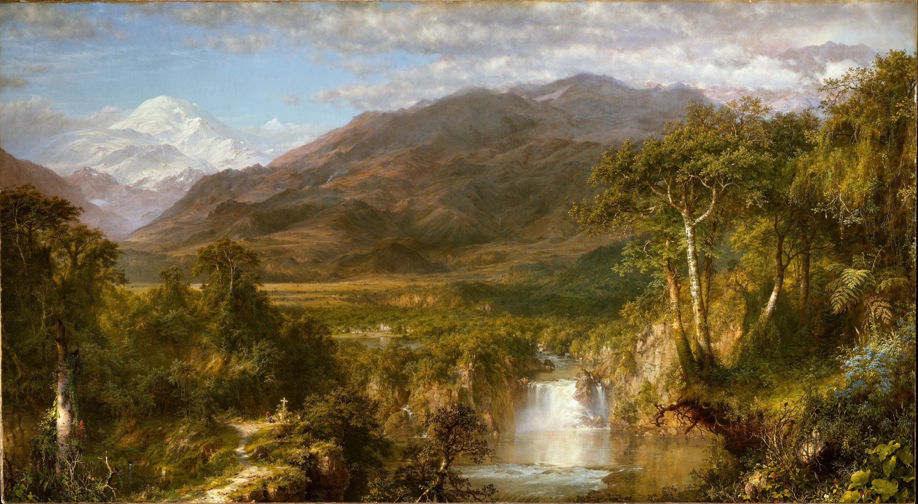
"Landscape is not synonymous with environment, it is the environment perceived, especially visually perceived”.
Appleton,
The Experience of Landscape, 1975
Notes:
So the next problem was identifying an appropriate entry point into these digital games from which to collect visual data and use as a basis for later analysis.
This is where Jay Appleton, the British landscape photographer, idea in his book The Experience of Landscape discussing the relationship between landscape and environment helped focus the research: simply put Landscape is not synonymous with environment, it is the environment perceived, especially visually perceived,
So focusing on virtual landscapes within the larger virtual environments would perhaps be manageable (given the scope of the study) and more effective at illustrating the dominant or emerging environment design paradigms, than simply trying to analyse entire virtual environments in digital games.

Slide 24
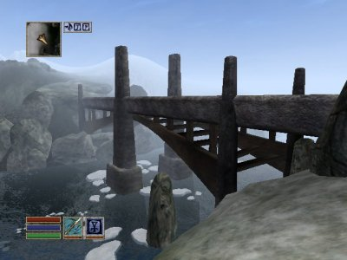
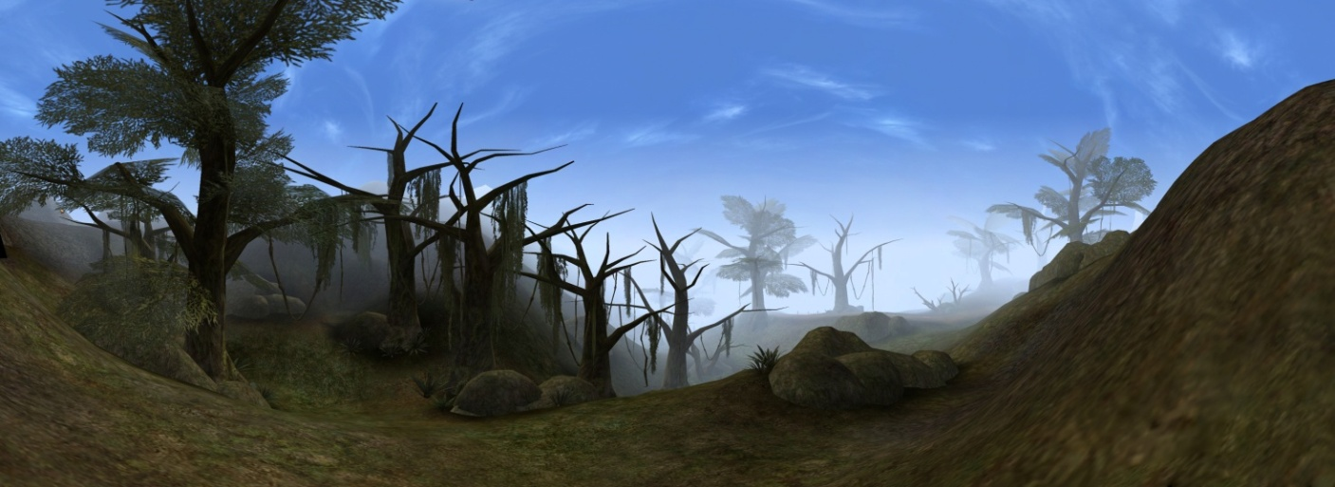
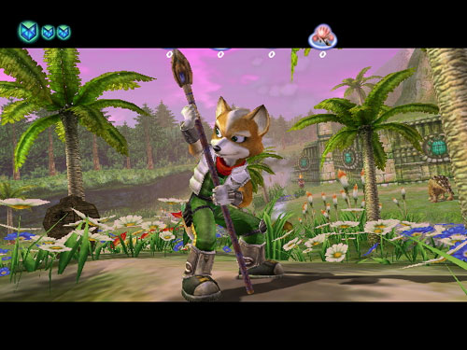
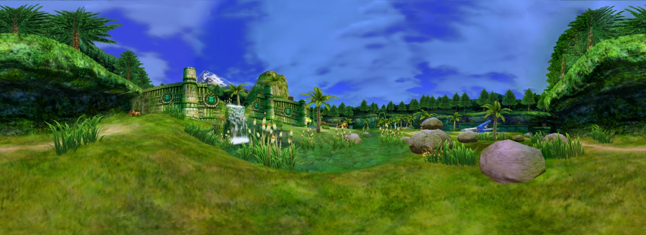
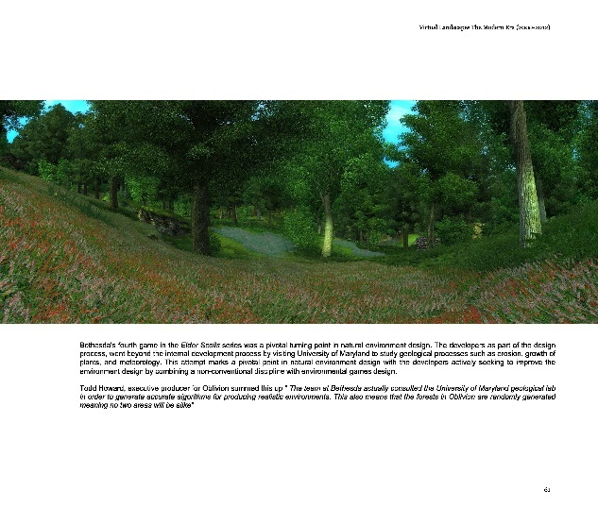
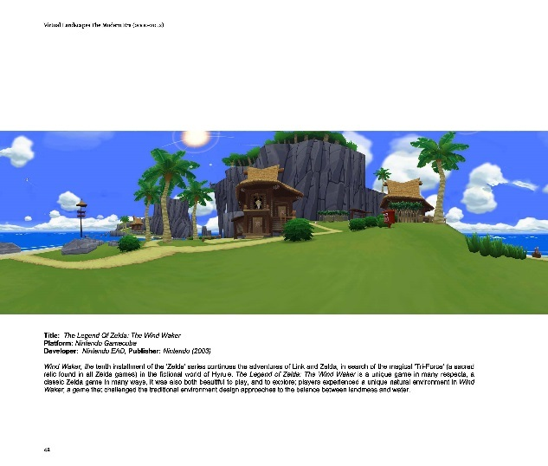
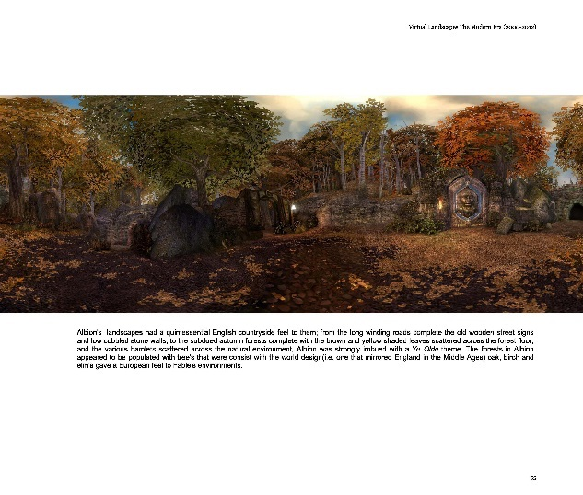
Notes:
What finally resulted was for the first time, a large collection of panoramic landscapes from across computer & video games across a three decade period.

Slide 25
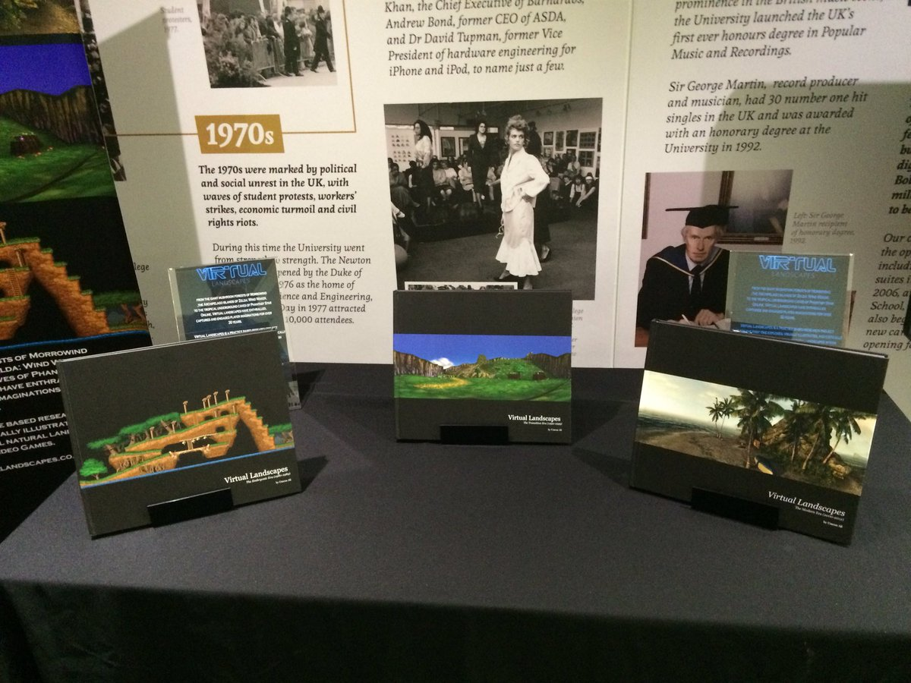
3-4 years of work
70 different Computer & Video Games covered over 30 years period
~12 Different platforms
~350 Unique UltraHD Virtual Landscape Panoramas
~300 High Definition ‘extracted’ Virtual Landscapes
~150 Digitally Enhanced HD Virtual Landscapes
Spread over three volumes, available in print, digital(ebook, PDF & itunes) and interactive formats
Notes:
What I found was landscapes, the virtual natural environment was an important and valued aspect of video games when they were featured, they were explored and experienced in ways that went beyond the designers expectations and intents
Immersive, interactive element was of growing importance
Games were moving from static to dynamic natural environments
“Living, breathing environments” ; increasingly virtual environments exist/function that independently of the players actions; i.e. things happened whilst ‘they were away’

Slide 26
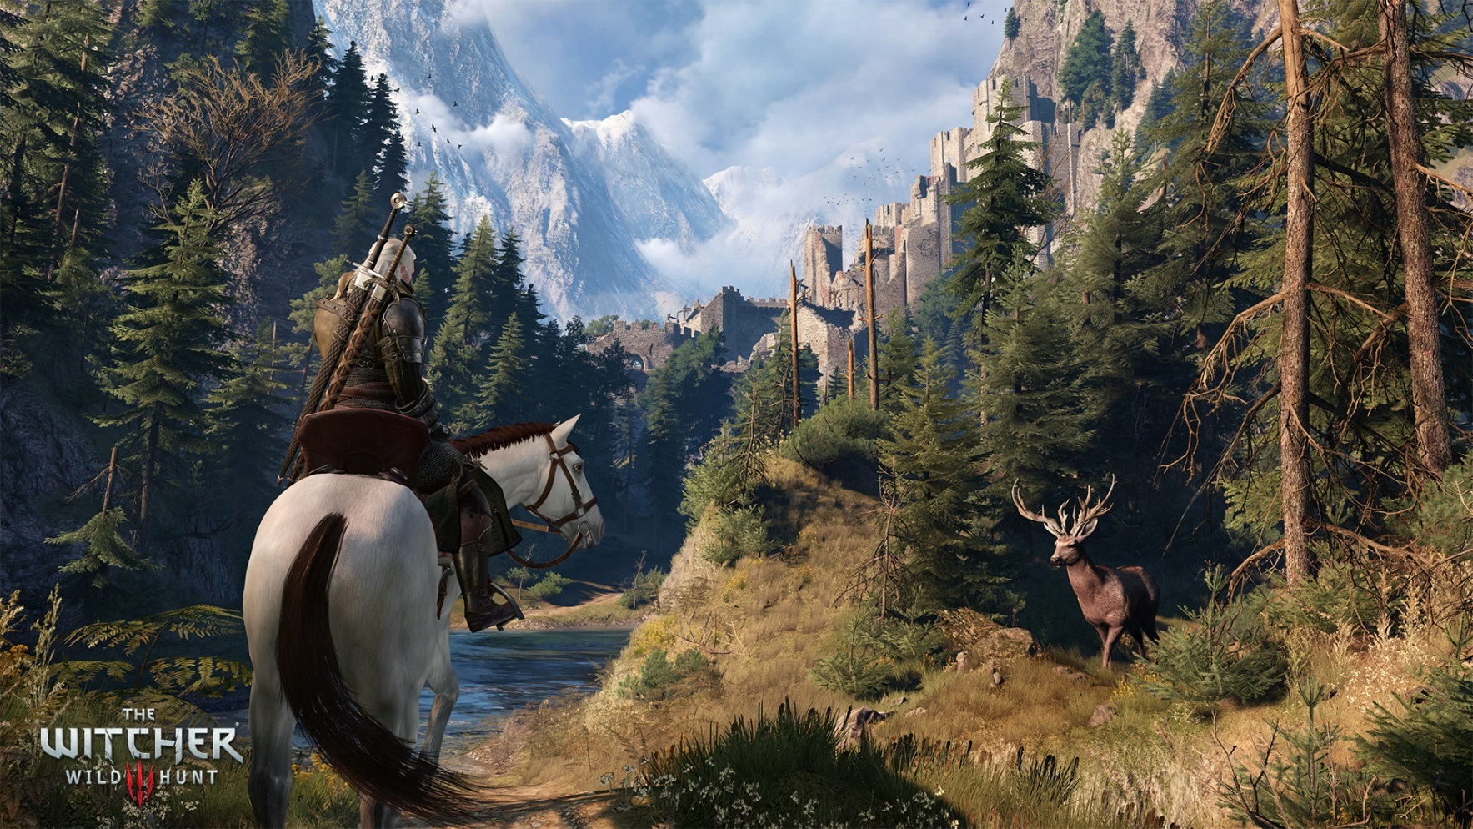
Virtual Ecosystems: The Witcher 3; The Wild Hunt
Notes:
CD Projekt Red’s The Witcher 3, open world game released in 2016, one of the game designers Damien Monnier spoke about the virtual ecosystem: …if you decide to interfere with that ecosystem, there will be consequences. Kill all the deer in the area, and the wolves will leave, to find other places with more food. Kill all the wolves, and the deer population will start to grow. Presumably, making changes to the food chain on the plant level (such as deforesting a whole area) would have consequences as well.
https://gameranx.com/updates/id/24708/article/the-witcher-3-wild-hunt-ecosystems-operate-on-their-own-can-be-interrupted-by-geralt/

Slide 27
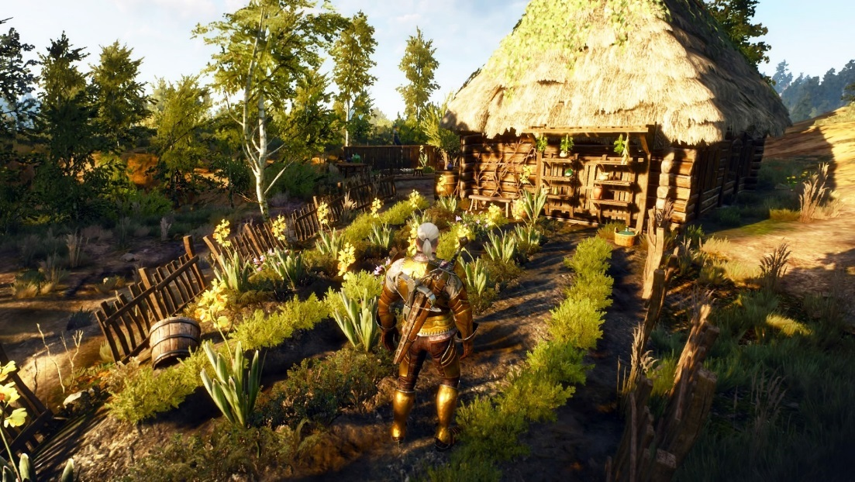
Virtual Ecosystems: The Witcher 3
Notes:
Interesting questions/interest/discussion online about the virtual ecology How do the monsters interact with the wildlife?
What effect does changing the population of one creature/animal have on the world inc narrative/gameplay?
Contemporary video games such as Nintendo’s Breath of the Wild, or the CD Projekt Red’s The Witcher 3, illustrate the vast immersive virtual natural environments complete with virtual ecosystems and complex virtual habitats are now possible and illustrate the potential of modern games technology and the potential for the medium in traditional ecosystem planning & design as a virtual habitat/ecosystem simulator.
This goes beyond the aesthetic; video games are increasingly embedding complex systems to replicate and simulate the natural environments including 'ecosystems'; with a variety of dynamic flora and fauna in ‘living’ virtual environments.

Slide 28
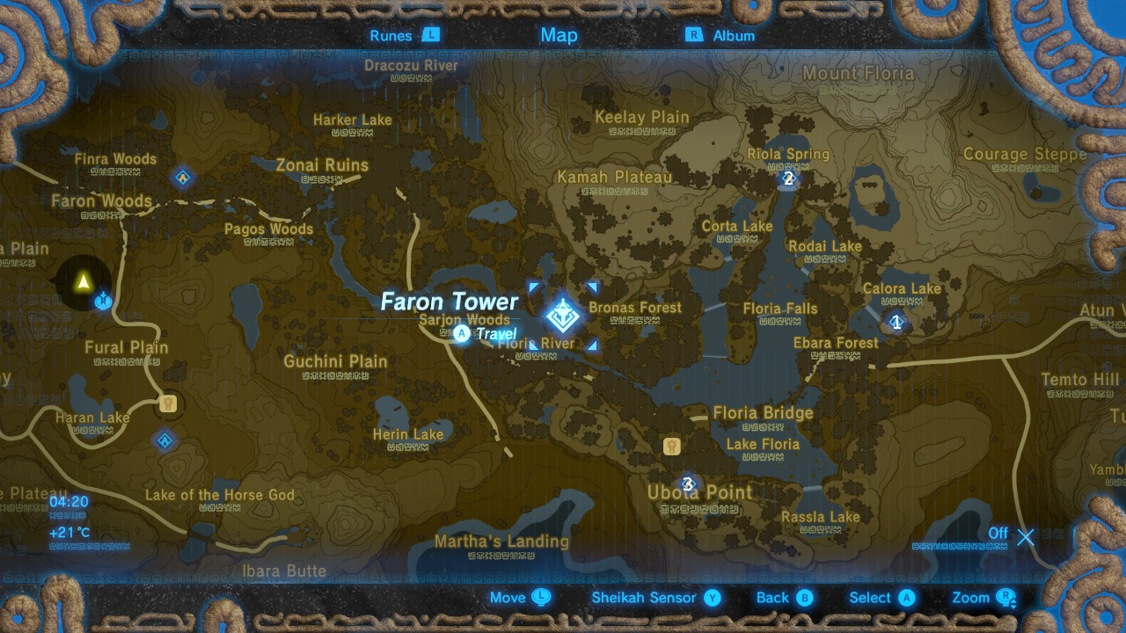
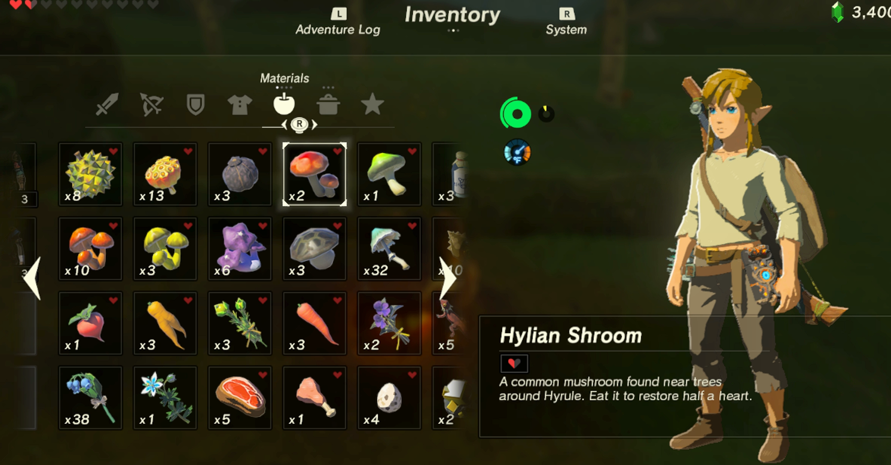
Virtual EcoSystems: Zelda Breath of the Wild
Massive Open world game; variety of complex habitats; complete with local character,
Huge variety flora & fauna in a dynamic ecosystem (~140)
Virtual ecosystem is a Integral part of Zelda: BOTW gameplay(cooking)
Virtual foraging is required to progress & ‘level up’ throughout the game
Flora can be over-foraged/is region specific (habitats)
Notes:
Nintendo’s critically acclaimed open world game, Zelda: Breath of The Wild (BOTW) illustrates how games can combine traditional concepts of gameplay with ecology and the natural environment into an award-winning game. Zelda BOTW features a massive open world game (~80sq km), from the sandy and arid Gerduo desert, to the cold and snowy Hebra mountains to the beautiful and lush Faron grasslands the land of Hyrule is presented in a variety of rich and diverse habitats; complete with local character and local wildlife. The virtual ecosystem isn’t a mere afterthought but an embedded and integral part of the gameplay; players are able to traverse the huge open world of Hyrule and not only encounter but interact with the huge variety flora & fauna in a dynamic ecosystem (~140 plants & animals). The games also utilises Virtual foraging which is required to progress & ‘level up’ throughout the game. Players need to forage for local ‘ingredients’ in order to concoct strange new potions and elixirs through cooking; apples, can be shook from trees, fish hiding in streams and rivers can be caught, and wild mushrooms growing in shaded woodland can be picked. However just like the real world, players also need to be careful as flora and fauna can be easily over-foraged leading to literally waiting for stocks to replenish, in order to make a particularly useful and needed potion

Slide 29
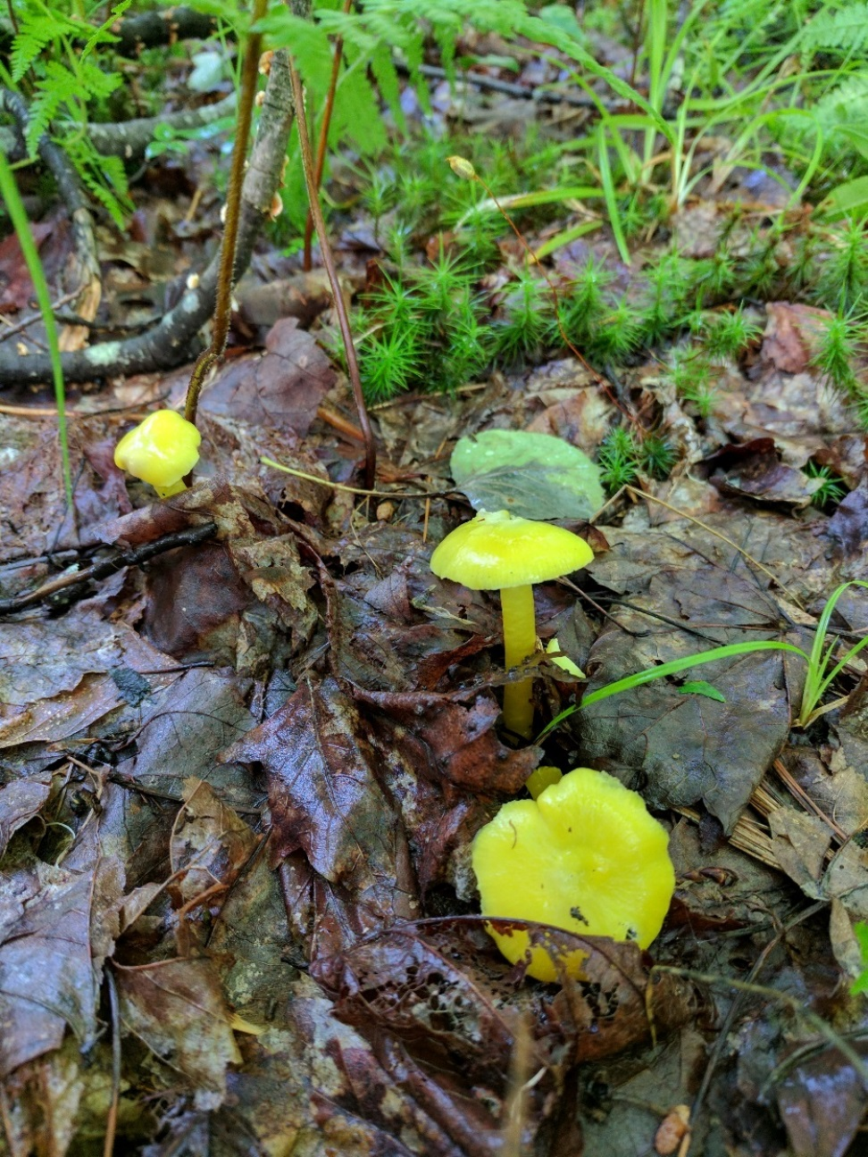
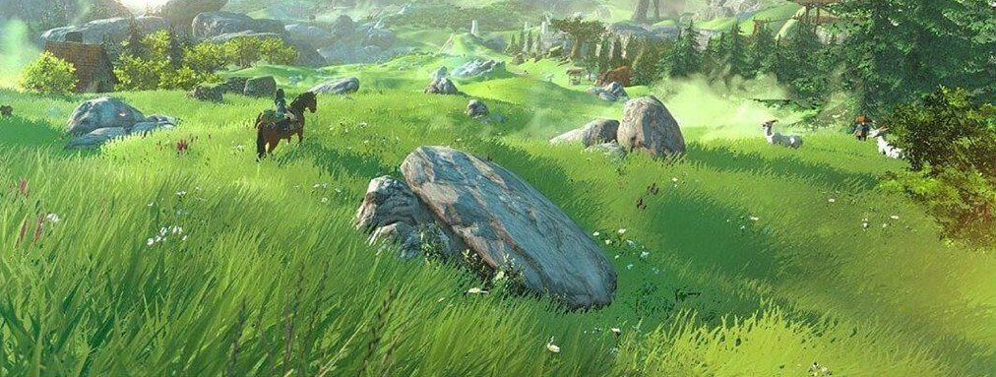
Virtual Ecosystems: Nintendo’s Zelda Breath of the Wild
“Found while camping. And it actually thunderstormed the night before. Swear I almost picked them.” thevortexmaster
Notes:
Certain flora are only found in specific regions, zapshrooms, a fungi in is found in a region where thunderstorms, and lightning (hence the name) are frequent, illustrating the intricate design of the virtual ecosystem.
How many children have read RHS encloypedia of plants vs flowers? Vs 12 million(3-4million) discussions online of children discussing ~60 plants, fruit names, locations, uses? Botany in action!

Slide 30
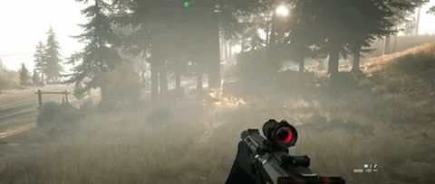
Virtual Ecosystems: Nintendo’s Zelda Breath of the Wild
FarCry 5 Dynamic Fire & Grass Interaction
“A kid who loves lighting the Hyrulian grassland on fire just might get excited about grassland restoration ecology when they find out it involves lighting real-life grasslands on fire.”
Dr. Anna Groves
Ecologist , PlantPeopleBlog
Notes:
So the living and dynamic ecosystems in games such as Zelda BOTW illustrate that not only does ecology have a firm place in modern games but can also be used to promote traditional ecology and as Dr. Anna Groves an American ecologist and gamer succinctly put it:
“A kid who loves lighting the Hyrulian grassland on fire just might get excited about grassland restoration ecology when they find out it involves lighting real-life grasslands on fire.”

Slide 31
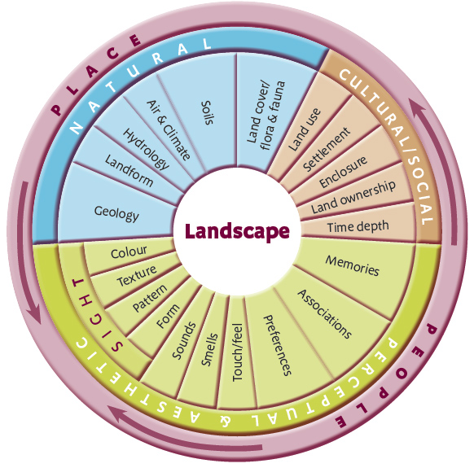
Components of the Virtual Landscape
Landscape
Physical
(physiographic)
Psychological
Figure: The landscape wheel from ‘Landscape Character Assessment (adapted from Tudor, 2014)
Notes:
After an analysis, what resulted from this contextual survey was data indicating landscape design in games was centred around a few core elements, however there was no real major design paradigm driving the design, and in fact it was fragmented, ad-hoc and largely asethic driven. During a lit review pass, I stumbled across landscape character assessments which largely capture the elements of virtual landscape design, and which I adapted with the contextual survey data to produce an initial design landscape design framework.

Slide 32
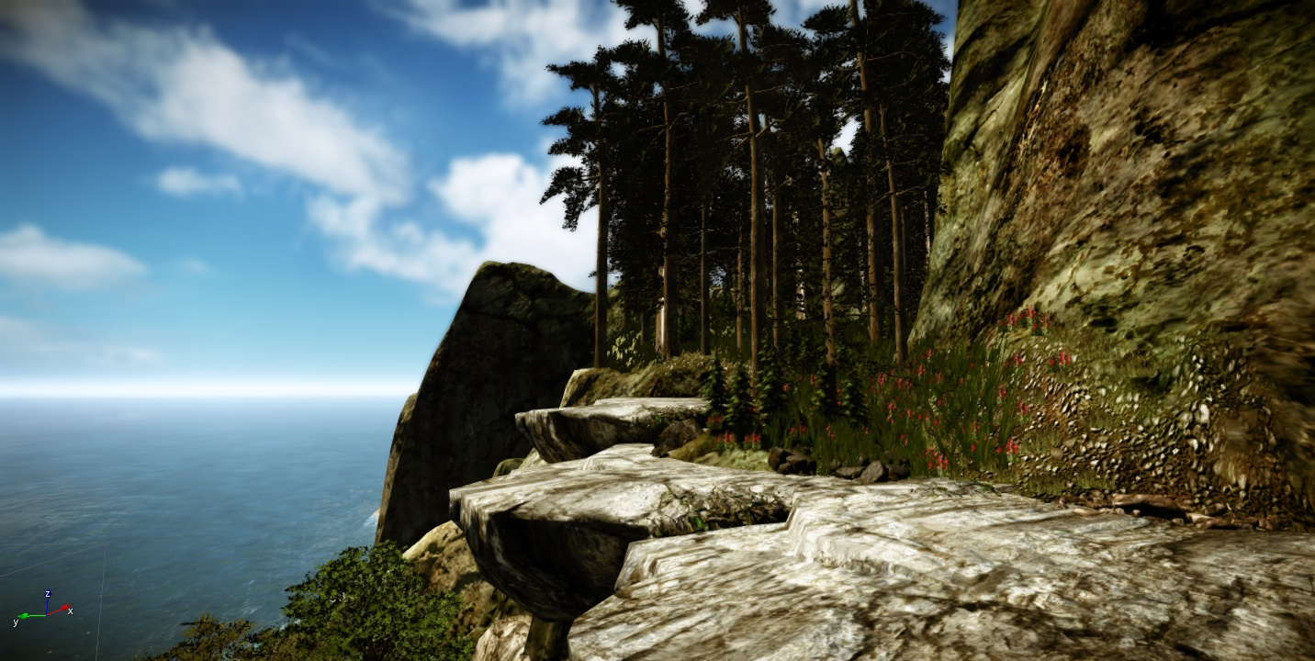
My Research : ShadowMoss Island
Notes:
So given the first study had led to an initial framework, the second step was the to examine if it was able to meet the demands of a production environment, ShadowMoss Island was born, and was a practice-based exploration of how VNE design could incorporate elements from disciplines such as Environmental Psychology and Geology, as well as reflections and observational analysis based on a field trip.
Photography
This method was chosen since it allows instant access to a place (virtual or physical space) in order provide a visual context to an otherwise difficult concept to describe) as a form of non-verbal communication, one that acts as entry point, to aid reflection and analysis, and as a method that allow the research to be transformed into more accessible (one that does not require lengthy time to absorb and digest) and appealing outcome; one that is more readily evolved into exhibit, ready to elicit response and incite critical discussion
Field Trip (Virtual & Physical)
This includes the standard definition of the term field trip (an observational method employed to gather data in a 'live' physical setting) but within this study I am including the virtual domain within this term (visiting a virtual space to observe and collect data for later analysis and reflection).

Slide 33
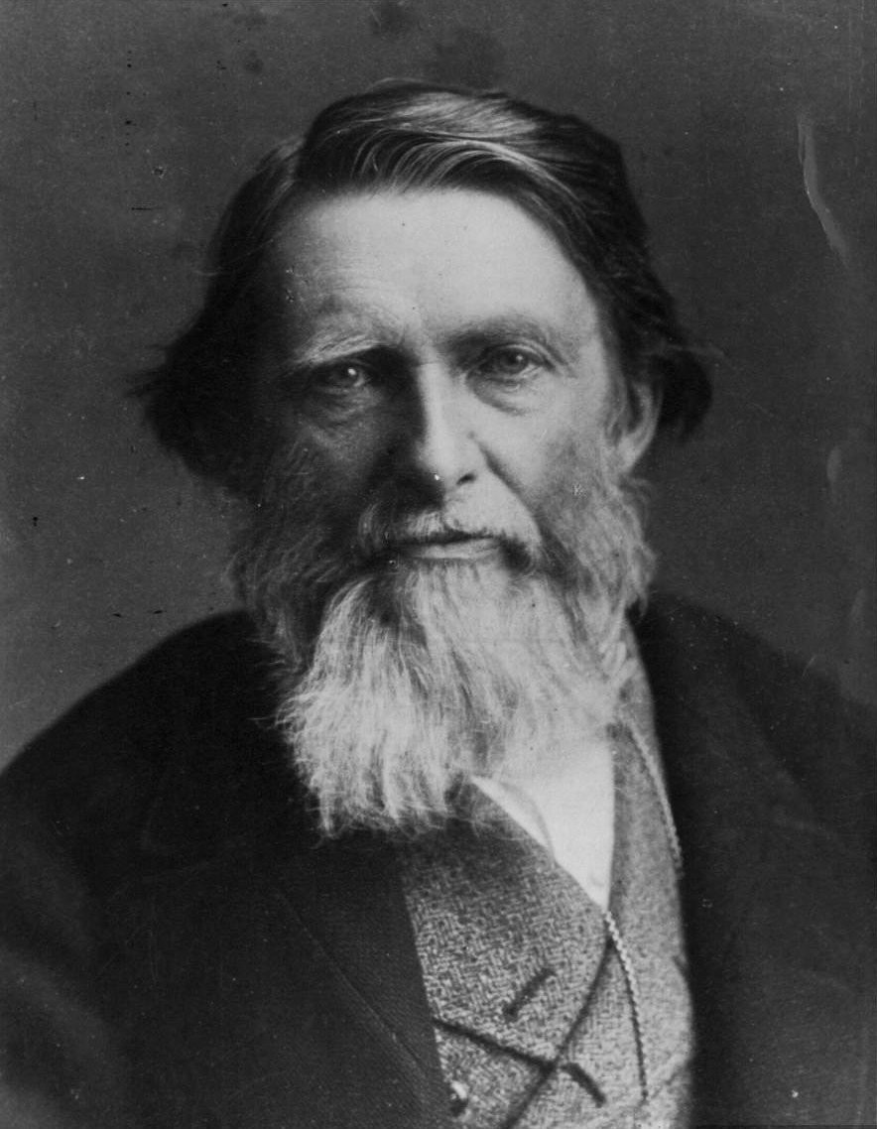
…go to nature in all singleness of heart... rejecting nothing, selecting nothing and scorning nothing
John Ruskin (1819 –1900)
Notes:
During a second major literature review pass, whilst exploring the relationship between art, landscape and geology I came across the works of John Ruskin, the noted art critic, writer and philanthropist. one particular dictum resonated very strongly with a core belief driving the research, and grounding subsequent work in Ruskin’s manifesto. He stated:
“Go to Nature in all singleness of heart, and walk with her laboriously and trustingly, having no other thoughts but how best to penetrate her meaning, and remember her instructions; rejecting nothing, selecting nothing, and scorning nothing; believing all things to be right and good, and rejoicing always in the truth.’ John Ruskin

Slide 34
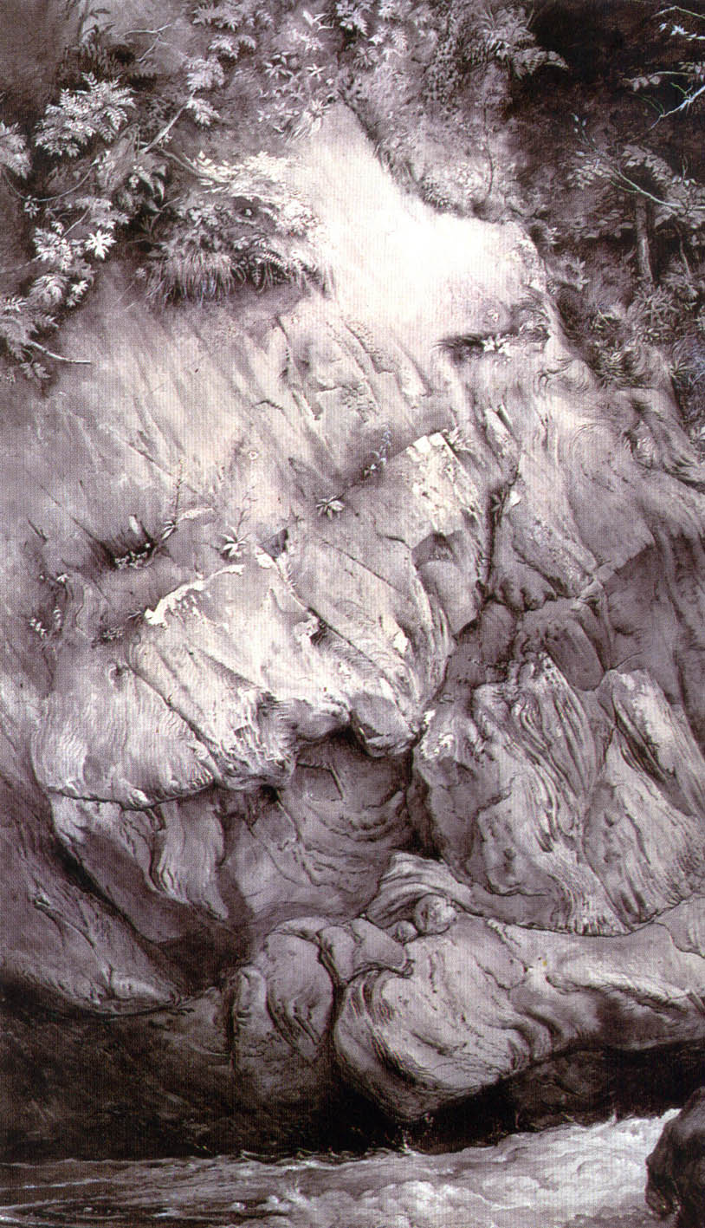
Gneiss Rock, Glenfinlas 1853 John Ruskin Ashmolean Museum, Oxford
Notes:
So inspired by his works such of his study of nice rock in Glen Finglas, I was particularly drawn to the idea of exploring a ‘Ruskin experience’, his belief that an understanding and deep appreciation of sciences such as geology for instance was critical in achieving authentic works of art, particularly in reference to the natural environment, So I began to examine how I could use this idea to enhance and drive a virtual environment design process.

Slide 35
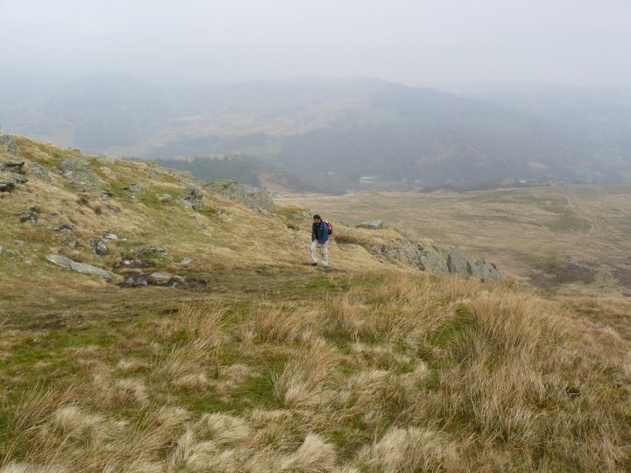
…go to nature in all singleness of heart... rejecting nothing, selecting nothing and scorning nothing.
John Ruskin (1819 –1900)
Notes:
Exploring the meaning of place in order to inform virtual spatial design.

Slide 36
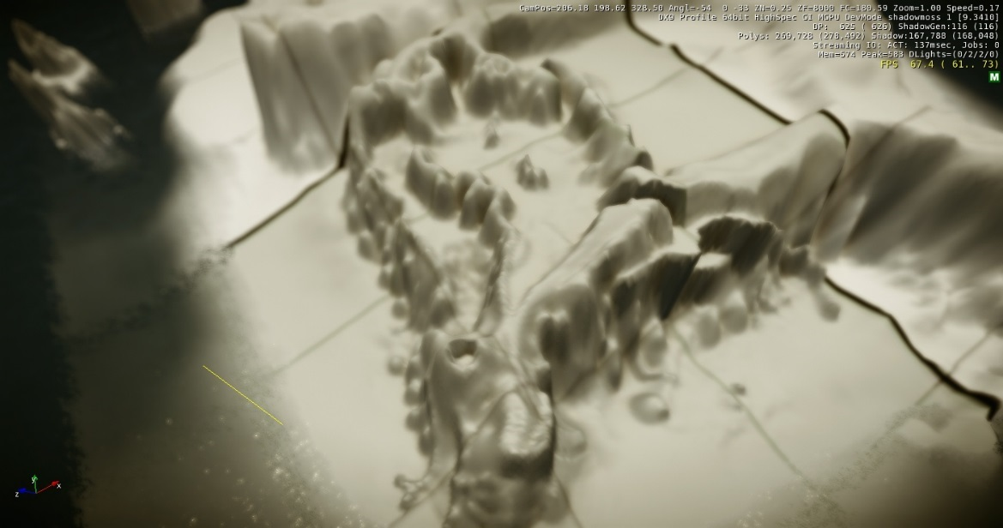
Notes:
After the field trip, I then started a process of reflecting and trying to embed my experiences into a virtual natural environment, I ended up selecting CryEngine 5, a very extensive games engine as the tool to build the digital game, given its very impressive technical capability.

Slide 37
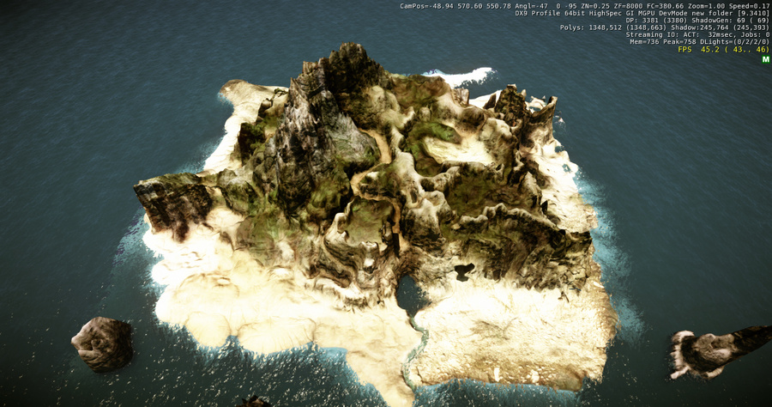

Slide 38
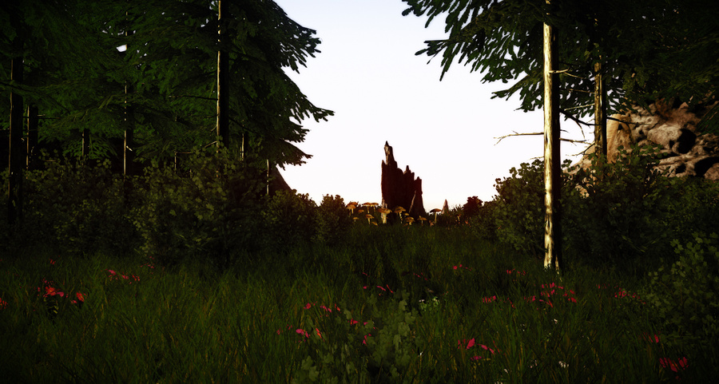

Slide 39
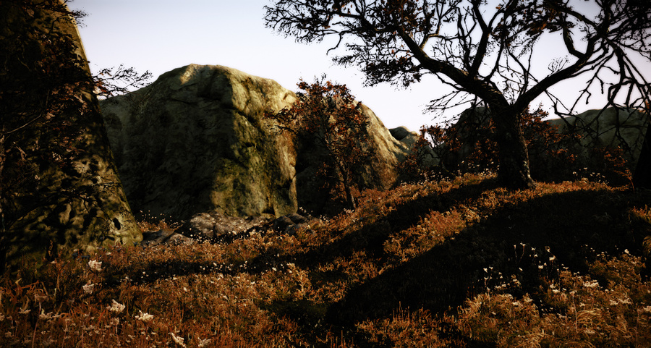

Slide 40
… 'Placelessness' equals an inability of a setting to encourage the formation of vivid images.
Edward Relph
Notes:
As research often does, Ruskin’s work led to an exploration of concepts of space and architecture, ideas of space, place and placelessness began to emerge, and one in particular Edward’s Relph’s ideas strangely began to resonate with elements of game design.

Slide 41
Space & Place
Phantasy Star Universe: AOTI’s Forest of Illusions exemplifying Golf Course Design (Ali, U 2016)
Relph’s Existential Insideness
“….a situation of deep, unself-conscious immersion in place and the experience most people know when they are at home in their own community and region” Seaman & Sowers (2008)
Notes:
I was particularly drawn to Relph’s idea of Existential Insideness which he described as “….a situation of deep, unself-conscious immersion in place and the experience most people know when they are at home in their own community and region”
This for me encapsulated the true goal of me as a virtual landscape designer, so I was interested in how, if at all I could achieve this feeling of Existential Insideless in a virtual environment,. This leads me to technologies that literally put you inside the virtual domain.

Slide 42
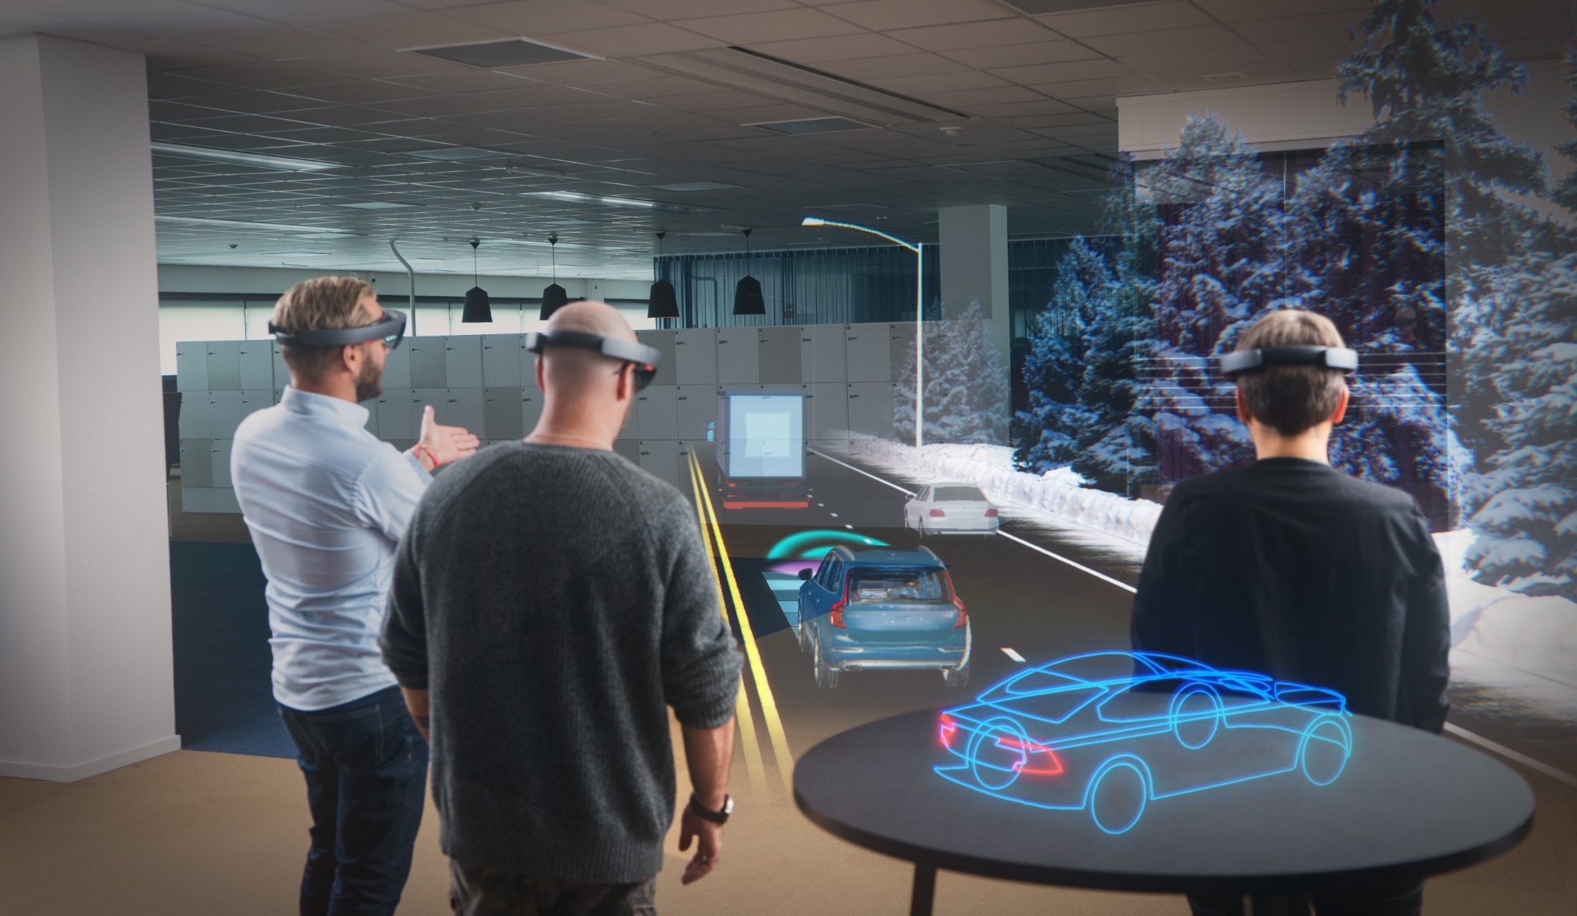
Space & Place: A.R & V.R
Microsoft's HoloLens
Notes:
Relationship between space & place is evolving in games design: changing realisation in both development & perception of video games: Designed as spaces; experienced as places
The technology: The 2D Screen is dead, as ecologists / engineers / architects/environmental managers you deal in space and place; the problem with the 2D screen is space, misses the nuances of site visits, feeling of ‘place’ vs space.
New technologies such in VR i.e. Ocuclus Rift, Vive, Sony PSVR, have disrupted games industry; still not ‘there’ yet……but games are pushing of the potential of V.R.
V.R & A.R offer spatially orientated technologies; spatiality is a key attribute of games, so VR and A.R in essence highlight, celebrate and expand upon the raison d'etre of video games

Slide 43
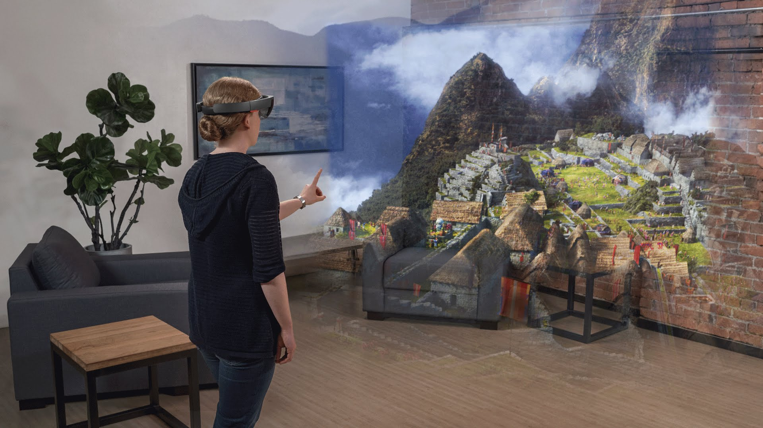
Space & Place: A.R & V.R
Microsoft's HoloLens
Notes:
How can they be useful?
Greater shareholder & Client engagement: paper plans vs ‘in situ’; on-site visits
Going beyond renders & visualisation: immersive & meaningful interaction (agency)
Games, esp VR/A.R offer the real potential to turn ‘space’ into place: Lighting, height, distance: time, real-time, weather, climate….interactions can be experienced rather than calculated/imagined
VR is still new inc A.R, Google Glass, Microsoft Hololens could enhance onsite visits combing virtual/physical environments/systems as one: integrated planning?

Slide 44
Research Outcomes: Spatiality
The simulacrum is never that which conceals the truth--it is the truth which conceals that there is none…..The simulacrum is true.” (Poster & Mourrain, 2002, pp.166-184)
Notes:
The research supports the notion of Spatiality as Raison D’etre within digital games, : Scenism embraces and develops the perspective of spatiality as one of the defining attributes of digital games and as such should be core focus of implementing a ‘scenistic’ approach. The framework offers not only game designers an opportunity to develop engaging spatial experiences using an array of game technologies that may not use ‘traditional’ elements of gameplay, but instead focus on emergent spatial-play elements such as exploration & discovery, prospect and refuge.

Slide 45
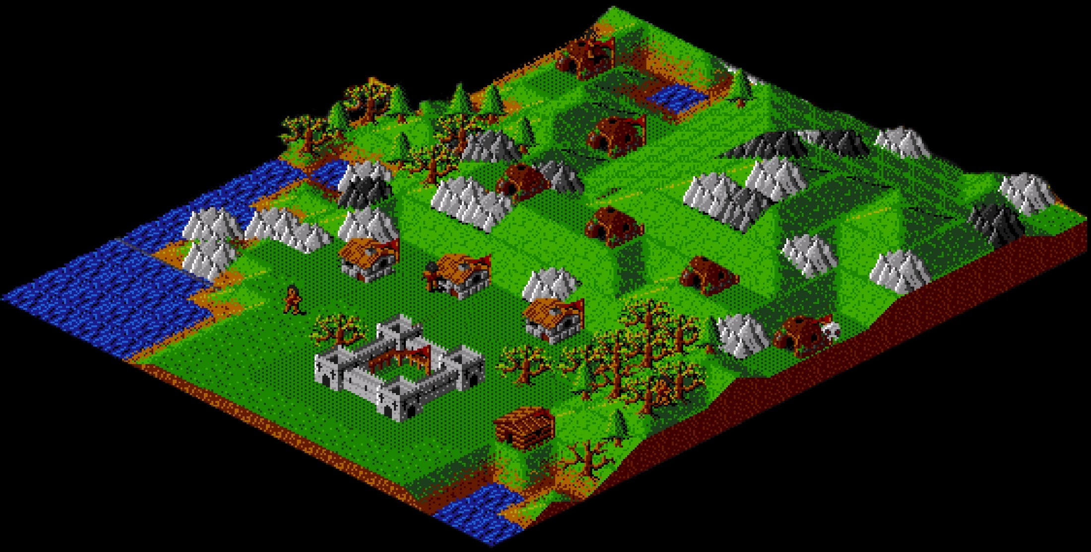
Research Outcomes: Gamespaces
Notes:
The study argues that gamespaces, in particular environments and corresponding landscapes have a significant impact on gameplay, as such the research suggest as new game design & production processes framework with an aim in developing richer and deeper virtual landscapes.

Slide 46
Research Outcomes: Gameplace
Notes:
This study proposes gameplace as a complimentary term to sit alongside gamespace; gamespace may refer to the particularly arrangement/configuration of the virtual space/environment in a game, whereas gameplace refers to a particular and specific location within a gamespace that evokes a meaning, whether that is to an individual or a group or a personal, cultural or otherwise level.

Slide 47
Virtual Natural Landscapes Component Framework
Virtual Natural Landscape
Design
Physical Nature
Landscape Character Assessment
Psychological Nature
Relph's Place & Placelessness
Genius Loci
Biophillic Design
Cognitive Spatial Mapping
Ruskin's Dictum
Notes:
What ultimately emerged after this piece of practice was not only a practical artefact of the initial VNED design framework; a game to explore, but also a much more deeper and richer framework began to emerge, particularly the perceptual and phycological impact and meaning of landscape had developed, one that attempted to unite game design, Relph’s placeness and Ruskin’s go to nature dictum.

Slide 48
Research Outcomes: Scenism Framework
Notes:
A range of tools, processes, artefacts and extensive recommendations were developed in the course of the research, resulting in the creation of historical VNE visual archive in a range of digital and physical ‘artefacts’ forms. ‘Scenism’ was the final resulting framework that arose as the embodiment of the proposed VNE/VNL design framework

Slide 49
Research Outcomes: Architects of Place
.
Notes:
Finally I believe that future digital games designers will move from being architects of space to Architects of Place, and will increasingly be educated in 'traditional' elements of landscape planning including ecology and architecture. This also represents a future opportunity for those in fields such as geology, ecology or landscape architecture to become collaborators in shaping future digital games, radically reshaping the professions for both future demands and challenges.
Meaning and ideas of nature,. Ecology, landscape, in function and in perceptions in digital games are yet to be fully explored and realised.

Slide 50
Research Outcomes: World Architects
Landscape by Tuğçe Kurak ‎[tugce.kurak@hotmail.com]
CryEngine 5
Masters in Landscape Architecture
MMU University‎
Notes:
This research supports the assertion that video games have the power to forge the future of ludic space-time (Brouchoud 2013; Walz 2010) and that landscape architecture, geology and ecology will increasingly blend with game design to create a new type of design and will herald new thinking crossing the boundaries between disciplines .
What you see here is work, in collaboration with Mark Jackson (landscape architect) and Eddy Fox, lead academic on the Masters in landscape architecture programme, by a Manc Metro Uni student who for the first time used games technology, namely CryEngine 5 to explore and design landscapes. This is set to be explored further at other Universities. Current work at UoS Rewilding an area near the river mersey

Slide 51
Conclusions & Summary
Technology in particularly video games as a distraction; ‘competition’ to the natural environment: video games can be a powerful tool in conservation, ecology and environmental management.
Video games can act as a Common Shared Framework, a shared platform for ecologists, managers, architects, engineers, public to all meet/work ‘in’
2D plans/datasets/renders etc.. into visual interactive simulacra; no imagination needed.
The future £500m video game project….
Q Who will design(and manage) the virtual ecosystems or the virtual habitats?
A: Ecologists as games design consultants (CIEEM/GDC)
Video games will increasingly move beyond explicit ‘ecology games’ to embedded use of ecology.
Ecologists, architects and environmental planners using game design, processes tools, engines alongside VR/AR to drive and share their work in more authentic, meaningful and collaborative manner.
Video games should be recognised a valuable experiences for teaching, planning and design.
Notes:
Video games will increasingly will function as ‘conduits’ to other disciplines; as games increasingly use ecology as a core gameplay feature; it’s value and relevance as a subject field will inevitably increase; exposing children to what is sometimes a quite an academic subject, in a fun, accessible and enjoyable manner, illustrating that video games can be powerful teaching tool.
On the flip side, future games designers will increasingly be educated in 'traditional' elements of landscape design including ecology and architecture. In addition, there will be future opportunities for those in fields such as ecology or landscape architecture to become collaborators in shaping future video games, radically reshaping both professions for both future demands and challenges.

Slide 52
Contact
Email: u.ali@salford.ac.uk
Twitter: https://twitter.com/Dr_UmranAli
LinkedIN: https://www.linkedin.com/in/dr-umran-ali/
University Of Salford
Profile: https://www.salford.ac.uk/arts-media/our-staff/arts-media-academics/umran-ali
SEEK Profile: https://www.seek.salford.ac.uk/profiles/AUmran.jsp
Any questions?
Notes:
If you would like know more or have a question, please feel free to contact me on any of the above.

Slide 53
Bibliography
Aarseth, E.J. (2007). Allegories of space: The Question of Spatiality in Computer Games. In F. von Borries, S. P. Walz & M. Böttger (eds.) Space time play: computer games, architecture and urbanism: the next level (pp. 44-47) Berlin: Birkhauser Verlag AG
Appleton, J. (1975). The experience of landscape. Chichester: Wiley.
Brouchoud, J. (2013, February 09). The Importance of Architecture in Video Games and Virtual Worlds. ArchVirtual. Retrieved January 15, 2016, from http://archvirtual.com/2013/02/09/the-importance-of-architecture-in-video-games-and-virtual-worlds/
Bunnell, K. (1998). The Integration of New Technology into Ceramic Designer-Maker Practice. (Unpublished PhD thesis) Robert Gordon University, Aberdeen.
England, L. (2015, March). Transitioning from Linear to Open World Design with Sunset Overdrive. Presented at GDC 2015 in San Francisco, California, USA. Retrieved from: http://www.gdcvault.com/play/1022341/Transitioning-from-Linear-to-Open.
Kojima, H. (2009, March). Solid Game Design: Making the Impossible Possible. Keynote at Game Developers Conference (GDC) 2009 presented at California, San Francisco, USA.
Konecki, K.T. (2011). Visual grounded theory: A methodological outline and examples from empirical work. Revija za sociologiju, 41(2), pp.131-160
Malins, J. & Gray, C. (1995). Appropriate Research Methodologies for Artists, Designers and Craftpersons: Research as a Learning Process. Gray's School of Art, Centre for Research in Art & Design.
Nassauer, J.I. (1983). Framing the Landscape in Photographic Simulation. Journal of Environmental Management. 16(4) pp.1-16
Salen, K. & Zimmerman, E. (2004). Rules of play: Game design fundamentals. MIT press.
Smith, H. & Dean, R. T. (2009). Practice-led research, research-led practice in the creative arts. Edinburgh University Press.
Jenkins, H. & Squire, K.D. (2002). The Art of Contested Spaces. In L. King (Ed.) Game On!. (pp.64-75). London: Barbican Press

Slide 54
List of Figures
Comparison of Progression of Openworld games (Source Hexapolis.com 2014)
CryEngine Feature Screenshots https://www.cryengine.com/
Dear Esther Panoroma, Ali, U 2012 Virtual Landscapes
BOTW Ecology taken from PlantPeopleBlog available at https://www.plantpeopleblog.com/blog/breath-of-the-wild
BOTW Background Lanscape, available at https://www.game-debate.com/news/21593/zelda-breath-of-the-wilds-world-looks-gorgeous-to-explore-in-new-trailer
The Witcher 3 landscape GIF available at https://gfycat.com/gifs/detail/disloyalplayfulelectriceel
The Witcher 3 landscape GIF available at https://gfycat.com/gifs/detail/jollyconfusedhuman
Edward Relph available at: https://www.nhltv.net/playlist/unsw-built-environment/PLvW1evjftfvntp6R2ItJ6TuEBFYcpKFsy
Game Engine Logo Image: Available from: https://medium.com/@muhsinking/should-you-make-your-own-game-engine-f6b7e3f4b6f5
Fable 3 Panorama, Ali, U 2012 Virtual Landscapes
GDC UE4 Open World Demo GIF By @moritzw
Ghouls & Ghosts Ali, U 2012 Virtual Landscapes
Landscape Animation, available at: https://i.pinimg.com/originals/03/bb/fb/03bbfb95d3410a404583edfdc5415ace.gif
Lone Cypress Tree Photograph, Ali, U 2016
Photogrammetry Images: available at https://80.lv, copyright Paul Dickinson (https://sketchfab.com/paul3uk)
Scencism Framework, Ali U 2016
Microsoft Hololens Image 1 available at https://it.videogamer.com/2017/08/21/fine-della-produzione-per-hololens-nuova-conferma/
Microsoft Hololens Image 2 available at http://fortune.com/2017/02/21/microsoft-hololens-update-delay/
ShadowMoss Island, Ali U 2016
Skyrim Animated GIF, available at: https://media.giphy.com/media/TWVidqvGHHnnW/giphy.gif
Skyrim Panorama, Ali, U 2012 Virtual Landscapes
Skyrim Panorama, Ali, U 2012 Virtual Landscapes
StarFox Adventures: Before & After Comparison
Study of Gneiss Rock available at: http://ruskin.ashmolean.org/collection/9006/9037/9358/all/per_page/25/offset/0/sort_by/seqn./object/14350
The Elder Scrolls 3: Morrowind – Before & After Comparison
The Heart of the Andes Painting by Frederic Edwin Church, available at https://en.wikipedia.org/wiki/The_Heart_of_the_Andes#/media/File:Church_Heart_of_the_Andes.jpg
The landscape wheel from ‘Landscape Character Assessment (adapted from Tudor, 2014)

