Slide 1
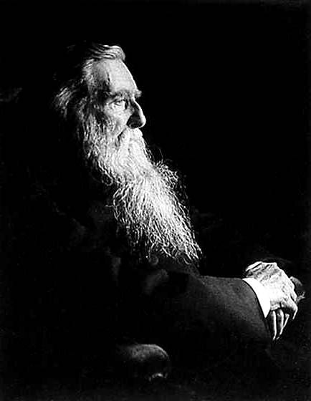
Virtual Landscapes:
Landscape Architecture & Games Design
Dr Umran Ali, B.Sc (Hons) M.A, PGCHEPR, SFHEA, Ph.D
Senior Lecturer in Creative Media
University of Salford

Slide 2
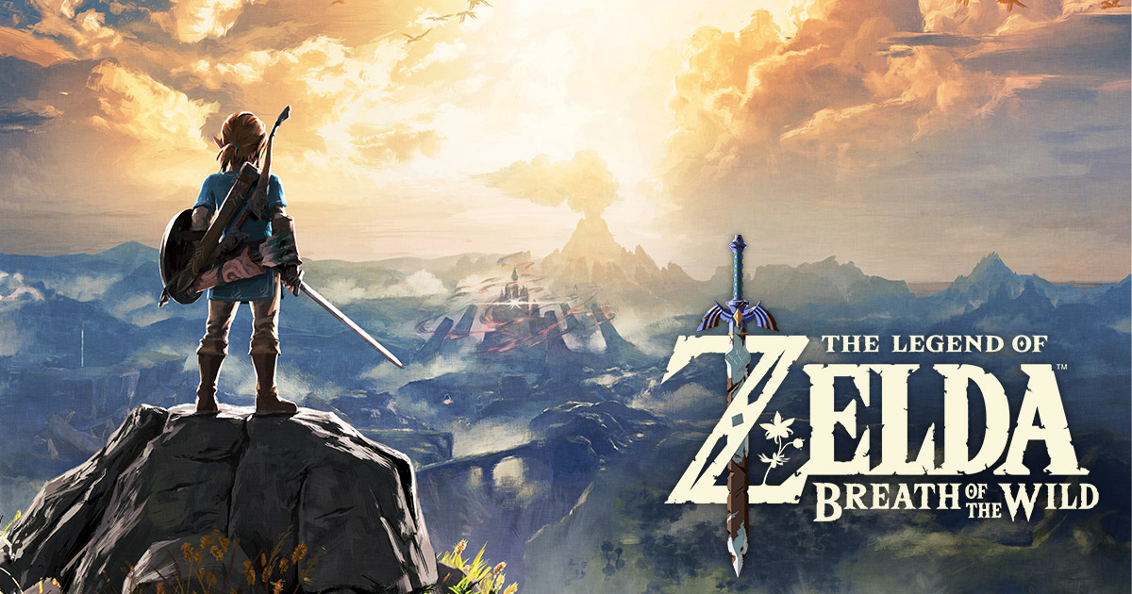
The Other Me….
PSN: DarkerForce
(Destiny 1 & 2…2,500hrs?)

Slide 3
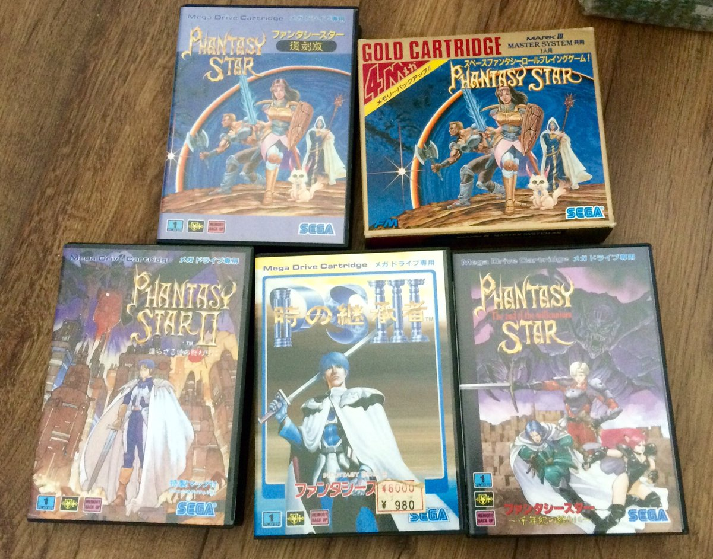
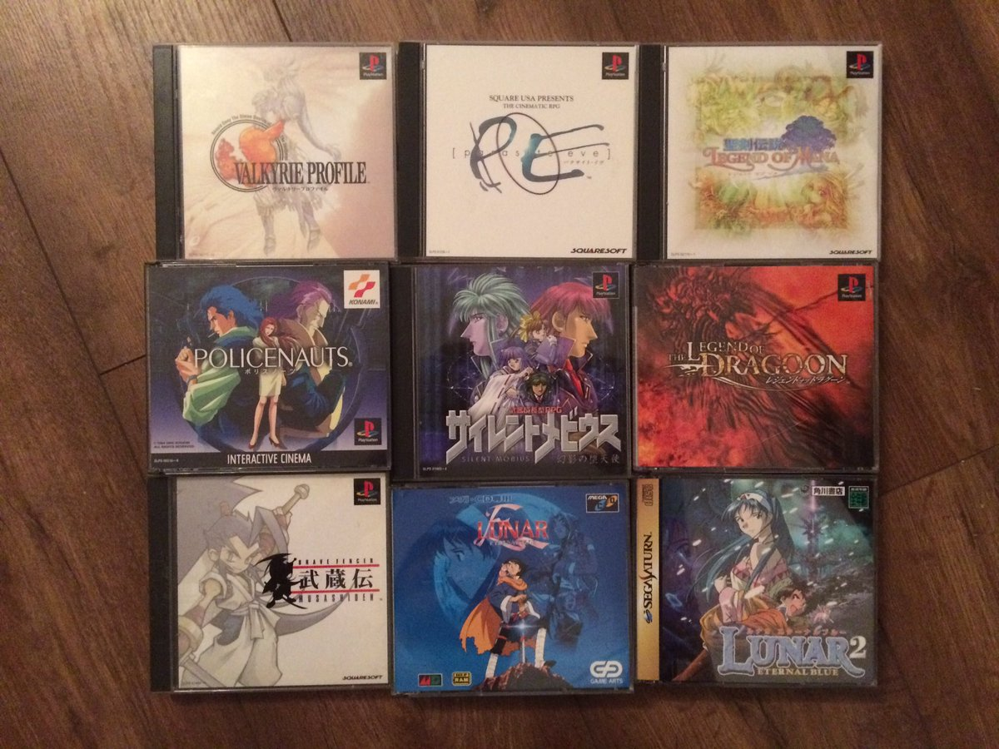
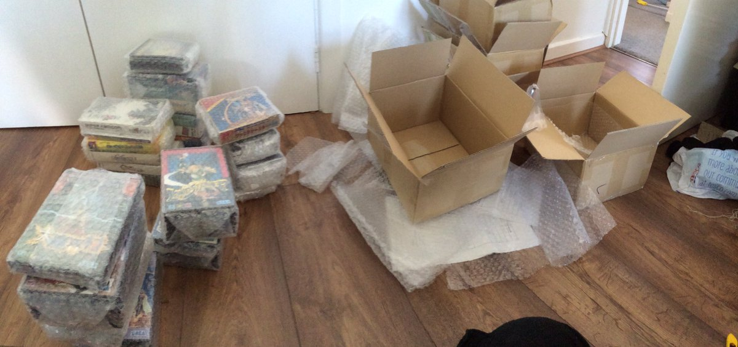
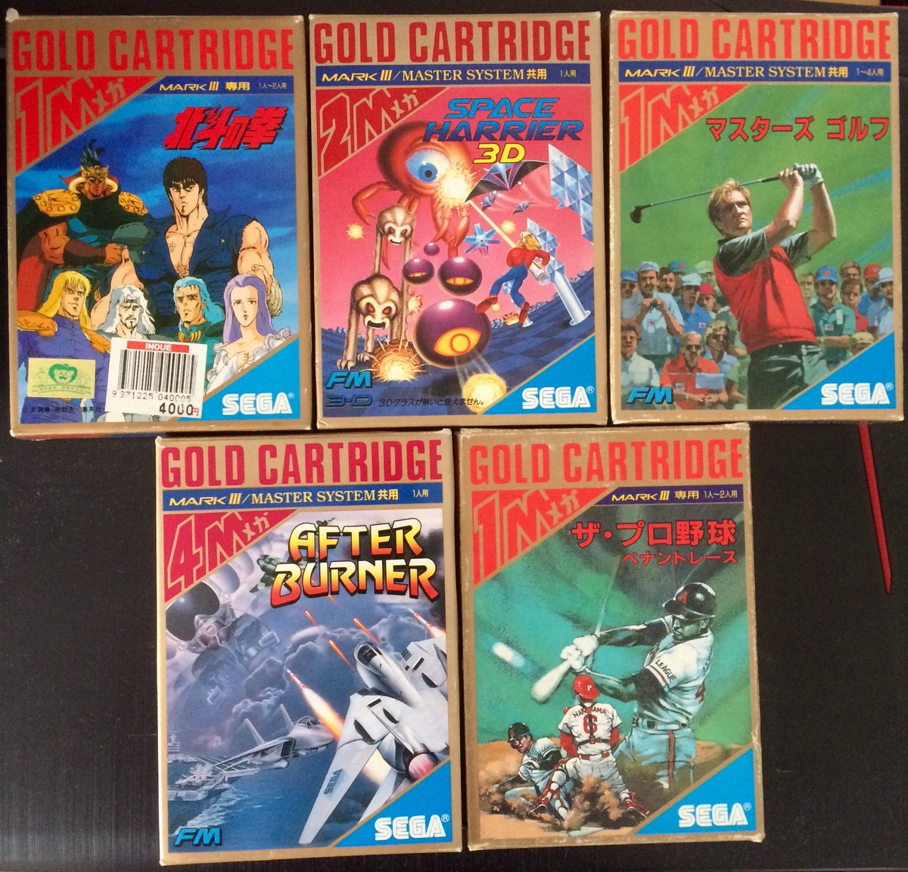
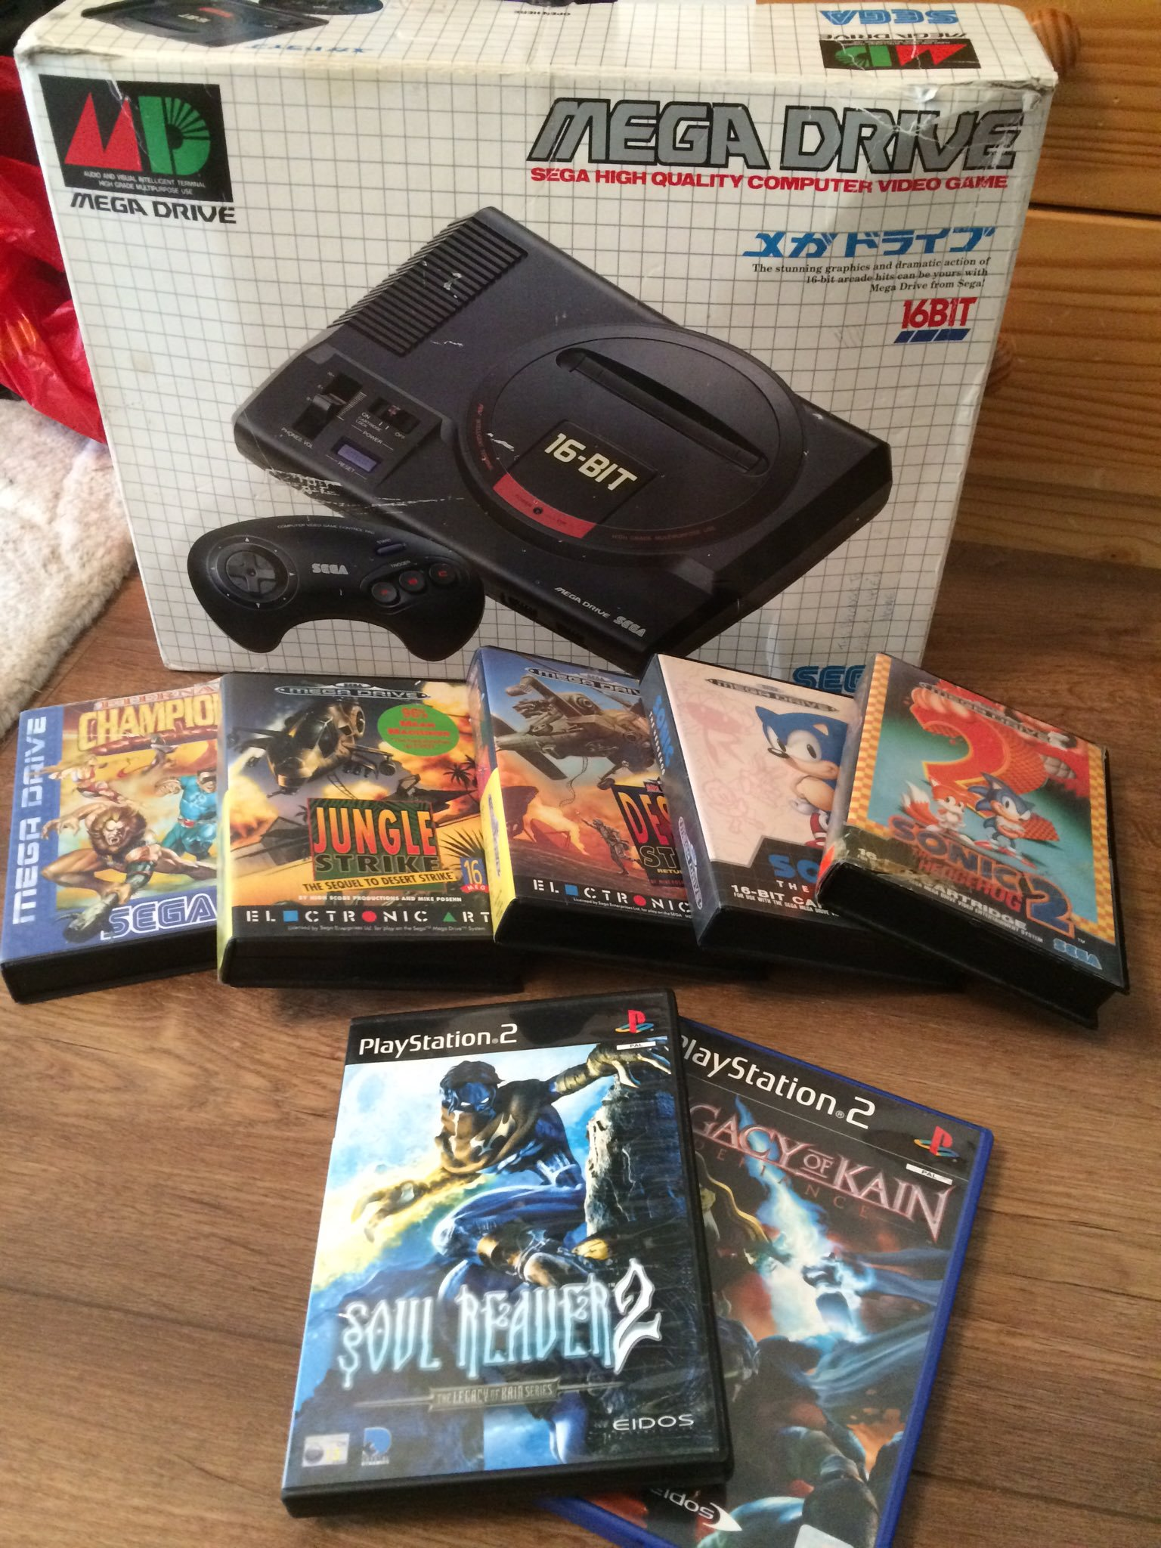
Overview

Slide 4
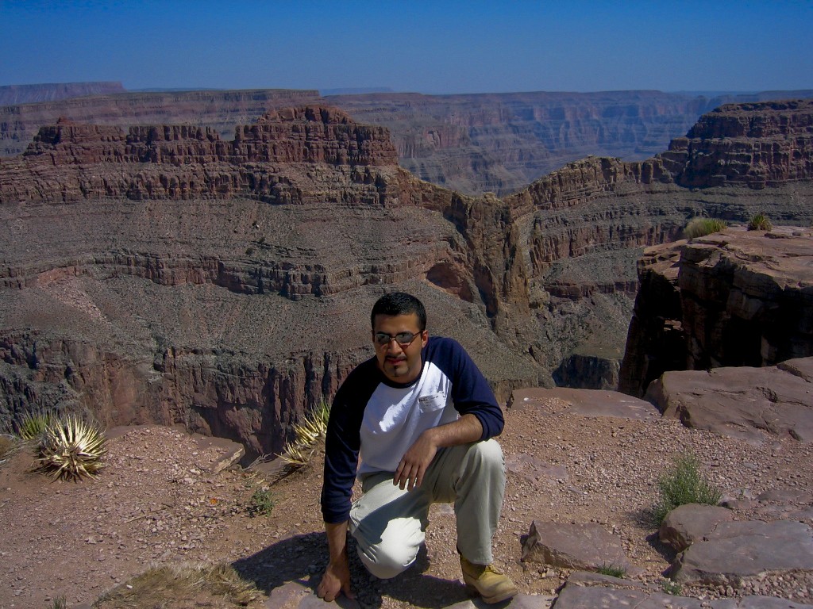
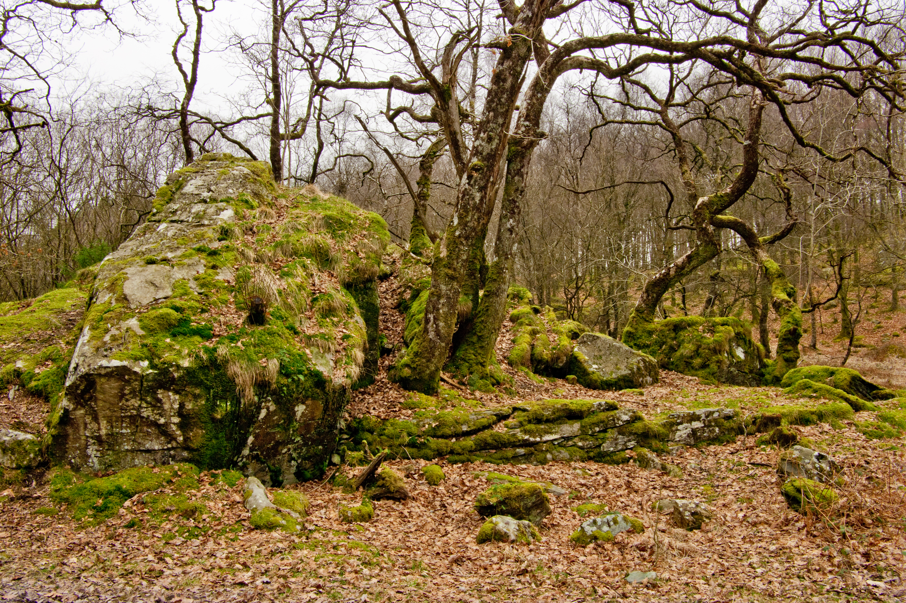
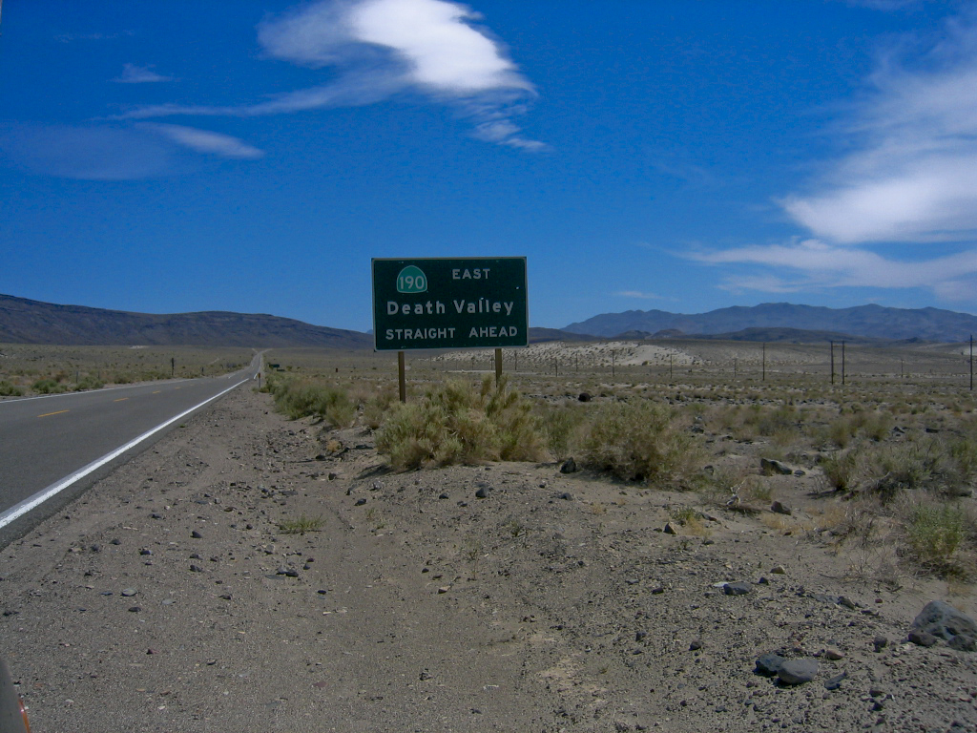
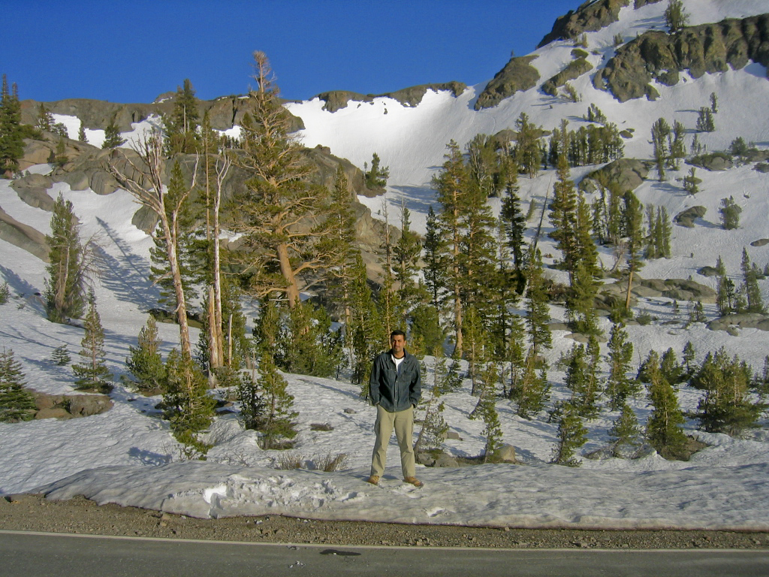
Overview

Slide 5
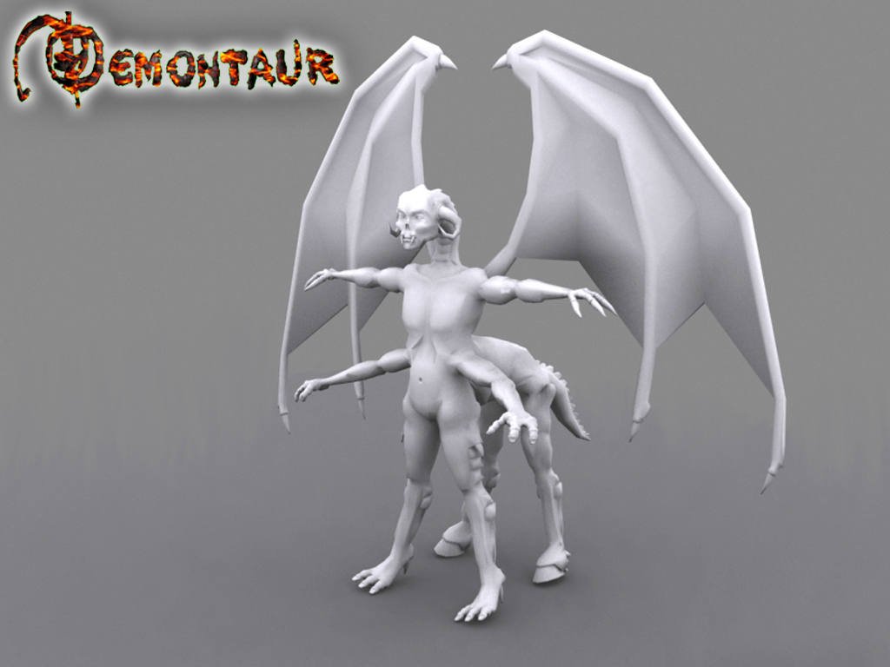
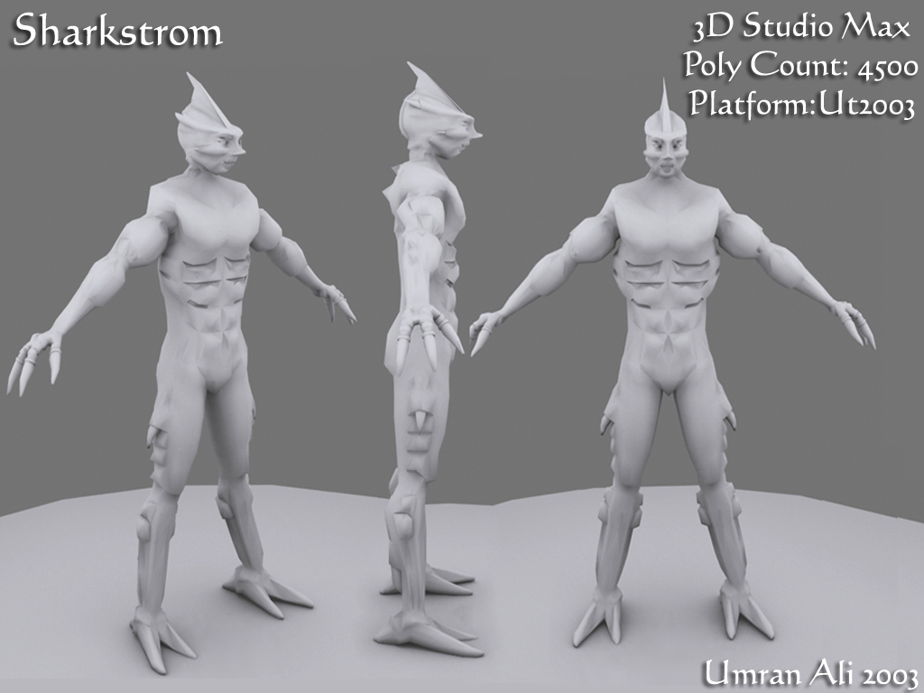
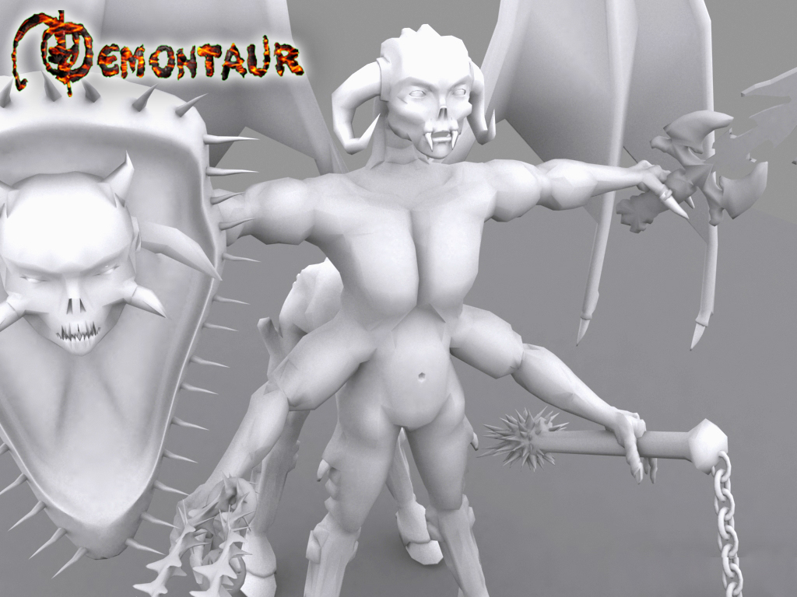
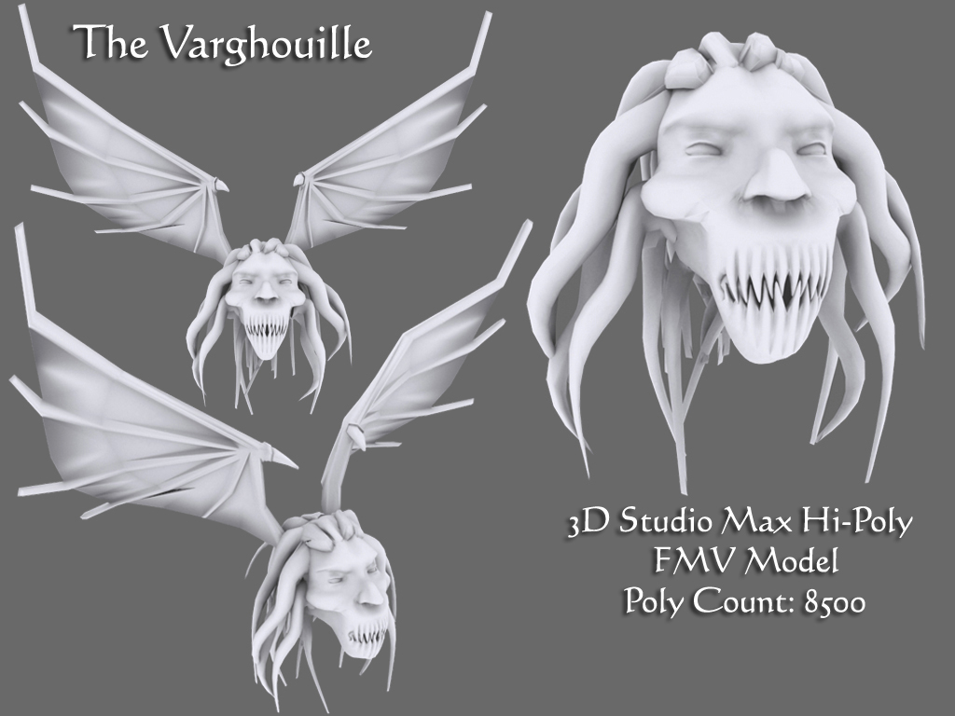

Slide 6
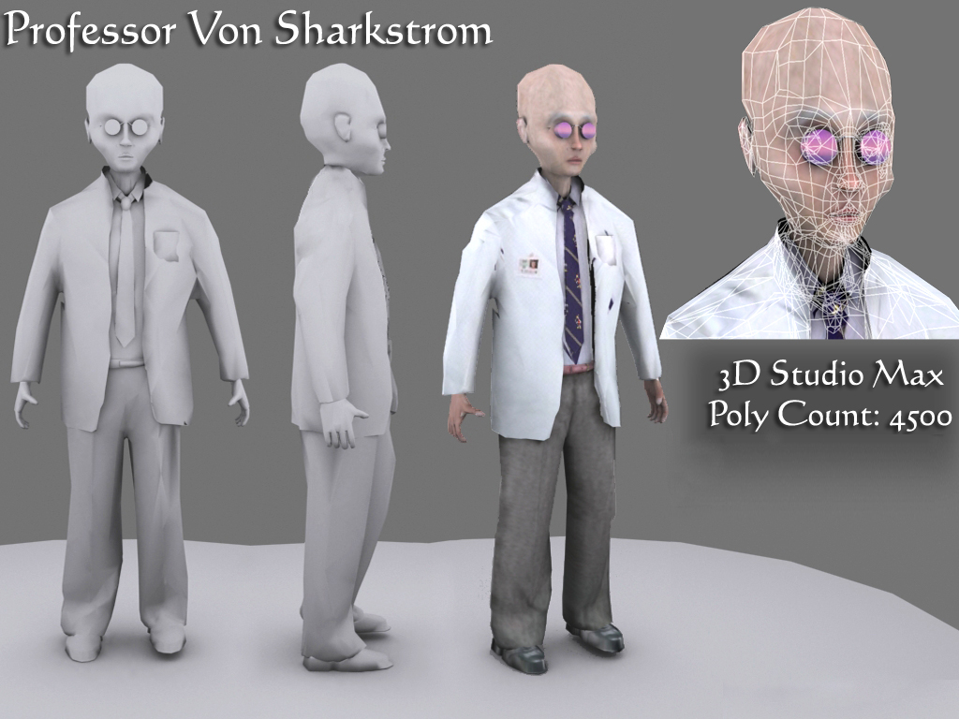
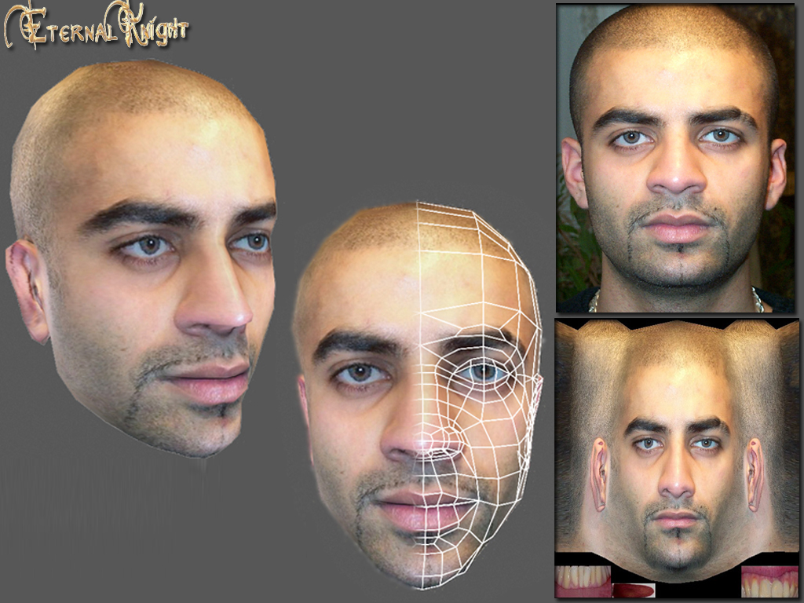
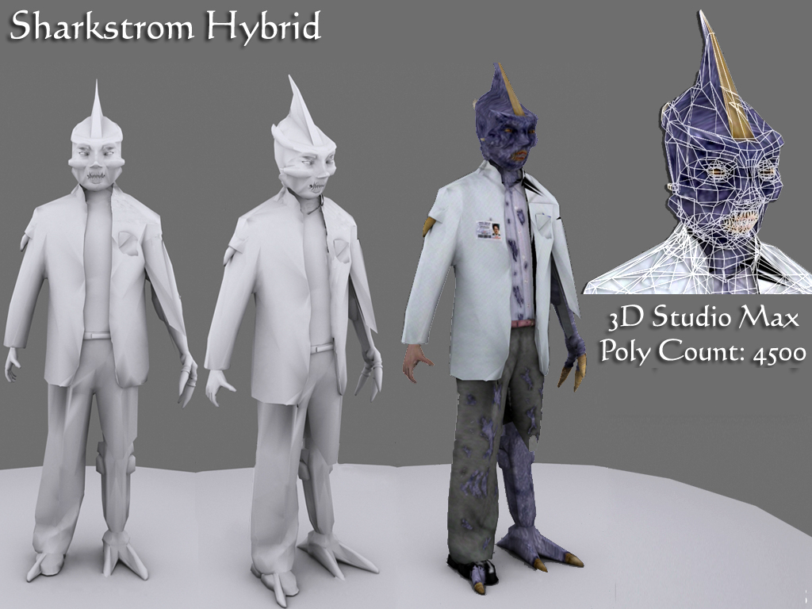
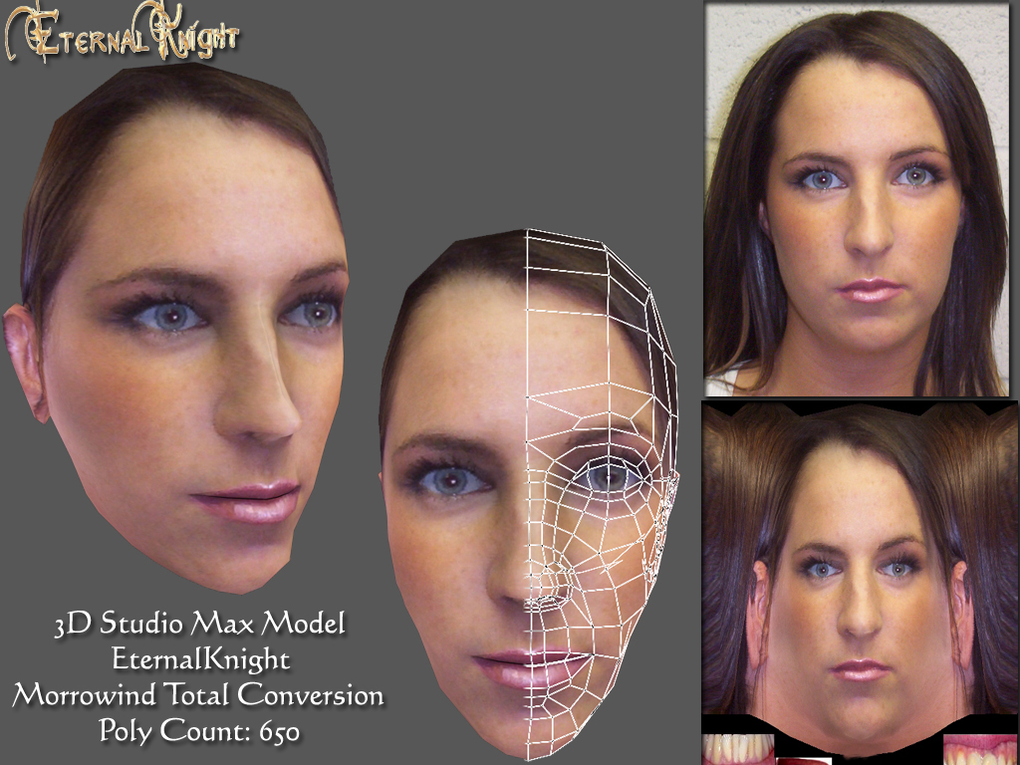

Slide 8
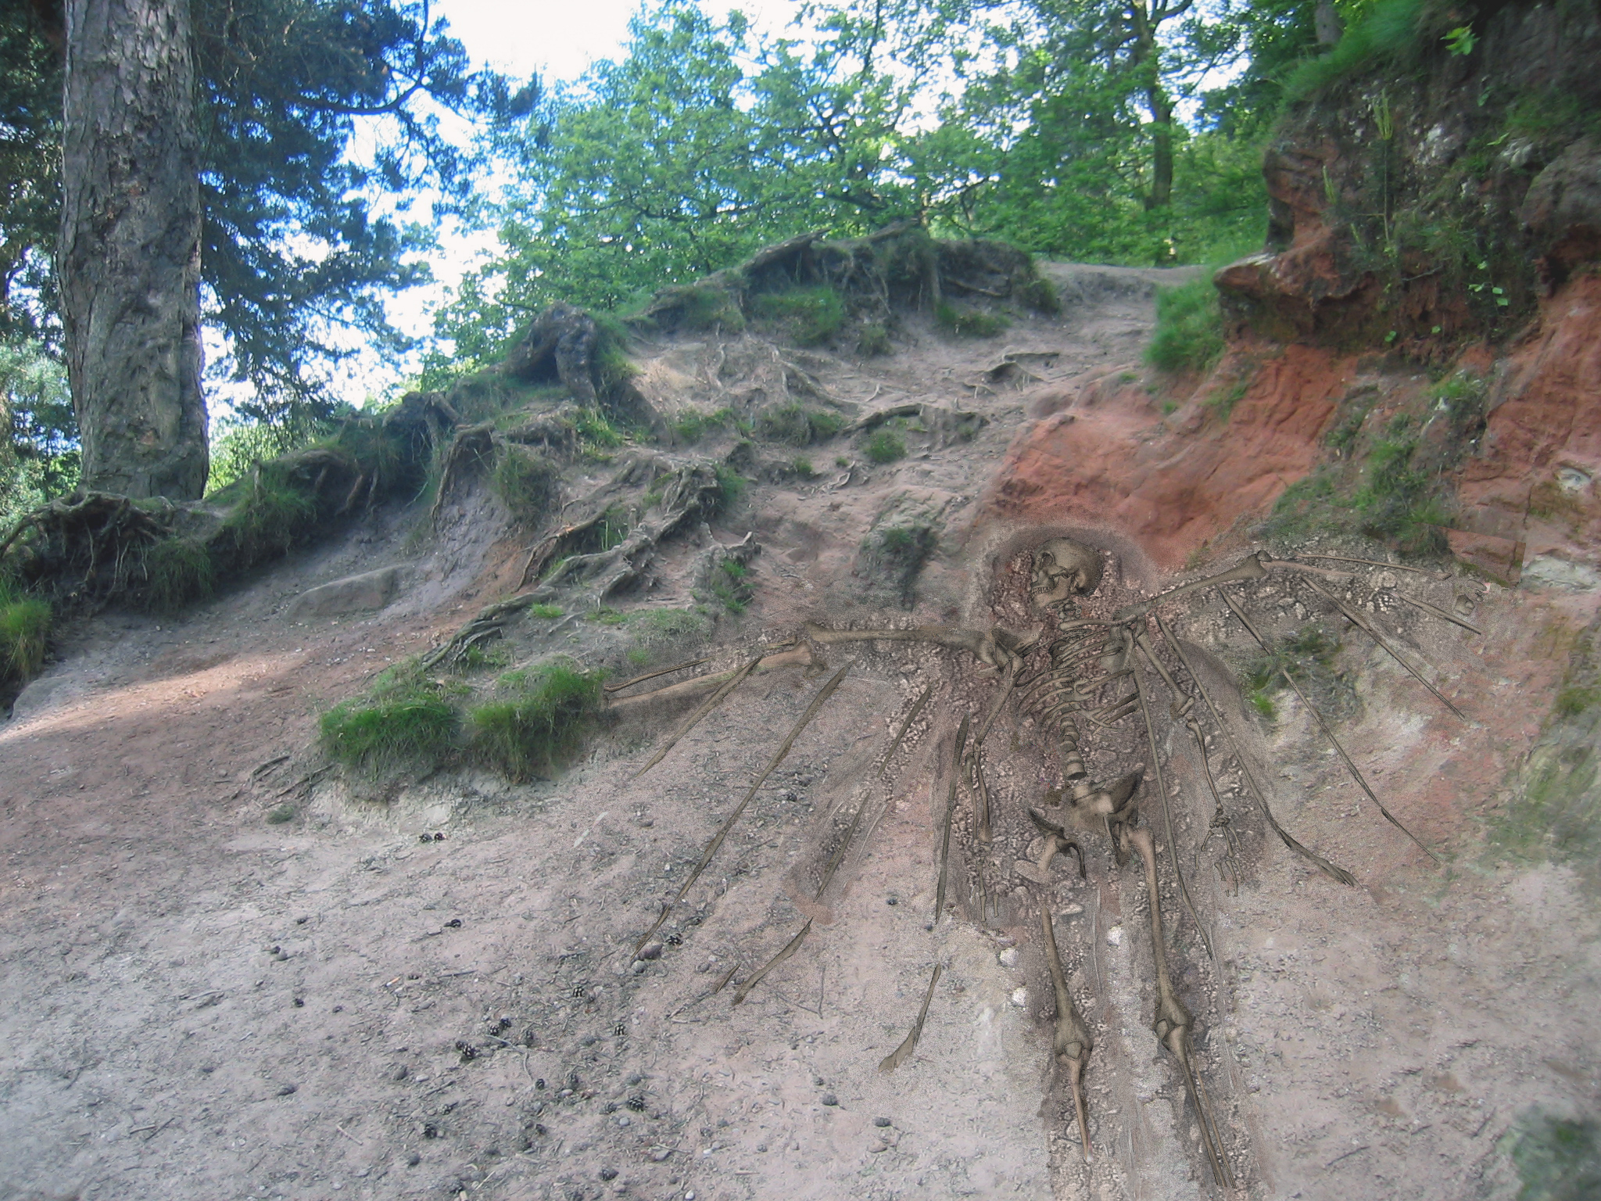

Slide 9
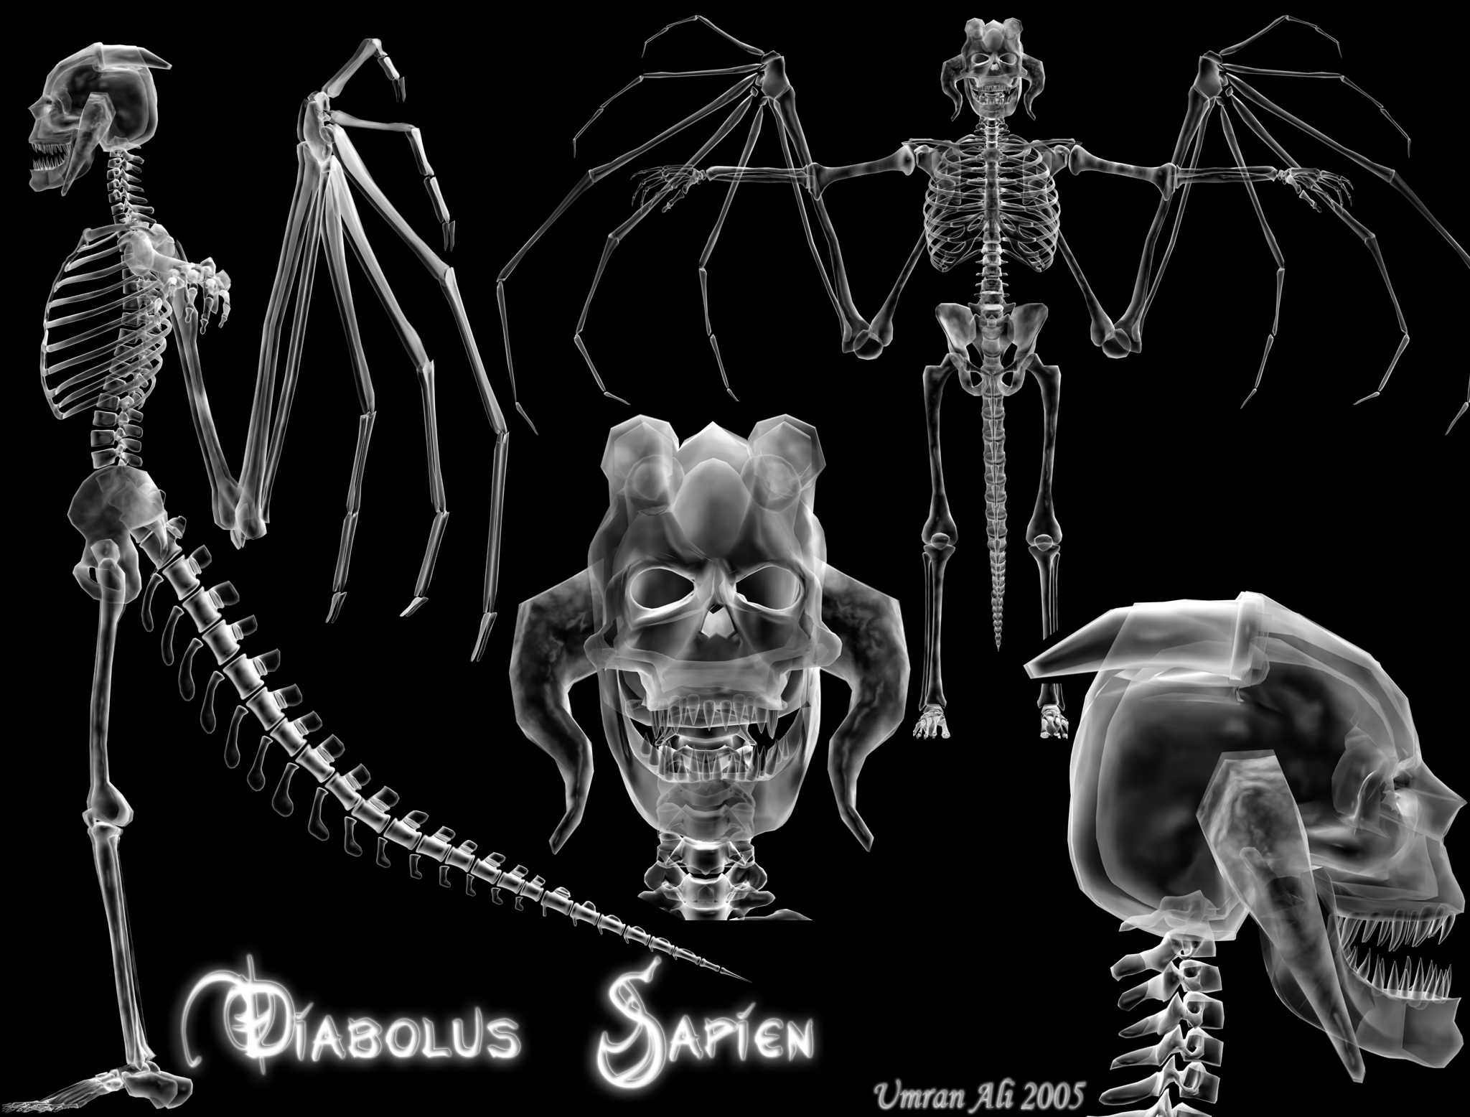

Slide 13
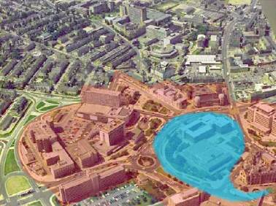
PlastiCity: Urban Planning Game
.
Mathias Fuchs LevelDesign, Art, Concept Steve Manthorp Concept, Gameplay Vera Schlusmans Unreal Script Programming, Concept, Gameplay Umran Ali Terrain Editing, Modelling Kelvin Ward Modelling, Digital Photos |  | Bradford City centre. The red zone is the core region containing the Townhall and the Museum of Film, Photography and Television. The blue zone marks the area for a possible lake.
PlastiCity - A Multiplayer Urban Planning Game
The project will create a gaming environment for single or multiple users which will allow players to reshape Bradford city centre according to their own, or a shared, vision. The game can be considered a ’serious’ game insofar as it is based on careful research into the City Council’s planning, the history of ’cities of the future’, The City Centre Masterplan, and the wishes and demands of the local population.
However, our intention is that the game should firstly and foremostly be fun to play. To this end, it is our intention that the game will contain additional playful elements (subgames) which will add to the playability, longevity and relevance to Bradfordians of the game experience.

Slide 16
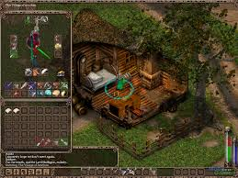
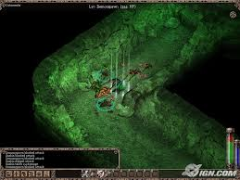
Heretic Kingdoms: The Inquisition
Kult: Heretic Kingdoms (2004)
Kult is an isometric role-playing video game, combining 3D technologies with the intuitive environment of an isometric game.
It was developed by Slovakian studio 3D People, with a storyline written by a script team that includes Chris Bateman and game mechanics designed by the International Hobo team. It was published in North America as Heretic Kingdoms: The Inquisition
Design/interface usbaility.

Slide 17
Current Research

Slide 18
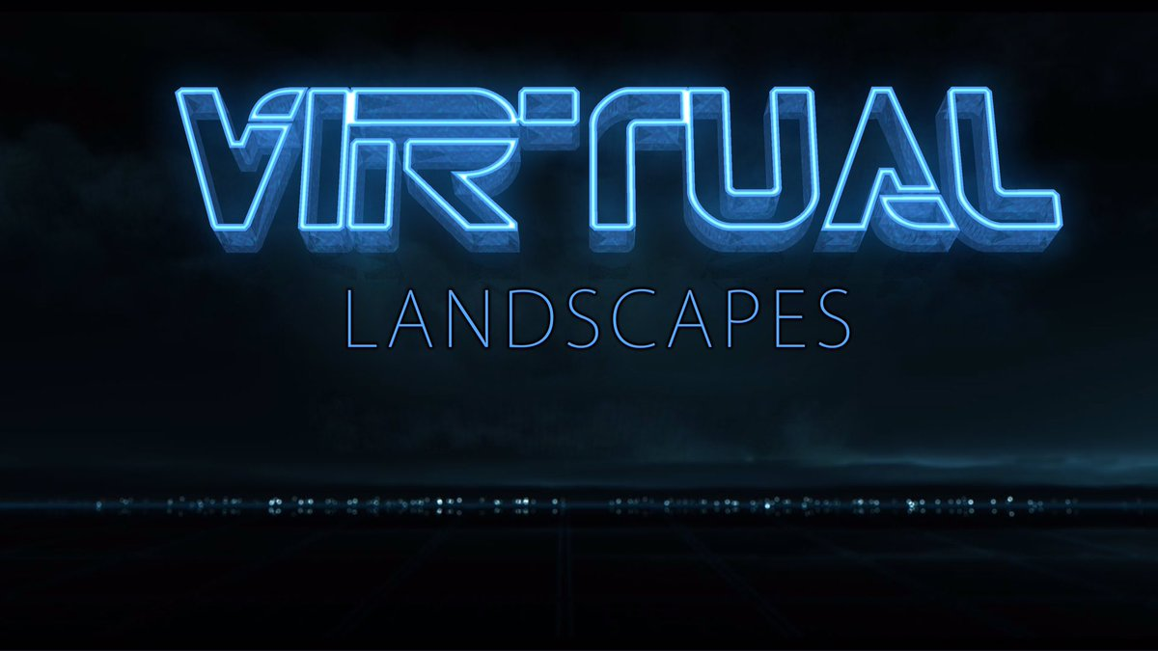

Slide 19
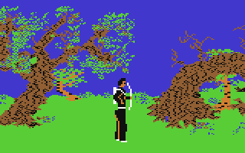
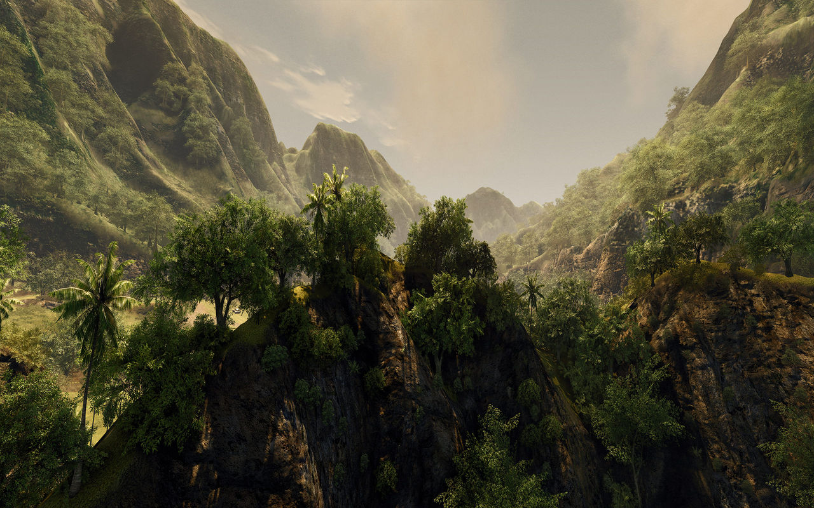

Slide 20
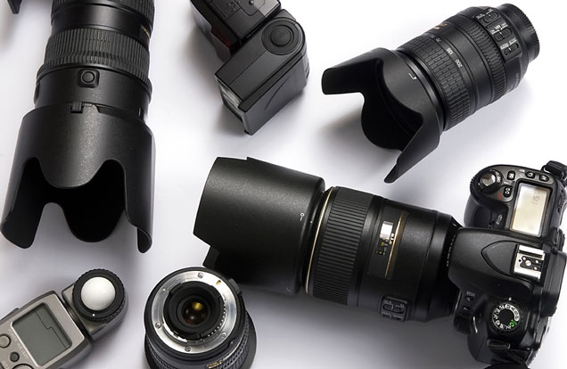
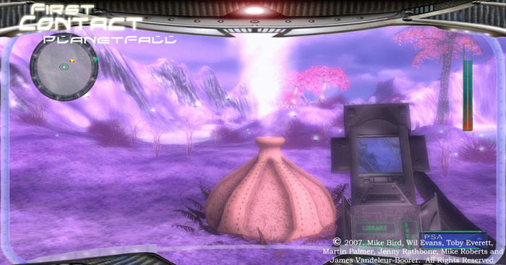
How can I propose a new methodology without critique of past works/artefacts?
Virtual photography has been used as a qualitative research method used to :
Determine the current legacy practice in games landscape design
Illustrate construction of VNE over last 30 years
Provide an unhindered visual perspective of the constructed design
Draw out difficult concepts related to VED.
Form of restoration? environments lost long ago are extracted and distilled
Photography as a -offers a reflective entrypoint into an exploration of the recording of the space

Slide 21
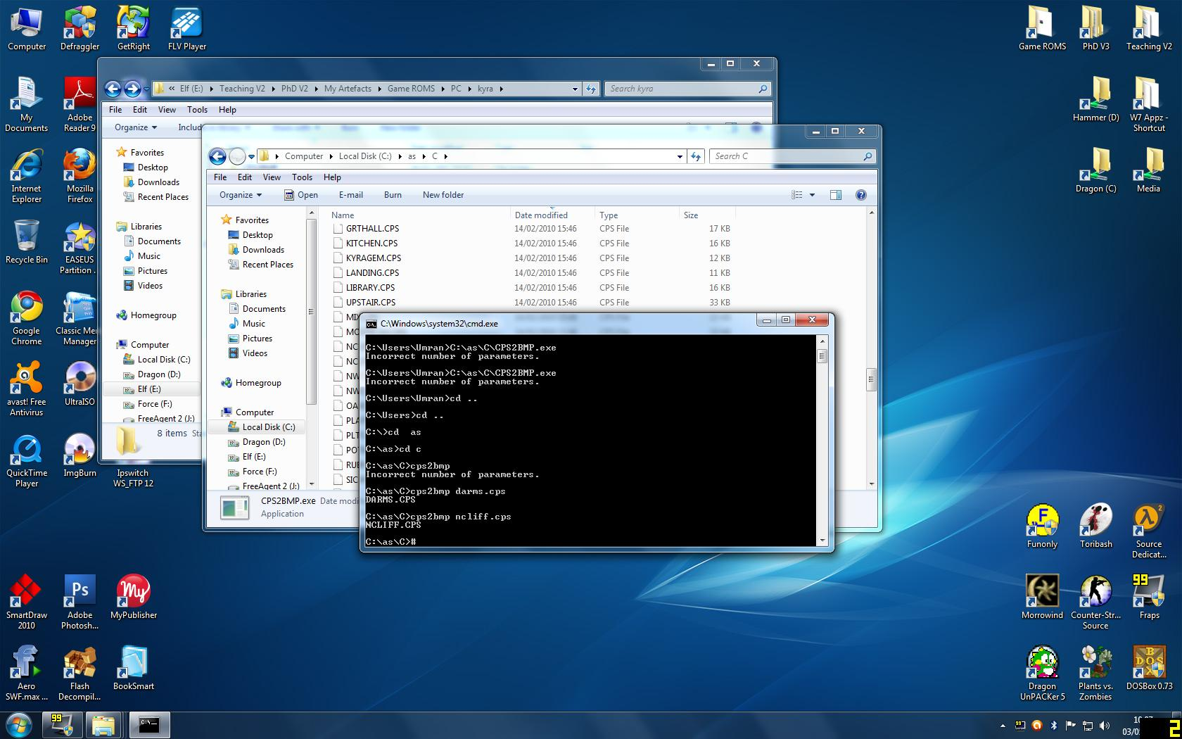
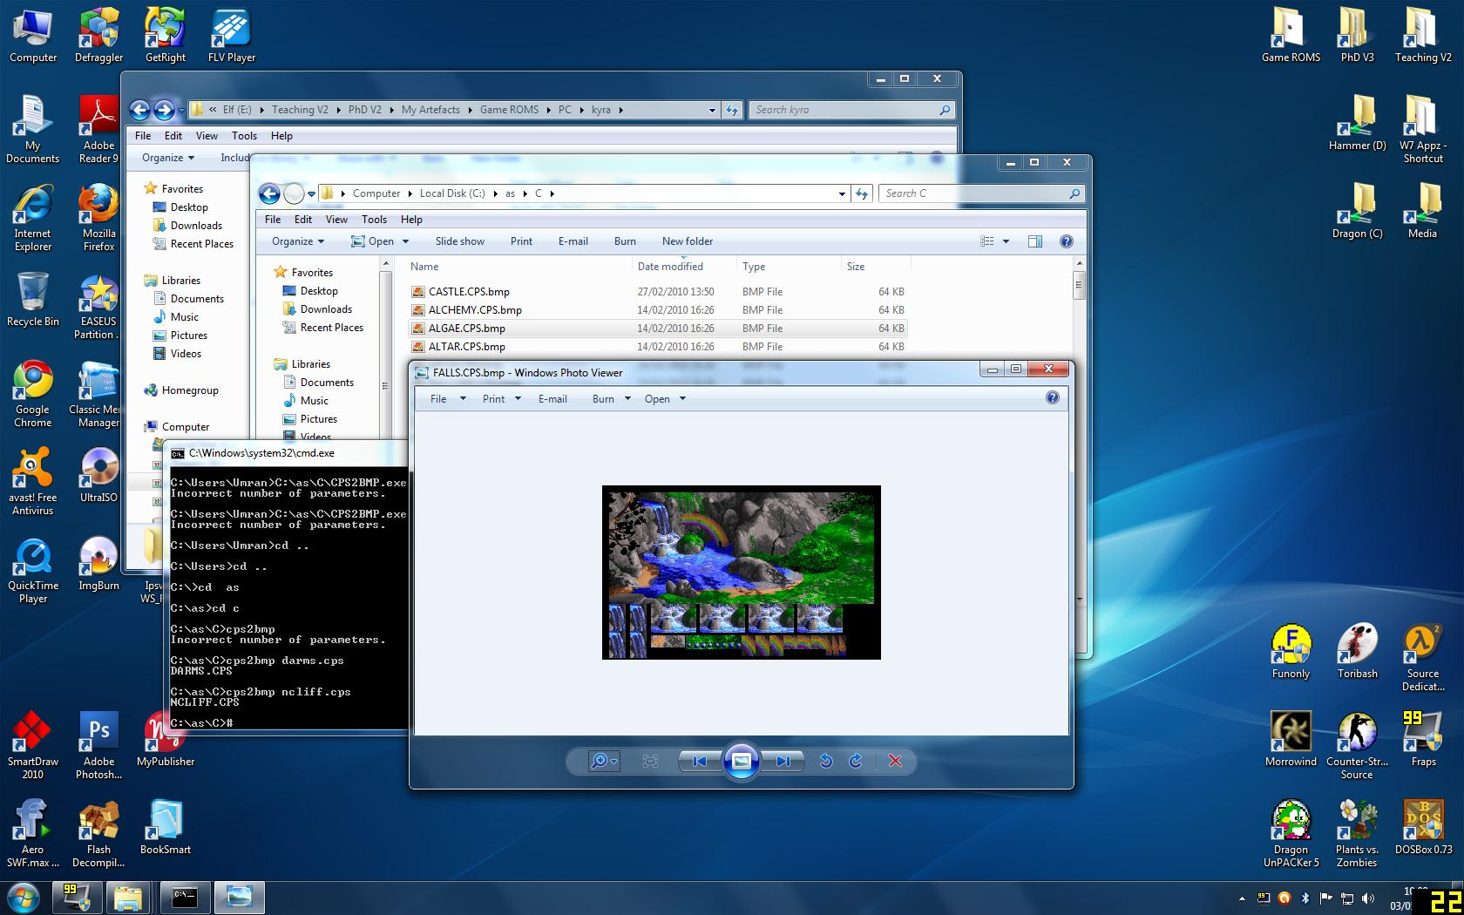
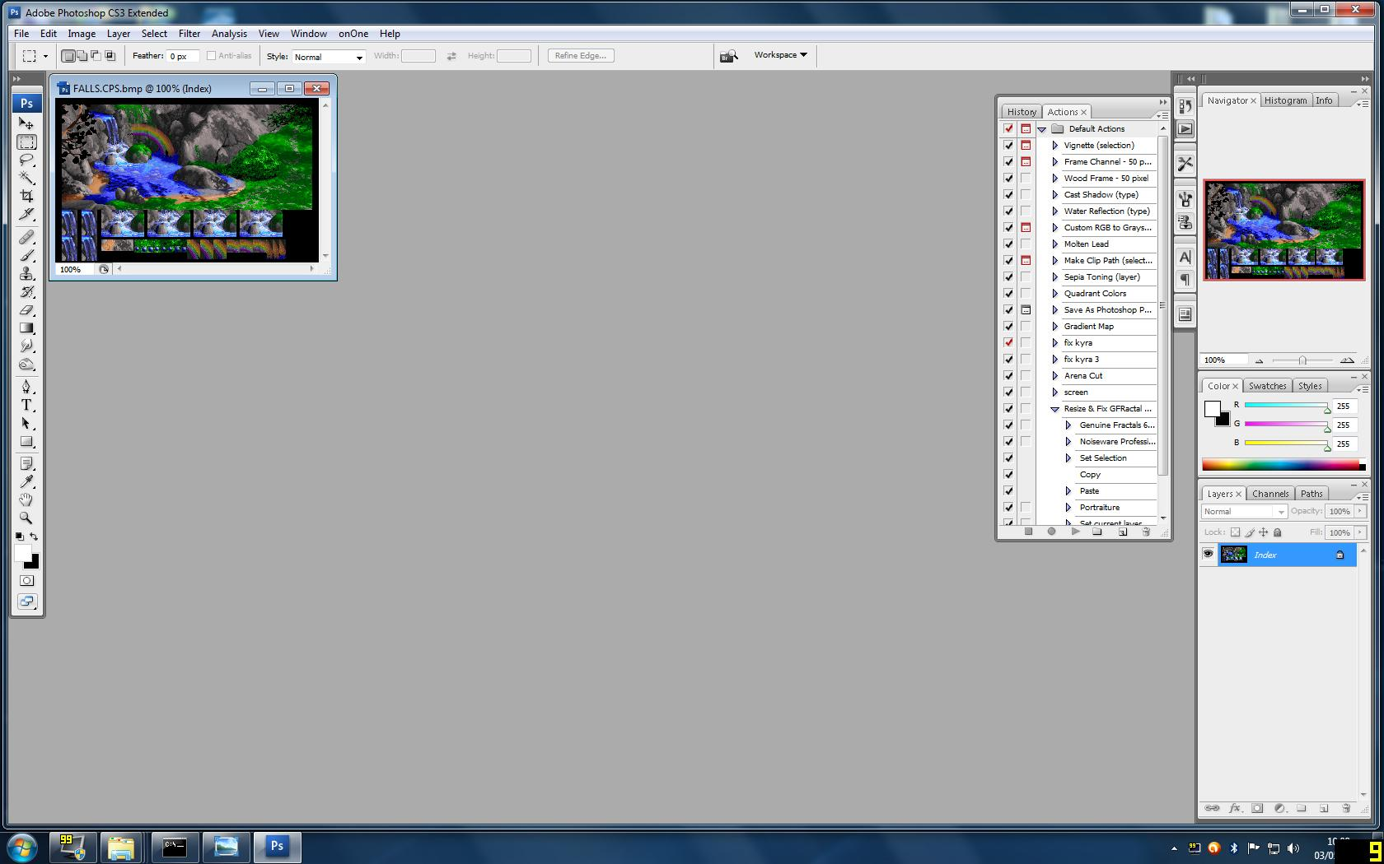
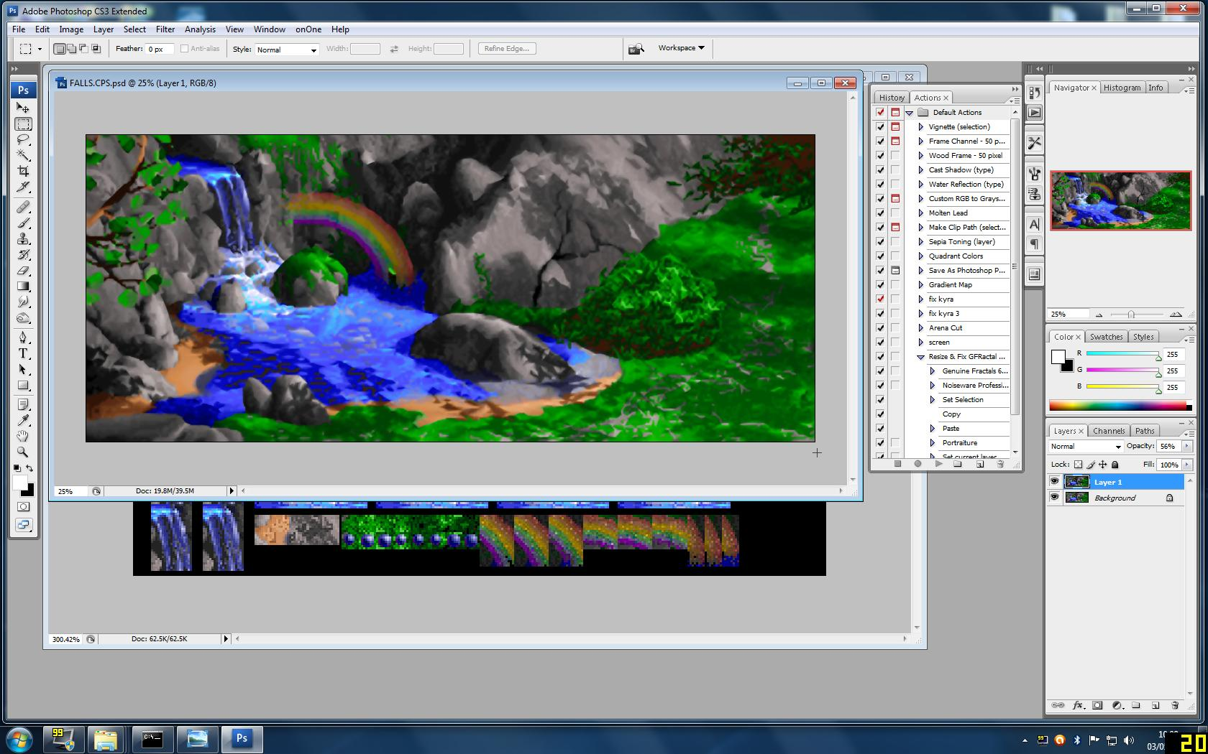

Slide 22
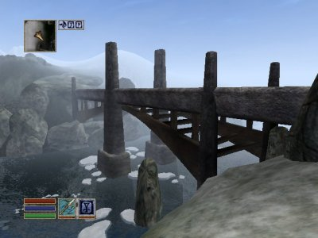
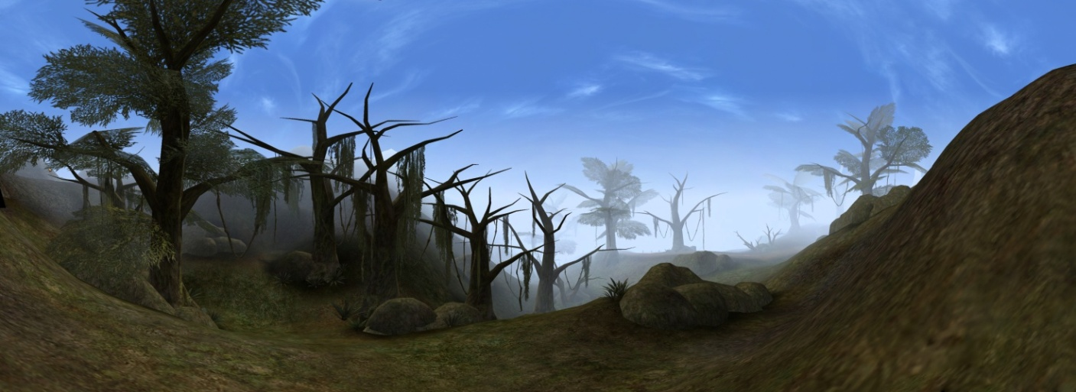
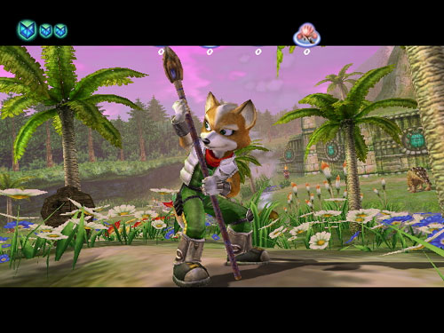
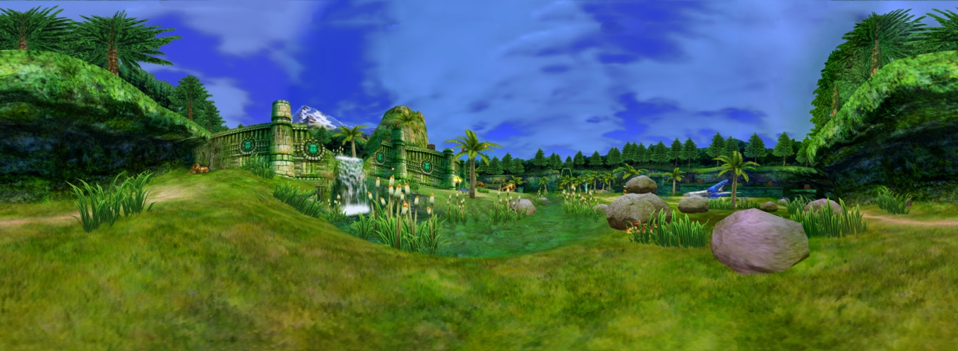
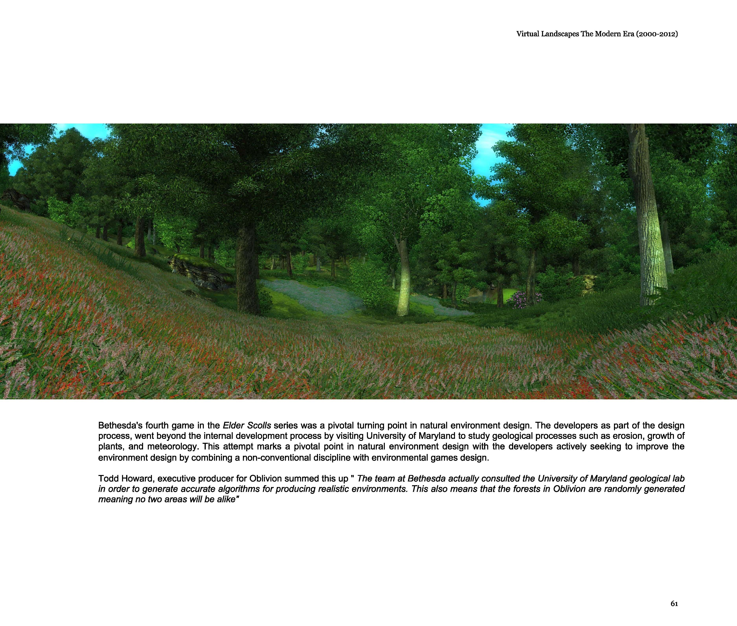
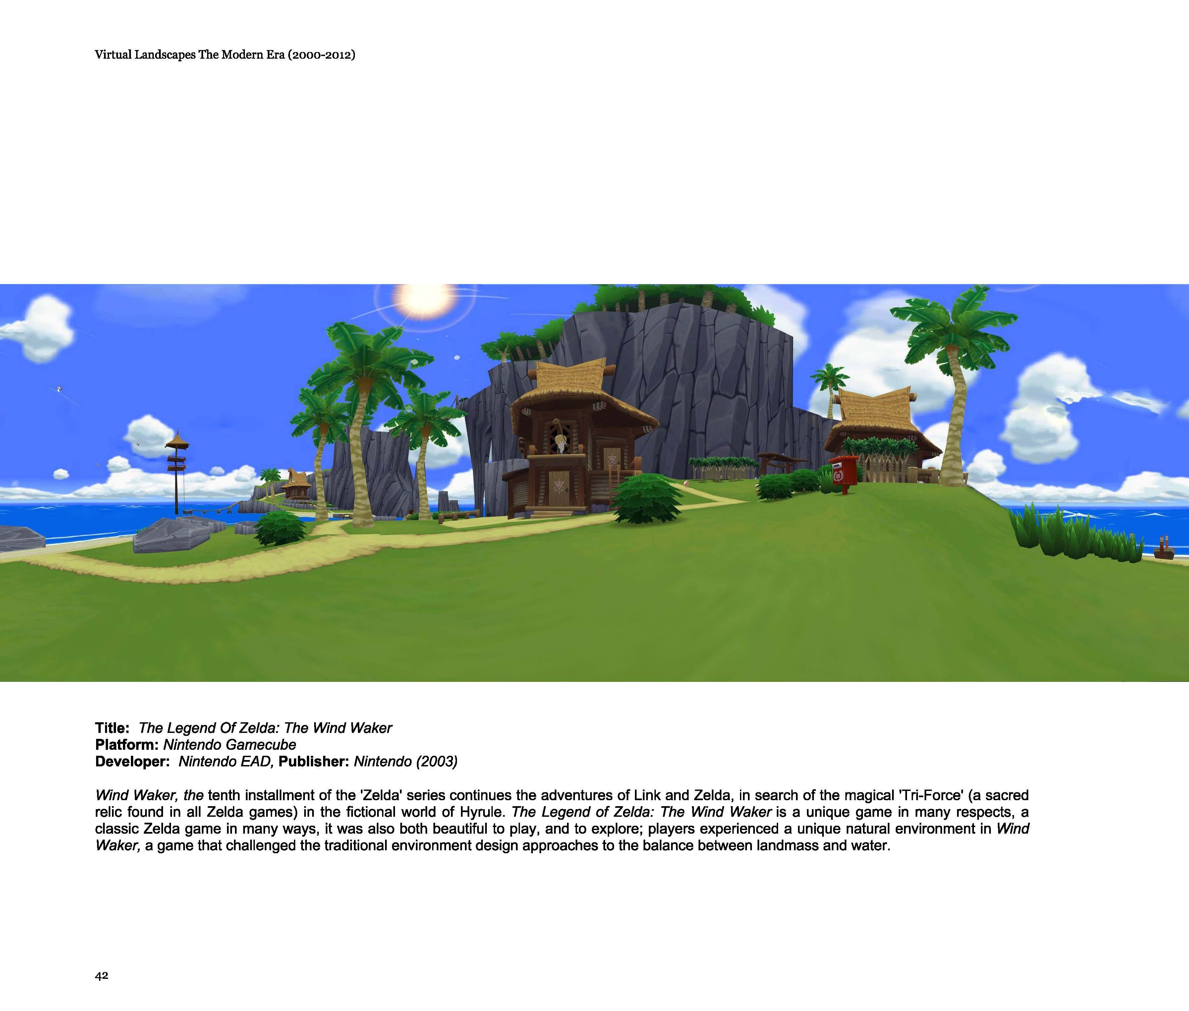
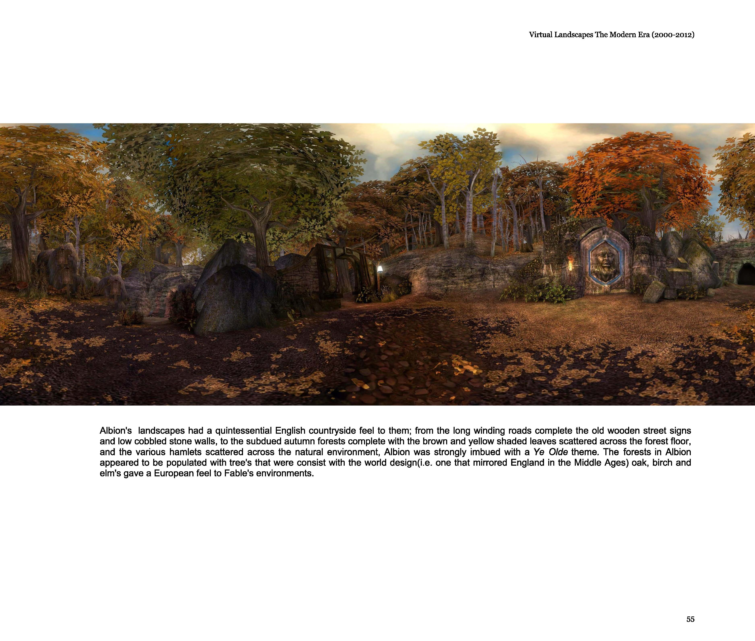

Slide 24
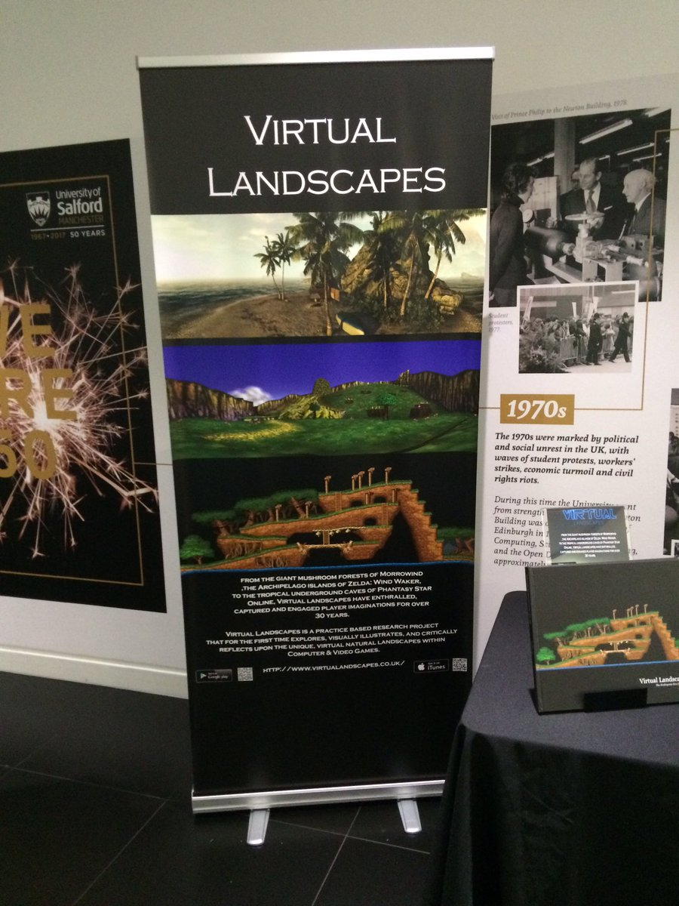

Slide 25
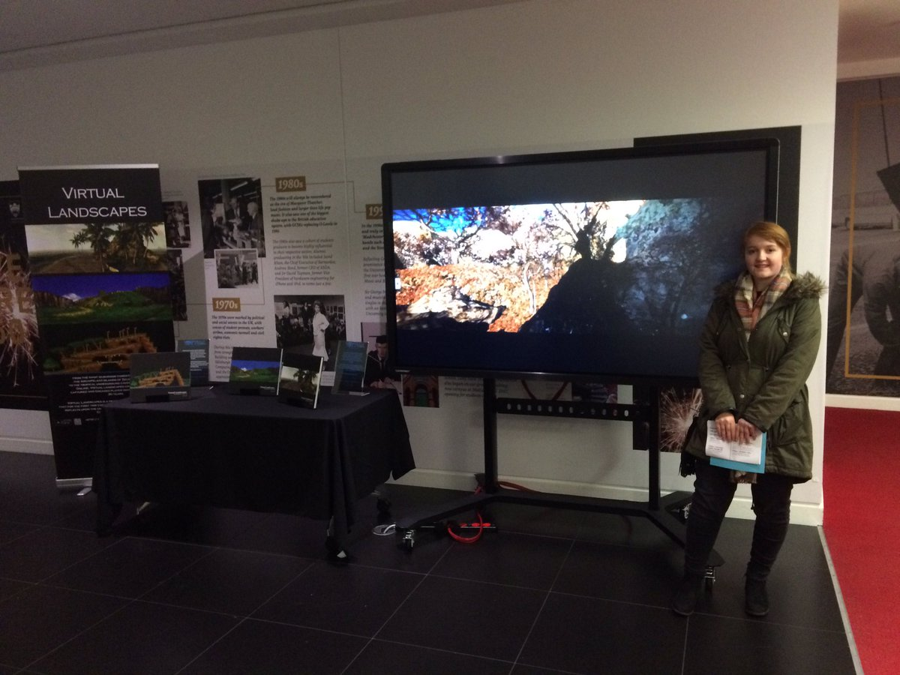

Slide 26
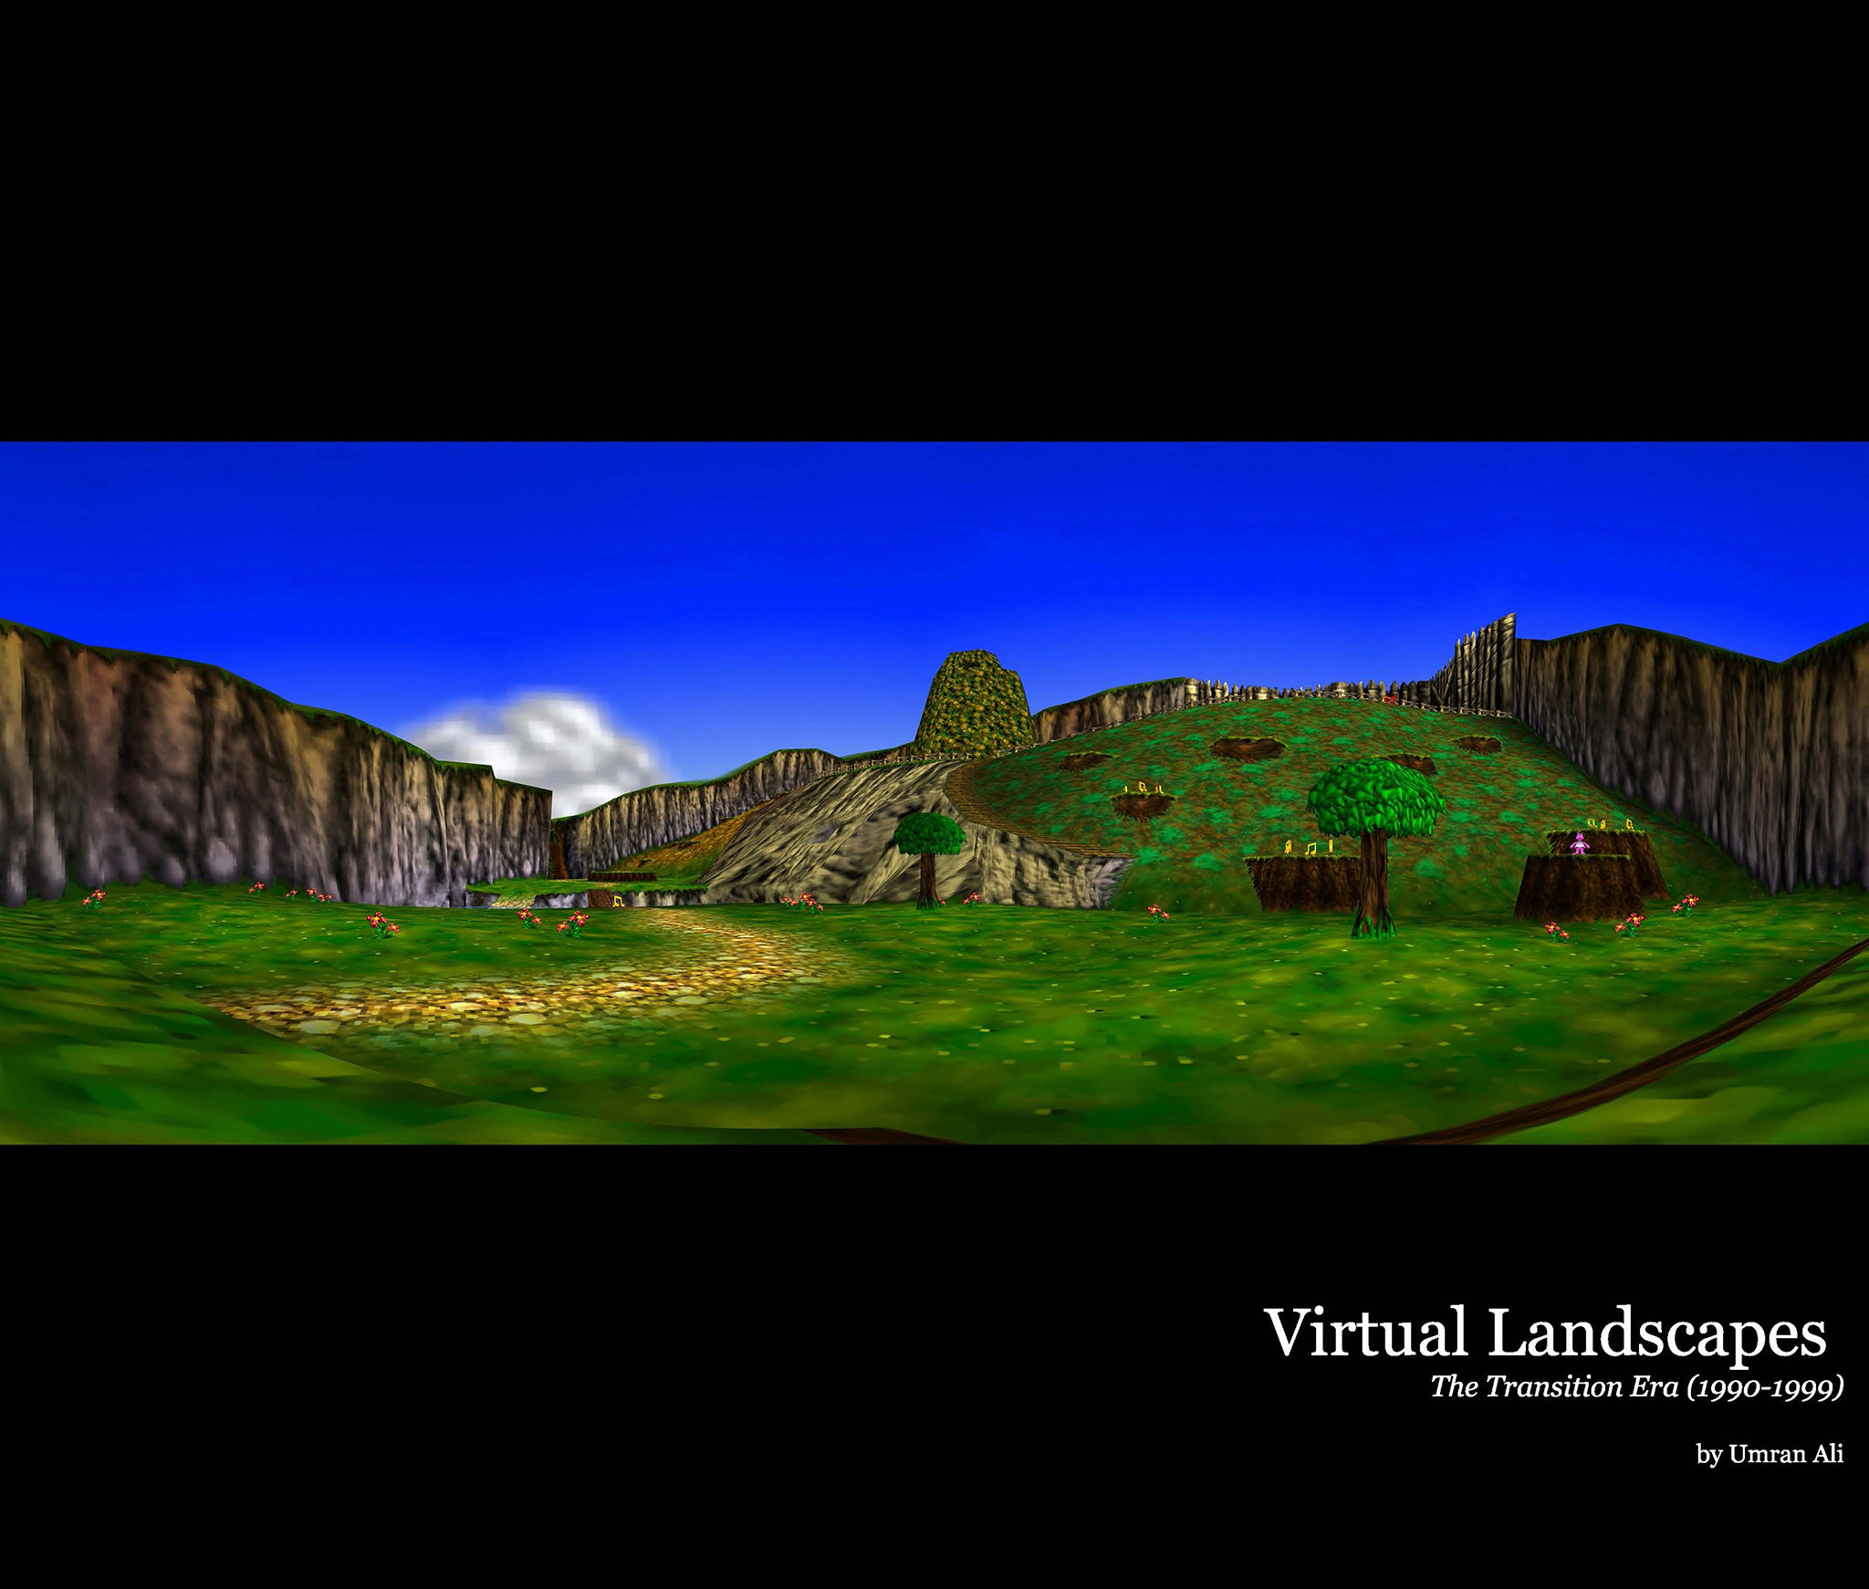
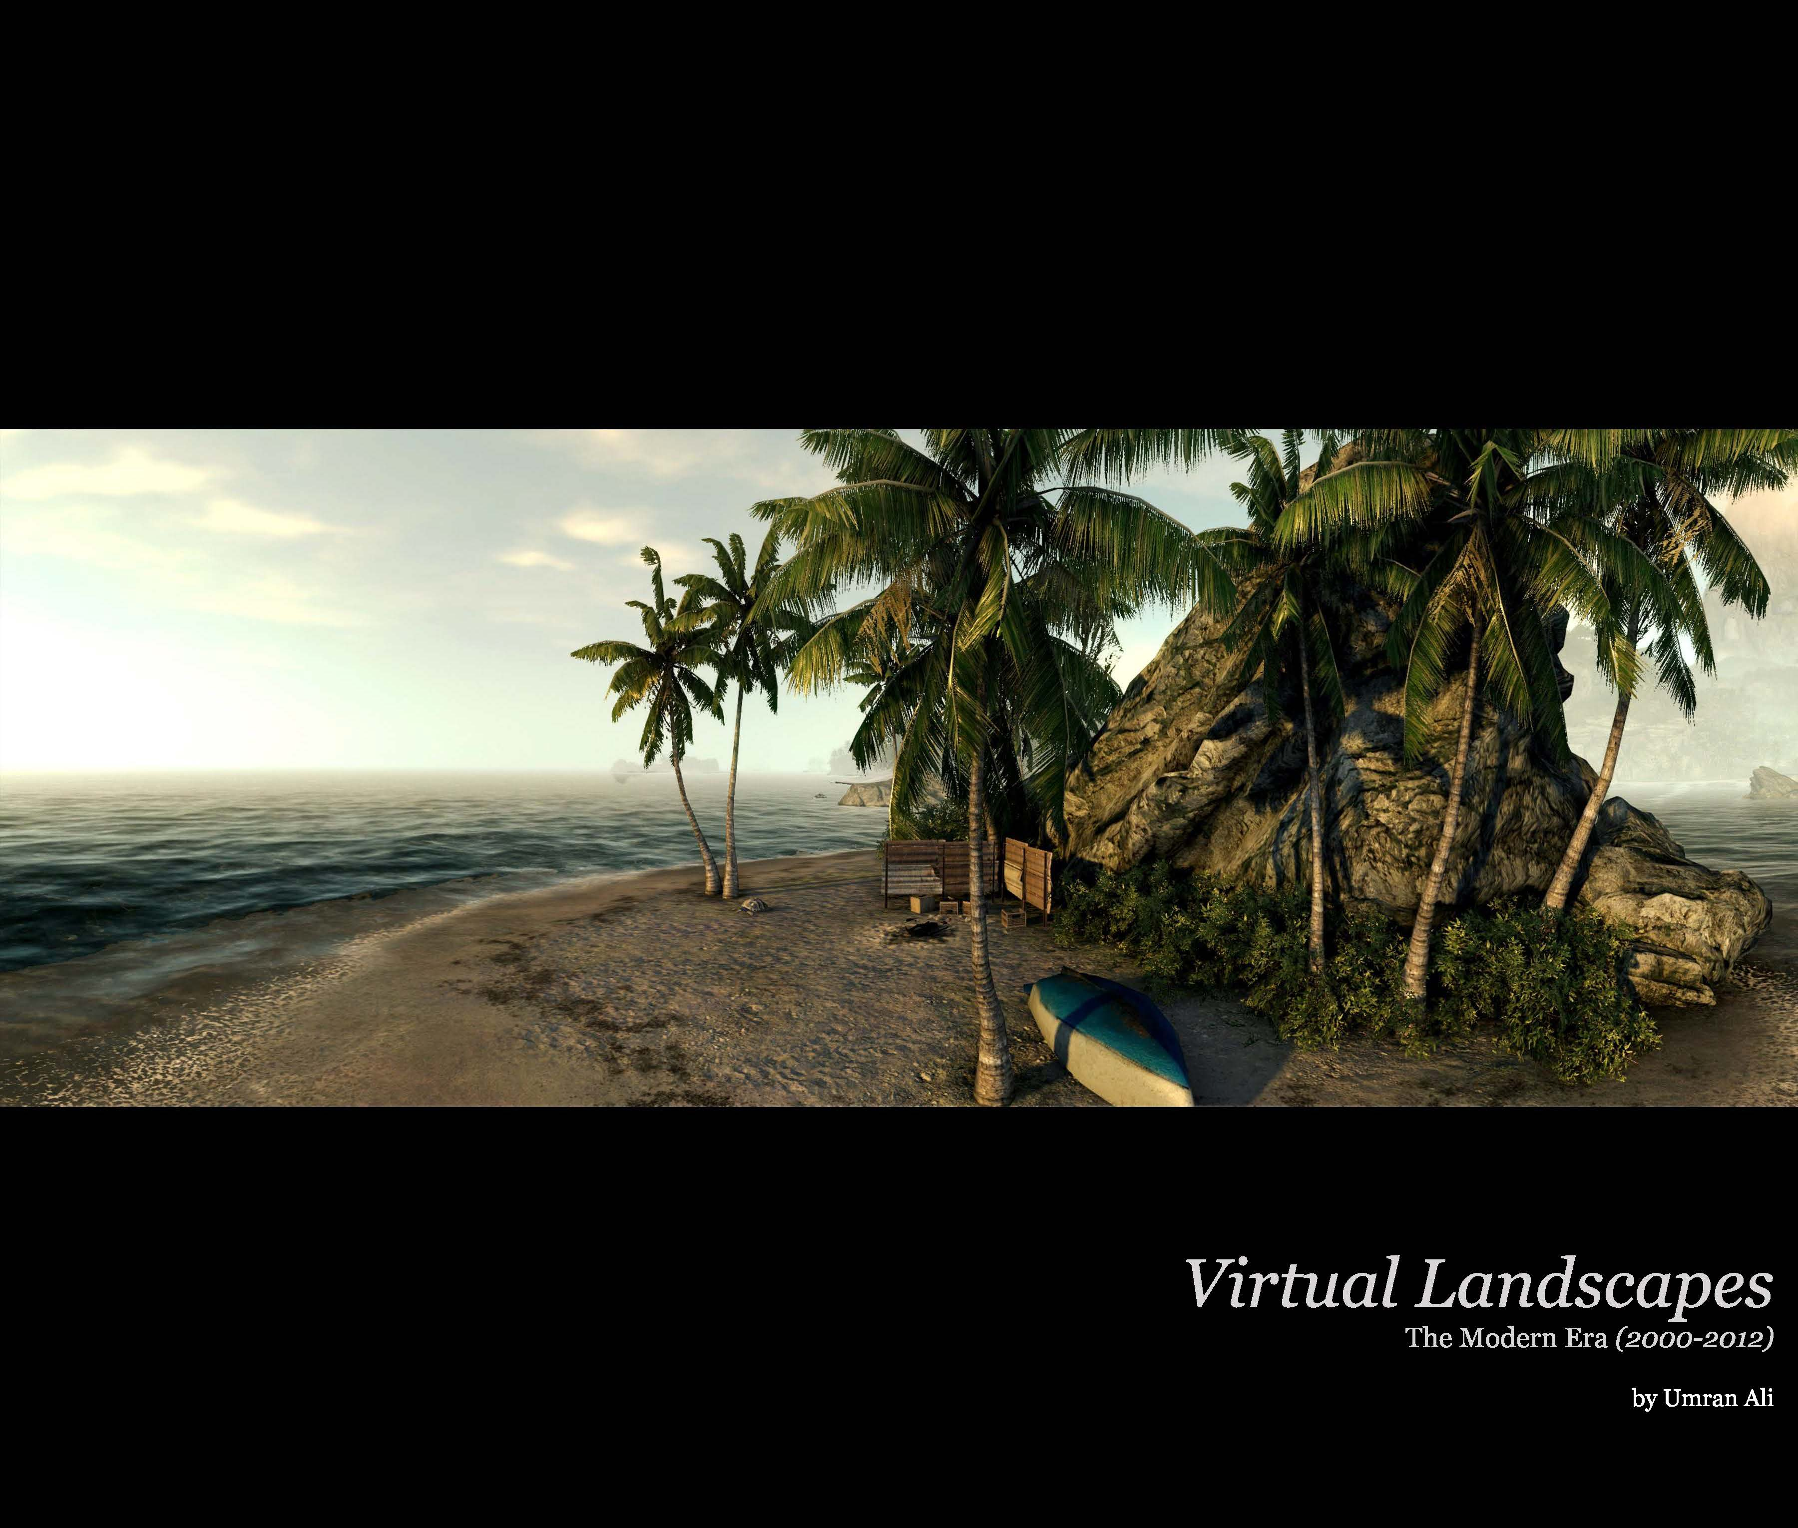
Virtual Landscapes
Reverse of Gamification (application of non game related disciplines (geology, psychology, landscape architecture) to games design(environment design)
3-4 years of work
~70 different Virtual Environments (CVG) covered over 30 years period
VNE Theoretical design framework
12 Different platforms
~350 Unique UltraHD Virtual Landscape Panoramas
~300 High Definition ‘extracted’ Virtual Landscapes
~150 Digitally Enhanced HD Virtual Landscapes
Exhibited on BBC Fusion & AniGame Fesitval(2012)
Spread over three volumes, available in print, digital(ebook, PDF & itunes & Google Play) and interactive formats.
…..My name is Mark Jackson and I am a Landscape Architect practicing in Adelaide, South Australia. I am currently writing an article on the crossover between digital and physical play, and your Virtual Landscapes series of books have been an invaluable read. What a colossal piece of work it must have been. I will no doubt make reference to it as a gauge of how much the industry has progressed in its portrayal of the landscape….

Slide 27
Virtual Landscapes
Moving beyond traditional book.
Primary purpose to be useful for students involved in Virtual Environment Design as a useful design tool for Artists & Designers
Re visualising the series as a interactive visual database
Needs to be Real-time tool
Provide access to massive datasets(15GB+)
Support variety of custom metadata
Allow for personal fully customisable selection of specific data
Online/offline

Slide 28
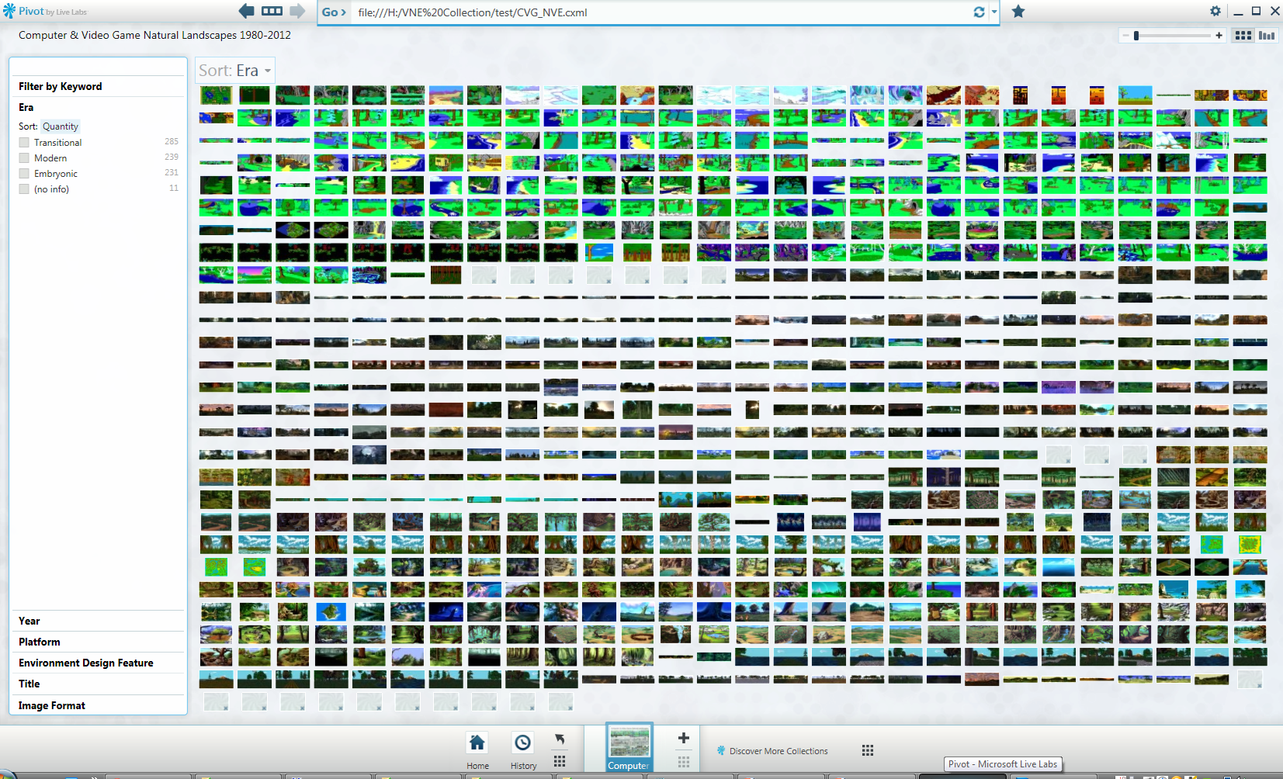
Advanced Workflows & Pipelines: Tools for Artists & Designers-Pivot Research Database
Virtual Landscapes
Moving beyond traditional book.
Primary purpose to be useful for students involved in Virtual Environment Design as a useful design tool for Artists & Designers
Re visualsing Series as a interactive visual database
Needs to be Real-time tool
Provide access to massive datasets(15GB+)
Support variety of custom metadata
Allow for personal fully customisable selection of specific data
Online/offline
Virtual Landscapes PivotViewer-15GB Visual Data available in real-time… A practical learning tool

Slide 29
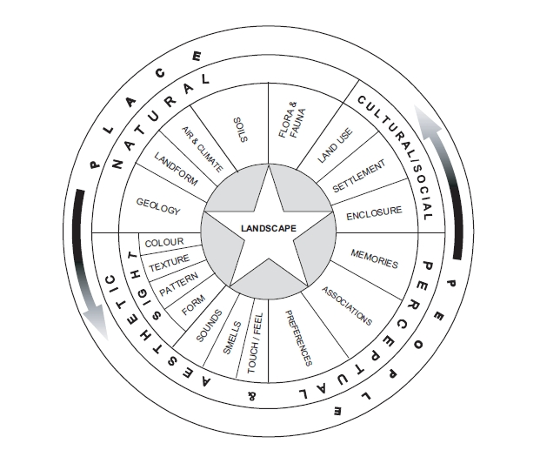
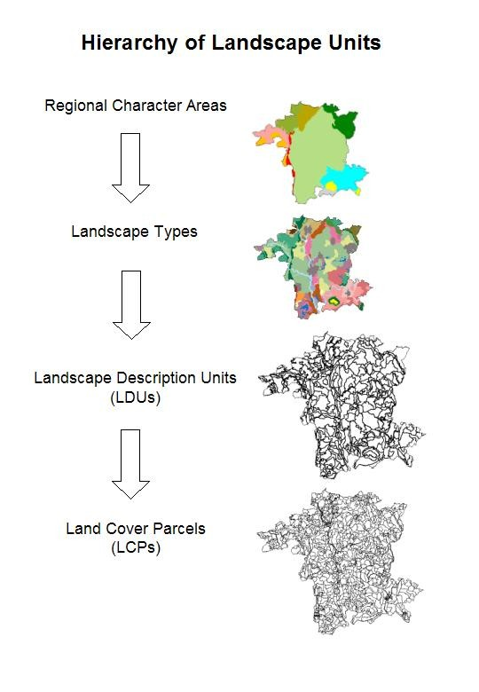

Slide 30
Virtual Landscapes Outcomes
Virtual Landscapes(Visual Case study) Led to initial VNED template,
Used to establish current practice & prove gap in knowledgebase, revealed that and interdicsplinary approach (Geology) could be used in games design(Oblivion ,2009)
Used to group important elements of virtual landscape design
Discovered LCA , reversed could form Game Version.
Natural Environment
LCA Process
LCA's
(LCAreas)
(LC Types)
LCA's
(LCAreas)
(LC Types)
Virtual Environment (Landscape )Design Process
Virtual
Natural Environment

Slide 31
ShadowMoss Island

Slide 32
ShadowMoss Island
The rationale for the project arose from the interim findings and outputs from a previous practice research (Virtual Landscapes).
ShadowMoss Island is an exploration of the meaning of landscape beyond games design, using an interdisciplinary approach to further develop the theoretical framework for Virtual Natural Environment (VNE) design developed during the Virtual Landscapes study, testing the framework through practice, after which an evaluation and refinement was made to the initial VNE framework.
This new framework was driven by John Ruskin's 'Go to Nature' dictum and by Edward Relph’s notion of 'placeness’

Slide 33
ShadowMoss Island
ShadowMoss Island is a practice-based exploration of the romanticised virtual environment, and would the VNE design process incorporate elements from environmental psychology, and landscape architecture but also help create more emotionally evocative and meaningful spaces through traditions such as romanticism
The project was developed through a combination of observational analysis and qualitative reflection based on a field trip to Moel Siabod in Wales, and digital games design. Finally, an experimental prototype game was created in a contemporary game engine (CryEngine)

Slide 34
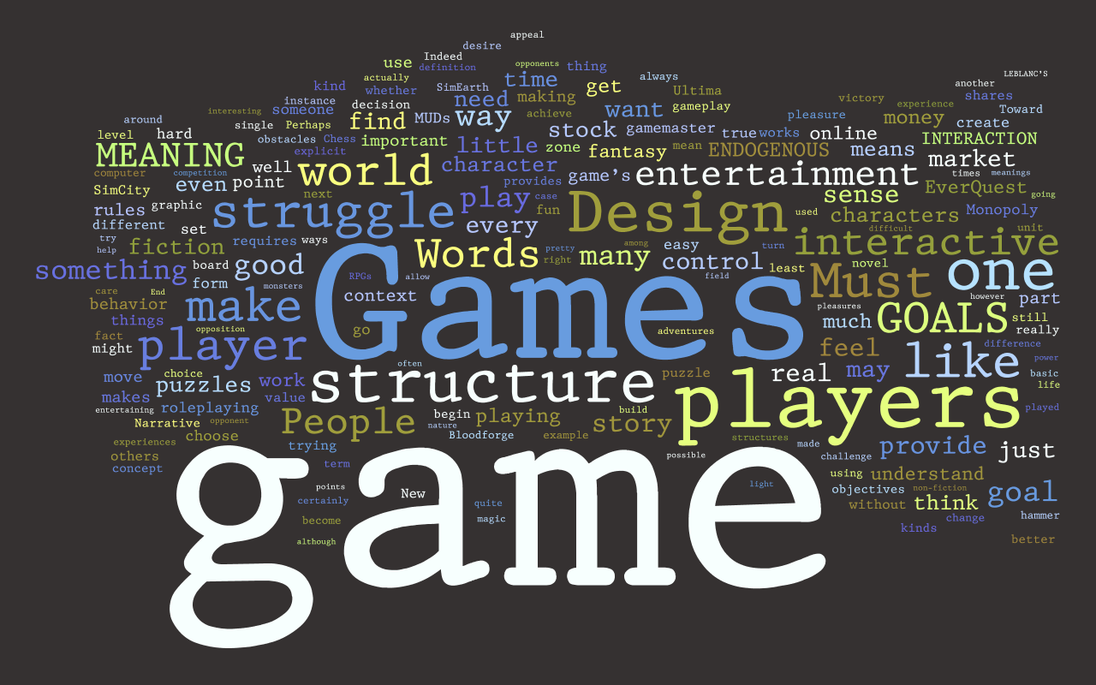
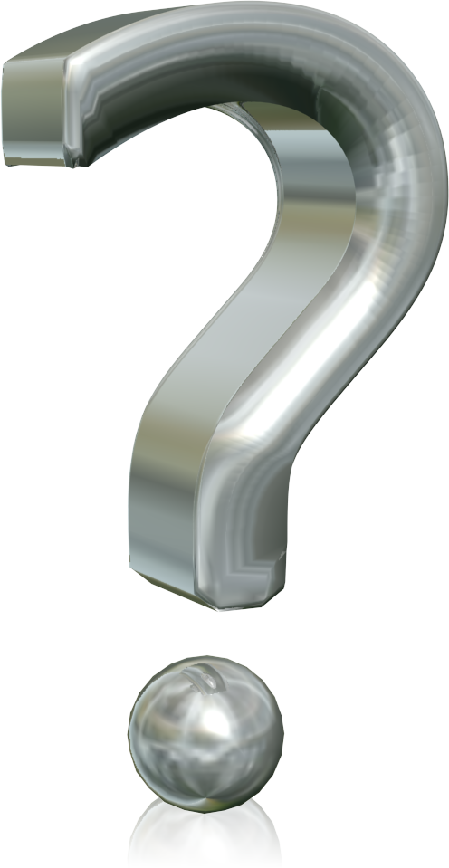
Grounded by Ruskin’s manifesto of ‘Go to Nature’ and by Relph’s ideas on ‘Placelessness’, how could I create a virtual space informed by these beliefs and create spaces that embodied ‘placeness’/meaning
Physical Field Trip
VL Key highlights as an initial framework
VNED Template to start and organise the Design process.
CryEngine 3 as the tool

Slide 35
New Framework=New knowledge?
Developing NED in games to a discipline not previously linked , through research, Landscape Character Assessments in geology was identified as a viable framework
LCA’s used to quantify the elements of landscapes in real environments
Why not use this framework reversed to essentially create natural landscapes in video games?

Slide 36
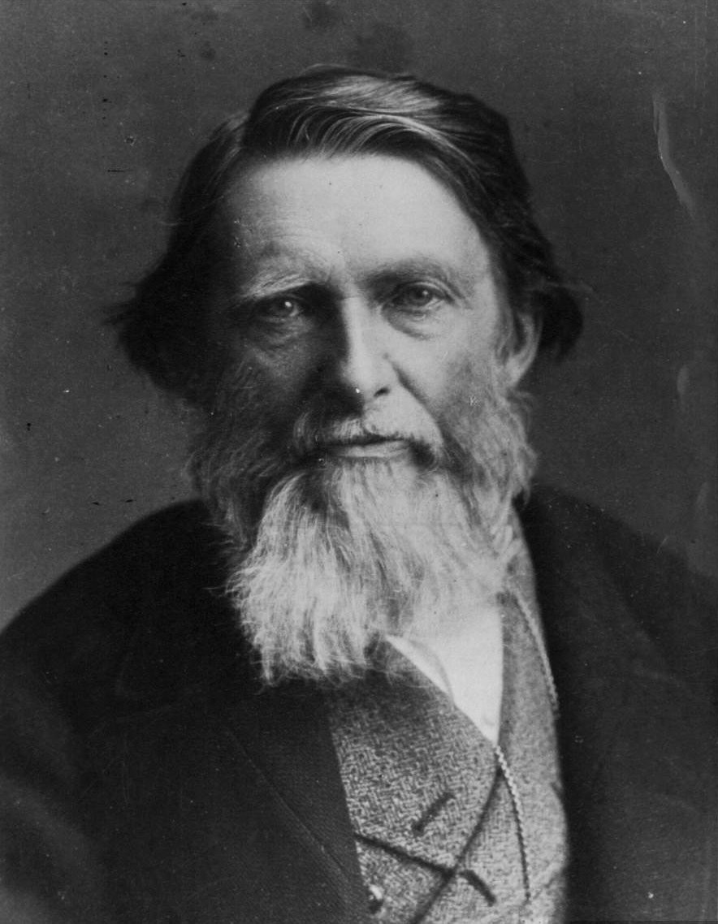
…go to Nature in all singleness of heart... rejecting nothing, selecting nothing and scorning nothing
John Ruskin (1819 –1900)

Slide 37
Gneiss Rock, Glenfinlas 1853 John Ruskin Ashmolean Museum, Oxford

Slide 38
… 'Placelessness' equals an inability of a setting to encourage the formation of vivid images.
Edward Relph

Slide 39
ShadowMoss Island

Slide 48
…go to Nature in all singleness of heart... rejecting nothing, selecting nothing and scorning nothing
John Ruskin (1819 –1900)
…I went back to nature…
(…it was bloody hard!!)
Umran Ali, 2011
Plas-y-Brenin

Slide 51
Starting points and motivations
Get out and ‘feel’ the landscape
The nature of the exchange/collaboration
Expert advice, comments and guidance
How communication developed
Emails, 2 day ‘residence’, various documentations inc recordings, notes etc…
Challenges and how these were overcome
Physical challenge! (get fit!)
Practical work carried out or planned
Two day residence (Wales)
ShadowMoss Game
Documentation/Framework
Game Trailer
How this exchange could be developed in the future

Slide 53
Advanced Workflows & Pipelines: Tools for Artists & Designers-MindFlow™

Slide 54
Advanced Workflows & Pipelines: Tools for Artists & Designers-MindFlow™

Slide 56
R&R Phase :250-500k Images
Video/Annotations, Audio
Current practice: Database(text) folder hierachy

Slide 57
MindFlow™

Slide 58
MindFlow™

Slide 59
MindFlow™
https://dl.dropboxusercontent.com/u/75369284/shadowmoss/Test.html

Slide 60
Advanced Workflows & Pipelines: Tools for Artists & Designers-MindFlow™

Slide 61
Advanced Workflows & Pipelines: Tools for Artists & Designers-MindFlow™
https://dl.dropboxusercontent.com/u/75369284/shadowmoss/Test.html
Rapid R&D Tool for contextual research
Based on Microsoft's Deepzoom technology
Enables both rapid creation of conextual research/data ‘boards’ that can be viewed online
Potential to develop with Microsoft Research (integrated with Microsoft R&D’s ‘MoodBoard’) as a funded collaboration.
Already been integrated with formal teaching/assessment on CVG programme.
Paper/prototype(2015)

Slide 63
The Future?
Convergence:
Tools; Landscape Architecture & Games Design will increasingly share a common tool framework
Terminology: Landscape Architecture & Games Design will begin to share, and develop a common grammar; room for new neologisms and ideas….
Employment: World architects/game designers and landscape architects will increasingly work in each others fields, both as consultants and core staff; there will be a need for high level expertise given the importance and growing impact of the subject fields.
Gameplace: As games evolve and develop, designers will increasingly focus on the notion of creating gameplace; a focus on creating unique evocative virtual places rather than space, L.A’s are primed to be leading on this idea.
Immersion & Interactivity: AR/VR in particular will allow a greater sense of ‘placeness’ in virtual environments; video games will be at the forefront of this newly re-emerging field.

Slide 64
http://goo.gl/M9S25

Slide 65
READ MORE ABOUT IT!
http://emergentlandscapes.wordpress.com/
https://twitter.com/Dr_UmranAli
http://umran.minus.com/

Slide 66
Bibliography
Aarseth, E.J. (2007). Allegories of space: The Question of Spatiality in Computer Games. In F. von Borries, S. P. Walz & M. Böttger (eds.) Space time play: computer games, architecture and urbanism: the next level (pp. 44-47) Berlin: Birkhauser Verlag AG
Appleton, J. (1975). The experience of landscape. Chichester: Wiley.
Brouchoud, J. (2013, February 09). The Importance of Architecture in Video Games and Virtual Worlds. ArchVirtual. Retrieved January 15, 2016, from http://archvirtual.com/2013/02/09/the-importance-of-architecture-in-video-games-and-virtual-worlds/
Malins, J. & Gray, C. (1995). Appropriate Research Methodologies for Artists, Designers and Craftpersons: Research as a Learning Process. Gray's School of Art, Centre for Research in Art & Design.
Nassauer, J.I. (1983). Framing the Landscape in Photographic Simulation. Journal of Environmental Management. 16(4) pp.1-16
Salen, K. & Zimmerman, E. (2004). Rules of play: Game design fundamentals. MIT press.
Smith, H. & Dean, R. T. (2009). Practice-led research, research-led practice in the creative arts. Edinburgh University Press.
Jenkins, H. & Squire, K.D. (2002). The Art of Contested Spaces. In L. King (Ed.) Game On!. (pp.64-75). London: Barbican Press

Slide 67
List of Figures
Comparison of Progression of Openworld games (Source Hexapolis.com 2014)
Dear Esther Panoroma, Ali, U 2012 Virtual Landscapes
Edward Relph available at: https://www.nhltv.net/playlist/unsw-built-environment/PLvW1evjftfvntp6R2ItJ6TuEBFYcpKFsy
Fable 3 Panorama, Ali, U 2012 Virtual Landscapes
Ghouls & Ghosts Ali, U 2012 Virtual Landscapes
Kult: Heretic Kingdoms; Screenshots available at https://store.steampowered.com/app/277650/Kult_Heretic_Kingdoms/
Lone Cypress Tree Photograph, Ali, U 2016
Ruskin inspires Salford academic to improve virtual landscapes Article Image (The Times Education Higher, United Kingdom, January 2016). www.timeshighereducation.com/news/ruskin-inspires-academic-improve-virtual-landscapes
Scencism Framework, Ali U 2016
ShadowMoss Island, Ali U 2016
Skyrim Panorama, Ali, U 2012 Virtual Landscapes
Skyrim Panorama, Ali, U 2012 Virtual Landscapes
StarFox Adventures: Before & After Comparison
Study of Gneiss Rock available at: http://ruskin.ashmolean.org/collection/9006/9037/9358/all/per_page/25/offset/0/sort_by/seqn./object/14350
The Elder Scrolls 3: Morrowind – Before & After Comparison Ali U 2016
The landscape wheel from ‘Landscape Character Assessment (adapted from Tudor, 2014)

