Slide 1
Virtual Landscapes: A Practice-Based Exploration of Natural Environment Design
Dr Umran Ali
University of Salford
School of Arts & Media
0161 295 6094
u.ali@salford.ac.uk

Slide 2
About Me
Senior Lecturer at University of Salford
Past:
Programme leader for BSc Computer & Video Games
Director of Creative Media.

Slide 3
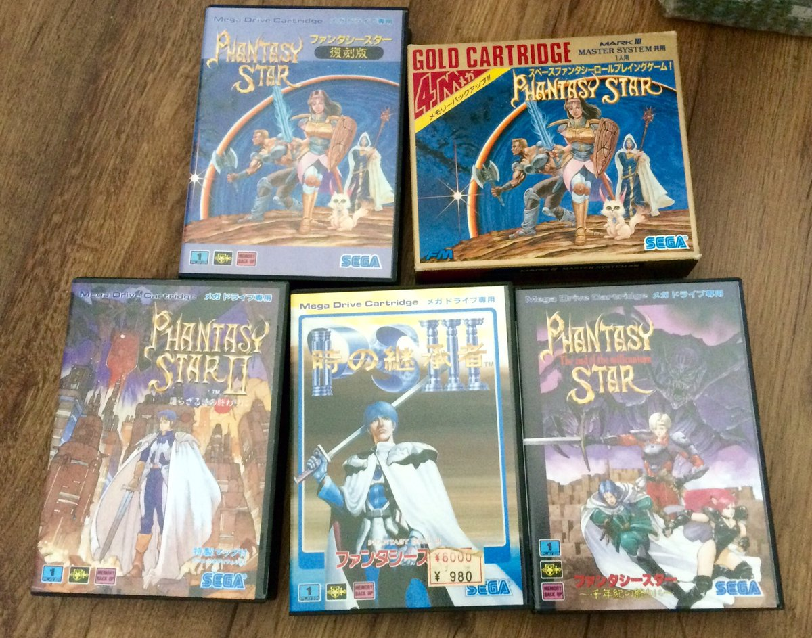
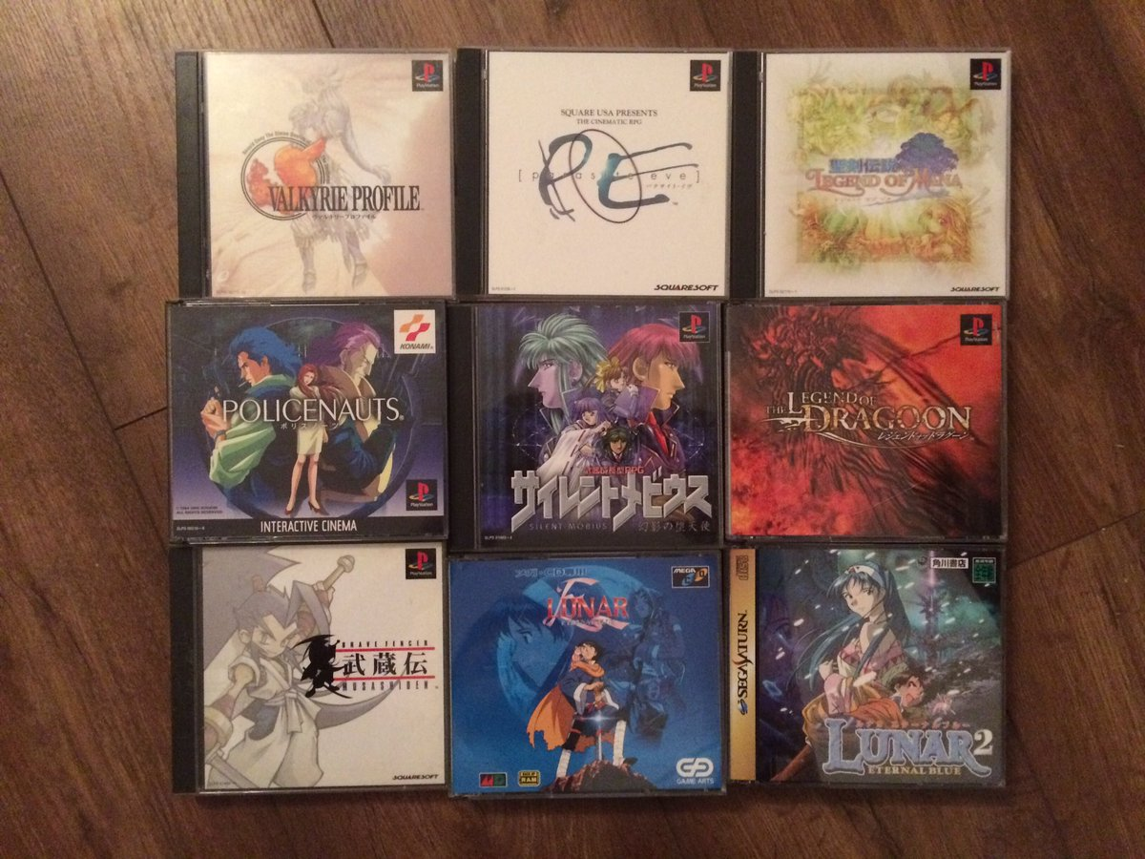
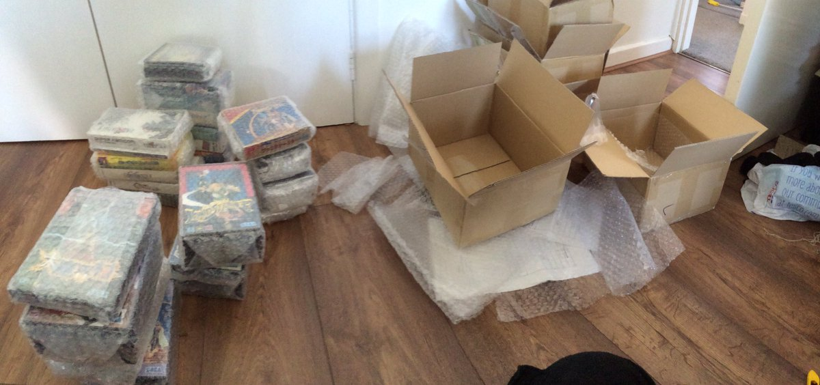
Overview
Notes:
Hardcore Gamer: 35 years...
eSports (Sci-Fi Gamer Finals 2003)
I collect games! (Games Collection featured on BBC News short (2004)

Slide 4
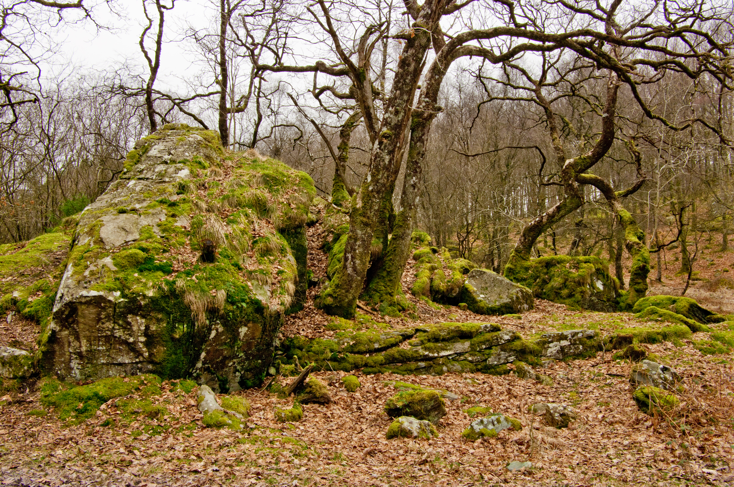
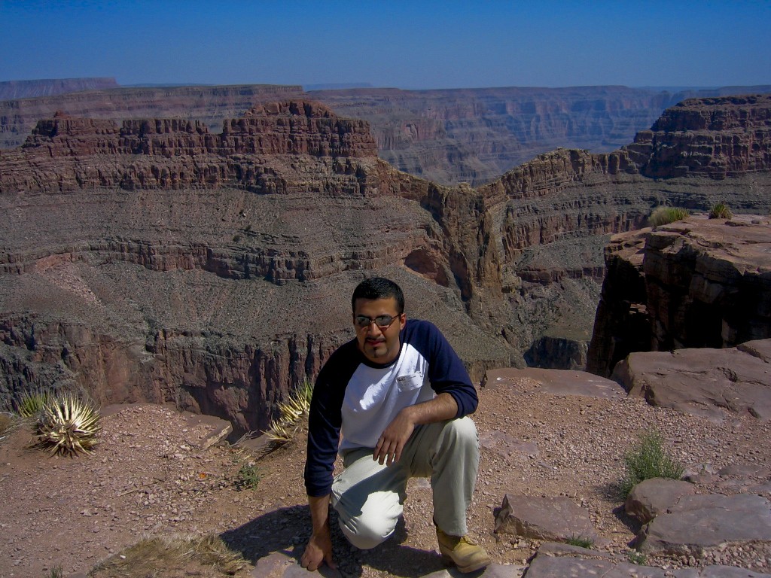
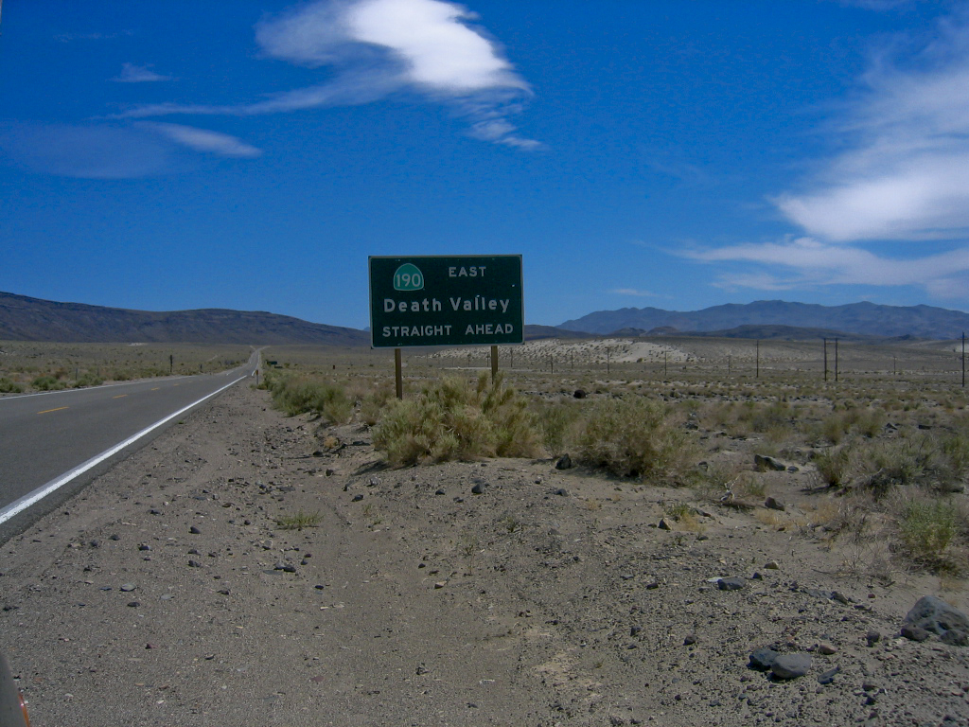
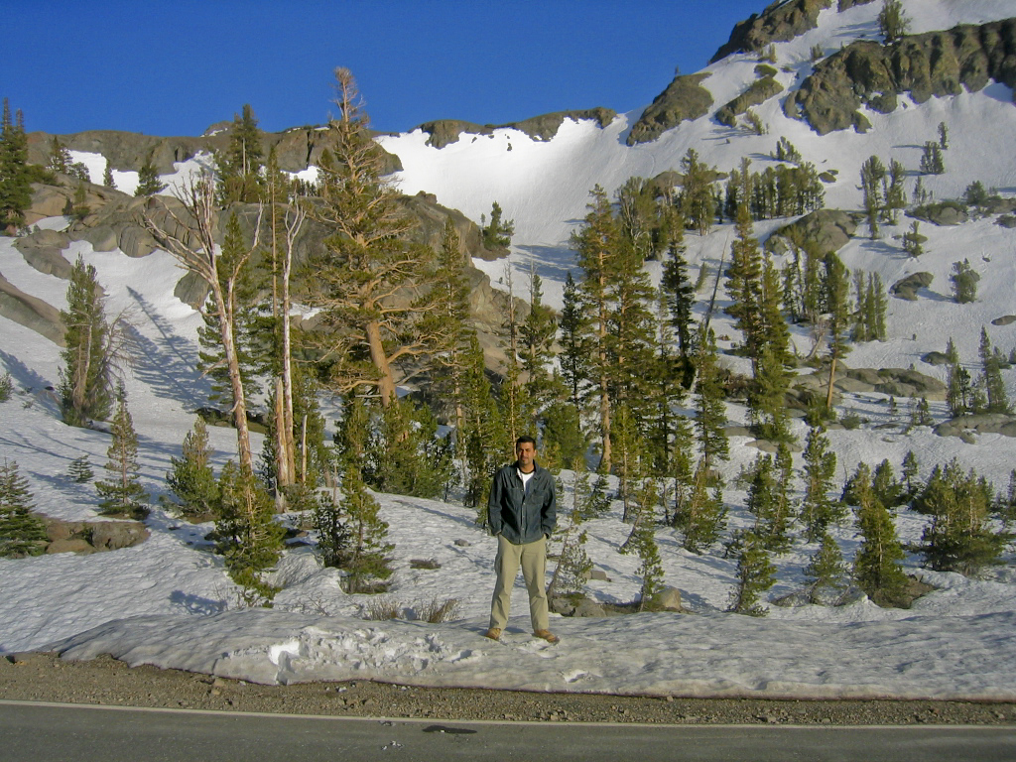
Overview
Notes:
My second passion is the natural environment, I’ve been a keen walker and climber for a number of years and I’ve been fortunate to have travelled across so many landscapes across the world , ranging from the snowy peaks of Yosemite park, the arid desserts of death valley to the wonderful rich mountains and valleys from across the UK.

Slide 5
Introduction
This study is a practice-based investigation that proposes an interdisciplinary approach towards natural environment design in computer and video games.
In this study I argue the current virtual natural environment design practice within computer and video games is not sufficiently developed to meet current or future demands. This was demonstrated by identifying areas of strong/weak practice with an aim to develop a new design framework that utilises a cross-disciplinary approach for practitioners, students and researchers.
The research proposes theoretical frameworks as well practical guidance within a new design framework for virtual natural environment design.

Slide 6
Motivation
Virtual Natural Environment Design
Pedagogic
Experience
13yrs teaching CVG D&P
Personal Interest
Professional Practice (Commissioned A&D projects)
Notes:
Pedagogic Experience: I am an active Higher Education academic who has developed, written and taught on a range of programmes in the areas of creative and digital media, with a specific interest in computer and video games theory and practice. For over a decade I have taught on a games degree, and taught games design and production
Personal Interest: The natural world, in particularly scenic landscapes, has captivated and held my attention for many years and as a result I have been an active and keen walker, as well as developing an interest in nature landscape photography. I am also a keen and passionate video game player,
Professional practice: my practise as a designer and artist over the last decade has involved undertaking a range of technical and creative problems at the forefront of artistic and commercial practice. Many of these challenges are only ever partially solved or left fully unexplored due to project limitations such as resource constraints. For a practitioner, these „unsolved‟ challenges can be frustrating, and after a number of projects a number of residual tasks, both creative and technical remained,

Slide 7
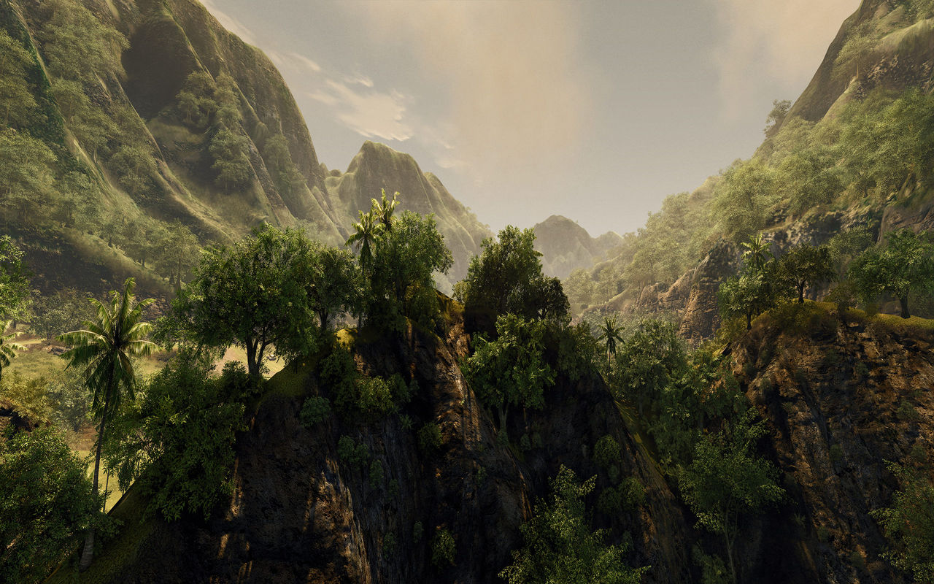
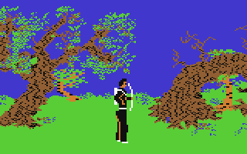
Notes:
Over the last few decades, Video games have gone from a niche pastime to one of the most popular entertainment industries surpassing TV, film and the music industries. From a bedroom industry to a multibillion pound industry , contemporary video games development can involve hundreds of specialists working across several years on budgets in excess of £4-500 million, with games such as GTA 5 generating billions of pounds of revenue as a single title, illustrating the popularity of the medium.
From a technological perspective, we’ve gone from blocky monocolour 2D landscapes, to fully realised 3D worlds complete with weather systems and complex immersive and interactive elements.

Slide 8
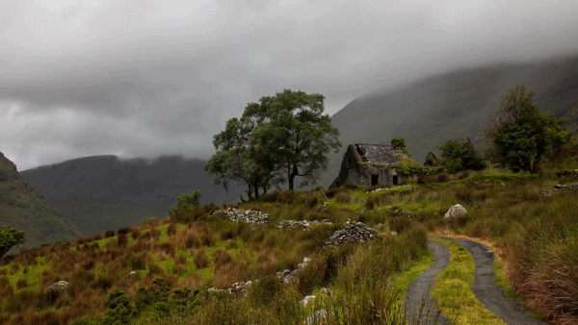
Theoretical Perspectives: Games Design as Spatial Art
Salen & Zimmerman (2004): Games design not ‘crystalized’ into a stable field of inquiry
Aarseth’s (2007): Spatiality as the raison d’être’ of games
Jenkins & Squire’s (2002) : Games as ‘spatial art’
Source: https://i.pinimg.com/originals/03/bb/fb/03bbfb95d3410a404583edfdc5415ace.gif
Notes:
The process of designing games, i.e games design is a rapidly evolving discipline yet despite the technological revolution, the field is still in the ‘feuding tribal’ era with pockets of competing theories and according to Salen & Zimmerman still has not ‘crystalized’ into a stable field of inquiry
The study supports Aarseth’s (2007) assertion that spatiality is the defining element in computer games as virtual environments are capable of being the raison d’être’ of a game; i.e. they can be enjoyed either in their own right.
The study adopts Jenkins & Squire’s (2002) position of viewing digital games as ‘spatial art’ and as such, they postulated games design should be grounded in landscape art, architecture, gardening and park design

Slide 9
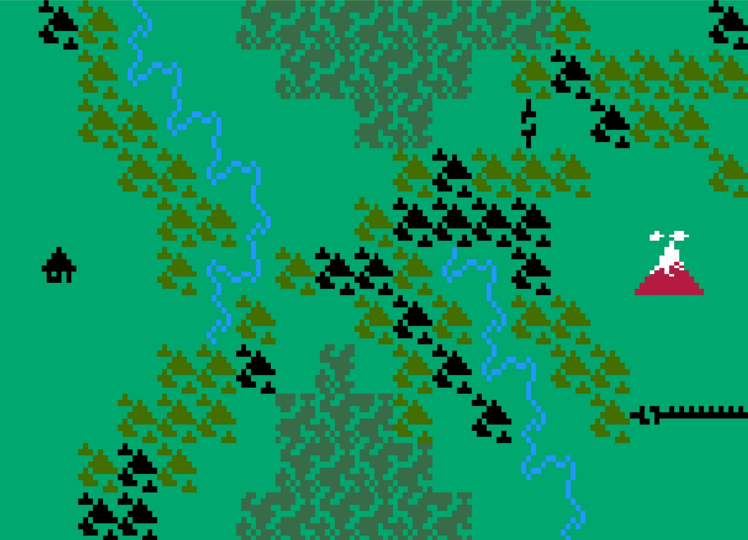
Notes:
Games, in particular gamespaces (the spatial configuration of a game) has evolved significantly over the last 30 years from simple limited 2D fixed size space to massive 3D spaces to completely immersive virtual reality spaces (Wolf, 2002; Boron, 2007)
Digital Games have increasingly becoming openworld, massive and complex; this is set to change further with the advent of VR and AR technologies (Fox, 2010; England, 2015).
However according to Yang, A unified Monolithic level design process is unlikely to emerge however, Intersectional level design, one that utilises as many design traditions as possible depending on the context is more likely (Yang, 2005).
Interestingly over the last few years, traditional architectural design has been used to games in both theoretical games design (Totten, 2014) as well as and practical application (The Witness, 2016).

Slide 10
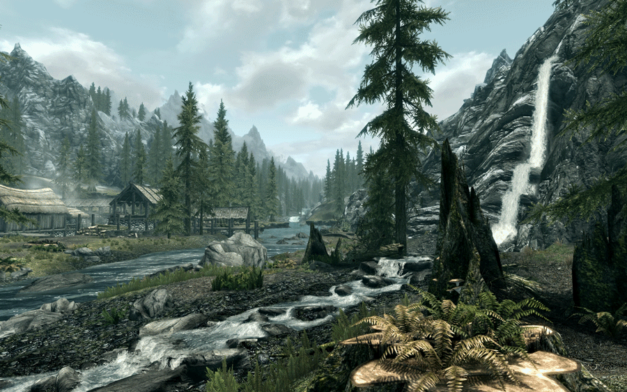
Theoretical Perspectives: Games as Spatial Art
“Games celebrate and explore spatial representation as a central motif .”(Aarseth, 2007)
“If games tell stories, they do so by organizing spatial features” (Jenkins & Squire’s , 2002)
“…as game designers dig deeper into these artistic traditions, they may develop more emotionally evocative and meaningful spaces”
(Jenkins & Squire, 2002)
Notes:
As Aeseth noted “The defining element in computer games is spatiality” (Aarseth, 2007, p.44)
“Games celebrate and explore spatial representation as a central motif .” (Aarseth, 2007, p.44)
Jenkins & Squire’s noted: “If games tell stories, they do so by organizing spatial features” Jenkins & Squire’s (2002)
They also considered the aesthetic influences in gamespaces ranging from expressionism to romanticism and postulate that “as game designers dig deeper into these artistic traditions, they may develop more emotionally evocative and meaningful spaces” (2002, p.7).

Slide 11
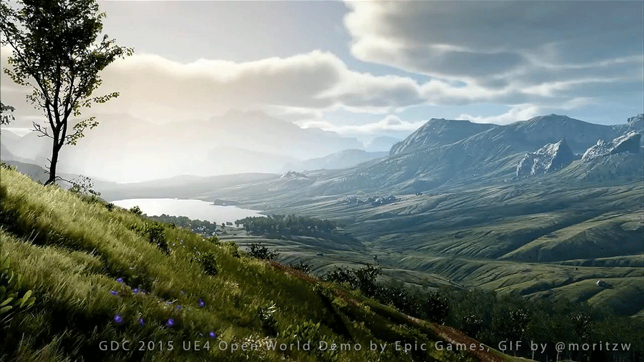
The Problem
Given the rapid and every increasingly complex nature of natural environment and landscapes in digital games, how will these spaces be designed and what if any is the dominant or emerging paradigms in the current design thinking, and what can and will inform the design and planning of these interactive and immersive future spaces?
Notes:
So the literature review and my professional practice had indicated the problem essentially was this: Given the rapid and every increasingly complex nature of natural environment and landscapes in digital games, how will these spaces be designed and what if any is the dominant or emerging paradigms in the current design thinking, and what can and will inform the design and planning of these interactive and immersive future spaces?

Slide 12
Research Questions
1. How have VNE’s/VML’s evolved in CVG over the last 30 years in both technological and design innovation and what has been (if any) the dominant design paradigm?
2. How have VNLs been perceived and experienced in games in CVG over the last 30 years
3. Can the intangible essence of landscapes be distilled into a structural production-based framework for virtual landscape design?
4. How can one employ a practical approach to natural environment design which goes beyond the dominant paradigm exemplified by narrative/visual driven design?
5. How can one create a framework for VNE designers that incorporates (external design and otherwise) traditions but remains connected to the reality of games production?
Notes:
This led to a series of questions I needed to explore: namely:

Slide 13
Methodology
Primarily practice-based research
Methodological ‘bricolage’, combining reflective practice, panoramic photography, virtual field trips and experimental design,
Practice based research (making games as part of the method)
Reflective Practioner (Schon)
Cycles of design, experimentation, reflection/analysis.
Notes:
Given the problem and what the literature review revealed it was time to plan an appropriate research strategy and select key methods, By applying a practice-based research methodology, and a methodological ‘bricolage’, combining reflective practice, panoramic photography, virtual field trips and experimental design, elements of digital game environment design practice were analysed with an aim to explore develop a new VNE design framework

Slide 14
Methodology
Insider Research
Smith & Dean (2009, p.23) state “…the advantages of the practitioner-researcher role are compelling: your ‗insider‘ knowledge, experience and status usually lends your research credibility and trustworthiness in the eyes of your peers, that is, you are not an external‘ researcher.”
Emergent Methodology
Bunnel (1998) defines this as "...possible strategies for problem solving emerge through immersion in the research problem and become more focused through action. Reflection in and on action and structured improvisation are valuable to the evolving research strategy".
Notes:
Two particular strategies emerged as critical:

Slide 15
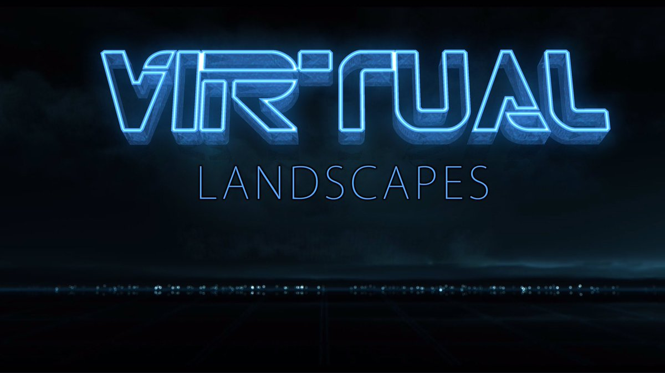
Notes:
This led to the first major part of the research, Virtual natural environments, in particular game landscapes were examined through a contextual review, a combination of previous professional practice in addition to a selection of digital games across a variety of platforms and genres over the last 30 years. The contextual review involved a detailed textual and visual-based historical survey of virtual landscapes, resulting in a practice-based exploration of virtual natural environment design.

Slide 16
Contextual Review
Gray & Malins (2004, p.49) “….to identify a gap‘ in existing knowledge, thus providing a rationale for the new research and a context for its original contribution to knowledge”
Visual Grounded Theory
Konecki (2011, p.133) “allow[s] researchers to incorporate visual data while designing their research projects within the framework of grounded theory” and therefore VGT which ―…relies on visual data for constructing categories, describing properties and generating/constructing theoretical hypotheses, which account for the visual phenomena…”
Notes:
This particular part of the study relied heavily on two key ideas/methods:
The first of which was a Contextual Review which Gray & Malins asserted was critical to help“…. identify a gap‘ in existing knowledge, thus providing a rationale for the new research and a context for its original contribution to knowledge”
The second of which was using Visual Grounded Theory Which Konecki argued “allow[s] researchers to incorporate visual data while designing their research projects within the framework of grounded theory” and therefore VGT which ―…relies on visual data for constructing categories, describing properties and generating/constructing theoretical hypotheses, which account for the visual phenomena…”

Slide 17
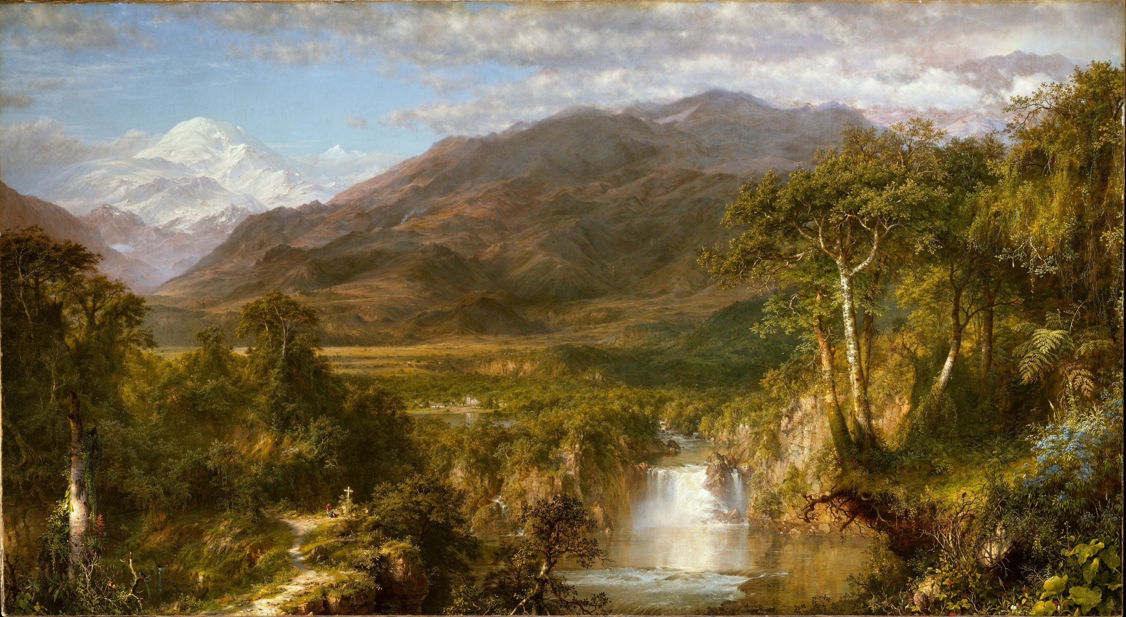
"Landscape is not synonymous with environment, it is the environment perceived, especially visually perceived”.
Appleton,
The Experience of Landscape, 1975
Notes:
So the next problem was identifying an appropriate entry point into these digital games from which to collect visual data and use as a basis for later analysis.
This is where Jay Appleton, the British landscape photographer, idea in his book The Experience of Landscape discussing the relationship between landscape and environment helped focus the research: simply put Landscape is not synonymous with environment, it is the environment perceived, especially visually perceived,
So focusing on virtual landscapes within the larger virtual environments would perhaps be manageable (given the scope of the study) and more effective at illustrating the dominant or emerging environment design paradigms, than simply trying to analyse entire virtual environments in digital games.

Slide 18
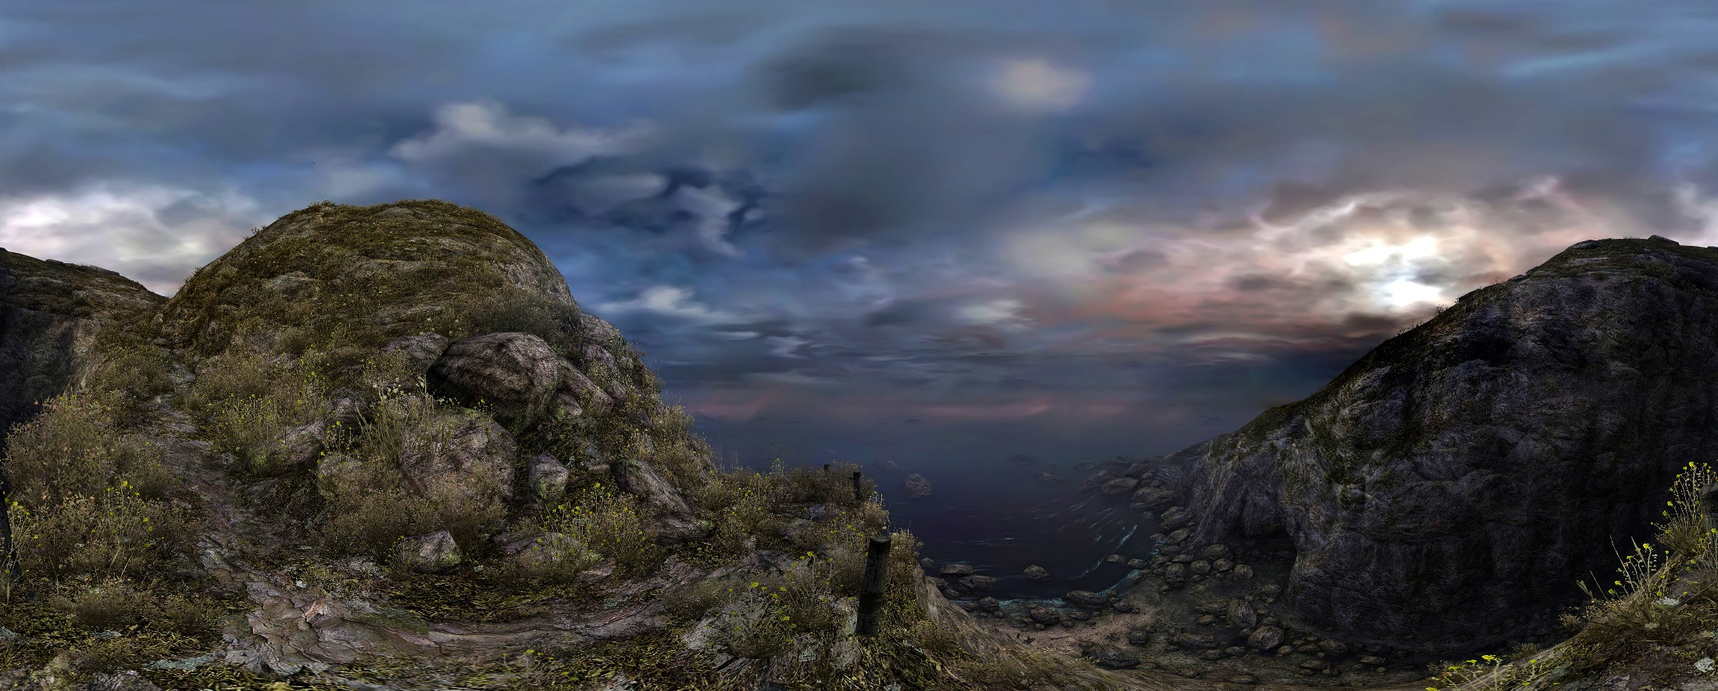
As Nausser (1993) argues the choice of framing can elicit different viewer responses: “Different photographic framing choices can elicit different viewer responses to a landscape. Framing formats that create large images with broad horizontal ranges may be superior for simulating field experience”
Notes:
The next problem was framing: how would I ‘frame ‘the digital natural landscapes. Well, partly inspired by the AA’s Landscape photographer of the year books, and Nausser who argued the choice of framing could elicit different viewer responses in that “Different photographic framing choices can elicit different viewer responses to a landscape. Framing formats that create large images with broad horizontal ranges may be superior for simulating field experience,
I chose to then adopt panoramic framing as a manner in which to present the virtual landscapes..

Slide 19
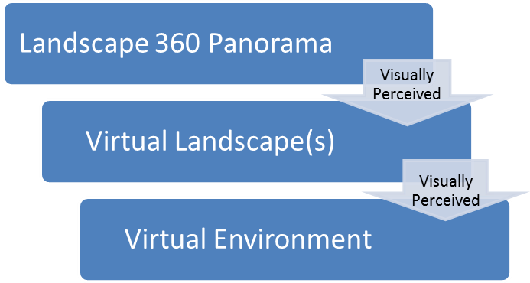
Figure : Relationship between environment, landscape and panoramic framing
Notes:
So using Appleton’s and Nausser’s assertion, what emerged was the above thinking: panoramic framing was the closest to how we naturally perceive landscapes, which in turn are strongly representational of how we perceive the wider environment.

Slide 20
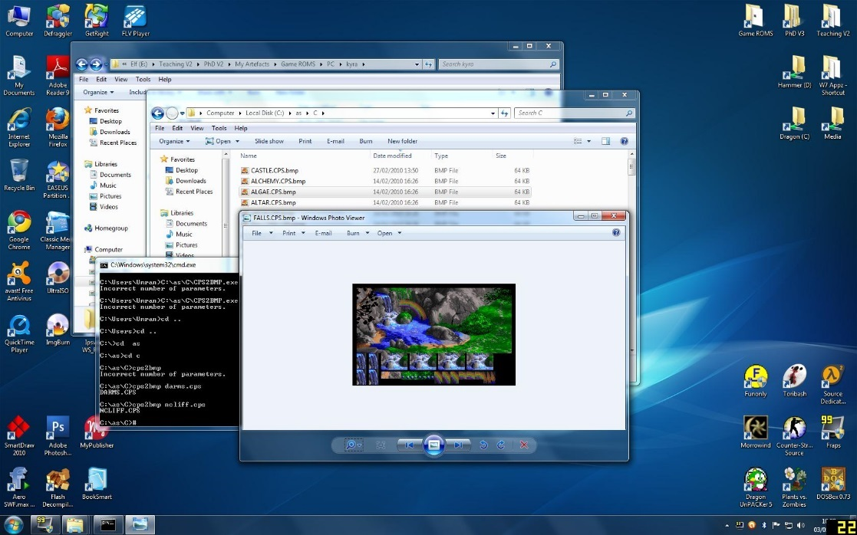
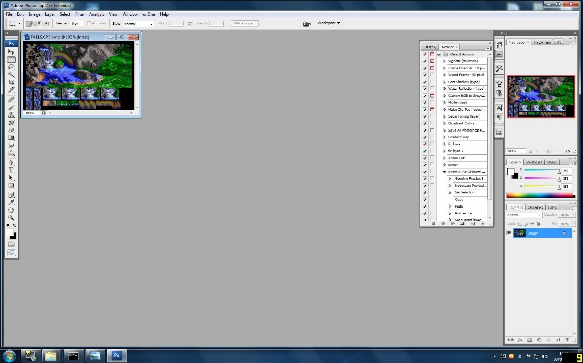
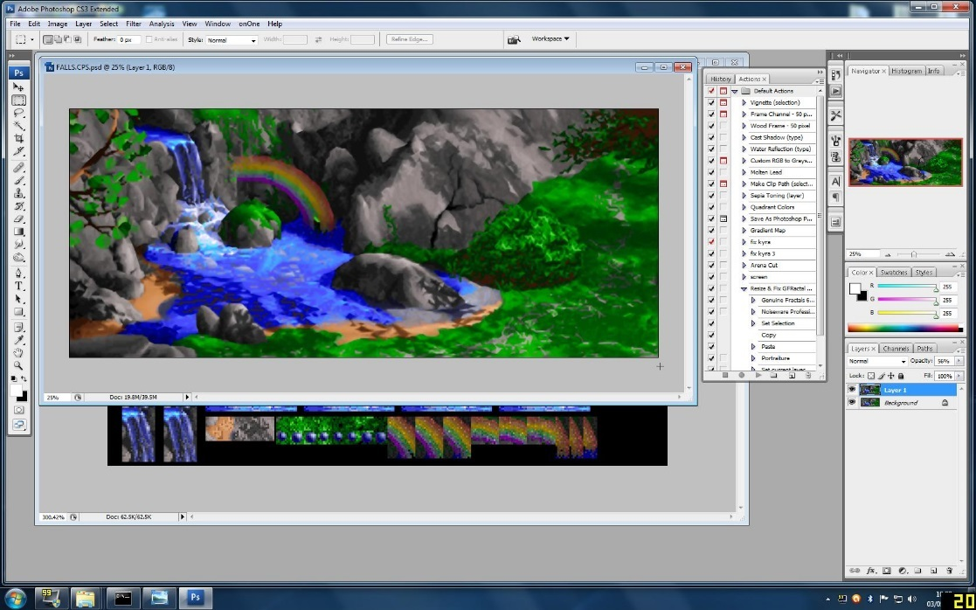
Notes:
So I began a very long and ardous process of sourcing, extracting and exposing, sometimes lost virtual landscapes from digital games from a period of thirty years ,from 1980-2012.

Slide 21
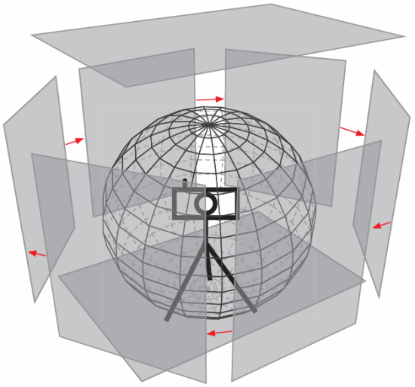
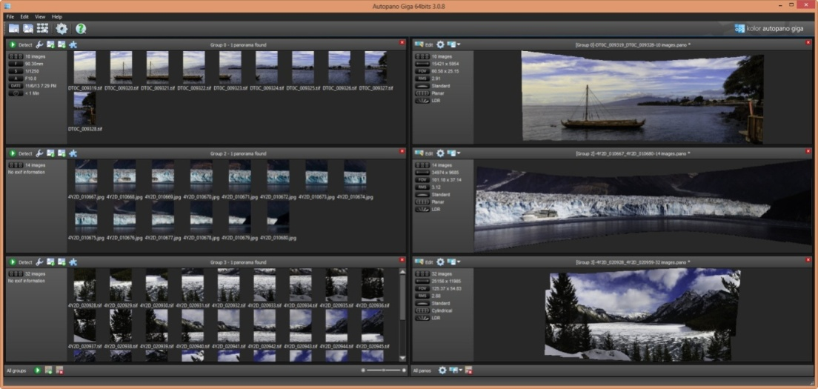
Figure 35: Phantasy Star Online; Before & After comparison of ‘raw Vs final panorama
Notes:
The final method that emerged and I developed was quite complicated, taking multiple images in the game using a virtual camera, these were then stitched up with Autogiga Pano,, cleaned and edited in Adobe Photoshop to produce a final panoramic image of the landscape.

Slide 22
Notes:
However this was never straightforward, often other elements that would hinder the view of the landscape needed to be removed, so HUD’s, characters, even the original perspective had to be changed in order to extract the panoramic landscapes.

Slide 24
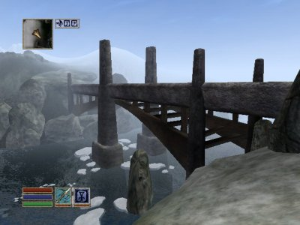
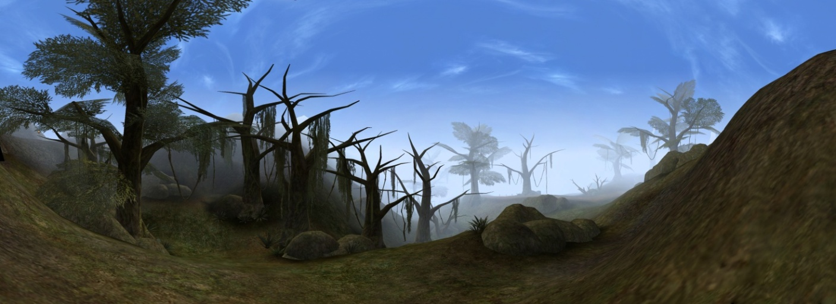
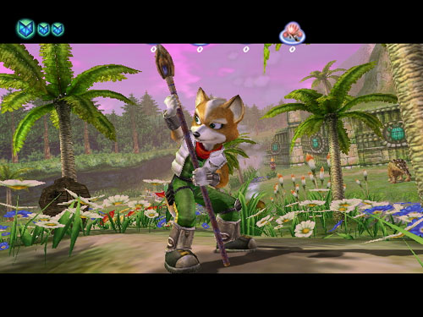
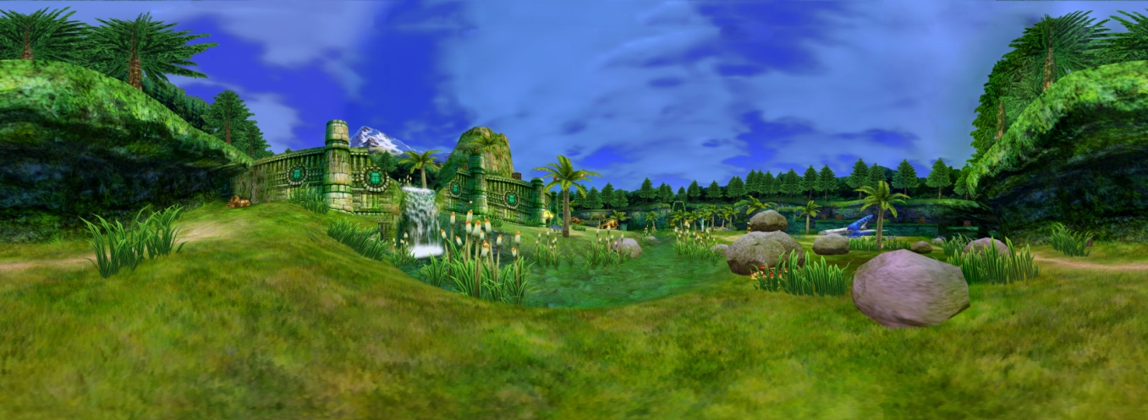
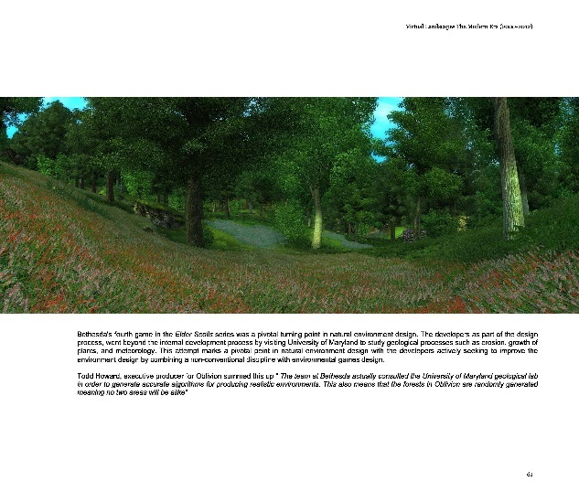
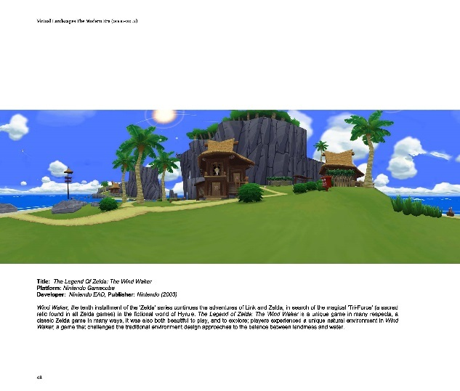
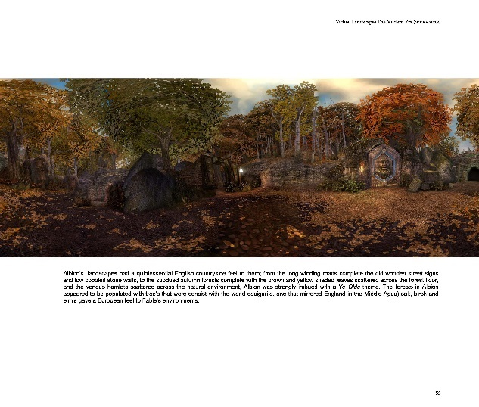
Notes:
What finally resulted was for the first time, a large collection of panoramic landscapes from across computer & video games across a three decade period.

Slide 25
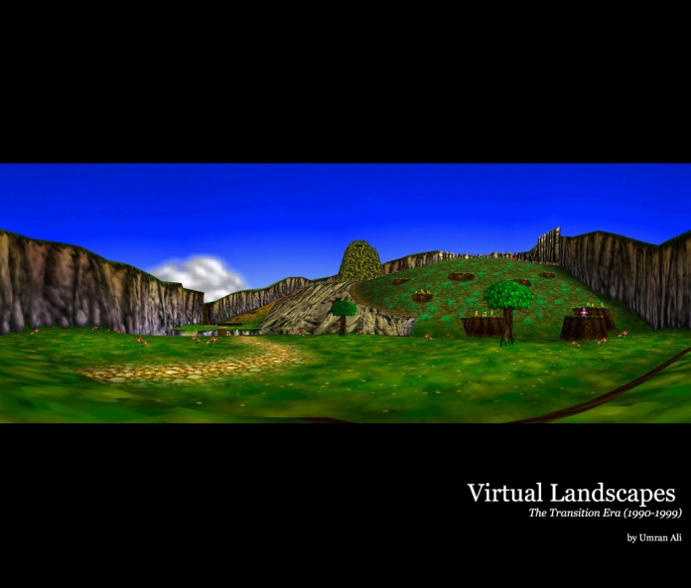
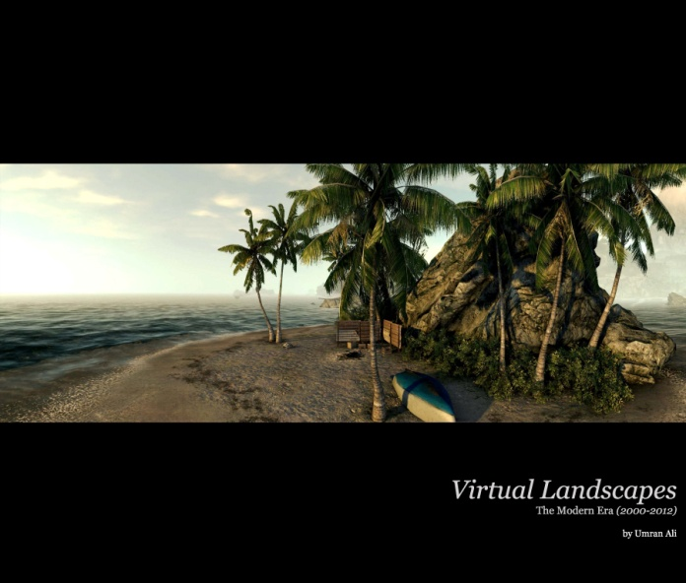
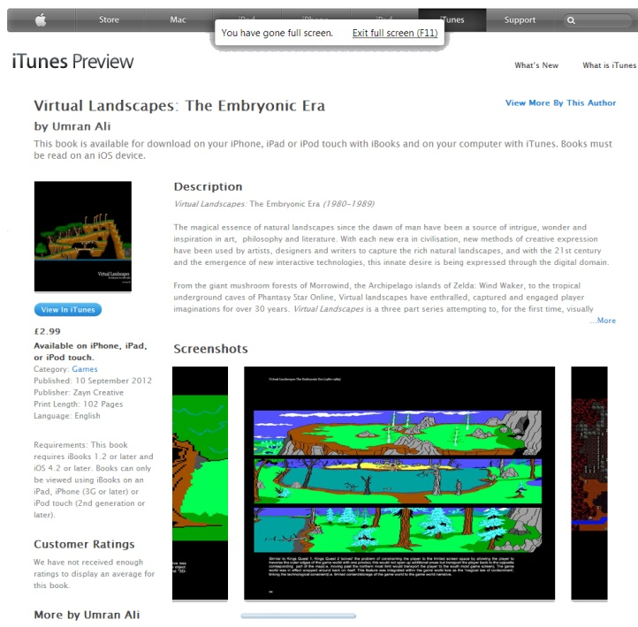
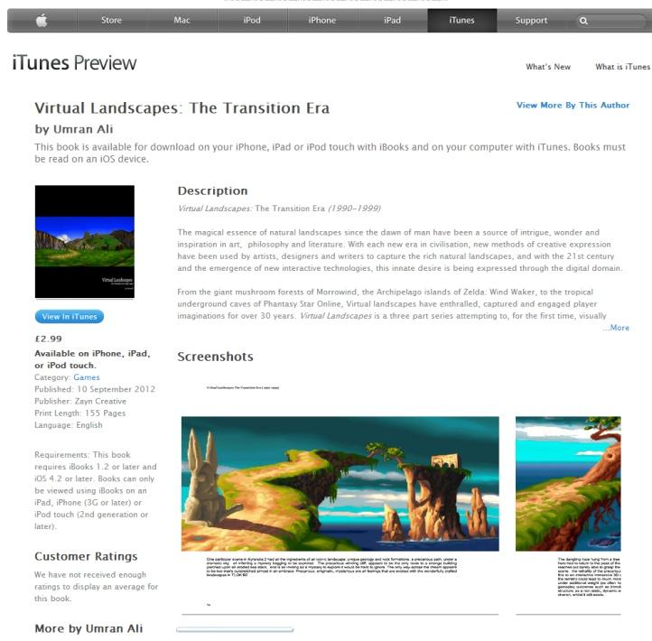
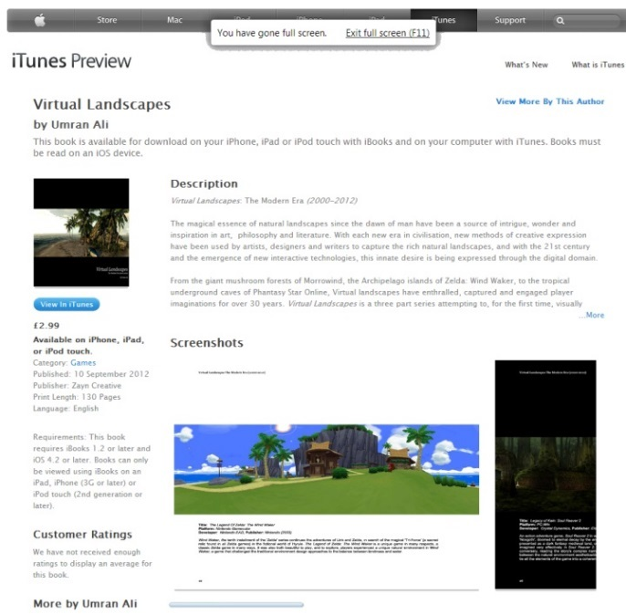
Notes:
This first pass of the research was published in print, and electronically as part of the process of disseminating and gathering feedback on how these virtual landscapes were regarded and perceived by gamers and non gamers alike. The reception was very positive, particularly to non-gamers which was surprising.

Slide 26
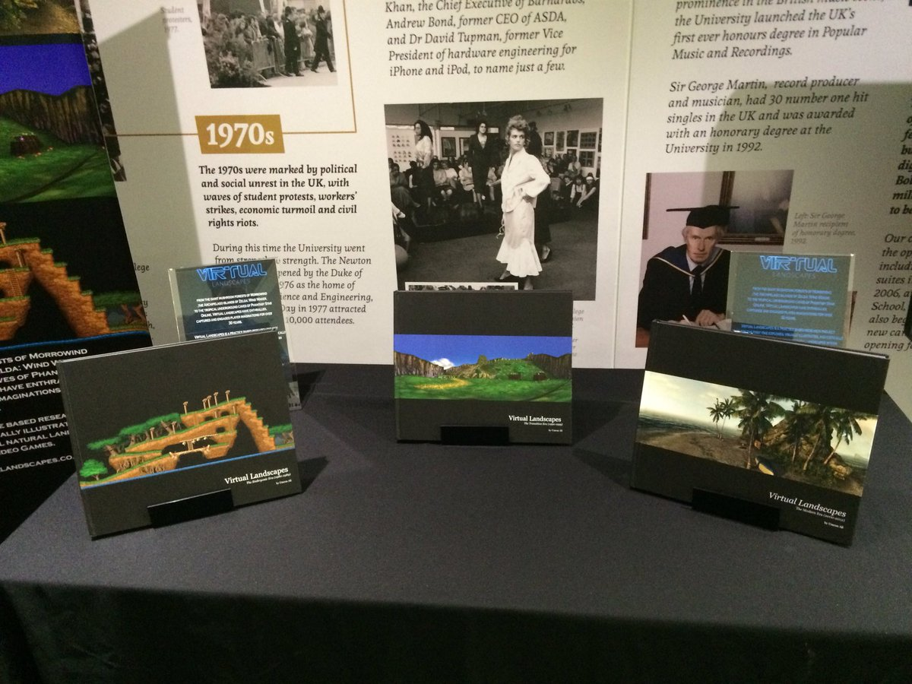
3-4 years of work
70 different Computer & Video Games covered over 30 years period
~12 Different platforms
~350 Unique UltraHD Virtual Landscape Panoramas
~300 High Definition ‘extracted’ Virtual Landscapes
~150 Digitally Enhanced HD Virtual Landscapes
Spread over three volumes, available in print, digital(ebook, PDF & itunes) and interactive formats

Slide 27
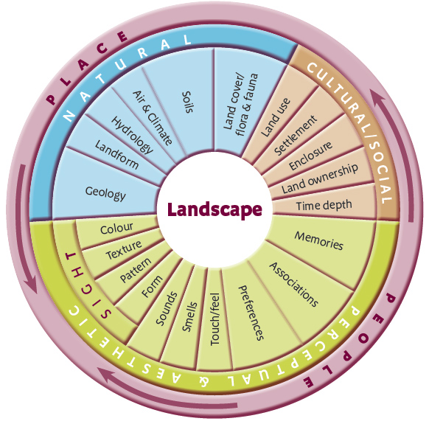
Components of Landscape
Landscape
Physical
(physiographic)
Psychological
Figure: The landscape wheel from ‘Landscape Character Assessment (adapted from Tudor, 2014)
Notes:
After an analysis, what resulted from this contextual survey was data indicating landscape design in games was centred around a few core elements, however there was no real major design paradigm driving the design, and in fact it was fragmented, ad-hoc and largely asethic driven. During a lit review pass, I stumbled across landscape character assessments which largely capture the elements of virtual landscape design, and which I adapted with the contextual survey data to produce an initial design landscape design framework.

Slide 28
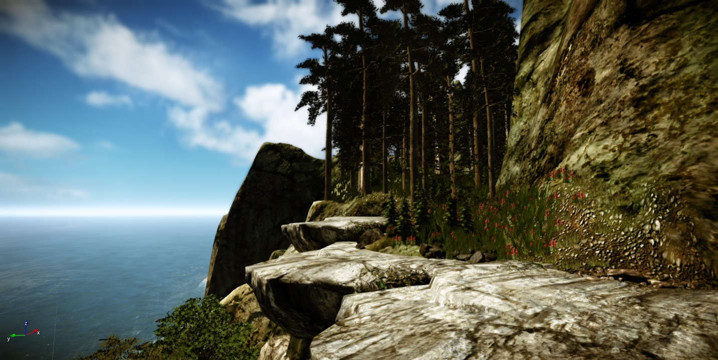
ShadowMoss Island
Notes:
So given the first study had led to an initial framework, the second step was the to examine if it was able to meet the demands of a production environment, ShadowMoss Island was born, and was a practice-based exploration of how VNE design could incorporate elements from disciplines such as Environmental Psychology and Geology, as well as reflections and observational analysis based on a field trip.
Photography
This method was chosen since it allows instant access to a place (virtual or physical space) in order provide a visual context to an otherwise difficult concept to describe) as a form of non-verbal communication, one that acts as entry point, to aid reflection and analysis, and as a method that allow the research to be transformed into more accessible (one that does not require lengthy time to absorb and digest) and appealing outcome; one that is more readily evolved into exhibit, ready to elicit response and incite critical discussion
Field Trip (Virtual & Physical)
This includes the standard definition of the term field trip (an observational method employed to gather data in a 'live' physical setting) but within this study I am including the virtual domain within this term (visiting a virtual space to observe and collect data for later analysis and reflection).

Slide 29
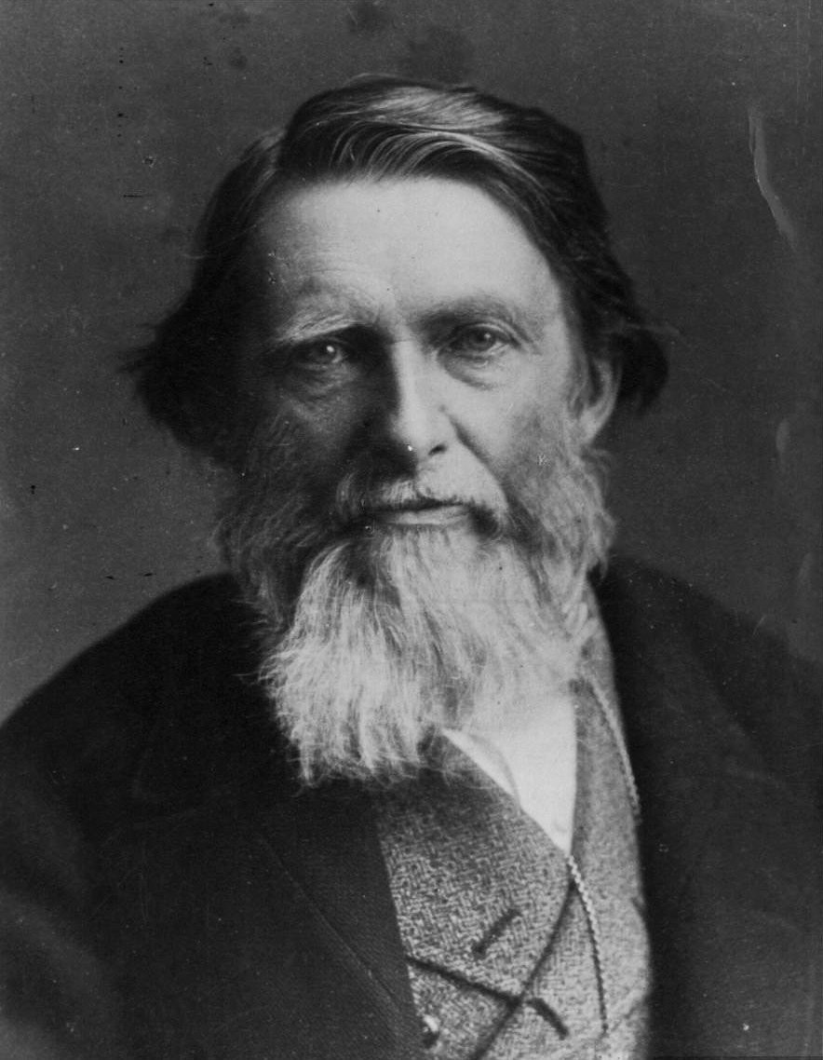
…go to nature in all singleness of heart... rejecting nothing, selecting nothing and scorning nothing
John Ruskin (1819 –1900)
Notes:
During a second major literature review pass, whilst exploring the relationship between art, landscape and geology I came across the works of John Ruskin, the noted art critic, writer and philanthropist. one particular dictum resonated very strongly with a core belief driving the research, and grounding subsequent work in Ruskin’s manifesto. He stated:
“Go to Nature in all singleness of heart, and walk with her laboriously and trustingly, having no other thoughts but how best to penetrate her meaning, and remember her instructions; rejecting nothing, selecting nothing, and scorning nothing; believing all things to be right and good, and rejoicing always in the truth.’ John Ruskin

Slide 30
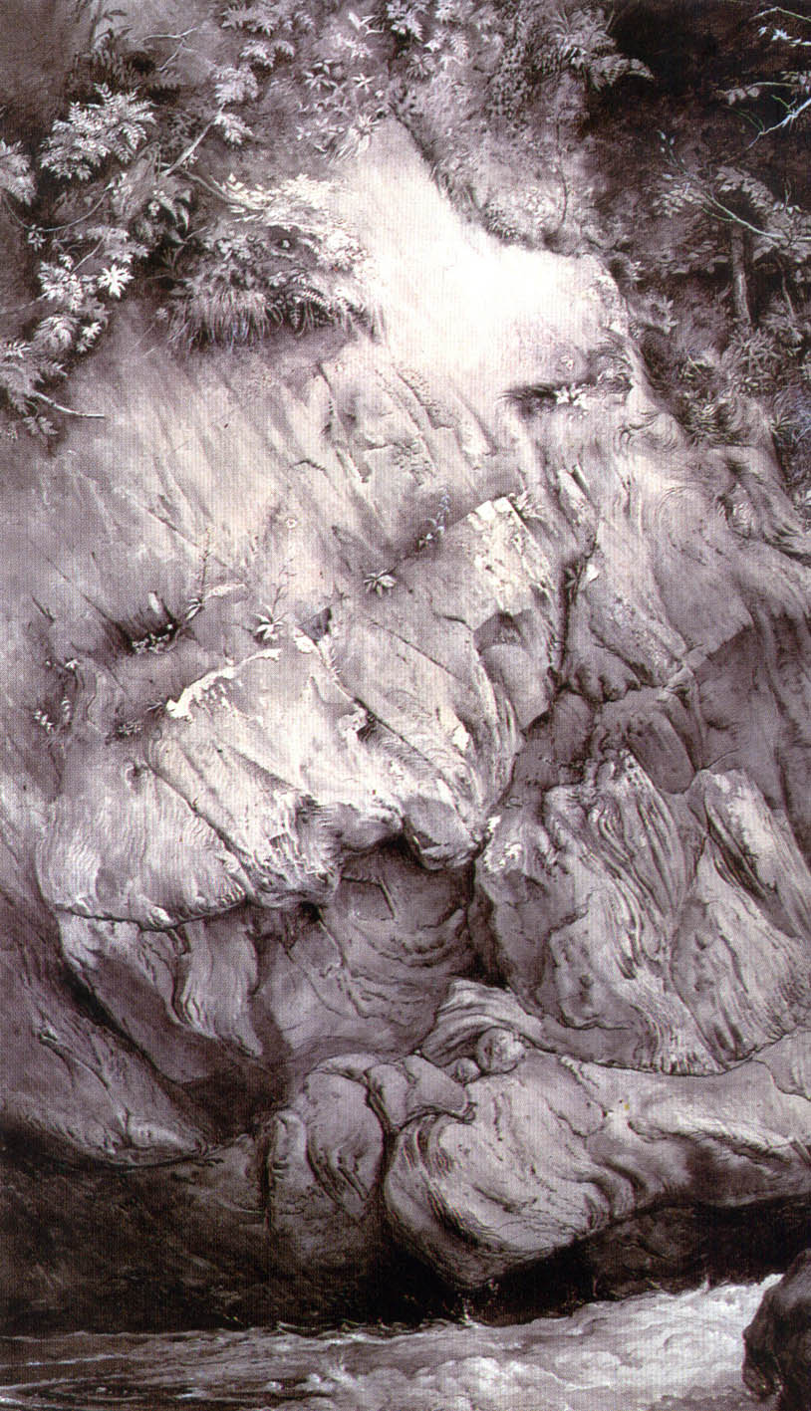
Gneiss Rock, Glenfinlas 1853 John Ruskin Ashmolean Museum, Oxford
Notes:
So inspired by his works such of his study of nice rock in Glen Finglas, I was particularly drawn to the idea of exploring a ‘Ruskin experience’, his belief that an understanding and deep appreciation of sciences such as geology for instance was critical in achieving authentic works of art, particularly in reference to the natural environment, So I began to examine how I could use this idea to enhance and drive a virtual environment design process.

Slide 31
… 'Placelessness' equals an inability of a setting to encourage the formation of vivid images.
Edward Relph
Notes:
As research often does, Ruskin’s work led to an exploration of concepts of space and architecture, ideas of space, place and placelessness began to emerge, and one in particular Edward’s Relph’s ideas strangley began to resonate with elements of game design.

Slide 32
Space & Place
Relph’s Existential Insideness
“….a situation of deep, unself-conscious immersion in place and the experience most people know when they are at home in their own community and region” Seaman & Sowers (2008)
Figure X: Phantasy Star Universe: AOTI’s Forest of Illusions exemplifying Golf Course Design
Notes:
I was particularly drawn to Relph’s idea of Existential Insideness which he described as “….a situation of deep, unself-conscious immersion in place and the experience most people know when they are at home in their own community and region”
This for me encapsulated the true goal of my experience as a virtual landscape designer, so I was interested in how, if at all I could achieve this feeling of Existential Insideless in a virtual environment,.

Slide 33
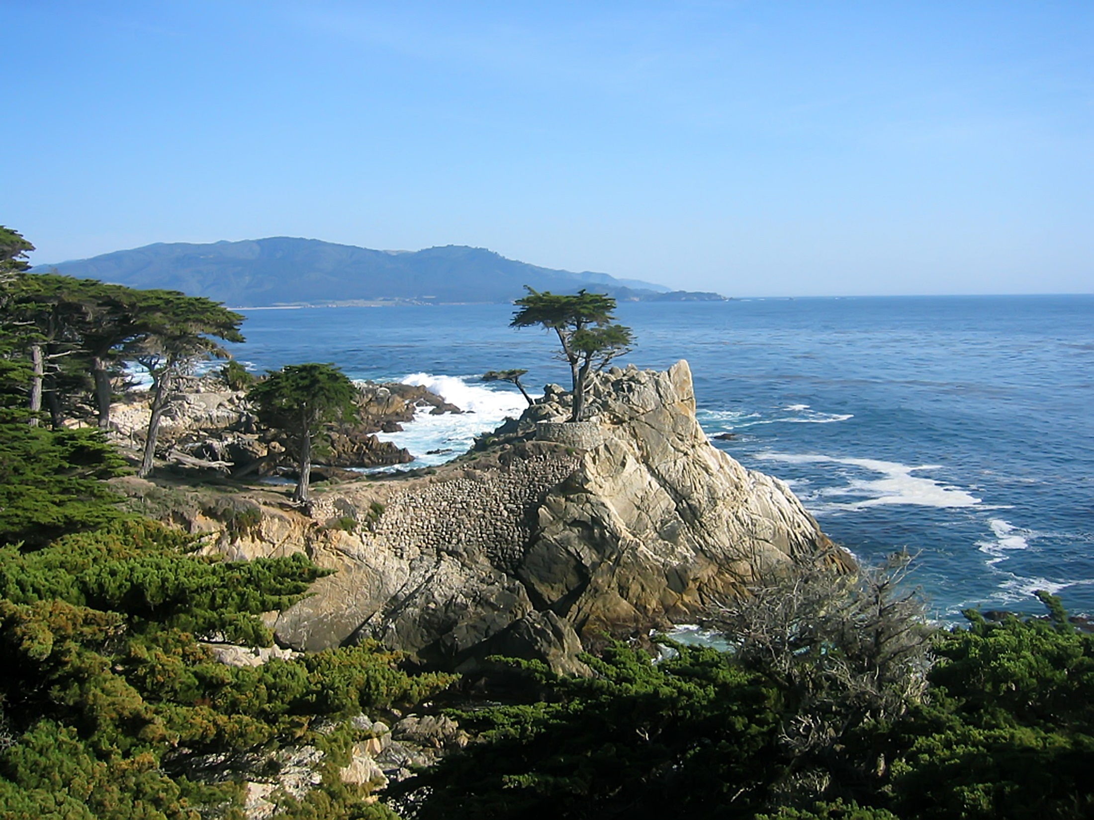
Notes:
So using this, and reflecting on particular landscapes I had visited in the past (such as the lone Cypress tree in California) I undertook a fieldtrip to try and capture in-action reflection on natural landscapes with a view to building a digital one going beyond the dominant aesesthic driven design approach.

Slide 34
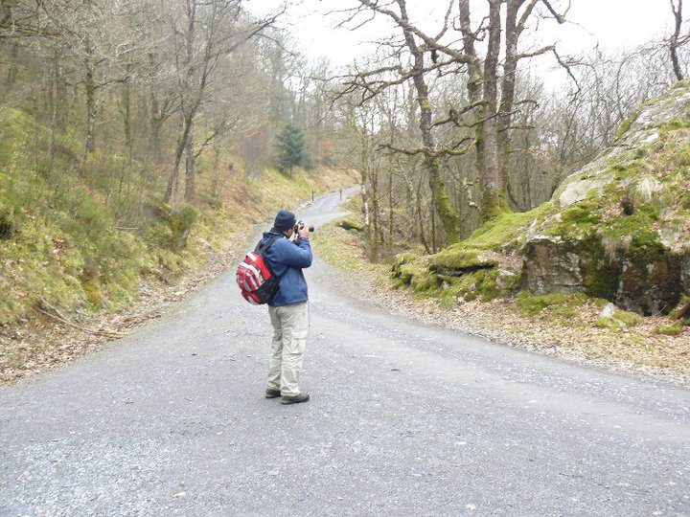
Notes:
So I chose a small place in Wales, Moll Shabod, and spent few days exploring the space and trying to explore the feeling of Existential Insideness in the Welsh wilderness,.

Slide 35
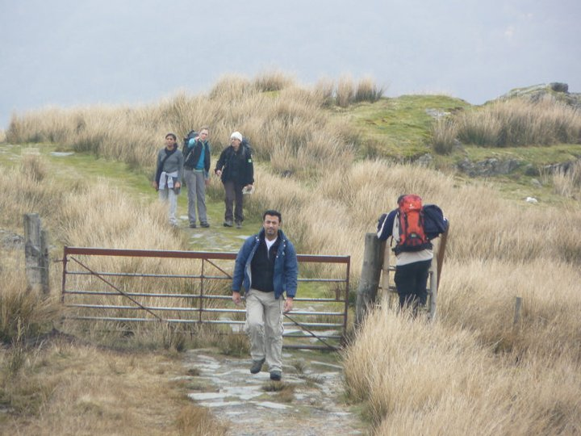

Slide 36
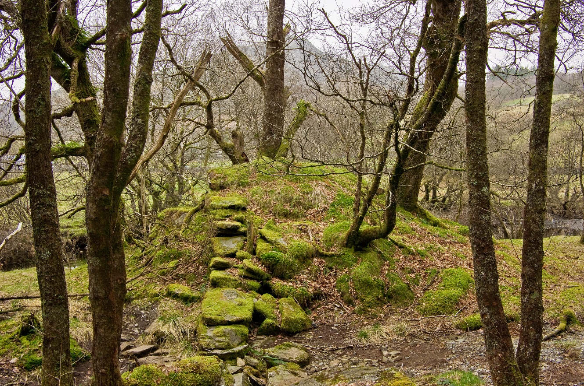

Slide 37
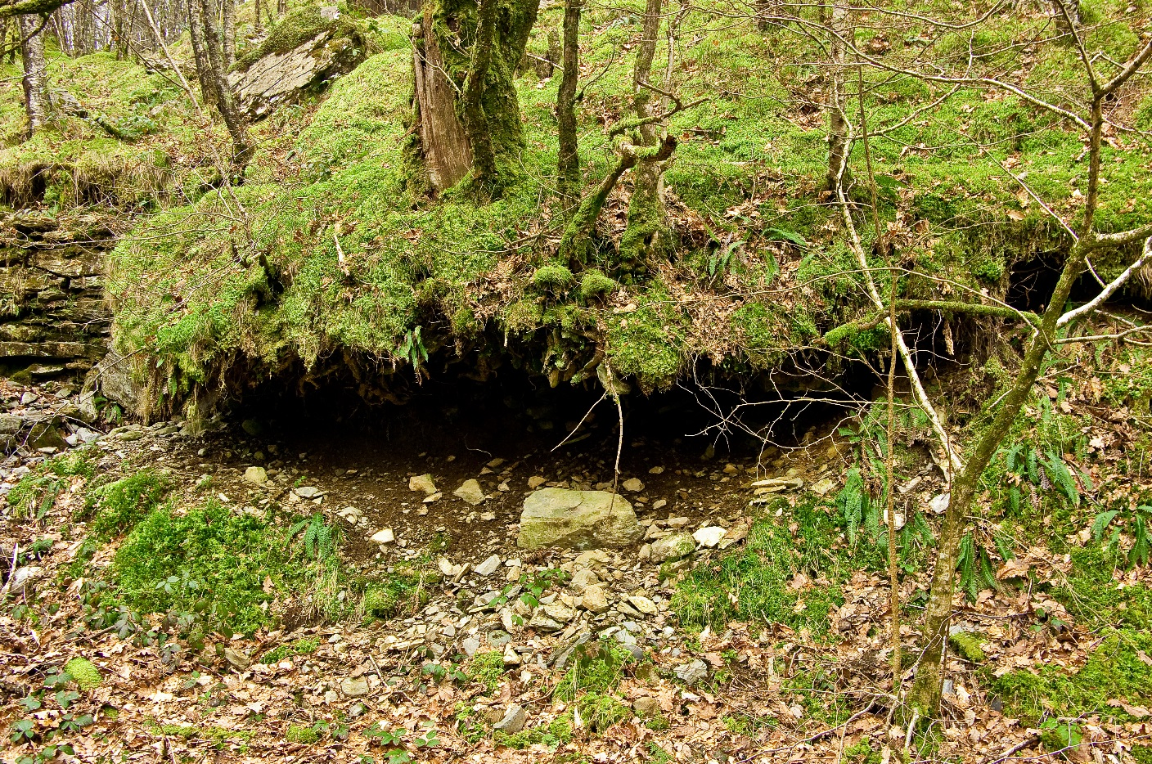

Slide 38
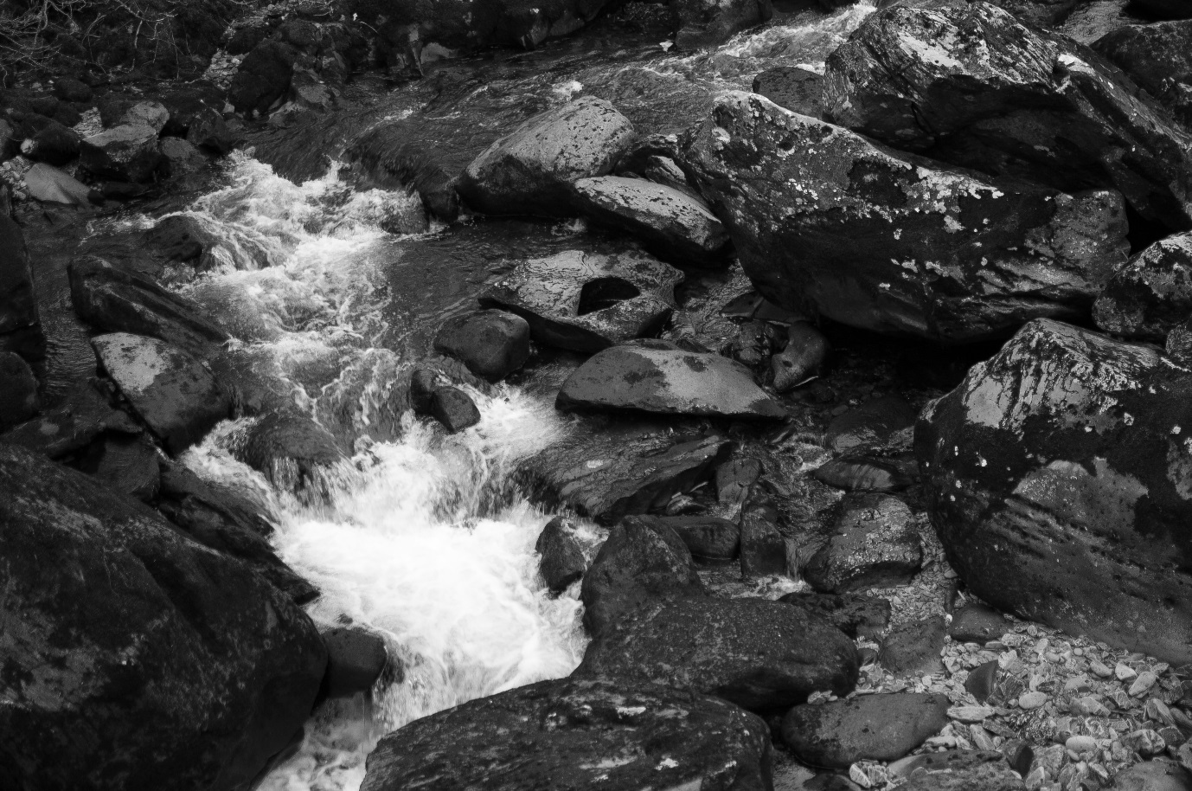

Slide 39
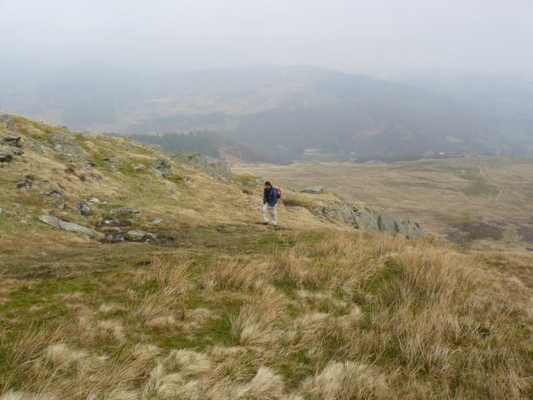
…go to nature in all singleness of heart... rejecting nothing, selecting nothing and scorning nothing.
John Ruskin (1819 –1900)

Slide 40
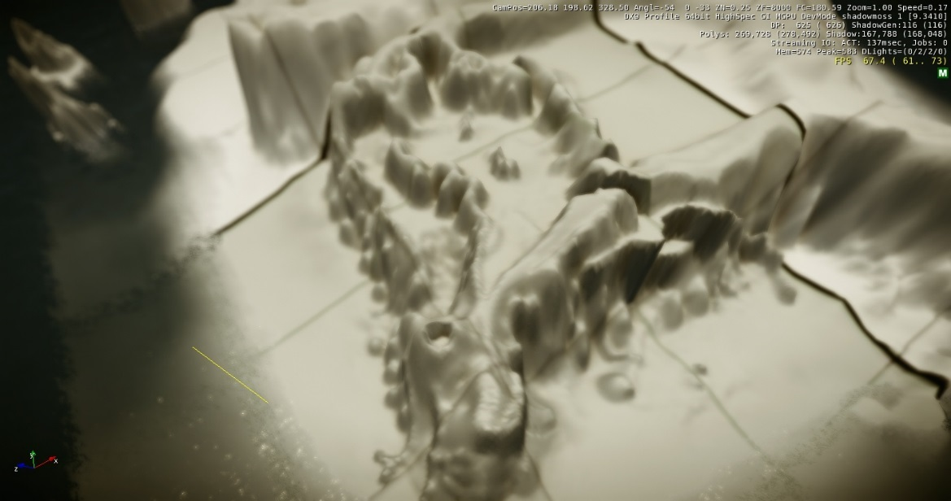
Notes:
After the field trip, I then started a process of reflecting and trying to embed my experiences into a virtual natural environment, I ended up selecting CryEngine 5, a very extensive games engine as the tool to build the digital game, given its very impressive technical capability.

Slide 41
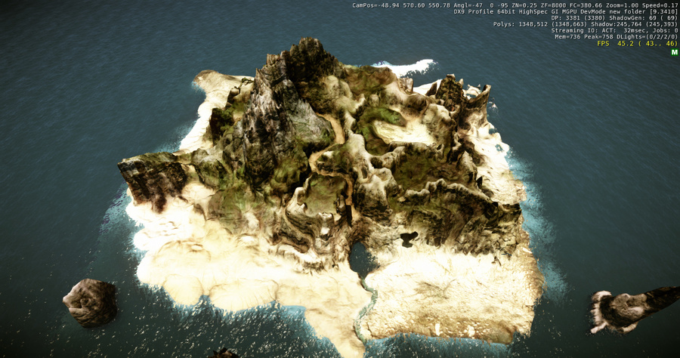

Slide 42
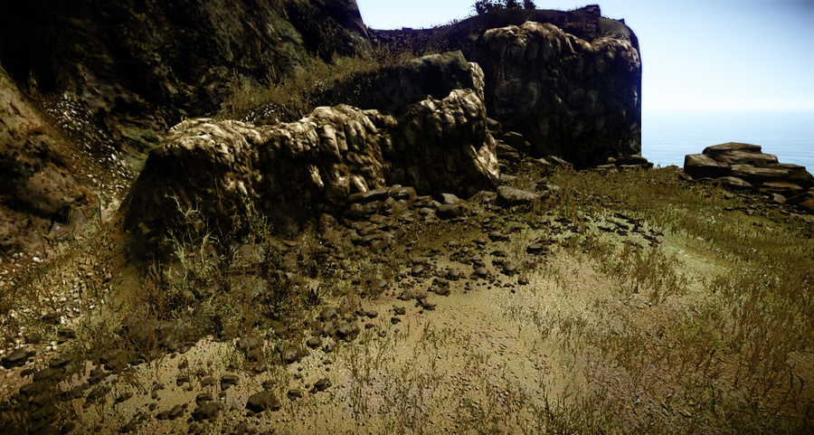

Slide 43
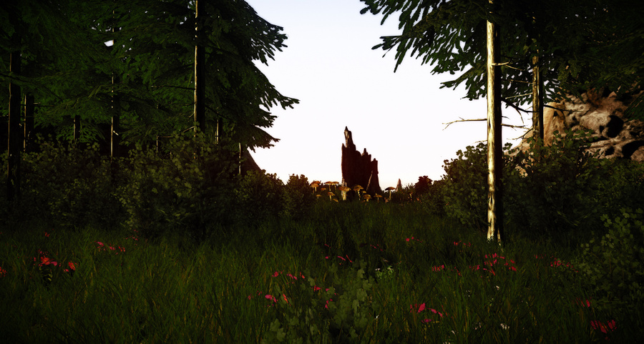

Slide 46
Figure 54: ShadowMoss Island Route Flow
Notes:
It wasn’t just an the aesthetics I wanted to replicate but I wanted to embed a sense of passed time, geology, physiographic nature, it’s impact on me during the field trip and explore concepts such as genius loci and biophilic design.

Slide 47
Components of Virtual Natural Landscapes
Virtual Natural Landscape
Design
Physical Nature
Landscape Character Assessment
Psychological Nature
Relph's Place & Placelessness
Genius Loci
Biophillic Design
Cognitive Spatial Mapping
Ruskin's Dictum
Notes:
What ultimately emerged after this piece of practice was not only a practical aretfact of the initial VNED design framework; a game to explore, but also a much more deeper and richer framework began to emerge, particularly the perceptual and phycological impact and meaning of landscape had developed, one that attempted to unite game design, Relph’s placeness and Ruskin’s go to nature dictum.

Slide 48
Research Outcomes
Notes:
In terms of the research outcomes, The research has significance to both professional and pedagogic practitioners working in the area of computer and video game natural environment design.
The research not only presents a theoretical model but also presents a practice-based outcomes to illustrate that this can be a creative and feasible approach. Within the framework, ShadowMoss Island provided a working exemplar of how field study could be conducted (capturing the field experience data in the journal/log) and provides a step by step guide in how a VNE design process should be staged in a contemporary (2017) games engine

Slide 49
Research Outcomes: Gamespaces
Notes:
The study argues that gamespaces, in particular environments and corresponding landscapes have a significant impact on gameplay, as such the research suggest as new game design & production processes framework with an aim in developing richer and deeper virtual landscapes.

Slide 50
Research Outcomes: Scenism Framework
Notes:
A range of tools, processes, artefacts and extensive recommendations were developed in the course of the research, resulting in the creation of historical VNE visual archive in a range of digital and physical ‘artefacts’ forms. ‘Scenism’ was the final resulting framework that arose as the embodiment of the proposed VNE/VNL design framework

Slide 51
Research Outcomes: Gameplace
Notes:
This study proposes gameplace as a complimentary term to sit alongside gamespace; gamespace may refer to the particularly arrangement/configuration of the virtual space/environment in a game, whereas gameplace refers to a particular and specific location within a gamespace that evokes a meaning, whether that is to an individual or a group or a personal, cultural or otherwise level.

Slide 52
Research Outcomes: World Architects
Landscape by Tuğçe Kurak ‎[tugce.kurak@hotmail.com]
CryEngine 5
Masters in Landscape Architecture
MMU University‎
Notes:
This research supports the assertion that video games have the power to forge the future of ludic space-time (Brouchoud 2013; Walz 2010) and that landscape architecture, geology and ecology will increasingly blend with game design to create a new type of design and will herald new thinking crossing the boundaries between disciplines .
What you see here is work, in collaboration with Mark Jackson (landscape architect) and Eddy Fox, lead academic on the Masters in landscape architecture programme, by a Manc Metro Uni student who for the first time were used games technology, namely CryEngine 5 to explore and design landscape architecture. This is set to be explored further at other Universities.

Slide 53
Research Outcomes: Spatiality
The simulacrum is never that which conceals the truth--it is the truth which conceals that there is none…..The simulacrum is true.” (Poster & Mourrain, 2002, pp.166-184)
Notes:
The research supports the notion of Spatiality as Raison D’etre within digital games, : Scenism embraces and develops the perspective of spatiality as one of the defining attributes of digital games and as such should be core focus of implementing a ‘scenistic’ approach. The framework offers not only game designers an opportunity to develop engaging spatial experiences using an array of game technologies that may not use ‘traditional’ elements of gameplay, but instead focus on emergent spatial-play elements such as exploration & discovery, prospect and refuge.

Slide 54
Conclusions
Visual Archive of Seminal Natural Environments in CVG(ebook & interactive database)
Beyond Aesthetic Natural Environment Design : Guidebook
MindFlow Tool: Interactive multimedia Mindmapping tool
Interactive Game Artefact(s)illustrating the design of ShadowMoss Island
Notes:
The research concludes with proposing a practical framework driven by viewing environment design from an alternative spatial perspective to the narrative or aesthetic driven approaches employed by environment design practitioners. The experimental ‘framework proposed in this study intends to assist practitioners in developing digital games from an alternative and informed position.
The research concludes with presenting ‘Scenism’ as the embodiment of the proposed VNE/VNL design framework, a unified and coherent construct, one that communicates the research in a more production focused manner for both professional and pedagogic practitioners working in the area of computer and video game natural environment and landscape design.

Slide 55
Conclusions: Architects of Place
.
Notes:
Finally I believe that future digital games designers will move from being architects of space to Architects of Place, and will increasingly be educated in 'traditional' elements of landscape planning including ecology and architecture. This represents a future opportunity for those in fields such as geology, ecology or landscape architecture to become collaborators in shaping future digital games, radically reshaping the professions for both future demands and challenges.
Meaning and ideas of landscape, in function and in perceptions in digital games are yet to be fully explored and realised. Thank you.

Slide 56
Contact
Email: u.ali@Salford.ac.uk
Twitter: https://twitter.com/Dr_UmranAli
LinkedIN: https://www.linkedin.com/in/dr-umran-ali/
University Of Salford Profile: https://www.salford.ac.uk/arts-media/our-staff/arts-media-academics/umran-ali
SEEK Profile: https://www.seek.salford.ac.uk/profiles/AUmran.jsp
Notes:
If you would like know more or have a question, please feel free to contact me on any of the above.

Slide 57
Bibliography
Aarseth, E.J. (2007). Allegories of space: The Question of Spatiality in Computer Games. In F. von Borries, S. P. Walz & M. Böttger (eds.) Space time play: computer games, architecture and urbanism: the next level (pp. 44-47) Berlin: Birkhauser Verlag AG
Appleton, J. (1975). The experience of landscape. Chichester: Wiley.
Brouchoud, J. (2013, February 09). The Importance of Architecture in Video Games and Virtual Worlds. ArchVirtual. Retrieved January 15, 2016, from http://archvirtual.com/2013/02/09/the-importance-of-architecture-in-video-games-and-virtual-worlds/
Bunnell, K. (1998). The Integration of New Technology into Ceramic Designer-Maker Practice. (Unpublished PhD thesis) Robert Gordon University, Aberdeen.
Konecki, K.T. (2011). Visual grounded theory: A methodological outline and examples from empirical work. Revija za sociologiju, 41(2), pp.131-160
Malins, J. & Gray, C. (1995). Appropriate Research Methodologies for Artists, Designers and Craftpersons: Research as a Learning Process. Gray's School of Art, Centre for Research in Art & Design.
Nassauer, J.I. (1983). Framing the Landscape in Photographic Simulation. Journal of Environmental Management. 16(4) pp.1-16
Salen, K. & Zimmerman, E. (2004). Rules of play: Game design fundamentals. MIT press.
Smith, H. & Dean, R. T. (2009). Practice-led research, research-led practice in the creative arts. Edinburgh University Press.
Jenkins, H. & Squire, K.D. (2002). The Art of Contested Spaces. In L. King (Ed.) Game On!. (pp.64-75). London: Barbican Press

Slide 58
List of Figures
Comparison of Progression of Openworld games (Source Hexapolis.com 2014)
Dear Esther Panoroma, Ali, U 2012 Virtual Landscapes
Edward Relph available at: https://www.nhltv.net/playlist/unsw-built-environment/PLvW1evjftfvntp6R2ItJ6TuEBFYcpKFsy
Fable 3 Panorama, Ali, U 2012 Virtual Landscapes
GDC UE4 Open World Demo GIF By @moritzw
Ghouls & Ghosts Ali, U 2012 Virtual Landscapes
Landscape Animation, available at: https://i.pinimg.com/originals/03/bb/fb/03bbfb95d3410a404583edfdc5415ace.gif
Landscape image available at: https://www.unrealengine.com/marketplace/landscape-auto-material
Lone Cypress Tree Photograph, Ali, U 2016
Scencism Framework, Ali U 2016
ShadowMoss Island, Ali U 2016
Skyrim Animated GIF, available at: https://media.giphy.com/media/TWVidqvGHHnnW/giphy.gif
Skyrim Panorama, Ali, U 2012 Virtual Landscapes
Skyrim Panorama, Ali, U 2012 Virtual Landscapes
StarFox Adventures: Before & After Comparison
Study of Gneiss Rock available at: http://ruskin.ashmolean.org/collection/9006/9037/9358/all/per_page/25/offset/0/sort_by/seqn./object/14350
The Elder Scrolls 3: Morrowind – Before & After Comparison
The Heart of the Andes Painting by Frederic Edwin Church, available at https://en.wikipedia.org/wiki/The_Heart_of_the_Andes#/media/File:Church_Heart_of_the_Andes.jpg
The landscape wheel from ‘Landscape Character Assessment (adapted from Tudor, 2014)

