Slide 1
Fostering undergraduate student success and leadership development through implementing and evaluating a coaching framework
Dr Jacqueline Leigh, Lisa Littlewood, Dr Emma Gillaspy, July 2018

Slide 2
Aims of Workshop
Explore the concept of coaching as a tool to promote student nurses leadership development (academic and clinical) and student success
Provide evidence of the framework
developed
Explore strategies for implementation
and provide evidence of student success
Utilise simulation to demonstrate application of the framework
Notes:
Participants will be introduced to the concept of coaching and to out unique coaching framework and how cultures to foster student success can be changed both in the university and healthcare setting
Participants will be invited to engage in a real life coaching conversation simulation. Feedback will be provided by an experienced coach. Student nurses who have experience of coaching in the
healthcare practice setting will share their experiences and impact on patient care. This will include impact on their clinical leadership development, peer teaching and resilience. We will challenge participants assumptions
about existing student support for undergraduate nursing programmes and share our applied problem solving techniques to identify multi-stakeholder key issues: • Personal tutoring policy/practices not delivering vision for
student experience transformation • Variable support in clinical practice for undergraduate student nurses of whom were not consistently encouraged to take ownership of their learning needs (unlock potential for learning) • NHS Trusts
increased undergraduate student numbers by 100 but without growing the practice placement capacity • Strategies for smooth role transition from student to qualified nurse. Our framework operationalises our shared vision recognising that the transformation of student learning and support will only be achieved if taken place in the empowered university and healthcare learning environment and that all involved exhibit the collective behaviours, knowledge and skills required to ‘unlock’ the student’s potential for learning: “Coaching raises students’ self-awareness, unlocking their potential for effective learning” Unique is how our coaching framework transfers across schools and organisations. The coaching framework includes an evaluation strategy and we will share our evaluation at the session.

Slide 3
Challenging our assumptions about existing student support- stakeholder issues
Personal tutoring policy/practices not delivering vision for student experience transformation
Variable support in clinical practice for undergraduate student nurses, most of whom were not consistently encouraged to take ownership of their learning needs (unlock potential for learning)
NHS Trusts increased undergraduate student numbers by 100 but without growing the practice placement capacity
Strategies for smooth role transition from student to qualified nurse

Slide 4
What does coaching mean to you?

Slide 5
Coaching
Intervention aimed at performance improvement or developing a particular competence. It is an ongoing process that consists of facilitating another person’s learning, development and performance
Dembkowski et al. (2006)

Slide 6
Benefits from a student perspective
Ownership of own learning journey
Builds confidence in asking/seeking help
Builds knowledge base as applying skills to practice which have previously been taught in university
Feel part of the team
Reinforces existing knowledge and enhances skills as you teach others
Increases opportunities to learn as peers explain
Gains respect from other members of the MDT as student nurses are valued and seen as part of the team not just a student following a nurse
Identifies weaknesses to improve on
Helps to get the student ready for role transition upon qualification
Supernumerary status is upheld enabling more self directed learning

Slide 7
Observation from the coaching model in practice
Witnessed first year students flourish with confidence from starting placement and looking to the second years for guidance. They worked alongside them eventually gaining the skills and confidence to enable them to take the lead for their own patients and plan individualized care. This gave them skills and confidence to take with them throughout their training to develop further along the way.
The variation in student skills and knowledge helped the coach to safely monitor the bay which enabled a smooth transition from mentoring to coaching. Whilst not losing the intimacy of the one to one learning with a qualified nurse when and where applicable.

Slide 9
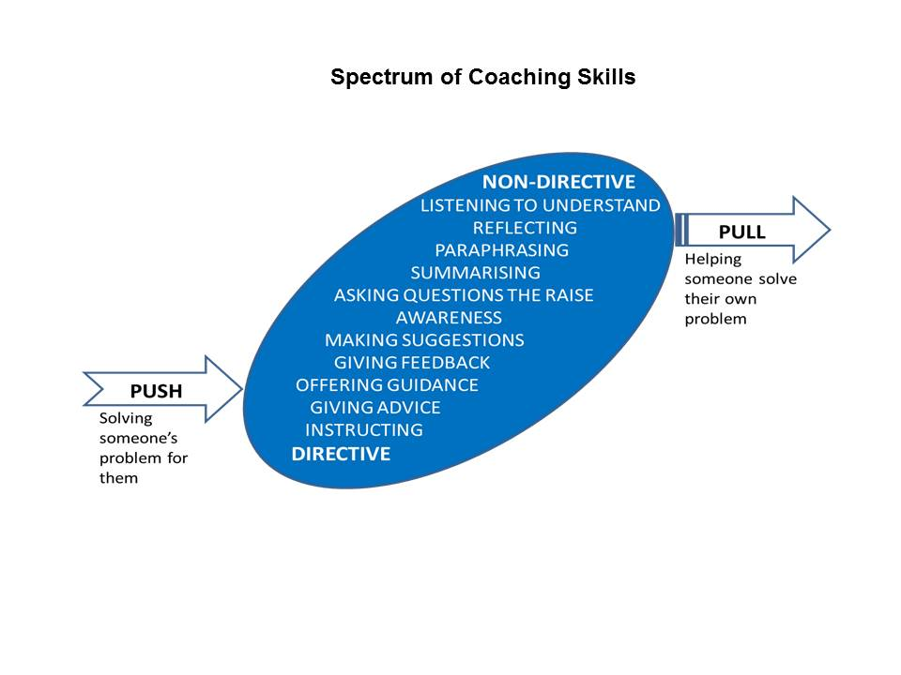
Spectrum of Coaching Skills
Taken from: Downey, M. (1999). Effective coaching (Orion business toolkit). London: Orion Business

Slide 10




Challenge and support
SUPPORT
COMFORTED
EMPOWERED
BORED
STRESSED
CHALLENGE
Adapted from: Blakey, J., Day, Ian, CIPD, & Ebrary, Inc. (2012). Challenging coaching:
Going beyond traditional coaching to face the facts. London ; Boston: Nicholas Brealey Pub.
Notes:
Bored – No impact
Comforted – Feels cosy, builds dependence, unpredictable results
Stressed – Focused on short term results, erodes self confidence, Alienates leader
Empowered – Delivers high quality results, builds self esteem, increases productivity

Slide 11
Levels of Listening
Level 3 – Global
Picking up emotions, tone body language, environment and self talk
Level 2 – Focused
The focus is with the coachee, listening to every word and conversational nuance
Level 1 – Internal
Hear the words but primarily aware of own opinions, feelings and needs
Level 0 – Tuned out
Not listening
Adapted from: Kimsey-House, K., Kimsey-House, H., Sandahl, P., & Whitworth, L. (2011).
Co-Active Coaching (3rd ed.). London: Nicholas Brealey Publishing.

Slide 12
Questioning Skills
Effective Coaching Questions
Open
  (to promote discussion)
Probing
  (to follow up on what has been said)
Focussed
  (to establish the real situation and real actions to be taken)
Leading Questions
  (to be avoided!)
What, Where, When, How (Why needs to be used carefully to avoid appearing judgemental)
Can you tell me more about…?
What were your feelings at the time?
What action will you take?
Don’t you think it would be better if…?
Why don’t you do the following…?

Slide 13
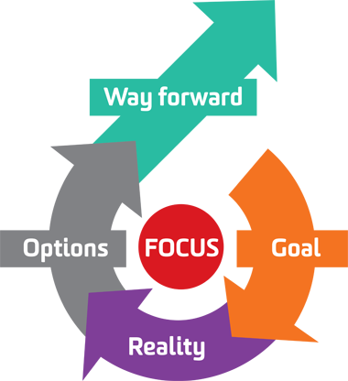
The G.R.O.W model
S.M.A.R.T. Goals
Specific
Measurable
Achievable/Action-oriented
Realistic
Time-bound
Image from http://aspirekc.com/Blog/2015/01/05/need-more-focus-try-the-grow-model/
Whitmore, J. (2009). Coaching for performance: GROWing human potential and purpose:
The principles and practice of coaching and leadership (4th ed.). London: Nicholas Brealey.

Slide 14

Coaching Conversation
Jamal is in his final year and on paper is progressing very well with excellent grades putting him on course for a solid 2:1. All his friends say he is doing well, however he has found it a real struggle and is never happy with the marks he gets. Whenever he gets praised he downplays it, and whenever he receives criticism (which is infrequently) he takes it to heart and feels that he needs to work even harder to improve. He has always been this way from school through to college and is quite competitive with his siblings.
Out on placement and in the university time management is a real issue, Jamal will work day and night on assignments, spending four times the time it takes his peers to complete work. This impacts on his other deadlines and he never knows when to stop. Due to completing clinical placements he has no time for other social activities or seeing friends and feels incredibly guilty when relaxing. His mind is constantly on work and yet he finds himself procrastinating and feeling low in enthusiasm.

