Slide 1
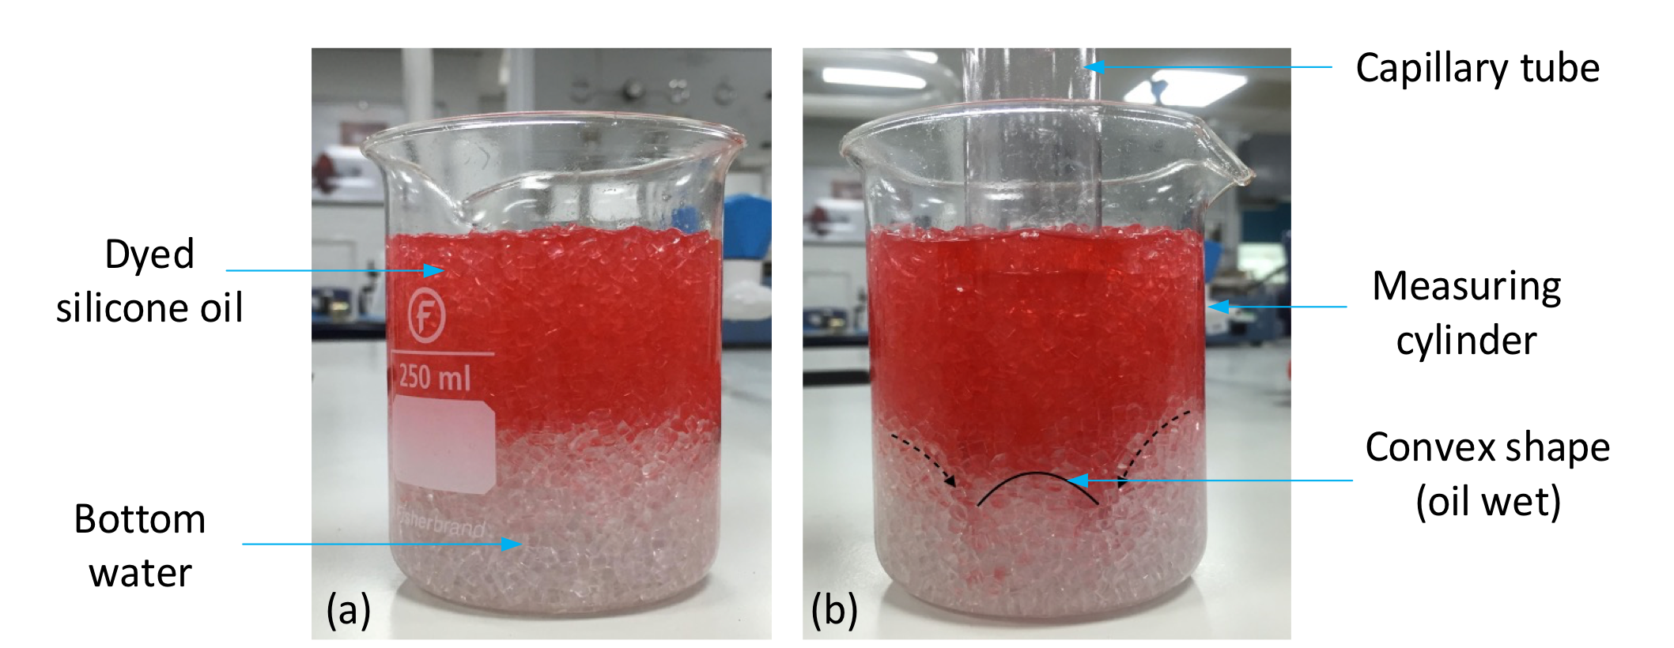
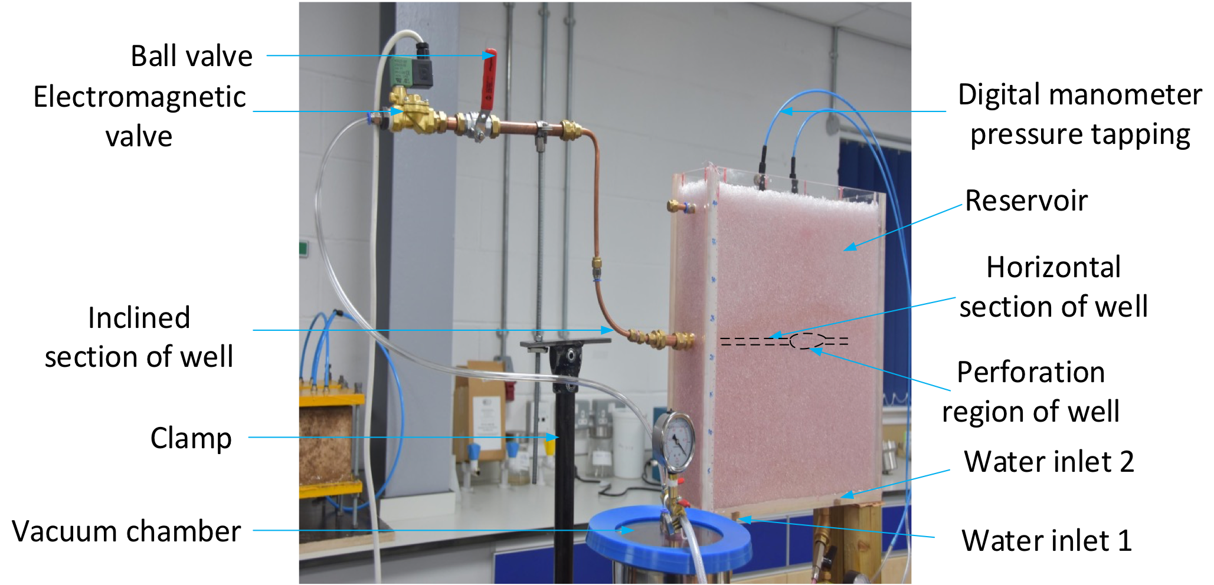
Proactive Control of Cresting in Homogeneous Oil Reservoirs - An Experimental Study
Hector Ngozi Akangbou*, Martin Burby, Ghasem Nasr
Petroleum Technology and Spray Research Groups
School of Computing Science and Engineering
Corresponding author’s email: h.n.akangbou@edu.salford.ac.uk
INTRODUCTION
Methods (CON’T)
Results (CON’T)
Cresting in horizontal wells unlike coning in vertical wells is a well-known reservoir problem, often described as the protruded, crest-like movement of effluent(s) (unwanted water and or gas) in an oil reservoir towards the perforation of a horizontal well as a result of the imbalance of gravitational and viscous forces (Kromah and Dawe, 2008). Cresting is majorly affected by pressure drop/Oil withdrawal rate, the intensity of the reservoir drive mechanism, water-Oil-Contact (WOC) and Gas-Oil-Contact (GOC). Cresting poses adverse effects in terms of overall oil productivity, operating and handling the cost of the water or gas produced and possibly the early shutting-in of wells. This study was motivated by the work of Beattie and Roberts (1996), who stated that shutting-in the vertical well for several days to allow the water level in the fractures to recede did not yield a sufficiently long period of low water production to be continued for a long term in a naturally gas fractured reservoir.
Fig. 2 (a) Before wettability test (b) After wettability test
Fig. 4 Cumulative oil and water produced in thick-oil rim reservoir simulated at 495 s
Table 1 Summary of simulated cases for thin- and thick-oil rim reservoirs
objectives
Case | Reservoir type | Oil column thickness, m | Breakthrough time, s | Shut-in time, s | Production time, s
Case 1 | Thick-oil rim reservoir | 0.34 | 140 | 0 (uninterrupted) | 495
Case 2 | Thick-oil rim reservoir | 0.34 | 140 | 960 | 495
Case 3 | Thick-oil rim reservoir | 0.34 | 140 | 2700 | 495
Case 4 | Thick-oil rim reservoir | 0.34 | 140 | 5400 | 495
Case 5 | Thick-oil rim reservoir | 0.34 | 140 | 7200 | 495
Case 6 | Thick-oil rim reservoir | 0.34 | 140 | 9000 | 495
Case 7 | Thin-oil rim reservoir | 0.18 | 63 | 0 (uninterrupted) | 210
Case 8 | Thin-oil rim reservoir | 0.18 | 63 | 960 | 210
Case 9 | Thin-oil rim reservoir | 0.18 | 63 | 2700 | 210
To proactively control cresting using an electromagnetic valve.
To apply the control procedure in producing lower volumes of cumulative water at higher cumulative oil produced from homogeneous thin- and thick-oil rim reservoirs, characterized by considerable gas cap and strong bottom aquifer.
Fig. 5 Cumulative oil and water produced in thin-oil rim reservoir simulated at 210 s
method
conclusions
To experimentally investigate the use of an electromagnetic valve in controlling the production of water during cresting from homogeneous thick- and thin-oil reservoirs, based on the principle of capillarity (reservoir wettability) and effluent(s) breakthrough time at shut-in times.
A 3.56% increment in oil produced and water reduction of 9.96% were observed in thick-oil rim homogeneous reservoir whereas a negligible increment in oil produced (0.7%) and 1.03% reduction in water produced was observed in thin-oil rim homogeneous reservoir.
The feasibility of this procedure depends on the thickness of the oil column. The larger the oil column, the longer the time required for water and gas to recede after shut-in.
In general, the longer the shut-in periods the higher the cumulative oil produced and the lower the cumulative water produced.
results
References
Akangbou, H. N., Burby, M. and Nasr, G. (2017) Effectively Optimizing Production of Horizontal Wells in Oil Reservoirs. Journal of Petroleum Science and Engineering, Elsevier.
Beattie, D.R, Roberts, B.E. (1996) Water coning in naturally fractured gas reservoirs. SPE gas technology conference.
Kromah, M. J. and Dawe, R. A.(2008) Reduction of Oil and Gas Coning Effects by Production Cycling and Horizontal Wells. Petroleum Science and Technology.
Fig. 3 (a) A thick-oil rim reservoir under static conditions (b) A thick-oil rim at T = 70 s
Fig. 1 Water and gas cresting rig (after Akangbou et al. 2017)

