Slide 1

Positive Cultural Belief about Adversity Predicts Posttraumatic Growth in Chinese Young Adults
Kathleen Alias Hiu-Man Chim^, Linda Dubrow-Marshall^, Peter Eachus^, Andrew Cheuck-Wing Tang*, Tze-Chui Lai*, & Wai-Yi Yvonne Chow*
^University of Salford (UK)
*The Open University of Hong Kong (Hong Kong)
Doctoral Candidate in Health & Social Care, University of Salford, UK
BPS DoCP Conference 8th July 2016
Notes:
ABSTRACT
Positive Cultural Belief about Adversity Predicts Posttraumatic Growth in Chinese Young Adults
Objectives: Socio-cultural influences have been conceptualised to play multiple roles in the cognitive processing underlying posttraumatic growth (PTG), yet, existing literature in this area remains sparse. This study aimed to examine the effects of Chinese cultural belief about adversity on the cognitive processing of PTG among Chinese young adults. Design: Due to the nature of PTG, prospective studies to test for causality are almost unfeasible and most importantly, unethical. Therefore, a cross-sectional retrospective design was used. Method: Participants (n=63; mean age= 23.11; 66.7% female) were Chinese young adults who reported having experienced at least one perceived highly challenging life event. The instruments assessed PTG, psychological distress, history of life stressors, cultural belief about adversity, perceived event stressfulness, core belief challenge, and rumination. Results: A stepwise multiple regression was used to evaluate whether a number of cognitive variables were necessary to predict PTG. Preliminary findings revealed that endorsement of positive Chinese cultural belief about adversity, intrusive and deliberate rumination could predict 37.2% of the variance in the total PTG scores. Negative Chinese cultural belief about adversity, perceived event stressfulness, core belief challenge, and psychological distress did not predict the total growth scores. Conclusions: The results suggest that having positive cultural belief about adversity is an important resource that may help individuals to look for positive meaning in the adverse experience. These preliminary findings help to provide an initial analytical basis for guiding the development of a subsequent qualitative research which aims to further disentangle the effects of Chinese culture on PTG.

Slide 2

Outline
Background Information
Methodology
Preliminary Findings

Slide 3
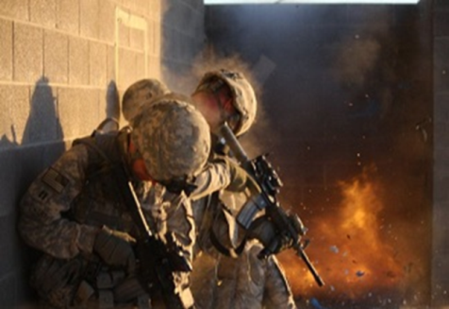
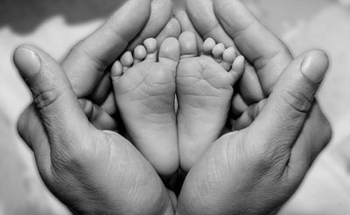
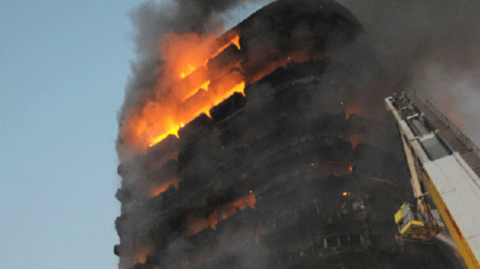
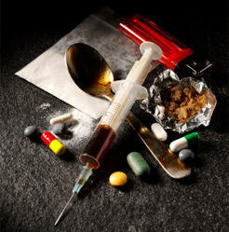

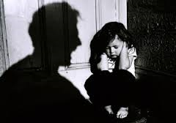
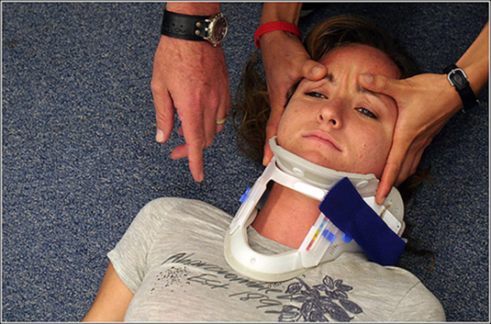

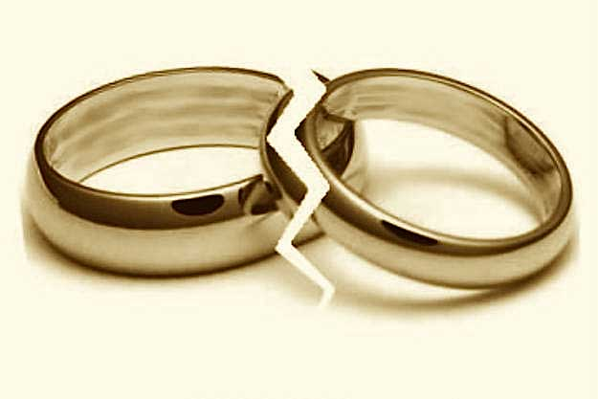

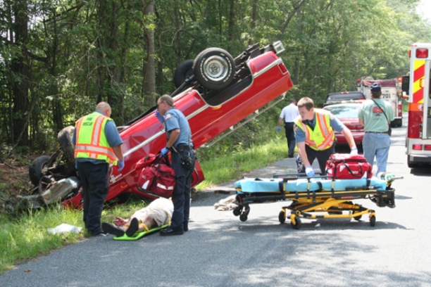

Slide 4
Potential Responses to Adverse Events
(O’Leary & Ickovics, 1994, p. 127)

Slide 5

Posttraumatic Growth (PTG)
“Positive psychological changes experienced as a result of the struggle with highly challenging life circumstances.”
(Tedeschi & Calhoun, 2004, p.1)

Slide 6
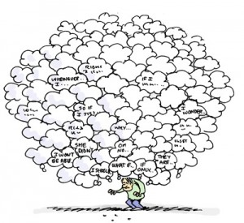


How Does Growth Take Place?
The Cognitive Processing of PTG
Rumination
(Intrusive vs. Deliberate)
(e.g. Stockton, Hunt, & Joseph 2011; Yuen et al., 2014
“Shattered Assumptions”
(Janoff-Bulman, 1992; Parkes, 1971)
Growth
Distress
“A Psychologically Seismic Event”
(Tedeschi & Calhoun, 2004, p. 5)
(e.g. Taku et al., 2008; Solomon & Dekel, 2007)

Slide 7
The Functional Descriptive
Model of Posttraumatic
Growth (Calhoun, Cann, &
Tedeschi, 2010, p. 6)
Person – Pretrauma
Individual Differences
Assumptive World Beliefs
Culturally Influenced
Potentially Disruptive Event
Emotional Distress
Emotional Distress
Assumptive Beliefs
Challenged
Goals/ Narrative Disrupted
Assumptive beliefs provide
context for event
Rumination
Mostly automatic& intrusive
Self analysis: Write/pray
Self disclosure: talk/share
*Manage emotional distress
*Redirect rumination
*Reassess goals
Sociocultural Influences
Proximate: Social support/Role models/
support for schema change and PTG
* Deliberate/Reflective/Constructive
*Rumination
*Schema change/Narrative revision
Distal: Cultural/societal themes
Posttraumatic growth
(Recognition of strengths/
resources/possibilities)
Acceptance of
‘changed’ world
More complex narrative
Increased wisdom
Greater Altruism
Well-being
Life Satisfaction

Slide 8
Limitations and Considerations
Single, shared events (e.g. earthquake, cancer, bereavement)
  Subjective appraisal
  Shattering of assumptive world
Participants largely from Western cultures
Either quantitative or qualitative approach
  insufficient to understanding the complex processing of PTG
Considerable aspects of PTG models not been thoroughly or empirically investigated

Slide 9
Common Issues Faced by HK Students
Depression hits half of Hong Kong secondary pupils and a quarter have considered suicide
(SCMP, Aug, 2015)
Lots of anxiety for Hong Kong students, parents must reduce pressure
(Sing Tao Daily, Mar, 2015)
Students at breaking point
(SCMP, Mar, 2016)
One in seven HKDSE students facing “unbearable” pressure because of insufficient time and uncertainties about the future
(The Standard, April, 2016)
90% students face academic pressure; 70% have insufficient free play
(UNICEF, Nov, 2014)
HKDSE students reveal the pains of pressure
(The Standard, April, 2016)

Slide 10

Suicides Among Young People in HK
Suicide
Leading cause of death among the 15–24-year-old age group
(Yip & Chak, 2011)
2010 – 2014
23 student suicides a year
2010: 2 tertiary students
2014: 3 tertiary students
Sept 2015 – Mar 2016
22 student suicides
10 tertiary students
(Cheung & Chiu, 2016)

Slide 11

What other issues are faced by Chinese tertiary students in Hong Kong?
Mental health issues among young people are growing
Roots of problems largely focused on chronic academic stress
But evidences show…
  Developmental & transitional stress
  High risk for trauma exposure (Breslau et al., 1998)
  Underemphasis on psychosocial competencies (Shek, 2012, 2010)
  Lack of attention paid to needs of tertiary students (Shek and Wong, 2011)
Learning from those who ‘thrived’?

Slide 12
Key Research Questions
What factors promote PTG among Hong Kong Chinese undergraduates experiencing a range of highly stressful events?
What other issues are faced by Hong Kong Chinese undergraduates?
How are these multiple factors of PTG understood in a HK Chinese context?

Slide 13
Conceptualisation of Chinese Beliefs about Adversity
(Shek, 2004, 2005; Leung & Shek, 2013)
Positive Beliefs
(Confucian)
Perseverance
Pain endurance
Self-discipline
Self-development
Emphasis on effort & challenge
Negative Beliefs
(Taoist, Buddhist)
Balance of harmony
Acceptance
Contentment
Uncontrollable life circumstances
Emphasis on luck & fate

Slide 14
The Functional Descriptive
Model of Posttraumatic
Growth (Calhoun, Cann, &
Tedeschi, 2010, p. 6)
Person – Pretrauma
Individual Differences
Assumptive World Beliefs
Culturally Influenced
Potentially Disruptive Event
Emotional Distress
Emotional Distress
Assumptive Beliefs
Challenged
Goals/ Narrative Disrupted
Assumptive beliefs provide
context for event
Rumination
Mostly automatic& intrusive
Self analysis: Write/pray
Self disclosure: talk/share
*Manage emotional distress
*Redirect rumination
*Reassess goals
Sociocultural Influences
Proximate: Social support/Role models/
support for schema change and PTG
* Deliberate/Reflective/Constructive
*Rumination
*Schema change/Narrative revision
Distal: Cultural/societal themes
Posttraumatic growth
(Recognition of strengths/
resources/possibilities)
Acceptance of
‘changed’ world
More complex narrative
Increased wisdom
Greater Altruism
Well-being
Life Satisfaction

Slide 15
Methodology

Slide 16
Sequential Explanatory Mixed Methods Design
(Creswell, Plano Clark, Gutmann, & Hanson, 2003; Tashakkori & Teddlie, 1998)
QUAN
qual
Interpretation based on
QUAN qual results
“A persuasive and strong mixed methods design addresses the decisions of level of integration, priority, timing, and mixing”
(Creswell & Plano Clark, 2007, p. 68)

Slide 17

Phase One (Quantitative)

Slide 18
Participants (Phase One)
Inclusion Criteria
  Aged 18 years or above
  Current higher diploma/undergraduate students or recent graduates
  Have experienced something very difficult/stressful during their life
  Proficient in English language
Exclusion Criterion
    Individuals who are in a psychologically unstable state will not be invited to participate in the study (e.g. currently in psychological treatment)

Slide 19








Measures (Phase One)
Chinese Beliefs About Adversity
(Challenge / Fate)
(9 items)
Core Beliefs Challenge
(9 items)
Perceived Event Stressfulness of Identified Event
Rumination
(Intrusive / Deliberate)
(20 items)
PTG
(10 items)
Life Stressors
(30 items)
Distress
(20 items)
Demographics

Slide 20
Results (Phase One):
Descriptive Statistics
Mean PTGI-SF = 29.70
(3-49)
Core Beliefs Challenge
(r=.335, p=.003)
Mean Age
= 23.11
(18-54)
N = 63
On-going Recruitment
Mean No. of
Events
= 4.77
(Range 1 – 12)
Mean Perceived Event Stressfulness = 5.73
(1-7)
66.7% Female
Chinese Cultural Beliefs about Adversity (Challenge)
(r = .247, p=.029)
Deliberate Rumination
(r = .380, p=.001)
96.83% Interested in Phase Two

Slide 21
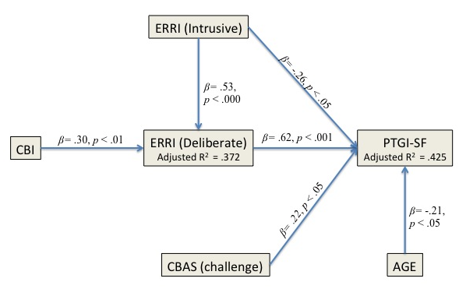
Results (Phase One):
Exploratory Path Model of PTG

Slide 22

Phase Two (Qualitative)

Slide 23


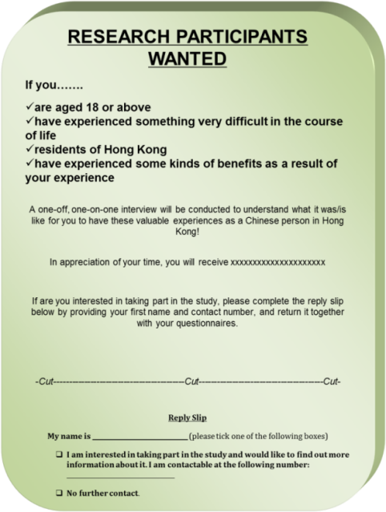


Methods (Phase Two)
Phenomenological Questions
How? What?
Interpretative Phenomenological Approach (IPA)
Reflectivity
Reflexivity
Bracketing
Homogeneity
PTG
Topics
Cultural influences
Core Beliefs Challenge
Rumination
Purposive Sampling
Face-to-face semi-structured interviews
Loose guidelines

Slide 24
Analysis(Phase Two)
Initial stage
Data familiarity
Second stage
Developing emergent themes
Third stage
Clustering of themes
Final Stage
Table of themes
Quality Assurance
Data Analysis
Research Approach
Philosophical Assumptions
Researcher’s background, beliefs, & biases
Data Collection Strategy
Sampling Technique
Stages based on Frost (2011, p. 57-59)
Factors based on Yilmaz (2013)

Slide 25



Gaining Insights:
Examples of Selected Cases
Participant No. 60
Witnessed a serious accident (19)
Adoption/foster care (0-8)
Serious physical/mental illness (10)
Emotional abuse/neglect (16-19)
Physical neglect (8-11)
Someone close died (8)
Witnessed family violence before 16 (10)
Robbed/mugged/physically attacked (11)
20
Participant No. 14
Serious disaster (12)
Serious money problem (20-20)
Serious physical / mental illness (19-20)
Emotional abuse / neglect (aged 13-15)
Physical neglect (Aged 18)
Abortion/miscarriage (21)
Someone close died (21)
Witnessed robbery, mugging / attack (13)
Physical abuse / attack by someone known before 16 (12-13)
Sexual harassment (18-23)
23
Participant No. 51
Witnessed a serious accident (12)
Someone close died suddenly/unexpectedly (23)
Someone close died (25)
29

Slide 26
Theoretical
Empirical support for socio-cultural influences on PTG
Educational
Issues beyond academic stress
Encourage endorsement of cultural beliefs that promote PTG
Methodological
Mixed methods research – Complementary strengths
Clinical
Alternative approach to mental health interventions
Purposeful guiding of meaningful cognitive processing
Predicted Contribution to Knowledge

Slide 27
Q&A
Thank You For Listening

