Slide 1
Gramsci and Foucault: Hegemony in the Global Episteme
David Kreps
September 2015

Slide 2
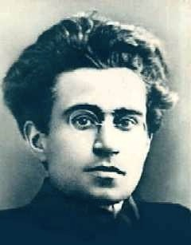
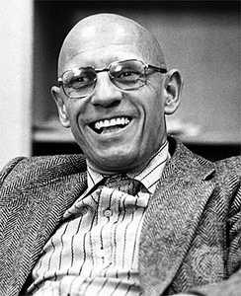
Michel Foucault
1926-1984 French poststructuralist philosopher and historian of ideas. Author of numerous books and academic lectures
Antonio Gramsci
1891-1937 Italian Marxist theoretician spent much time in prison. Most of what we know is in ‘Prison Notebooks’

Slide 3
Hegemony Force and consent used by the dominant to rule more effectively than with force alone
Power/Knowledge Power is not located in those who exercise it - relations of power are everywhere, especially within ‘knowledge’

Slide 4
Discipline
Selves constituted by the institutions, languages and practices we grow up with
Culture Shifting alliances of different social groups vying for hegemony - more than just ‘economic necessity’

Slide 5
Dissonance Gramsci: power over - macropolitics - state and social classes Foucault: power between - micropolitics - decentred individuals
Consonance Foucauldian Gramsci: hegemony situated within discursive micropolitics Gramscian Foucault: resistance is possible through the collective revolution of the self

Slide 6
Hegemony in the Global Episteme
/ˌep.ɪˈstiːm/ Foucault: the historical a priori that grounds knowledge and its discourses and thus represents the condition of their possibility within a particular epoch
Gill: transnational historic bloc
Hardt & Negri: Empire: (distributed/epistemic) neoliberal ascendancy

Slide 7
Hegemony in the Global Episteme
Laclau & Mouffe: hegemony articulates (discursive) social identities
Consumerised / financialised / virtualised social identities: a new transnational and distributed hegemonic governmentality
Global episteme: hegemony and resistance: Google, Apple, Facebook, Monsanto, Nestle, TPP/TTIP vs Syriza, Podemos, Sanders and Corbyn.

Slide 8
Leadership
Newspaper barons and private education vs ‘Social media’ mediated social movements
‘Social media’ belong to corporate interests - a site of resistance where hegemony is fought for at the interpersonal level – the collective revolution of the self
Arab Spring – leaderless – US:Sanders, Greece:Tsipras UK:Corbyn etc – heads of social movements organised online

Slide 9
Gramsci and Foucault: A Reassessment
Edited by - David Kreps
Foreword - Stephen Gill - the Post-Modern Prince
Chapters David Kreps - Introduction - three camps: Gramsci right, Foucault right, or the possibility of some benefit to using both
Alex Demirovic - Truth and power
Ngai-Ling Sum - Discourses of competitiveness
Marcus Schulzke - Power and resistance
Jean-Paul Gagnon - Education and democracy
Sonita Sarker - Subaltern positions without identity: Dalit and indigenous US
Jelle Verserien & Brecht de Smet - Religion, modernity, Catholic and Shia
Efe Gurcan & Onur Bakiner - Latin American revolutionary politics
Heather Brunskell-Evans - Western child psychology in post-invasion Iraq
David Kreps - Complexity theory: can hegemony emerge from micro politics?

Slide 10
Gramsci and Foucault: A Reassessment
Edited by David Kreps
Ashgate Publishing February 2015
http://bit.ly/gramscifoucault

