Slide 1
CA4: R= -OH
CA4P: R= -OPO₃H₂
CA4F: R= -F

Slide 3
Fluorescence Intensity / Laser power (F/P)
Fluorescence
Intensity (F, AU)
Average laser power at sample (P, mW)

Slide 4
% Conversion Z → E in focal volume
Average laser power at sample (mW)

Slide 5
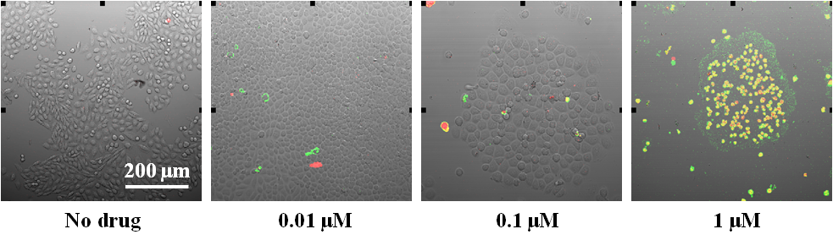
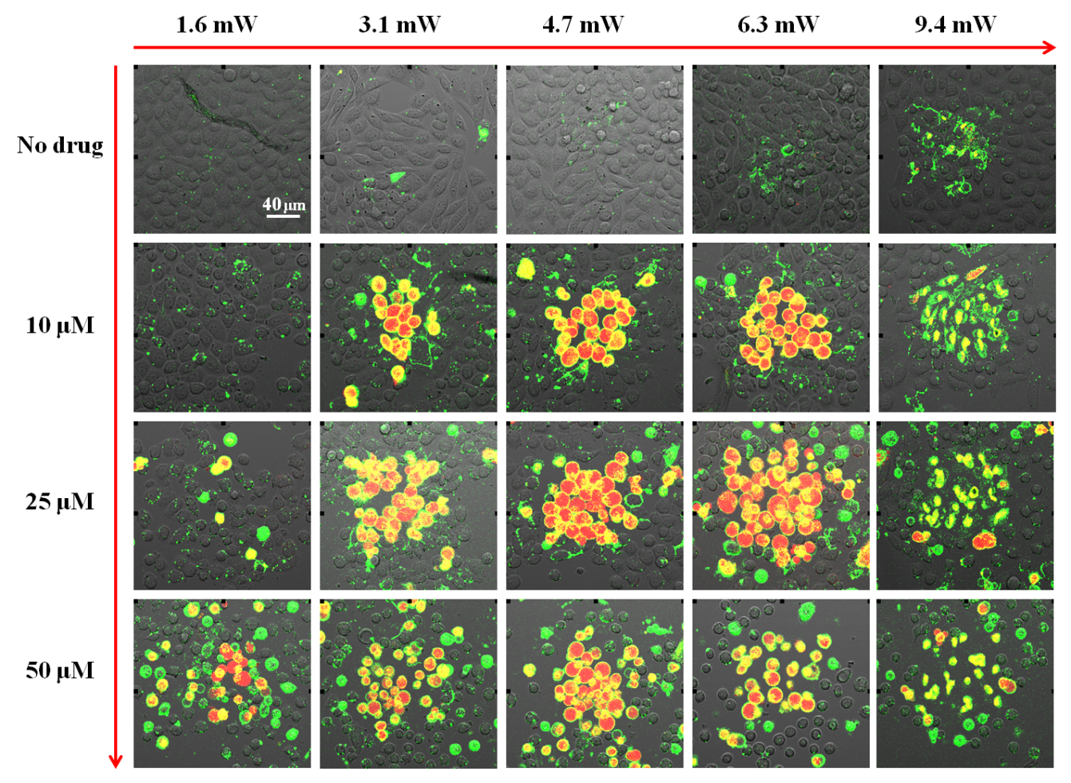
a b c d e
1.6 mW 3.1 mW 4.7 mW 6.3 mW 9.4 mW
A
B
1, 0 μM
2, 10 μM
3, 25 μM
4, 50 μM
0 μM
0.1 μM
1 μM

