Slide 1

Young offenders’ trauma on release from custody
Neal Hazel
Director, CSR.Salford, University of Salford, UK
Tim Bateman
University of Bedfordshire, UK
ESC Conference, Budapest, 5 September 2013

Slide 2






A 5-year England-wide programme which examines and promotes best practice in the resettlement of young people and young adults leaving custody.
www.beyondyouthcustody.net

Slide 3



Paper takes data from research over 15 years:
Evaluation of Medway Secure Training Centre (1998-2000)
Assessment of the Detention and Training Order (2000-2002)
Young offenders’ experiences of Criminal Justice (2000-2002)
Evaluation of RESET resettlement programme (2005-2007)
Resettlement needs of girls in custody (2011-2013)
Data from qualitative depth interviews with young people (and parents)
Young people aged 12 to 17

Slide 4

Mixed experiences of release
Release process is easy for some:
I reckon it was easy. I just come out and everything is the same, not the same but over the two days everything felt the same. It was like I had never gone to prison
John, 17
But ‘two days’ to feel the same gives hints at the transition process and initial issues >

Slide 5
Dream of getting out, no anticipation of disorientation
Key words repeated in interviews:
mad, buzzing, strange, weird
Big thing innit, just getting let out. And then I felt weird for a bit.... I couldn’t speak. It was weird...I knew I’d be happy and everything, but I didn’t know it was going to feel like that.
Ella, 17
Weird, It done my head in
Tony, 14
I knew it was gonna be a bit weird but I didn’t think...I dunno. I think it just hit me to be honest, I dunno.
Sasha, 17

Slide 6

Trauma effects felt by young people
Physical stress symptoms
When my mum came and picked me up from the prison, when I came out and I was sitting in the car, I felt sick. I was shaking cos I didn’t know what to do and that.
Ella, 17

Slide 7
Trauma effects felt by young people
Overwhelmed psychological anxiety
I couldn’t handle it, like the first day I couldn’t handle being out of prison. I just couldn’t stop crying and felt depressed all the time.
Sasha, 17
I was really scared when I am out. I was all scared cos I thought everyone was looking at me. I felt scared. I walked around town, and I thought everyone was just ataring at me, but they weren’t it was just me.
Peter, 17

Slide 8

Trauma effects felt by young people
Quiet and withdrawn
I came out and it was weird. I could hardly talk for about a week
Ben, 17
He was very withdrawn when he first came out. He didn’t want to go anywhere or anything. He was very withdrawn. He is back [to himself] now. Yes, he is speaking now and he does go out with his friends.
Grandparent

Slide 9
Trauma effects felt by young people
Agoraphobic symptoms
Just indoors with all my family and friends, I didn’t go out
Sasha, 17
I just weren’t ready to go out. I felt weird
Ella, 17 (did not leave the house for 10 days)

Slide 10
Trauma effects felt by young people
Agoraphobic symptoms – neighbourhoud felt alien and unfamiliar
I didn’t really want to go out. I wasn’t used to being there. I had to start again getting used to the area.
Ben, 17
Exacerbated by fear of being returned to custody:
I was scared of getting in trouble and getting taken back...As long as I was in the house, I wouldn’t mind.
Ella, 17
Contrasted with others who react with binge on life or binge on antisocial behaviour

Slide 11
Trauma effects felt by young people
Physical tiredness [stress or physical readjustment?]
I just used to get right tired, cos inside you used to like walk around there not doing much really
Gary, 14
And walking as well, that was mad, walking. My legs felt like spaghetti.
Martin, 16

Slide 12
What was stressful about the experience?
Disorientated and scared
Lost, I think I was. I didn’t know where I was going to go or what. I just came out of there. It was like my life had just stopped and swung back round and kicked me.
Martin, 16
I walked into the shop, and I didn’t know what I wanted
Peter, 17
I came out and I was scared. I didn’t know what to do, I didn’t know where to go. I kept sitting down. I was like seeing cars going past and I was like, “Can’t believe I’m out”
Jenny, 16

Slide 13
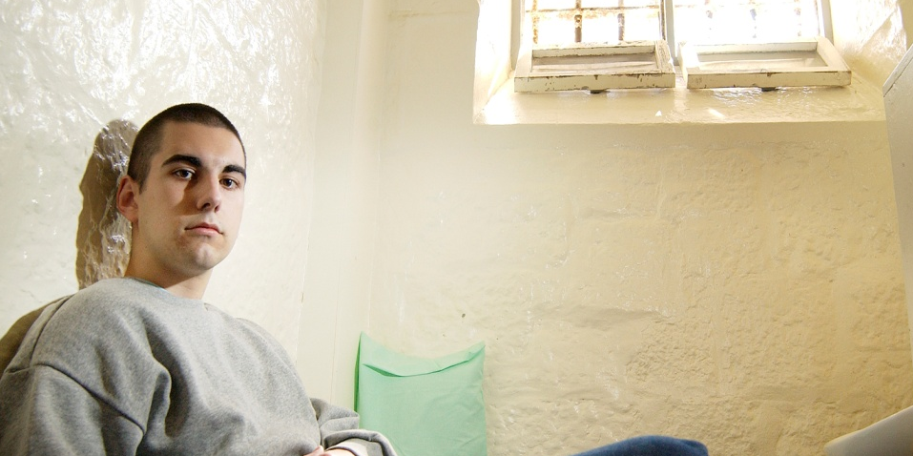
What was stressful about the experience?
Pace of life literally and perception
I came home and everything was faster, cos everything’s slow down there [in custody]. You don’t really do owt do you? So you come out and everyone’s just rushing about as normal and ... so it takes you a while to keep up and carry back on.
Gary, 14
Everyone rushing about. Everyone is mad. You are used to sitting down all day.
Martin, 16

Slide 14
What was stressful about the experience?
The normal was suddenly unfamiliar – destabilised
I dunno, I was shocked really....happy to get out, yeah...[but] yeah, it felt weird. Like seeing a bus and everything, it felt weird
Sasha, 17
I was walking into shops and I was thinking, “Oh my gosh”, cos I didn’t see a shop [inside]. I didn’t actually like, all I saw was pure girls. I didn’t see like cars or food shops and that.
Jenny, 16

Slide 15
What was stressful about the experience?
Adapting to a world that’s moved on
There’s new owners in the shops and all that. It was a bit strange, but I’ve got used to it now
Steve, 17
Eg thinking been ‘robbed’ when new coin in change (Barry, 14)

Slide 16
What was stressful about the experience?
Learning to interact again – especially with family and friends
I didn’t know what to say to mum and dad when I came out. And I didn’t know what to say to my friends. I like never talked to hardly anyone. I just kept myself to myself.
Peter, 17
I was in the bedroom with my cousin celebrating that I’d just come out. And usually, like me and my cousin chat away and everything but in the bedroom I was just looking and smiling and embarrassed, going all red and everything. Going all red. I didn’t want to talk to them. She started talking to me and I was, “Yeah yeah”. I just didn’t know what to say. It is a weird experience, a really weird experience.
Ben, 17

Slide 17

What was stressful about the experience?
Suggestion of difficulty with the opposite sex after single sex institution?
It was strange seeing boys walking past me. It was strange seeing boys walking past me. People was coming up to me: “How are you? And I weren’t really relating to them.
Jenny, 16

Slide 18
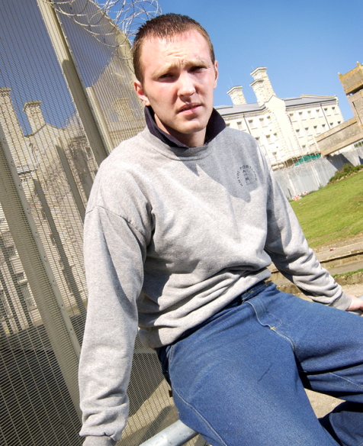
What was stressful about the experience?
Lack of regulation like eating and sleeping patterns
Just my sleeping pattern. [In custody], I wake up in the morning and make the bed and then eat my breakfast for a certain time. But it’s just getting back into a sleeping pattern, waking up at 2.30 in the afternoon again.
Sean, 16
Unable to cope with taking initiative or act independently

Slide 19
Negative support
Pressure of being focus of attention when interactions are stressful
Cos everything was going too fast. Like people, all my family were coming over, get all this birthday stuff and....I dunno, like every time I see someone, it was like “Oh how was prison?” “How was this, how was that?” and yeah, it was just the same thing over and over.
Sasha, 17

Slide 20
Conclusions
Release from prison is traumatic for young people, not so recognised by literature
Disorienting and scary experience
Physical and psychological symptoms of stress
Trauma not anticipated, nor prepared for
Even young people with high levels of support
Supporters can make matters worse

Slide 21
Recommendations
Service providers should acknowledge and prepare for traumatic nature of release
All young people should be met at the gate by someone they have good relationship with
Structured timetable for initial period, discussed in advance
Greater use of Release on Temporary Licence
Additional shorter ROTL
If just for an hour, just like walking around (Barry, 14)
Advice to young people and family for graduated exposure and acclimatisation
More alone time with family in different environments before release
Consider physical preparation for release as well

Slide 22
Bateman T, Hazel N and Wright S (2013) Resettlement of young people leaving custody: Lessons from the literature London: Beyond Youth Custody/Nacro
(http://www.beyondyouthcustody.net/resources/publications/lessons-from-the-literature/)

