Slide 1
Resettlement after prisons:
What the Government needs to know for the new youth custody Bill
Neal Hazel
Director, Centre for Social Research (CSR.Salford)
Tim Bateman
University of Bedfordshire
British Society of Criminology Conference
Wolverhampton, July 2013

Slide 2

Context of concern
73% custody reoffending rate – and getting higher
Expensive at £100 to £200k pa per place
Low literacy rates (half of 15-17s at primary level)
80%+ exclusion rates
Custodial contracts for STCs, SCHs and educ in YOIs coming to an end

Slide 3
Green paper on youth custody
Transforming Youth Custody: Putting education at the heart of detention (Feb 2013, MoJ and DfE)
  MOJ and YJB drafting legislation now
Custody is the “chance to end the chaos”
  BUT - Custody interrupts ties, disengages, trauma
Education at the heart – enables them to engage
Secure Colleges
  Like Borstals and STCs
“More effectively linked to what happens in the community”
  Signs that the MoJ is moving towards emphasising this.

Slide 4




Custody Evaluations
Evaluation of Medway Secure Training Centre (1998-2000)
Assessment of Detention and Training Order (2000-2002)
Evaluation of RESET programme (2005-2008)
Development of recommendations on resettlement (2010)
Evaluation of RAP and IRS (2005-2008)
Evaluation of the YJB Resettlement Consortium Pilots
(2010-2012)
Evaluation of Pilot Resettlement Support Panel Scheme
(2005-2008)
Evaluation of the Daedalus Project (Heron Unit) (2009-2012)

Slide 5
Factors linked to reduced offending
Evaluation of Medway Secure Training Centre
  Involvement in ETE or leisure after release
Assessment of Detention and Training Order
  (1) Involvement in ETE after release and (2) stable accommodation
Evaluation of RESET programme
  Areas having a manager coordinating agency partnerships
Evaluation of the YJB Resettlement Consortium Pilots
  (1) Having more needs addressed by agencies and (2) ETE

Slide 6
Green paper on youth custody
Transforming Youth Custody: Putting education at the heart of detention
Custody is the “chance to end the chaos”
Education at the heart – enables them to engage
  Yes, important BUT whole range of needs that need to be met holistically.
Secure Colleges
  BUT research showed key to be what happened when came out (any ETE or organised leisure)
“More effectively linked to what happens in the community”
  Yes, that’s at the heart – and signs that the MoJ is hearing that.
  So, what does research suggest the legislation focus on ensuring?

Slide 7


Recent summary reports
Hazel N and Liddle M (2012) Resettlement in England and Wales: Key policy and practice messages from research London: Youth Justice Board
Bateman T, Hazel N and Wright (2013) Resettlement of young people leaving custody: Lessons from the literature London: Beyond Youth Custody (www.beyondyouthcustody.net)

Slide 8
Two key principles from research
Smooth transition from custody to community
Effective cooperation between custody and community focused on resettlement throughout
Holistic response to complex needs in community
Widespread partnership coordination to address multiple needs
So, all about coordination and partnerships

Slide 9

Cooperation between custody and community
Resettlement should be the focus of detention
  One joint planning team across custody and community to ensure continuity and shared ownership
  Focus on resettlement from conviction (or before)
  Young person placed close to home
  Fewer institutions in order to build links
  Reducing transfers
  Case-management role for institutions

Slide 10

Cooperation between custody and community
Preparation for release
  Institutions prepare for readjustment from conviction
  Marry education to what’s available outside
  Unblock ROTL (risk and short sentences)
  Allow community agencies access
  Sort out the CSCS issues

Slide 11

Cooperation between custody and community
Preparing the home provision
  ETE should be in place in time for release (target)
  Intensive support in immediate period
  Immediate housing provision
  Early homeless assessments
  No deregistering of looked-after children
  Roll-on, roll-off courses
  Summer courses

Slide 12

Cooperation between custody and community
Info flow between custody and community
  Sharing of who to contact
  Central recording of all in-custody work
  Info passed on prior to release
  Consistent completion of common recording system

Slide 13

Coordinated community approach
Overall strategic management
  Early senior-level buy-in from LA departments
  Shared aims and targets
  Shared operational management to be user focused
  Closer working with Probation

Slide 14
Coordinated community approach
“Service broker” model
  Role focused on partnership coordination – not cases
  National guidance needed
Developing wraparound services
  Wide range of partnerships needed (for complex group)
  Partners beyond youth justice, and beyond state sector
  Prioritise accommodation
  Prioritise employer links
  (beyond construction)

Slide 15

Coordinated community approach
Meeting the young person’s needs
  Keep the young person occupied
  Ensure that the family is on-board
  Avoid increased breaching
  Ensure enforcement agencies are on-board
  Have a tapered exit plan

Slide 16
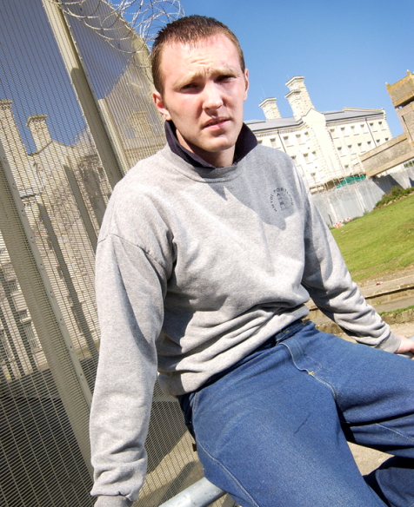
Key questions for Government:
Emphasis on introducing market forces or what works? What works
Education or resettlement? Resettlement
Who should be responsible for resettlement? Probably Yots, but with as many having stake as possible
How to ensure that everyone has a stake and plays a part?
How to incentivise resettlement? (Easier to control instructions)
How can ROTL benefit when placed so far from home?
How to engage employers in these times?
How to keep open accommodation?
How do you resettle those on remand?

Slide 17

Moving Beyond – key questions for researchers:
How can the transition at 18yrs be made more seamless?
How can we sustain engagement?
How can we give enhanced support without increasing the risk of breaching?
How might services take account of gender? Do black and minority young people require specific provision?
How to we resource and manage a tapered exit strategy?
Are the resettlement lessons the same for remands?
Do we have the right resettlement aims?

Slide 18






Moving Beyond:
A 5-year national programme which examines and promotes best practice in the resettlement of young people and young adults leaving custody.
www.beyondyouthcustody.net

