Slide 1
Linking Sustainable Drainage Systems (SuDS) and ecosystem services: new connections in urban ecology
Chunglim Mak¹, Philip James¹, and Miklas Scholz²
¹Ecosystems & Environment Research Centre, School of Environment & Life Sciences, Peel Building
²Civil Engineering Research Group, School of Computing, Science and Engineering, Newton Building

Slide 2
Content
Introduction – Urban Diffuse Pollution
Current Situation
The Idea
Explanations and demonstration – River Irwell Catchment
Further Research

Slide 3
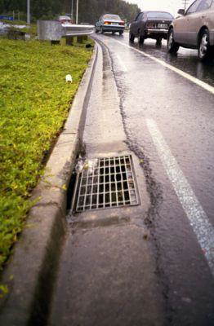
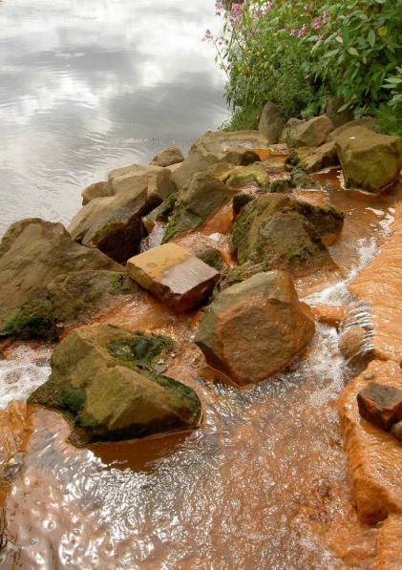
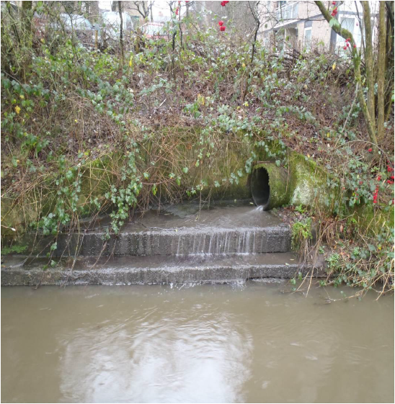
Introduction – Urban Diffuse Pollution
1
2
3

Slide 4
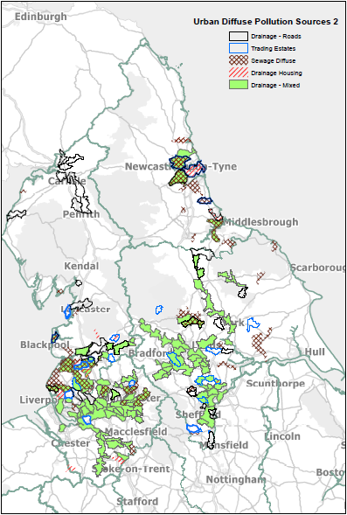
Current Situation 1
Urban Runoff causing activities
Drainage – Roads
Drainage Housing
Drainage – Mixed
4

Slide 5
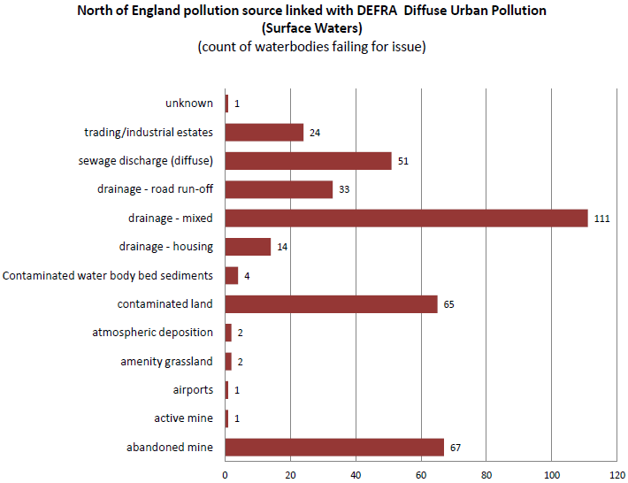
Current Situation 2
5

Slide 6
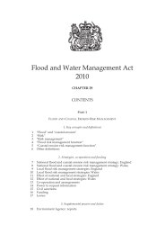
Current Situation 3 – Key legislations
April 2014?
6

Slide 7
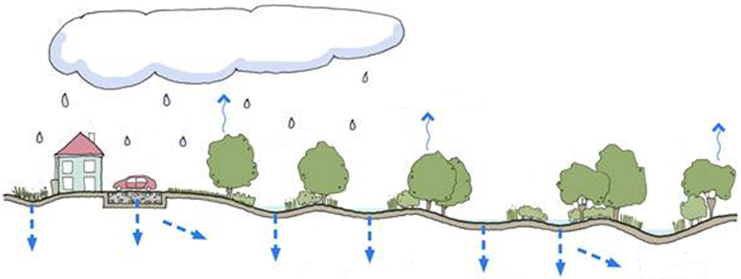
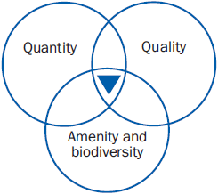
Current Situation 4 – SuDS
7
Solar energy
8
Prevention
evapotranspiration
Source Control
Regional Control
Site Control
receiving water body
infiltration

Slide 8
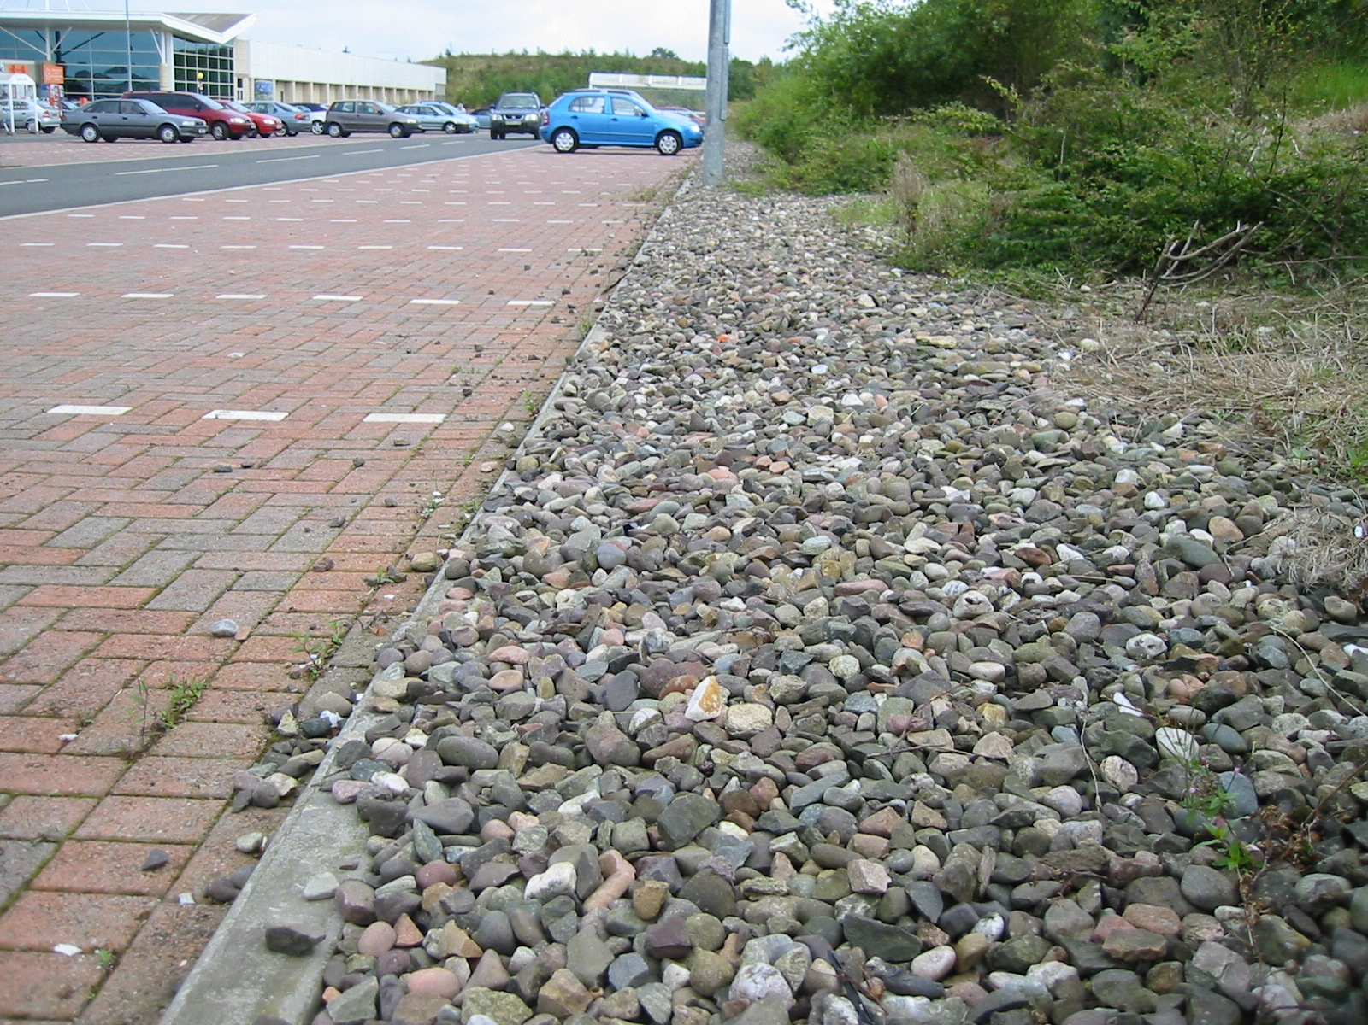
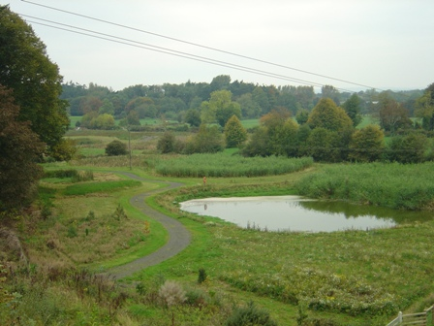
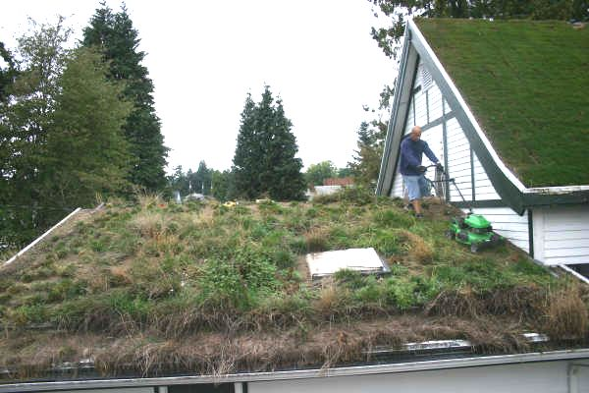
Current Situation 5 – SuDS types
Rainwater Harvesting
Pervious pavements
Filter strips
Swales
Green roofs
Ponds
Infiltration devices
Wetlands
Underground storage
Bioretention
9
10
12
11

Slide 9
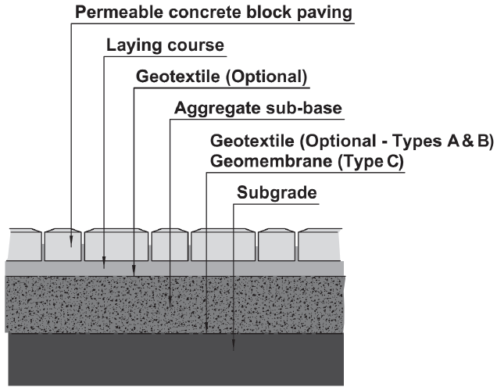
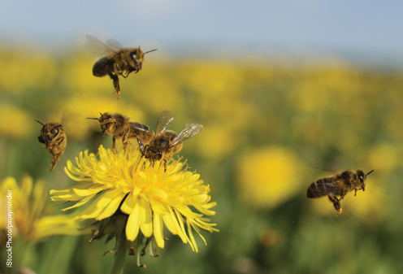
Current Situation 6 – Knowledge Gap
13
15
14a
14b

Slide 10
The Idea
SuDS Planning Tool using the ecosystem services and disservices approach.

Slide 11
Ecosystem Service
SuDS type
16a, b
Rainwater Harvesting
Supporting
Habitat for species
Pervious pavements
Provisioning
Filter strips
Food
Fresh water
Raw material
Swales
Regulating
Green roofs
Groundwater recharge
Flood mitigation
Water purification
Ponds
Local climate and air quality regulation
Urban Heat Island Mitigation
Infiltration devices
Global climate and green house gas regulation
Wetlands
Carbon sequestration
Pollination
Underground storage
Cultural
Recreation
Bioretention
Education
Aesthetic

Slide 12
SuDS type
17a, b, c
Ecosystem Disservice
Rainwater Harvesting
Supporting
Littering by animals foraging in bins
Pervious pavements
Disease carrying animals
Filter strips
Habitat competition with humans
Accidents
Swales
Green roofs
Regulating
Drainage failures
Contaminant mobilization
Ponds
Maintenance
VOC emissions
Damage to infrastructures
Infiltration devices
Plant pollen allergies
Wetlands
Cultural
Underground storage
Land use conflicts
Fear and stress
Bioretention

Slide 13
Explanation 1 - usage
Web based user interface, with clickable links containing specific, detailed information to aid the following tasks:
Deciding on where to locate a new SuDS development.
Analysing an existing SuDS system.
Designing a new SuDS system.
Compiling public policy documents.

Slide 14
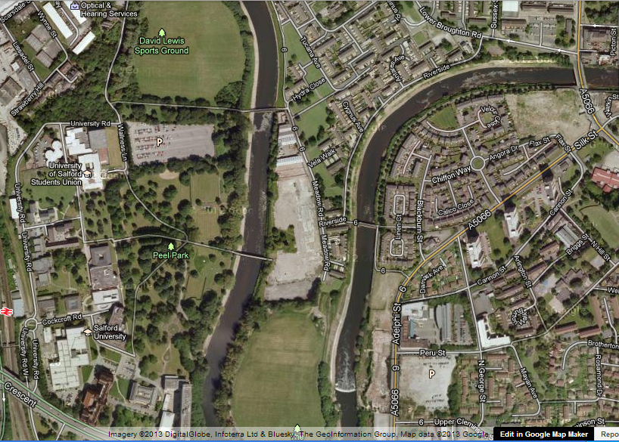
Demonstration – River Irwell Catchment
River Irwell Catchment Pilot – Rivers Return

Slide 15
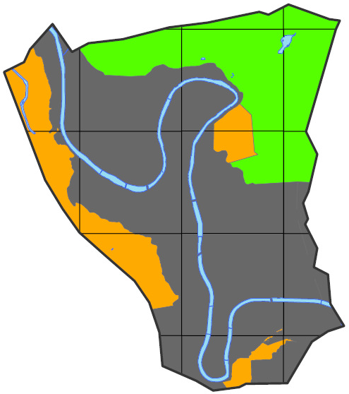
Lower Irwell Valley – SuDS advice map
21
The SuDS advice map
< 5m above nominal river level. Underlain by unfavourable drift geology (till) Within flood protection zones 2 or 3. Storage based SuDS.
> 5m above nominal river level . Underlain by undifferentiated glacial deposits or alluvium Outside all flood protection zones. Infiltration and storage based SuDS.
> 5m above nominal river level. Underlain by sand/gravel drift deposits. Outside flood protection zones 2 and 3. Infiltration based SuDS.

Slide 16
Description
Habitats provide everything that an individual plant or animal needs to survive: food, water, and shelter. Each ecosystem provides different habitats that can be essential for a species’ lifecycle. Migratory species including birds, fish, mammals and insects all depend upon different ecosystems during their movements.
Ecosystem Service
SuDS type
Measurement Indicators
Habitat diversity, Landcover, Biodiversity
Rainwater Harvesting
Supporting
Habitat for species
Habitat for species
Habitat for species
Pervious pavements
Definition
A Storage based SuDS consisting of shallow ponds and marshes, covered almost entirely with aquatic vegetation. Six types of SuDS wetlands (shallow wetlands, extended detention shallow wetlands, pocket wetlands, pond/wetland systems, submerged gravel wetlands, and wetland channels). A positive water balance must be maintained in order to prevent the wetland from dying off. Most SuDS wetlands in Europe are soil or gravel based horizontal-flow systems planted with T. Latifolia and/or P. Australis).
Habitat diversity
Aquatic: aquatic mesohabitats coverage.
Terrestrial: terrestrial vegetation structure and coverage.
Provisioning
Filter strips
Food
Fresh water
Valuation indicators
Travel Cost, Benefit Transfer
Wetlands are Excellent for Habitat for Species and Water Purification.
Raw material
Swales
Regulating
Green roofs
Groundwater recharge
Flood mitigation
Water Purification
Water purification
Ponds
Local climate and air quality regulation
Wetlands are Excellent for Recreation.
Urban Heat Island Mitigation
Infiltration devices
Global climate and green house gas regulation
Wetlands
Carbon sequestration
Wetlands
Wetlands
Pollination
Underground storage
Cultural
Measurement Indicators
Landcover, Legal accessibility, Recreational structures
Recreation
Recreation
Bioretention
Education
Aesthetic

Slide 17
SuDS type
Ecosystem Disservice
Rainwater Harvesting
Indicator
Habitats conducive to ticks and rats
Supporting
Littering by animals foraging in bins
Pervious pavements
Disease carrying animals
Disease carrying animals
Filter strips
Habitat competition with humans
Indicator
Costs of maintenance
Accidents
Swales
Green roofs
Regulating
Drainage failures
Maintenance
Contaminant mobilization
Ponds
Maintenance
VOC emissions
Indicator
Land value, Profitability
Damage to infrastructures
Infiltration devices
Plant pollen allergies
Wetlands
Wetlands
Cultural
Underground storage
Landuse conflicts
Land use conflicts
Fear and stress
Bioretention
Indicator
Areas of non-illumination
Fear and stress

Slide 18
Measurement Indicators
Habitat diversity, Landcover, Biodiversity
Ecosystem Service
SuDS type
Rainwater Harvesting
Definition
An infiltration based SuDS categorized into two types of surfaces: permeable and porous. Permeable surfaces are made up of materials that do not contain any voids in itself. However, through surfacing arrangements, they allow water to infiltrate through the gaps in-between. An example would be concrete block paving. Porous surfaces are made up of materials that are porous in itself. Water passing over these surfaces can infiltrate through them and into the aggregate sub base below. Examples are grass, gravel, porous concrete, and porous asphalt. Typical construction materials are subgrade, geomembrane, aggregate, geotextile, and either impermeable pavement blocks or porous surfaces, depending on which two surface types is chosen to be used.
Supporting
Habitat for species
Habitat for species
Pervious pavements
Pervious pavements
Pervious pavements
Pervious pavements are Poor for Habitat For Species.
Provisioning
Filter strips
Food
Fresh water
Measurement Indicators
pH, Nitrates and Phosphates contents
Raw material
Swales
Regulating
Green roofs
Groundwater recharge
Flood mitigation
Water Purification
Water purification
Ponds
Local climate and air quality regulation
Urban Heat Island Mitigation
Urban Heat Island Mitigation
Infiltration devices
Global climate and green house gas regulation
Wetlands
Carbon sequestration
Pollination
Measurement Indicator
Colour of paving
Underground storage
Cultural
Recreation
Bioretention
Education
Aesthetic

Slide 19
SuDS type
Ecosystem Disservice
Rainwater Harvesting
Supporting
Littering by animals foraging in bins
Pervious pavements
Pervious pavements
Disease carrying animals
Indicator
Permeability
Filter strips
Habitat competition with humans
Accidents
Swales
Drainage failures
Green roofs
Regulating
Drainage failures
Maintenance
Contaminant mobilization
Ponds
Maintenance
VOC emissions
Damage to infrastructures
Infiltration devices
Indicator
Costs of maintenance
Plant pollen allergies
Wetlands
Cultural
Underground storage
Indicator
Land value, Profitability
Landuse conflicts
Land use conflicts
Fear and stress
Bioretention

Slide 20
SuDS techniques comparisons
SuDS techniques | E.S for comparisons | E.DS for comparisons | Additional E.S | Additional E.DS
Wetlands | Habitat For Species Water Purification | Maintenance Landuse Conflicts | Recreation | Disease Carrying Animals Fear and Stress
Pervious Pavements |  |  | Urban Heat Island Mitigation | Drainage Failures

Slide 21
Further Development
SuDS type, ecosystem service and disservices linkages validation.
Research on the strength class definitions.
Ecosystem services and disservices valuation indicators and methods.
Web site development.
SuDS sites to trial planning tool.

Slide 22
Chunglim Mak c.mak@edu.salford.ac.uk

Slide 23
Reference 1
1, 2, and 3. JAMES, P., ATKINSON, S., BARLOW, D., BATES, A., COMYN, F., DUDDY, M., DUTTON, D., FRASER, J., HORSFALL, W., HOTHERSALL, A., LOWRY, K., MOORE, A., ROTHWELL, J., SCHOFIELD, M., SMITH, A., SURTEES, A., TAYLOR, D., TOLLITT, B., TOWERS, C., TZOULAS, K., WHITAKER, G. & CAUSER, K. 2012. The Irwell Catchment Pilot: The Rivers Return. In: THE ENVIRONMENT AGENCY (ed.). Warrington.James, P., et al. (2012). The Irwell Catchment Pilot: The Rivers Return. The Environment Agency. Warrington.
4. ENVIRONMENT AGENCY 2013. Urban Diffuse Pollution Challenge - Evidence Pack. In: APPENDIX 2 - URBAN DIFFUSE POLLUTION SOURCES 2 (ed.).
5. ENVIRONMENT AGENCY 2013. Urban Diffuse Pollution Challenge - Evidence Pack. In: NORTH OF ENGLAND POLLUTION SOURCE LINKED WITH DEFRA DIFFUSE URBAN POLLUTION (SURFACE WATERS) - COUNT OF WATERBODIES FAILING FOR ISSUE (ed.).
6. ANNE MCINTOSH MP 2012. Flooding. In: DEFRA (ed.).
7, 9, 13, 18. B. WOODS-BALLARD, R. KELLAGHER, P. MARTIN, C. JEFFERIES, R. BRAY & P. SHAFFER 2007. C697 The SUDS Manual. C697. London: CIRIA.
8. CIRIA 2012. SuDS management train. In: SUDS MANAGEMENT TRAIN (ed.).

Slide 24
Reference 2
10. SUDSNET 2008. Permeable paving. In: PERMEABLE PAVING AND FILTER DRAIN AT SUPERMARKET (ed.).
11. WAGNER, T. 2012. Troy's Green Roof. In: TROYS_GREENROOF10 (ed.).
12. FORBES, G., FOY, B. & MULHOLLAND, M. 2010. The role of Constructed Wetlands in treating farmyard dirty water. In: THE CONSTRUCTED WETLAND AT GREENMOUNT CAMPUS, C. (ed.). The Department of Agriculture and Rural Development - Northern Ireland.
14a. GOLDMAN, R. L. 2010. Ecosystem Services: How People Benefit from Nature. In: ECOSYSTEM SERVICES: HOW PEOPLE BENEFIT FROM NATURE (ed.). Environment - Science and Policy for Sustainable Development.
14b. SNOW, S. 2008. Green Eyes On: Bee Pollen Cures Allergies. www.treehugger.com/green-food/green-eyes-on-bee-pollen-cures-allergies.html.
15. Microsoft. 2013.
16a. MILLENIUM ECOSYSTEM ASSESSMENT. 2005. Chapter 2: Ecosystems and their services. Ecosystems and Human Well-being: A Framework for Assessment.

Slide 25
Reference 3
16b, 19. TEEB. 2010. TEEB Manual for Cities: Ecosystem Services in Urban Management. www.teebweb.org.
17a. LYYTIMAKI, J., PETERSEN, L. K., NORMANDER, B. & BEZAK, P. 2008. Nature as a nuisance? Ecosystem services and disservices to urban lifestyle. Environmental Sciences, 5, 161-172.
17b. GOMEZ-BAGGETHUM, E. & BARTON, N. D. 2013. Classifying and valuing ecosystem services for urban planning. Ecological Economics, 86, 235-245.
17c. Antia, D. J. D. 2009. Formation and Control of Self-Sealing High Permeability Groundwater Mounds in Impermeable Sediment: Implications for SUDS and Sustainable Pressure Mound Management. Sustainability, 1, 855-923.
20. KSIAZEK, K., FANT, J. & SKOGEN, K. 2012. An assessment of pollen limitation on Chicago green roofs. Landscape and Urban Planning, 107, 401-408.
21. DONCASTER, S., STOVIN, V. & MORROW, B. 2008. Lower Irwell Valley, Salford Integrated Urban Drainage Pilot Project TRE344 Final Report.

