Slide 1
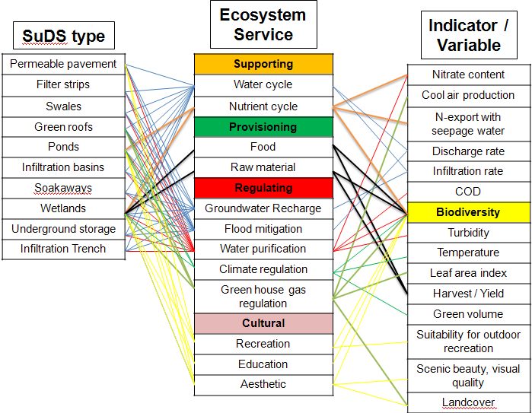
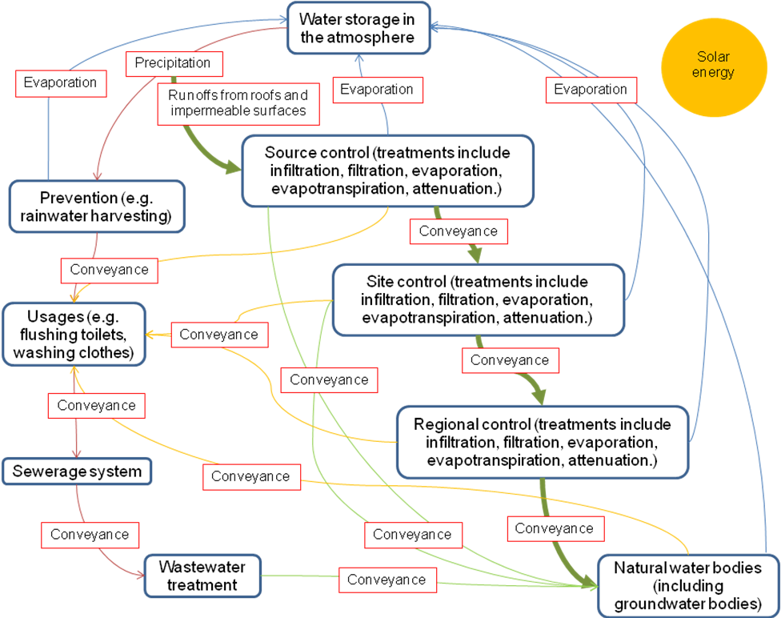
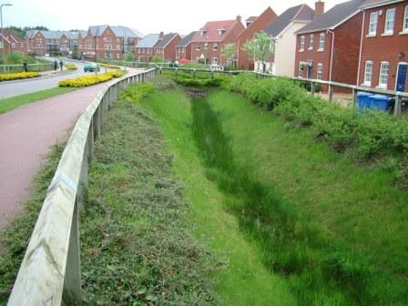
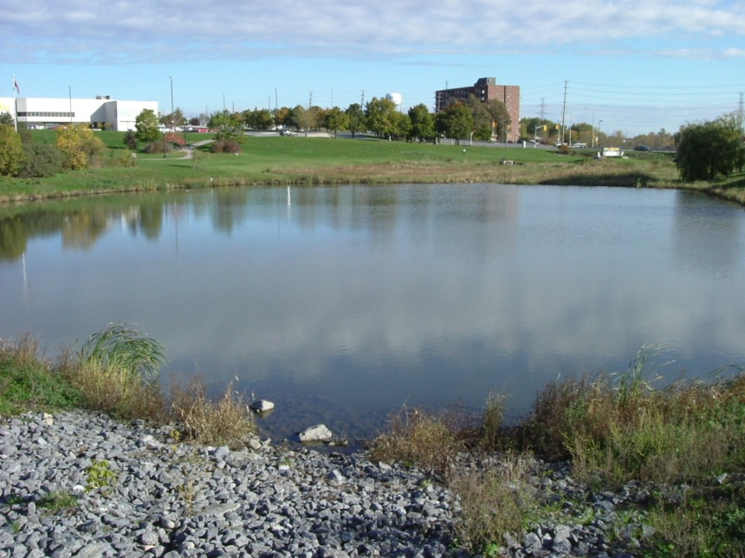
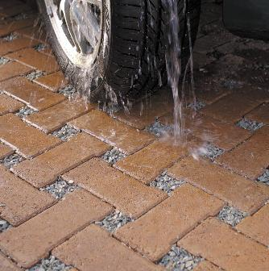
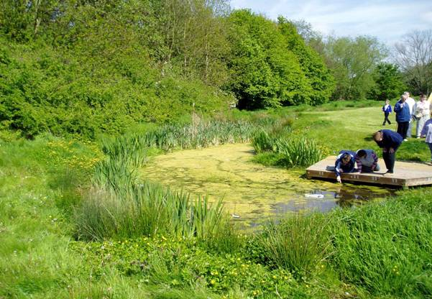
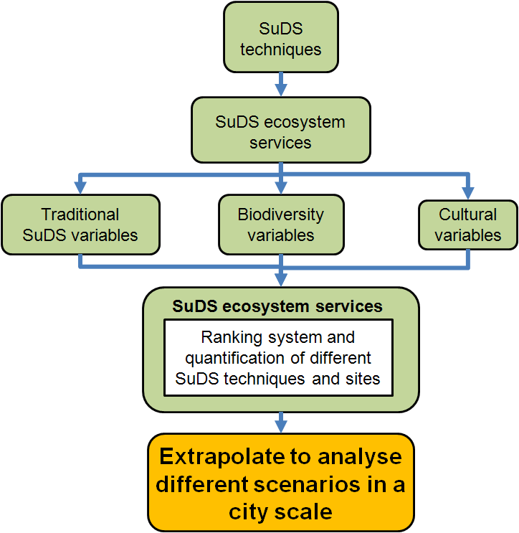
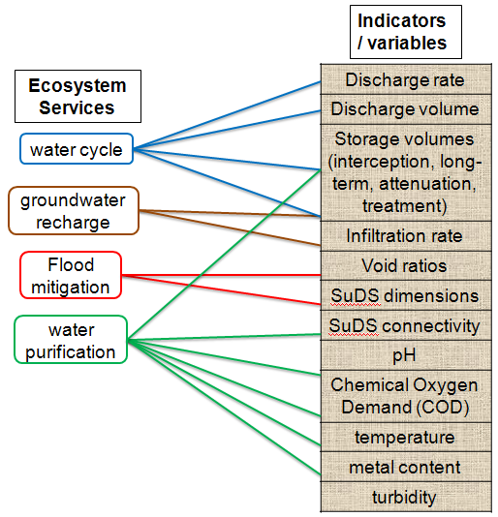
Resilient Ecosystem Service Assessments for Sustainable Drainage Systems (SuDS)
Chunglim Mak, Philip James and Miklas Scholz
1. Background and aim
3. Ecosystem services that SuDS can generate
Sustainable Drainage Systems (SuDS) have been shown to be the preferred solution in dealing with excess urban flooding compared with traditional drainage methods (Woods-Ballard et al, 2007). Aside from flood prevention and water purification, SuDS also have the potential to offer a variety of other ecosystem services such as climate regulation, recreation, and aesthetic. Traditional SuDS variables do not show the potential of these ecosystem services. Therefore, new techniques are required to examine ecosystem services generation potential of different SuDS systems. The aim is to develop a rapid ecosystem services assessment tool for SuDS. This tool will combine on-site measurements of traditional SuDS variables, along with biodiversity and cultural services variables. Biodiversity is an important variable to many ecosystem services (see Figure 7). The research area will be within the Greater Manchester region.
Ecosystem services are provisions from the natural environment that are beneficial to human beings. According to the Millennium Ecosystem Assessment (MEA, 2005), they are split into four categories: supporting, provisioning, regulating, and cultural (Figure 7).
2. SuDS
4. Research methods
Research location – various SuDS sites in the Greater Manchester Region.
Biodiversity examination – terrestrial and aquatic.
Terrestrial variables – vegetation landcover and genera diversity of vascular plants. Data will be recorded “using a checklist in combination with Tandy’s Isovist Technique and the Domin cover scale" (Tzoulas and James, 2010).
Aquatic variables – mesohabitat components, such as shaded area, Glyceria, Nymphaea alba (floating), Myriophyllum (submerged) and Sparganium on a SuDS site (Pond Action, 1998). Land cover data will be recorded similar to terrestrial.
Biodiversity examination result – overall biodiversity score for each SuDS sites (Tzoulas and James, 2010).
Cultural services – aesthetic, recreation, and education.
Cultural variables – number of visitors or facilities, land cover, and costs to travel to these SuDS sites.
Figure 2– Swale
Figure 3– SuDS pond
Figure 7 – Ecosystem services that SuDS can generate
Figure 8 illustrates the final outcome of these ecosystem services examinations.
Figure 4 – Permeable Paving
Figure 5 – Wetland
Figure 1 – SuDS treatment train within water cycle (CIRIA, 2007)
SuDS is a water management method that employs the treatment train concept within the urban water cycle (Woods-Ballard et al, 2007), as shown in Figure 1. Stormwater is purified and the flow rate decreased before arriving at the destined natural water bodies. SuDS is made up of various techniques, as shown in Figures 1 to 4. Water cycle, flood mitigation, water purification, and groundwater recharge are the most obvious ecosystem services associated with SuDS. Traditional variables in SuDS design and their associated ecosystem services are shown in Figure 6.
BIGGS, J., FOX, G., NICOLET, P., WALKER, D., WHITFIELD, M. & WILLIAMS, P. 1998. A guide to the methods of the National Pond Survey. Oxford: Pond Action.
MILLENIUM ECOSYSTEMASSESSMENT. 2005. Chapter 2: Ecosystems and their services. Ecosystems and Human Well-being: A Framework for Assessment.
TZOULAS, K. & JAMES, P. 2009. Making biodiversity measures accessible to non-specialists: an innovative method for rapid assessment of urban biodiversity. Urban Ecosystems, 13, 113-127.
WOODS-BALLARD. B, KELLAGHER. R, MARTIN. P, JEFFERIES. C, BRAY. R & SHAFFER. P 2007. CIRIA C697: The SUDS Manual. CIRIA C697. London: CIRIA.
Figure 6 – Traditional SuDS variables, along with their associated ecosystem services
Figure 8 – Research process

