Slide 1
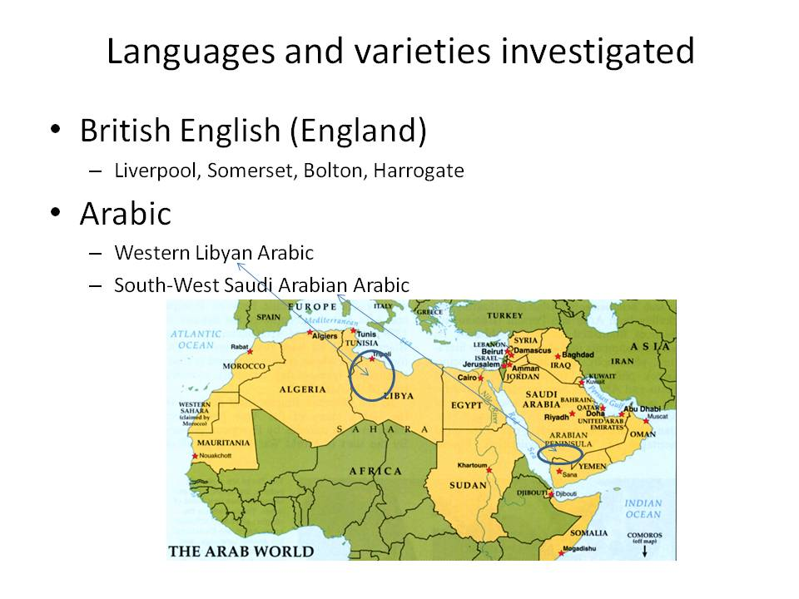
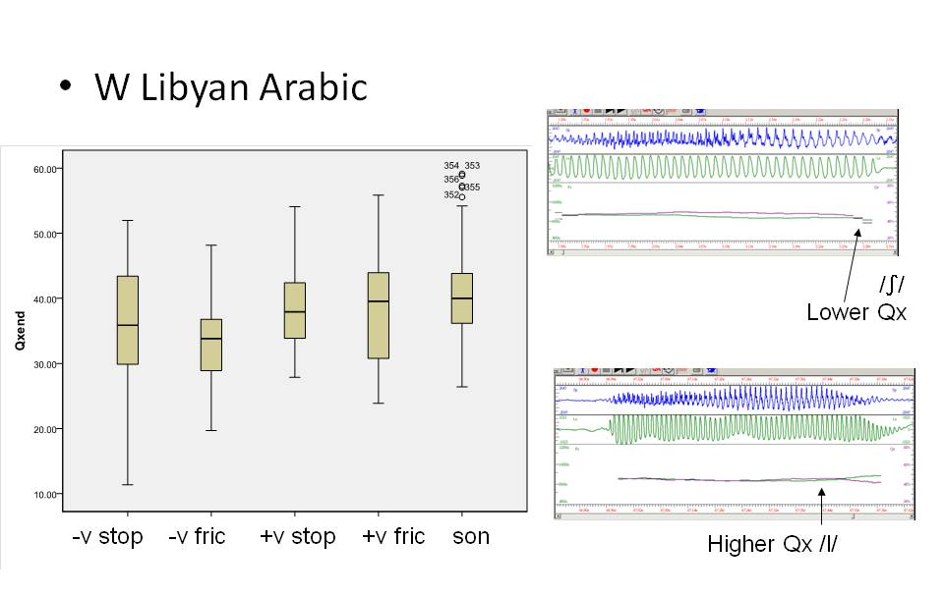
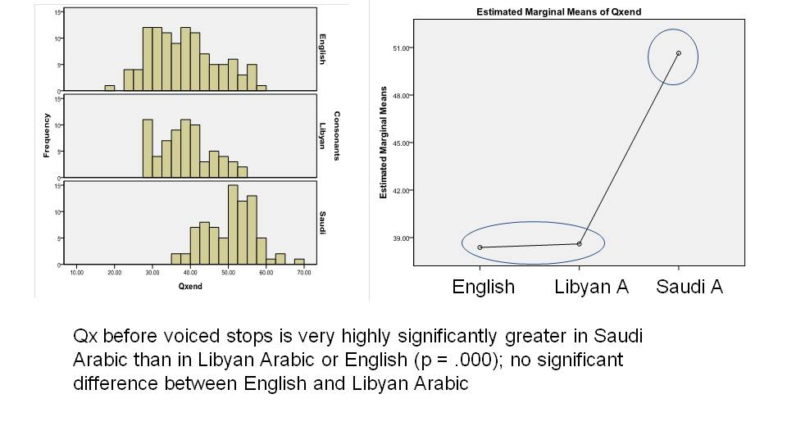
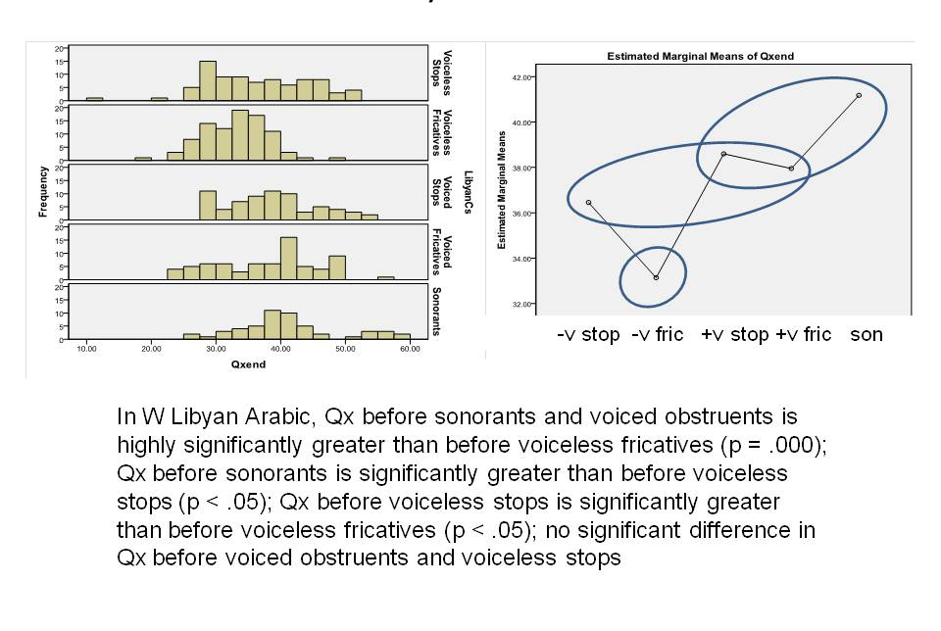
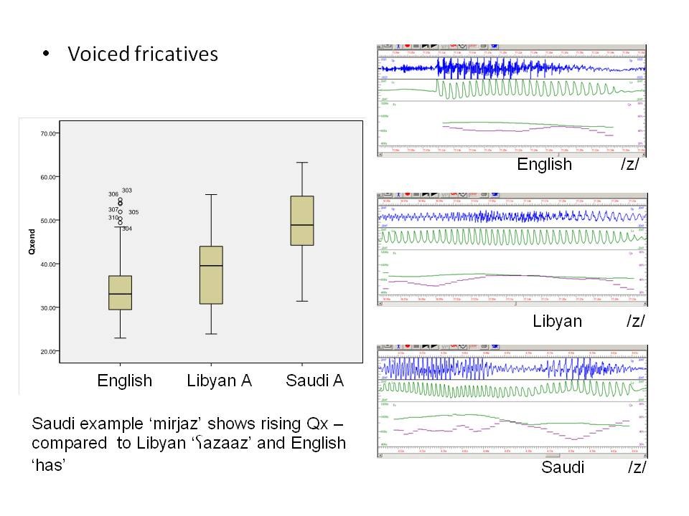
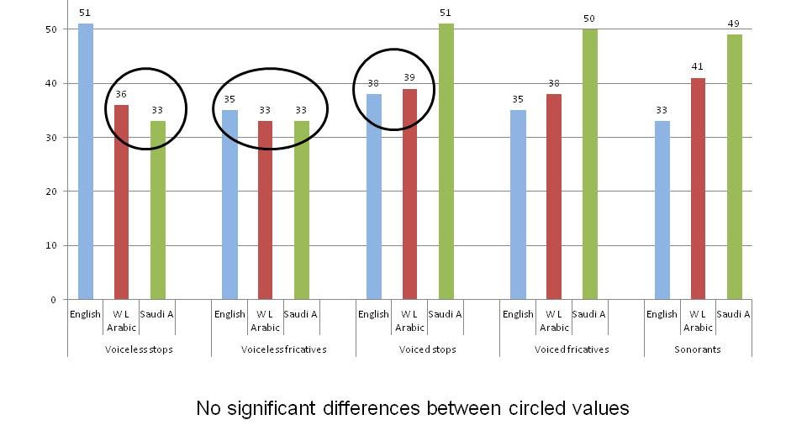
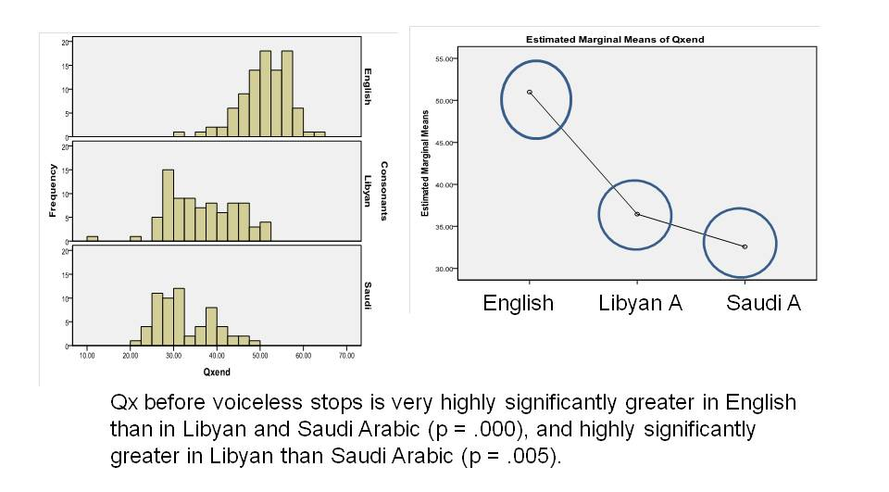
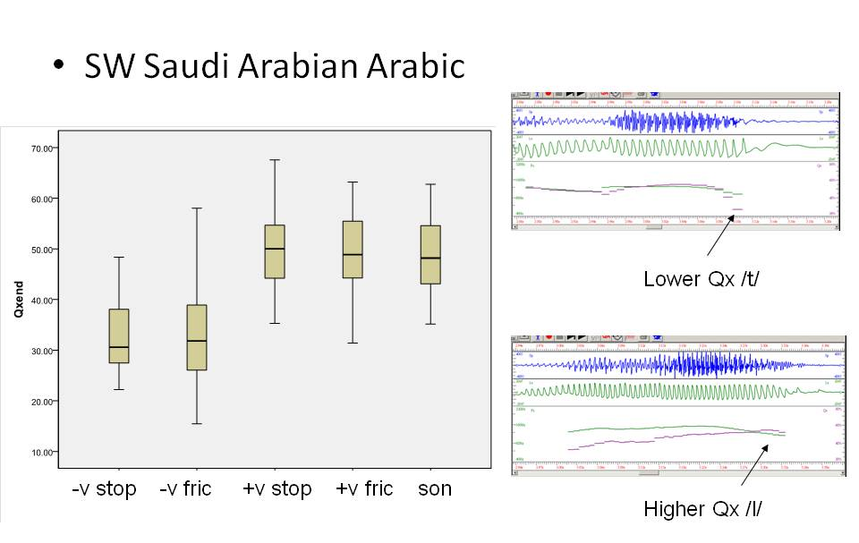
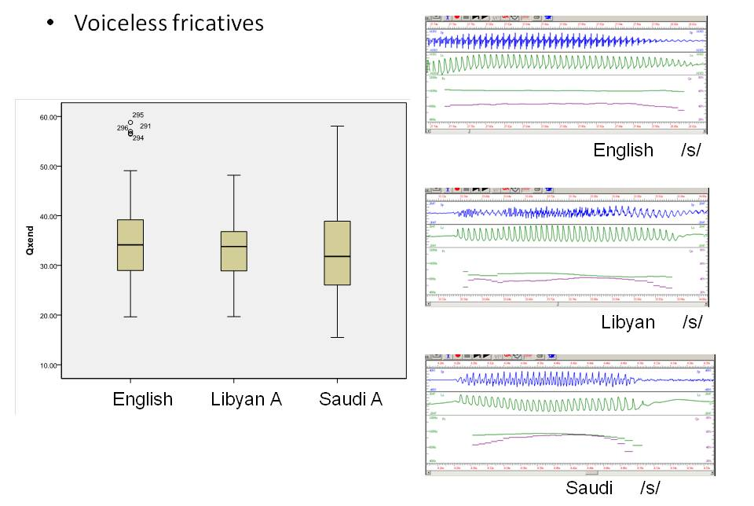
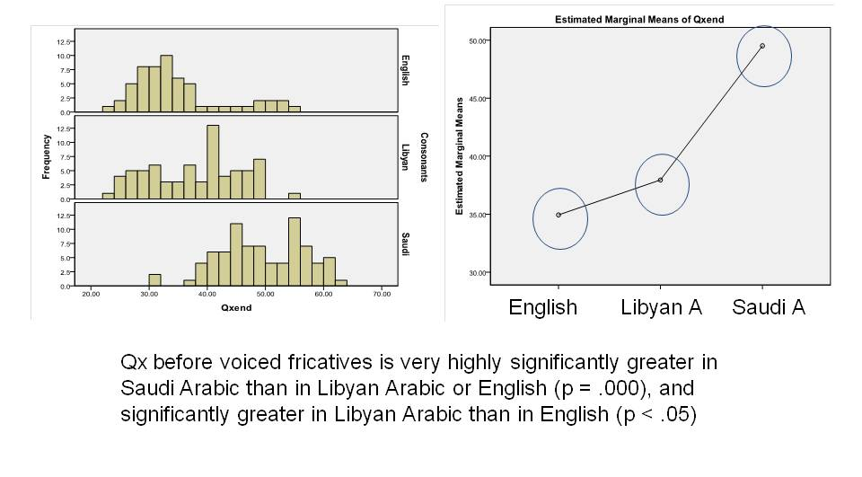
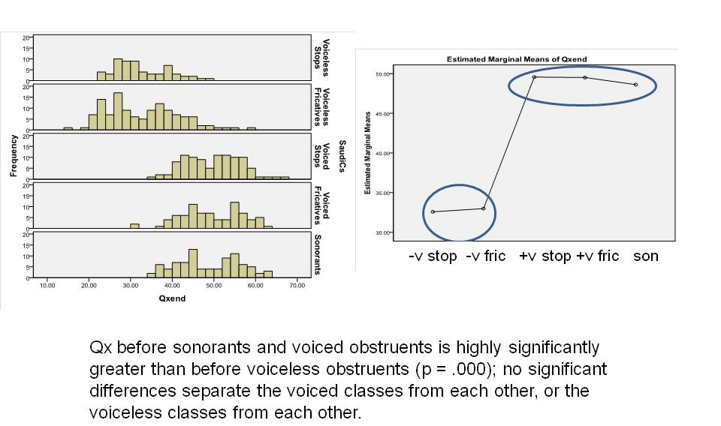
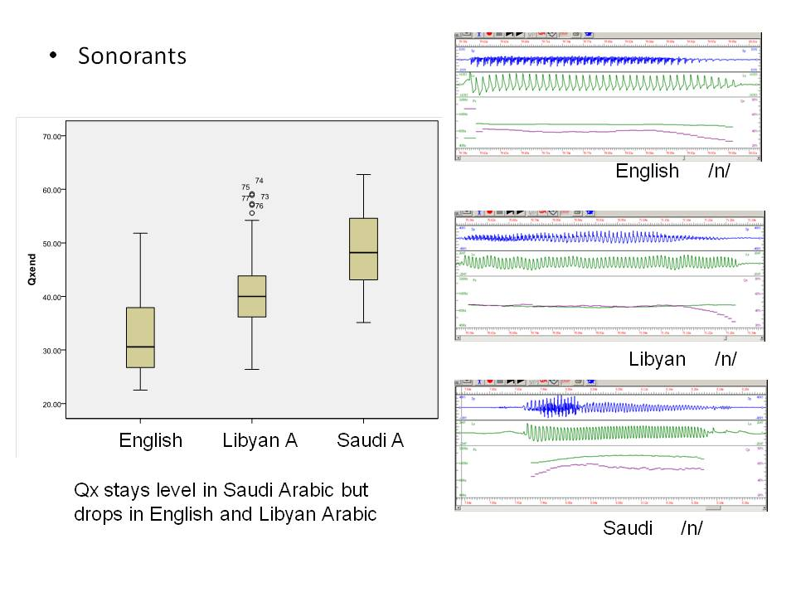
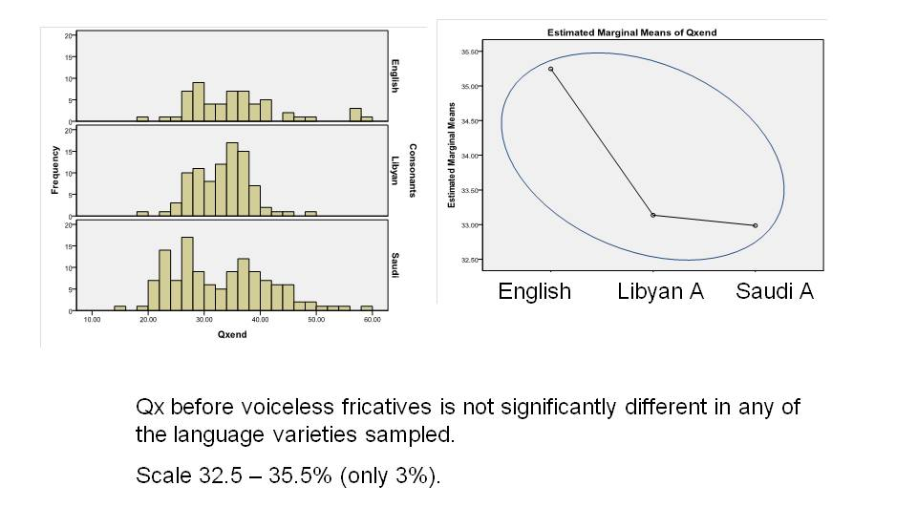
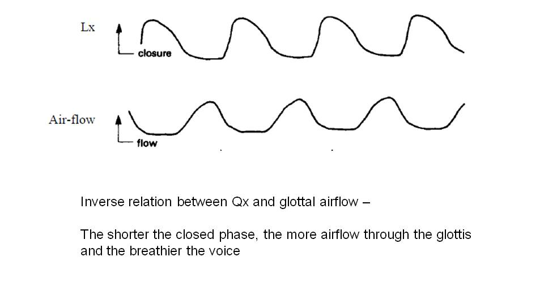
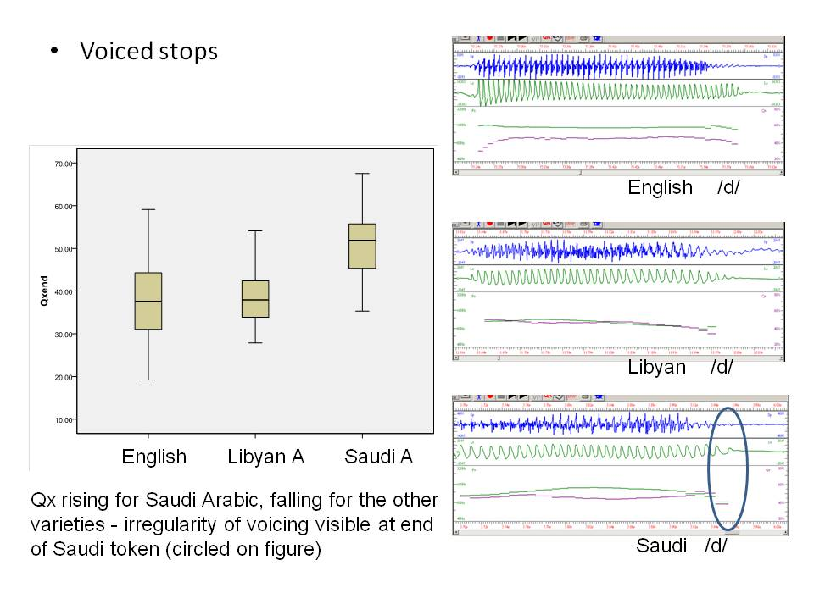
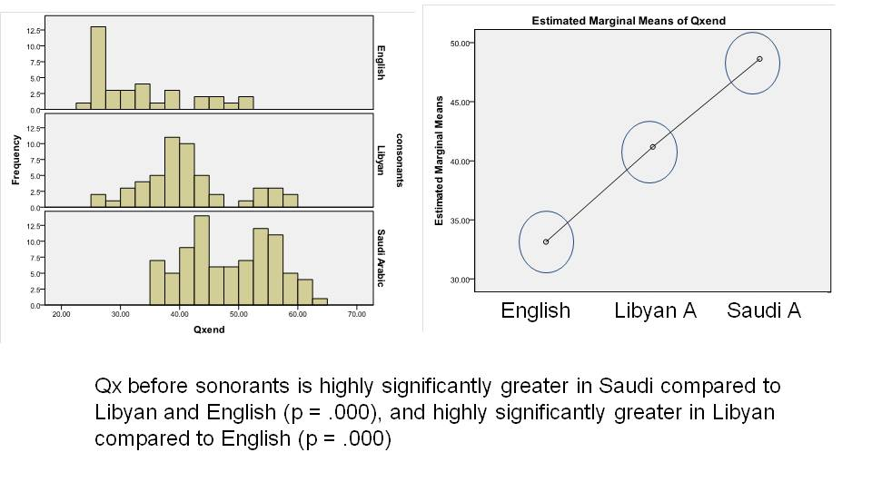
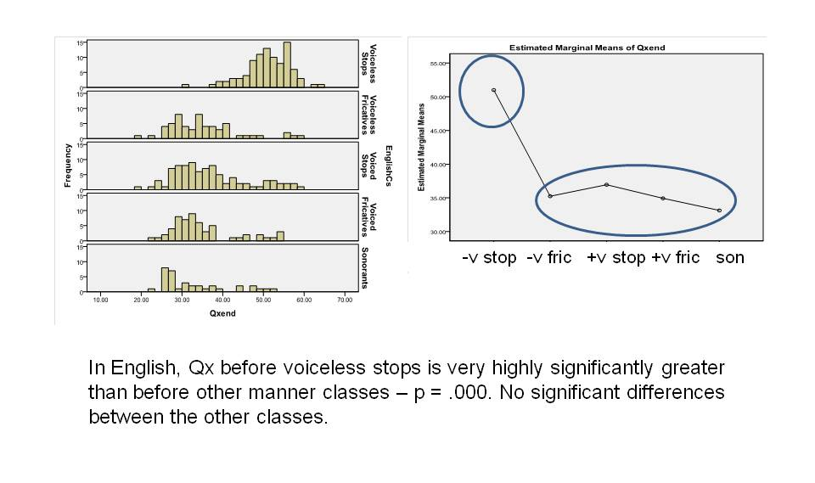
The language-specific nature of phonological categories: evidence from the interaction of laryngographic closed quotient values with manner of articulation
Barry Heselwood ¹, Janet Watson², Munira Al-Azraqi³, Samia Naïm⁴ & Reem Maghrabi⁵
1 University of Leeds; 2 University of Salford; 3 Dammam University, Saudi Arabia; 4 Laboratoire de langues et civilisations à tradition orale, Centre national de la recherche scientifique, Paris; King Abdulaziz University, Saudi Arabia, LabPhon 13, Stuttgart, July 2012
References
Cantineau , J. (1946) Esquisse d’une phonologie de l’arabe classique. In Etudes de linguistique arabe. Paris: Klincksieck, 165-204.
Danecki, J. (2012) Majhūra/mahmūsa. Encyclopedia of Arabic Language and Linguistics. Brill Online.
Garbell , I. (1958) Remarks on the historical phonology of an East Mediterranean Arabic dialect. Word 14, 303-37.
Heselwood , B. & R. Maghrabi (2012) Laryngeal closed quotient vlaues in relation to the majhūr-mahmūs distinction in traditional Arabic grammar. Colloque International Backing / Base Articulatoire Arrière, Université Sorbonne Nouvelle, Paris, May 2-4, 2012.
Roach, P. (1973) Glottalization of English /p/, /t/, /k/ and /ʧ/ - a re-examination. JIPA 3, 10-21.
Watson, J. & Asiri, Y. (2008) Prepausal devoicing and glottalization in varieties of the South-Western Arabian Peninsula. In Arabic and Its Varieties: Phonetic and Prosodic Aspects. M. Embarki (ed). 17-38.

