Slide 1
FIGURE 1

Slide 2
FIGURE 2
540 580 620 660 700
Absorption Fluorescence
2-Photon cross section (σ₂)
GM units
Normalised Absorbance
Wavelength (nm)

Slide 3
FIGURE 3
.
τ, ns
τ, E-CA4
τ, E-CA4F
φ, E-CA4
φ
Log(viscosity) mPa.s

Slide 4
FIGURE 4
C

Slide 5
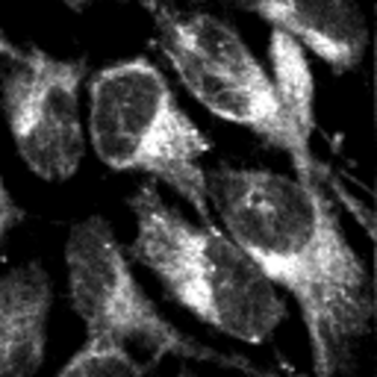
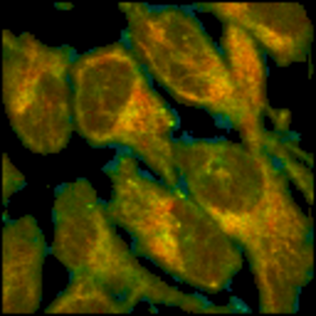
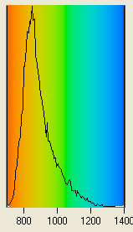
FIGURE 5A
a
b
c
d
e
Fluorescence
lifetime (ps)

Slide 6
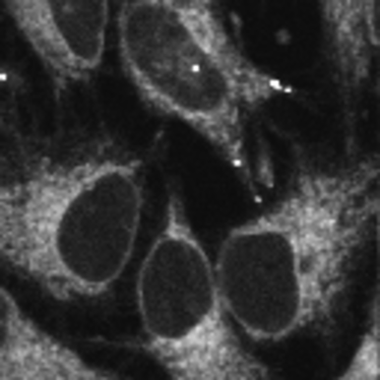
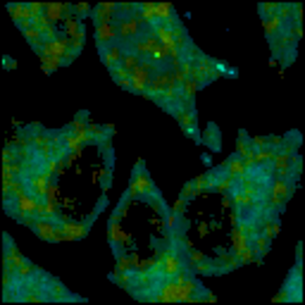
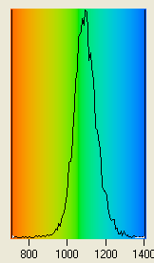
FIGURE 5B
a
b
c
d
e
Fluorescence
lifetime (ps)

Slide 7
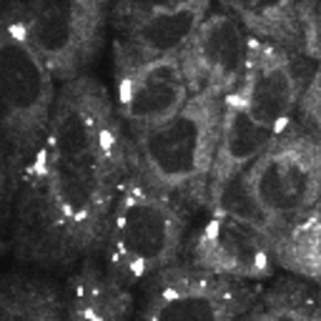
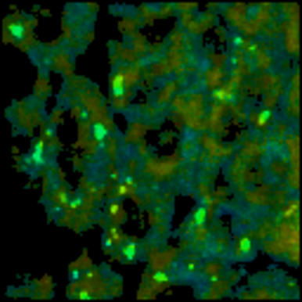
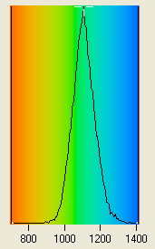
FIGURE 5C
a
b
c
d
e
Fluorescence
lifetime (ps)

Slide 8
A
B
…
.
…
.
…
.
…
.
C
FIGURE 6
……
……

