Slide 1
Changes in the Values of Ecosystem Services along a Rural-Urban Gradient
Kathleen Radford
University of Salford, UK

Slide 2
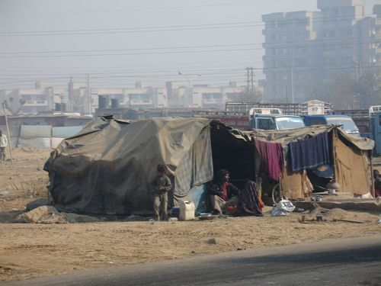
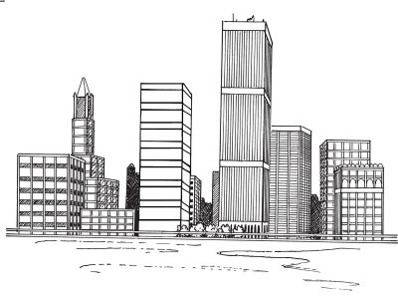
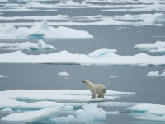
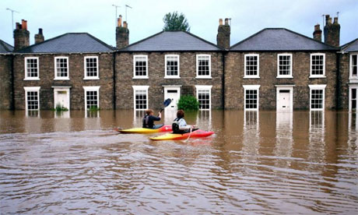
Urban Environments

Slide 3
Ecosystem services important to urban environments
Aesthetics
Recreation
Spiritual
Genetic/ Biodiversity Conservation
Air Quality
Noise Buffering
Climate
Pollination
Water Flow Regulation

Slide 4
Valuing Ecosystem Services in Non-Economic Terms
Recreation | Recreation potential (number of opportunities available in public and private space).
Genetic / Biodiversity Conservation | Biodiversity potential (Shannon-Weiner Index)
Air Quality | Carbon sequestration (Tonnes of carbon sequestration acre⁻¹year⁻¹ = 0.00335[%tree cover])
Noise Buffering | Assess if noise is a problem and whether physical attempts have been made to buffer noise.

Slide 5
Valuing Ecosystem Services in Non-Economic Terms
Climate | Climate change adaptation and mitigation (assess measures implemented to adapt and mitigate)
Pollination | Pollination potential (abundance and diversity of flowering plants)
Water Flow Regulation | Maximum potential rainfall retention (S = 2540/CN – 25.4)

Slide 6
New Assessment Tool
Aesthetic and Spiritual Ecosystem Services
Residential Environment Assessment Tool
Green Flag Award

Slide 7
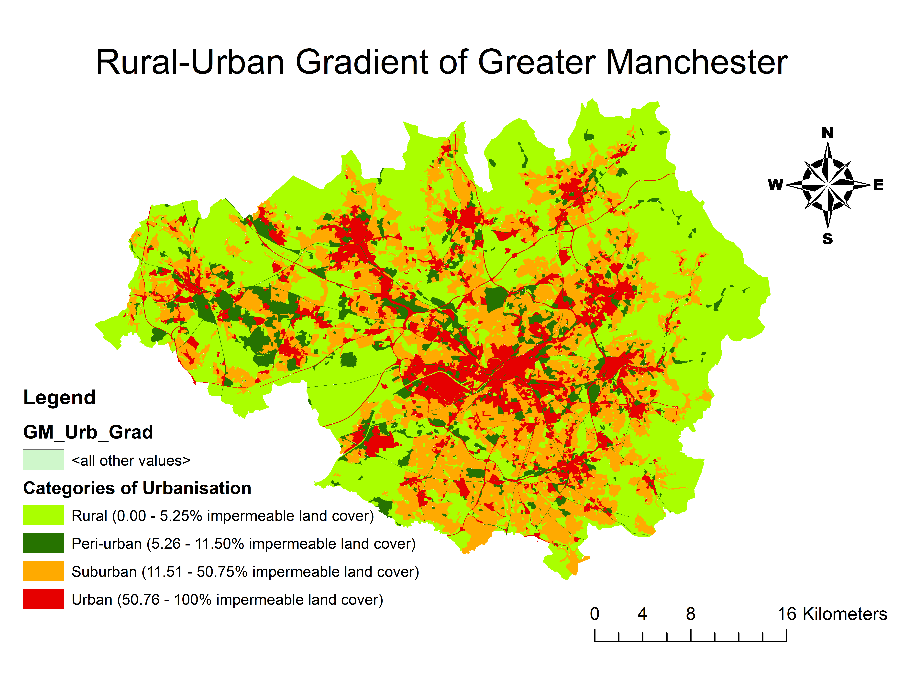

Slide 8
Results: Cultural Services

Slide 9
Results: Regulatory Services

Slide 10
Results: Provisioning Services

Slide 11
Urban environments – the problems?
Ecosystem Service | Rural | Peri-Urban | Suburban | Urban
Aesthetics
Spiritual
Recreation
Climate Change A&M
Noise Buffering
Pollination Potential
Biodiversity Potential
Water Flow Regulation

Slide 12
Contact details:
Kathleen Radford
University of Salford, Manchester, UK
Email: k.g.radford@edu.salford.ac.uk
www.els.salford.ac.uk/urbannature

