Slide 1
Open Access Celebratory Event 30th September 2010

Slide 2
Ghassan Aouad PVC Research & Innovation

Slide 3
Deposit Statistics
October 2009 to Sept 2010
1482 deposits
500+
Notes:
Graph showing the growth of USIR since the OA event held in September 2010.
1482 deposits during the past 12 months.
September has seen in excess of 500 deposits into USIR.

Slide 4
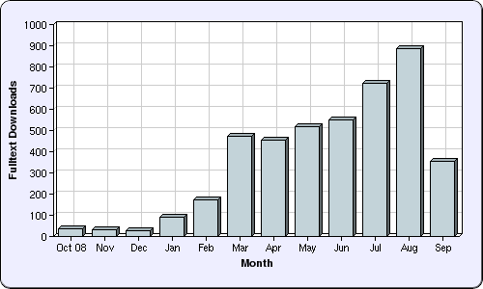
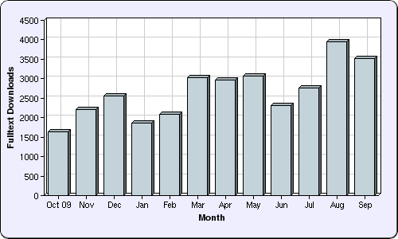
Download Statistics
October 2008 to Sept 2009
4,315 downloads
October 2009 to Sept 2010
32,673 downloads
Notes:
Download stats have increased greatly in the past 12 months compared to the previous 12 months.
Reasons for this: more publicity around USIR, particularly as Salford received a lot of press for being the 100th University to announce an Open Access Mandate. USIR is also now registered with various services that collate and index our data in search engines such as Google and Google Scholar.
Works in USIR are consistently being accessed by people in a wide range of countries such as the US, Australia, India, Germany, China and Canada.

Slide 5
Links to USIR author pages from Centre
web pages
Notes:
All three colleges have been supporting the growth of USIR during the past 12 months. The next few slides give an example of how each colleagues has contributed to USIR and the ethos of Open Access.
Many of the research centres in the College of A&SS have established links from their staff profile pages to author pages in USIR, most research centre also have a link to USIR from their research centre home pages

Slide 6
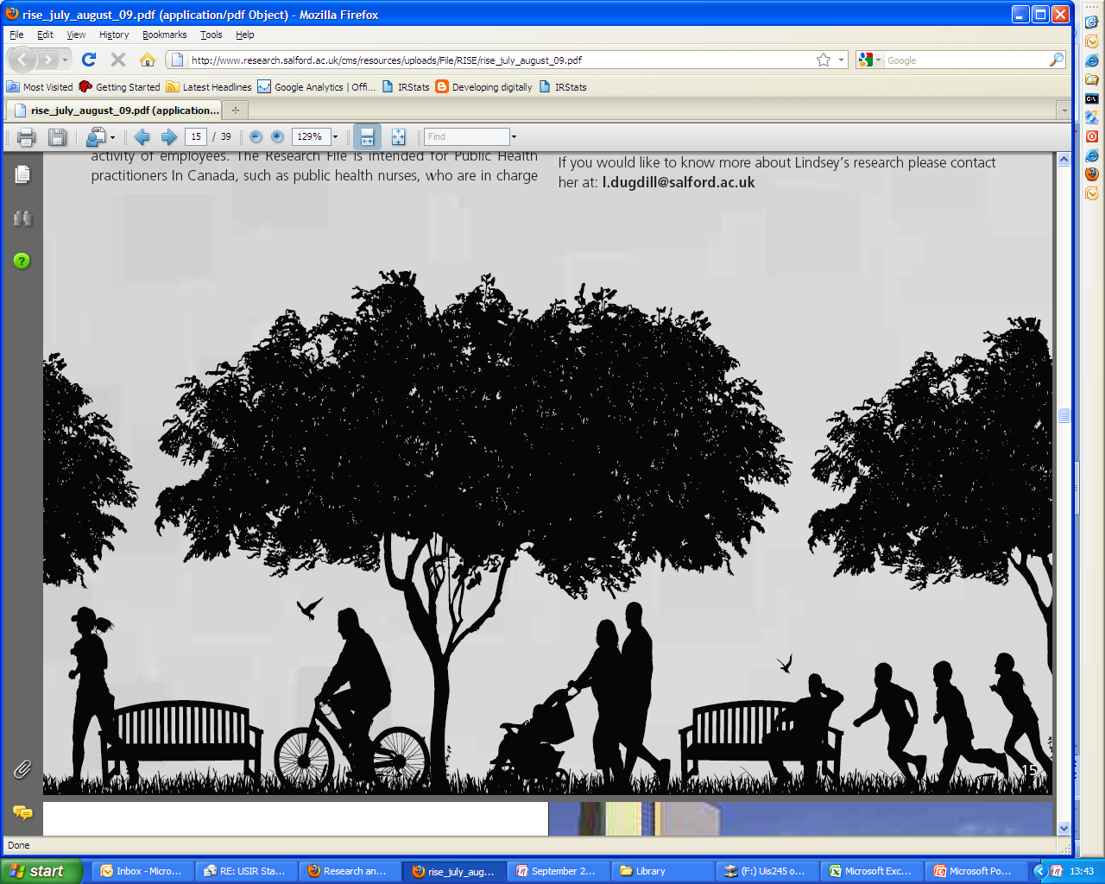
Work deposited into USIR helps to inform
Canadian Public and Health Professionals
Work deposited into USIR helps to inform the
Canadian Public Health Professionals
Notes:
College of Health and Social Care
Lindsay Dugdill, Centre for Social Justice Research, submitted an article into USIR. Health professionals in Canada were drawn to her work via the entry in USIR. Lindsay’s research has now been used by the Canadian Fitness and Lifestyle Research Institute and by Canadian Public Health professionals to promote healthy lifestyles and physical activity. A excellent example of Open Access articles being shared and used for the greater good.

Slide 7
Over 365 publications deposited since
1st October 2009
Notes:
College of Science and Technology
The Centre of Disaster Resilience has also shown particular support to USIR over the past 12 months.
One of the Centres PhD students, Chamindi Malalgoda, has been busy adding publications to USIR on behalf of centre members. Once all of the publications have been made live there will be over 365 publications available in USIR.

Slide 8
Julie Berry Acting Director, The Library

Slide 9
USIR Achievements
USIR Team
Repository Manager
Repository Officer
Library Systems
Academic Support Librarians
USIR Web Pages
1-2-1 training
Copyright advice
SPoRT Programme
Monthly Statistics
Publicity
Notes:
Support to researchers: one to one training for deposits, advice on copyright, sessions on Open Access now embed into SPoRT programme.
Monthly Statistics: Started in June. Reports showing number of new deposits, number of live records, top ten downloads for each college
Profile raised externally: 100th institution to announce mandate, Times Higher article, VC keynotes at conferences, articles in RISE. Raised internally too by attending at the September Research Centre meetings with Ghassan, Vian and Matt. Deposits have increased as a result.
Improved look and feel: New Library web pages for USIR. Author browse within eprints is now more user friendly too.
USIR team: Repository Manager, Repository Officer & Repository Systems Officer. USIR now hosted externally and heavily supported by the supplier team

Slide 10
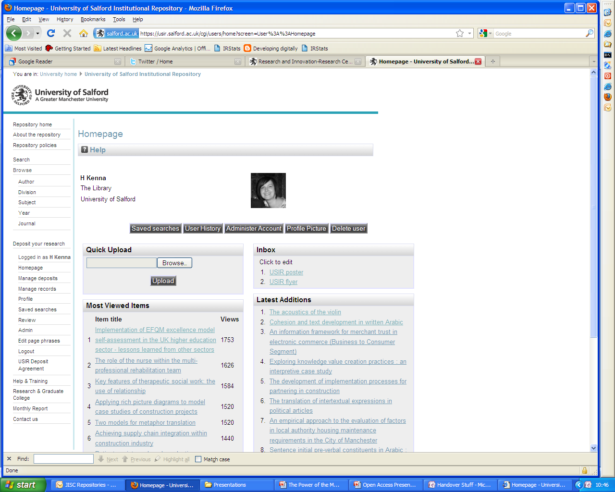
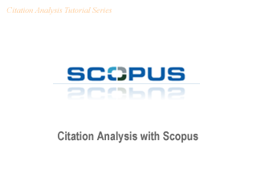
USIR Developments
MePrints
Embed USIR into research practice
Citation Data
Audio Visual Research
Notes:
Personalisation: once logged in researchers now see a homepage providing information on their latest additions and their most viewed items
AV presentation: Upgrade to the software which presents images and audio in a more appropriate format. Focuses on the image rather than the description. We’d be interested to hear from any one whose research output isn’t in the traditional text format and to work with them to improve the look and feel of AV material in USIR.
Citation data: Citation counts from Scopus are in the process of being added to all records where a full text document is attached. We are also investigating of Google Scholar and Web of Science counts
Embed USIR into research practice: We’d like to do more work needed around embedding USIR deposit into research practice. Work with researchers at an earlier stage in order to flag USIR as a good way of disseminating work and complying with Funding Council mandates

Slide 11
Acknowledgements
Highest number of deposits:
Dr Paul Rowlett (Faculty of Arts and Social Science)
Prof Charles Egbu (Faculty of Bus. Law & Built Env.)
Prof Sarah Tyson (Faculty of Health & Social Care)
Dr Bruno Fazenda (Faculty of Science, Eng. & Env.)
Notes:
During the past 12 months we’d like to acknowledge the following people:
Dr Paul Rowlett, Faculty of Arts and Social Science (17 items)
Prof Sarah Tyson, Faculty of Health and Social Care (48 items)
Prof Charles Egbu, Faculty of Business, Law & Built Env (84 items)
Dr Bruno Fazenda, Faculty of Science, Eng. & Env (30 items)
They have deposited the highest number of works into USIR for each of their faculties.

Slide 12
Acknowledgements
Highest number of downloads
Prof Andrew Moorhouse
Acoustics Research Centre
1184 downloads
3000th Deposit!
Dr Darren Brookes
Centre for Parasitology & Disease Research
Notes:
The past 12 months has also seen an incredible 1184 downloads for a Technical Report on ‘Research into aerodynamic modulation of wind turbine noise’, authored by Dr Andrew Moorhouse and his colleagues in the Acoustics Research Centre.
This month also saw the 300th deposit for USIR. Dr Darren Brooks, Centre for Parasitology and Disease Research.

Slide 13
Professor Martin Hall Vice-Chancellor

Slide 14
Open Access: Moving to the next level
Deposits are the foundation of an effective Open Access Repository
The next level: enabling new kinds of research and innovation through friction-free access to information and analysis
An example, currently in development at our university

Slide 15
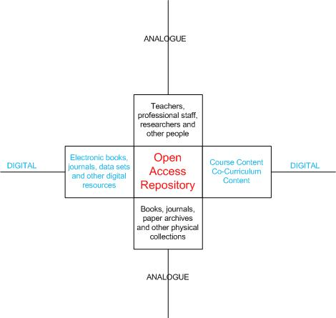
The core:
the Open
Access
Repository

Slide 16
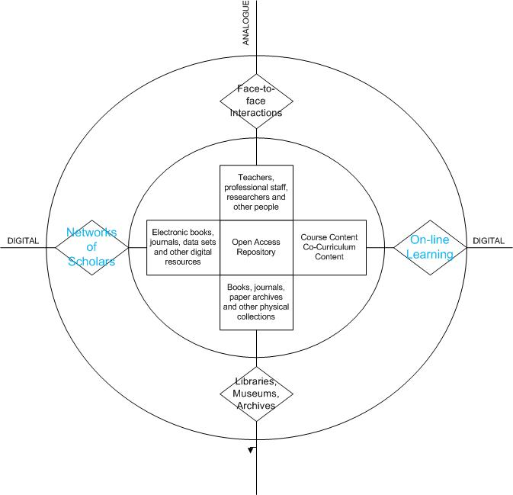
The system: interactions enabled and advanced by digital and analogue technologies

Slide 17
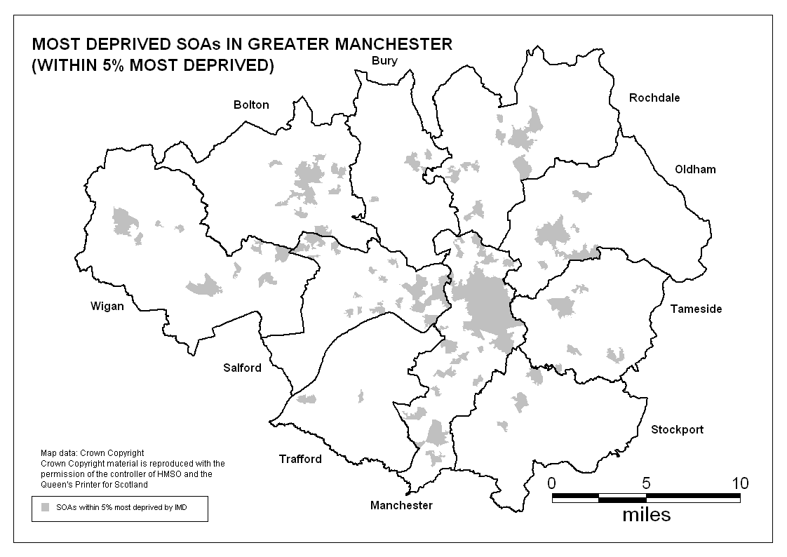
An example: Better Life Chances
Research fields: public health, epidemiology, social policy, housing, built environment, security and safeguarding
Partners: local authority, city region, police authority, health services
Potentially: integration into new Local Enterprise Partnership

Slide 18
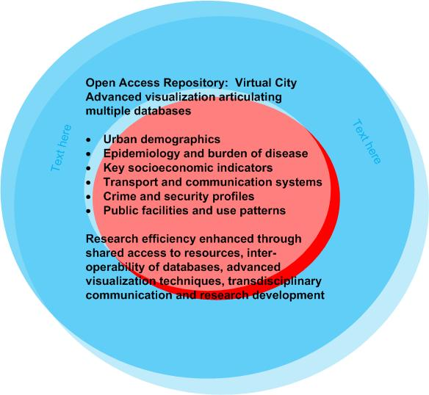

Slide 19
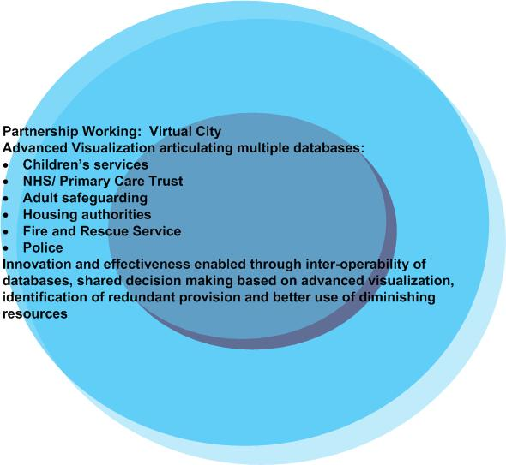

Slide 20
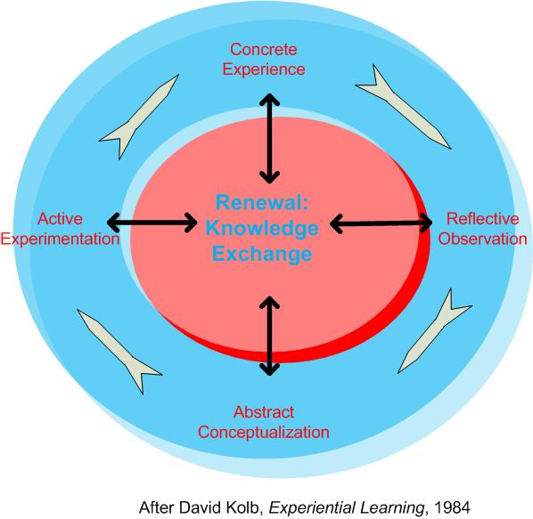

Slide 21
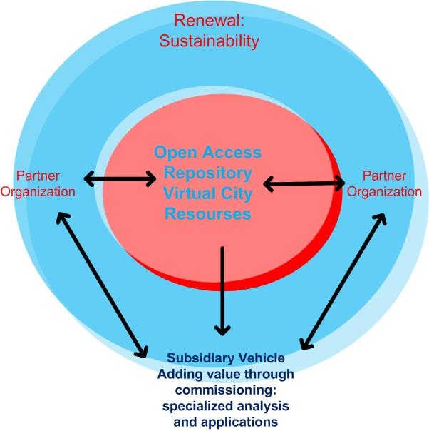

Slide 22
Objective: research and action on all drivers of deprivation
Educational attainment
Skills
Employment
Income levels
Health & well being
Teenage pregnancy
Aspirations…..
Access to employment
Transport links
Schools
Decent homes
Housing mix and choice
Quality of environment
Facilities & assets
Access to services
Technology…
Crime and anti social behaviour rates,
public confidence
Cleanliness and use of open spaces
Housing management
Street scene management
Community Cohesion

Slide 23
Thank You!
Notes:
Invite attendees to stay for a drink

