Slide 1
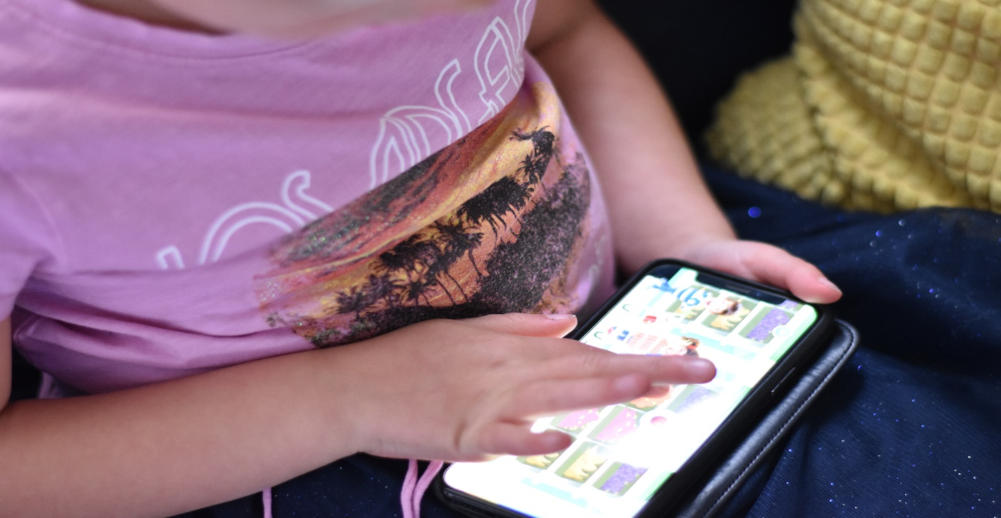
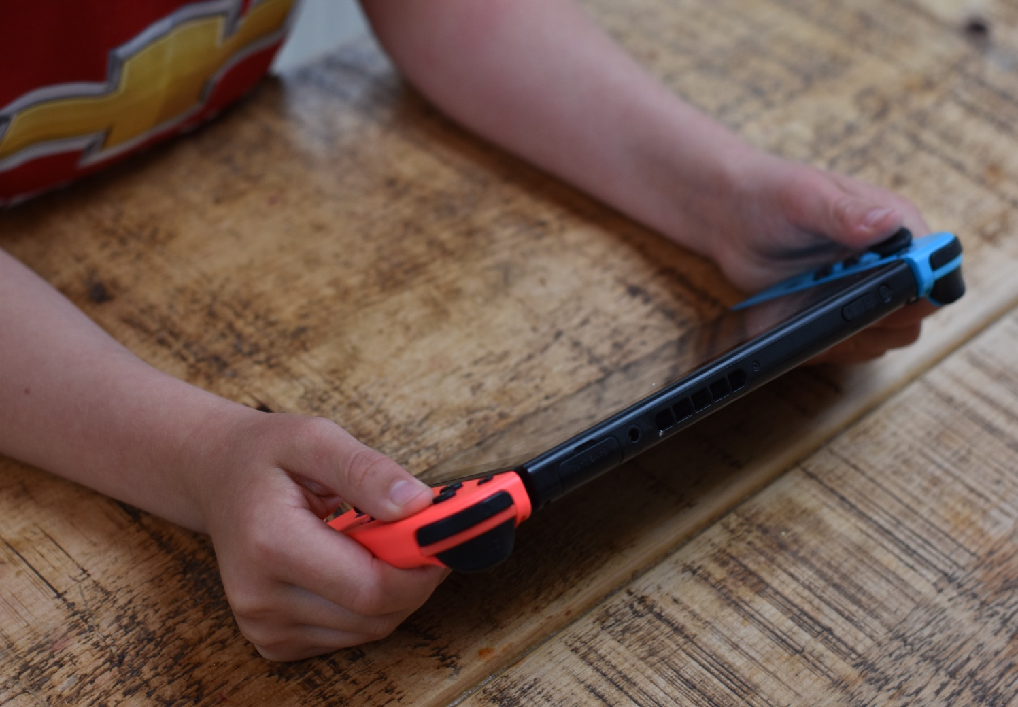
The Relationship Between Use of Personal Electronic Devices and Musculoskeletal Pain in Children: A Systematic Review
A Clark, AM Cooper-Ryan, T Brown and SJ Preece
School of Health and Society, University of Salford UK
Sponsor: Cardinus Risk Management Limited
BACKGROUND
Over the last decade the incidence of musculoskeletal disorders (MSDs) in adults has increased. It has been suggested this is due to the rapid development and usage of computer technology [1]. Risk factors associated with adults use of personal electronic devices (PEDs) i.e. laptops, computers, smartphones and tablets, have been identified. Namely, type of device being used, duration using them and positions they are using them [2].
As well as the increasing use by adults, the use of PEDs has increased rapidly in under 18’s[3]. Moreover, there are anecdotal reports of an increase in children reporting musculoskeletal (MSK) pain . However, there is a scarcity of knowledge on the incidence of MSK pain in children, their use of PEDS and whether PED usage is associated with MSK pain. As such there is a need to understand the potential link between PEDs use and MSKs in children. Moreover, it is vital that risk factors associated with PED usage and children’s MSK pain are explored. This knowledge will assist in understanding the possible implications for the future workplace and ergonomics sector, as well as potentially inform guidance on safe PED usage.
RESULTS
N=12,671 articles were screened and n=43 were eligible for inclusion.
Figure 1: PRISMA flow chart for selecting articles
Key Findings:
Study type: n=35 were cross-sectional, seven cohort studies and one test re-test.
Outcome measures used: n = 27 used subjective outcome measures, e.g. Nordic Muscular Questionnaire and the visual analogue scale for pain, n = 7 used both subjective and objective outcome measures e.g. 3D posture analysis, and EMG, and n=8 used only objective measures.
PED researched: current literature focuses on computer (n=9) and video games (n = 4).
Results showed that there was limited evidence of the link between PED usage and MSK pain. Potential risk factors associated with MSK pain and PEDs usage were themed through this paper (see Figure 2) .
Records identified through database search (n= 18136)
(8386 from Pubmed, 5893 from EBSCO, 3782 from Ovid)
Duplicates removed (n= 5465)
Records screened using the screening questions
(n = 12671)
Articles removed during screening (n= 12612)
CONCLUSIONS
The review concluded that due to the low quality of papers, predominance of subjective outcome measures used and the lack of longitudinal studies these risk factors could not be conclusively demonstrated.
The results from the systematic review:
Highlight the gap in knowledge and the need for further research into this area.
Little is know about the risk factors of children using PEDs .
Does using PEDs lead to children developing MSK pain?
More research is needed, utilising either cohort or longitudinal designs, using both objective and subjective outcome measures to provide a greater understanding about the risk factors of children’s MSK pain and PED usage ad type of PEDs being used by children.
For more information please see the white paper which was produced:
http://usir.salford.ac.uk/id/eprint/52480
REFERENCES
[1] Toh et al 2017 PLoS One, 12
[2] Jun et al 2017 Int Arch Occup Environ Health, 90
[3] Ofcom 2016 Children and parents: Media use and attitudes report
Funding Acknowledgements
The PhD is co-funded by the University of Salford and Cardinus Risk Management Limited.
Full – text articles assessed for eligibility
(n= 149)
Full text were excluded if:
The articles were not in English
Unable to obtain the article
Case reports, conferences, editorials or letters
Their definition of adolescents was over 18yrs.
Only somatic symptoms (headaches) were examined
articles that were older than 1998
Studies included for the systematic review (articles were assessed for quality using the standard quality assessment)
(n=43)
AIMS
A systematic review was conducted to examine the usage of PEDs related to MSK conditions and pain in children (under 18 years old), as well as identify any associated risk factors. The systematic review had two aims:
To review the current evidence-base around the relationship between MSK pain in children and the use of PEDs.
To map out the key risk factors which may underlie MSK pain in the context of PED use.
METHODS
Electronic searches were conducted of the following databases: EBSCO (CINAHL, MEDLINE, SPORT Discus with Full Text), Ovid Online (Amed and MEDLINE), and PubMed Central. Searches were limited to cross-sectional, observational or experimental studies published since 1993.
Key words used related to those to describing PEDs, MSK pain and children. The articles were screened using a protocol following a two-phase process, this was followed by data extraction (main study details including study type, participants and risk factors investigated) and quality appraisal of the included papers.
MSK Pain – different parts of the body
Time spent on the device
Position on the device
What device they are using
What are they doing on the device
Figure 2: Potential risk factors of developing MSK pain when using PEDs
Notes:
A1 By default:
Title = 64pts | Subheadings=40pts | Body text=20 | References=14
Uses text box for heading and text box for body text and ‘Groups’ them together
To ‘ungroup’ the boxes at once, so that you manipulate them separately…
From the ‘Home’ tab, click on the ‘Select’ button in the ‘Editing’ group
Choose ‘Select All’. All of the objectives are selected.
From the ‘Drawing Tools’ tab, select the ‘Group’ button in the ‘Arrange’ group
Click on ‘Ungroup’. All of the objects are now individual objects.

