Slide 1
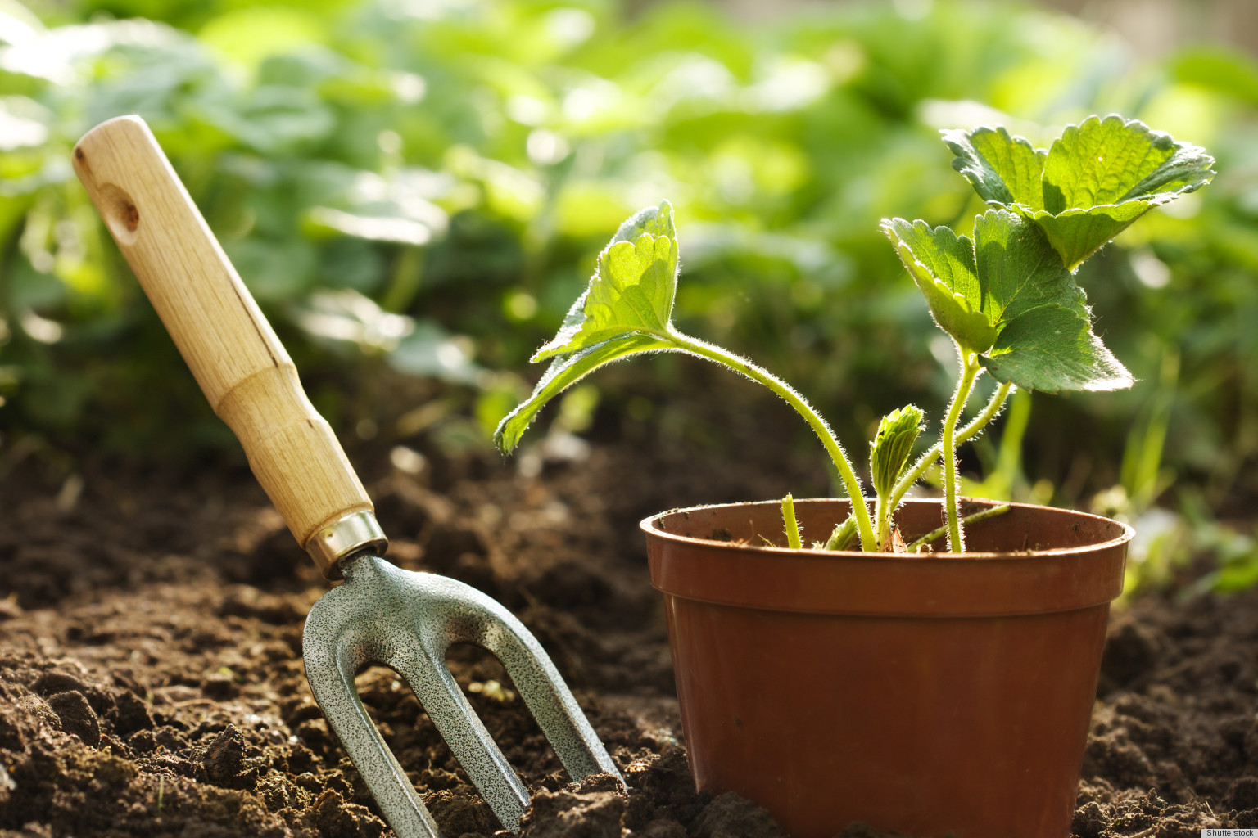
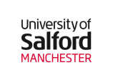

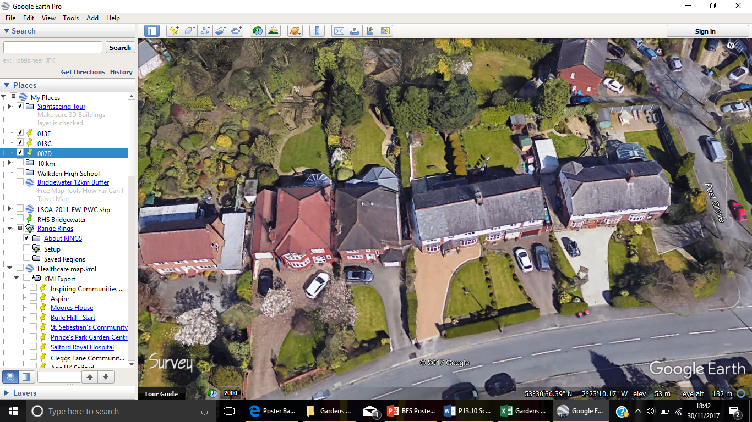
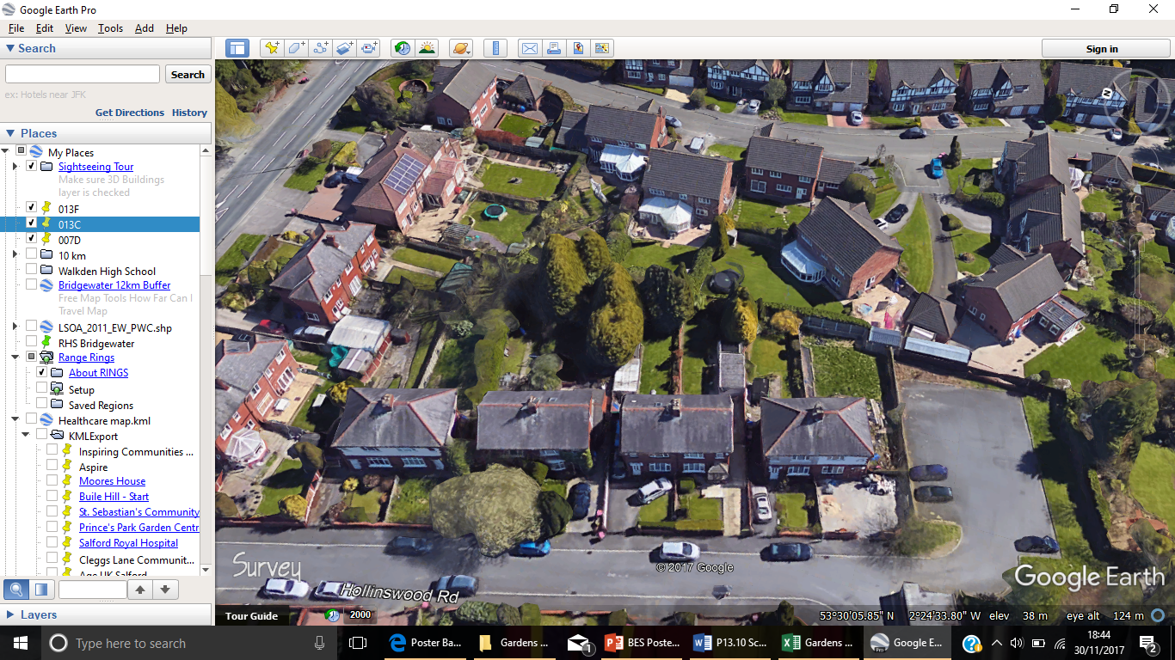
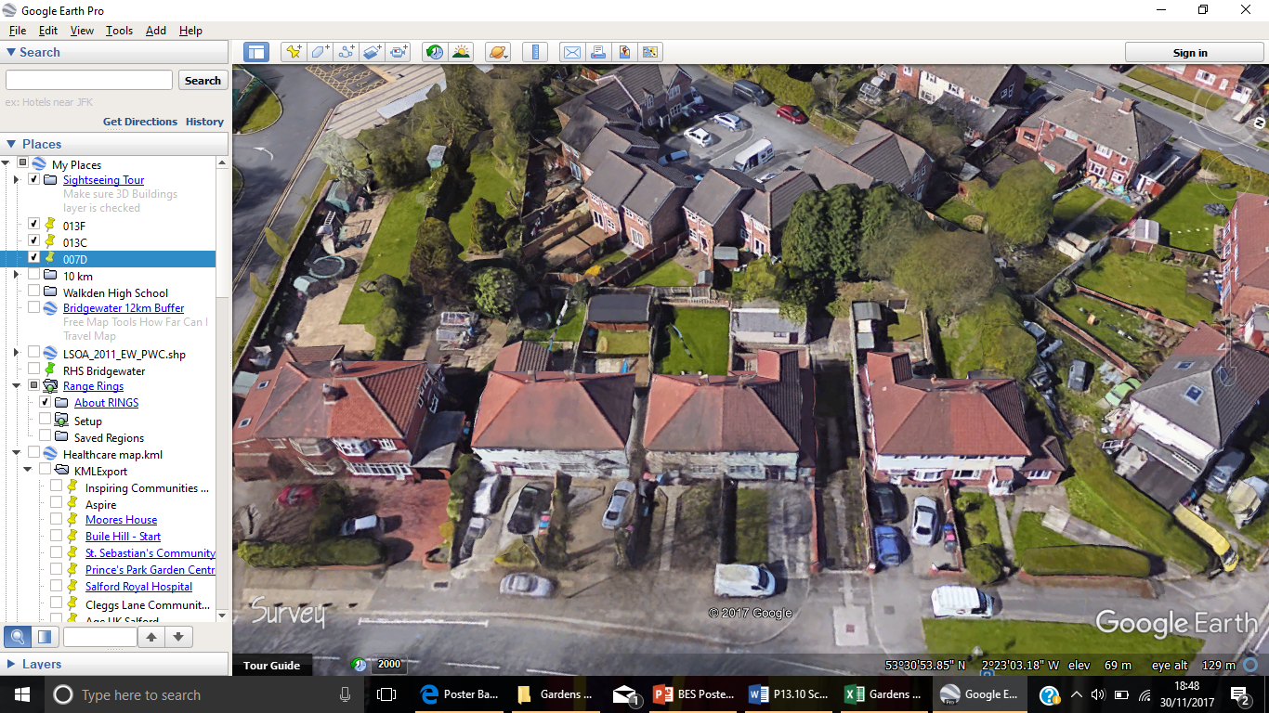

Exposing the Luxury Effect
Scaletta, K. University of Salford., Dennis, M. University of Manchester., Hardman, M. University of Salford., Griffiths, A. Royal Horticultural Society., James, P. University of Salford.
We can detect the signature of the luxury effect amongst the most accessible green space to the general public: private gardens.
Low- and middle-income households have less environmentally diverse outdoor space, which limits their Natural Capital value.
Garden feature diversity and, therefore, the health and wellbeing benefits of gardens are not equally accessible by all.
Introduction
Methods
Study sites were chosen along a deprivation gradient to represent socio-economic variation across neighbourhoods (LSOAs) in Salford.
Within an urban environment, the natural capital of private gardens provides a range of benefits which are key elements for human well-being .
Private gardens, as with other green spaces, may be assessed for their natural capital on three criteria: their quantity or size, their quality (which is often assessed by vegetation cover), and the accessibility relating to spatial distribution and the social factors which affect it (Barrera et al, 2016).
This research uses these three criteria to assess private gardens as a source of natural capital and investigates the variation socio-economic factors cause.
10% Least Deprived
50% Most Deprived
10% Most Deprived
Data on seven characteristics of household gardens were collected from satellite imagery available on Google Earth:
Number of trees
Number of shrubs
Area of trees and shrubs (m²)
Area of plants (m²)
Area of lawn (m²)
Area of pave (m²)
Total garden area (m²)
LSOA – A
LSOA - B
LSOA - C
Results
A
Table 1: Table to show percentage of gardens where feature is present and median household income within each LSOA.
B
C
Figure 1: A graph of total garden area against garden feature diversity.
A positive trend can be seen between total garden area and feature diversity, with LSOA - A exhibiting the greatest feature diversity (Figure 1). Despite LSOA - C being more deprived, it maintains a higher feature diversity than LSOA - B. LSOA – A, on average, has more of each garden feature, more permeable surfaces (vegetation and lawn), and less impermeable (pavement) than the more deprived LSOAs (Table 1).
Discussion
LSOA - A has a median annual household income of £46,907. In comparison, LSOA - B and LSOA - C have median household incomes of £30,011 and £22,685 respectively (Table 1). The greater feature diversity attributed by LSOA - A is likely due to a higher disposable income for garden items and maintenance (Figure 1). Gardens with more feature diversity produce a greater variation in habitats, thus a greater species richness. Fuller et al (2007) reported positive associations between the species richness of urban greenspaces and the well-being of visitors, with strongest responses to vegetation richness.
LSOA - A recorded greater percentages of vegetation and feature diversity, two key elements for many cultural ecosystem services (Table 1). Therefore, this research has shown variation in socio-economic factors does cause the luxury effect in urban household gardens, thus the natural capital and cultural services are affected. The next stage of the investigation will be took at more LSOAs within the 50% most deprived to ascertain the nature of the change.
How rich do you need to be to make the most of your garden?
Barrera, F., Reyes-Paecke, S., Banzhaff, E. (2016). Indicators of green spaces in contrasting urban settings. Ecological Indicators, 62, 212-219.
Fuller, R., A., Irvine, K., N., Devine-Wright, P., Warren, P., H., Gaston, K., J. (2007). Psychological benefits of greenspace increase with biodiversity. Biology Letter, 3, 390-394.
@KatieScaletta
k.l.Scaletta@edu.Salford.ac.uk

