Slide 1
Investigating the impact of social variation on Edge Space.
Katherine L Scaletta
K.L.Scaletta@edu.Salford.ac.uk
1
of 20
of 20

Slide 2
25 Year Environment Plan
They want me to do what?
2
of 20
of 20

Slide 3
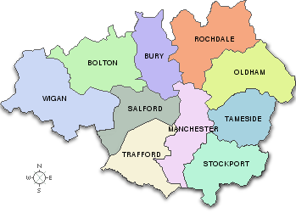
of 20

Slide 4
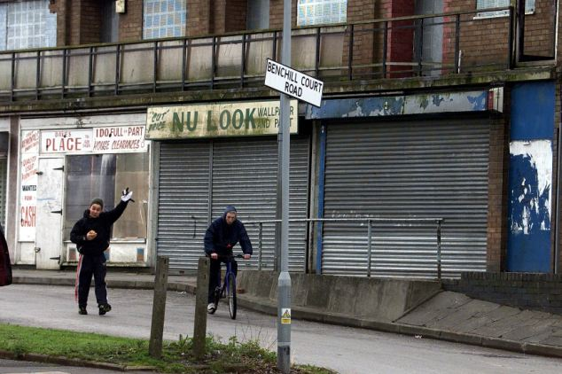
of 20

Slide 5
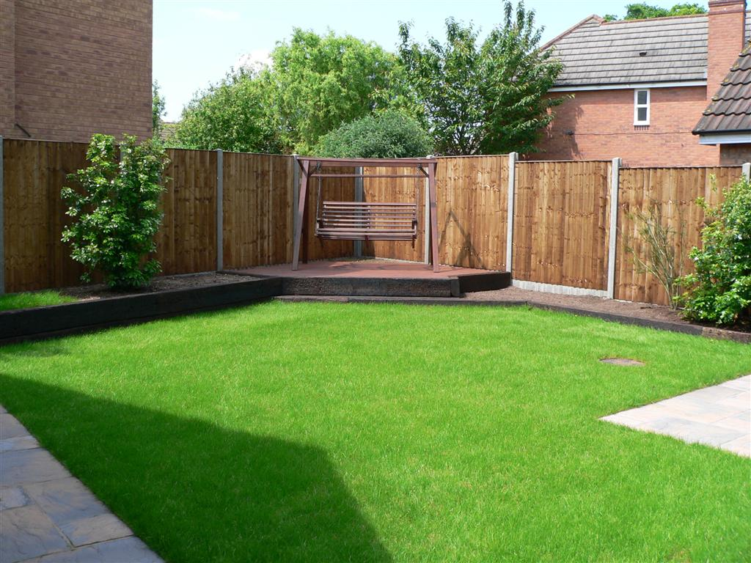
Edge Space: Privately owned land without the primary purpose of environmental gain.
of 20

Slide 6
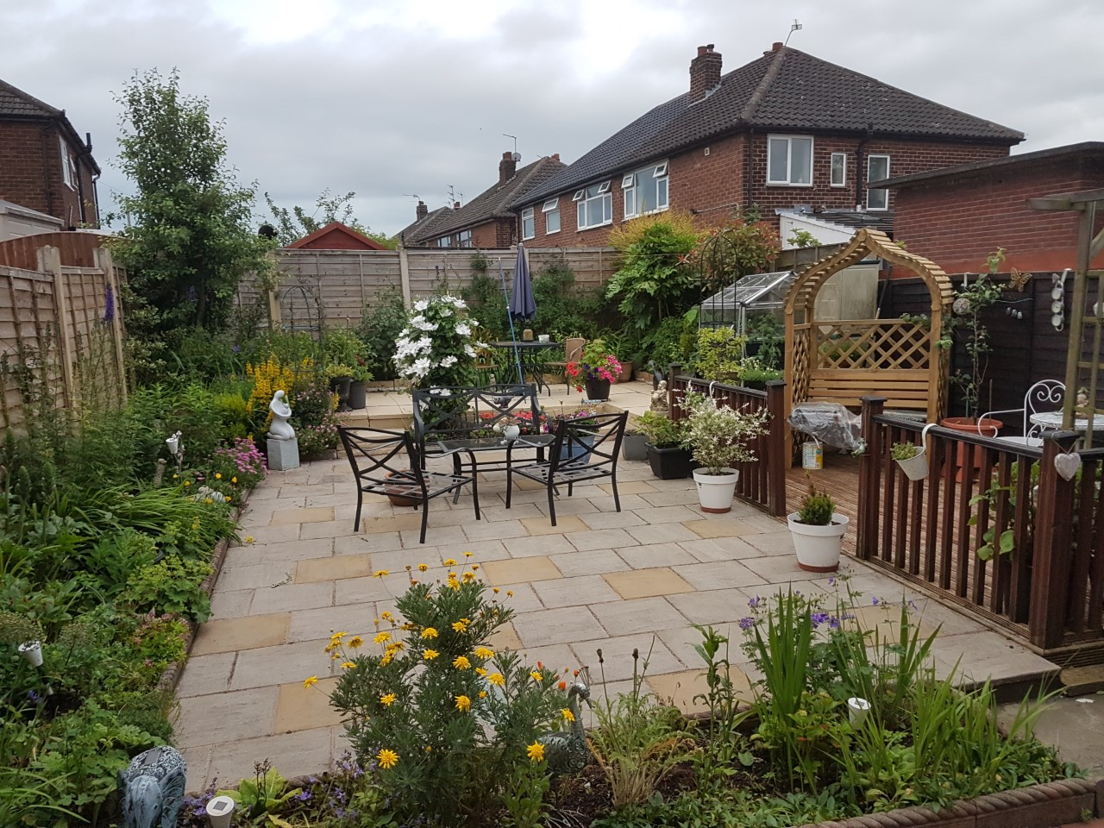
of 20

Slide 7
of 20

Slide 8
Identifying the Size and Characteristics of Edge Space
8
of 20
of 20

Slide 9
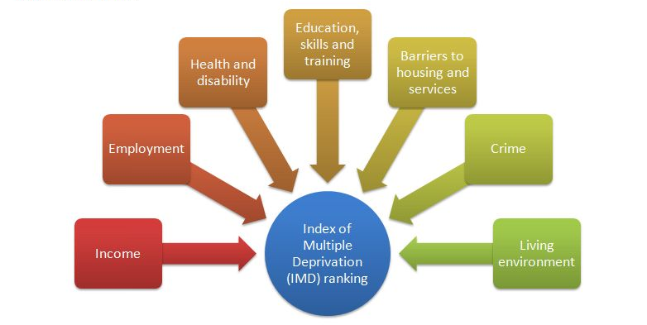
Effects of Social Factors
Index of Multiple Deprivation
of 20

Slide 10
Effects of Social Factors
Index of Multiple Deprivation
of 20

Slide 11
Effects of Social Factors
Index of Multiple Deprivation
of 20

Slide 12
Effects of Social Factors
Experian Mosaic
12
of 20
of 20

Slide 13
Does the method work?
Yes – Using aerial photography it is possible to use characteristics to distinguish between streets.
13
of 20
of 20

Slide 14
Creating Garden Profiles For Each LSOA
14
of 20
of 20

Slide 15
Creating Garden Profiles For Each LSOA
15
of 20
of 20

Slide 16
Creating Diversity Profiles For Each LSOA
1 = Trees
2 = Shrubs
3 = Plants
4 = Lawn
5 = Pave
16
of 20
of 20

Slide 17
Creating Diversity Profiles For Each LSOA
1 = Trees
2 = Shrubs
3 = Plants
4 = Lawn
5 = Pave
17
of 20
of 20

Slide 18
Yet To Come…
of 20

Slide 19
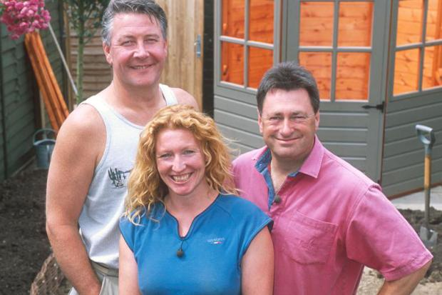
Yet To Come…
of 20

Slide 20
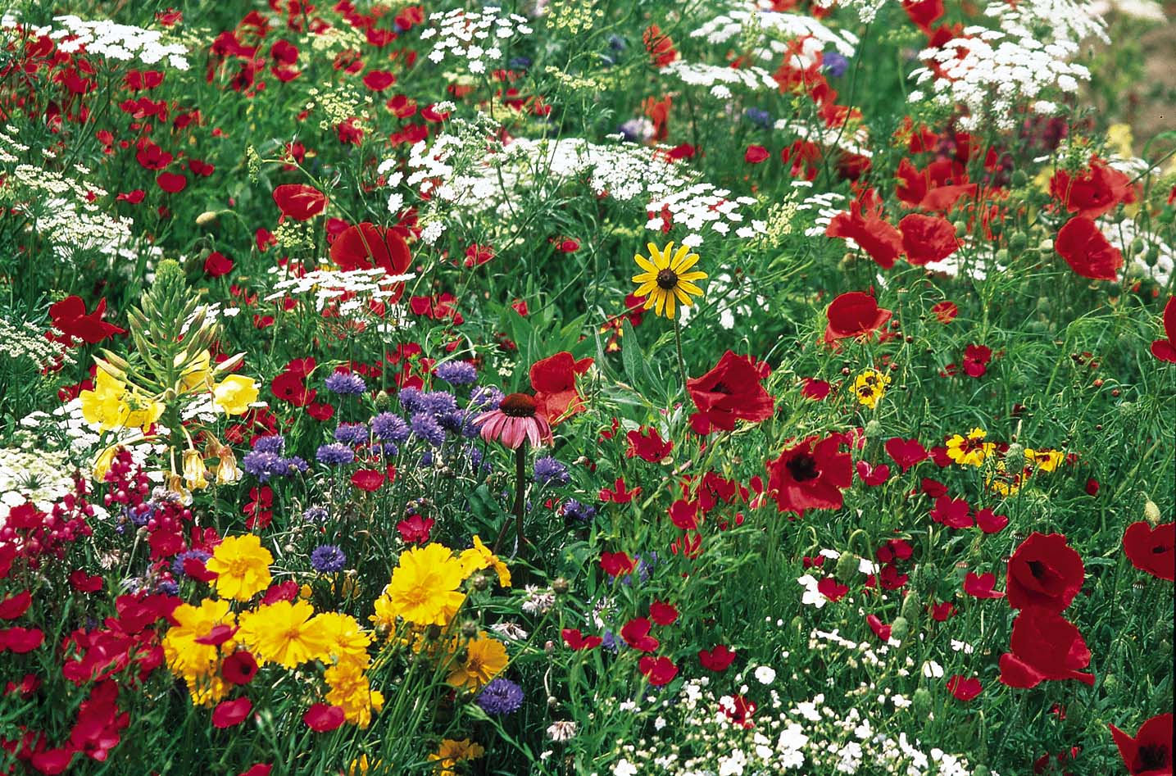
The Bigger Picture.
of 20

