Slide 1
3rd International Conference on Advances in Civil & Environmental Engineering, UET TAXILA Pakistan. (ICACEE-2024)
The Research on Asphalt Concrete Modification using Hydrated Lime (Ca(OH)₂)
Dr. Yu Wang
Reader in Civil & Environmental Engineering
School of Science, Engineering & Environment, University of Salford, Manchester UK
ICACEE-2024
1

Slide 2
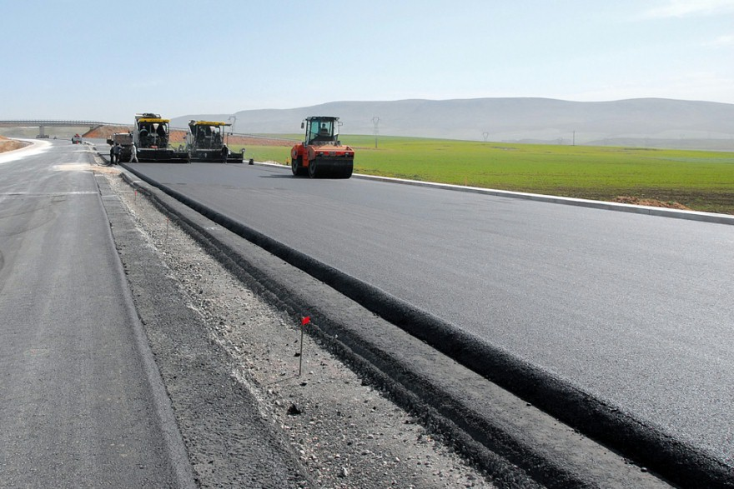
Outline
Background
Research carried out
Some results & findings
Research in future
ICACEE-2024

Slide 3
Fatigue cracking
ICACEE-2024

Slide 4
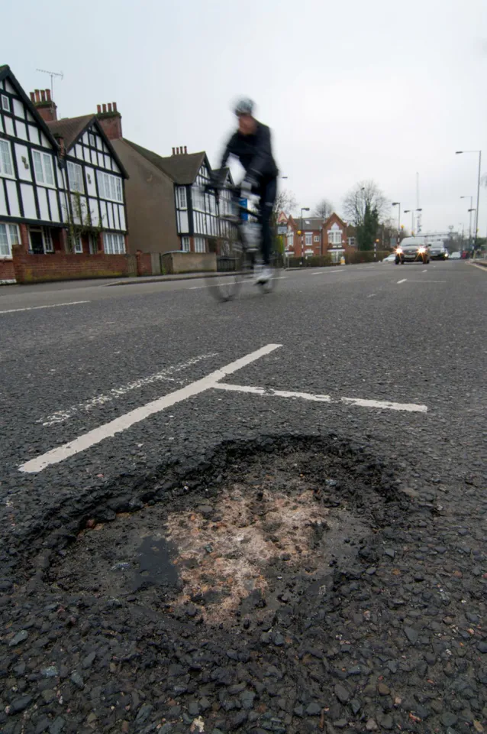
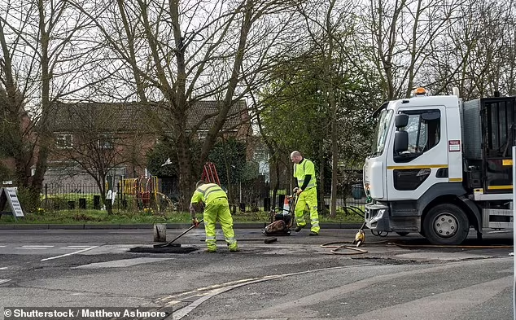
The cost to repair Britain’s pothole-stricken roads has soared to more than £12bn and works could take more than nine years to complete (The Annual Local Authority Road Maintenance (ALARM) survey in 2022)
According to 2023 report, road damage caused to vehicles in England costs drivers an average of £922 to fix.
Councils face difficult choices over road maintenance schemes in 2024 as inflation adds £500m to costs (A new survey from the County Councils Network (CCN))
ICACEE-2024

Slide 5
Lime has been used in hot mix asphalt (HMA) since 1910 in the United States
In Europe, hydrated lime was used to improve bitumen/aggregate adhesion in the 1950s. Since entering 2000, hydrated lime is being increasingly used in asphalt mixtures in most European countries.
Hydrated lime is now seen as a multifunctional additive that increases the durability of asphalt mixes for:
The resistance to moisture damage and frost,
The resistance to chemical aging,
The resistance to performant deformation or rutting.
ICACEE-2024

Slide 6
Research Rationale
There are still knowledge gaps needing to fill:
Wider experimental study for the Ca(OH)₂ (HL) optimistic content for varied pavement applications.
Wider experimental study for more material properties .
Deep scientific knowledge for material characterization.
Deep knowledge for the coupled thermo-mechanical effect on the HL modified HMA concrete.
Deep scientific knowledge property characterization and modelling tools for pavement design and predictive simulation.
ICACEE-2024

Slide 7
Experimental Studies
HMA mixes designed for surface, levelling and base layers
Control mixes using the limestone dust for the mineral additive.
Modified mixes using HL to replace limestone dust at five different percentages, i.e., 1, 1.5, 2, 2.5, 3%, by the total weight of aggregate.
ICACEE-2024

Slide 8
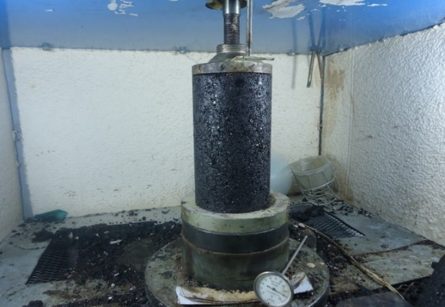
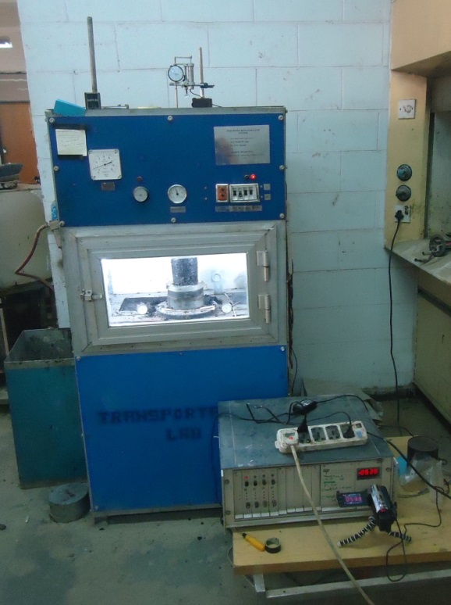
Uni-axial Tests
Tests were conducted at temperatures: 20, 40, and 60°C.
Under a repetitive load of 138 kPa up to 10,000 repetitions.
Measuring for Permanent deformation and resilient modulus.
Specimen size: 101.6×203.2
ICACEE-2024

Slide 9
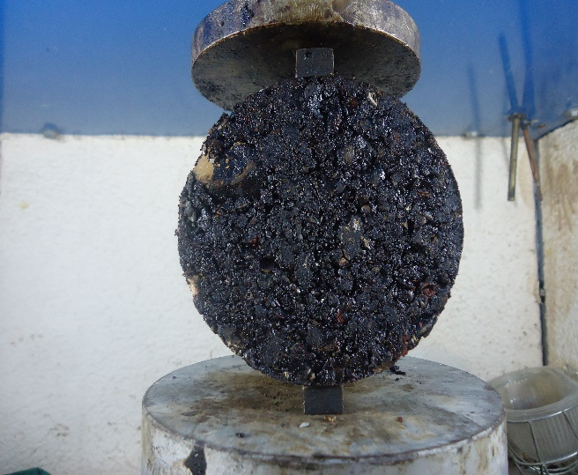
Moisture Susceptibility Test
Unconditioned state test
Splitting tests following after 1 Hr 25ºC water bath.
Conditioned state test
Splitting tests following a cycle of :
Fully Saturated and exposed for 16 hrs at -18ºC
24 hrs in 60ºC water bath
1 hr in 25ºC water bath.
Specimen size: 101.6×63.5
Splitting tensile test
ICACEE-2024

Slide 10
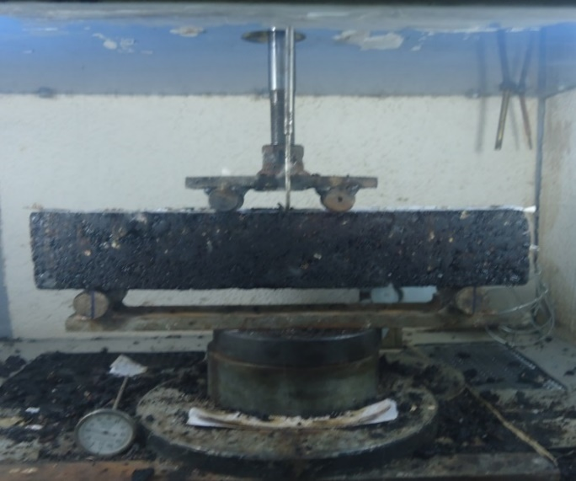
Fatigue Test
Four-point bending tests under repetitive loads
Four loads: 223, 310, 402, 490 N.
Time loading: 0.1sec’s followed by 0.4 sec’s rest.
Repetitions: up to 100,000.
Temperature: 15, 20, 25 ± 1°C
Specimen size: 318×76×76
Flexural Test by Four Point Loading
ICACEE-2024

Slide 11
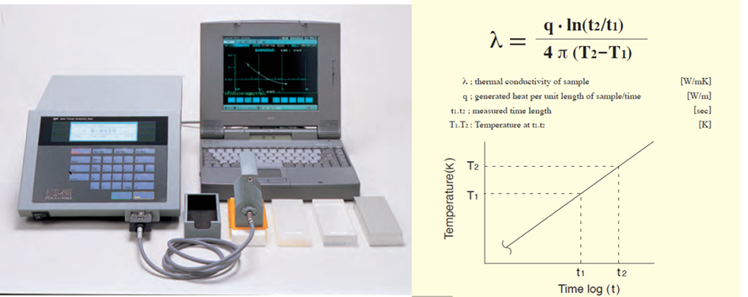
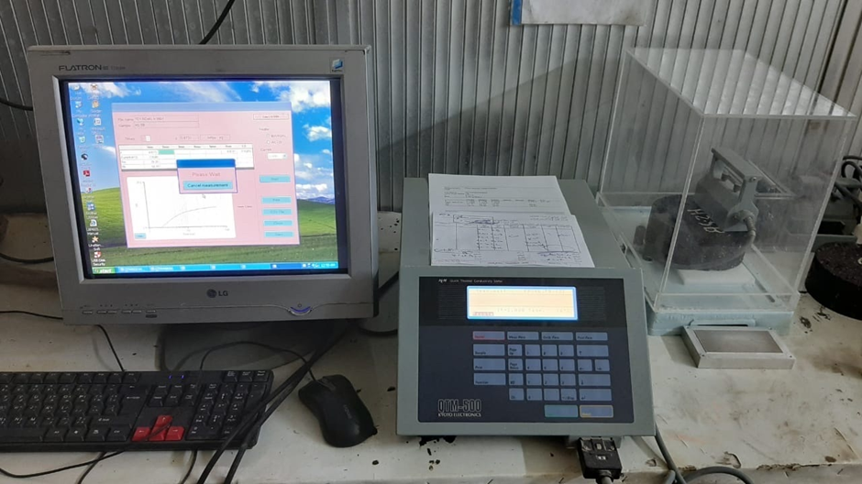
Thermal Properties Test
Thermal conductivity.
Specific heat.
Quick Thermal Conductivity Meter QTM500
Experiment Setup
ICACEE-2024

Slide 12
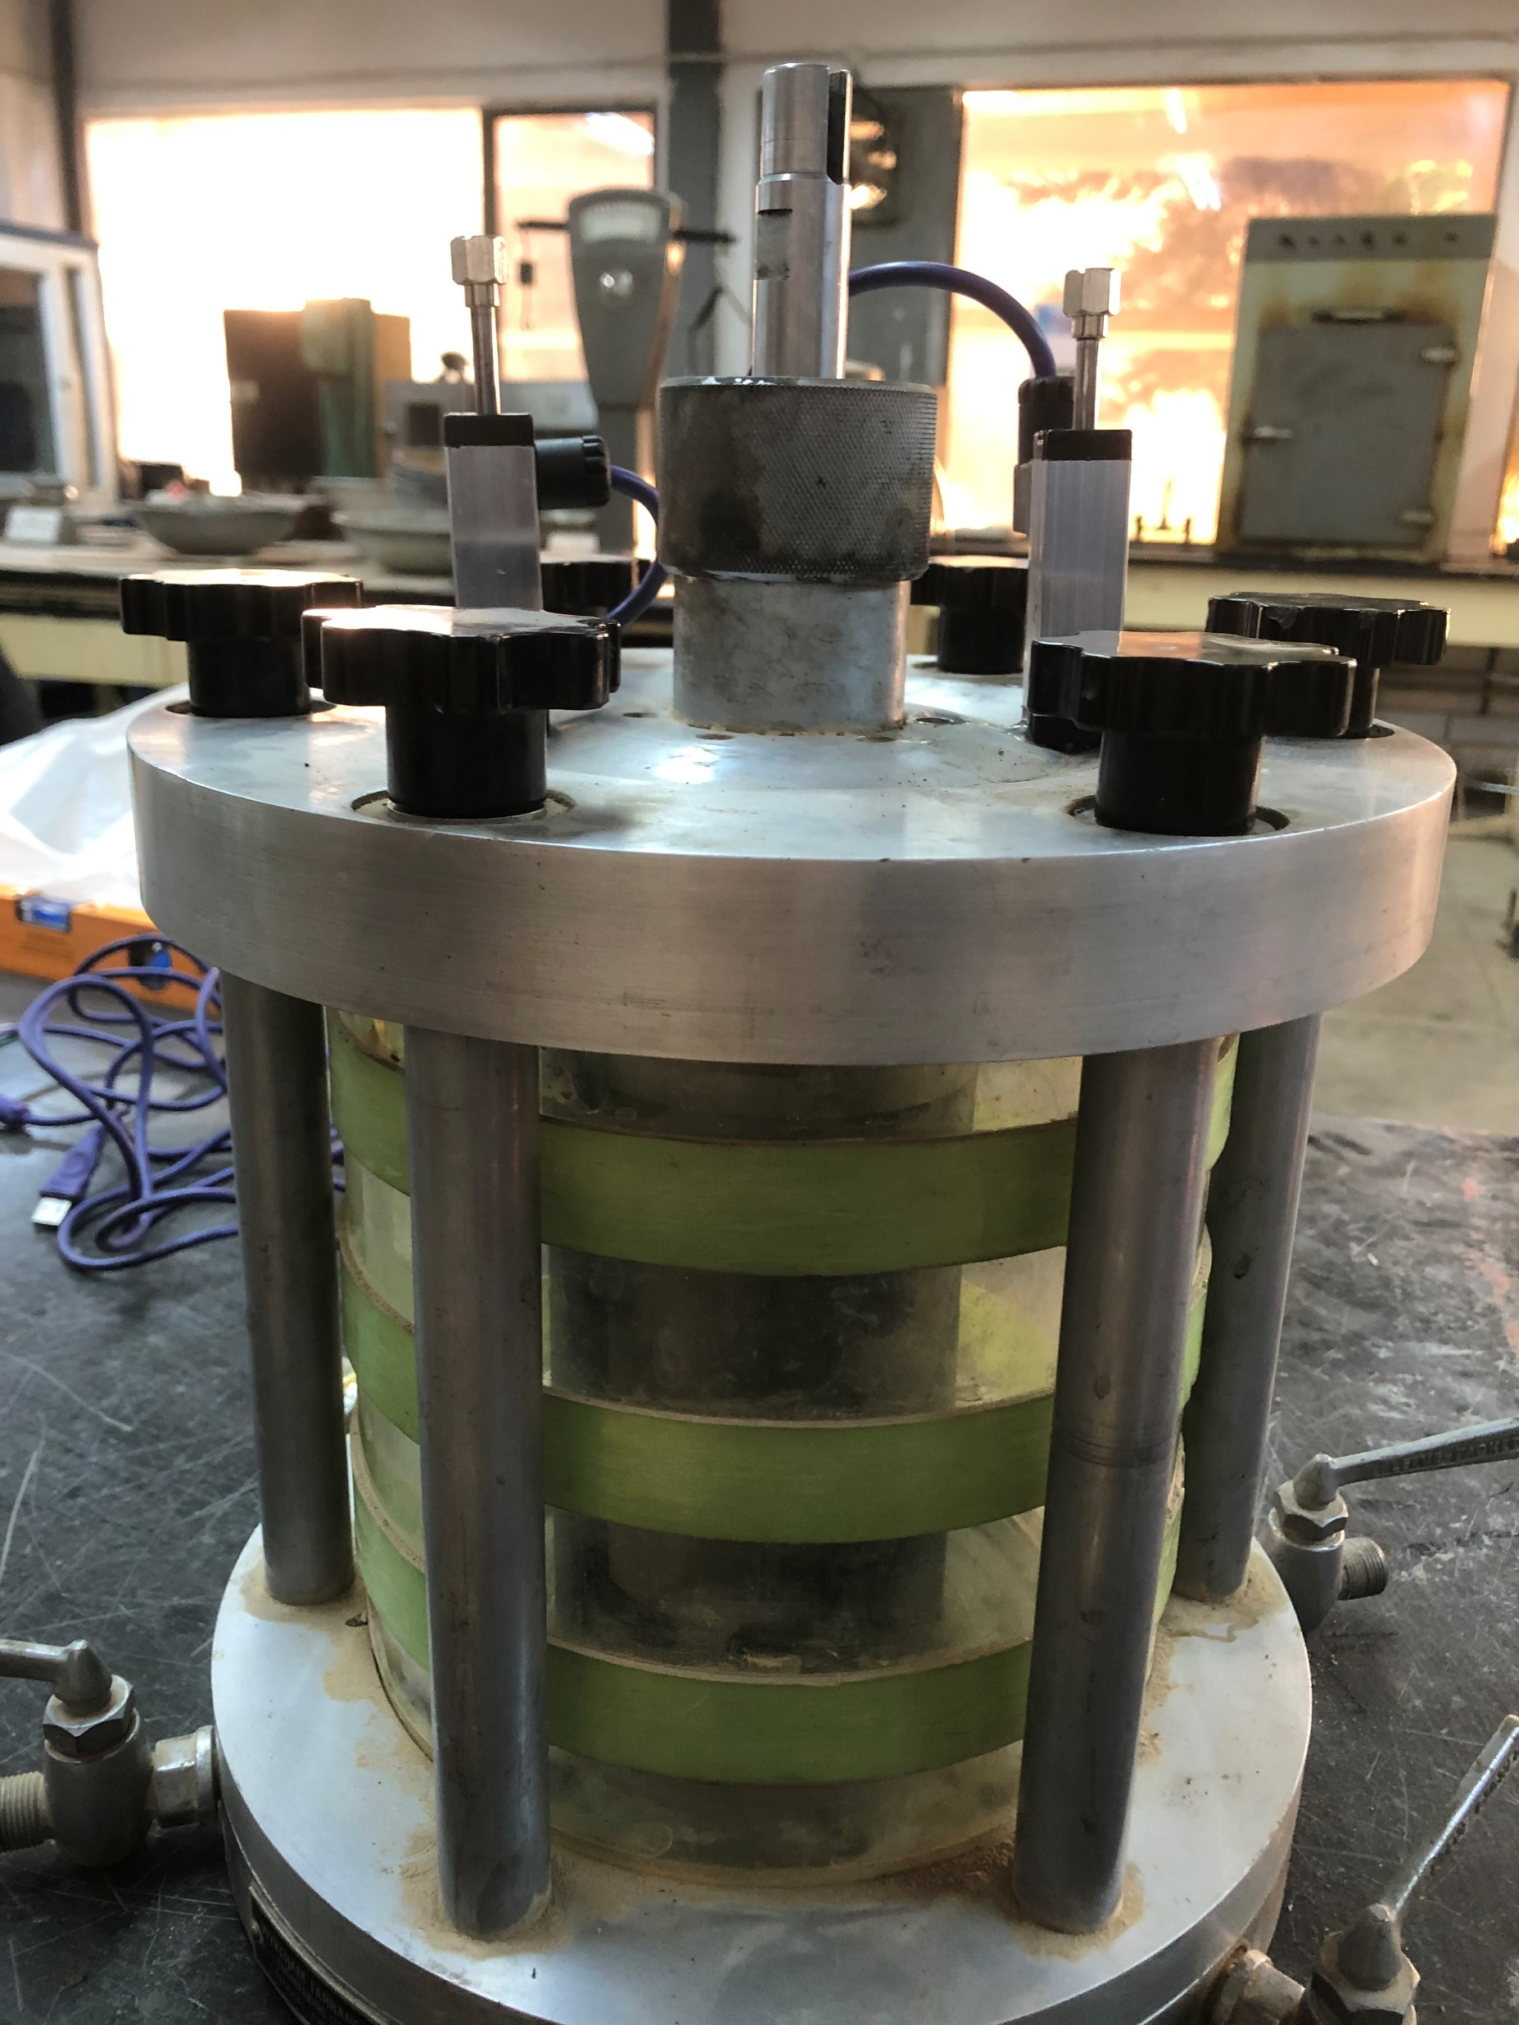
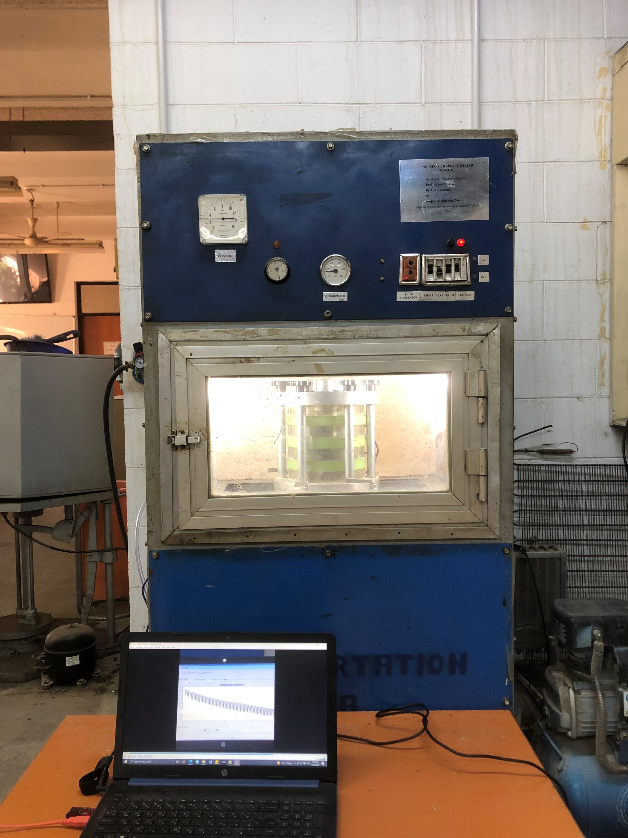
Tri-axial Test
Deviates: 10, 20, 30 psi.
Temperature: 20, 40, 60°C
Measuring for Permanent deformation and resilient modulus.
ICACEE-2024

Slide 13
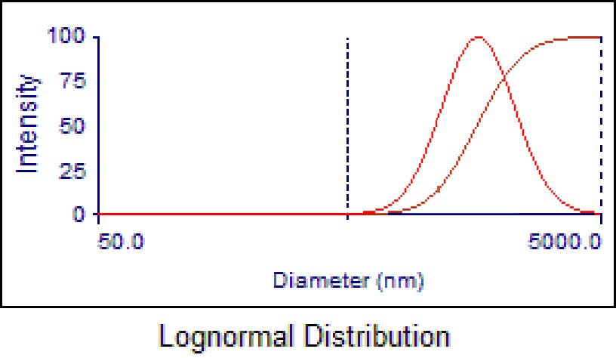
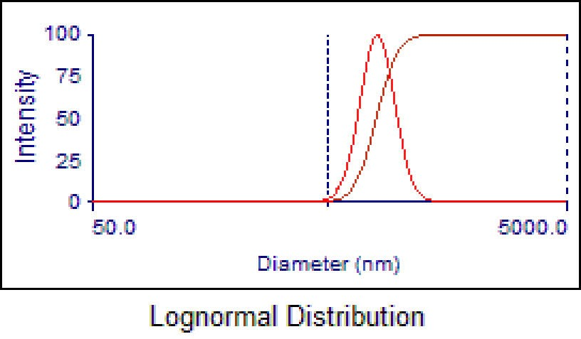
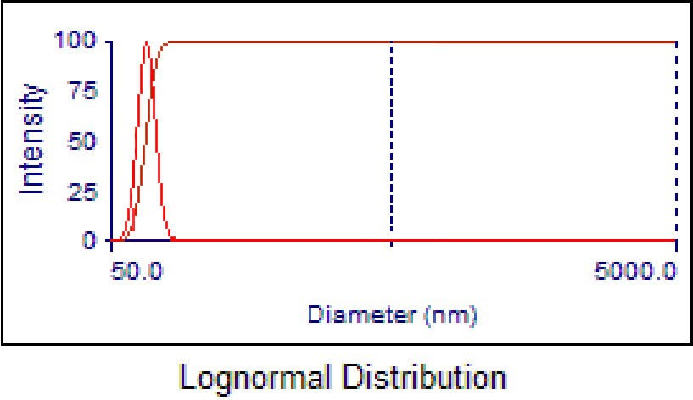
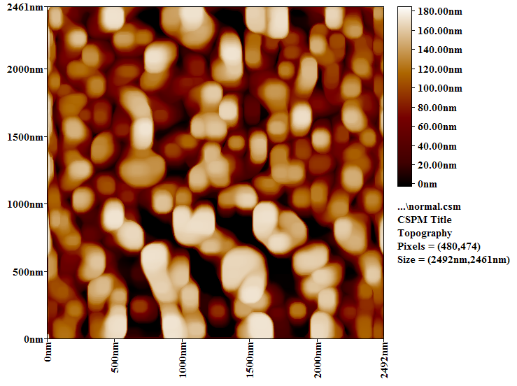
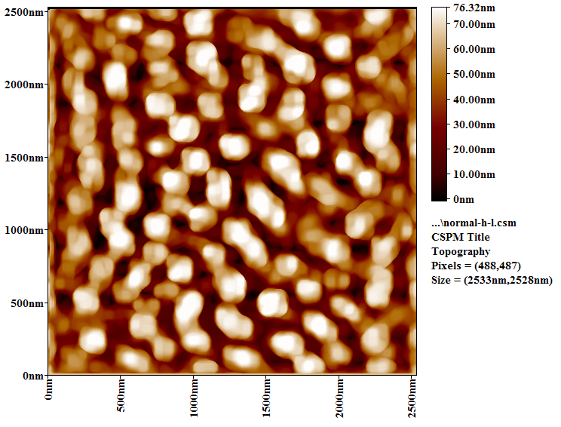
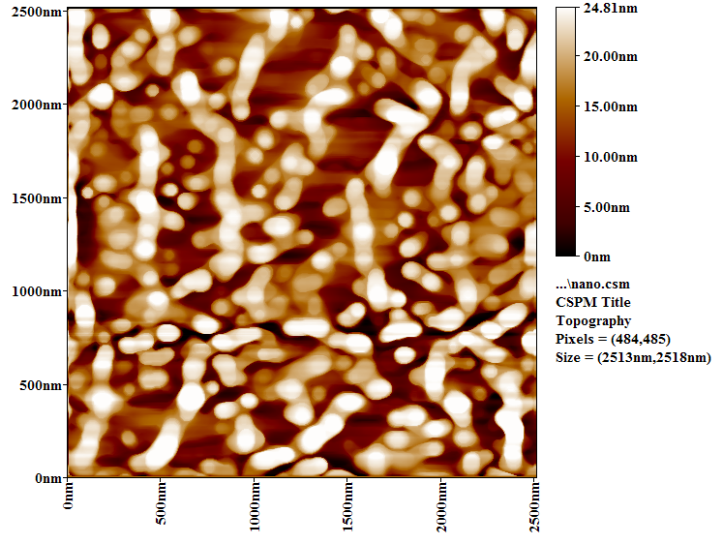
Size Effect of HL on the Mechanical Performance of the Modified HMA Concrete
regular (r-HL)
sub-nano (sn-HL)
nano (n-HL)
ICACEE-2024

Slide 14
Modelling Coupled Thermomechanical Effect on HL HMA Pavement
Motion equation
$\frac{E}{2\left(1+v\right)}\left(\frac{1}{\left(1−2v\right)}∇\left(∇∙u\right)+∇^{2}u\right)+f=ρ\frac{∂^{2}u}{{∂t}^{2}}$
u - displacement vector (u_{x} , u_{y} , u_{z}), f - body force, E - modulus, $v$ - Poisson ratio,
ρ - density.
Energy equation
$ρC_{p}\frac{dT}{dt}=∇(k∇T)+ρr−α(3λ+2μ)T\frac{dε_{kk}}{dt}$
T - temperature, C_{p} - speciﬁc heat, k - thermal conductivity, r - heat source,
$ε_{kk}$ - thermal deformation.
ICACEE-2024

Slide 15
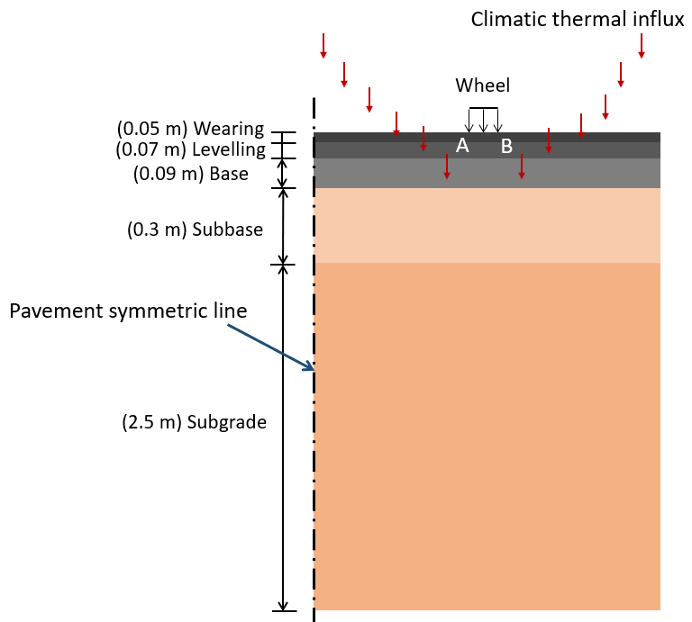
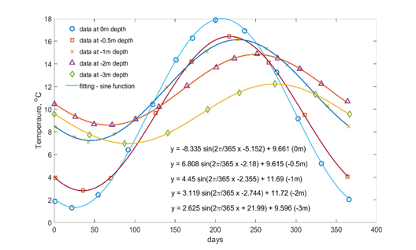
Thermomechanical modelling for pavement
Annual monthly average daily Global Horizontal Irradiance by hours
Vertical annual daily ground temperature profile
ICACEE-2024

Slide 16
Results & Findings
High HL content up to 3% by total weight of aggregate shows in an obvious improvement on the resistance to permanent deformation under repeated loads. The improvement is highly pronounced at hot weather conditions.
Further high HL content does not mean a definite improvement on the mixes’ durability. Extra HL reduces the effective amount of asphalt cement.
Although sub-nano HL shows the best for mixes moisture susceptibility at 2% content, but the improvement is marginal compared to nano HL. Overall, 2~2.5% nano HL is proposed to be the optimum for the surface wearing course.
2.5% HL mixes have enhanced thermal properties, the thermal conductivity and specific heat. However, for the HL modified mix there is no correlation between the thermal properties and either the optimum asphalt cement or the mineral filler content.
2.5% HL replacement for limestone dust generated the optimum fatigue life increment for wearing course mix in the temperature range 15-25°C.
Tri-axial tests provide the material properties close-to-real-world situation. The tri-axial property characterization and a numerical modelling further confirmed the benefit of the HL modified asphalt pavement on the thermal fatigue and thermomechanical deformation resistance.
ICACEE-2024

Slide 17
More Information can be found in the publications
A.F. Al-Tameemi, Yu Wang, A. Albayati, 2016, Experimental study of the performance related properties of the asphalt concrete modified with hydrated lime, Journal of Materials in Civil Engineering, 28(5): 04015185.
A.F. Al-Tameemi, Yu Wang, A. Albayati, J. Haynes, 2019, Moisture Susceptibility and Fatigue Performance of Hydrated Lime–Modified Asphalt Concrete: Experiment and Design Application Case Study, Journal of Materials in Civil Engineering, 31(4): 04019019.
A. Albayati, Yu Wang, J. Haynes, 2022, Size Effect of Hydrated Lime on the Mechanical Performance of Asphalt Concrete, Materials, 15: 3715.
A. Al-Ashaibi, Yu Wang, A. Albayati, J. Byzyka, M. Scholz, L. Weekes, 2022, Thermal Properties of Hydrated Lime-Modified Asphalt Concrete and Modelling Evaluation for Their Effect on the Constructed Pavements in Service, Sustainability, 14: 7827.
Q Wei, A. Al-Ashaibi, Yu Wang, A. Albayati, B.J. Haynes, 2022, Experimental Study of Temperature Effect on The Mechanical Tensile Fatigue of Hydrated Lime Modified Asphalt Concrete and Case Application for The Analysis of Climatic Effect on Constructed Pavement, Case Studies in Construction Materials, 17(12): e01622.
Azedin Al Ashaibi, Yu Wang, Amjad Albayati, Laurence Weekes, Jonathan Haynes, 2024, Uni-and Tri-axial Tests and Property Characterization for Thermomechanical Effect on Hydrated Lime Modified Asphalt Concrete, Construction and Building Materials, accept.
ICACEE-2024

Slide 18
Research in Future
Quantify HL effects on:
Material rheological properties
Thermo-viscoelasticity; Thermo-viscoplasticity
Dynamic behaviour/response under different temperature
Kinetic hardening
Thermal aging
ICACEE-2024

Slide 19
Acknowledgement
All the reported work were produced from an international collaboration between the research team led by Prof. Amjad Albayati at University of Baghdad in Iraq and the team at the University of Salford.
ICACEE-2024

Slide 20
Thank You
ICACEE-2024

