Slide 1
Women’s Wellbeing at Work across the Life course: a focus on The Menopause NHS England Health Champions Network, 5th September 2024
C.E.Edge1@salford.ac.uk
Dr Clare Edge
Lecturer in Psychology and WOW Network Coordinator
@WOW_Womeninwork
@Clare_Edge
Image published under CC0 1.0 Universal (CC0 1.0)
via the Centre for Ageing Better Age Positive Image Library

Slide 2
Introduction: what will be the take home messages?
Wider context of women’s life course wellbeing: the taboo of the Three M’s
How do we challenge workplace perceptions and stereotypes relating to women, menopause and ageing?
Acknowledging differing and intersectional experiences
Promoting self-efficacy and positive self-beliefs around the menopause

Slide 3
Tackling the Taboo around the Three M’s
Tackling the Taboo around the Three M’s (Grandey et al., 2018: Tackling Taboo Topics: A Review of the Three Ms in Working Women’s Lives - Alicia A. Grandey, Allison S. Gabriel, Eden B. King, 2020 (sagepub.com)): Menstruation, Maternity, Menopause. (see for example, Geukes et al.,2020: https://linkinghub.elsevier.com/retrieve/pii/S0378512220302723; Hardy et al., 2018: Tackling the taboo: talking menopause-related problems at work | Emerald Insight)
Creating safe channels for discussion (e.g. menopause café; women’s wellbeing groups).
Promoting menopause self-efficacy e.g. in having discussions about these health issues for women and colleagues by providing training on symptoms and symptoms management/support at the workplace level.
Notes:
Demystifying HRT etc- menopause discourse

Slide 4
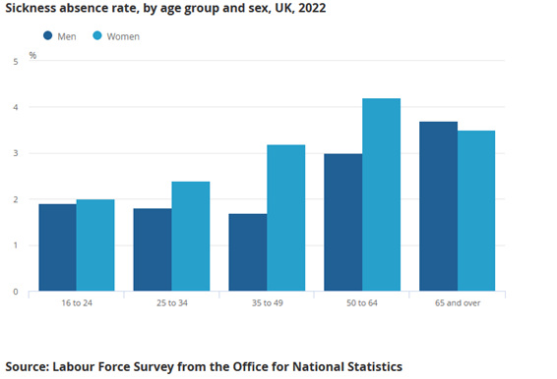
Challenges for Wellbeing of Older Women@Work: why should stakeholders engage?

Slide 5
Challenging broader social norms around ageing women in work
E.g. ideal worker norms (see for example, Steffan & Loretto, 2024 Menopause, work and mid‐life: Challenging the ideal worker stereotype - Steffan - Gender, Work & Organization - Wiley Online Library) and promoting flexibility
promotion of positive self-beliefs around ageing as a woman – challenging the ‘invisibility’ that women experience (see for example, Bowman et al., 2017).
Negative perceptions of ageing: stereotypes
Negative cultural stereotypes valuing youthful attractiveness while devaluing age (Ballard et al., 2009)
Stigmatization of the menopause relates to its medicalization and silence (Ferguson and Parry, 1998; Nosek et al, 2010)
How menopause is experienced can be linked to self-esteem (Ayers et al., 2010)

Slide 6
Gendered self-growing old: Framing menopause positively and demystifying the menopause and the menopause transition
Framing menopause positively and demystifying the menopause and the menopause transition: reversing the narrative around medicalisation- emphasis on loss/deficiency and challenging the silence to focus on positive themes e.g. transformational to challenge the ‘invisibility’ women face (Griffiths et al., 2013; Westwood, 2022), the emphasis needs to be on the workplace not on the individual ways to ‘fix the woman’ – e.g. ‘menowashing’ in supermarkets a range of menopause products aimed at women with very little scientific basis.
Looking Forward: Positive perceptions of the ageing and the menopause
‘Ageing can bring freedom, self-awareness, growth, reflection, and reassessment of role’ (Salis et al., 2018 p. 521)
Transformational:
Older women’s narratives viewed the menopause as:
“Moving on”; “…there’s a confidence that comes with age”
(Salis et al., 2018 p. 530)
Image published under CC0 1.0 Universal (CC0 1.0)
via the Centre for Ageing Better Age Positive Image Library

Slide 7
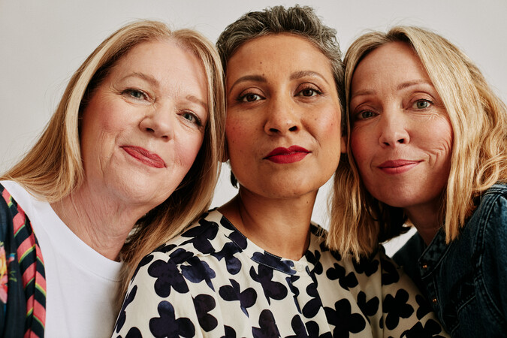
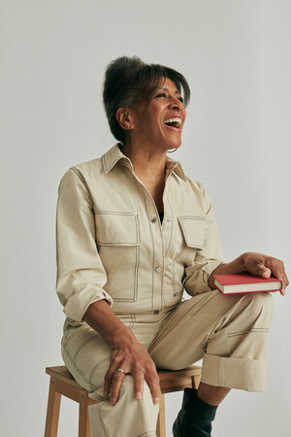
https://ageing-better.org.uk/news/latest-image-library-collection-offers-glamorous-and-realistic-response
Image published under CC0 1.0 Universal (CC0 1.0)
via the Centre for Ageing Better Age Positive Image Library
Notes:
https://theconversation.com/ageing-gracefully-how-women-steer-the-line-between-inauthentic-and-old-35726

Slide 8
A Life course approach acknowledging varying experiences…
Whilst acknowledging the varying experiences in menopause symptoms severity- 75% of those with severe symptoms were shown to have negative impacts on work ability (see for example, Geukes et al., 2016)- some concrete tips here on dealing with impacts on workability i.e. adapting work role and environment, flexibility in working patterns, sickness absence policies etc.
Life course approach- involving younger and older women in the conversation promotion of self-efficacy around the menopause – there was a significant correlation between menopausal attitude and menopause symptom management (Geukes et al., 2023; Kwak, Park & Kang, 2014).
“…when you're going through the menopause…a lack of oestrogen in your body can do a lot of things, because I was reading a menopause book as well, and some of the things that it was describing, at one time I thought I was going really daft because I thought I was losing …- I went to the doctors and said I think I'm losing my marbles…I think sometimes as well, going through that sort of thing, I think that stopped me from progressing more than I probably would have done, because you lose confidence in yourself I think a little bit” [Participant 3, 64 years old, Customer Service Role, Large Public Sector Organisation].

Slide 9
Wider wellbeing needs to be promoted around age of onset of the perimenopause/menopause- combatting and reducing work stress
Wider wellbeing needs to be promoted around age of onset of the perimenopause/menopause- combatting and reducing work stress e.g. job clarity, environmental clarity,
reducing ‘invisibility’ experienced as a woman by promoting the value of women in work and changing the narrative to successful ageing rather than ageing as a deficiency (Centre for Ageing Better Image Resource Library Age-positive image library | Centre for Ageing Better (ageing-better.org.uk); Barrett, 2022: Centering Age Inequality: Developing a Sociology-of-Age Framework)
additional techniques such as mindfulness, self-efficacy interventions, strategies to reduce work rumination may compliment this (Geukes et al. 2023; Hardy, Thorne, Griffiths & Hunter, 2018)

Slide 10
Self-efficacy intervention example:
Self-efficacy interventions (Geukes et al. 2023): https://linkinghub.elsevier.com/retrieve/pii/S037851222300364X
“The workshop consisted of general information on the different stages of women’s lives and the possibilities and possible problems that may arise from them. The topics discussed were female sex hormones and their interactions, menstruation, fertility, pregnancy, menopause and existing laws and regulations on complaints and problems that may arise from them in combination with work. This information was based on recent literature and guidelines. Based on the view that organisational culture change is important, the educational intervention additionally consisted of a workshop for managers and human resources (HR) staff. Managers and HR staff from the intervention department could register for this. This was voluntary, and not mandated from the department. This workshop contained the same information as the basic workshop for employees but was aimed at managers/supervisors. In addition, guidance was given on how to introduce the topic in a productive and non-confrontational way.”

Slide 11
Join the WOW Wellbeing & Older Women@Work academic network!
A vibrant network of researchers and stakeholders (50 plus academics and stakeholders focusing on social psychology, human resource management and occupational medicine across over 25 countries including a range of practitioner, policy and national and EU level governmental institutions) exploring:
Structural, social and health inequalities: the diverse needs of older women in the workplace
Stereotypes, prejudice and identity across the life course: perceptions of growing older across the generations
The workplace environment: what are the key barriers and facilitators to workplace wellbeing across Europe? what enables older women to stay in work for longer?
You can also find us on Linkedin: Wellbeing & Older Women@Work: the European Network https://www.linkedin.com/groups/14104101/
and X: https://x.com/WOW_Womeninwork

Slide 12
Useful resources:
BRITISH MENOPAUSE SOCIETY Tool for clinicians Information for GPs and other health professionals (2023)
20-BMS-TfC-Menopause-in-ethnic-minority-women-JUNE2023-A.pdf
A GUIDE TO MANAGING MENOPAUSE AT WORK (CIPD) (2021)
line-manager-guide-to-menopause_tcm18-95174.pdf
Let’s talk about the menopause: Centre for Ageing Better (2021):
Let’s talk about the menopause | Centre for Ageing Better (ageing-better.org.uk)
Other useful resources:
BMS website to find an accredited menopause clinician
WHC factsheets

