Slide 1
Decolonising through Reflexive Practice - An Institutional Pilot

Slide 2
What is decolonising through reflexive practice?
Lots of things influenced the creation of the resource:
My background and experience
My frustrations
My views on academic development and practice
In terms of influences on approach/content:
Social constructivism
Social justice education and critical pedagogy
CRT
Racialisation and power
Decolonisation vs. decoloniality discussion
Reflective and reflexive practice
TRAAC model (Tran, 2021)
“Critically reflexive practice embraces subjective understandings of reality.....it helps us understand how we constitute our realities and identities in relational ways” (Cunliffe, 2004)
“Critical pedagogy attempts to understand how power works through the production, distribution, and consumption of knowledge within particular institutional contexts and seeks to constitute students as informed subjects and social agents” (Giroux, 2010)
“Like critical pedagogy, a decolonizing education is one that exceeds the confines of the school, college or university to intervene in the reinvention of the world” (Carol Azumah Dennis in Bhambra et al., 2018)

Slide 3
The journey
Talks and scoping
Discussions and wider talks/sessions
Resource creation
Academic development approach – local
Aim? Evaluation, impactful, embedded and natural
E-course creation
Wider pilot of academic development approach & student pilot (4 seminar-series)
Continuous reflection and improvement
Need to evaluate
Consideration of impact and how to measure it

Slide 4
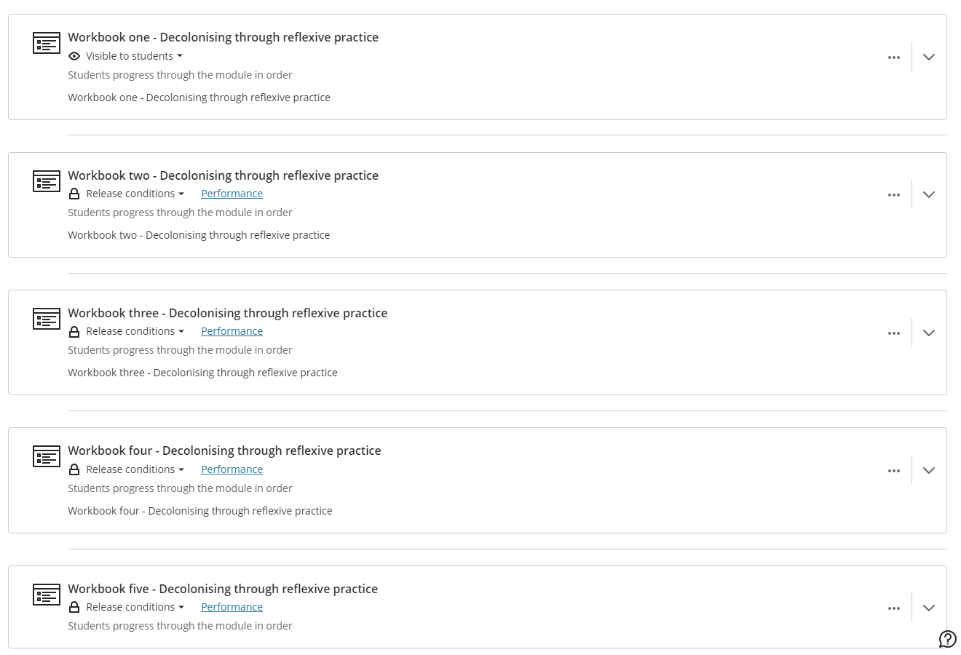

Slide 5
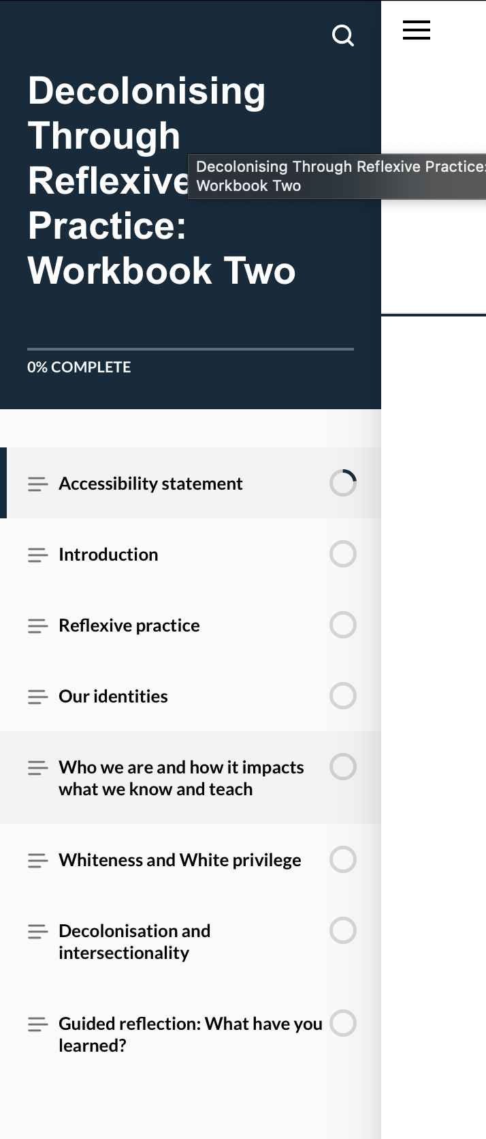
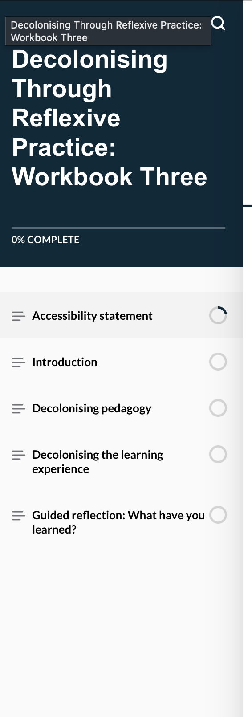
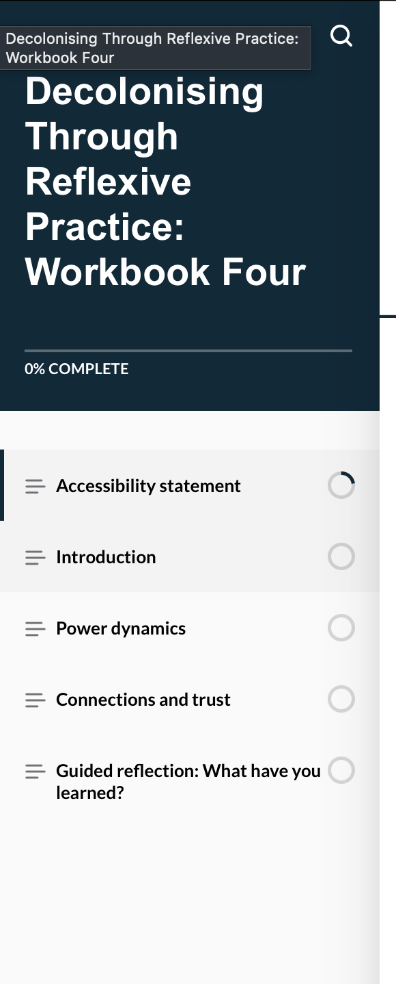
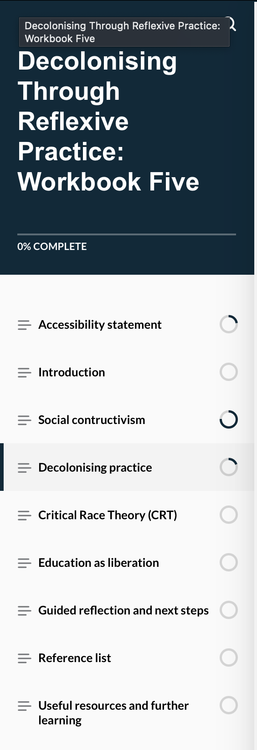

Slide 6
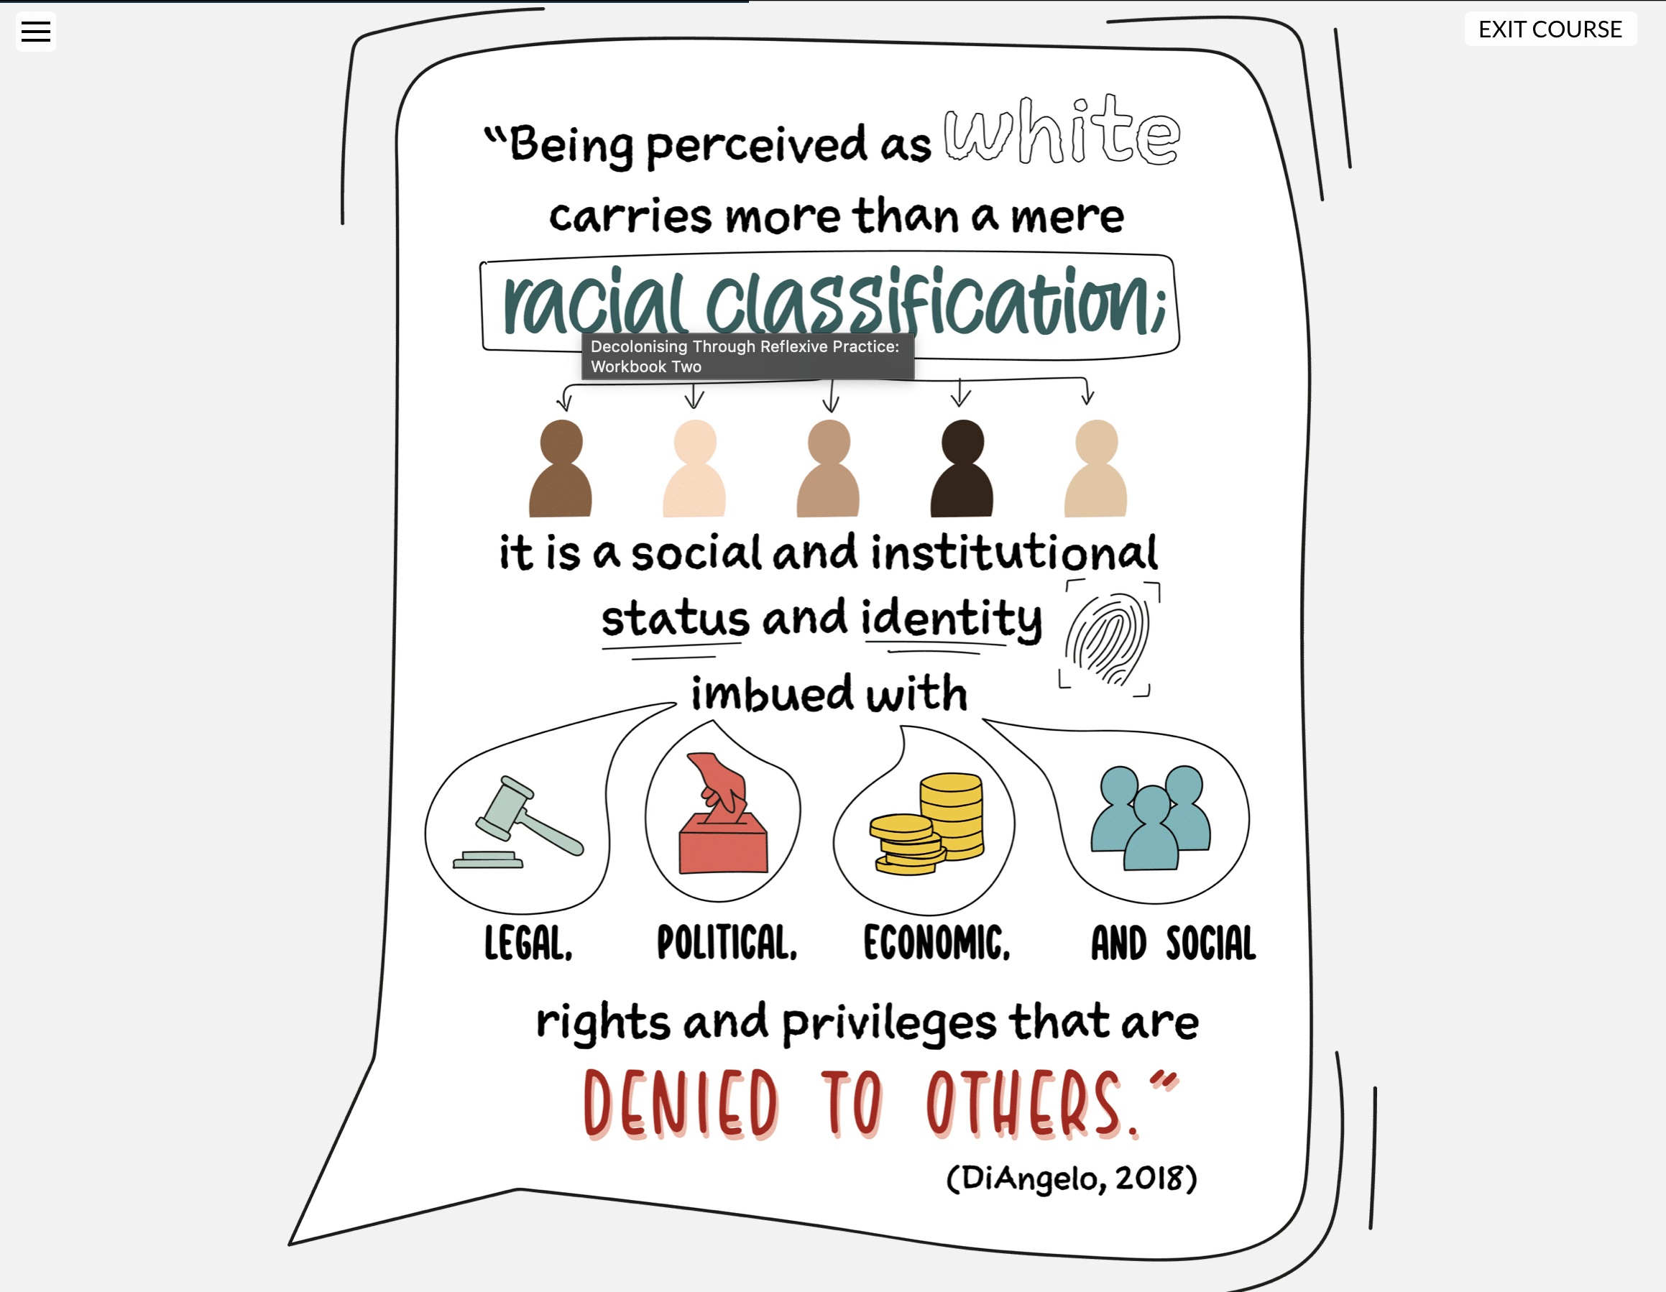

Slide 7
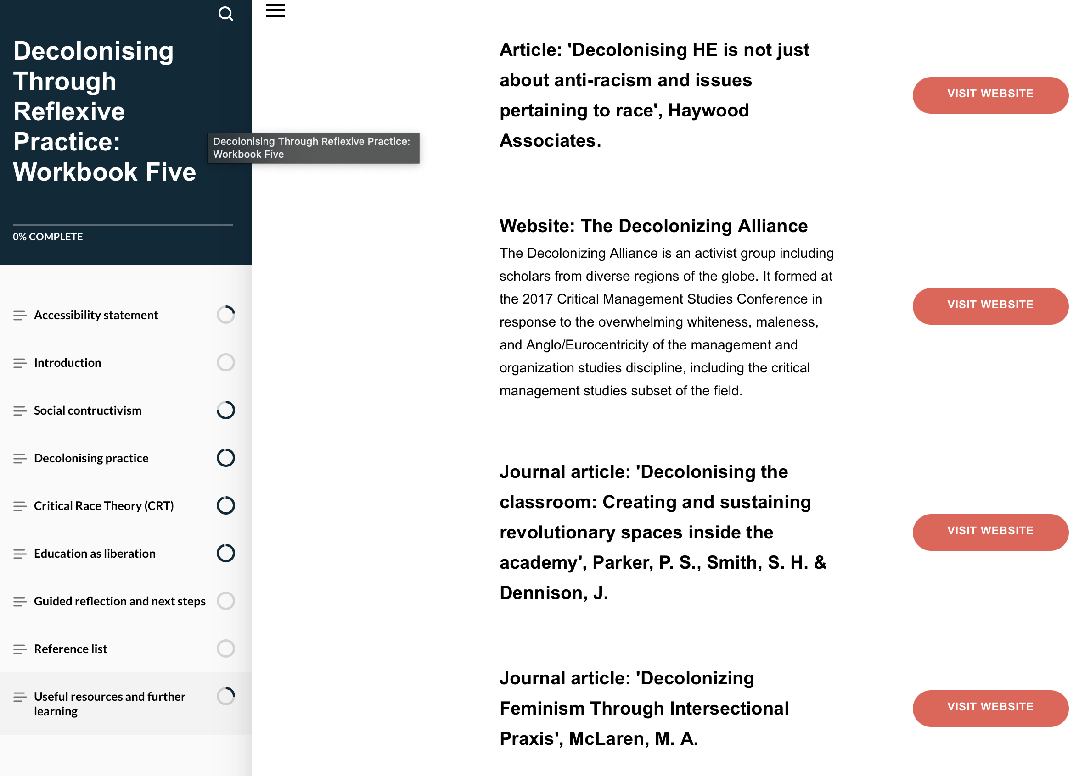
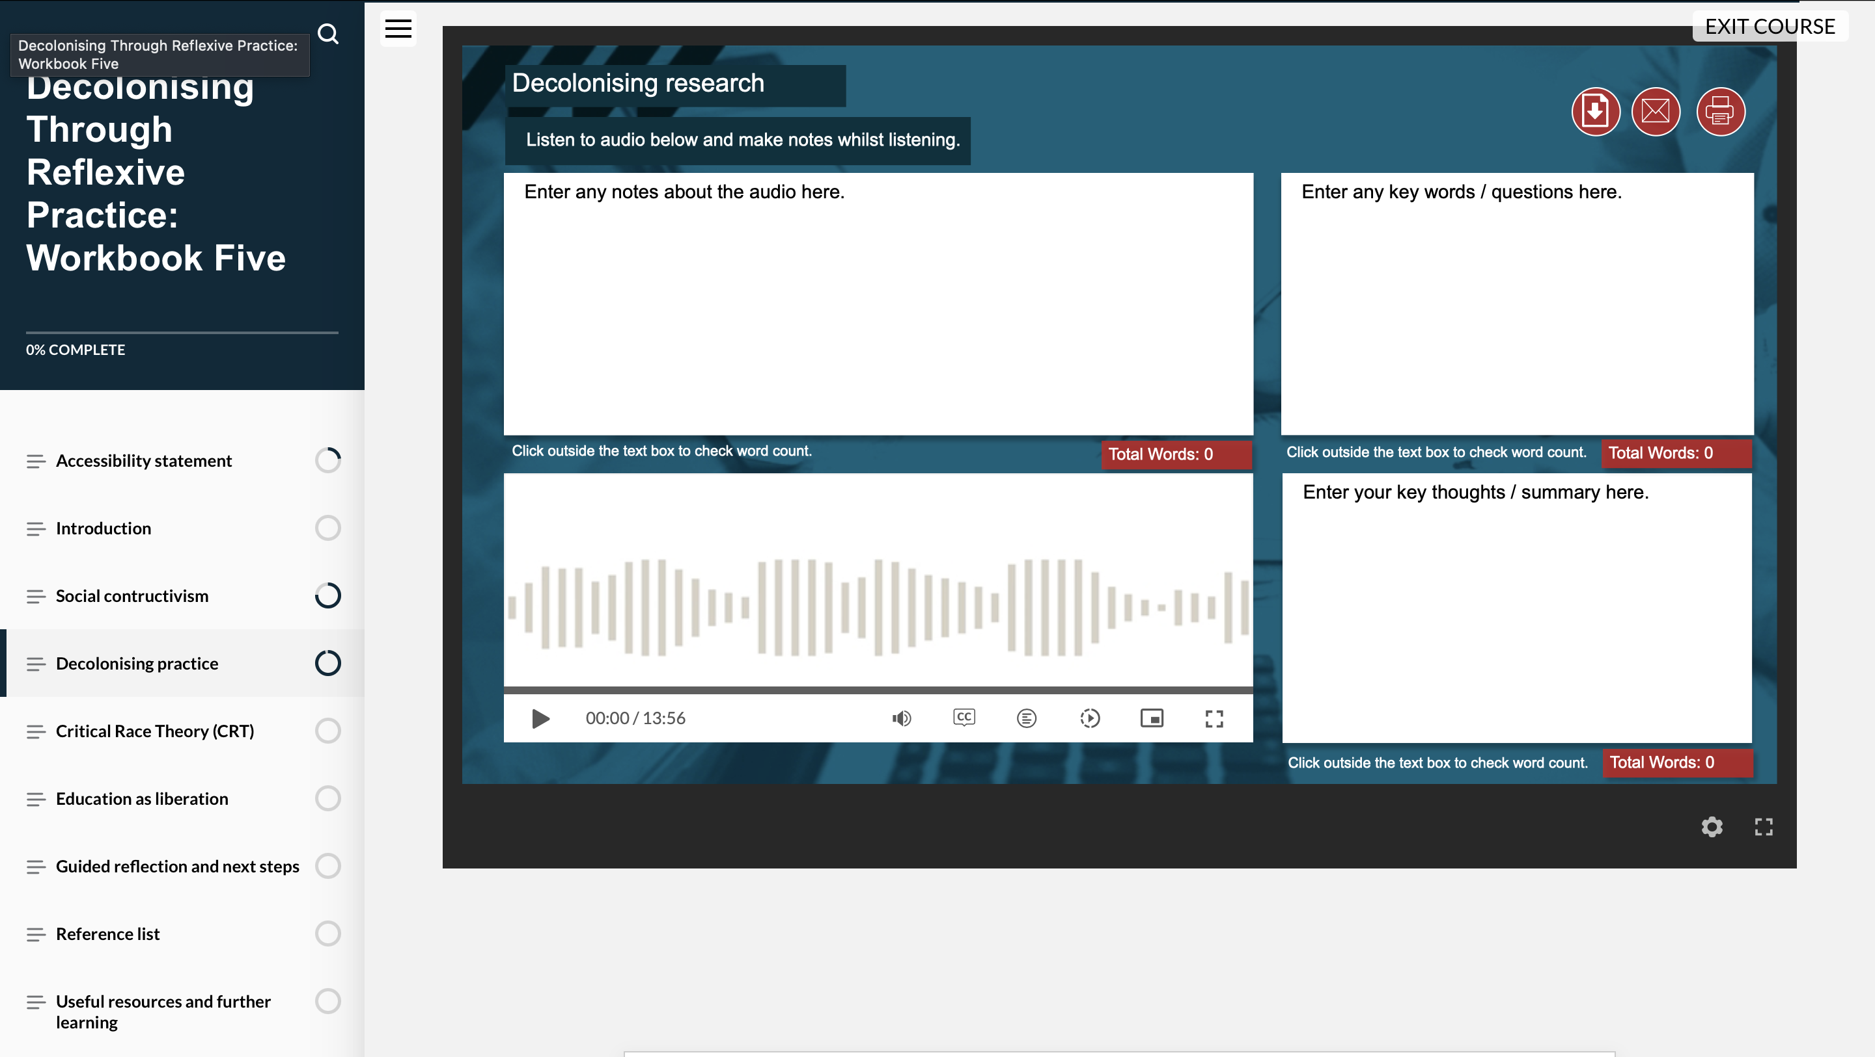

Slide 12
Staff Approach | Student Approach
Evolving – started in 2020/2021 roughly | New –this year
Focuses on the academic | 4 seminars
Academic development approach | Linked to staff pilot this year
Content just one part | optional
Materials (now e-course) | Considered ways to get students to engage
Part of commitment to equity including award gap | 4 seminar focus (1. intro to decolonising, 2. decolonising and empowering student voice, 3. decolonising your learning experience, 4. decolonising and influencing your education)

Slide 13
Challenges? Obstacles? Issues?

Slide 14
2024 pilot summarized initial feedback – full evaluating to be end of T3/beginning of T1
Staff:
Majority found workbooks engaging and were comfortable with content
Majority felt they help them understand decolonizing and provided a good starting point
Majority felt workshops helped prepare for decolonizing practice
Valued workshops as way to unpack and discuss workbooks
Many felt workbooks were well designed and present
Students:
All enjoyed the seminars and learnt a lot about decolonizing education
Majority want more
All want decolonizing approach to other modules based on these seminars and feel all students should engage with decolonizing work
Some students joined my podcast to discuss their experience (release around 24th June on podcast series: https://open.spotify.com/show/7z9kYBypPXtL9EQEAAaewL?si=8021d35de5674716

Slide 15
Changes (thinking, content, relationships)
empowering
enjoyable
engaging
inspiring
Great content / diverse approach
impactful
fabulous

Slide 16
Improvements?
A wider range of input or resources feeding into it
More time and more sessions
More diverse cohorts
Interdisciplinary approach
Follow ups
Timing of course in year

Slide 17
So what? What next?
Evaluation of e-course and pilot
Impact and follow up
External access under review
Honest institutional commitment / embedding
Is it sustainable?
Are we really decolonising or are we purposefully avoiding certain issues?

