Slide 1
Facilitating inclusivity in Nursing: Telling real stories and impacting real change through nursing education
Chidinma Victory Oforji- Lecturer in Adult Nursing, School of Health and Society
Davina Whitnall- Equality, Diversity & Inclusion Lead, Learning & Teaching Enhancement Centre
Oluchi Okoroafor-Masters of Art in Nursing student

Slide 2
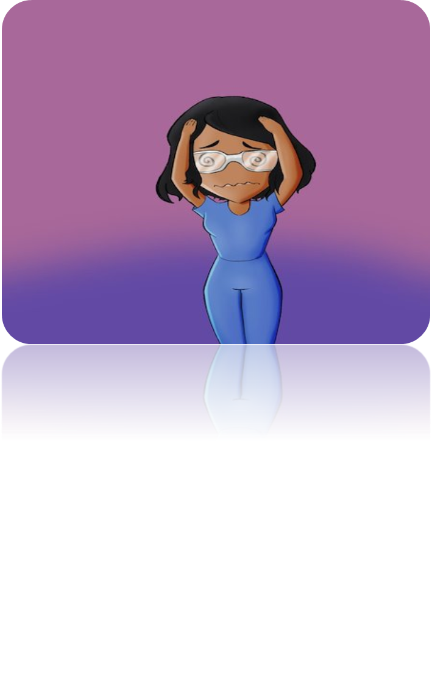
WHY?
Rising incidences of discrimination, and inequalities across all tiers, levels, and specialties in nursing
About 59% of nursing staff have been subjected to racial discrimination within the National Health Service and 77.3% Faced victimization for challenging discriminatory practices (SHU, 2022)
Evidence of systemic disparities and inequalities that affect nurses of certain ethnic and racial backgrounds (NMC, 2024)
Interestingly, racially minoritized nurses make up about 19% of the entire nursing workforce but up to 25% are faced with fitness-to-practice challenges
Discrimination posing a significant challenge in clinical practice and nursing education
Increase in nurse attrition at all stages of their career including student nurses (Ford, 2023)
Inequalities across all nursing sectors contribute to health inequalities and disparities
The need for decolonization, globalization, and de-nationalization of the nursing education curriculum to reflect in practice
But How do we segregate the concept of intuitionalism and ‘theoretical inclusion’, ‘inclusion vs exclusion 'How can we reflect theory in practice?

Slide 3
HOW ?
Tackle exclusion and discrimination from the roots, which is where nursing starts education
The need for diagnosis and recognition: Statistics VS Lived/living experience that can influence reflection
Delve into the richness of diversity and lived experiences to implement realistic and practical changes
When students and nursing staff were asked what equity, diversity, and inclusion looked like from their perspective, they replied that awareness, the practicality of EDI strategies, policies and procedures, university procedures, and realistic actions

Slide 4
We describe the discrepancies between ‘practicality’ and ‘Theory’ as ‘unintentional exclusion’ defined as discrimination existing from institutional policies, practices, and procedures as well as the epistemology of ignorance and unawareness.
inclusivity can be termed as ‘Easier said than done’ due to the complexity of inclusion and its impact on meeting the diverse needs of nursing students and staff from a racially minoritized, neurodiverse, and disability perspective.
Unintentional bias is the cherry on the cake of standard discrimination
We then define inclusivity in nursing as an umbrella term and tackle it as a syndrome through real scenarios and not just numbers or statistics and facilitate inclusivity in nursing practice through nursing education.

Slide 5
Objectives
Drawn from a wider perspective
Create awareness of the need of a decolonized nursing curriculum and challenges around bias and unintentional discrimination in nursing to facilitate inclusivity
Tackle the ontology of ‘ignorance’ by ‘walking a mile in the shoes’ of lived and living experiences of discrimination to enhance an intentionally inclusive nursing education and practice
Enhance own practice through techniques to implement in curriculum design, assessment, and feedback in the university and at stakeholder organizations such as the NHS
Embedding practice through decolonized nursing curriculum designs, EDI Chatter, and university and placement policies and procedures including through PEIA completion, PMEP log actions.
Facilitating metacognition of cultural competence in nursing education and practice.
Implement practical and realistic actions to facilitate change

Slide 6
Story telling through podcasting
The process involves sharing of lived and living experiences of students, staff nursing lecturers, and educators through storytelling
The real stories of real people are shared through storytelling, reflected on, and used to impact our curriculum, policies, guides, and procedures
Psychological safety and emotional intelligence are implemented considering the emotions of podcast guests.

Slide 7
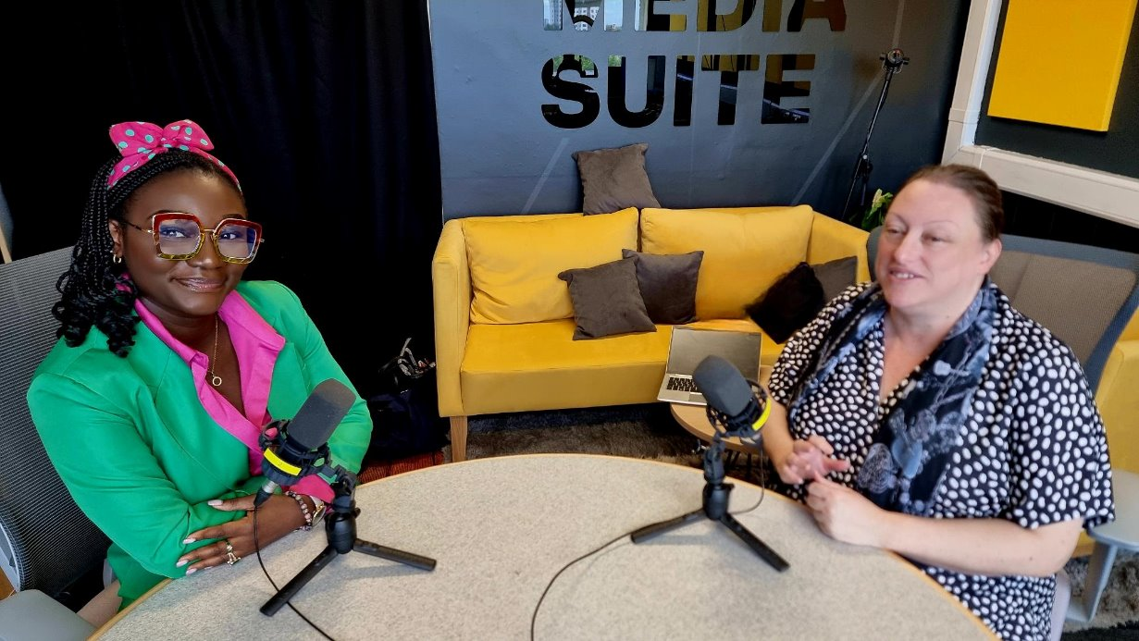
Story telling through podcasting
Unintentional Discrimination (sharepoint.com)​

Slide 8
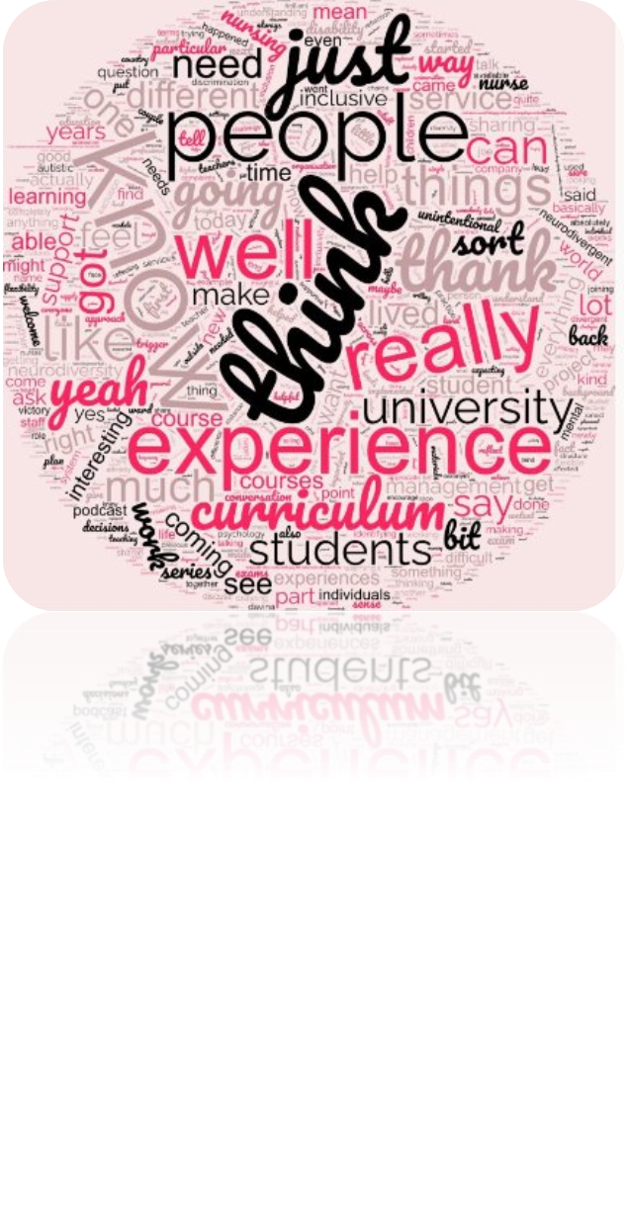
Impact
Development of a Continuous Professional Development (CPD) Module, that is innovative, interactive, and different from the traditional EDI modules
Development of the EDI Chatter
Development of the SWAB Community of Practice-Student-Led Wellbeing and Academic Buddy system
Being heard- Action in Education and practice to facilitate inclusivity in nursing practice (Tool Kit)
Development of the International training development- The Anti-Racism in Nursing Training Program, Republic of Ireland
Telling your truth: Disability Partnerships
Nursing Times Award Nomination
Diversity and Inclusion Award obtained

Slide 9
Scope
School of Health and Society-Nursing
Practice Development
Nursing Stakeholders involvement
gradual spread across all schools and impact on University College Dublin (UCD)

Slide 10
Conclusion
Podcast guest from staff
Open student invitation
Discrimination and exclusion in whatever umbrella it falls under is a social justice concern with a significant impact on nurses, students, and patients
Identifying and tackling exclusion and discrimination in nursing practice from its root, is the route to intentional and practical inclusivity in nursing
Intentional inclusivity is the route to impacting practical change in nursing practice, education, policies and procedures

Slide 11
References
Campbell, Paul; Duke, Ben (2023). An Evaluation of the Racially Inclusive Practice in Assessment Guidance Intervention on Students’ and Staff’s Experiences of Assessment in HE: A Multi-University Case Study. University of Leicester. Report. https://doi.org/10.25392/leicester.data.23579565.v1​​
Goldberg, T. D. (2006). Racial Europeanization. Ethnic and Racial Studies, 29, 331–364. https://doi.org/10.1080/01419870500465611
Miller, E., & Nambiar-Greenwood, G. (2022). Exploring the lived experience of student nurses perspective of racism within education and clinical practice: Utilising the flipped classroom. Nurse Education Today, 105581. https://doi.org/10.1016/j.nedt.2022.105581
Nelson, L.L. (2021). Using the Universal Design for Learning Framework to Understand the Power of Belonging. In: Jones, J.L., Gallus, K.L. (eds) Belonging and Resilience in Individuals with Developmental Disabilities. Emerging Issues in Family and Individual Resilience. Springer, Cham. https://doi.org/10.1007/978-3-030-81277-5_4 ​​
Sanger, C.S. (2020). Inclusive Pedagogy and Universal Design Approaches for Diverse Learning Environments. In: Sanger, C., Gleason, N. (eds) Diversity and Inclusion in Global Higher Education. Palgrave Macmillan, Singapore. https://doi.org/10.1007/978-981-15-1628-3_2 ​​
Sheffield Hallam University (2022) New research exposes systemic racism in the NHS as nurses launch Manifesto for Change. Available at: New research exposes systemic racism in the NHS as nurses launch Manifesto for Change | Sheffield Hallam University (shu.ac.uk)
Workforce Race Equality Standard (2021) 2020 Data Analysis Report for NHS Trusts and Clinical Commissioning Group. Available at: Workforce-Race-Equality-Standard-2020-report.pdf (england.nhs.uk)

Slide 12
Thank you
Chidinma Victory Oforji
C.V.Oforji@salford.ac.uk
Davina Whitnall
d.c.whitnall@salford.ac.uk

