Slide 1
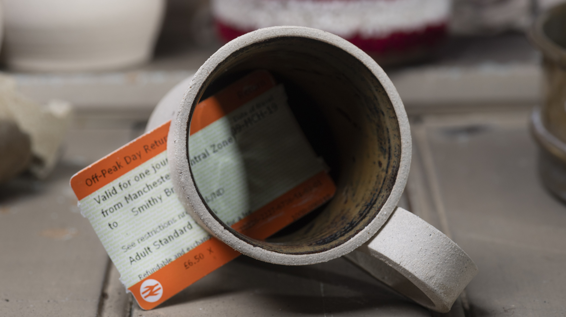
Angela Tait
The COVID Clay Diary

Slide 2
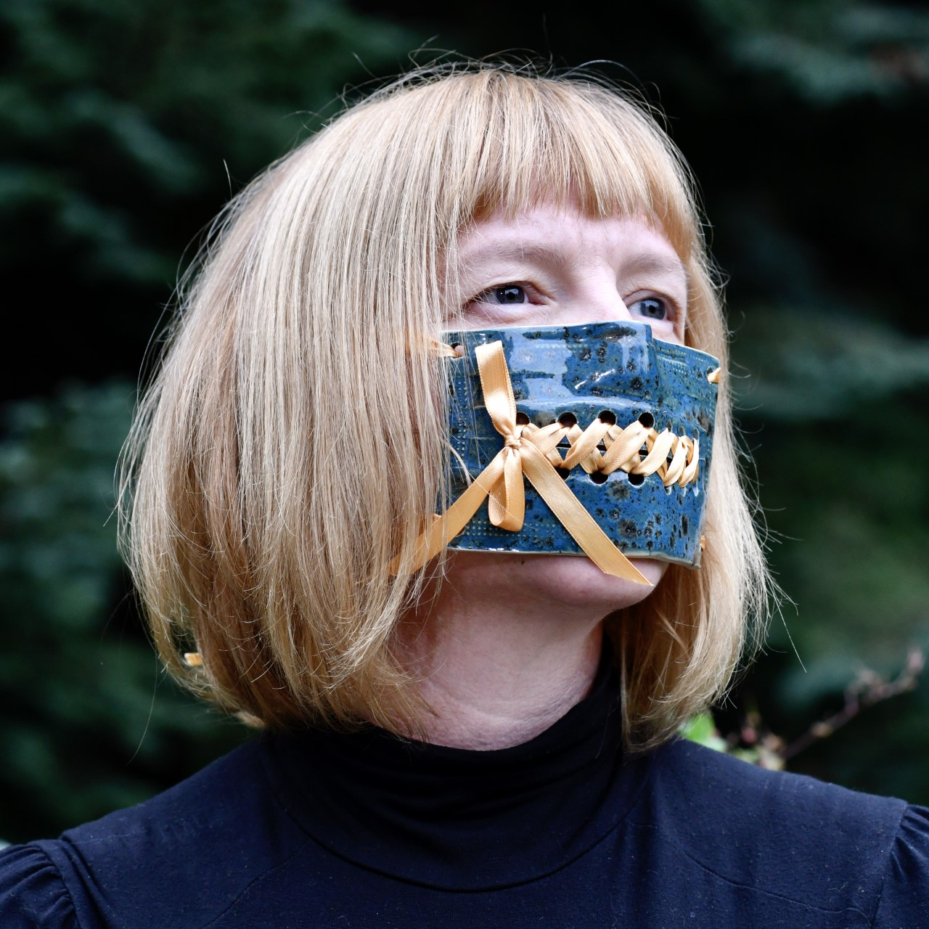
Introduction
Sculptor
Researcher
Ceramicist
Educator
Sometimes I have to do things like wash up or cook

Slide 4
The next day the clay diary was born

Slide 5
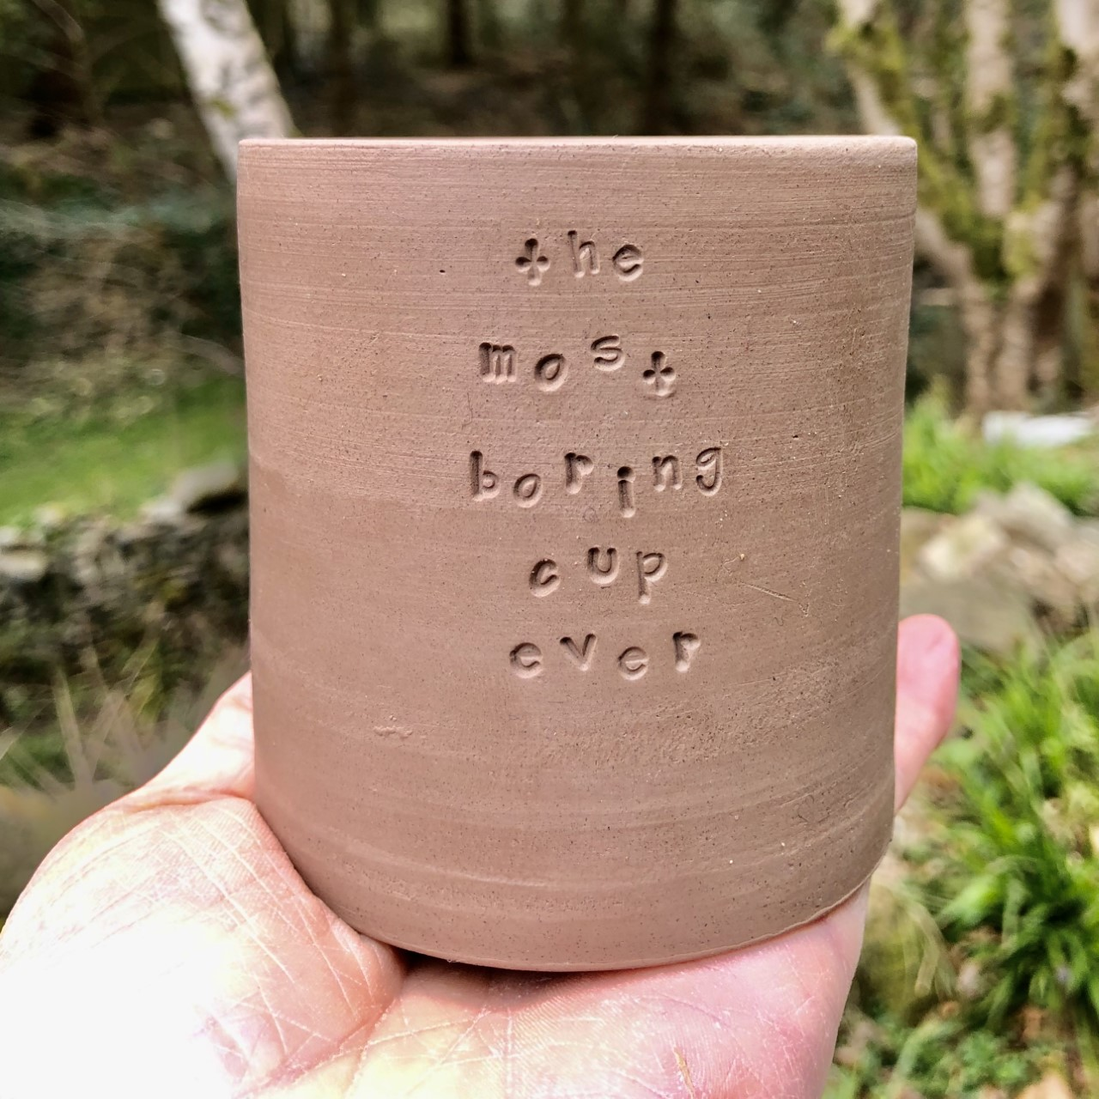
The use of the vessel form
Day 13
The Most Boring Cup Ever

Slide 6
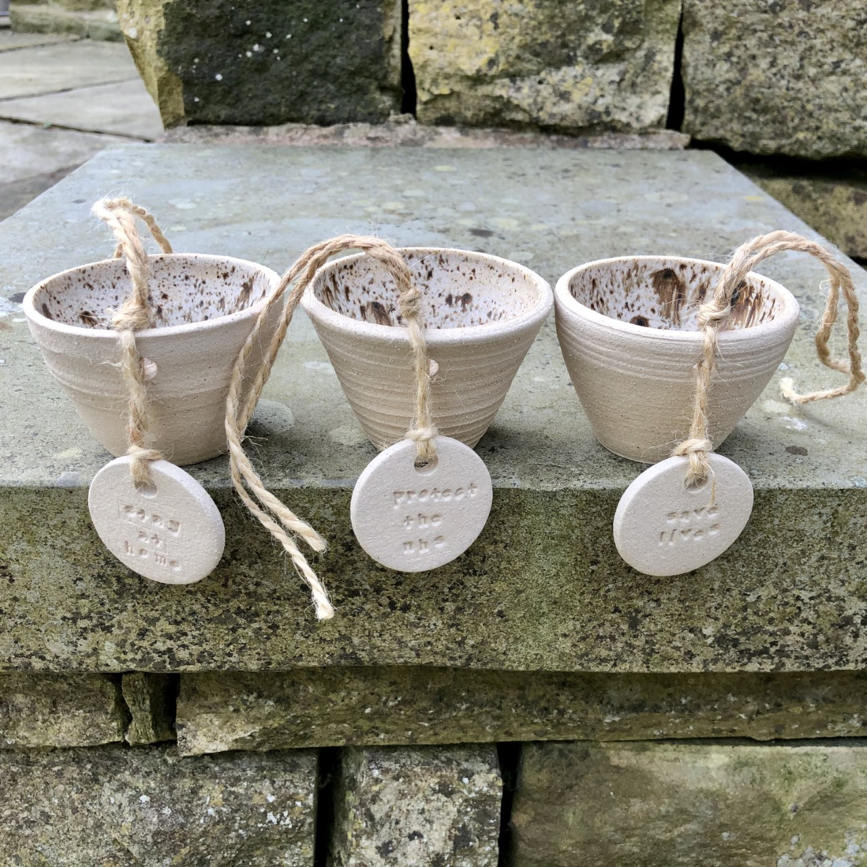
The Diary
The diary was initially personal, it was by me and about my experience.
But lots of the themes were universal.
It quickly started to become about the wider social, cultural and political events of the pandemic
Day 6
We all stop to watch the 4pm press conferences

Slide 7
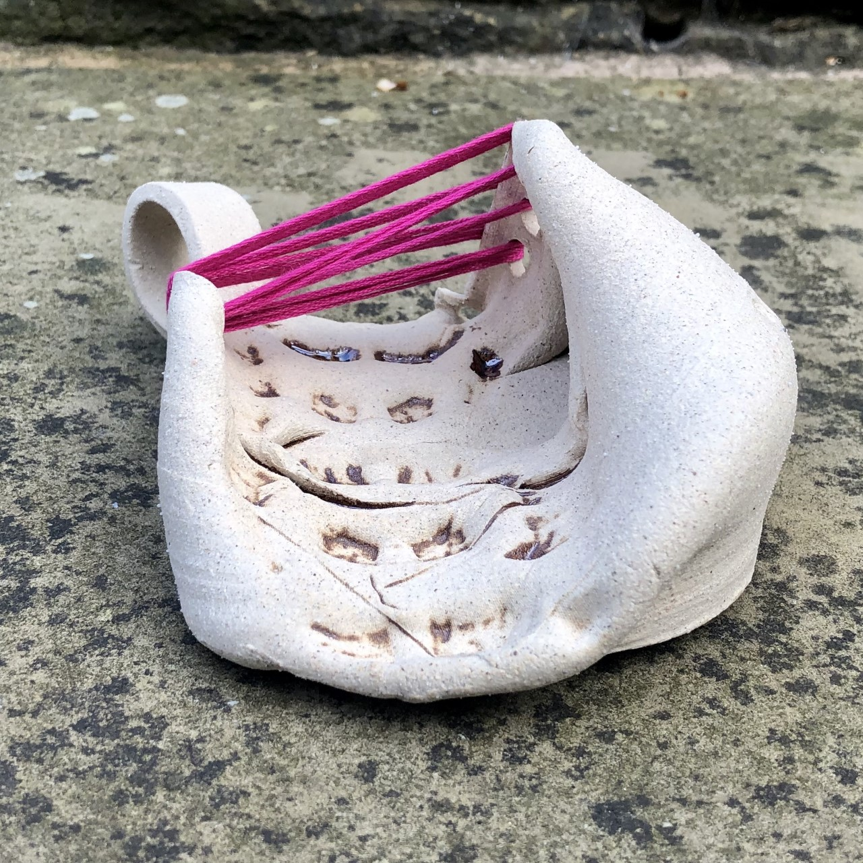
The way we exercise
Day 12
I ran over a thrown vessel with my bike because the gyms were closed and they way I’d exercised had changed. This was both a personal and universal theme. People were out walking more than ever before because there was nowhere else to go.
Before lockdown I didn’t even know I owned a bike #truefact

Slide 8
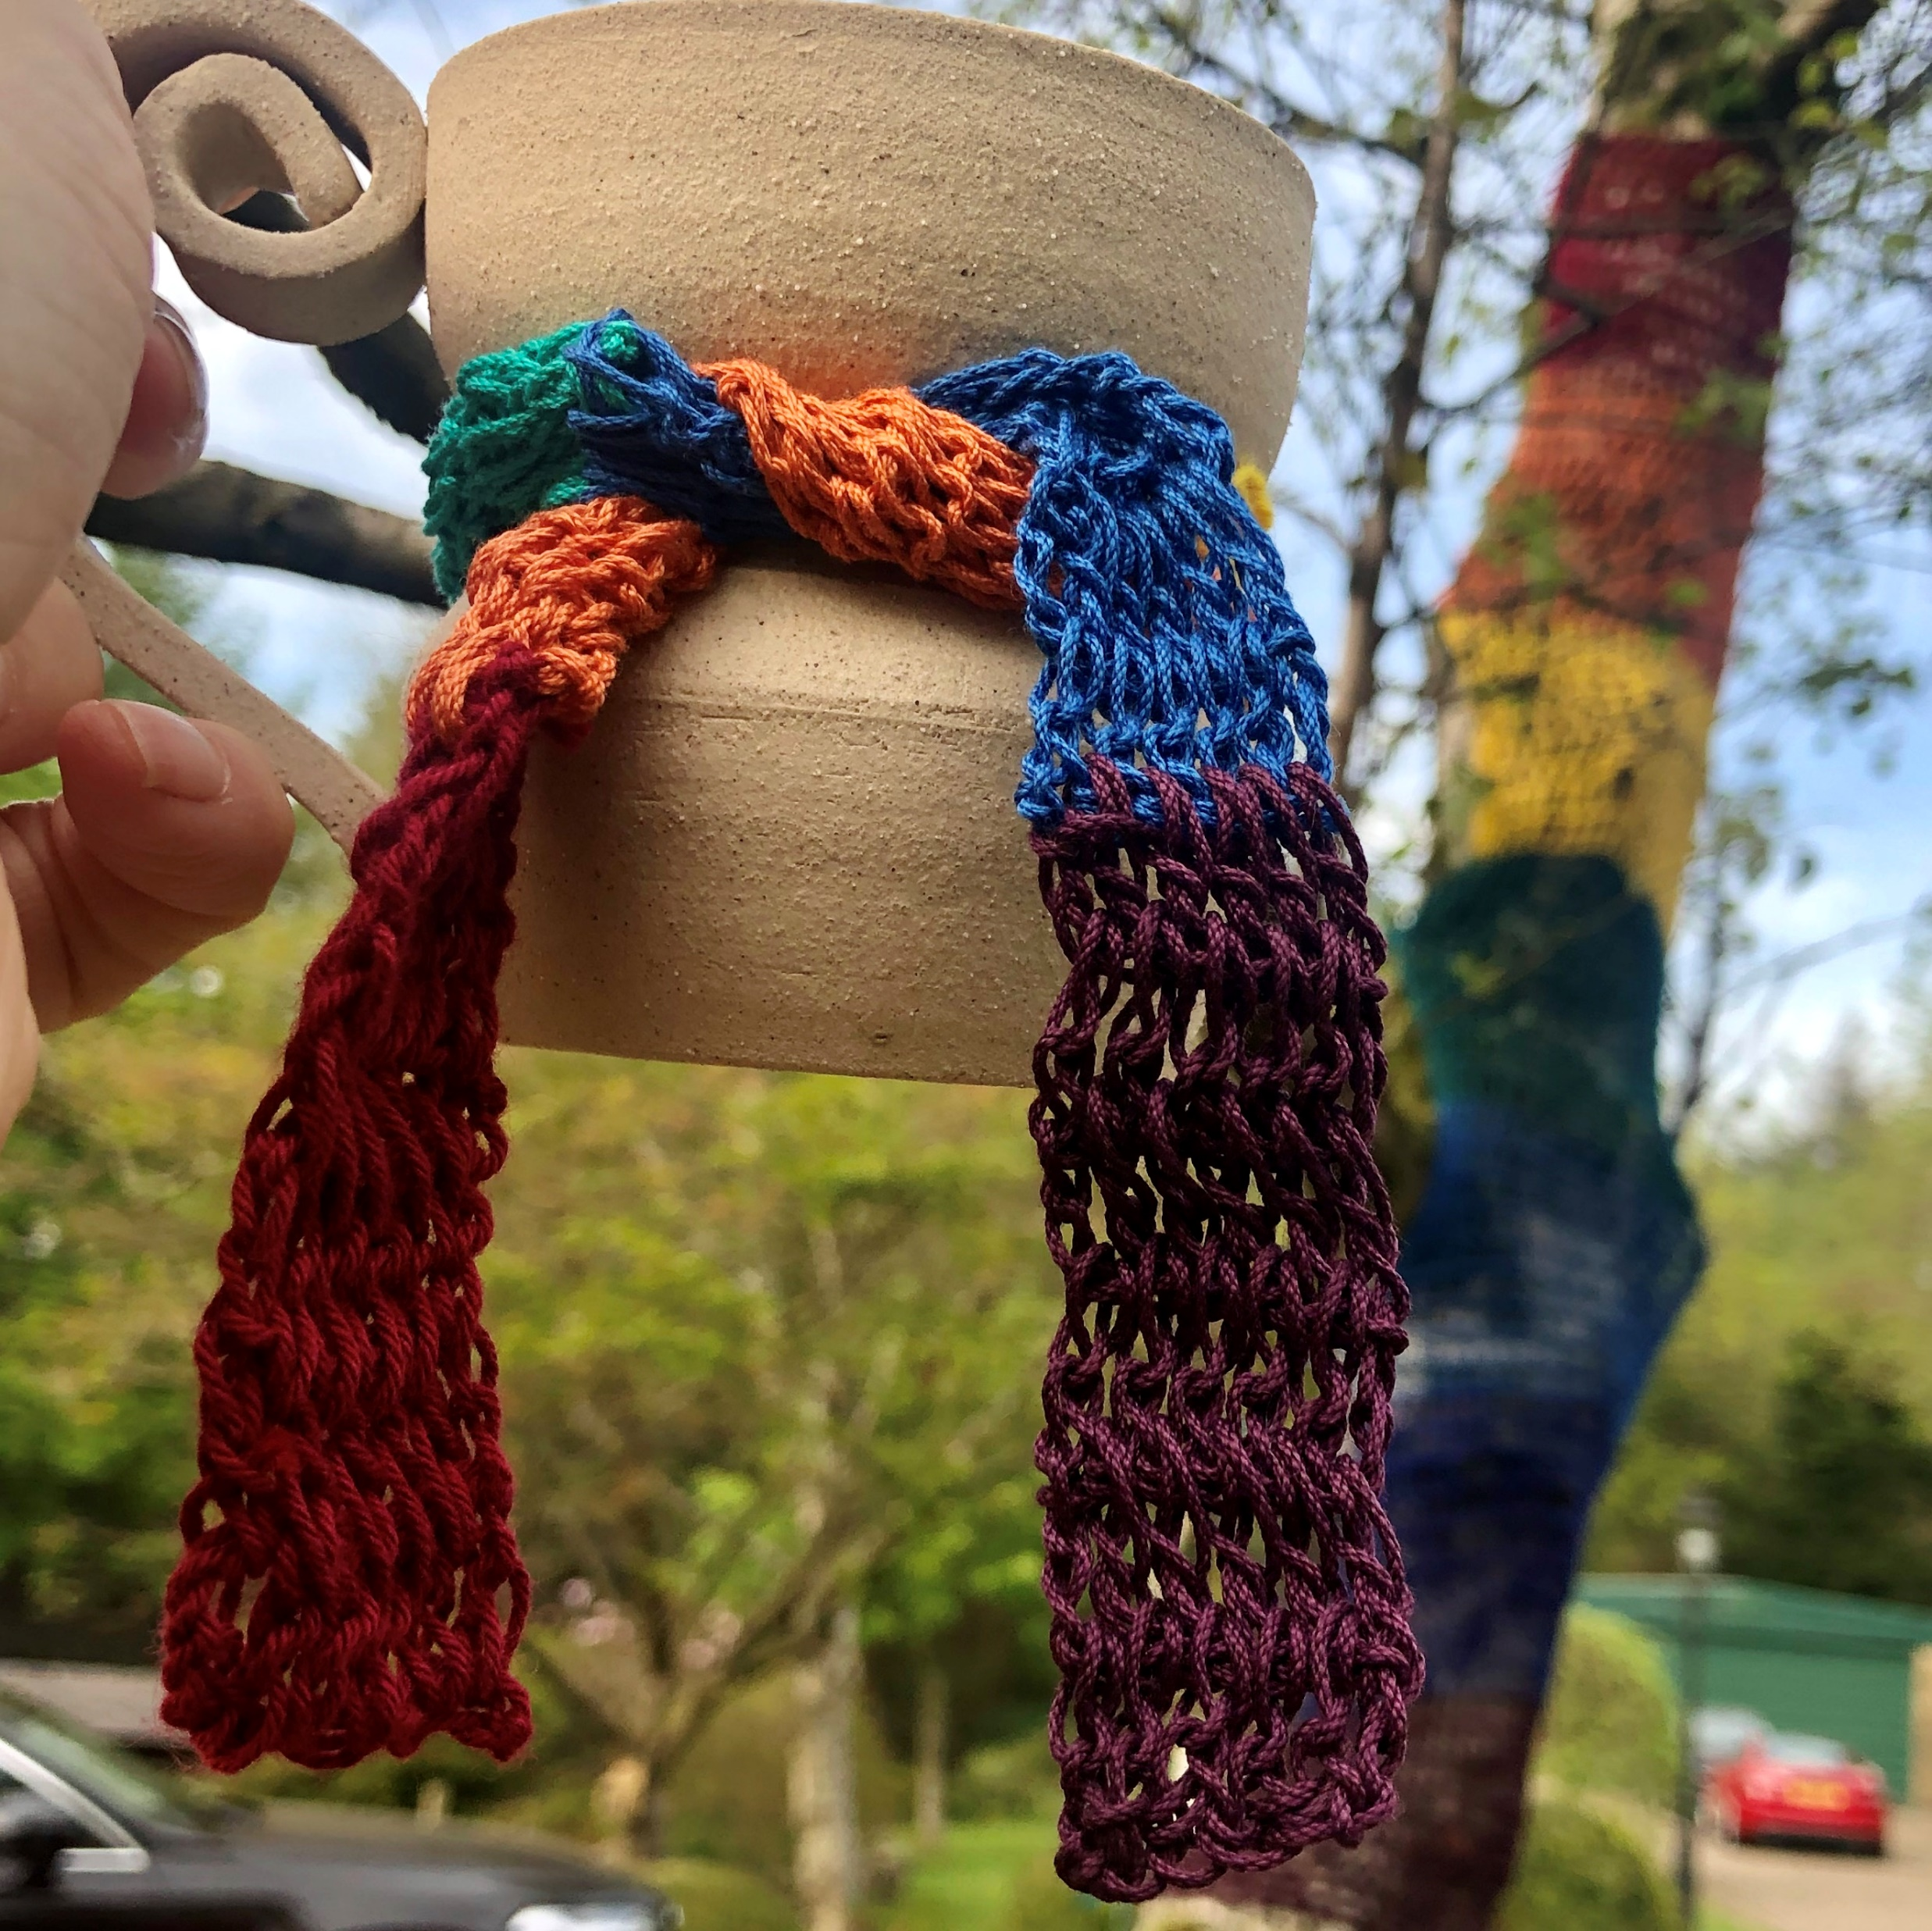
Day 24 Rainbows are everywhere
Key Workers

Slide 9
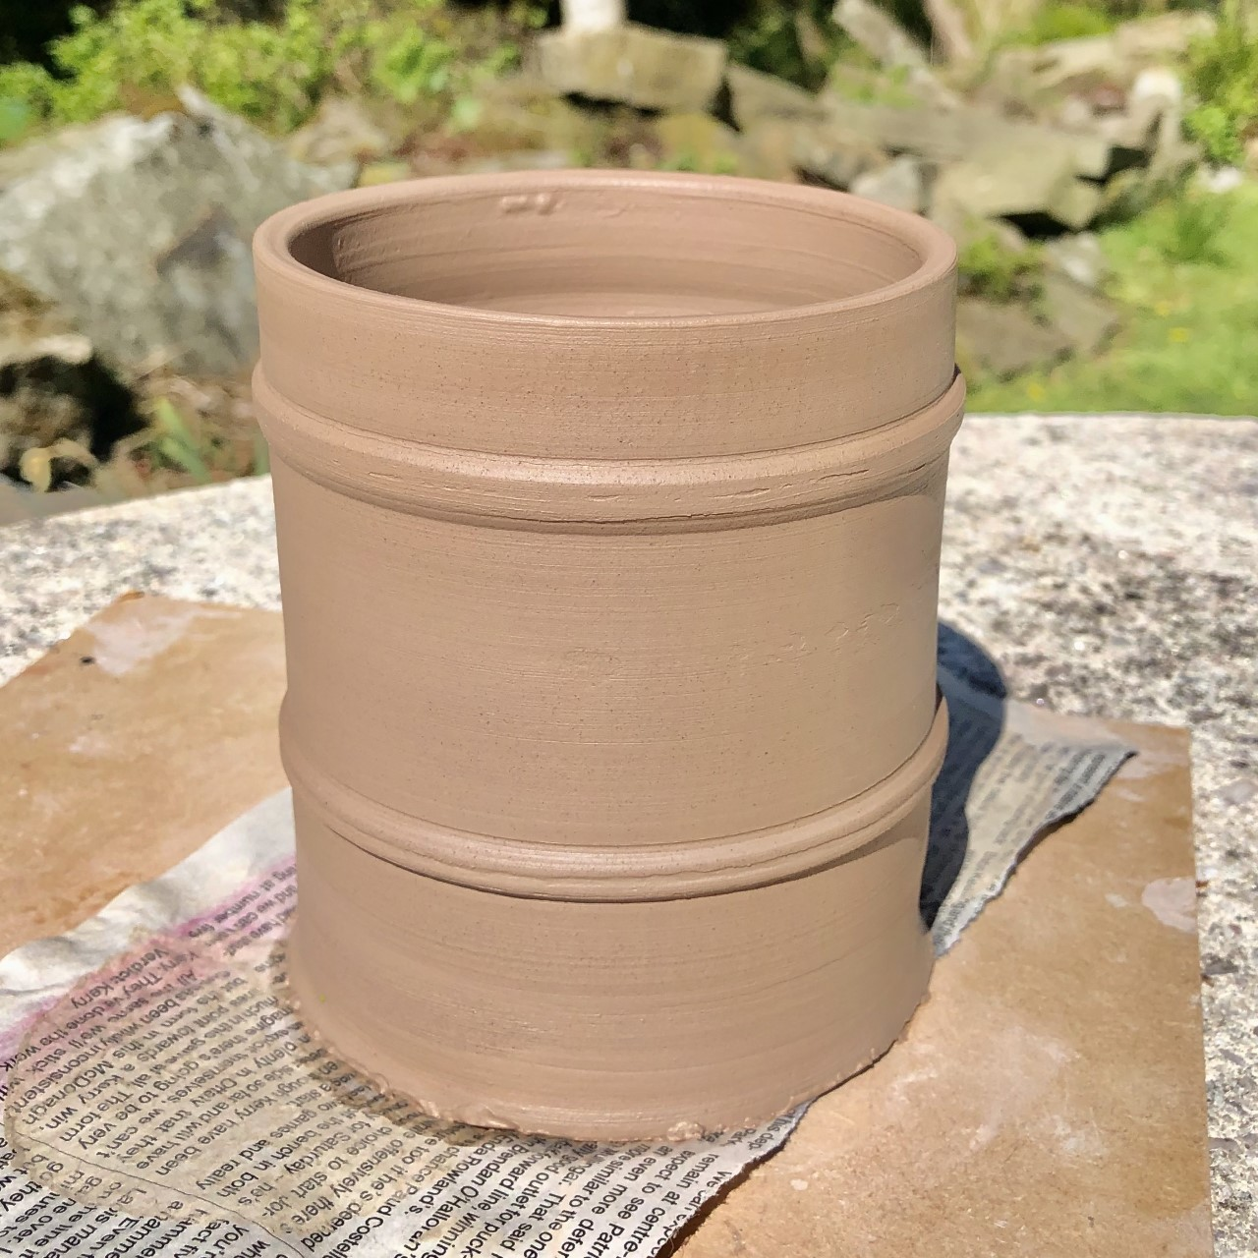
The financial markets are in turmoil
Day 35
The price of oil went negative for the first time in history. This meant the oil companies had to pay their customers to take it

Slide 10
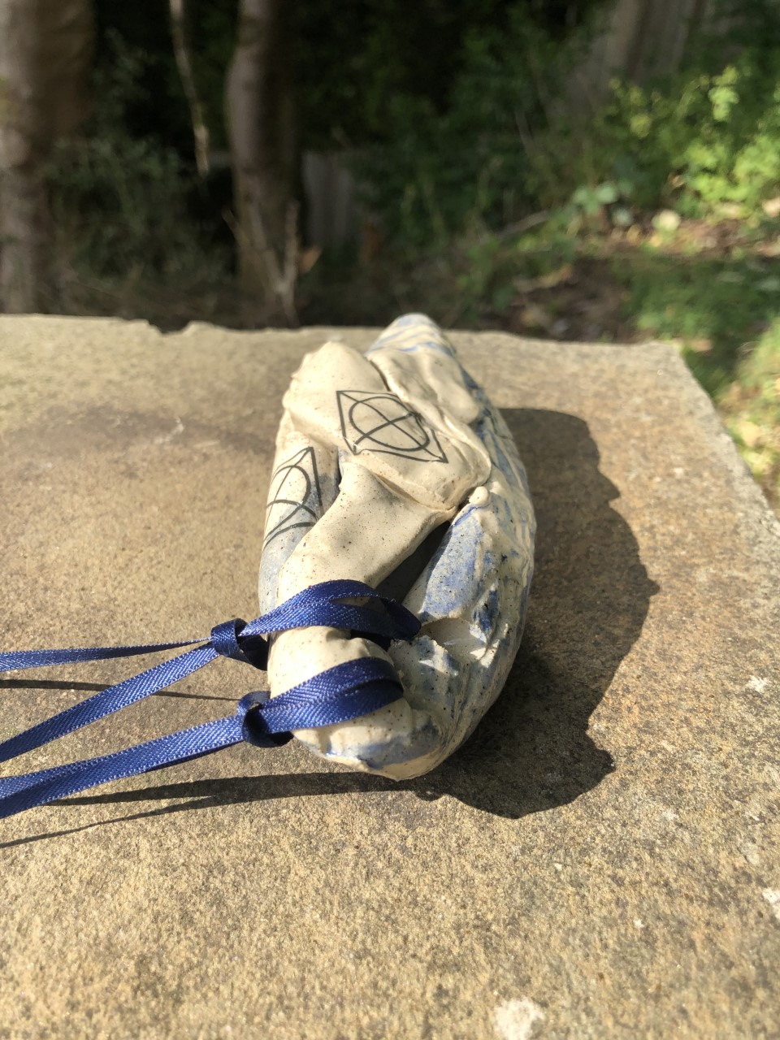
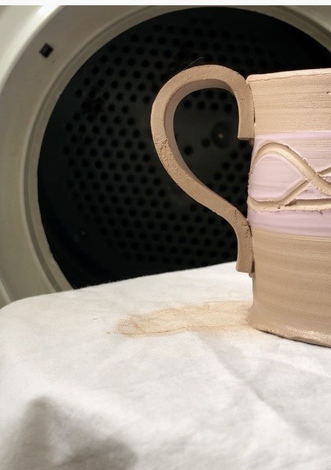
My world became very small
Day 54
Plenty of the cups ended up not resembling cups.
On Day 54 I threw a perfectly good cup complete with a handle and put it in the tumble dryer

Slide 11
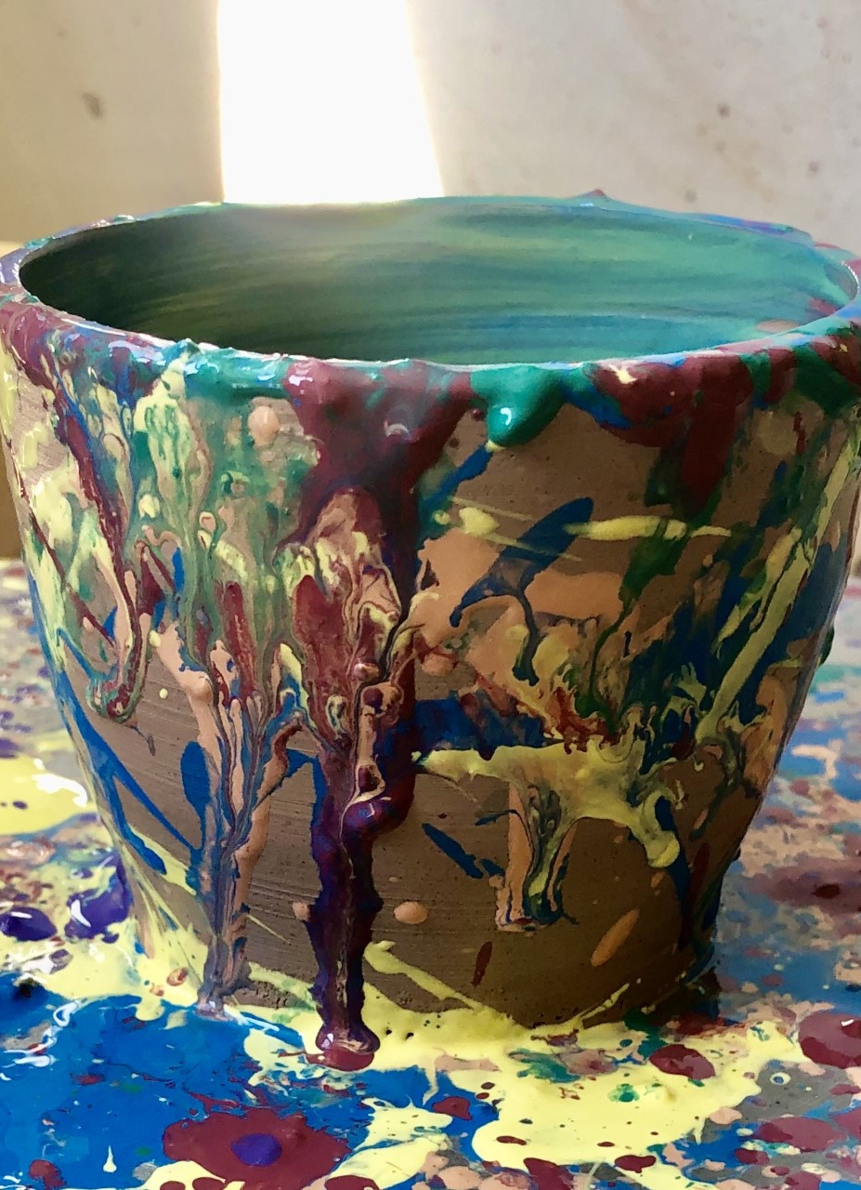
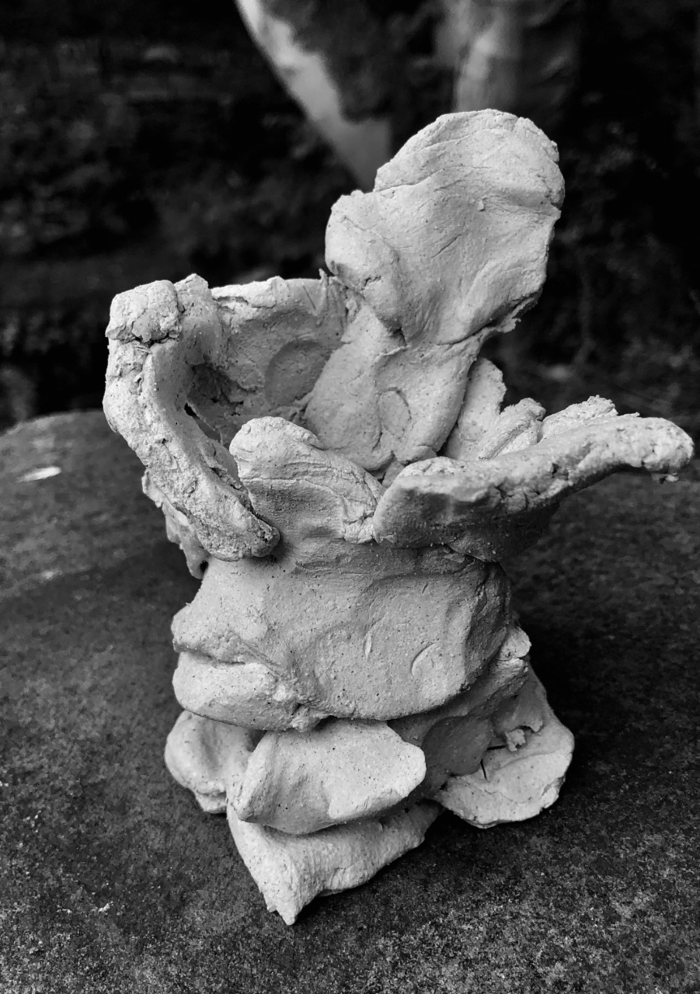
I made pieces about my lecturing work
Day 73 – Rebecca Warren
Day 65 – Pollocks to that

Slide 12
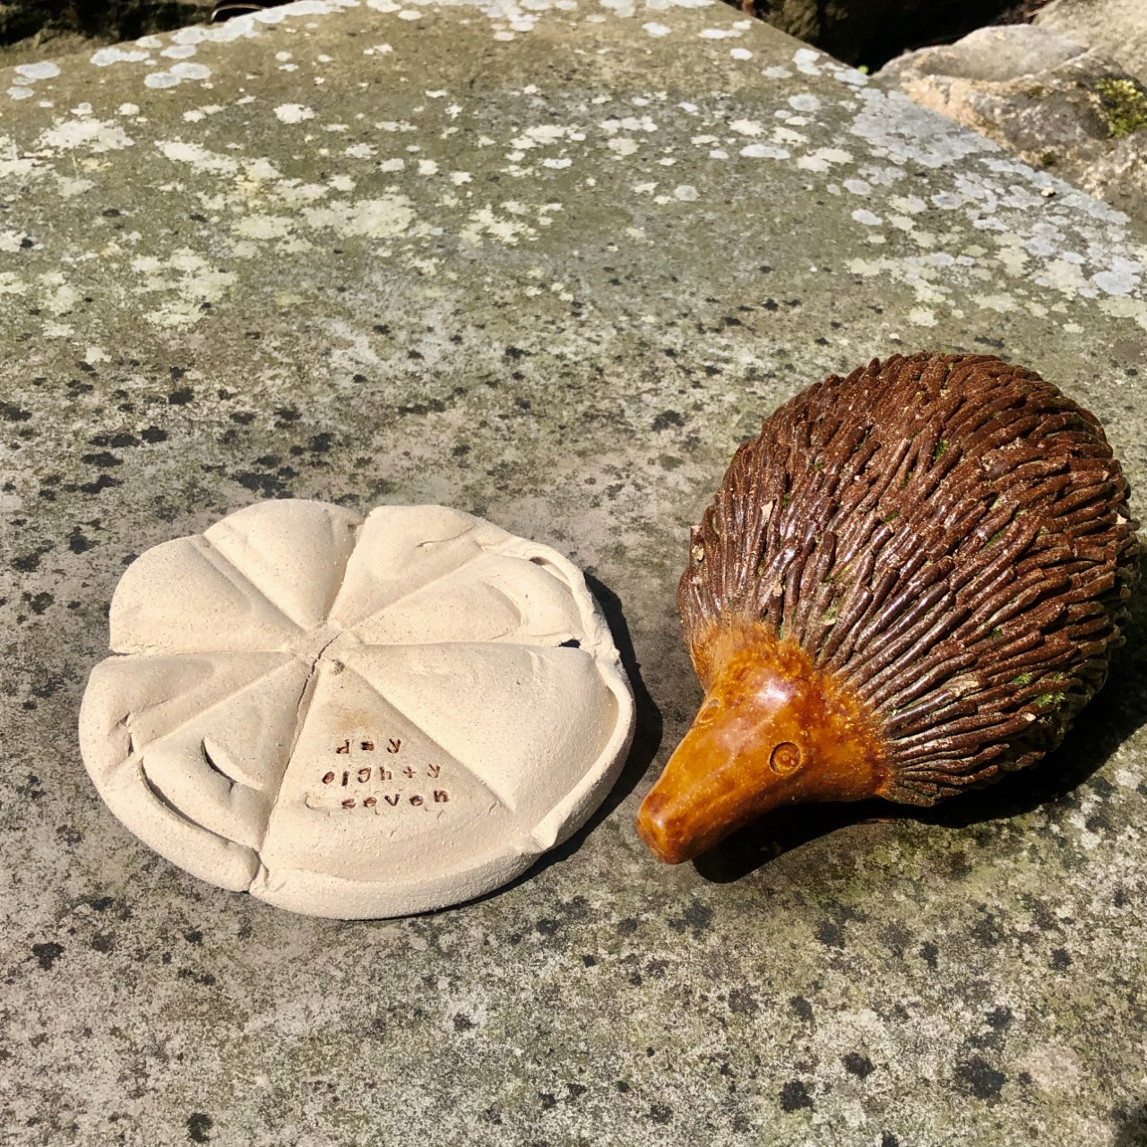
By the end I was struggling for ideas
Day 87
Another perfectly serviceable cup found its way into the sandwich toaster

Slide 13
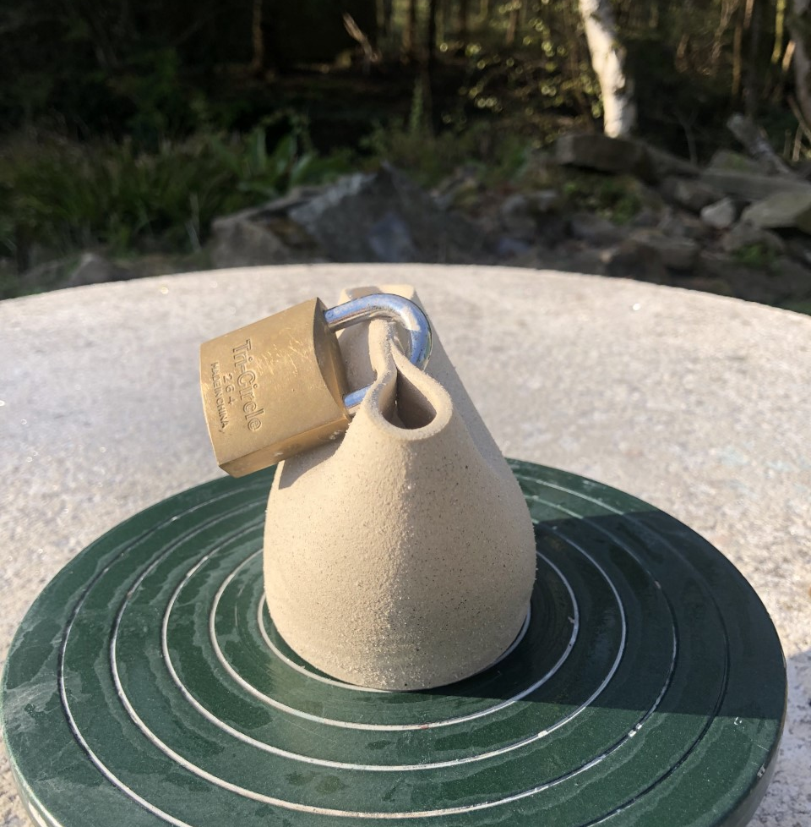
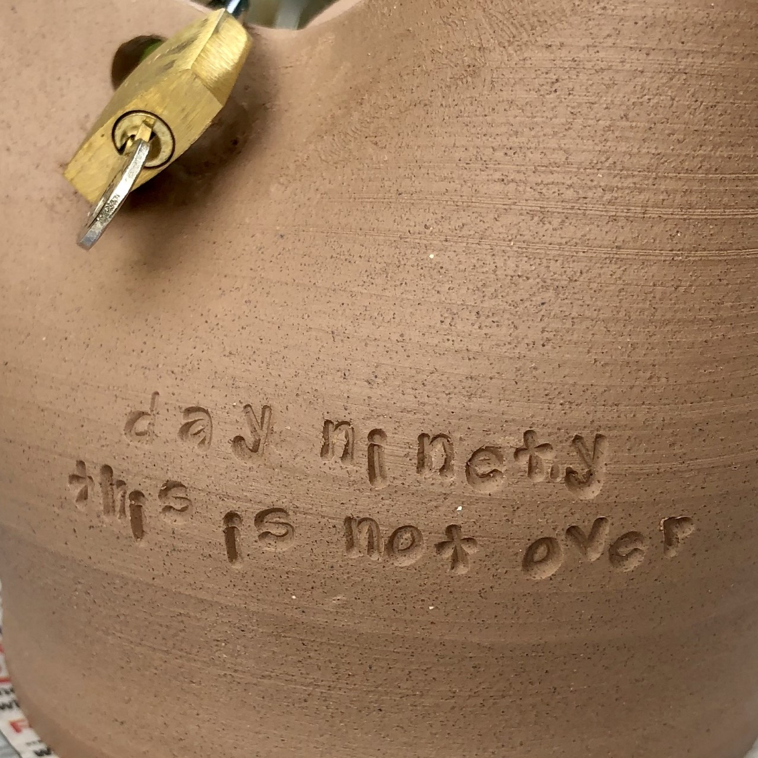
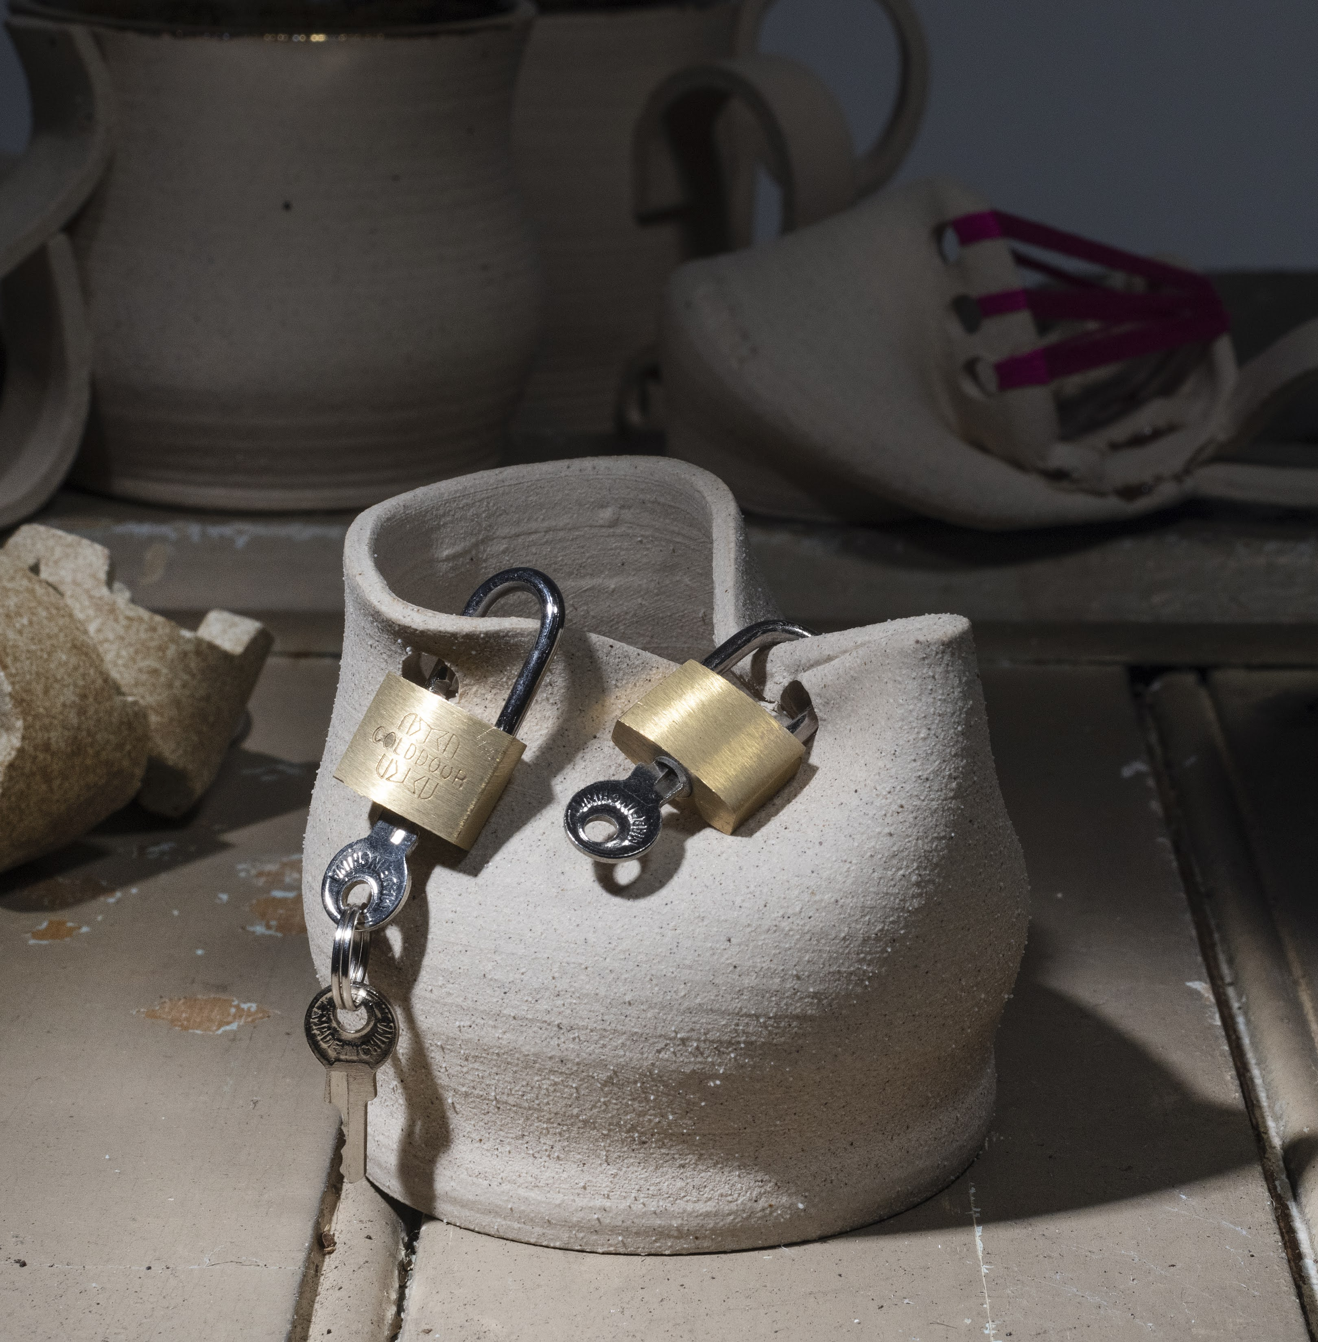
The beginning and the end
Day 7 - Lockdown
Day 90 - This is not over

Slide 14
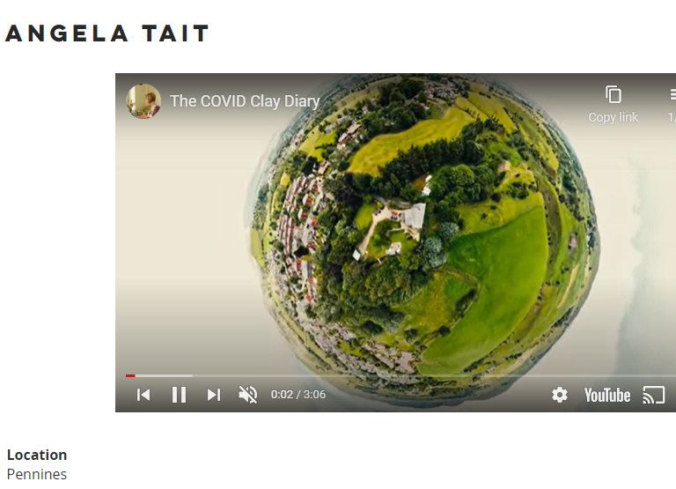
What happened to the clay diary next?
Artist Parviz Qadir was commissioned to collect creative responses to the pandemic
He asked me if he could include the clay diary, so Zach and I made a film using his drone to photograph the work
Link

Slide 15
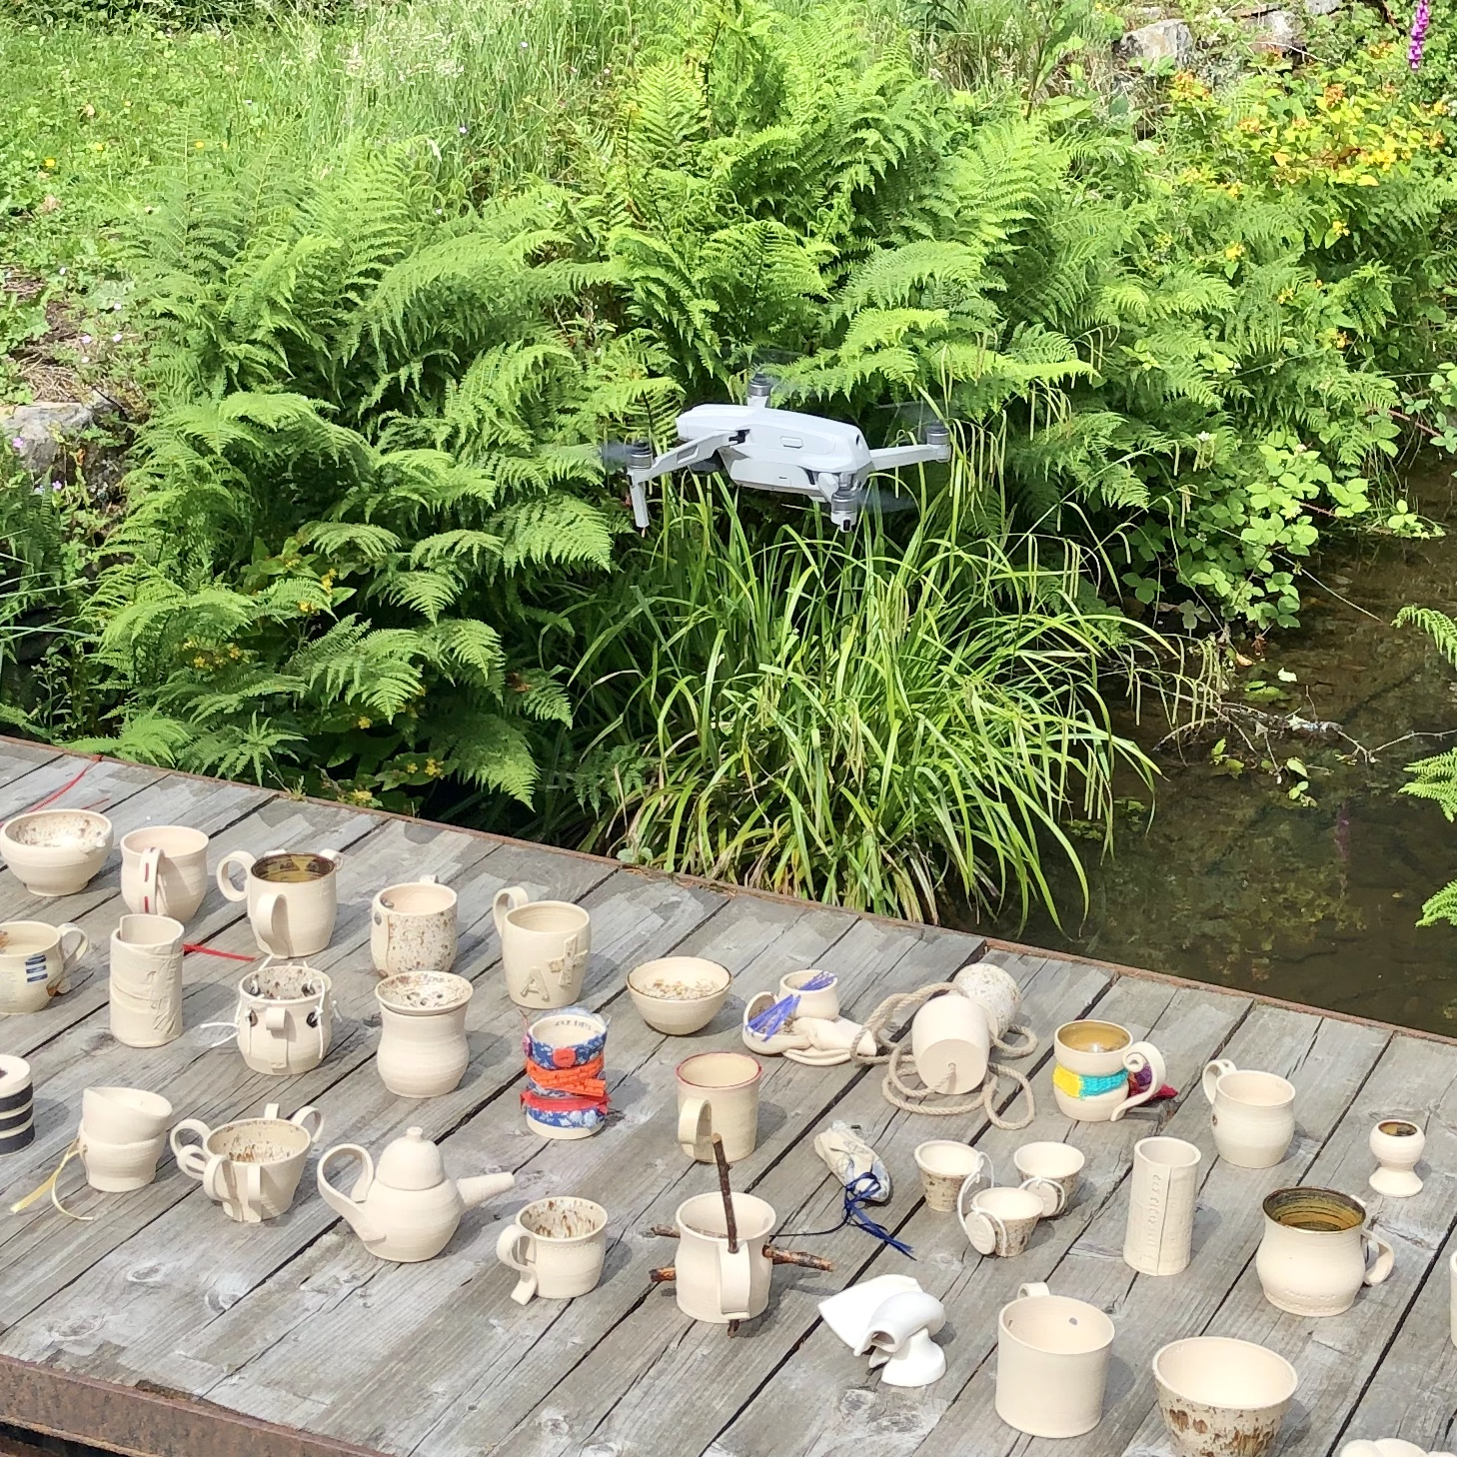

Slide 16
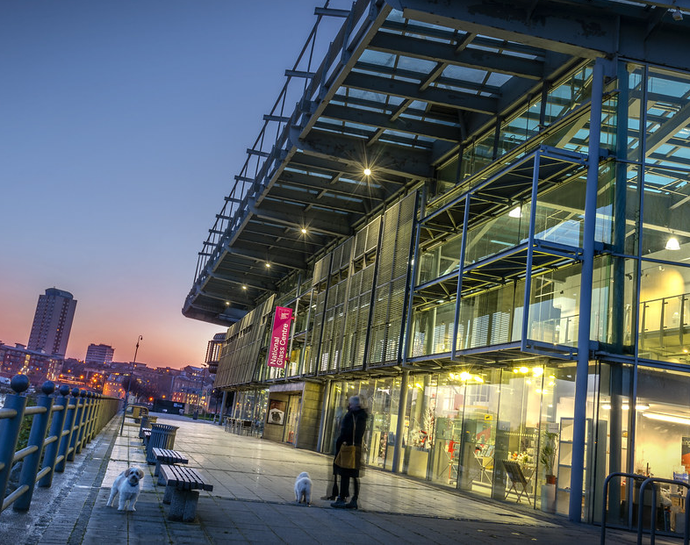
Exhibition
The clay diary is being shown in the National Glass Centre in Sunderland

Slide 20
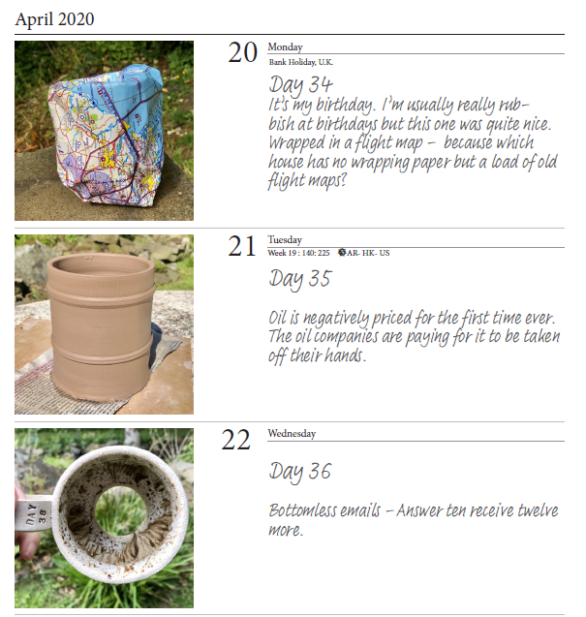
Publication
There is a book in the form of an office diary

Slide 21
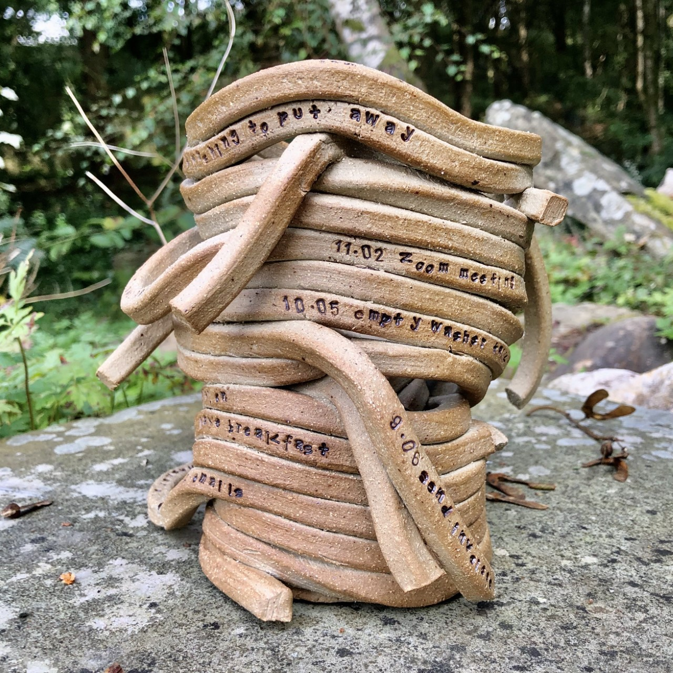
What next?
The diary is in the Glass Centre until October then it has no further plans.
I have made other clay diaries since and am currently exploring ideas like this

Slide 22
Tomorrow
I’m working at the Arts Centre on another of my recent projects, ‘Smalls’.
The performance will be broadcast live alongside the archive streaming

Slide 23
?

