Slide 1
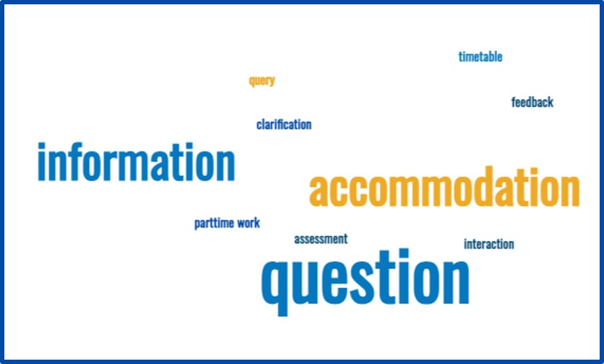
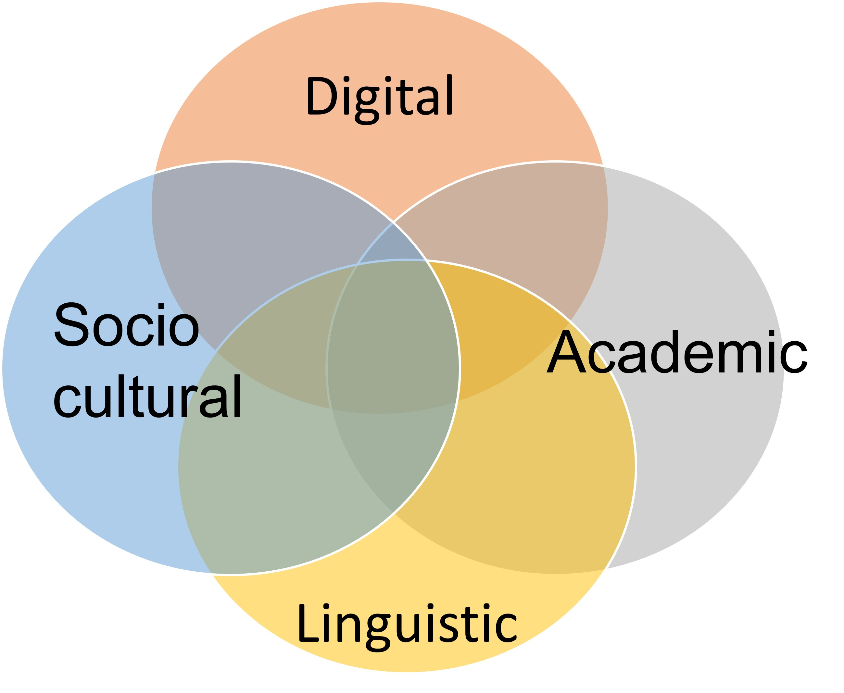
"I don't have a lot of foreign friends": a buddy scheme enhances home and international student nurse experience Ebba Brooks e.brooks@salford.ac.uk The Library, University of Salford. Acknowledgements: Helen Franks, Gill Colgan, Dr Emilie Whittaker, Dr Emma Smith.
Introduction and objectives
Results
Discussion
This research aimed to learn more about student experience of participating in a buddy scheme established to provide support for international nursing students on a one-year programme. The buddy scheme matched new international students with home students at the same level of study. It was informed by research which has identified four areas where universities can help international students successfully transition (Bell, 2016; Newman & Gulliver, 2023) – see Fig. 1 below - and focused on two of these domains (sociocultural and academic) in particular. The buddy scheme aimed to assist international students’ academic transitions by signposting them to support; and their socio-cultural transitions by combatting loneliness and isolation. The research was conducted against a background of growing numbers of international students entering UKHE (HEPI et al., 2023), and with an awareness that universities must ensure that these students have an equitable experience that will allow them to thrive (Jisc, 2023).
1. Positive impact on international student socio-cultural transition
International students particularly valued the practical help offered by the scheme on a range of issues from finding accommodation to part time work: “Sharing information and resolving queries and getting clarification.” “Making out time to enquire about the challenges, prompt feedback on any questions” This is likely because the buddy scheme was most active at the start of each semester when the international students were newly arrived and facing multiple logistical transitional challenges; they used the buddy scheme to orient themselves. All of them felt that the scheme was useful or very useful in getting used to life in the UK and at Salford.
Many UK universities run buddy schemes for international students but there has been little scholarly research into their effectiveness or experiences of participating beyond general student satisfaction levels. An exception is a Plymouth University study which found a correlation between students’ participation in a buddy scheme with improved social and academic performance (McMahon, Webb, & Schaefe, 2020). While examining any correlation with academic performance was outside the scope of this study, it did find that students positively valued its socio-cultural impact. This is in line with the literature on peer support, of which buddy schemes are a form, which notes a positive influence on international students’ socio-cultural transition (Wonkhe, 2022; Shu et al., 2020; McPherson et al., 2017). As such this study provides further evidence to support any HEI which is considering a buddy scheme for this purpose. An unforeseen pedagogical impact uncovered by this research is the real-world value of skills developed during the scheme by home students, which suggests that aspects of the scheme provided an authentic learning experience (Lombardi, 2007; Reeves et al., 2002) for these future nurses. This could be useful for nursing educators in particular considering how to develop such schemes for future cohorts and indicates an area for further research.
Fig 2: Wordcloud: what international students most valued
Fig 1: Domains where universities can support international student transitions
2. Value of intercultural exchange for home students
Home students identified a lack of opportunities to develop friendships with international students (in line with the literature, see for example Bethel et al., 2020) and therefore valued the scheme highly in terms of their sociocultural experience, particularly around breaking down cultural barriers. They described a lack of opportunity for intercultural exchange in their daily lives. The buddy scheme gave them an opportunity to encounter and build relationships with people they would not have met otherwise before. For this reason, the buddy scheme enriched their experience: “I've made a few friends from it as well that I've stayed in contact with afterwards.”
Conclusions
The positive impact on socio-cultural transition was in line with existing research on the value of buddy schemes as a form of peer support. Furthermore home students valued the authentic learning experience that the buddy scheme provided. This adds to the overall positive evidence of buddy schemes as a means by which UK universities can support both international and home students.
Methods
“It has given me a bit more confidence to speak to people who are from different backgrounds because to be completely honest, I don't have a lot of foreign friends.”
An online survey was sent to 59 participants, with n=7 responses, a response rate of 11.86%. It asked them to evaluate their access to social and academic support before and during the scheme through textual and numerical questions. A self-selecting subgroup of participants (n=3) subsequently took part in semi structured interviews to reveal their experiences and insights. These were audio recorded and transcribed before data was analysed, using inductive textual analysis, to draw out key themes.
References
3. An authentic learning experience
Effective communication with a wide range of people from diverse backgrounds is a key proficiency that nurses are expected to demonstrate (Nursing and Midwifery Council [NMC], 2018). Home students identified that skills they developed would be useful in future professional practice: “It’s been a positive impact on my professional life in terms of skills I've gained with communication, time management, planning […] and more understanding of different people's cultures“
Bethel, A., Ward, C., & Fetvadjiev, V. H. (2020). Cross-cultural transition and psychological adaptation of international students: the mediating role of host national connectedness. Frontiers in Education, 5. https://doi.org/10.3389/feduc.2020.539950 ; Bell, I. (2016). International Students Transition into Scottish Higher Education: A Scoping Study. https://www.enhancementthemes.ac.uk/docs/ethemes/student-transitions/international-students---transitions-into-scottish-higher-education-a-scoping-study.pdf?sfvrsn=58faf681_8​;​ Davis, M. (2022). Examining and improving inclusive practice in institutional academic integrity policies, procedures, teaching and support. International Journal of Educational Integrity, 18:14. https://doi.org/10.1007/s40979-022-00108-x​; HEPI, Universities UK, Kaplan International Pathways & London Economics. (2023). The benefits and costs of international higher education students to the UK economy. https://www.hepi.ac.uk/wp-content/uploads/2023/05/Full-Report-Benefits-and-costs-of-international-students.pdf ;​McMahon, P., Webb, O., & Schaefe, N. (2020). Examining the efficacy of a buddy programme for international students’ integration, language ability and academic performance. https://www.ukcisa.org.uk/Research--Policy/Resource-bank/resources/191/Examining-the-efficacy-of-a-buddy-programme-for-international-students-integration-language-ability-and-academic-performance- ; McPherson, C., Punch, S., & Graham, E. (2017). Transitions from Undergraduate to Taught Postgraduate Study: Emotion, Integration and Belonging. Journal of Perspectives in Applied Academic Practice, 5 (2), 42-50. https://doi.org/10.14297/jpaap.v5i2.265​​; Lombardi, M. (2007). Authentic Learning for the 21st Century: An Overview. https://www.researchgate.net/publication/220040581_Authentic_Learning_for_the_21st_Century_An_Overview ; Newman, T., & Gulliver. M. (2023). International students’ digital experience phase one: a review of policy, academic literature and views from UK higher education. JISC. https://repository-jisc-ac-uk.salford.idm.oclc.org/9102/1/international-students-digital-experience-a-review-of-policy-academic-literature-and-views-from-uk-he.pdf ; Nursing and Midwifery Council. (2018). Standards of Proficiency for Registered Nurses. https://www.nmc.org.uk/globalassets/sitedocuments/standards-of-proficiency/nurses/future-nurse-proficiencies.pdf ; Reeves, T. C., Herrington, J., & Oliver, R. (2002). Authentic activities and online learning. Annual Conference Proceedings of Higher Education Research and Development Society of Australasia. http://www.ecu.edu.au/conferences/herdsa/main/papers/ref/pdf/Reeves.pdf ; Shu, F., Ahmed, S.F., Pickett, M., Ayman, R., McAbee, S. (2020). Social support perceptions, network characteristics, and international student adjustment. International Journal of Intercultural Relations. (74) 136-148. https://doi.org/10.1016/j.ijintrel.2019.11.002.​​ ; Wonkhe. (2022). Students’ perceptions of belonging and inclusion at university. https://wonkhe.com/wp-content/wonkhe-uploads/2022/02/Belonging-and-inclusion-survey-Wonkhe-Pearson-Feb-22.pdf
Disclosure statement: All materials included in this poster represent my own work. Anything cited or paraphrased within the text is included in the reference list. The work has not been previously published nor is it is being considered for publication elsewhere. There are no potential or actual conflicts of interest which might have influenced me in reporting these findings completely and honestly.

