Slide 1
Decolonising through Reflexive Practice - An Institutional Pilot

Slide 2
PART 1 – THE COURSE AND APPROACH

Slide 3
What is decolonising through reflexive practice?
“Critically reflexive practice embraces subjective understandings of reality.....it helps us understand how we constitute our realities and identities in relational ways” (Cunliffe, 2004)
Lots of things influenced the creation of the resource:
My background and experience
My frustrations
My views on academic development and practice
In terms of influences on approach/content:
Social constructivism
Social justice education and critical pedagogy
CRT
Racialisation and power
Decolonisation vs. decoloniality discussion
Reflective and reflexive practice
TRAAC model (Tran, 2021)
“Like critical pedagogy, a decolonizing education is one that exceeds the confines of the school, college or university to intervene in the reinvention of the world” (Carol Azumah Dennis in Bhambra et al., 2018)

Slide 4
The journey
Talks and scoping
Discussions and wider talks/sessions
Resource creation
Academic development approach – SBS
Evaluation, impact, review of pilot and next steps
E-course creation
institutional pilot of academic development approach & student pilot (4 seminar-series)
Continuous reflection and improvement
Need to evaluate efforts
Consideration of impact and how to measure it

Slide 5
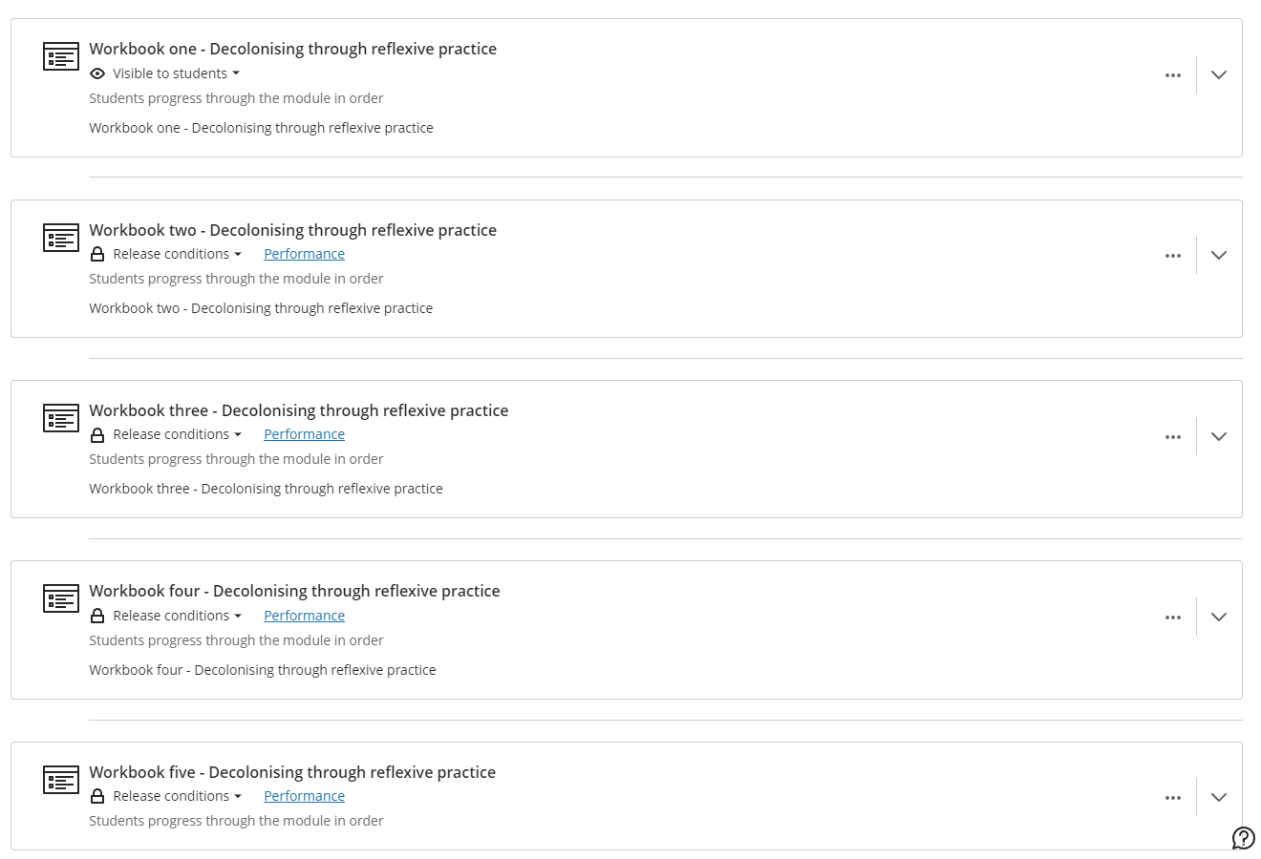

Slide 6
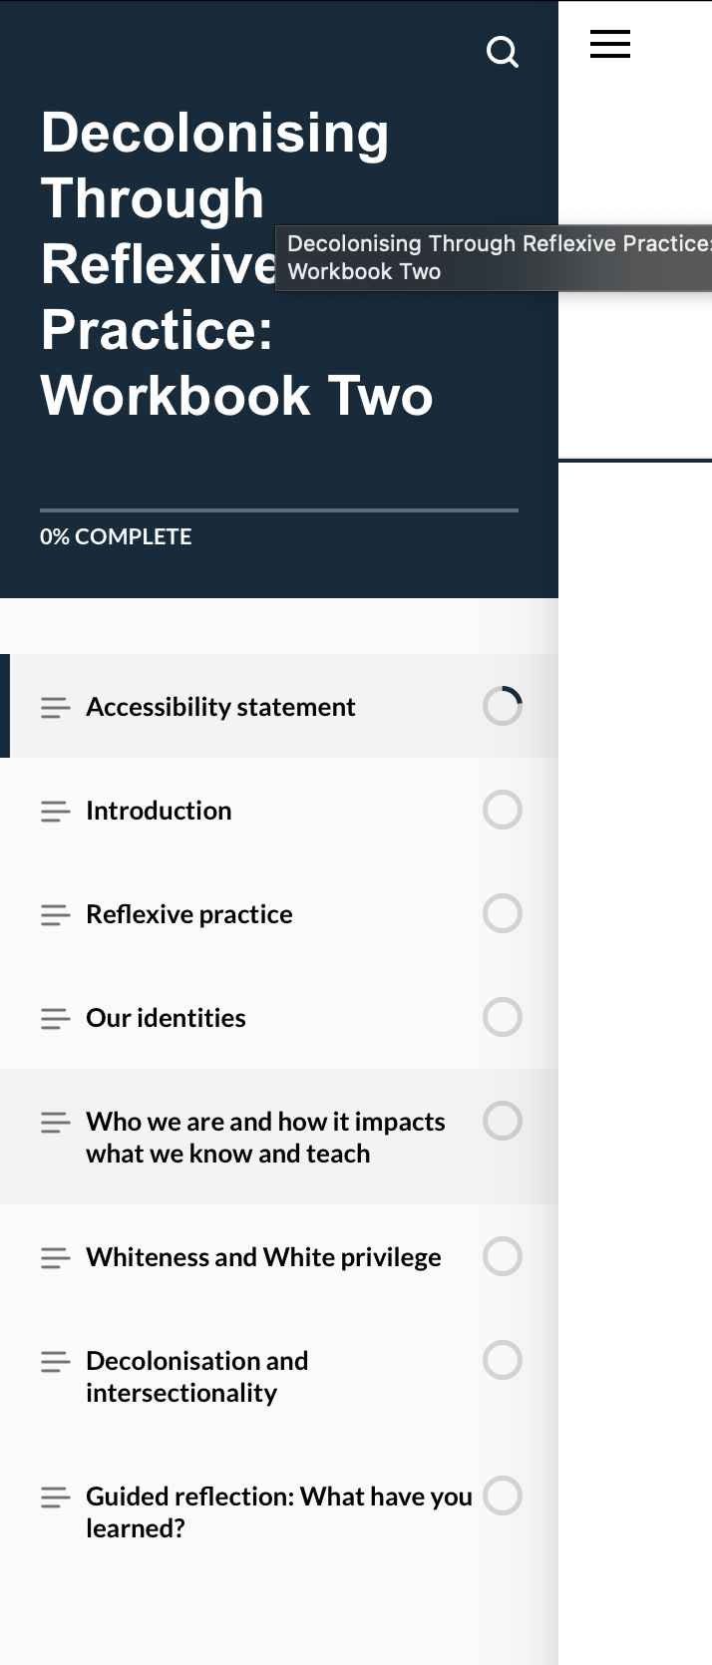
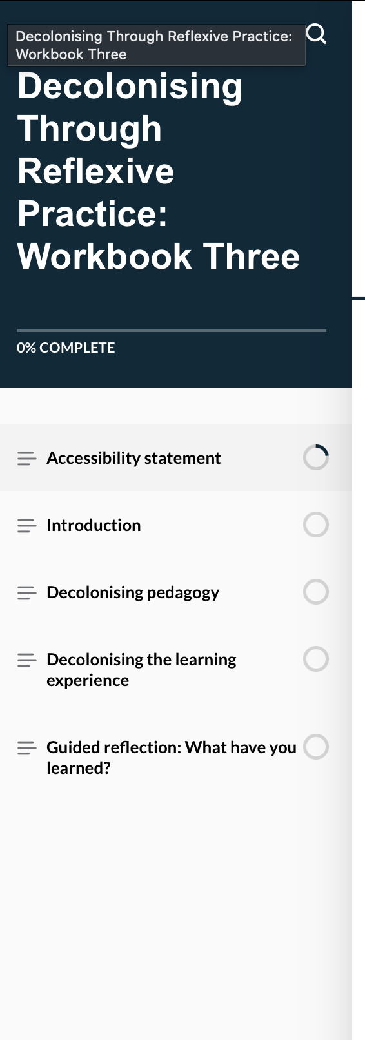
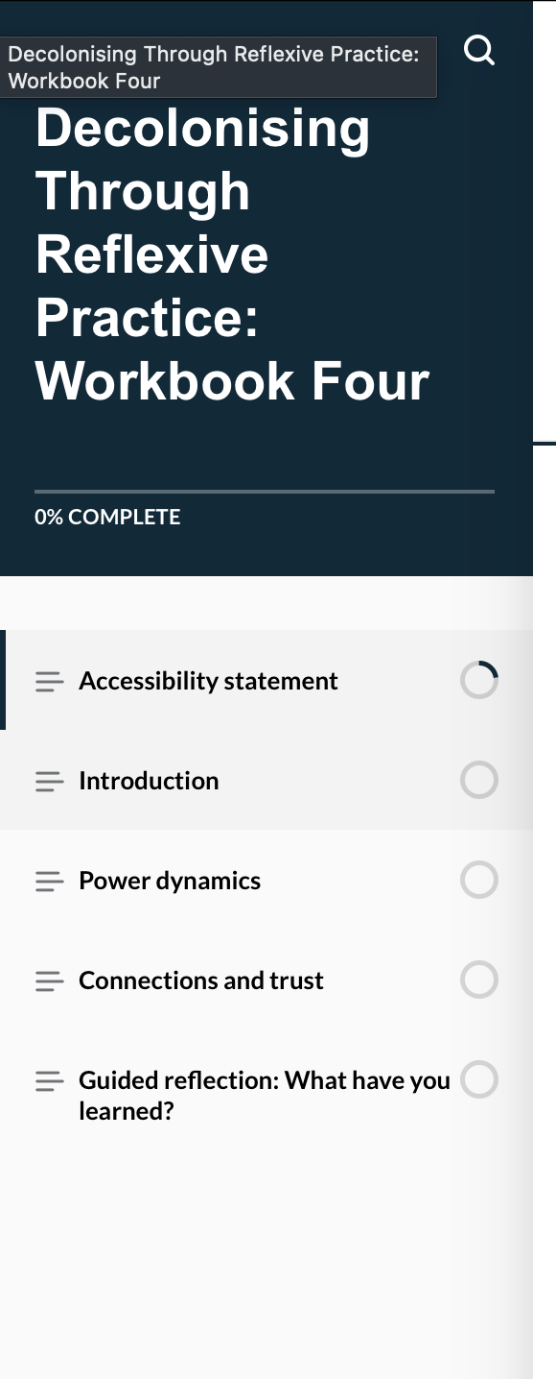
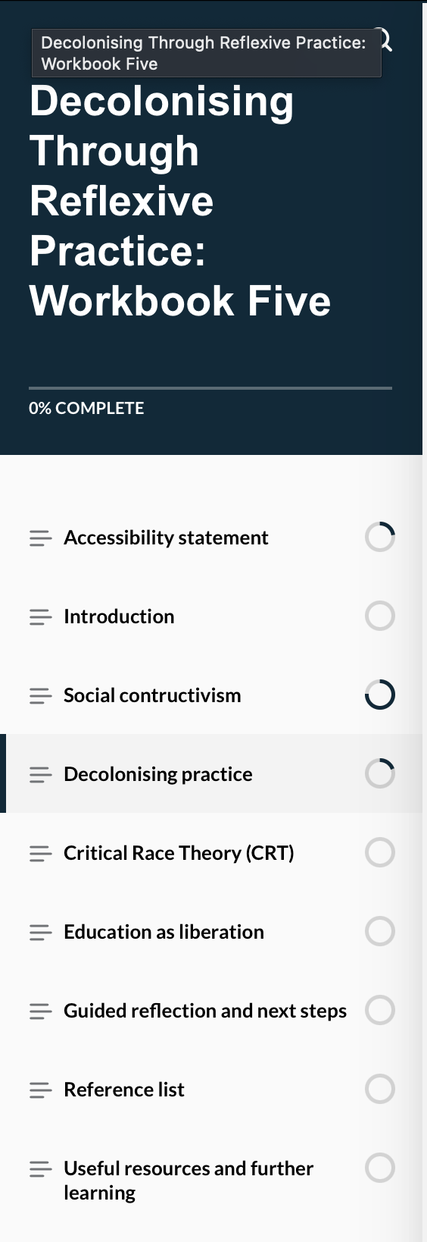

Slide 7
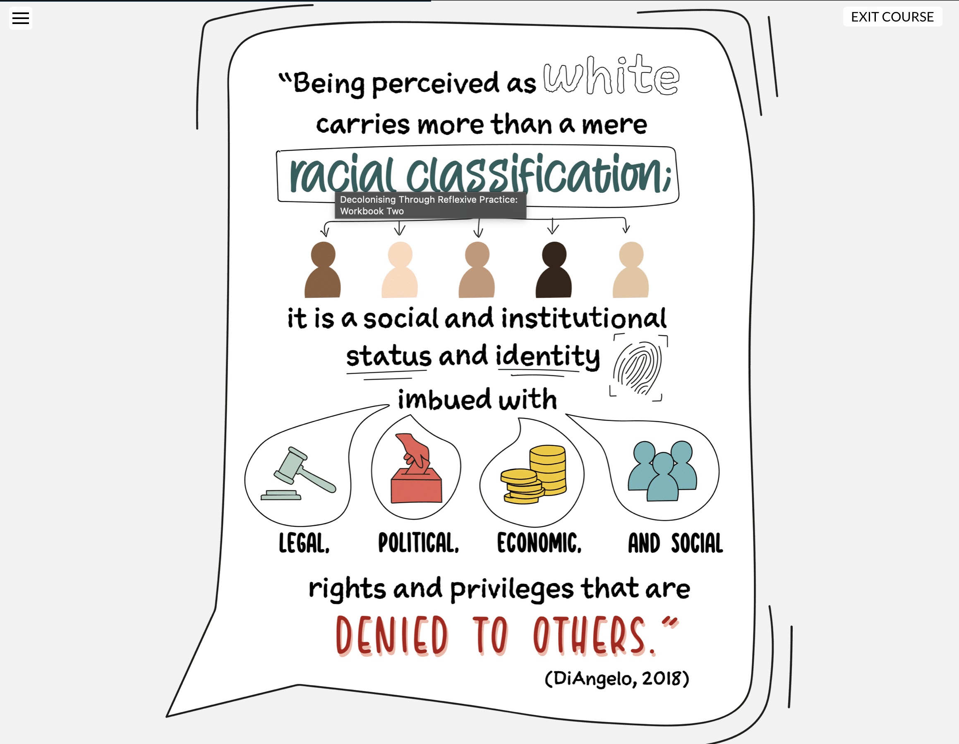

Slide 8
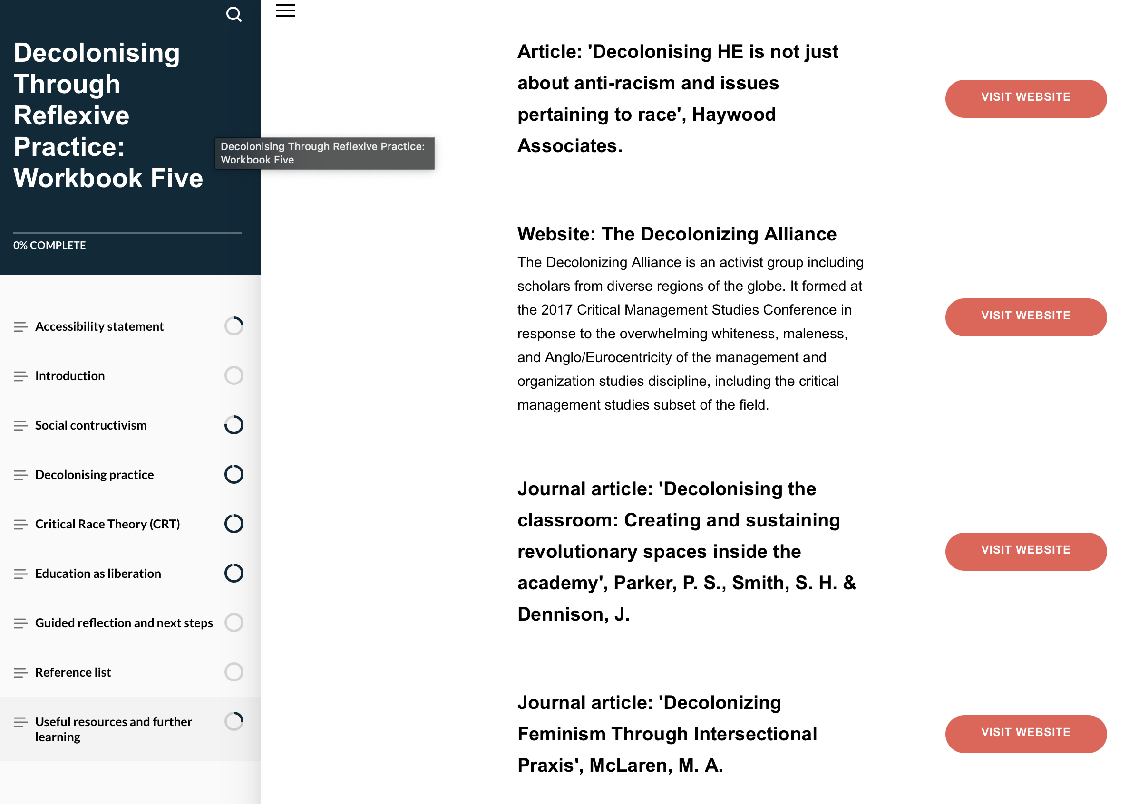
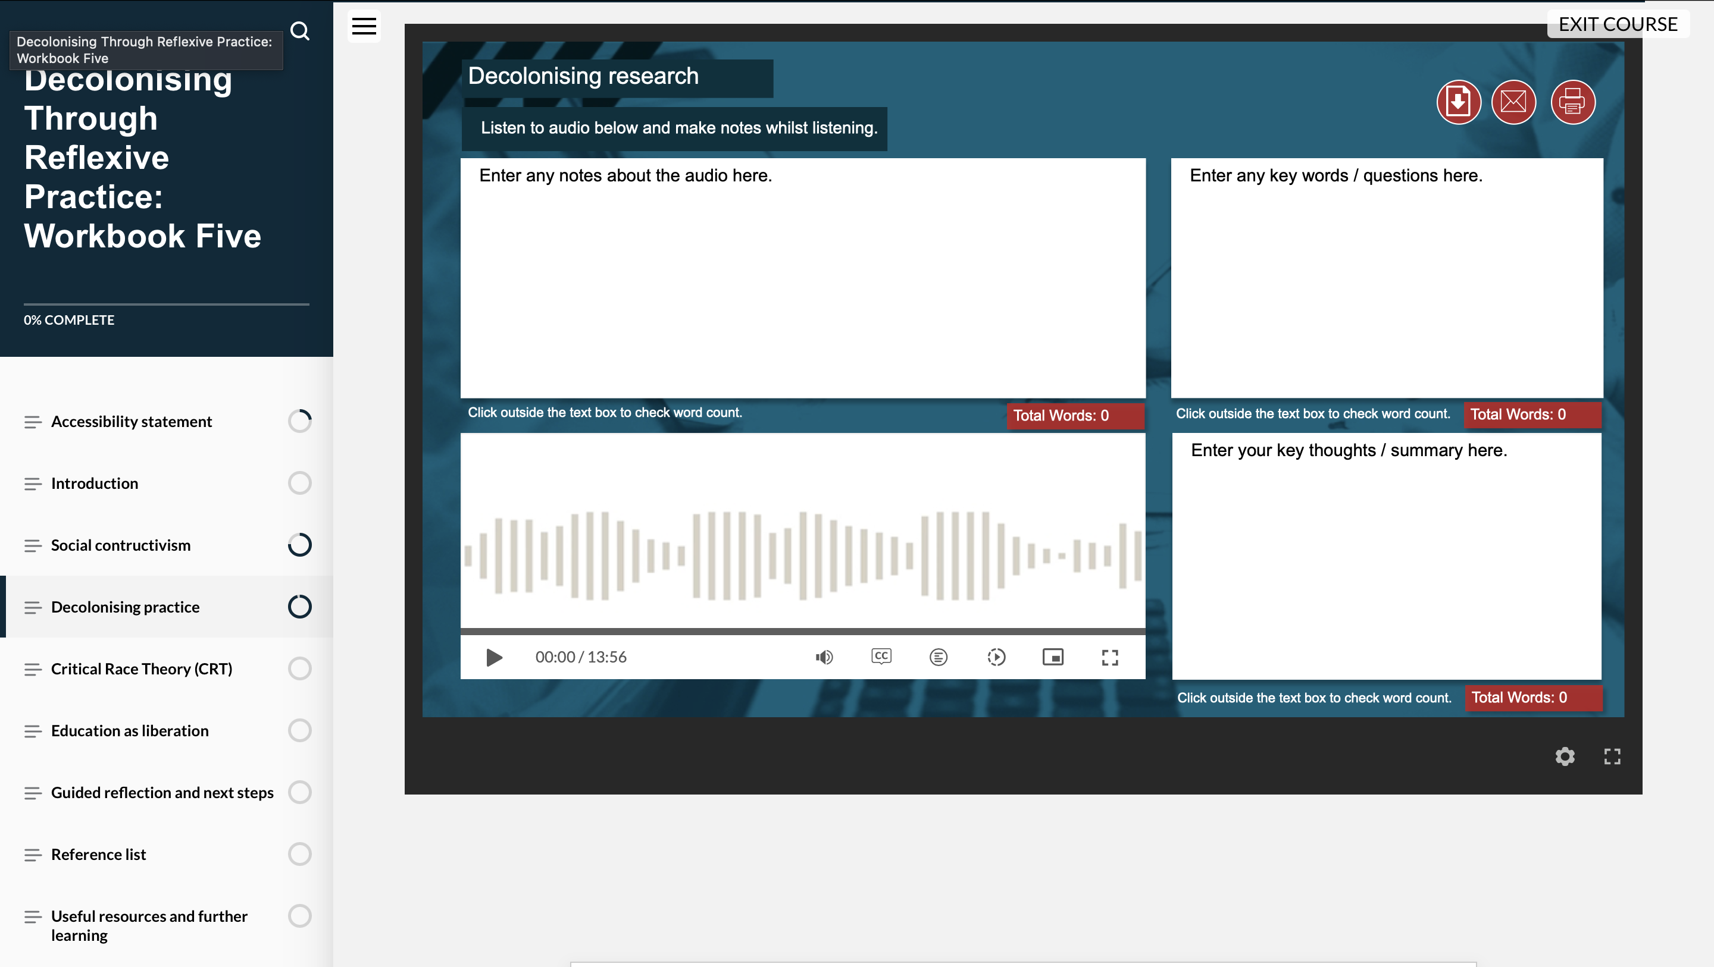

Slide 11
PART 2 – FEEDBACK AND EVALUATION

Slide 12
I evaluated the pilot by reviewing the following:
Blackboard access data
Feedback forms
interviews

Slide 13
Highlights from the pilot–Staff feedback
Blackboard data for the course showed that there were 45 active users with over 240 hours of access
Staff feedback forms showed colleagues the workbooks were “informative”, “easy to navigate”, ”beautifully presented”, “well produced”
Key themes from the interviews:
Positive experience of the workbooks
Feelings of empowerment through engaging with the course
Need to focus lived experience of students
Consideration of knowledge/knowledge types reflected on

Slide 14
Highlights from the pilot–Student feedback
Student feedback on the seminars noted that all the students:
Enjoyed the seminars
Learnt a lot about decolonizing education and student experience
Want a decolonized education
Think that all students should have access to/engage with decolonizing seminars
Students joined my podcast series on Belonging to discuss their experience of the decolonizing seminars. Some key highlights include:
A shift and awareness about what decolonizing education means
How they view decolonization as liberation, with one guest student stating decolonising is “liberation from oppressive legacies that have been passed down consciously or unconsciously through education”
The seminars were a catalyst for students to reflect on their other modules and experience
https://open.spotify.com/show/7z9kYBypPXtL9EQEAAaewL?si=8021d35de5674716

Slide 15
PART 3 – IMPROVEMENTS AND WHAT NEXT

Slide 16
Improvements?
A wider range of input or resources feeding into it
More time and more sessions
More diverse cohorts/ Interdisciplinary approach
Follow ups and consulting with colleagues to embed

Slide 17
Challenges of the pilot
Time to organize
Buy-in
Balancing priorities for colleagues
When is a “good time” in the academic year
Follow up work
resource

Slide 18
So what? What next?
Reality check for those working in decolonizing education; are we really? Or are we silent in the face of live-streamed colonization, genocide and beyond?
Review of the evaluation through UoS institutional channels to discuss what happens
Resource the work
Do we build on the success of the work or do we drop it?
We are exploring requests for external access and usage of the course with 3 colleagues in other institutions already requesting access

Slide 19
My email:
s.safadi1@Salford.ac.uk

