Slide 1
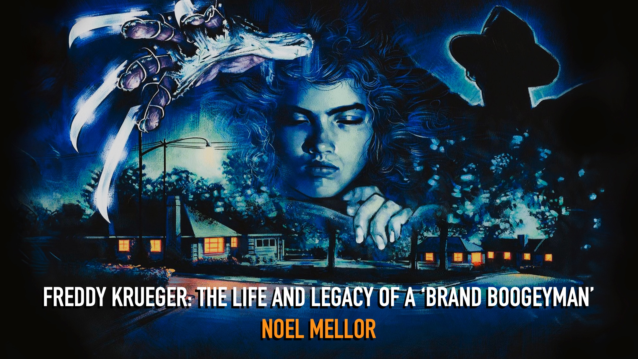
Notes:
What I’d like to talk about today is A Nightmare on Elm Street as a brand… and its audience-centric approach to marketing, during the first ten years of the series.
I’ll be talking through New Line Cinema’s use of Freddy as an ambassador for the franchise, and how his cultural flexibility supported a period of unprecedented success.

Slide 2
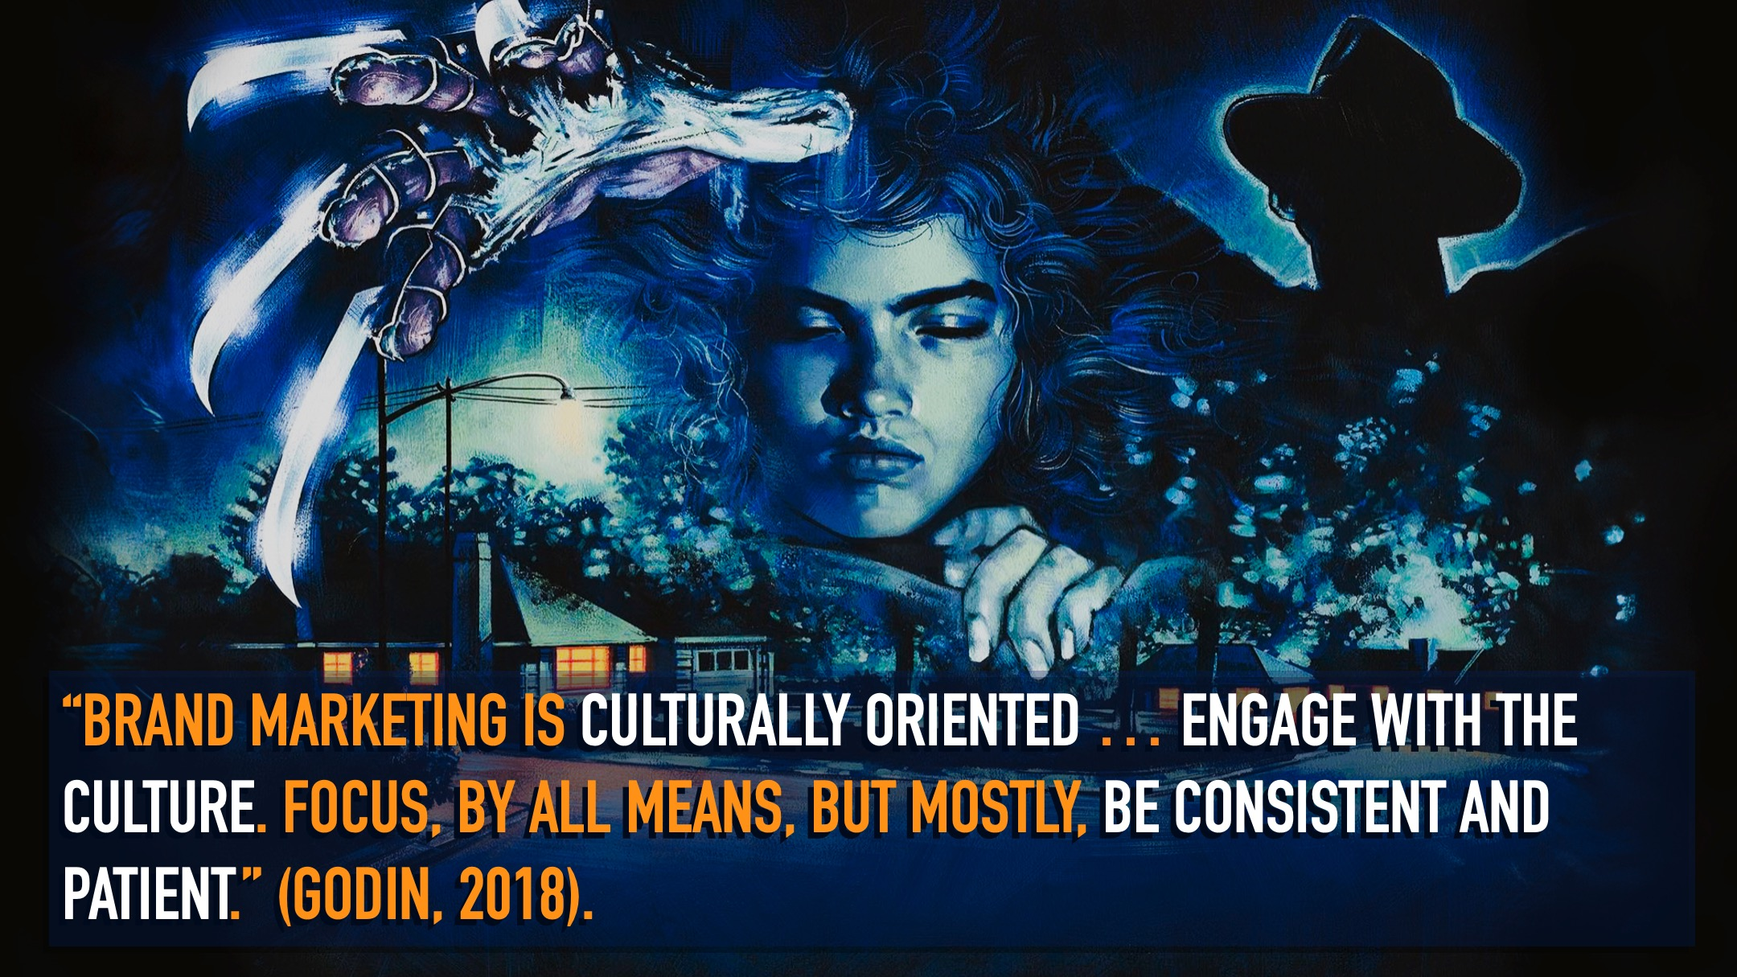
Notes:
I’ll argue a strong visual identity, clear core idea and willingness to respond to consumer need – concepts we typically associate with product marketing – allows the series (via Freddy) to become “culturally oriented”.
Now of course, this way of thinking does create a discussion around film as art versus film as commercial product.
And I recognise this can be a controversial or at least challenging position to take so, I’d like first to offer some personal context…

Slide 3
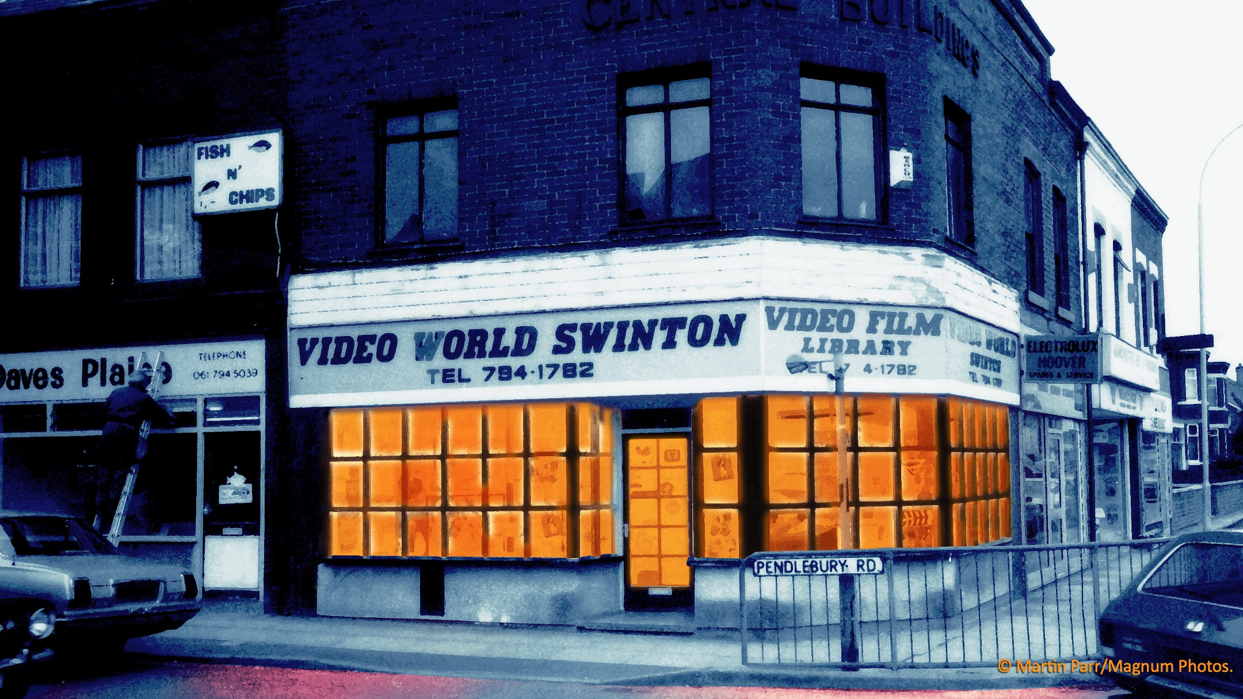
Notes:
Like probably a lot of people here, I was introduced to Freddy at a very young age **not literally of course, that wouldn’t have ended well**
I’d have been about nine years old when the first film hit the shelves of Video World in Swinton… by which point Freddy was already the talk of the school playground.
And this store, that movie (and many others like it) were very important to me – establishing a lifelong love of genre film that has led me here today…. still talking about Freddy some 40 years later…
But I should also say that, as well as being a fan of sadistic child murderers, I’ve also worked for many years (and now teach) in the much uglier, more morally questionable world of brand marketing.
So, sadly I can’t help but see the world through that more cynical lens.

Slide 4
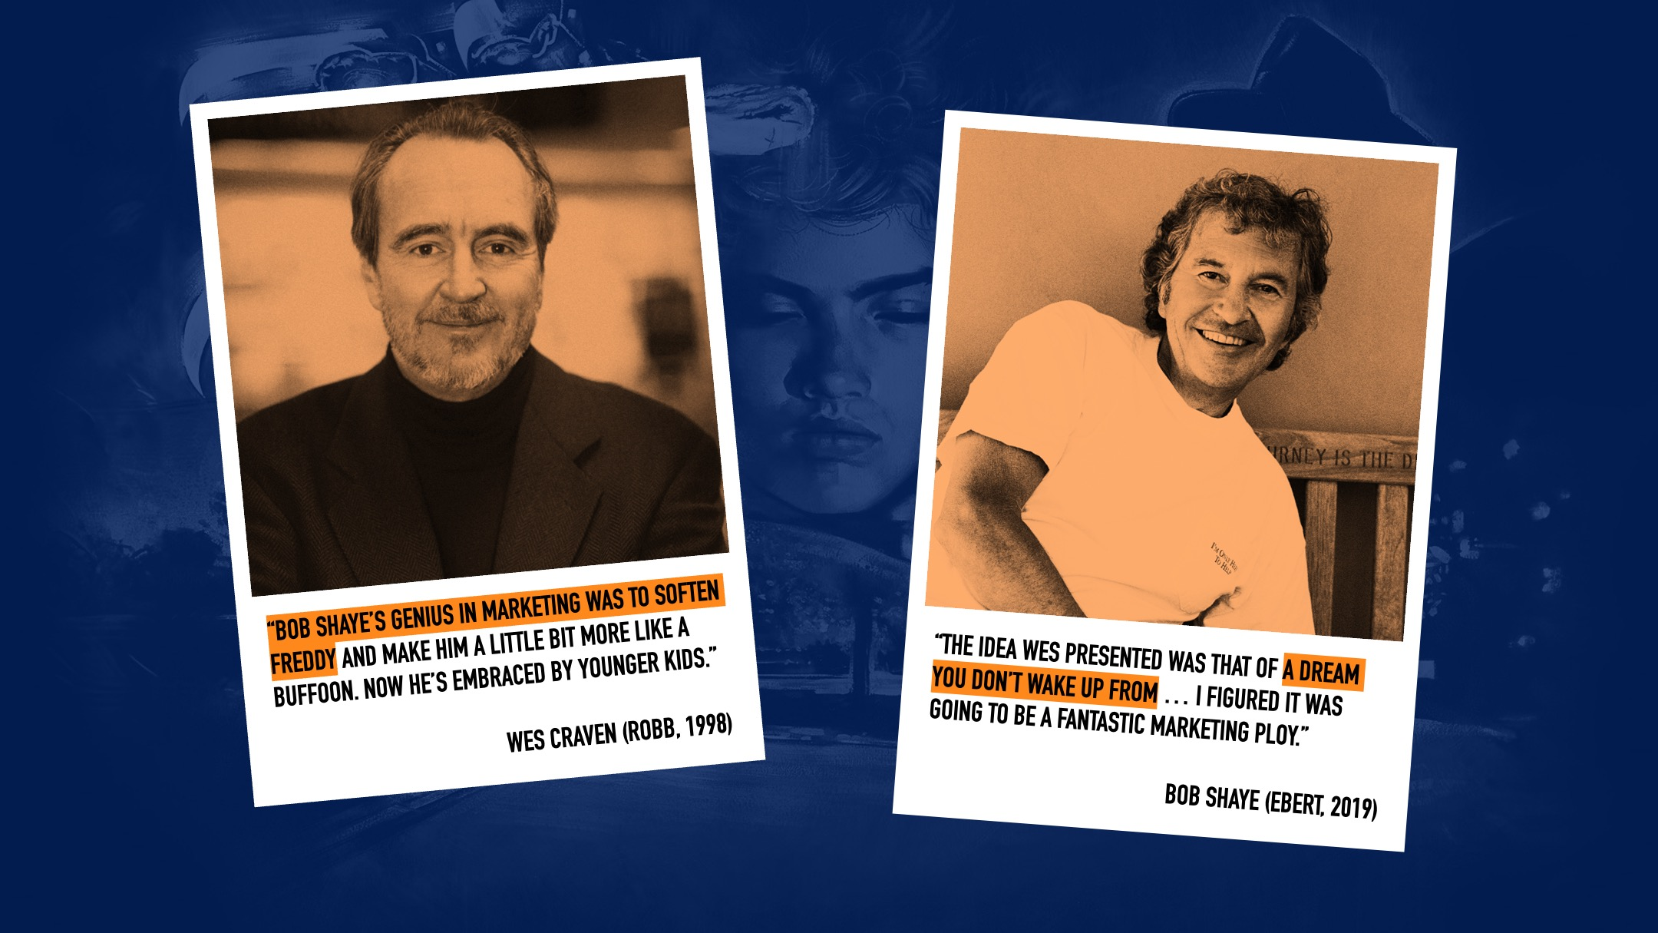
Notes:
But, as a film fan and a marketer, what fascinates me is everything that equipped A Nightmare on Elm Street to be a hyper successful brand right out of the gate…
And how, in that initial ten-year run, there is this brilliant conflict (or marriage) at play between its creator and its producer that supports this success.
On the one hand you have Wes Craven’s vision, representing the film as art. Then on the other, New Line Cinema Producer Bob Shaye, whose purpose is to develop that vision into a franchise-friendly product.
And what comes out of this collaboration is this perfectly formed, yet still malleable, ‘brand boogeyman’ in Freddy Krueger... who can then be manipulated to market and merchandise each film according to the changing needs and expectations of the audience.

Slide 5
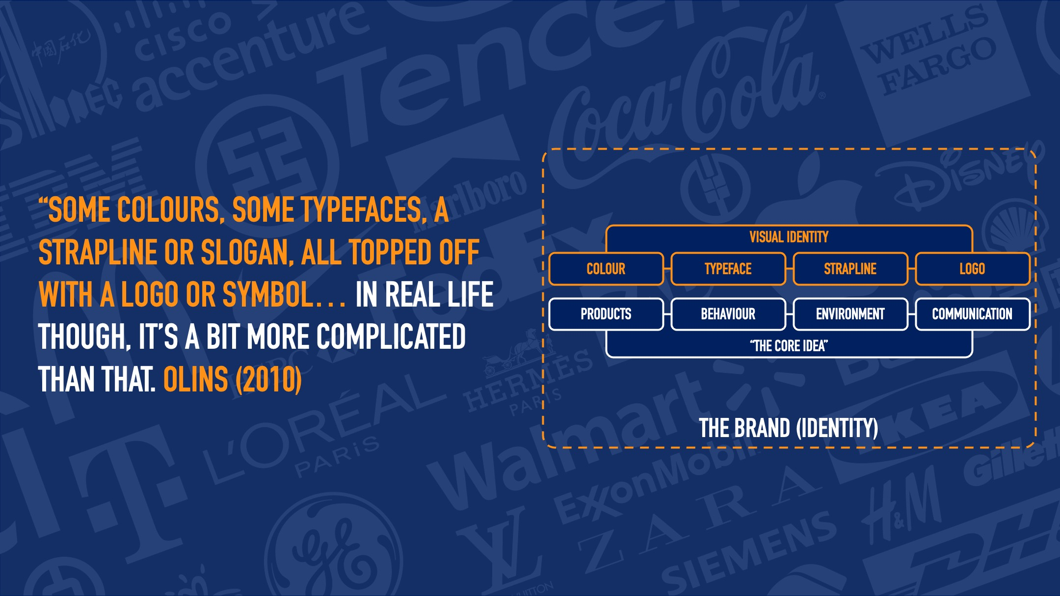
Notes:
Any successful product marketing strategy starts with understanding the brand identity that supports the product… and how this will live in consumer’s minds.
Typically, we think of a brand identity as “some colours, some typefaces, a strapline or slogan, all topped off with a logo or symbol”.
But there are several additional moving parts to consider in managing a brand, particularly one that aspires to become something more culturally impactful.
In addition to a visual identity then, a brand must ensure its products, its behaviours, the environments it places itself in, and the way it communicates, all make sense to the consumer.
All these components make up what Olins refers to as ‘the core idea’, which must be fully symbiotic with the visual identity, to establish a meaningful and long-lasting audience relationship.

Slide 6
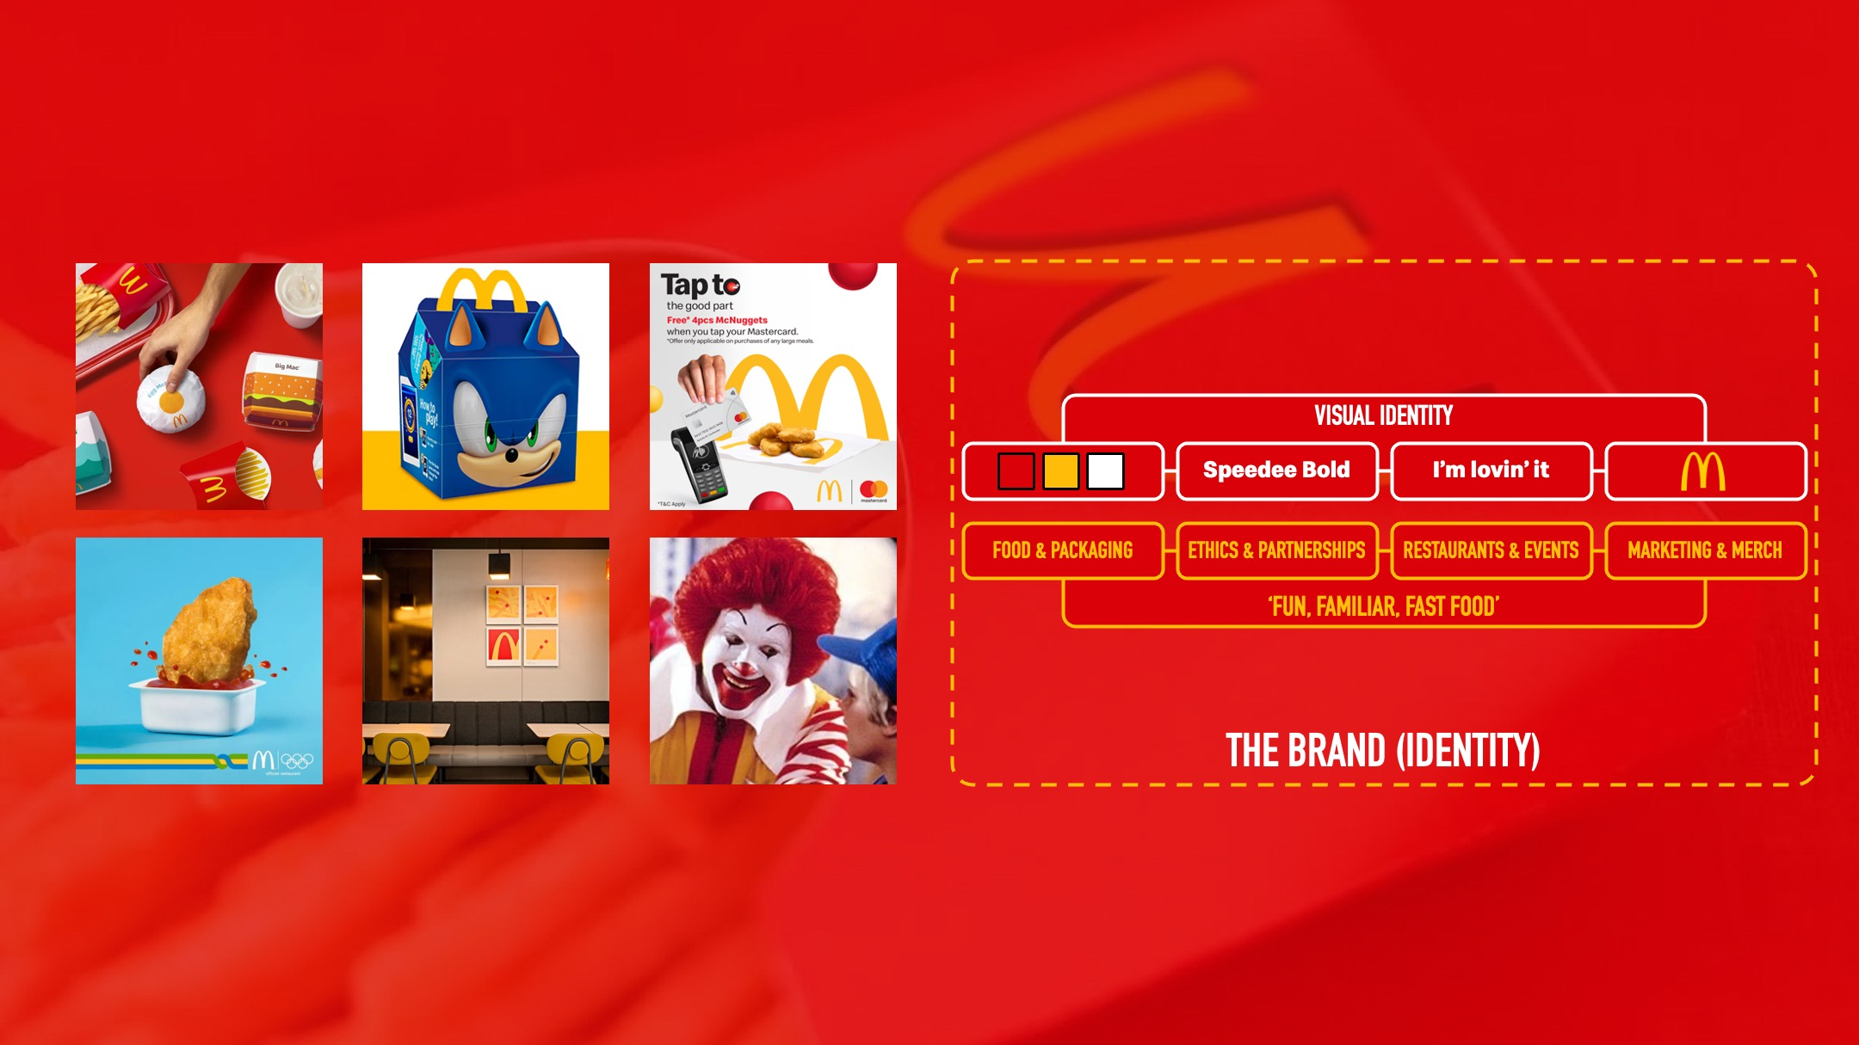
Notes:
As an example, McDonalds is one of the most successful, pervasive brands in the world with a visual identity based around three core colours, a bespoke font, strapline and simple logo.
But the McDonalds ‘core idea’ – which might be summarised as ‘fun, familiar fast food’ – also includes:
Hundreds of individually designed packaged products
A variety of commercial partners at both consumer and corporate level
Physical and metaphysical environments, so… restaurants, but also sponsored events like the Olympics
And of course, all of the marketing communications that go with all of this activity.

Slide 7
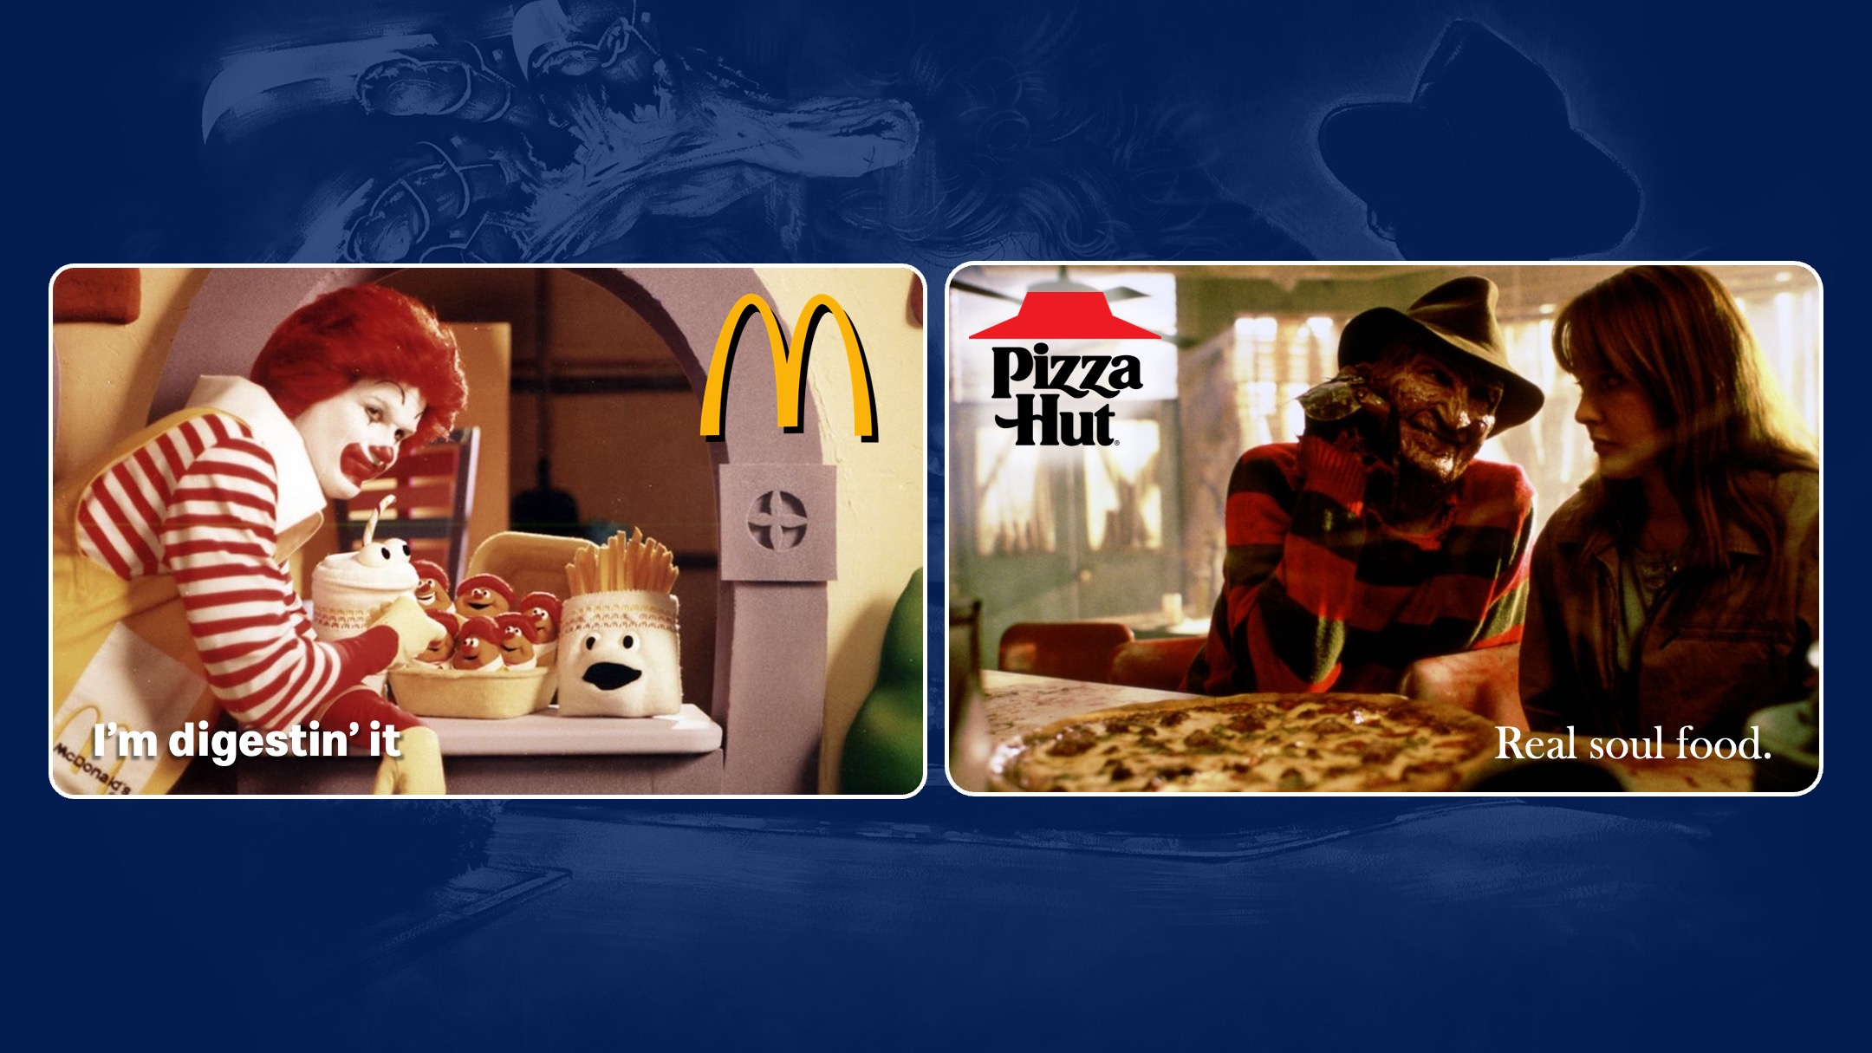
Notes:
That ability to appeal to a massive global audience – while also slowly killing our children – is something both Ronald McDonald and Freddy know all about…
But while Ronald’s ambassadorship for the McDonalds brand has quietly ended, it’s impossible to imagine a future for the Elm Street franchise that wouldn’t include - or indeed be built around - Freddy.

Slide 8
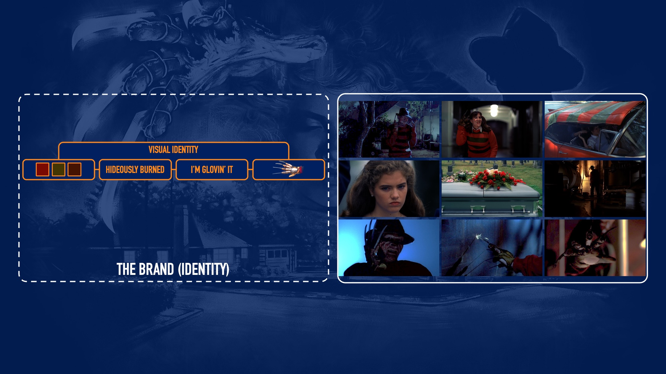
Notes:
So what is it about the brand boogeyman of the Elm Street franchise, and how do we define his brand identity?
Well, his brand colours of red, green and brown are well established in the first film… whether it’s his clothing, or the many references to it throughout.
And while he doesn’t have a ‘typeface’ to easily identify him, he most certainly has a face-type… which is of course ’hideously burned’.
And while the film posters have their own straplines, some of which we’ll come to later, if we’re assigning one to Freddy specifically, I think this one works quite well.
And as the glove is such a vital part of the iconography from the start, you’d have to say it’s the closest thing he has to a logo.

Slide 9
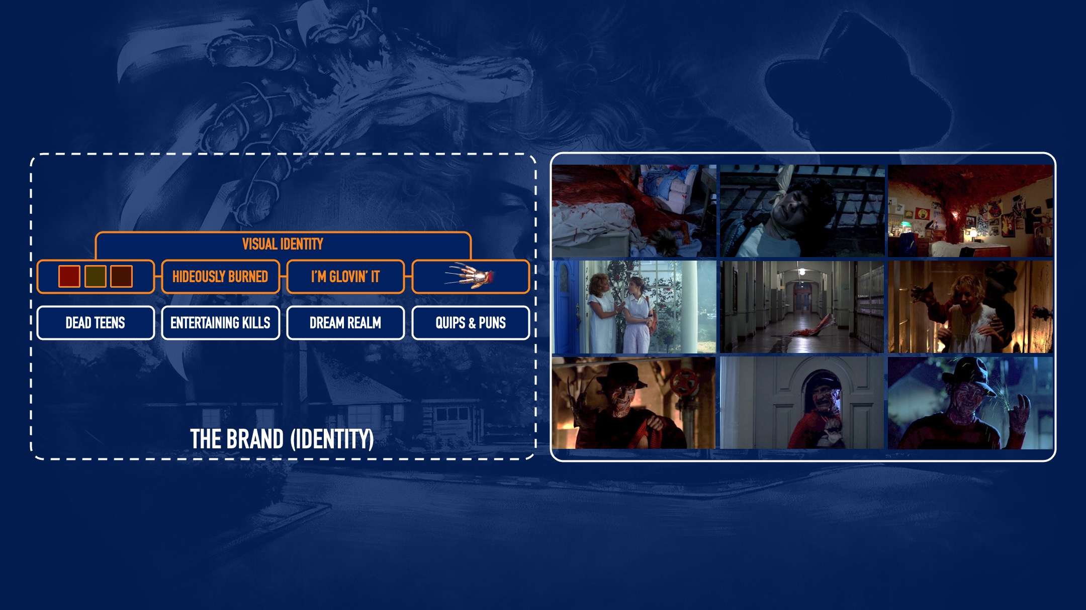
Notes:
When it comes to Freddy’s range of products, he has a well-established line of dead teenagers he’s very proud of.
And his behaviours, importantly, involve picking off those teenage victims one-by-one in creatively entertaining ways.
The environments he operates in are (mostly) the dream world… though there are recurring locations within that like 1428 Elm Street, Springwood High School and his boiler room.
And of course, how he communicates is vital. A sinister-yet-playful tone in the first movie, which develops later through the series to become increasingly quippy and comedic.

Slide 10
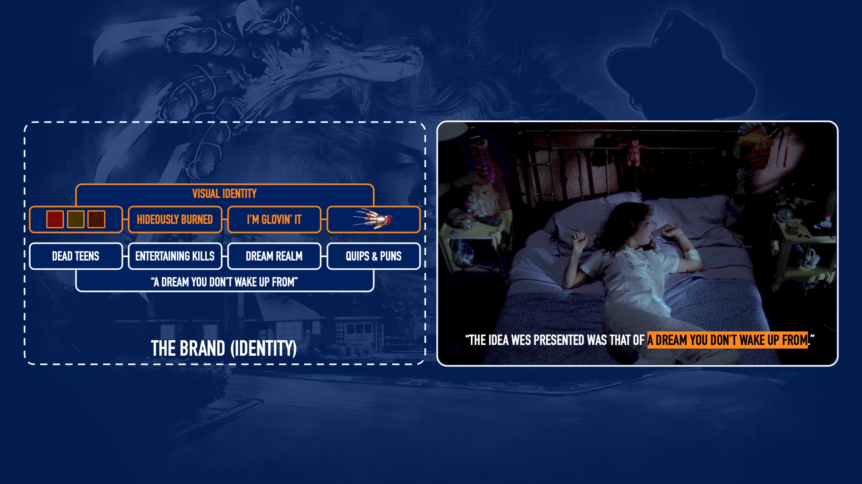
Notes:
What Freddy promises the audience then, via his core idea, is exactly what appealed to Bob Shaye in the first place… the notion that if you’re fated to meet Freddy, it will be in a dream from which you won’t wake up.
This consistency helps galvanise Freddy’s brand identity, but also more deeply defines his relationship with the final girls of the series… The individuals who refuse to subscribe to his core idea and insist on waking from the dream – in other words, his most difficult customers.
Now on the face of it, these points might feel contrived or flippant but, if you remove or alter any of these points too much, you not only disrupt that essential brand identity, you break a contract that has been established with the audience about what they should expect.

Slide 11
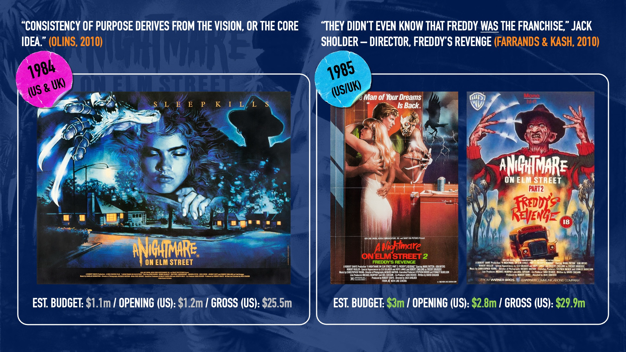
Notes:
The Elm Street franchise then, starts with that strong visual identity, directly tied into a relatable core idea… a consistency of purpose, based on Craven’s artistic vision.
But the durability of the series comes from learning during the making of the second film that already by this time, as director Jack Sholder puts it: “Freddy was the franchise.”
Putting Freddy’s name in the title was a vital first step in the character’s journey to becoming “culturally oriented” as was the way in which he moved visibly out of the shadows in the marketing materials.

Slide 12
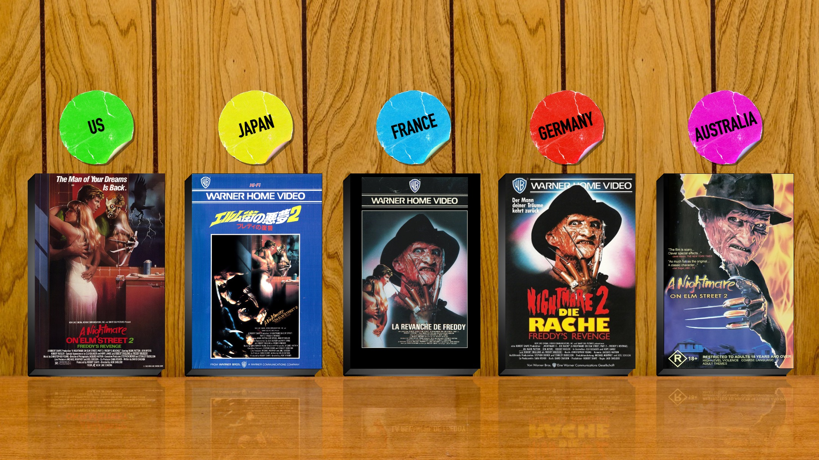
Notes:
Globally, some markets made use of the more conservative, or at least more cryptic US artwork for rental releases of Freddy’s Revenge, but most pushed this creative to either the side, to the back or just didn’t use it at all.
Instead, as with the UK artwork, for most international releases Freddy would take centre stage… and audiences who saw the glove, the jumper, the hat and the face, knew the man of their dreams was back.

Slide 13
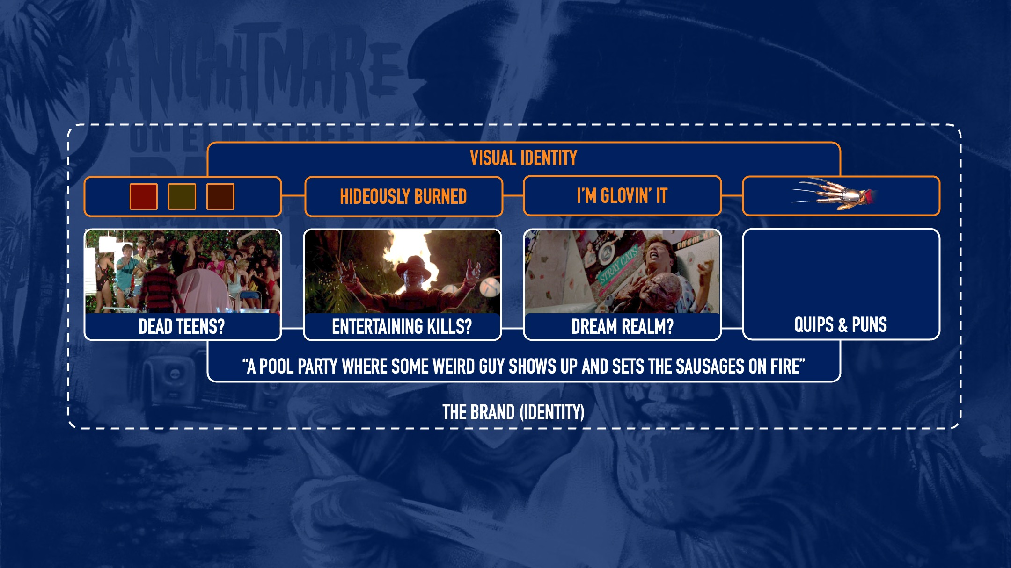
Notes:
The film - as a commercial product - was a success, both theatrically and on home video. But critically, faced complaints about its creative direction, specifically in having Freddy spill out of the dream world and into reality.
This suggests that while the marketing successfully amplified the brand identity and acknowledged what consumers wanted enough for them to see it, the film itself strayed too far from vital elements of the core idea.
So instead of being limited to the dream realm environment, Freddy was loose in the real world. Instead of picking off teens one-by-one in creatively entertaining ways, he was chasing 30 of them around the garden for a bit.
Instead of being ‘a dream you don’t wake up from’, the core idea is reduced to ‘a pool party where some weird guy shows up and sets the sausages on fire’.

Slide 14
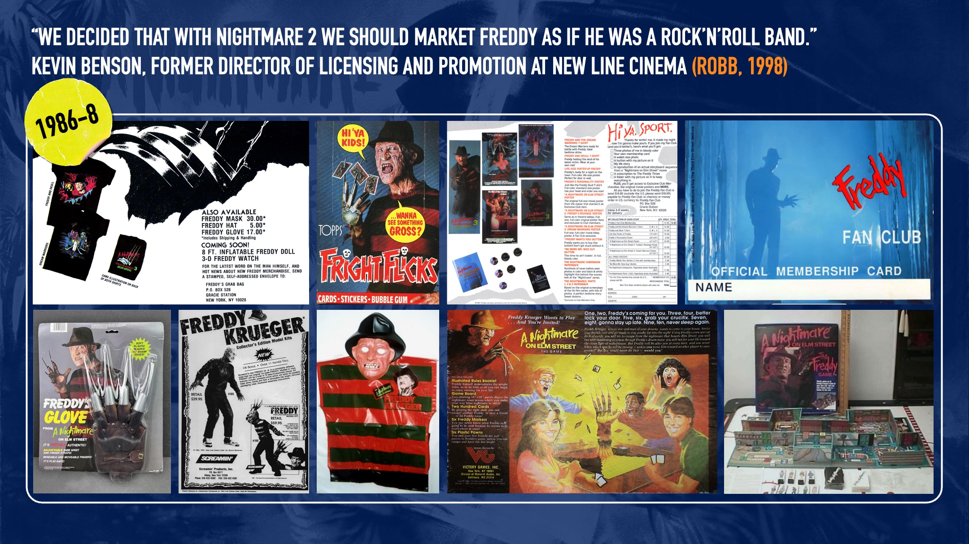
Notes:
From there though, the marketing and merchandising associated with brand Freddy, only goes from strength to strength.
Then director of licensing and promotion at New Line Cinema, Kevin Benson, says the sequel offered the chance to market Freddy “as if he was a rock ‘n’ roll band” to reach a much wider audience.
This starts with photoshoots and the odd t-shirt, but by 1987 it’s posters, pins, masks, hats, jumpers, gloves, model kits and a fan club. All plainly targeted at younger fans and often with Freddy addressing them directly with a “hiya kids” or “hiya sport”.

Slide 15
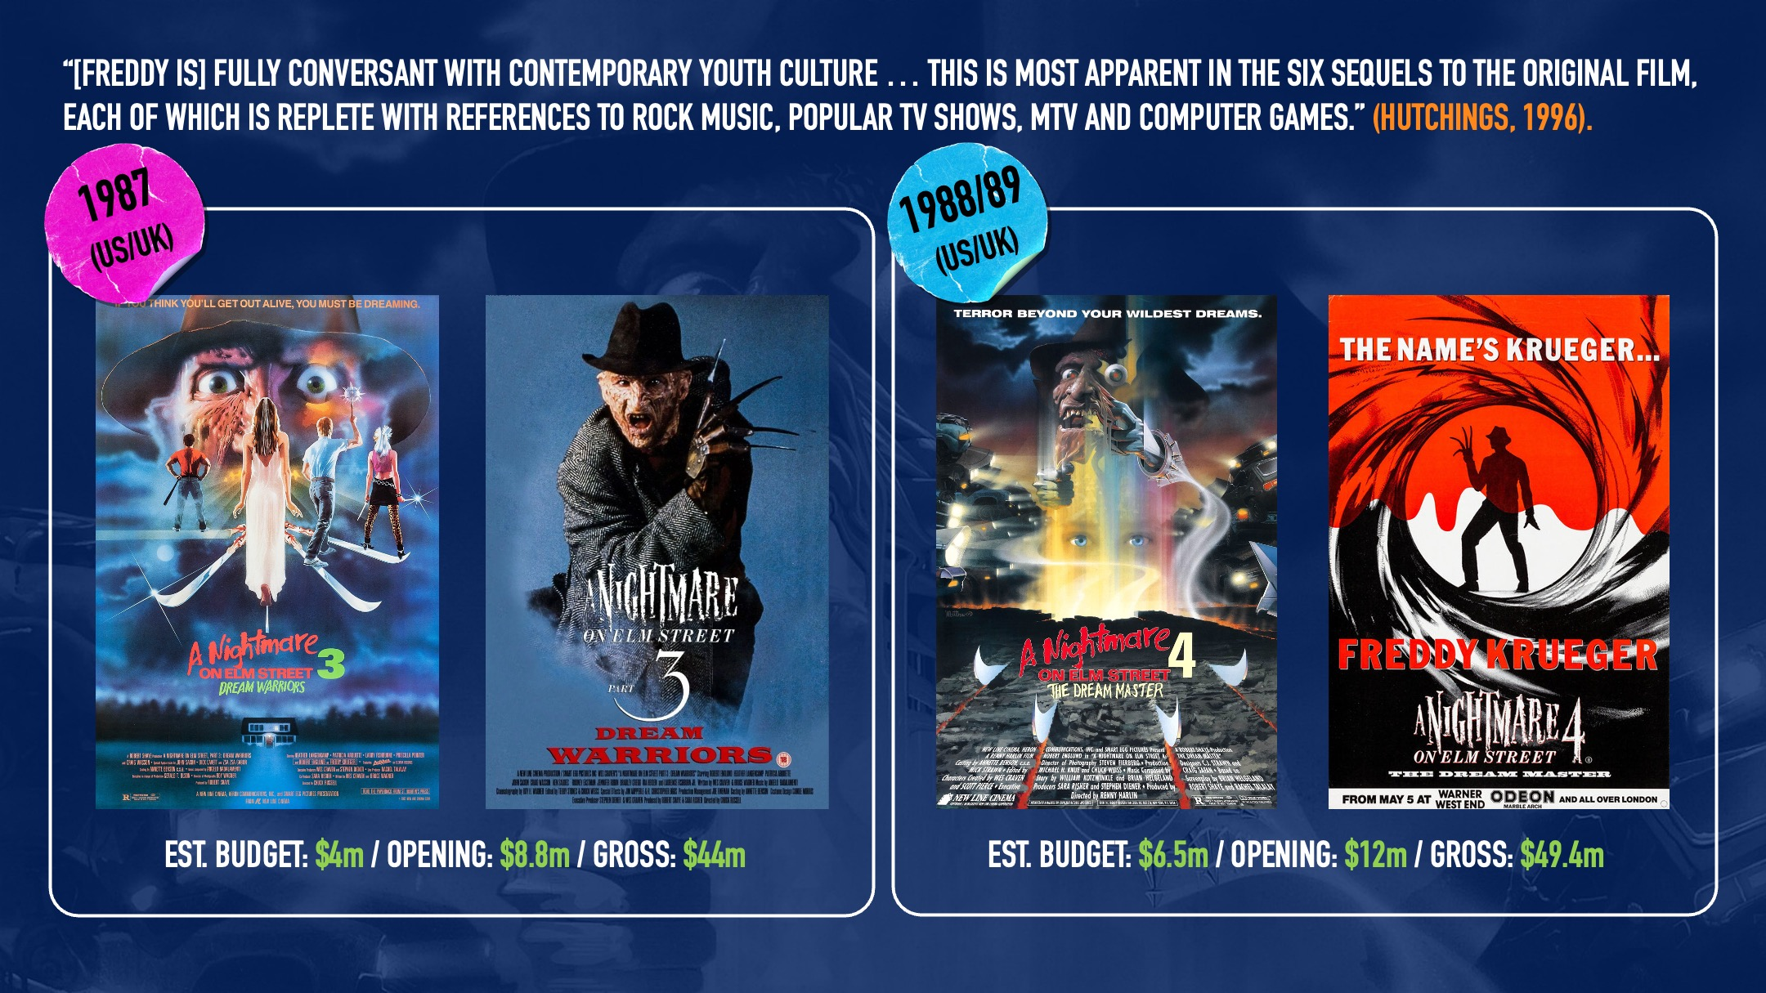
Notes:
By now then, Freddy is truly “culturally oriented”, transcending his medium thanks to an effortless intertextual fluidity.
And it’s at this point New Line Cinema starts to allow the relationship Freddy has built with audiences via marketing and merchandising to feed back into the film product itself.
A Nightmare on Elm Street 3: Dream Warriors (1987), restored the dream realm of the core idea, and made this abundantly clear via the title and poster campaign.
And in the film, the narrative flexibility of Freddy and the dream realm is used to explore teen suicide, self-harm, role playing games and drug abuse, connecting Freddy more deeply with the culture by reflecting societal concerns.
For A Nightmare on Elm Street 4: The Dream Master (1988), the dream realm is once again heavily present in the US and UK marketing, but Freddy’s role as a pop culture icon is emphasised in a UK teaser poster referencing James Bond.
The film itself also adopted a modern editing and visual style, which Robert Englund himself acknowledges as what made him realise director Renny Harlin was creating “the MTV Nightmare”.

Slide 16
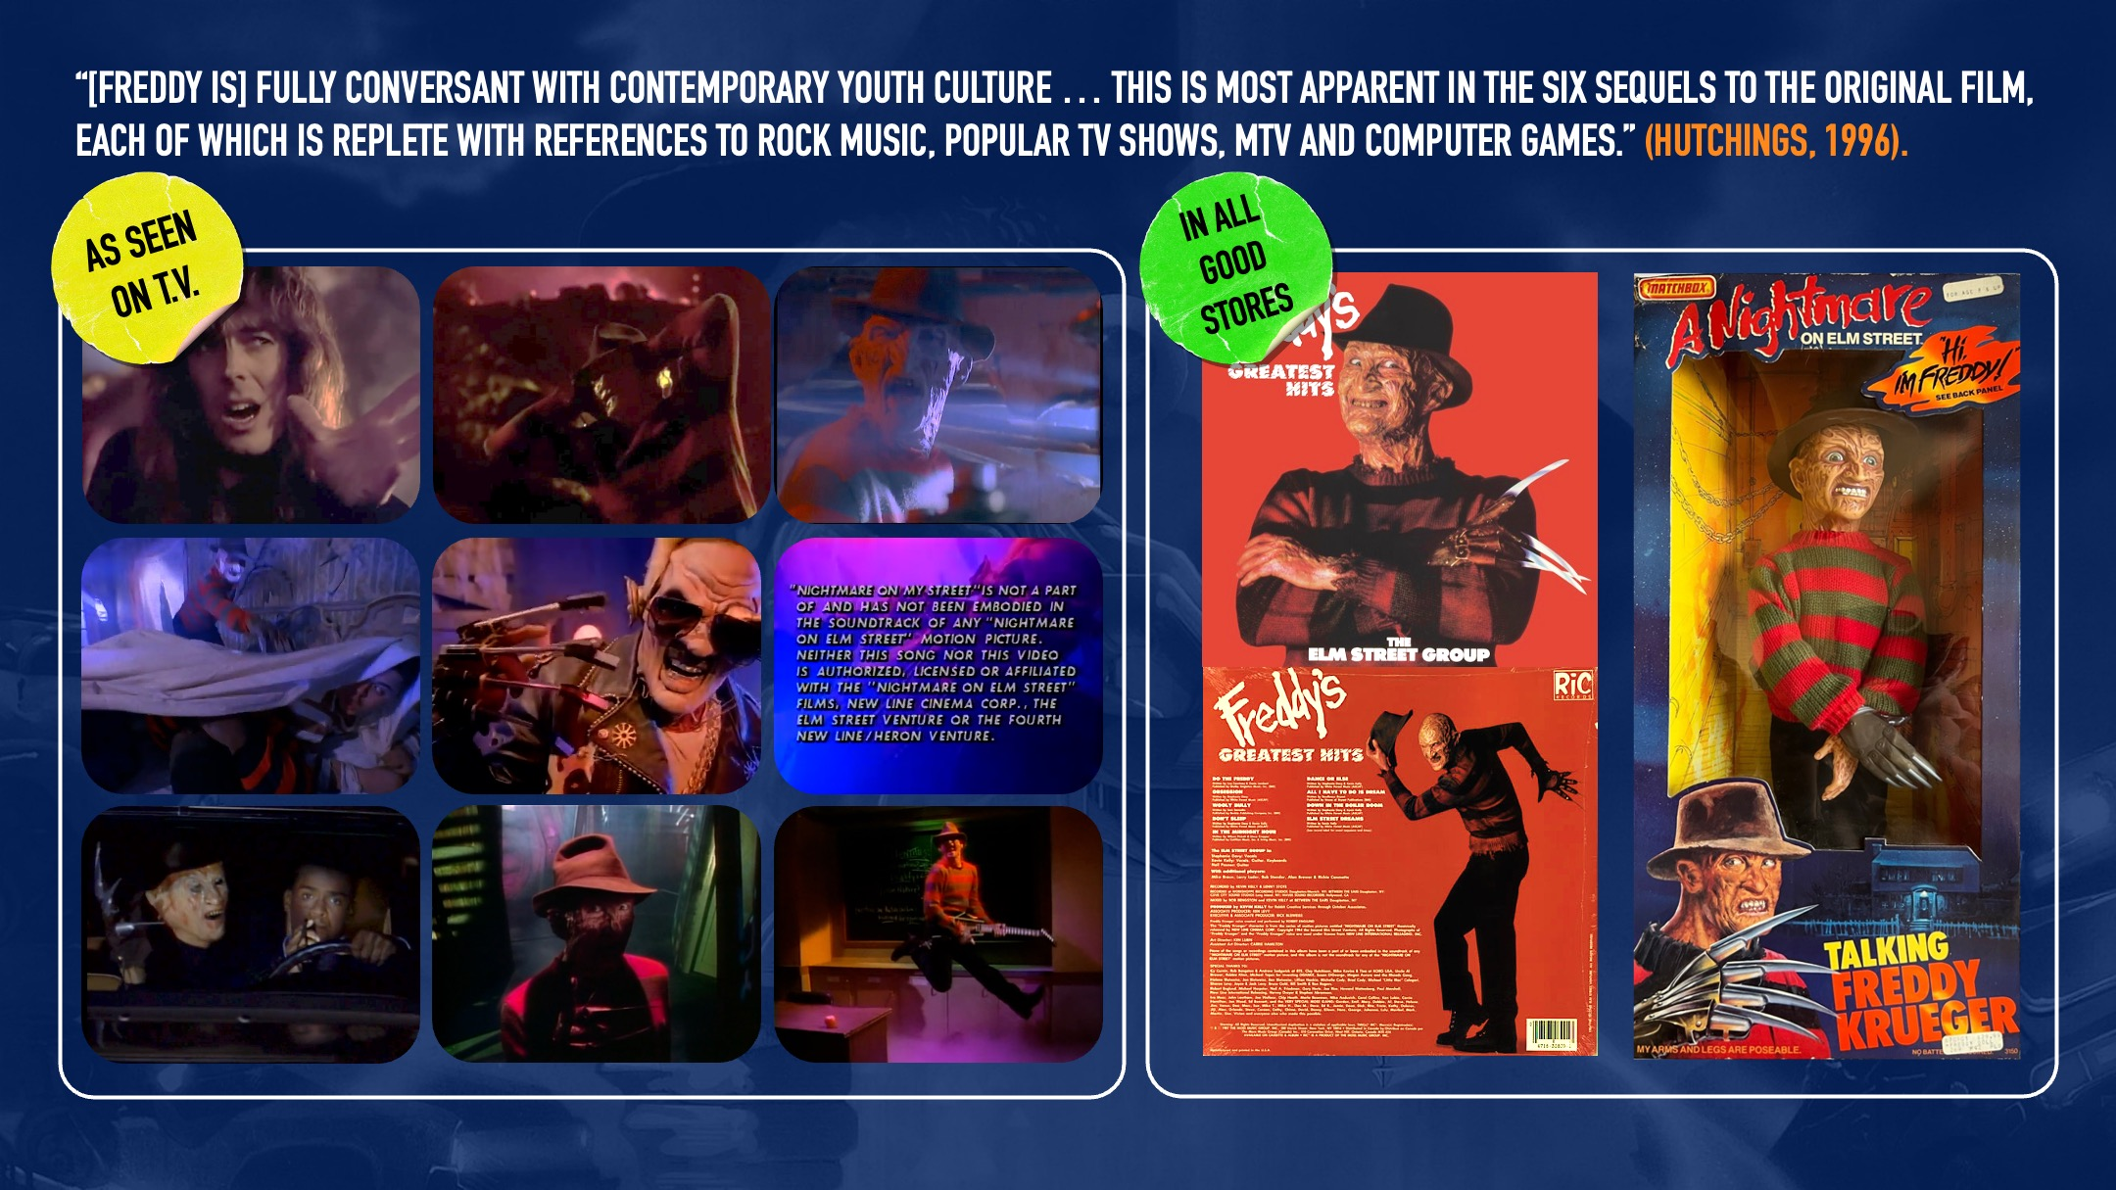
Notes:
Officially, Freddy is by this time appearing in music videos for the films, interacting with the musicians themselves.
Unofficially, he’s being heavily referenced by DJ Jazzy Jeff and The Fresh Prince’s ‘Nightmare on My Street’ as well as on The Fresh Prince of Bel Air TV series.
In ad breaks, audiences are invited to call The Freddy Krueger Hotline and in the Freddy’s Nightmares TV series, he is addressing them directly in their homes - making them somehow complicit in his murderous chaos.
The merchandising madness arguably peaks with the infamous Matchbox Talking Freddy Doll in 1989 though.
Launched ahead of A Nightmare on Elm Street 5: The Dream Child, the doll was controversial enough to generate a level of press and TV coverage even Bob Shaye’s healthy new marketing budget would never have stretched to.

Slide 17
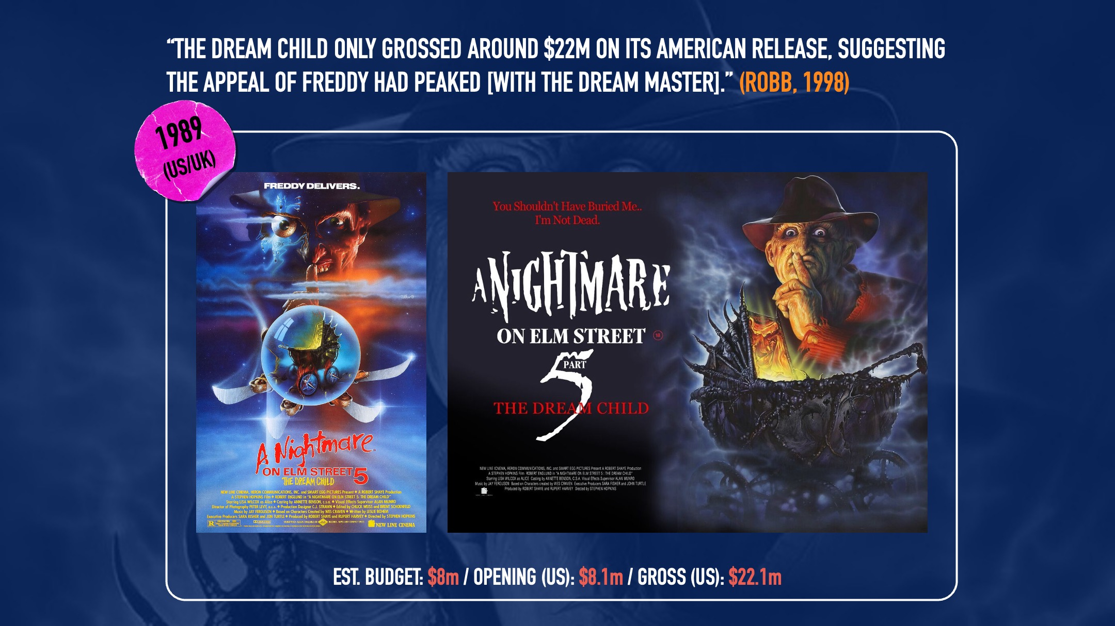
Notes:
Across all channels, Freddy was deepening his relationship with the audience, conversing directly with them via the screen as well as the posters.
Box office takings for the fifth film though, suggested “the appeal of Freddy had already passed its peak” and perhaps, the character was now becoming a victim of his own popularity.
So in response to this apparent audience apathy, New Line Cinema decided to do exactly what it thought it’s consumers might want.
Killing Freddy off would arguably be its most marketing-based creative decision so far, as would the way in which the studio chose to do it...
And the UK marketing for Freddy’s Dead: The Final Nightmare was an absolute masterclass...

Slide 18
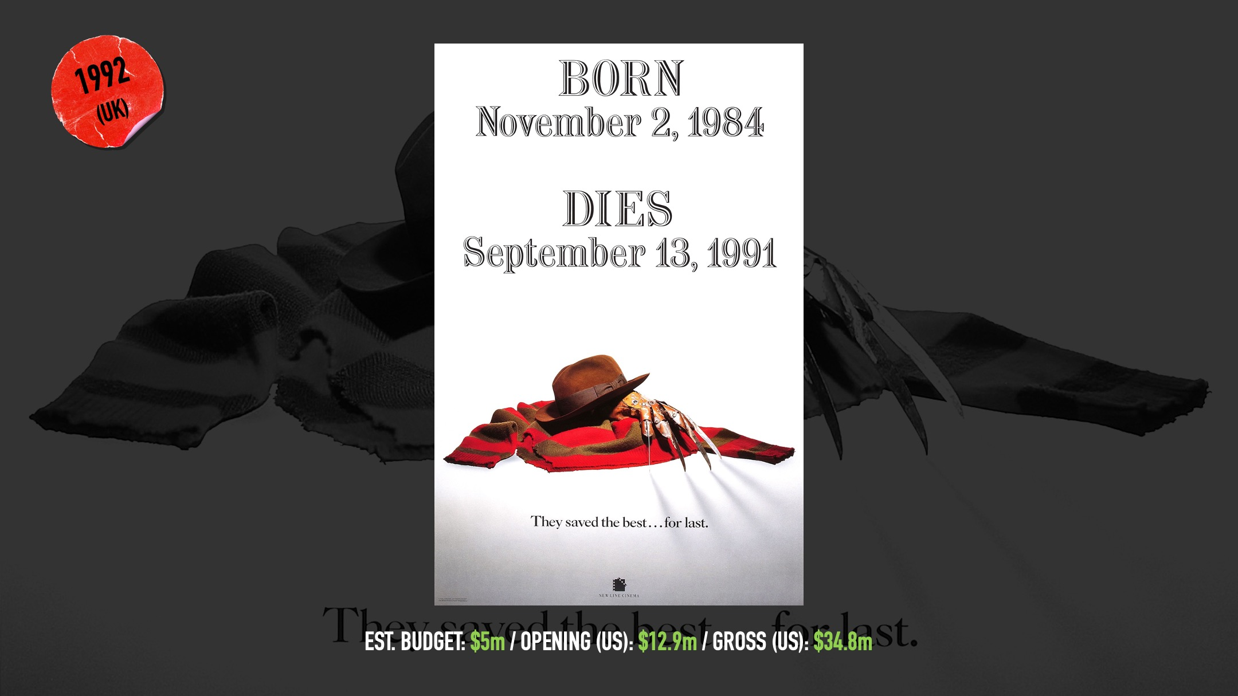
Notes:
Comfortably and confidently reliant on its established visual identity, the UK teaser didn’t even mention A Nightmare on Elm Street. Definitive proof, if any were needed by now, that Freddy ‘was the franchise’.
Evoking the climactic death of The Wicked Witch of The West in 1939’s The Wizard of Oz, it simply showed Freddy’s trademark sweater, hat and bladed glove in a crumpled heap on the ground – with a headstone font announcing his birth and forthcoming death.
Not only was it an effective use of the brand identity, it reassured jaded audiences that the studio had listened, and would reward viewers desire to see Krueger dead – with a film that the tagline proudly announced would be the best of the series.
Now of course, the choice to add 3D to the climax of the film was something director Rachel Talalay admits was also a marketing department choice, but whether it was this or the more explicit choice to kill Freddy, the messaging connected, and the film was a hit.

Slide 19
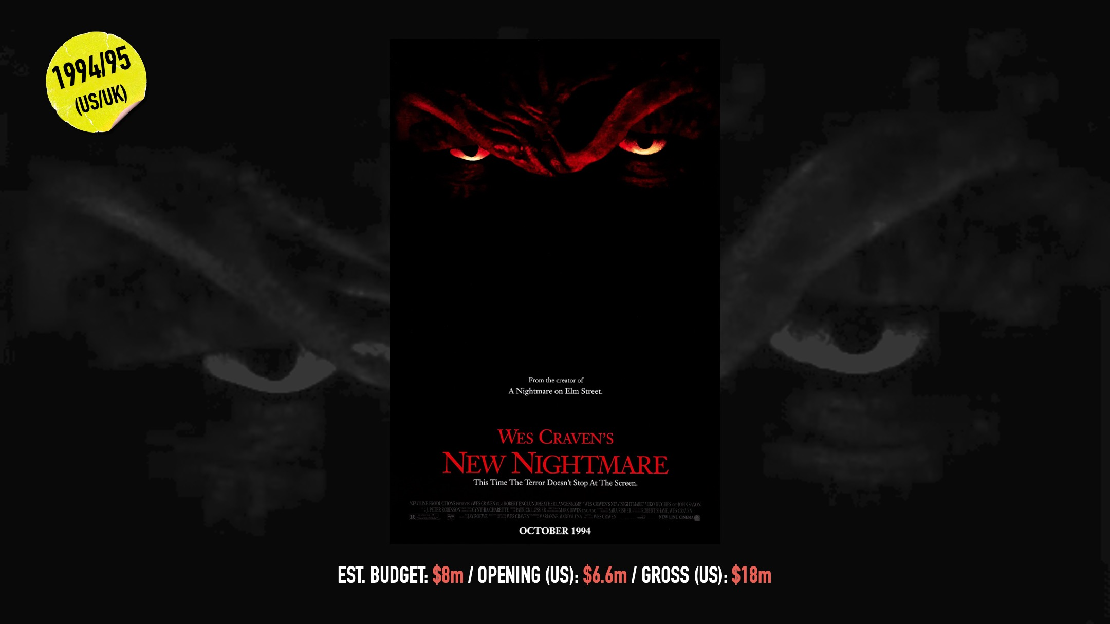
Notes:
However, if Freddy’s Dead represented the perfect deployment of visual identity, core idea and response to audience need, the movie that followed just three years later took the opposite approach.
Wes Craven’s New Nightmare resurrected Freddy with a new look and again had him move beyond the dream realm into the ‘real world’ (or at least a semi-fictionalised version of it).
The marketing distanced itself even further from the character… no hat, no glove, no jumper, just a close-up of Krueger’s barely recognisable eyes and some vague messaging that seemed almost embarrassed to be connected with him.
The trailers were more explicit, suggesting the film’s poor box office performance might be because audiences just didn’t want to see Freddy. But based on the posters alone, it’s also possible that many of them just couldn’t.
Now, the film fan in me will always jump to this film’s defence, to tell you it’s an underrated classic and the blueprint for the meta-anxieties of Craven’s later, more successful Scream films.
But the marketer in me sees a product that failed, because it strayed too far from its own identity and misread what audiences wanted and expected at that time.

Slide 20
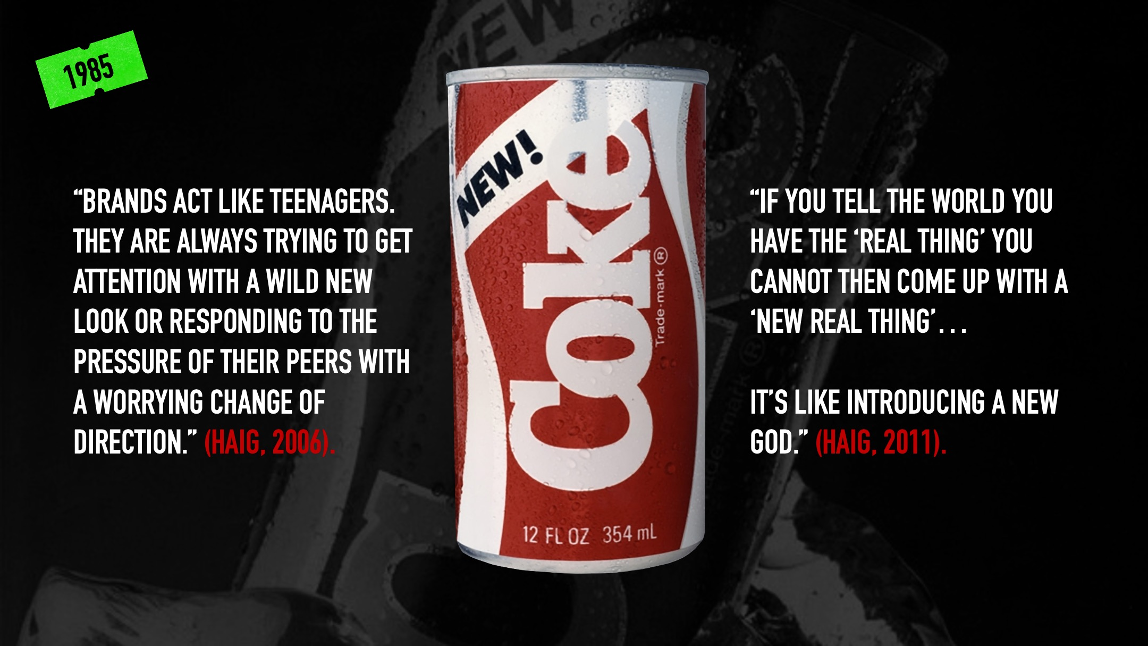
Notes:
According to Haig, there are parallels to be drawn between the most successful brands and religious cults – from levels of faith and life-long devotion to the creation of iconic deities.
Managing these brands though isn’t always easy and, in moments of panic, they can “act like teenagers” with severe visual reinvention or ideology changes – in a bid to stand out from their peers.
One of the most famous blunders in brand marketing history came for Coca-Cola in 1985 when, under market pressure from Pepsi, it decided to relaunch itself with a revised recipe.
‘New Coke’ contradicted decades of messaging built around Coca-Cola not as a product, but as a vital part of culture… which subsequently harmed consumers relationship with that product.
In other words, Like New Nightmare, New Coke betrayed its identity, misread what audiences wanted and expected, and paid a heavy price.

Slide 21
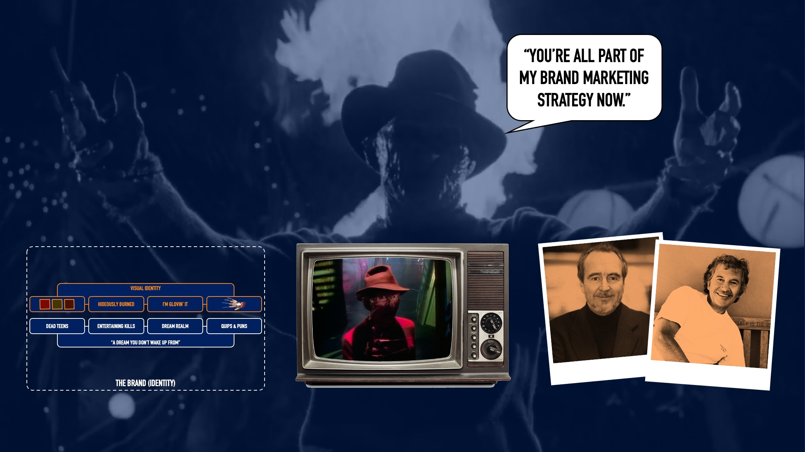
Notes:
So, if there is a secret to brand longevity, it’s certainly rooted in bold, consistent visuals, matched with a clear, accessible core idea.
But whether your selling burgers, soft drinks or slashers, it’s important to recognise and play to the strengths of your product – while listening to your audience.
And while design by committee isn’t always a good thing, bringing audiences into the conversation creates a sense of community… which is something horror benefits from more than any other genre.
Bob Shaye was right to recognise that, for A Nightmare on Elm Street, Freddy was what consumers would buy…
But it was the strength of Wes Craven’s visual identity and core idea for the character, which created returning customers.
And while there were missteps along the way, it’s that marriage of artistic vision and cultural resonance which is why we’re all here today… still talking about Freddy, some 40 years later.

Slide 22
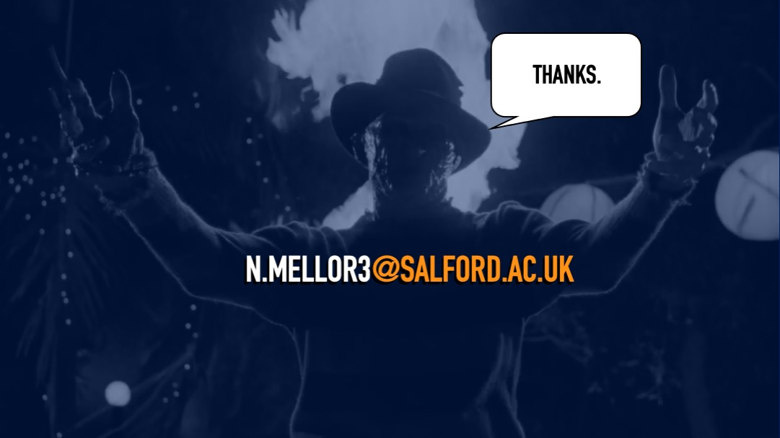

Slide 23
