Slide 1
Effective Practices in AI Literacy Education A Legal Education Perspective
Craig Smith LLB (Hons), LLM, SFHEA
Lecturer in Law – Salford Business School, University of Salford

Slide 2
Agenda
Why AI in Legal Education?
A module titled ‘Artificial Intelligence and Law’ or ‘AI Law’
Strategies used for
Learning & Teaching
Assessment
Practical use of Generative AI
Student Voice
Recommendations

Slide 3
AI in Legal Practice

Slide 4
At the end of 2023 : 75% of the largest firms using AI 60% exploring GenAI 33% of small firms
Risk Outlook Report (2023) Solicitors Regulation Authority (SRA)

Slide 5
GenAI and Legal Practice
ChatGPT: New York lawyer admits using AI for case research (6 cases) - BBC
Woman who used nine ‘fabricated’ AI cases in court loses appeal - The Independent
LiP presents false citations to court after asking ChatGPT - Law Gazette

Slide 6
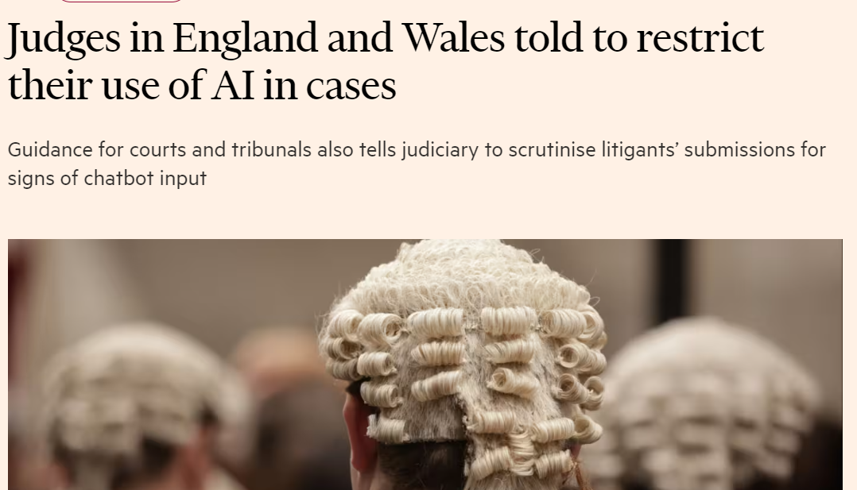
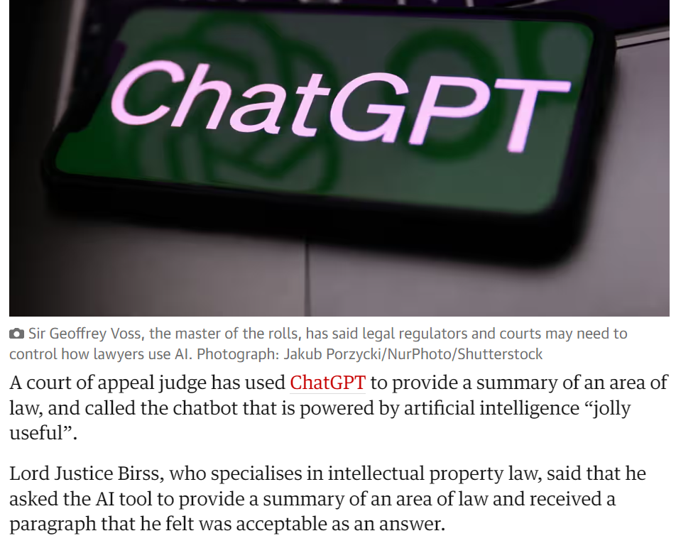
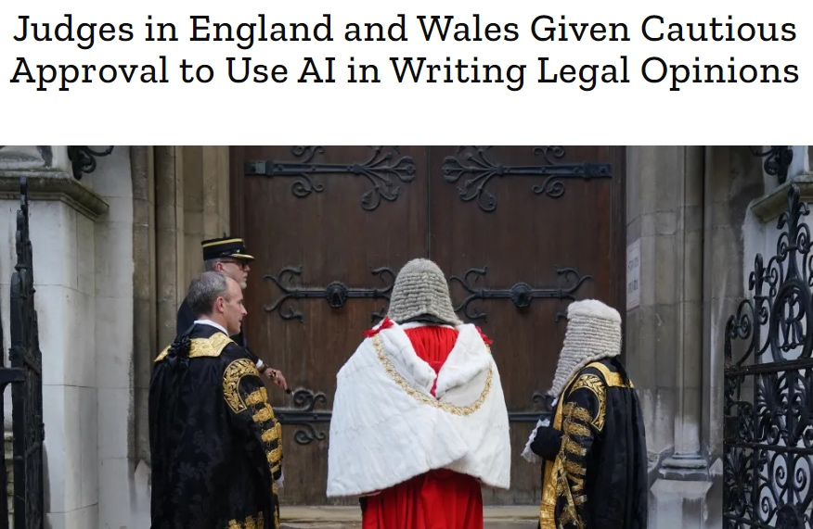

Slide 7
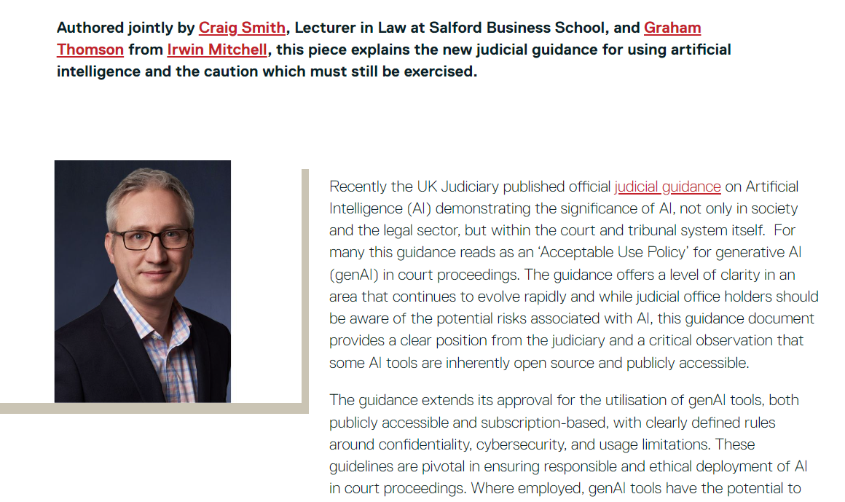

Slide 8
Challenge to Legal Education
Responsibility for Legal Educators to teach AI?
Do I have to change what I do as a law lecturer?
Is your profession the same?

Slide 9
Challenge to Legal Education
How to train a legal professional in GenAI?
How to teach using GenAI?
How to assess with GenAI?

Slide 10
Effective Practices in AI Literacy Education
Chapter 14
Susskind and Susskind (2023) argue that AI plays a pivotal role in shaping the future of legal practice, supporting Astromskis’s (2019) review of the postgraduate law programmes across the EU that use Technology in the title of the degree.
An undergraduate law degree (LLB) should prepare ­students by introducing both innovative and disruptive technologies during the LLB.

Slide 11
Module
A final-year optional module, ‘Artificial Intelligence and Law’, worth 20 credits.
Delivered alongside two other modules in a 12-week term, with lectures, seminars, tutorials, and independent study, once a year.
Attracts an average of 50 students annually (currently has 80).
Examines the evolving relationship between AI and the legal sector.

Slide 12
Learning & Teaching
Lectures incorporate recent news articles to highlight AI’s prevalence in society and law, fostering dialogue and challenging students’ understanding.
Students are encouraged to actively participate by selecting and sharing AI related news stories with peers, aligning with the concept that active learners contribute to their own knowledge creation (Schreiber & Valle, 2013).

Slide 13
Seminars - Practical use of GenAI
Students are introduced to GenAI tools like Copilot, ChatGPT, and Gemini in seminars.
They perform academic/legal tasks such as creating prompts, asking questions, comparing responses, summarising texts, debating legal points, and drafting legal documents.
They also research legal AI technologies like Lexis+ AI, DoNotPay, and Contend Legal, sharing and evaluating these from a particular stance.

Slide 14
Independent Study
Non-legal AI tools in arts, ­storytelling, and game creation are explored to prepare students as responsible consumers, stimulating discussions on data privacy, IP, and consumer rights.
Students complete online training courses via platforms like LinkedIn Learning, culminating in certificates.
These courses mirror workplace training requirements by focusing on data protection and digital skills.
They serve as formative opportunities, completed independently outside of timetabled sessions.

Slide 15
Assessment
Assessment 1: An individual 15-minute presentation on AI and emerging technologies in the legal field, covering topics like law firms, law courts, private, public, criminal, or IP law.
Assessment 2: A 2000-word essay with two parts.
Part 1: Critically evaluate the current state of AI regulation, considering emerging issues and global regulatory developments.
Part 2: Reflect on your use of GenAI in Part 1 or your decision not to use it.

Slide 16
Student Voice
Student feedback was collected at two points
The first questionnaire received 27 responses
The second questionnaire saw increased participation with 42 responses

Slide 17
Results
Over 80% of students felt they were contributing and engaging effectively, indicating effective teaching methods and positive peer ­influence.
Students generally held positive views, using keywords like ‘happy’, ‘interesting’, ‘creative’, ‘good’, and ‘engage’.
Students appreciated interactivity and group work, particularly on AI’s impact on law firms and criminal law. Engaging with peers enables active learners who contribute to the development of their own knowledge

Slide 18
Results
Integrating practical examples and AI technology helps apply theoretical knowledge to real world scenarios, enhancing digital skills and employability. Seminars were particularly engaging.
Students recognised AI’s impact on career prospects and academic goals, demonstrating curiosity and readiness to explore AI’s broader implications. This evidences the integration and educator competence that students expect for GenAI in education
Incorporating AI proved effective, with positive results from discussing AI concepts, using relevant examples, and encouraging AI in assessments. Digital courses supported essential digital skill development.

Slide 19
Results
Challenges include exploring creative AI applications, measuring digital skill development, and keeping pace with AI technology and legal developments.
Educators should focus on developing AI literacy and digital skills alongside students as both are learning together.

Slide 20
Recommendations
A digital society demands universities to embrace digital skills in teaching and learning.
Educators in HE should offer opportunities within existing frameworks.
I urge colleagues to engage with GenAI and embrace the digital skills modern graduates need.
Facilitate social learning experiences and introduce legal foundations related to AI technologies.
While theory is essential, practical digital skills empower students beyond academia.

Slide 21
Recommendations
Be adventurous and engage
Weave in ethical theory
Use real-life examples
Build on successful approaches
Identify areas of improvement
Understand the module impact

Slide 22
My Thanks
Dr Christine O'Dea CMBE
Davy Tsz Kit Ng
Kings College London
Emerald Publishing

Slide 23
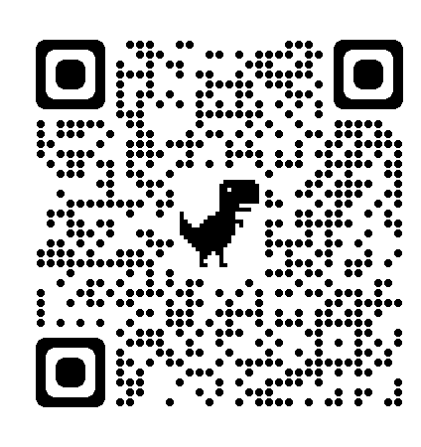
Thank You
Craig Smith LLB (Hons), LLM, SFHEA
c.a.smith3@salford.ac.uk
LinkedIn: craigsmithlaw

Slide 24
Questions?

