Slide 1
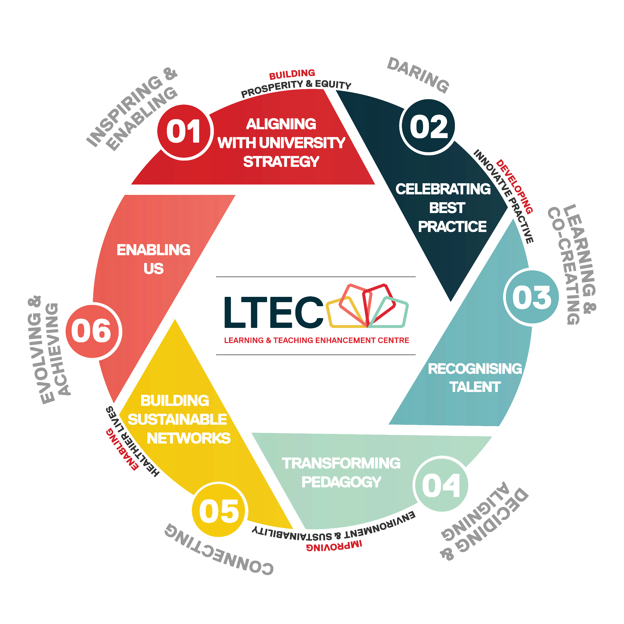
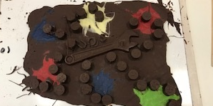
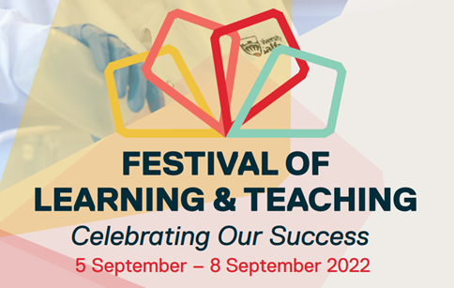
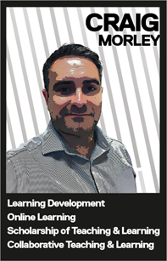
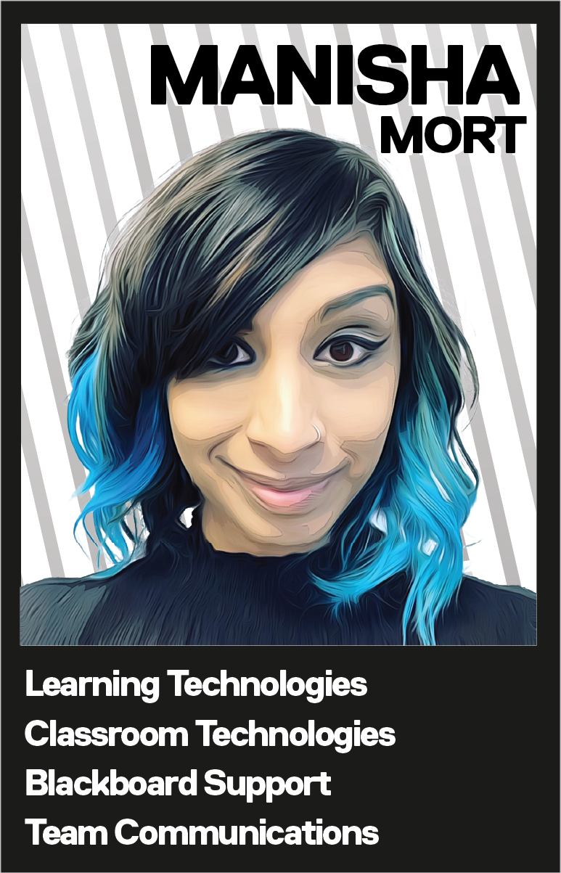
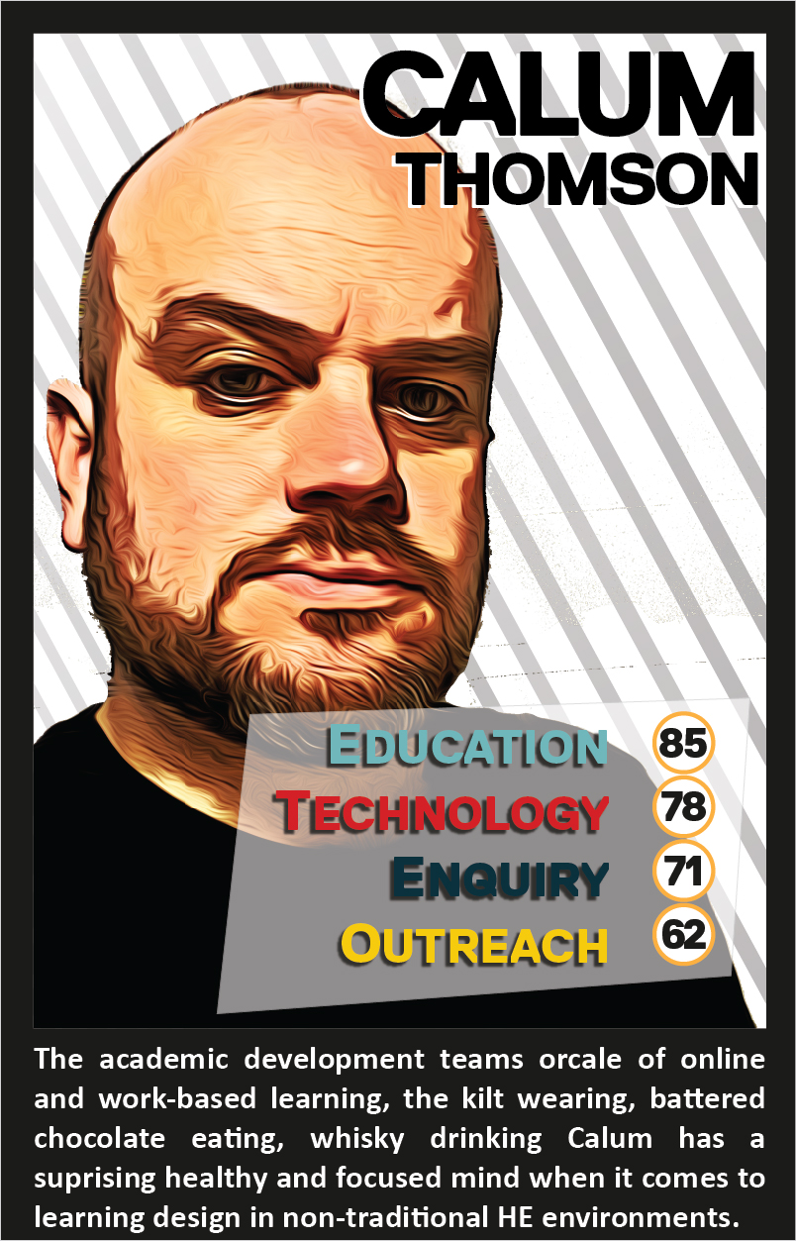
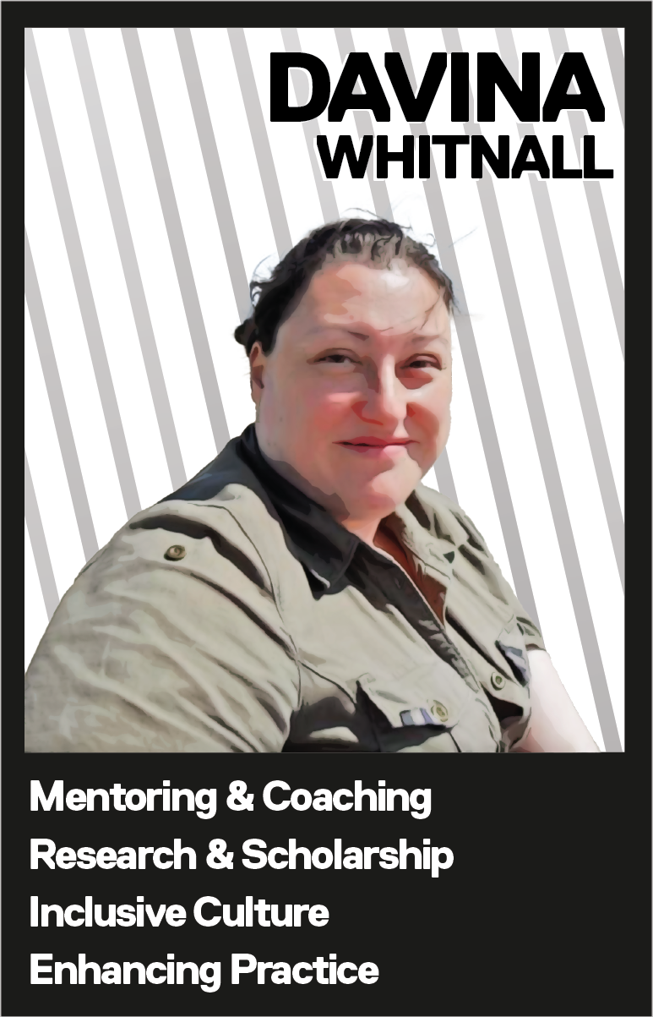
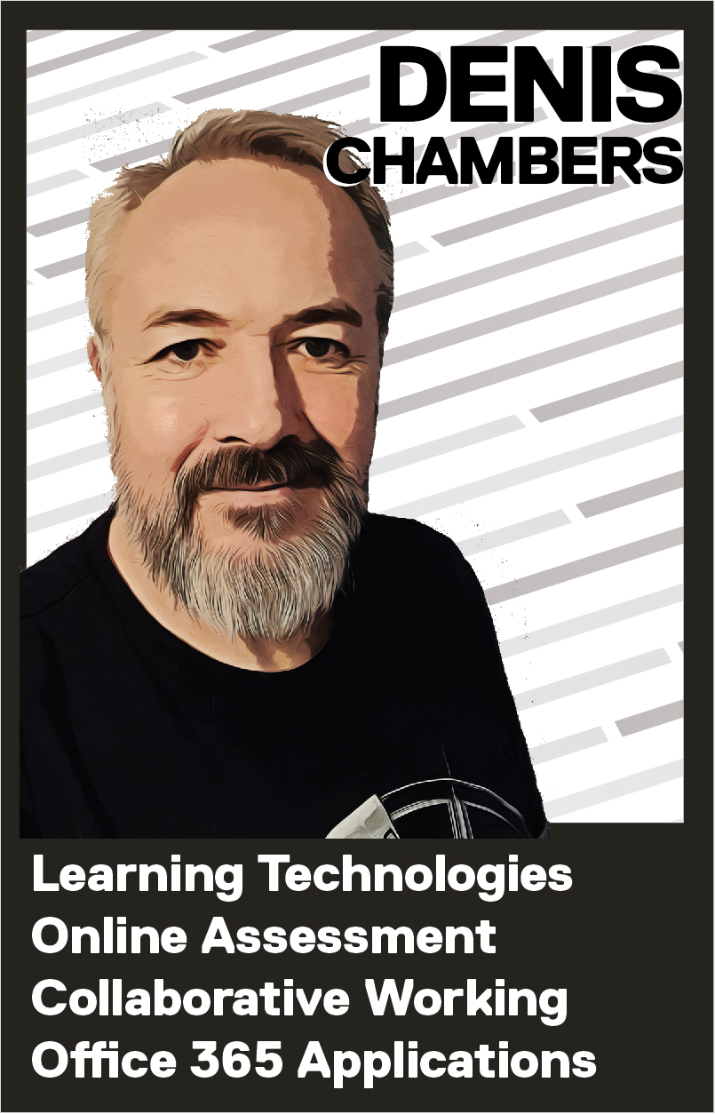
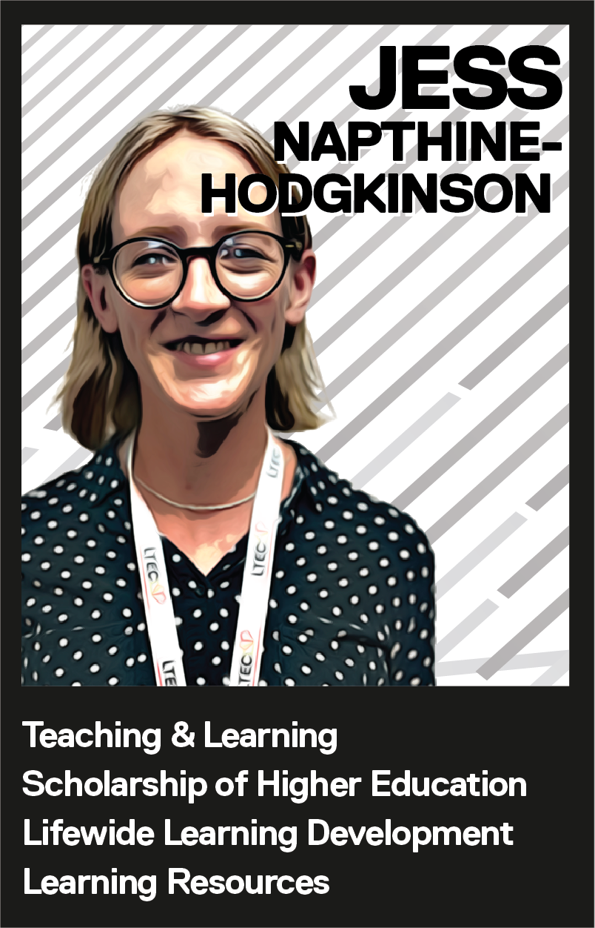
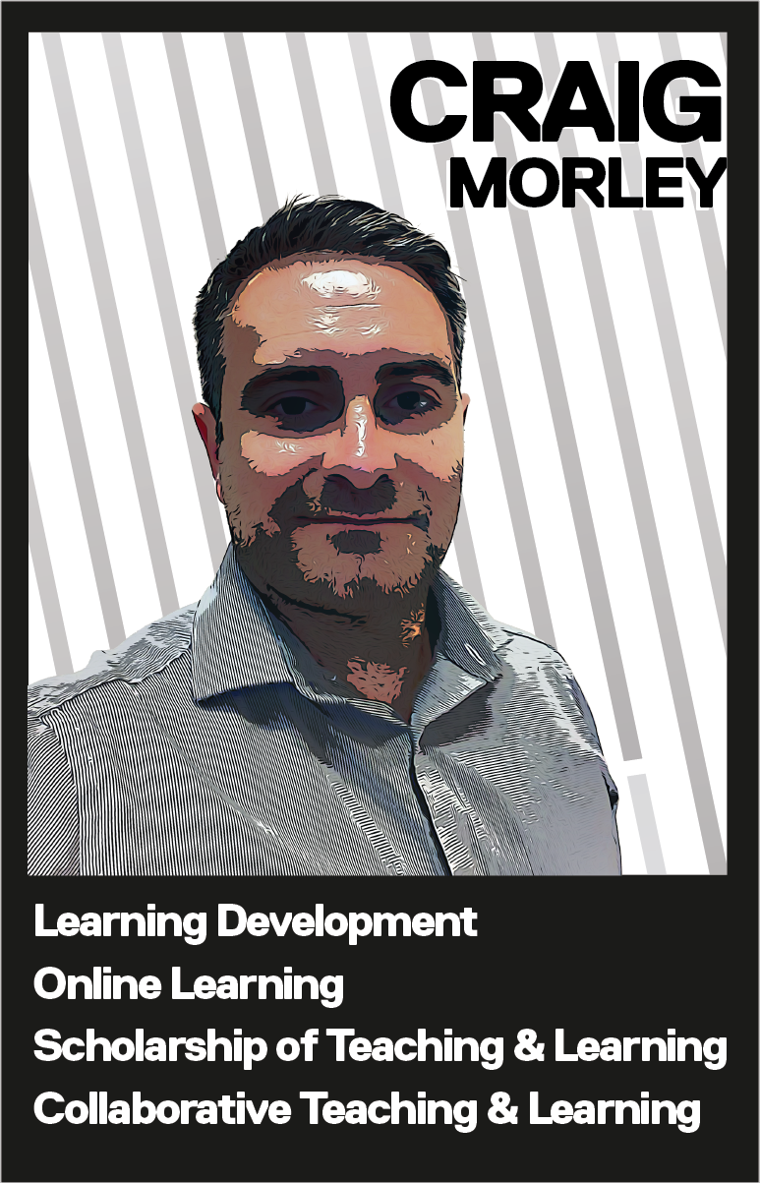
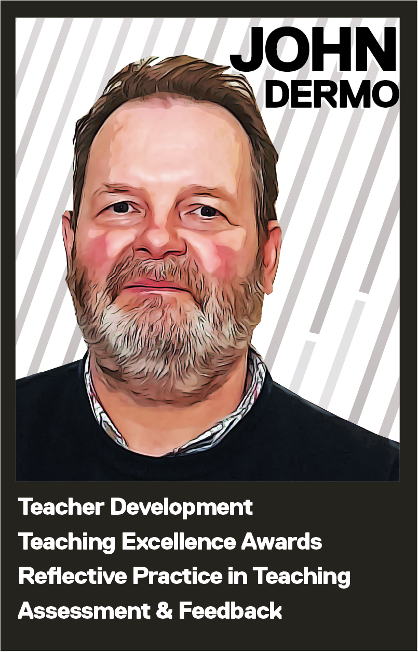
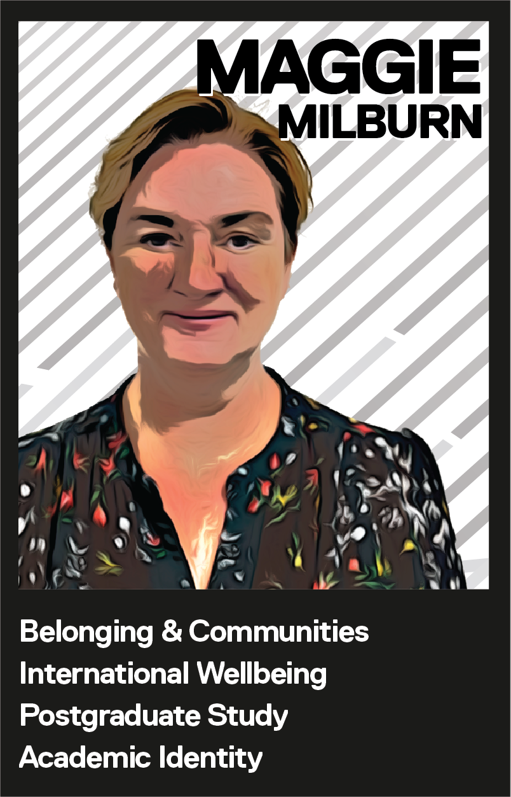
"A Picture Tells a Thousand Words; An Experience Provokes Infinite Emotions”
Building a creative community to support academic practice at University of Salford
Diverse Skillset
New Team, New Vision
Central to brand of LTEC.
Place LTEC at the centre or our 6 strategic pillars, as well as institutional priorities and behaviours.
Image is conceptualised around a camera lens to emphasise our focus, perspective, clarity, adaptability and depth.
Creative approaches to planning and strategy…
Colleagues from mutliple disciplines with ranging experience.
14 colleagues drawing from internal and external teams.
Messy
Purposeful
Hands on and tactile working with chocolate and clay.
Expression of strategy and planning.
3. Strategy Wheel
Fun
Creative Approach
Lead by Example
6. Embracing Creativness
Collaborative, lighthearted, different and new for everyone.
Starting from a blank sheet. No name, no preconcpetions, only expectations.
Post-pandemic excitement to be new, brave and innovative.
1. Introduction
Embracing a culture of creativity to foster innovation, originality and uniquity. Staff development events which merge strategic planning and response to institutional need through playfulness and imagination.
Vision: To be a nationally recognised Centre of Excellence for higher education pedagogical enhancement and development. Through inclusive, equitable and diverse practice, we achieving outstanding recognition for our staff and supporting inspirational learning and teaching to transform lives.
Mission: To lead the University community in innovative digitally enabled and societally focused, inclusive pedagogic practice and scholarship of education.
Designed in consultation with Marketing team.
A sub brand of the University brand, set to secondary colour palette.
Design to be bold, bright and recognisable from distance.
Concept of four kites, flying high, representing each academic school.
Creation of Hub site, newsletter, external website, promotion materials and sub-brands for events.
Clearly linked to brand through colours and imagery.
Clear and simple layout designed around what the audience do, not how the team is structured.
Presents multiple cogs of LTEC as single, consistent voice.
Dynamic with minimal static structured content.
Focus surfacing timely and timebound information via news feeds.
Developed to accept and search colleague contributed content.
4. Creating our Brand
Forming our team, connecting, coming together professionally and practically.
Establishing ways of working, processes, culture and norms.
Setting our strategy, short mid and long term planning.
Achieving and celebrating, recognising our success.
7. Our Creative Reach
2. Objectives
04
23 / 24
Initially exercise in team recognising their strengths, interests and talents.
Initial concept of ‘Top Trump’ cards.
Distinctive, different style.
Set style for images across LTEC resources.
03
Jun – Sep ‘22
5. Branding Us
02
Jan – Jun ‘22
01
Oct - Dec ‘21
Feedback & Evaluation
Authors
Prof Jess Power - Associate Pro Vice Chancellor Learning and Teaching Enhancement
Dr Calum Thomson – Higher Technical Skills Lead
Davina Whitnall – Equity, Diversity and Inclusion Lead
Learning & Teaching Enhancement Centre, University of Salford
Contact: ltec@salford.ac.uk
“LTEC is no longer this abstract department that does things that help us become better academics and practitioners. Its putting people in in front of us so that we can actually build a connection with them.”
“I always recognise anything that comes from LTEC because it's got a brand that stands out. It's outward facing, it's recognisable, and it really does distinguish LTEC as an entity within the university itself.”

