Slide 1
Card games as effective tools to enhance bioscience laboratory health and safety education
by Rumana Rafiq
Games created by: R. Rafiq, H. Matthews, D. Abedalreza, F. Yahya and M. Jones

Slide 2
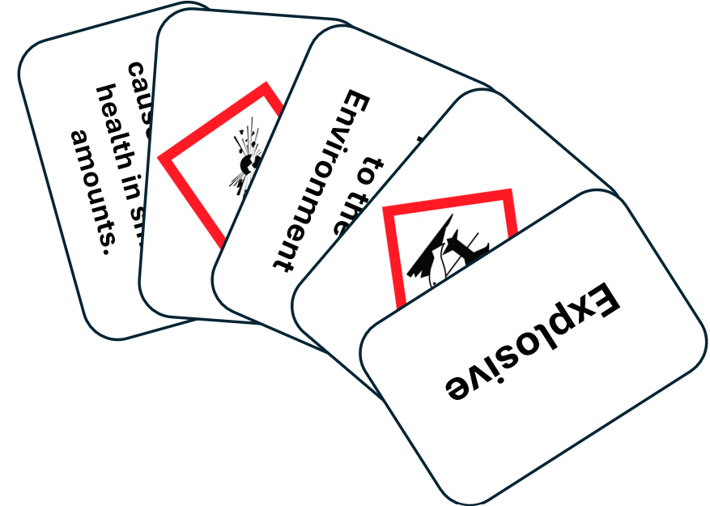
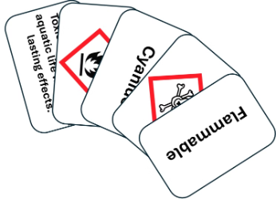
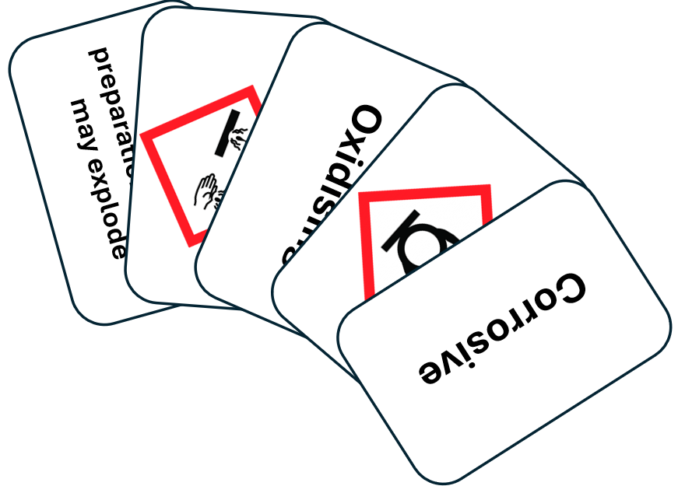
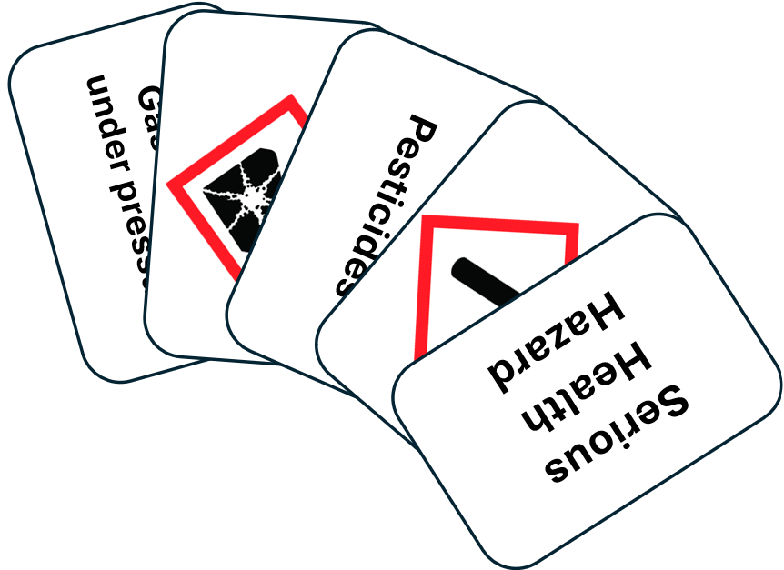
Methods: Gamified Learning
Game Design
Health and safety Hazard hunter
Personal Protective Equipment (PPE) lab gear up
Laboratory Equipment Identification
Integration
Integrated into health and safety induction (First year UG students)
Assessment
Baseline: 10-point scale
Post-game: 10-point scale
Surveys: enjoyment and value

Slide 3
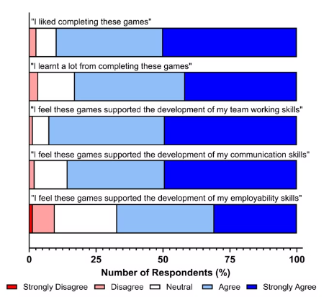
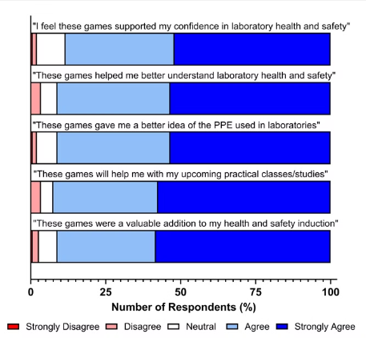
Impact: Positive Outcomes
89.7%
82.9%
91.1%
Students enjoyed the games
Learnt a lot while playing
Valuable addition to induction
Figure 1 and 2. Stacked horizontal bar charts illustrating students’ enjoyment and perceived value of the card games. The charts show students’ responses on whether the games: (1) were enjoyable, (2) supported development in teamwork, communication, and employability skills, (3) increased confidence in lab health and safety, (4) enhanced understanding of health and safety and PPE, (5) help with upcoming practical's and (6) were a valuable addition to their induction.

Slide 4
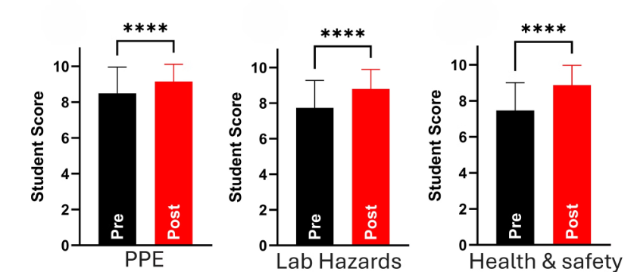
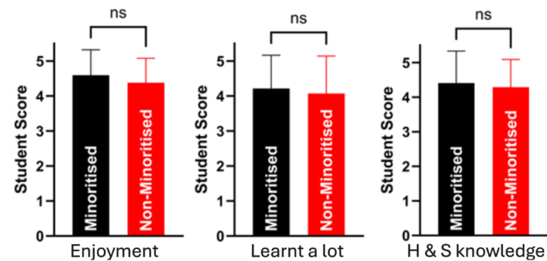
Results: Self-perceived Knowledge Improvement & Equity
PPE
Lab Hazards
Health & Safety
Enjoyment
Learnt a lot
H & S knowledge
Figure 3: Overall self-perceived knowledge of PPE, lab hazards and Health and safety.
Figure 4: Health and safety knowledge, enjoyment and learning perceptions by minority status
Enjoyment
Learnt a lot
H & S knowledge
Enjoyment
Learnt a lot
H & S knowledge
Figure 5: Health and safety knowledge, enjoyment and learning perceptions by socioeconomic status
Figure 6: Health and safety knowledge, enjoyment and learning perceptions by entry qualifications

Slide 5
Conclusion
Card games effectively enhance health and safety education in bioscience laboratories.
Engaging learning enhances student understanding and retention of critical safety knowledge.
Equitable learning tool for all students
Adaptable design allows for broad educational applications across various disciplines.
Games created by: R. Rafiq, H. Matthews, D. Abedalreza, F. Yahya and M. Jones
Thank you for your attention.

