Slide 1
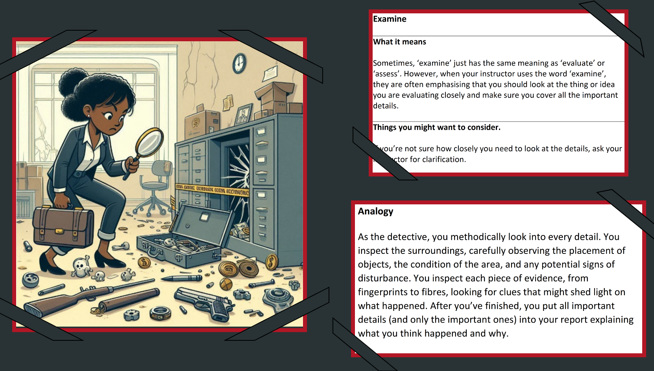
Development of a Command Words Learning Toolkit: Understanding the Disparities and Strategies for Enhancing Educational Equity Christopher Veysey C.L.Veysey@salford.ac.uk Salford Languages, University of Salford and Berna S. Sayan b.s.sayan@salford.ac.uk School of Science, Engineering & Environment, University of Salford
Introduction
The attainment gap between students entering higher education (HE) with BTEC qualifications and those with A-levels has gained attention in pedagogical research (Finlayson, 2018; Nuffield Foundation, 2022). While BTECs provide practical, application-based learning and offer university access for disadvantaged students, data shows higher dropout rates and lower degree classifications among BTEC learners compared to A-level peers (Swinton, 2020). Differences in assessment styles may contribute to this disparity (Office for Students, 2022).
A-levels emphasise “command words” like "analyse," "evaluate," and "discuss," teaching students how to respond through systematic practice, which prepares them for HE assessments (Taylor, 2023). In contrast, BTECs focus on task-based skills, where command words appear but are not explicitly taught or emphasised (Taylor, 2023). As a result, BTEC learners may struggle to interpret and respond to these terms, disadvantaging them in HE assessments that are often closer in style to A-level than BTEC assessments.
This disparity may be addressed by creating a command word glossary for BTEC students that provides clear definitions, examples, and guidance. By making the meaning of these words explicit, we can help BTEC learners approach HE assessments more confidently, fostering educational equity.
initial understanding. Responses used a four-point Likert scale and included open-ended questions. Data analysis combined quantitative Likert scale summaries with qualitative coding of open-ended responses to evaluate the toolkit’s effectiveness and identify deeper insights.
Table 1: Examples of student narrative feedback.
‘It was incredibly informative, especially because I am working on a reflection and an assignment. This workshop helped me grasp exactly what was being asked for. ‘
‘I have always struggled deciphering the question and needed further clarification from teachers. This workshop has helped me to grow confidence and has helped to expand my literacy.’
‘Amazing workshop, very engaging and helps those feeling less confident to work in groups. I enjoyed working with different people outside my friend group.’
‘This workshop was extremely helpful towards my academics. I strongly believe it should be part of the curriculum.’
Results
1- Toolkit design: The toolkit covered nine commonly used command words, each presented with three components: a core meaning, an analogy and a visual cue. These were printed on 27 A4 sheets, divided into eight sets in different colours and laminated for durability, creating an engaging representation of complex terms. For example, "Examine" was defined as closely evaluating details, likened to a detective analysing a crime scene, and represented by a visual cue of a detective scrutinising evidence. Similarly, "Justify" was defined as providing evidence to support a conclusion, compared to presenting a case in court, and supported by a visual image of a judge justifying her decision in a report.
Discussion
This study highlights significant variability in how UK universities define common command words, an underexplored issue that may challenge students transitioning into HE. The development of a command words glossary, paired with storytelling and visual cues, represents a novel intervention not previously explored.
All participants reported improved understanding of assessment vocabulary, increased confidence, and better academic preparedness. While immediate impacts on attainment remain unmeasurable, the positive feedback suggests potential long-term benefits, especially for addressing disparities between A-level and BTEC learners.
The small sample size limits generalisability, but the results justify scaling this pilot to larger, diverse cohorts. Future research should assess the long-term effects on academic attainment and on closing the awarding gap in pursuit of fostering greater educational equity.
Aims and Objectives
Aim: To create a comprehensive learning toolkit that enhances learners’ contextual understanding of command words in HE assessments.
Objectives:
Analyse the definitions of frequently used command words across diverse HE institutions; distil these into core definitions and supportive explanations using accessible language.
Design narrative-based analogies and visual aids to reinforce core concepts, enhance comprehension and strengthen contextual understanding.
2- Command the command words workshop: The "Command the Command Words" workshop was advertised to the entire Biomedical Sciences cohort to ensure inclusivity, and 20 students attended the workshop. Of these, five students had A-level backgrounds and three were from BTEC pathways. The others were from T-level, international or mixed BTEC/A-level backgrounds. One BTEC student declined to complete the feedback questionnaire. Due to the small number of BTEC participants, it was not possible to achieve statistically significant results on how students perceived the command words support. Nevertheless, all attendees (100%) reported that the workshop enhanced their understanding of command words, helped clarify higher education assessment vocabulary and expectations, and was likely to positively impact their academic performance. Additionally, students noted that creating visual cues to represent command words improved their grasp of the terms' meanings. Table 1 gives examples of the narratives provided by the workshop attendees.
References
Finlayson, R. (2018) 'Richer data tells us more about students in higher education', Office for Students. Available at: https://www.officeforstudents.org.uk/news-blog-and-events/blog/richer-data-tells-us-more-about-students-in-higher-education/ (Accessed: January 2024).
Nuffield Foundation (2022) 'Students with BTECs are successful across a range of university outcomes', Nuffield Foundation. Available at: https://www.nuffieldfoundation.org/news/students-with-btecs-university-success (Accessed: February 2024).
Office for Students (2022) 'Schools, attainment and the role of higher education'. Available at: https://www.officeforstudents.org.uk/publications/schools-attainment-and-the-role-of-higher-education/ (Accessed: February 2024).
Swinton, K. (2020) 'The BTEC ‘problem': Retention, attainment and progression'. Available at: https://pure.northampton.ac.uk/en/publications/the-btec-problem-one-strategy-aiming-to-help-with-retention-attai (Accessed: January 2024).
Taylor, N. (2023) 'A-levels vs BTECs: which should you take?', The Uni Guide. Available at: https://www.theuniguide.co.uk/advice/a-level-choices/a-levels-or-btecs-which-should-you-take (Accessed: January 2024).
Methods
Command word glossaries from 13 UK HE institutions were analysed, and core definitions synthesised into a unified glossary. A storytelling approach was adopted to contextualise command words, featuring a crime scene investigation scenario supported by AI-generated visual cues. The resulting toolkit was tested in a workshop with Biomedical Sciences students from BTEC and A-level backgrounds. Feedback was gathered via questionnaires, addressing students’ educational backgrounds, personal details, prior exposure to command words, and
Disclosure Statement: All the materials included within this article represent the author's work. Any citations or work that is paraphrased is included within the reference list. This work has not been previously published, nor is it being considered for publication elsewhere. The authors have no conflict of interest to declare in relation to this article.

