Slide 1
​
Keynote: How AI is shaping the Modern Lawyer
Craig Smith
Lecture in Law University of Salford
LLB (Hons), LLM, SFHEA

Slide 2
AI Literacy
Everyone’s talking about AI or AI literacy.
AI is reshaping professions — fast.
Your approach depends on how you use it.
The EU AI Act is making AI literacy mandatory.
But this is more than compliance…
It’s about reputation, risk, and readiness. (3 Rs)

Slide 3
The Conversation Starter
Let’s start simple:
Have you used any form of AI in your work recently?
If so, which AI and what for?
If not, that’s just as interesting — what’s stopping you?

Slide 4
What Is AI Literacy?
Understanding AI. Technology. Skill. Utilisation. Literacy.
The ability to understand, use, and question AI tools.
Dual focus:
Opportunities: automation, insight, efficiency.
Risks: hallucinations, legal exposure, ethics.
Brings a level of equity across all functions. This is not just for the IT team or innovation teams.

Slide 5
Why it matters?
Pressure + Practical
EU AI Act
UK Regulatory Bodies (SRA) (BSB) (GMC) (ICO)
Training is important.
Awareness and Discussion is the First Step.

Slide 6
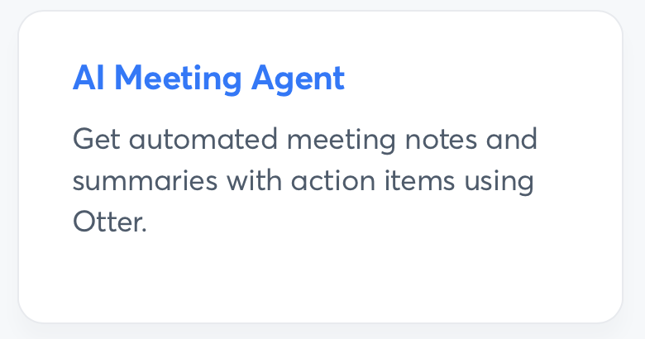
Example
Sending your AI chatbot to meetings
Otter.ai - is an American transcription software company based in California.
The company develops speech to text transcription applications using AI.
Who is the meeting for?
Your presence in a meeting?

Slide 7
“The cases cited were not legitimate.”
A US lawyer used AI to draft documents in a case against Walmart.
Nearly all cited cases were hallucinated.
Judge noted: “None exist... peculiar phrasing…”
Firm admitted: “Our AI hallucinated... this was embarrassing.”
This is not a one-off.

Slide 8
The Law Society Gazette – Manchester
A litigant presented fictitious submissions in court based on ChatGPT answers. In a civil case in Manchester, one party represented and one unrepresented:
The barrister argued there was no precedent for advancing the case. One case name was fabricated, while the other three were real but with different cited passages from the judgment.
All four citations were fictitious but appeared legitimate.

Slide 9
You’re working with AI. You’re not alone.
We have just seen two court examples. UK and US.
You have shared with me examples of your own use.
Together as a Team.

Slide 10
You’re not alone. You’re working against AI.
You’re not just navigating how to use AI in your own practice.
You’re also up against people using it, sometimes recklessly, sometimes strategically.
And the line between the two isn’t always clear.
Can you recognise it?
Can your team recognise it?

Slide 11
Risks You Should Know
Using AI without a level of literacy is dangerous.
You remain fully responsible for your outputs.
Reputation damage if errors are discovered.
Data risk.
May breach ethical/legal guidelines.
AI still hallucinates…

Slide 12
Rethink AI — It’s a Tool, Not a Threat
IBM: Augmented Intelligence
Not about replacing us but empowering us.
AI handles the repetitive; you handle the strategic.
Embrace AI to:
Free up time
Reduce routine
Focus on people and insight
Only you know how best AI can do that.

Slide 13
AI as a Competitive Advantage
Time is money and AI is speed.
Process data and trends faster than ever.
Predictive insights, smarter workflows.
Deliver better results.
Outperform competitors.

Slide 14
Skills for the Future
In-demand skills:
Critical thinking
Creativity
Judgment
Ethical awareness
Digital Skills
It’s not just what you do… It’s how you do it with AI…

Slide 15
What can you do today?
Start with relevant use cases
Talk about AI across all levels
Embrace mistakes as learning
Focus on safe, not just fast
Collaborate across teams
Align with ethics frameworks
Encourage critical review of outputs
Build a feedback loop

Slide 16
The 3 Es of Impact
Educate
Train and explain AI tools and risks
Everyone needs a shared understanding to use AI responsibly.
Engage
Involve people at all levels
Talk about and discuss AI openly
Empower
Safe spaces to test, learn, and grow
Learning through practice builds trust and long term capability.

Slide 17
The 3 Rs of -
Reputation
Professional credibility
Clients expect diligence. One AI error can go viral.
Risk
Legal, ethical, and data exposure
You must comply with current and evolving rules.
Readiness
Workforce capability
The future of practice demands AI confidence.

Slide 18
Final Thoughts
AI won’t replace you…
…but someone who understands and can use AI will…
AI literacy is your safeguard, advantage, and obligation.
The time to build capability is now.

Slide 19
The Reflective Starter
Think about your use of AI tools, casually, outside of work?
(CoPilot)
(Other tools)
What did you use it for?
What worked well or didn’t?
If you didn’t use any, was that a conscious choice? Why are you opting out?

Slide 20
AI + Legal Education: Rethinking the Future Lawyer
Empowering law students with digital confidence through Generative AI.
From classroom debates with ChatGPT
To research on student perceptions
How can AI shape smarter, fairer, and more practice ready legal education pathways?
Everyone is a student of AI right now!
Lecturers, Law Students, Legal Professionals.

Slide 21
Future of AI
What is the future of AI?
LLM Impact – AI – Stakeholders
Is it about access?
Is it about patients / clients?
Is it about internal business delivery?
Agentic AI
What do you think?

Slide 22
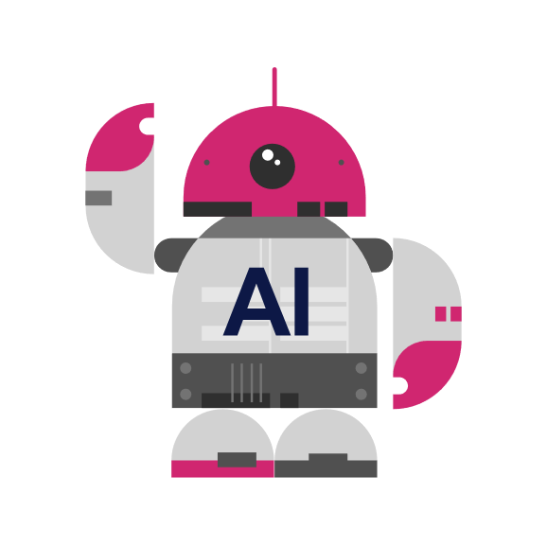
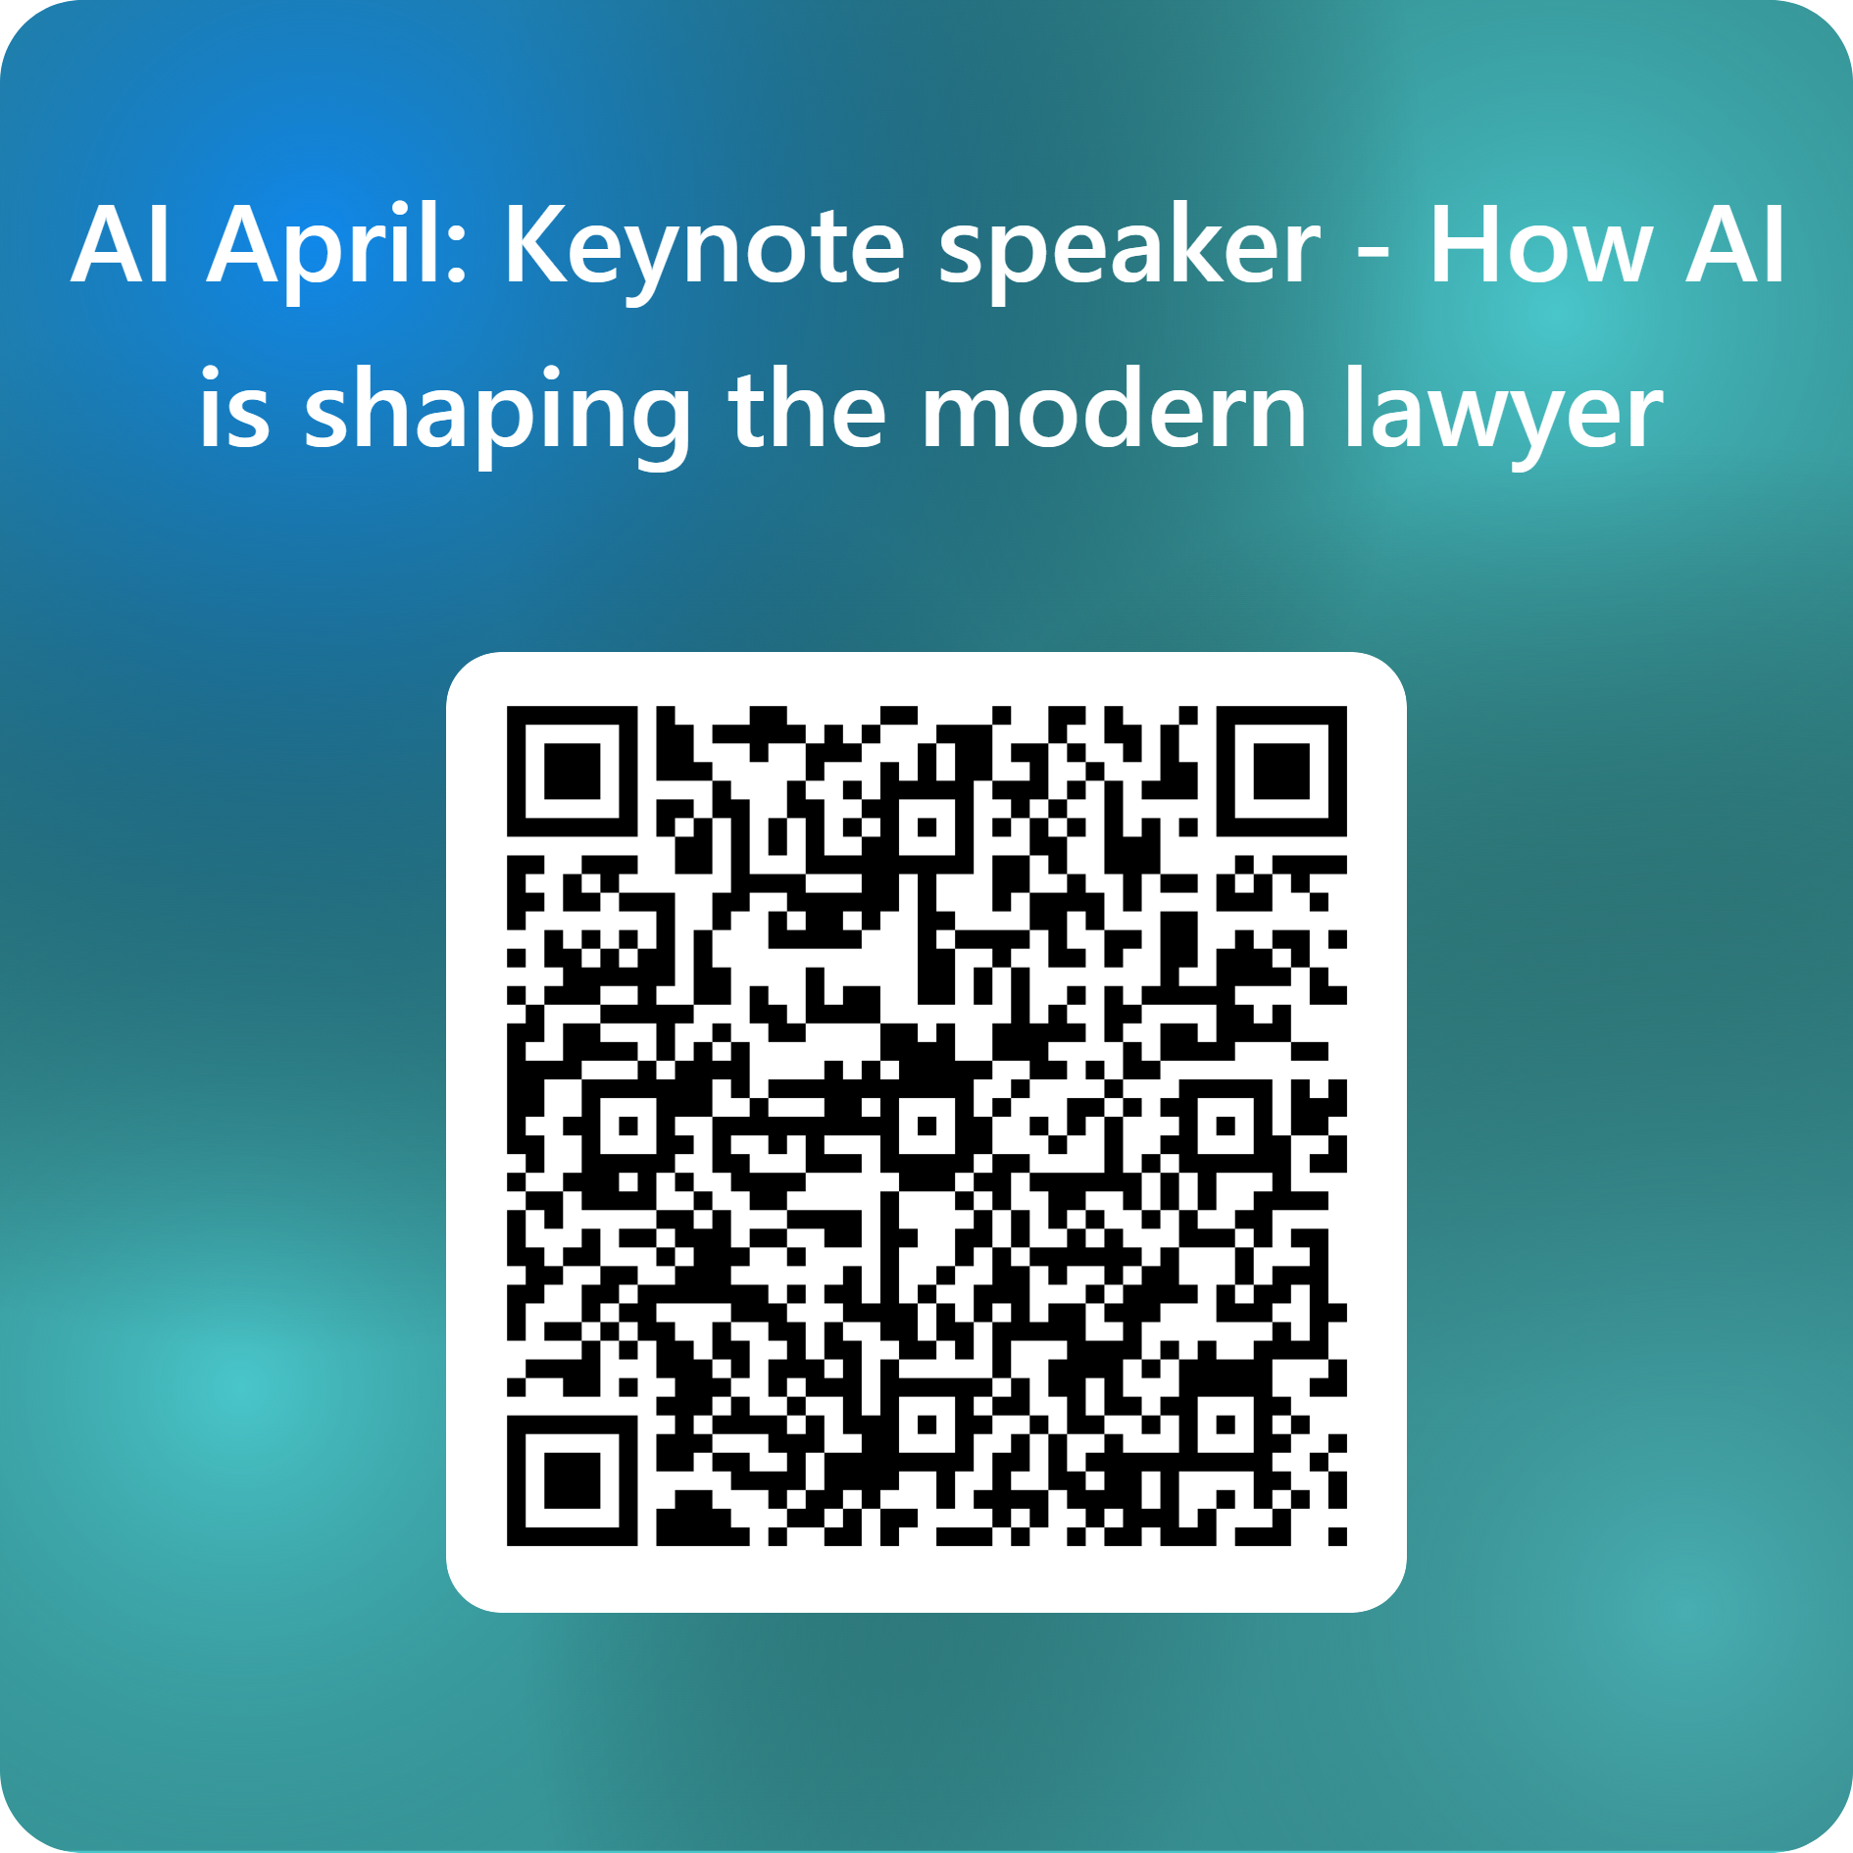
April Learning festival
Thank you!
Connect with Craig Smith
on LinkedIn

