Slide 1
Building excellence in HE learning and teaching through exceptional CPD
ITLN sub-group consortium
Rhodes, S., Power, J., Spark, G., Agossou, M., Blackwell Young, J.
Presented by Prof Jess Power
20-05-2025

Slide 2
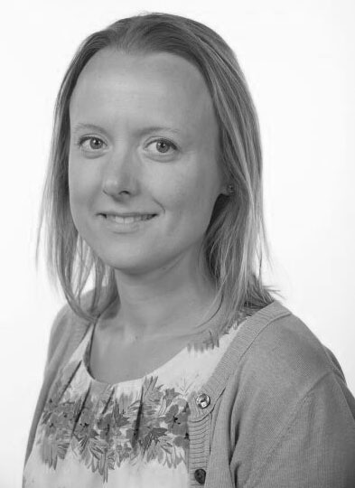
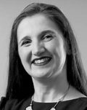
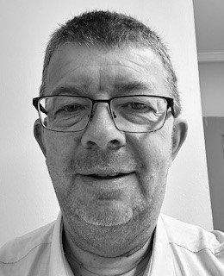
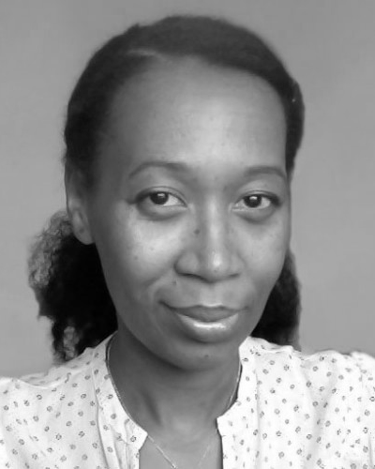
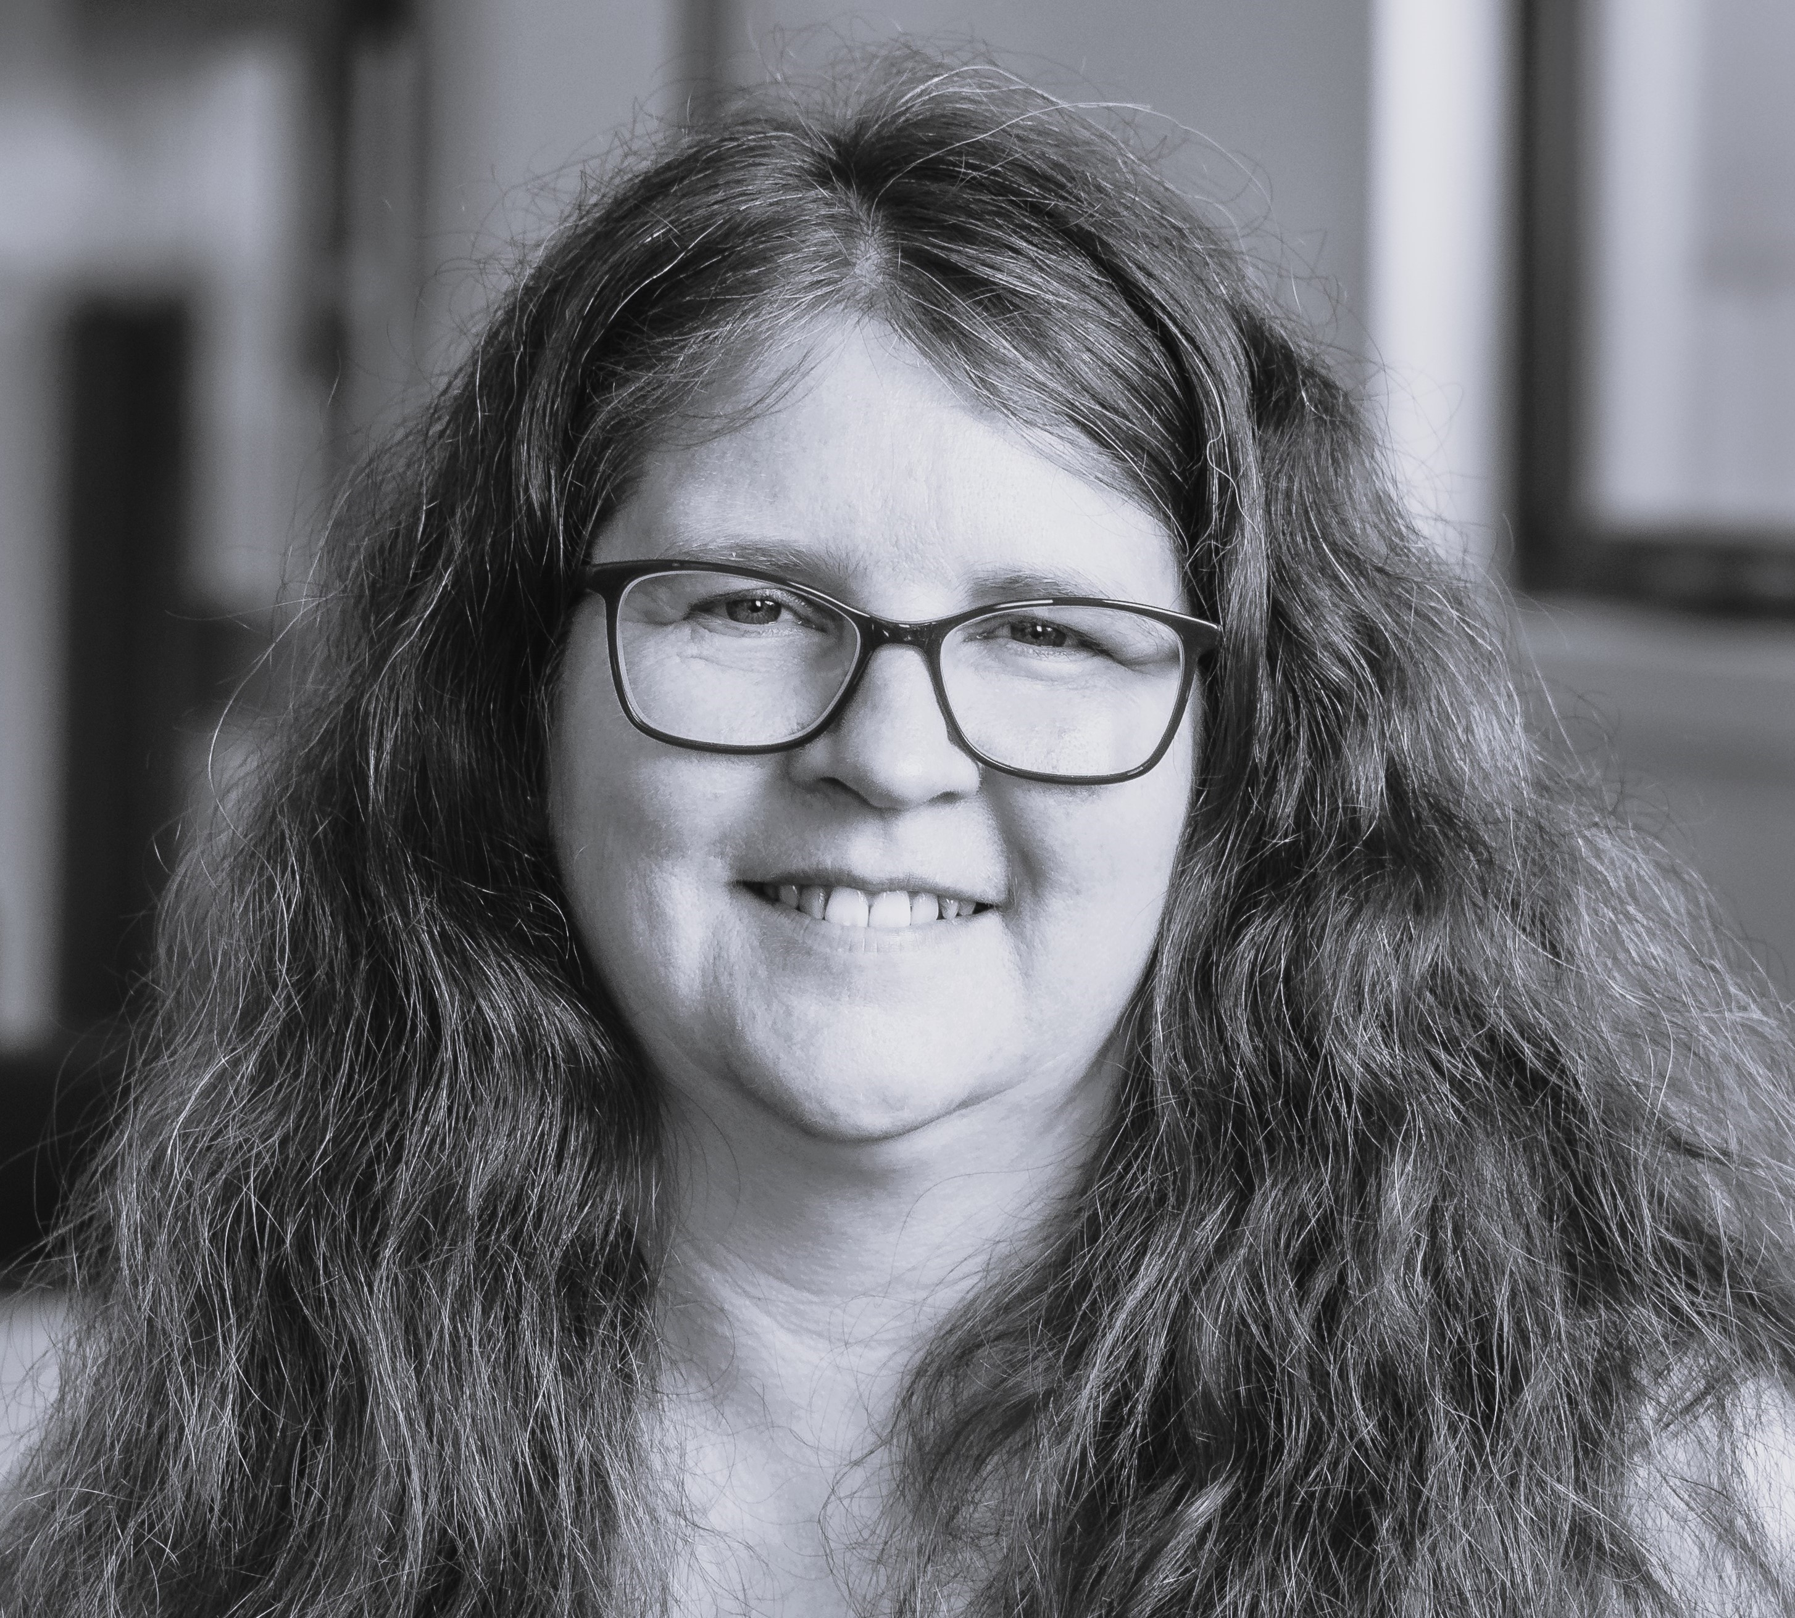
Introduction
ITLN International Teaching and Learning Network
June 2024: meet 3 times per year
Kate Strudwick, Tina Byrom , Fay Glendenning
Purpose
Connect and support individuals involved in teaching and learning, both in the UK and internationally
Sub-group: Supporting institutional pedagogical development (5 members)
Sarah Rhodes, Jess Power, Gordon Spark, Marie-Josiane Agossou, Julie Blackwell Young.
Keele University, The University of Salford, University of Dundee, London South Bank University, and Abertay University

Slide 3
which has been created to access and capture diverse insights and perspectives including industry partners, professional services staff, employers, alumni, and students.
Suggestion scoping project: gathering insights into inducting staff into HE L&T
Share the insights
1. Approaches to enhancing CPD to ensure consistency of teaching excellence.
2. A synergy of different perspectives regarding what works in providing a high-quality inclusive educational experience.
3. Development of resilience within learning communities which drive continuous improvement.

Slide 4
Approaches to enhancing CPD to ensure consistency of teaching excellence.
Theme Overview
• Continuous Learning: Encouraging staff to engage in ongoing professional development to stay updated with the latest teaching methodologies and technologies.
• Collaborative Practices: Promoting peer-to-peer learning and mentorship programs to share best practices and foster a culture of collective improvement.
• Reflective Practice: Implementing regular self-assessment and reflection sessions to help educators identify areas for growth and adapt their teaching strategies accordingly.
• Standardization and Flexibility: Balancing standardized training programs with the flexibility to address individual educator needs and institutional goals.
Key Takeaways
Principles, not policy (agile)
NTF/CATES (different priorities))
Promotions rounds (leadership)
Intervention projects
Dedicated support for technical
HEA fellowship themes
CPD off the shelf support (HR)
Enhancement session
Importance of 1-1

Slide 5
Theme Overview
Perspectives regarding what works in providing a high quality inclusive educational experience.
• Inclusive Dialogue: Facilitating open discussions among staff members from diverse backgrounds to share experiences and insights, fostering a collaborative and inclusive environment.
• Cross-Disciplinary Training: Implementing training programs that draw on best practices from various fields to enhance staff skills and knowledge comprehensively.
• Cultural Awareness: Promoting cultural competence through workshops and training sessions that help staff understand and appreciate diverse perspectives and backgrounds.
• Authentic Development Plans: Creating tailored professional development plans that address the unique needs and strengths of each staff member, ensuring equitable growth opportunities.
• Feedback Integration: Regularly collecting and integrating feedback from staff to continuously refine and improve development programs, ensuring they remain relevant and effective.
Key Takeaways
Links to apprenticeships
Dedicated centres to support AP
Funded scholarships
Showcasing excellence
Enabling dissemination
New to teaching / PG CAP
Mapping to Advance HE PSF
PGR demo/teaching
Onboarding /welcome

Slide 6
Development of resilience within learning communities which drive continuous improvement.
Theme Overview
• Supportive Networks: Building strong support systems among students, faculty, and staff to foster a sense of belonging and mutual encouragement.
• Growth Mindset: Encouraging a mindset that views challenges as opportunities for growth and learning, rather than obstacles.
• Feedback Loops: Establishing regular feedback mechanisms to continuously assess and improve teaching practices and student experiences.
• Resource Accessibility: Ensuring that all members of the learning community have access to necessary resources and support to overcome academic and personal challenges.
Key Takeaways
Newsletters
Celebration events
Festivals: showcase excellence
Strategic Centre Plans
Dedicated hub
Bespoke training opportunities
Communities of practice

Slide 7
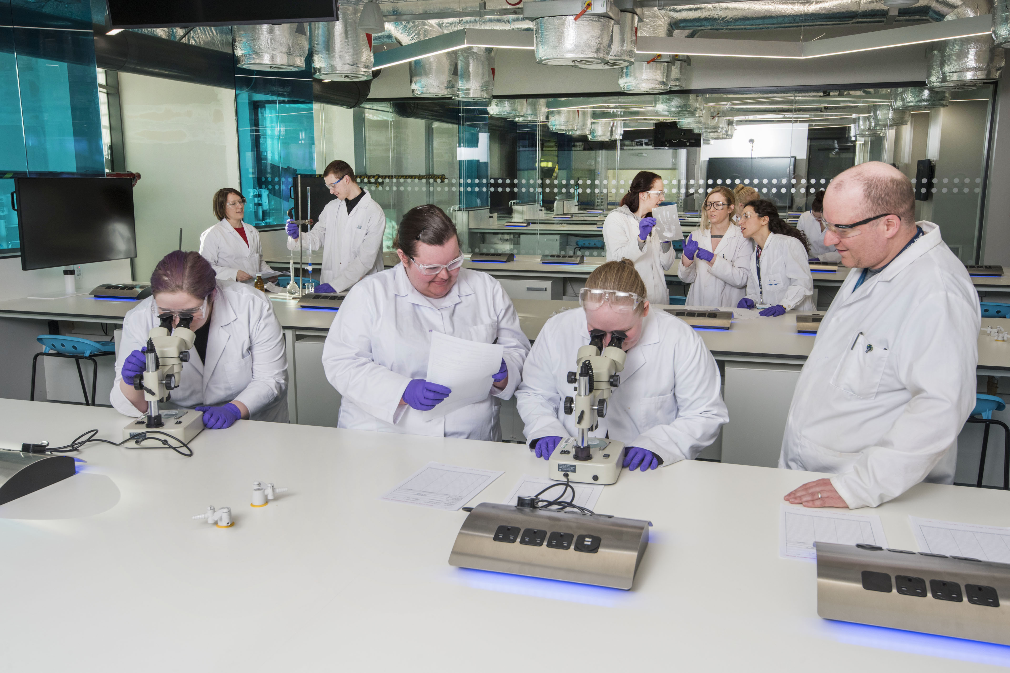
Insights
Five primary themes have been drawn our scoping project which enable us to supporting institutional pedagogical development
Need for flexible CPD (empowerment)
Sharing of inclusive educational experiences
Confidence building – resilience and continuous improvement
Embedding of collaborative and reflective practices
Tailored professional development

Slide 8
Thank you
Any questions
Sarah Rhodes: s.rhodes@keele.ac.uk
Jess Power: e.j.power@salford.ac.uk
Gordon Spark: G.A.Z.Spark@dundee.ac.uk
Marie-Josiane Agossou: agossoum@lsbu.ac.uk
Julie Blackwell Young: j.blackwell-young@abertay.ac.uk

